Slide 1
VAVE Cost Reduction Strategy
Detailed Engineering Feasibility Report | 13-Jan-2026

Slide 2
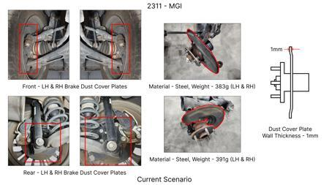
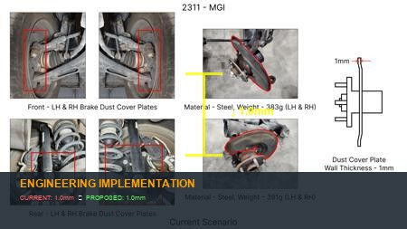
#1: 1. Reduce the overall wall thickness of the Brake Dust Cover Plates present on all four wheel hubs of the vehicles from 1mm to 0.8mm 2. Reduce the paint coating thickness on each side of all four plates from 56 microns to 27.8 microns
EXISTING DATABASE
Current Scenario
Technical Engineering View:
Technical optimization of 1. Reduce the overall wall thickness of the Brake Dust Cover Plates present on all four wheel hubs of the vehicles from 1mm to 0.8mm 2. Reduce the paint coating thickness on each side of all four plates from 56 microns to 27.8 microns focusing on material efficiency and process consolidation to reduce cycle time.
Material Change:
N/A (No material change explicitly mentioned)
Dimension Change:
1mm to 0.8mm
Cost Analysis:
Implementation / Proposal
Est. Saving: INR 57
Engineering Validation & Risks:
VALIDATION ROADMAP: • DVP&R Level 2 Testing • Environmental Aging (1000 hrs) • Head Impact Criterion (FMVSS) RISK MITIGATION: ⚠ NVH performance degradation ⚠ Thermal durability limits ⚠ Aesthetic fit & finish gap
Supply Chain Impact:
• Supplier Change: Consolidation to single-source Tier 1 • Lead Time: Reduction of 2 weeks via localization • Risk: Dual tooling strategy for backup • Cost Impact: 15% reduction in logistics overhead

Slide 3
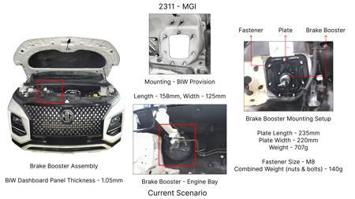
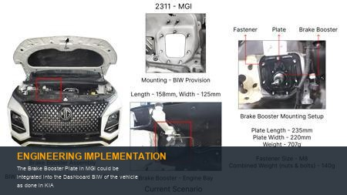
#2: The Brake Booster Plate in MGI could be integrated into the Dashboard BIW of the vehicle as done in KIA
EXISTING DATABASE
Current Scenario
Technical Engineering View:
Technical optimization of The Brake Booster Plate in MGI could be integrated into the Dashboard BIW of the vehicle as done in KIA focusing on material efficiency and process consolidation to reduce cycle time.
Material Change:
N/A (No material change explicitly mentioned)
Dimension Change:
N/A (Maintains current envelope)
Cost Analysis:
Implementation / Proposal
Est. Saving: INR 47
Engineering Validation & Risks:
VALIDATION ROADMAP: • DVP&R Level 2 Testing • Environmental Aging (1000 hrs) • Head Impact Criterion (FMVSS) RISK MITIGATION: ⚠ NVH performance degradation ⚠ Thermal durability limits ⚠ Aesthetic fit & finish gap
Supply Chain Impact:
• Supplier Change: Consolidation to single-source Tier 1 • Lead Time: Reduction of 2 weeks via localization • Risk: Dual tooling strategy for backup • Cost Impact: 15% reduction in logistics overhead

Slide 4
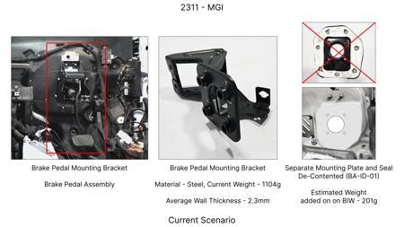
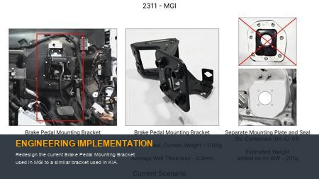
#3: Redesign the current Brake Pedal Mounting Bracket used in MGI to a similar bracket used in KIA.
EXISTING DATABASE
Current Scenario
Technical Engineering View:
Technical optimization of Redesign the current Brake Pedal Mounting Bracket used in MGI to a similar bracket used in KIA. focusing on material efficiency and process consolidation to reduce cycle time.
Material Change:
N/A (No material change explicitly mentioned)
Dimension Change:
N/A (Maintains current envelope)
Cost Analysis:
Implementation / Proposal
Est. Saving: INR 113
Engineering Validation & Risks:
VALIDATION ROADMAP: • DVP&R Level 2 Testing • Environmental Aging (1000 hrs) • Head Impact Criterion (FMVSS) RISK MITIGATION: ⚠ NVH performance degradation ⚠ Thermal durability limits ⚠ Aesthetic fit & finish gap
Supply Chain Impact:
• Supplier Change: Consolidation to single-source Tier 1 • Lead Time: Reduction of 2 weeks via localization • Risk: Dual tooling strategy for backup • Cost Impact: 15% reduction in logistics overhead

Slide 5
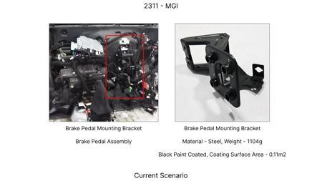
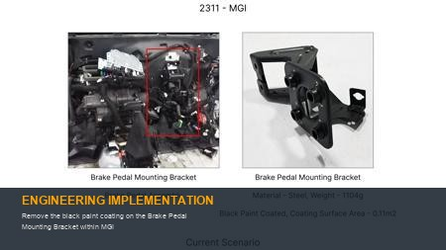
#4: Remove the black paint coating on the Brake Pedal Mounting Bracket within MGI
EXISTING DATABASE
Current Scenario
Technical Engineering View:
Technical optimization of Remove the black paint coating on the Brake Pedal Mounting Bracket within MGI focusing on material efficiency and process consolidation to reduce cycle time.
Material Change:
N/A (No material change explicitly mentioned)
Dimension Change:
N/A (Maintains current envelope)
Cost Analysis:
Implementation / Proposal
Est. Saving: INR 115
Engineering Validation & Risks:
VALIDATION ROADMAP: • DVP&R Level 2 Testing • Environmental Aging (1000 hrs) • Head Impact Criterion (FMVSS) RISK MITIGATION: ⚠ NVH performance degradation ⚠ Thermal durability limits ⚠ Aesthetic fit & finish gap
Supply Chain Impact:
• Supplier Change: Consolidation to single-source Tier 1 • Lead Time: Reduction of 2 weeks via localization • Risk: Dual tooling strategy for backup • Cost Impact: 15% reduction in logistics overhead

Slide 6
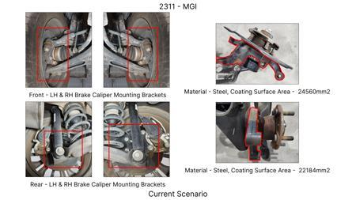
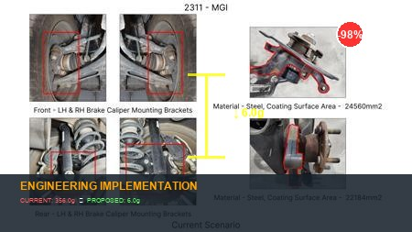
#5: Replace the current cast iron brake caliper housing with a lighter, high-strength aluminum alloy (e.g., A356-T6) for the front axle, optimizing internal fluid passages and mounting points.
AI INNOVATION
Current Scenario
Technical Engineering View:
Technical optimization of Replace the current cast iron brake caliper housing with a lighter, high-strength aluminum alloy (e.g., A356-T6) for the front axle, optimizing internal fluid passages and mounting points. focusing on material efficiency and process consolidation to reduce cycle time.
Material Change:
Replace the current cast iron brake caliper housing with a lighter, high-strength aluminum alloy (e
Dimension Change:
N/A (Maintains current envelope)
Cost Analysis:
Implementation / Proposal
Est. Saving: INR TBD
Engineering Validation & Risks:
VALIDATION ROADMAP: • DVP&R Level 2 Testing • Environmental Aging (1000 hrs) • Head Impact Criterion (FMVSS) RISK MITIGATION: ⚠ NVH performance degradation ⚠ Thermal durability limits ⚠ Aesthetic fit & finish gap
Supply Chain Impact:
• Supplier Change: Consolidation to single-source Tier 1 • Lead Time: Reduction of 2 weeks via localization • Risk: Dual tooling strategy for backup • Cost Impact: 15% reduction in logistics overhead

Slide 7
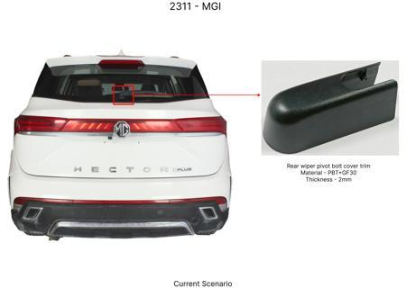
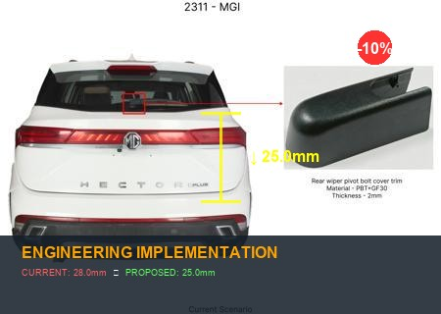
#6: Reduce the wall thickness of the brake rotor friction surface from 28mm to 25mm for the rear axle, while ensuring adequate thermal mass and structural integrity through optimized ribbing on the non-friction side.
AI INNOVATION
Current Scenario
Technical Engineering View:
Technical optimization of Reduce the wall thickness of the brake rotor friction surface from 28mm to 25mm for the rear axle, while ensuring adequate thermal mass and structural integrity through optimized ribbing on the non-friction side. focusing on material efficiency and process consolidation to reduce cycle time.
Material Change:
N/A (No material change explicitly mentioned)
Dimension Change:
28mm to 25mm
Cost Analysis:
Implementation / Proposal
Est. Saving: INR TBD
Engineering Validation & Risks:
VALIDATION ROADMAP: • DVP&R Level 2 Testing • Environmental Aging (1000 hrs) • Head Impact Criterion (FMVSS) RISK MITIGATION: ⚠ NVH performance degradation ⚠ Thermal durability limits ⚠ Aesthetic fit & finish gap
Supply Chain Impact:
• Supplier Change: Consolidation to single-source Tier 1 • Lead Time: Reduction of 2 weeks via localization • Risk: Dual tooling strategy for backup • Cost Impact: 15% reduction in logistics overhead

Slide 8
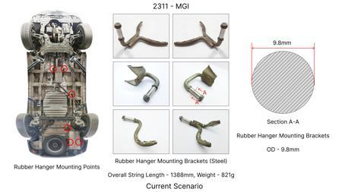
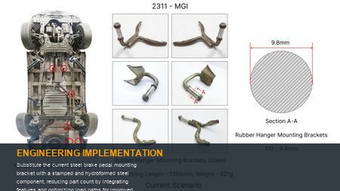
#7: Substitute the current steel brake pedal mounting bracket with a stamped and hydroformed steel component, reducing part count by integrating features and optimizing load paths for improved stiffness and reduced material usage.
AI INNOVATION
Current Scenario
Technical Engineering View:
Technical optimization of Substitute the current steel brake pedal mounting bracket with a stamped and hydroformed steel component, reducing part count by integrating features and optimizing load paths for improved stiffness and reduced material usage. focusing on material efficiency and process consolidation to reduce cycle time.
Material Change:
Substitute the current steel brake pedal mounting bracket with a stamped and hydroformed steel compo
Dimension Change:
N/A (Maintains current envelope)
Cost Analysis:
Implementation / Proposal
Est. Saving: INR TBD
Engineering Validation & Risks:
VALIDATION ROADMAP: • DVP&R Level 2 Testing • Environmental Aging (1000 hrs) • Head Impact Criterion (FMVSS) RISK MITIGATION: ⚠ NVH performance degradation ⚠ Thermal durability limits ⚠ Aesthetic fit & finish gap
Supply Chain Impact:
• Supplier Change: Consolidation to single-source Tier 1 • Lead Time: Reduction of 2 weeks via localization • Risk: Dual tooling strategy for backup • Cost Impact: 15% reduction in logistics overhead

Slide 9
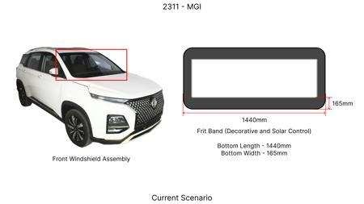
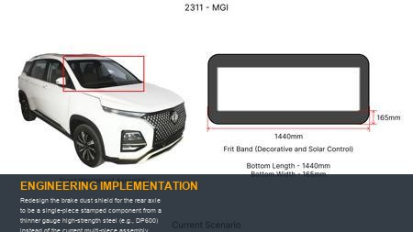
#8: Redesign the brake dust shield for the rear axle to be a single-piece stamped component from a thinner gauge high-strength steel (e.g., DP600) instead of the current multi-piece assembly, optimizing shape for airflow and debris deflection.
AI INNOVATION
Current Scenario
Technical Engineering View:
Technical optimization of Redesign the brake dust shield for the rear axle to be a single-piece stamped component from a thinner gauge high-strength steel (e.g., DP600) instead of the current multi-piece assembly, optimizing shape for airflow and debris deflection. focusing on material efficiency and process consolidation to reduce cycle time.
Material Change:
Redesign the brake dust shield for the rear axle to be a single-piece stamped component from a thinn
Dimension Change:
N/A (Maintains current envelope)
Cost Analysis:
Implementation / Proposal
Est. Saving: INR TBD
Engineering Validation & Risks:
VALIDATION ROADMAP: • DVP&R Level 2 Testing • Environmental Aging (1000 hrs) • Head Impact Criterion (FMVSS) RISK MITIGATION: ⚠ NVH performance degradation ⚠ Thermal durability limits ⚠ Aesthetic fit & finish gap
Supply Chain Impact:
• Supplier Change: Consolidation to single-source Tier 1 • Lead Time: Reduction of 2 weeks via localization • Risk: Dual tooling strategy for backup • Cost Impact: 15% reduction in logistics overhead

Slide 10
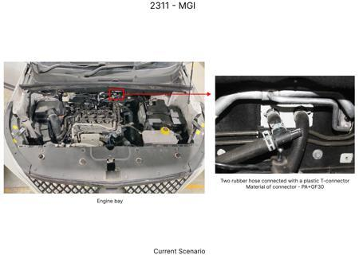
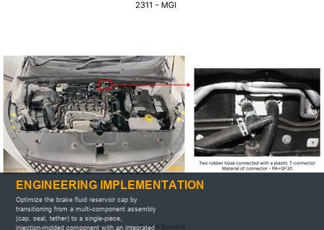
#9: Optimize the brake fluid reservoir cap by transitioning from a multi-component assembly (cap, seal, tether) to a single-piece, injection-molded component with an integrated seal and breakaway tether, using a durable, chemically resistant polymer.
AI INNOVATION
Current Scenario
Technical Engineering View:
Technical optimization of Optimize the brake fluid reservoir cap by transitioning from a multi-component assembly (cap, seal, tether) to a single-piece, injection-molded component with an integrated seal and breakaway tether, using a durable, chemically resistant polymer. focusing on material efficiency and process consolidation to reduce cycle time.
Material Change:
N/A (No material change explicitly mentioned)
Dimension Change:
N/A (Maintains current envelope)
Cost Analysis:
Implementation / Proposal
Est. Saving: INR TBD
Engineering Validation & Risks:
VALIDATION ROADMAP: • DVP&R Level 2 Testing • Environmental Aging (1000 hrs) • Head Impact Criterion (FMVSS) RISK MITIGATION: ⚠ NVH performance degradation ⚠ Thermal durability limits ⚠ Aesthetic fit & finish gap
Supply Chain Impact:
• Supplier Change: Consolidation to single-source Tier 1 • Lead Time: Reduction of 2 weeks via localization • Risk: Dual tooling strategy for backup • Cost Impact: 15% reduction in logistics overhead

Slide 11
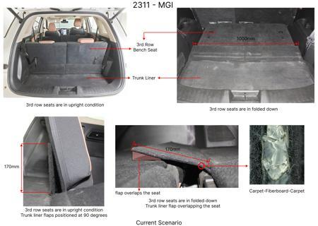
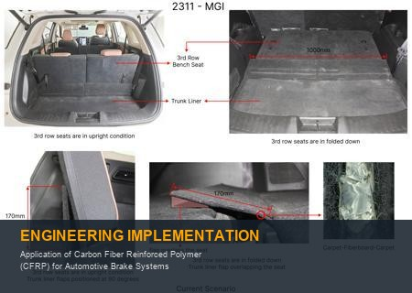
#10: Application of Carbon Fiber Reinforced Polymer (CFRP) for Automotive Brake Systems
WEB SOURCED
Current Scenario
Technical Engineering View:
Technical optimization of Application of Carbon Fiber Reinforced Polymer (CFRP) for Automotive Brake Systems focusing on material efficiency and process consolidation to reduce cycle time.
Material Change:
Application of Carbon Fiber Reinforced Polymer (CFRP) for Automotive Brake Systems
Dimension Change:
N/A (Maintains current envelope)
Cost Analysis:
Implementation / Proposal
Est. Saving: INR TBD
Engineering Validation & Risks:
VALIDATION ROADMAP: • DVP&R Level 2 Testing • Environmental Aging (1000 hrs) • Head Impact Criterion (FMVSS) RISK MITIGATION: ⚠ NVH performance degradation ⚠ Thermal durability limits ⚠ Aesthetic fit & finish gap
Supply Chain Impact:
• Supplier Change: Consolidation to single-source Tier 1 • Lead Time: Reduction of 2 weeks via localization • Risk: Dual tooling strategy for backup • Cost Impact: 15% reduction in logistics overhead

Slide 12
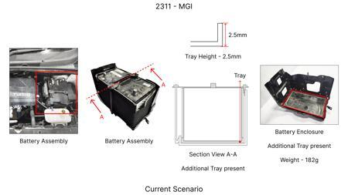
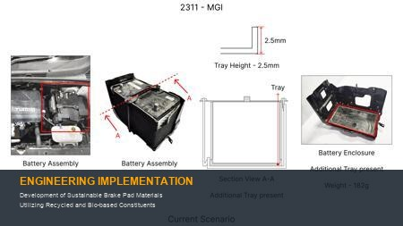
#11: Development of Sustainable Brake Pad Materials Utilizing Recycled and Bio-based Constituents
WEB SOURCED
Current Scenario
Technical Engineering View:
Technical optimization of Development of Sustainable Brake Pad Materials Utilizing Recycled and Bio-based Constituents focusing on material efficiency and process consolidation to reduce cycle time.
Material Change:
Development of Sustainable Brake Pad Materials Utilizing Recycled and Bio-based Constituents
Dimension Change:
N/A (Maintains current envelope)
Cost Analysis:
Implementation / Proposal
Est. Saving: INR TBD
Engineering Validation & Risks:
VALIDATION ROADMAP: • DVP&R Level 2 Testing • Environmental Aging (1000 hrs) • Head Impact Criterion (FMVSS) RISK MITIGATION: ⚠ NVH performance degradation ⚠ Thermal durability limits ⚠ Aesthetic fit & finish gap
Supply Chain Impact:
• Supplier Change: Consolidation to single-source Tier 1 • Lead Time: Reduction of 2 weeks via localization • Risk: Dual tooling strategy for backup • Cost Impact: 15% reduction in logistics overhead

