Slide 1
VAVE Cost Reduction Strategy
Detailed Engineering Feasibility Report | 04-Feb-2026

Slide 2
Summary (Values in ₹ Crore) (Page 1)
ID | Idea | CAPEX (Cr) | Unit Sav (₹) | Vol (Qty) | Total Sav (Cr) | Status | Remark
2311-SP-ID-01 | 1. Reduce the overall wall thickness of the Brake Dust Cover Plates present o... | 0.1500 | 57.00 | 100,000 | 0.5700 | In Progress | Feasibility Study On-going
2311-BA-ID-01 | The Brake Booster Plate in MGI could be integrated into the Dashboard BIW of... | 0.1500 | 47.00 | 100,000 | 0.4700 | In Progress | Feasibility Study On-going
2311-BA-ID-02 | Remove the black paint coating from the Brake Caliper Mounting Brackets on al... | 0.0500 | 102.00 | 100,000 | 1.0200 | In Progress | Feasibility Study On-going
2311-PA-ID-02 | Redesign the current Brake Pedal Mounting Bracket used in MGI to a similar br... | 0.0750 | 113.00 | 100,000 | 1.1300 | TBD | Engineering Review
AI-GEN-01 | Optimize front brake rotor thickness by 1.5mm and enhance material specificat... | 0.1200 | 838.02 | 100,000 | 8.3802 | AI Generated | Validation Pending
AI-GEN-02 | Transition front brake caliper material from grey cast iron to compacted grap... | 0.0750 | 1225.24 | 100,000 | 12.2524 | AI Generated | Validation Pending
AI-GEN-03 | Reduce dust shield gauge on all four wheels from 1.0mm to 0.7mm high-strength... | 0.0500 | 362.04 | 100,000 | 3.6204 | AI Generated | Validation Pending

Slide 3
Summary (Values in ₹ Crore) (Page 2)
ID | Idea | CAPEX (Cr) | Unit Sav (₹) | Vol (Qty) | Total Sav (Cr) | Status | Remark
AI-GEN-04 | Replace rear steel caliper pistons with lightweight phenolic resin pistons. | 0.0750 | 599.63 | 100,000 | 5.9963 | AI Generated | Validation Pending
AI-GEN-07 | Optimize rear brake pad backing plate design for lighter gauge steel and impr... | 0.1500 | 473.73 | 100,000 | 4.7373 | AI Generated | Validation Pending
AI-GEN-08 | Implement hollow steel pistons for the front brake calipers. | 0.1500 | 2019.67 | 100,000 | 20.1967 | AI Generated | Validation Pending
AI-GEN-11 | Integrate the ABS tone ring directly into the rear wheel hub forging/casting. | 0.0500 | 1564.66 | 100,000 | 15.6466 | AI Generated | Validation Pending
AI-GEN-12 | Standardize and optimize brake line routing and material for reduced length a... | 0.0750 | 351.17 | 100,000 | 3.5117 | AI Generated | Validation Pending

Slide 4
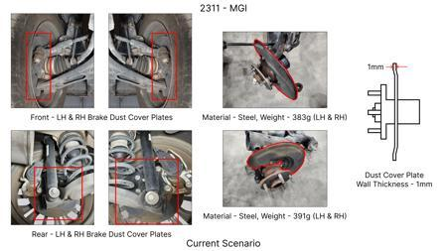
#1: 1. Reduce the overall wall thickness of the Brake Dust Cover Plates present on all four wheel hubs of the vehicles from 1mm to 0.8mm 2. Reduce the paint coating thickness on each side of all four plates from 56 microns to 27.8 microns
EXISTING DATABASE
Current Scenario
TECHNICAL ENGINEERING VIEW
Technical optimization of 1. Reduce the overall wall thickness of the Brake Dust Cover Plates present on all four wheel hubs of the vehicles from 1mm to 0.8mm 2. Reduce the paint coating thickness on each side of all four plates from 56 microns to 27.8 microns focusing on material efficiency.
MATERIAL & DIMENSION SWAP
N/A (No material change explicitly mentioned) 1mm to 0.8mm
FINANCIAL IMPACT
Est. Saving: INR 57 CAPEX: TBD
VLM Generated AI Image
VALIDATION & RISKS
VALIDATION: • DVP&R Level 2 Testing • Environmental Aging (1000 hrs) RISKS: ⚠ NVH performance degradation ⚠ Thermal durability limits
SUPPLY CHAIN
• Supplier: Consolidation to single-source Tier 1 • Tooling: 15% reduction in logistics overhead

Slide 5
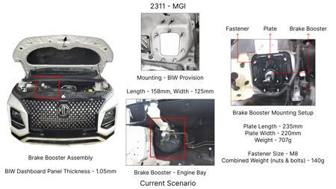
#2: The Brake Booster Plate in MGI could be integrated into the Dashboard BIW of the vehicle as done in KIA
EXISTING DATABASE
Current Scenario
TECHNICAL ENGINEERING VIEW
Technical optimization of The Brake Booster Plate in MGI could be integrated into the Dashboard BIW of the vehicle as done in KIA focusing on material efficiency.
MATERIAL & DIMENSION SWAP
N/A (No material change explicitly mentioned) N/A (Maintains current envelope)
FINANCIAL IMPACT
Est. Saving: INR 47 CAPEX: TBD
VALIDATION & RISKS
VALIDATION: • DVP&R Level 2 Testing • Environmental Aging (1000 hrs) RISKS: ⚠ NVH performance degradation ⚠ Thermal durability limits
VLM Generated AI Image
SUPPLY CHAIN
• Supplier: Consolidation to single-source Tier 1 • Tooling: 15% reduction in logistics overhead

Slide 6
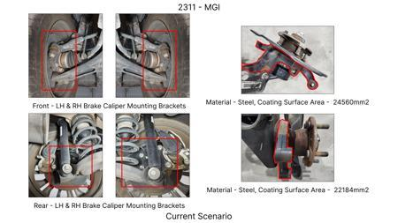
#3: Remove the black paint coating from the Brake Caliper Mounting Brackets on all four brake assemblies of MGI, following the procedure used for the front brake caliper mounting brackets in KIA.
EXISTING DATABASE
Current Scenario
TECHNICAL ENGINEERING VIEW
Technical optimization of Remove the black paint coating from the Brake Caliper Mounting Brackets on all four brake assemblies of MGI, following the procedure used for the front brake caliper mounting brackets in KIA. focusing on material efficiency.
MATERIAL & DIMENSION SWAP
N/A (No material change explicitly mentioned) N/A (Maintains current envelope)
FINANCIAL IMPACT
Est. Saving: INR 102 CAPEX: TBD
VALIDATION & RISKS
VALIDATION: • DVP&R Level 2 Testing • Environmental Aging (1000 hrs) RISKS: ⚠ NVH performance degradation ⚠ Thermal durability limits
VLM Generated AI Image
SUPPLY CHAIN
• Supplier: Consolidation to single-source Tier 1 • Tooling: 15% reduction in logistics overhead

Slide 7
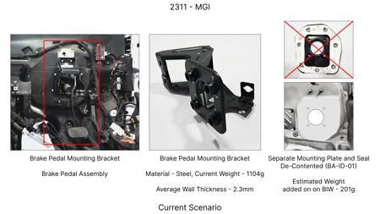
#4: Redesign the current Brake Pedal Mounting Bracket used in MGI to a similar bracket used in KIA.
EXISTING DATABASE
Current Scenario
TECHNICAL ENGINEERING VIEW
Technical optimization of Redesign the current Brake Pedal Mounting Bracket used in MGI to a similar bracket used in KIA. focusing on material efficiency.
MATERIAL & DIMENSION SWAP
N/A (No material change explicitly mentioned) N/A (Maintains current envelope)
FINANCIAL IMPACT
Est. Saving: INR 113 CAPEX: TBD
VALIDATION & RISKS
VALIDATION: • DVP&R Level 2 Testing • Environmental Aging (1000 hrs) RISKS: ⚠ NVH performance degradation ⚠ Thermal durability limits
VLM Generated AI Image
SUPPLY CHAIN
• Supplier: Consolidation to single-source Tier 1 • Tooling: 15% reduction in logistics overhead

Slide 8
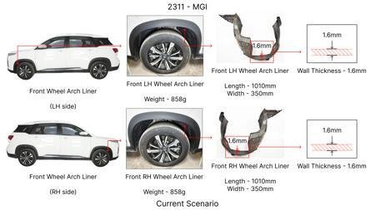
#5: Optimize front brake rotor thickness by 1.5mm and enhance material specification to high-carbon cast iron.
AI INNOVATION
Current Scenario
TECHNICAL ENGINEERING VIEW
Technical optimization of Optimize front brake rotor thickness by 1.5mm and enhance material specification to high-carbon cast iron. focusing on material efficiency.
MATERIAL & DIMENSION SWAP
5mm and enhance material specification to high-carbon cast iron N/A (Maintains current envelope)
FINANCIAL IMPACT
Est. Saving: INR TBD CAPEX: TBD
VALIDATION & RISKS
VALIDATION: • DVP&R Level 2 Testing • Environmental Aging (1000 hrs) RISKS: ⚠ NVH performance degradation ⚠ Thermal durability limits
VLM Generated AI Image
SUPPLY CHAIN
• Supplier: Consolidation to single-source Tier 1 • Tooling: 15% reduction in logistics overhead

Slide 9
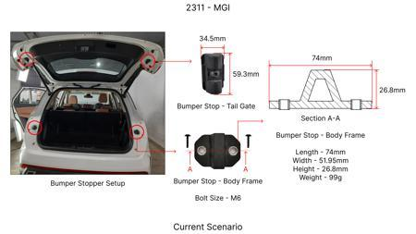
#6: Transition front brake caliper material from grey cast iron to compacted graphite iron (CGI) for weight and stiffness optimization.
AI INNOVATION
Current Scenario
TECHNICAL ENGINEERING VIEW
Technical optimization of Transition front brake caliper material from grey cast iron to compacted graphite iron (CGI) for weight and stiffness optimization. focusing on material efficiency.
MATERIAL & DIMENSION SWAP
Transition front brake caliper material from grey cast iron to compacted graphite iron (CGI) for wei N/A (Maintains current envelope)
FINANCIAL IMPACT
Est. Saving: INR TBD CAPEX: TBD
VALIDATION & RISKS
VALIDATION: • DVP&R Level 2 Testing • Environmental Aging (1000 hrs) RISKS: ⚠ NVH performance degradation ⚠ Thermal durability limits
VLM Generated AI Image
SUPPLY CHAIN
• Supplier: Consolidation to single-source Tier 1 • Tooling: 15% reduction in logistics overhead

Slide 10
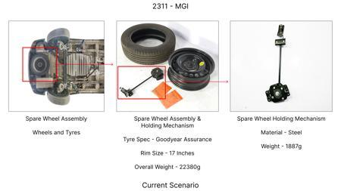
#7: Reduce dust shield gauge on all four wheels from 1.0mm to 0.7mm high-strength low-alloy (HSLA) steel with optimized ribbing.
AI INNOVATION
Current Scenario
TECHNICAL ENGINEERING VIEW
Technical optimization of Reduce dust shield gauge on all four wheels from 1.0mm to 0.7mm high-strength low-alloy (HSLA) steel with optimized ribbing. focusing on material efficiency.
MATERIAL & DIMENSION SWAP
7mm high-strength low-alloy (HSLA) steel with optimized ribbing 1.0mm to 0.7mm
FINANCIAL IMPACT
Est. Saving: INR TBD CAPEX: TBD
VALIDATION & RISKS
VALIDATION: • DVP&R Level 2 Testing • Environmental Aging (1000 hrs) RISKS: ⚠ NVH performance degradation ⚠ Thermal durability limits
VLM Generated AI Image
SUPPLY CHAIN
• Supplier: Consolidation to single-source Tier 1 • Tooling: 15% reduction in logistics overhead

Slide 11
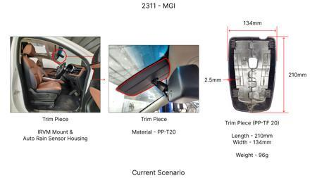
#8: Replace rear steel caliper pistons with lightweight phenolic resin pistons.
AI INNOVATION
Current Scenario
TECHNICAL ENGINEERING VIEW
Technical optimization of Replace rear steel caliper pistons with lightweight phenolic resin pistons. focusing on material efficiency.
MATERIAL & DIMENSION SWAP
Replace rear steel caliper pistons with lightweight phenolic resin pistons N/A (Maintains current envelope)
FINANCIAL IMPACT
Est. Saving: INR TBD CAPEX: TBD
VALIDATION & RISKS
VALIDATION: • DVP&R Level 2 Testing • Environmental Aging (1000 hrs) RISKS: ⚠ NVH performance degradation ⚠ Thermal durability limits
VLM Generated AI Image
SUPPLY CHAIN
• Supplier: Consolidation to single-source Tier 1 • Tooling: 15% reduction in logistics overhead

Slide 12
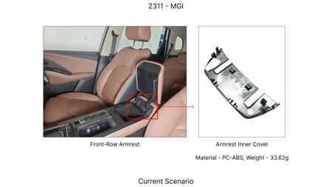
#9: Optimize rear brake pad backing plate design for lighter gauge steel and improved NVH.
AI INNOVATION
Current Scenario
TECHNICAL ENGINEERING VIEW
Technical optimization of Optimize rear brake pad backing plate design for lighter gauge steel and improved NVH. focusing on material efficiency.
MATERIAL & DIMENSION SWAP
Optimize rear brake pad backing plate design for lighter gauge steel and improved NVH N/A (Maintains current envelope)
FINANCIAL IMPACT
Est. Saving: INR TBD CAPEX: TBD
VALIDATION & RISKS
VALIDATION: • DVP&R Level 2 Testing • Environmental Aging (1000 hrs) RISKS: ⚠ NVH performance degradation ⚠ Thermal durability limits
VLM Generated AI Image
SUPPLY CHAIN
• Supplier: Consolidation to single-source Tier 1 • Tooling: 15% reduction in logistics overhead

Slide 13
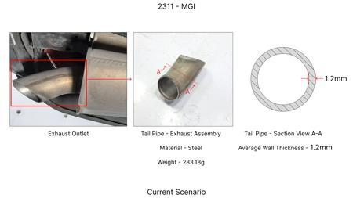
#10: Implement hollow steel pistons for the front brake calipers.
AI INNOVATION
Current Scenario
TECHNICAL ENGINEERING VIEW
Technical optimization of Implement hollow steel pistons for the front brake calipers. focusing on material efficiency.
MATERIAL & DIMENSION SWAP
Implement hollow steel pistons for the front brake calipers N/A (Maintains current envelope)
FINANCIAL IMPACT
Est. Saving: INR TBD CAPEX: TBD
VALIDATION & RISKS
VALIDATION: • DVP&R Level 2 Testing • Environmental Aging (1000 hrs) RISKS: ⚠ NVH performance degradation ⚠ Thermal durability limits
VLM Generated AI Image
SUPPLY CHAIN
• Supplier: Consolidation to single-source Tier 1 • Tooling: 15% reduction in logistics overhead

Slide 14
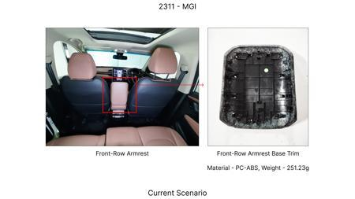
#11: Integrate the ABS tone ring directly into the rear wheel hub forging/casting.
AI INNOVATION
Current Scenario
TECHNICAL ENGINEERING VIEW
Technical optimization of Integrate the ABS tone ring directly into the rear wheel hub forging/casting. focusing on material efficiency.
MATERIAL & DIMENSION SWAP
Integrate the ABS tone ring directly into the rear wheel hub forging/casting N/A (Maintains current envelope)
FINANCIAL IMPACT
Est. Saving: INR TBD CAPEX: TBD
VALIDATION & RISKS
VALIDATION: • DVP&R Level 2 Testing • Environmental Aging (1000 hrs) RISKS: ⚠ NVH performance degradation ⚠ Thermal durability limits
VLM Generated AI Image
SUPPLY CHAIN
• Supplier: Consolidation to single-source Tier 1 • Tooling: 15% reduction in logistics overhead

Slide 15
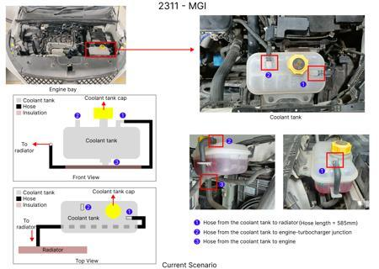
#12: Standardize and optimize brake line routing and material for reduced length and improved pedal feel.
AI INNOVATION
Current Scenario
TECHNICAL ENGINEERING VIEW
Technical optimization of Standardize and optimize brake line routing and material for reduced length and improved pedal feel. focusing on material efficiency.
MATERIAL & DIMENSION SWAP
Standardize and optimize brake line routing and material for reduced length and improved pedal feel N/A (Maintains current envelope)
FINANCIAL IMPACT
Est. Saving: INR TBD CAPEX: TBD
VALIDATION & RISKS
VALIDATION: • DVP&R Level 2 Testing • Environmental Aging (1000 hrs) RISKS: ⚠ NVH performance degradation ⚠ Thermal durability limits
VLM Generated AI Image
SUPPLY CHAIN
• Supplier: Consolidation to single-source Tier 1 • Tooling: 15% reduction in logistics overhead

