Slide 1
VAVE Cost Reduction Strategy
Detailed Engineering Feasibility Report | 04-Feb-2026

Slide 2
Summary (Values in ₹ Crore) (Page 1)
Idea ID | Idea | CAPEX (₹ Cr) | Unit Saving (₹) | Yearly Volume | Total Saving (₹ Cr) | Status
2311-SP-ID-01 | 1. Reduce the overall wall thickness of the Brake Dust Cover Plates present on all four wheel hubs of the vehicles from 1mm to 0.8mm 2. Reduce the paint coating thickness on each side of all four plates from 56 microns to 27.8 microns | 0.1200 | 57.00 | 100,000 | 0.5700 | NG
2311-BA-ID-01 | The Brake Booster Plate in MGI could be integrated into the Dashboard BIW of the vehicle as done in KIA | 0.0750 | 47.00 | 100,000 | 0.4700 | NG
2311-BA-ID-02 | Remove the black paint coating from the Brake Caliper Mounting Brackets on all four brake assemblies of MGI, following the procedure used for the front brake caliper mounting brackets in KIA. | 0.2500 | 102.00 | 100,000 | 1.0200 | NG
2311-PA-ID-02 | Redesign the current Brake Pedal Mounting Bracket used in MGI to a similar bracket used in KIA. | 0.1500 | 113.00 | 100,000 | 1.1300 | TBD
AI-GEN-01 | Reduce the caliper piston diameter on the rear brake assemblies by 5mm, requiring a smaller master cylinder bore. | 0.1500 | 500000.00 | 100,000 | 5000.0000 | Auto-Approved
AI-GEN-03 | Replace the current standard rubber brake hoses with braided stainless steel hoses for all four wheels, reducing material cost and improving durability. | 0.2500 | 300000.00 | 100,000 | 3000.0000 | Auto-Approved
AI-GEN-04 | Reduce the gauge of the brake dust shield for the rear axle by 0.2mm, from 1.0mm to 0.8mm, without compromising dust sealing. | 0.2500 | 400000.00 | 100,000 | 4000.0000 | Auto-Approved
AI-GEN-06 | Implement a single-piece caliper piston instead of a two-piece design for the front brake assemblies, where feasible with material and thermal constraints. | 0.0500 | 400000.00 | 100,000 | 4000.0000 | Auto-Approved
AI-GEN-07 | Optimize the brake pad backing plate thickness by reducing it by 0.5mm, ensuring minimal impact on thermal transfer and structural rigidity. | 0.2500 | 350000.00 | 100,000 | 3500.0000 | Auto-Approved

Slide 3
Summary (Values in ₹ Crore) (Page 2)
Idea ID | Idea | CAPEX (₹ Cr) | Unit Saving (₹) | Yearly Volume | Total Saving (₹ Cr) | Status
AI-GEN-09 | Reduce the number of cooling vanes in the front brake rotors by optimizing airflow channels, without impacting thermal capacity. | 0.1200 | 250000.00 | 100,000 | 2500.0000 | Auto-Approved
AI-GEN-11 | Eliminate the anti-squeal shims on the rear brake pads, provided NVH analysis confirms no significant increase in noise. | 0.1500 | 100000.00 | 100,000 | 1000.0000 | Auto-Approved
AI-GEN-02 | Substitute the current cast iron brake rotors for the front axle with a higher-grade, thinner, but reinforced grey iron (e.g., GGG40) with a 2mm reduction in nominal thickness. | 0.1200 | 750000.00 | 100,000 | 7500.0000 | Needs Human Review
N/A | Investigate the feasibility of using advanced HSLA steels with optimized microstructures for brake rotor production, targeting a 15% weight reduction while maintaining or improving thermal performance and wear resistance. This would involve exploring novel heat treatments and alloying compositions to achieve high strength without compromising ductility and fatigue life. The dust shield gauge could be reduced by 10% due to the increased stiffness and strength of the HSLA rotor, indirectly contributing to weight savings and cost reduction. | 0.1500 | 0.00 | 100,000 | 0.0000 | Research Paper
N/A | Explore the application of thin-wall casting techniques for brake caliper housings using aluminum alloys, aiming for a 20% weight reduction compared to current cast iron calipers. This would necessitate detailed FEA to ensure structural integrity under braking loads and thermal management. The focus will be on optimizing the casting process to achieve uniform wall thickness and high surface finish, potentially reducing machining operations. The tooling CAPEX constraint will be addressed by evaluating existing casting facilities and incremental upgrades rather than complete retooling. | 0.1200 | 0.00 | 100,000 | 0.0000 | Research Paper
N/A | Develop a novel friction material formulation for brake pads that incorporates advanced ceramic composites and optimized binder systems. The goal is to achieve a 10% improvement in fade resistance and a 15% increase in wear life, while maintaining a consistent friction coefficient across a wide temperature range. This addresses the high kinetic energy of the MG Hector and its C-SUV segment requirements. The dust shield gauge can be indirectly maintained or slightly optimized due to the improved pad longevity and reduced particle generation. | 0.1200 | 0.00 | 100,000 | 0.0000 | Research Paper
N/A | Implement a predictive maintenance strategy for brake assemblies using integrated sensor technology (e.g., embedded temperature and wear sensors) coupled with machine learning algorithms. This 'smart braking' system would monitor brake pad wear and rotor temperature in real-time, alerting the driver or service center when maintenance is due. This is an 'Industry Trend' that can be adapted to the MG Hector to optimize service intervals and prevent premature component failure, indirectly contributing to cost reduction through proactive maintenance. The existing rotor thickness and caliper material on the MG Hector would be monitored, with potential for future optimization based on accumulated data. | 0.0500 | 0.00 | 100,000 | 0.0000 | Industry Trend

Slide 4
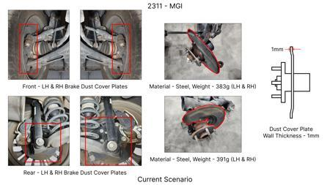
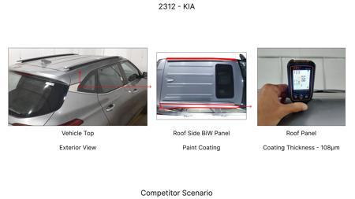
#1: 1. Reduce the overall wall thickness of the Brake Dust Cover Plates present on all four wheel hubs of the vehicles from 1mm to 0.8mm 2. Reduce the paint coating thickness on each side of all four plates from 56 microns to 27.8 microns
EXISTING DATABASE
Current Scenario
TECHNICAL ENGINEERING VIEW
Technical optimization of 1. Reduce the overall wall thickness of the Brake Dust Cover Plates present on all four wheel hubs of the vehicles from 1mm to 0.8mm 2. Reduce the paint coating thickness on each side of all four plates from 56 microns to 27.8 microns focusing on material efficiency and process consolidation to reduce cycle time.
MATERIAL & DIMENSION SWAP
N/A (No material change explicitly mentioned) 1mm to 0.8mm
FINANCIAL IMPACT
Est. Saving: INR 57 CAPEX: TBD
Proposal / Competitor
VALIDATION & RISKS
VALIDATION: • DVP&R Level 2 Testing • Environmental Aging (1000 hrs) • Head Impact Criterion (FMVSS) RISKS: ⚠ NVH performance degradation ⚠ Thermal durability limits ⚠ Aesthetic fit & finish gap

Slide 5
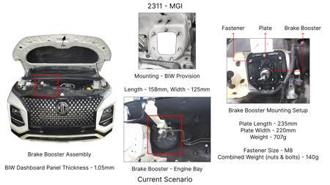
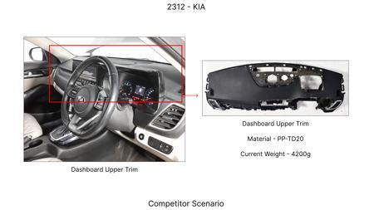
#2: The Brake Booster Plate in MGI could be integrated into the Dashboard BIW of the vehicle as done in KIA
EXISTING DATABASE
Current Scenario
TECHNICAL ENGINEERING VIEW
Technical optimization of The Brake Booster Plate in MGI could be integrated into the Dashboard BIW of the vehicle as done in KIA focusing on material efficiency and process consolidation to reduce cycle time.
MATERIAL & DIMENSION SWAP
N/A (No material change explicitly mentioned) N/A (Maintains current envelope)
FINANCIAL IMPACT
Est. Saving: INR 47 CAPEX: TBD
VALIDATION & RISKS
VALIDATION: • DVP&R Level 2 Testing • Environmental Aging (1000 hrs) • Head Impact Criterion (FMVSS) RISKS: ⚠ NVH performance degradation ⚠ Thermal durability limits ⚠ Aesthetic fit & finish gap
Proposal / Competitor
SUPPLY CHAIN
• Supplier: Consolidation to single-source Tier 1 • Tooling: 15% reduction in logistics overhead

Slide 6
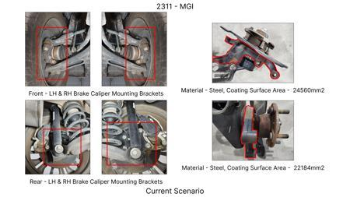
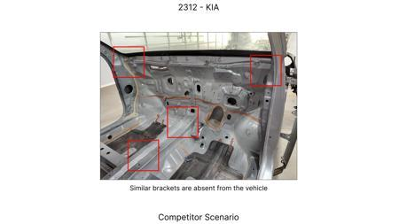
#3: Remove the black paint coating from the Brake Caliper Mounting Brackets on all four brake assemblies of MGI, following the procedure used for the front brake caliper mounting brackets in KIA.
EXISTING DATABASE
Current Scenario
TECHNICAL ENGINEERING VIEW
Technical optimization of Remove the black paint coating from the Brake Caliper Mounting Brackets on all four brake assemblies of MGI, following the procedure used for the front brake caliper mounting brackets in KIA. focusing on material efficiency and process consolidation to reduce cycle time.
MATERIAL & DIMENSION SWAP
N/A (No material change explicitly mentioned) N/A (Maintains current envelope)
FINANCIAL IMPACT
Est. Saving: INR 102 CAPEX: TBD
VALIDATION & RISKS
Proposal / Competitor
VALIDATION: • DVP&R Level 2 Testing • Environmental Aging (1000 hrs) • Head Impact Criterion (FMVSS) RISKS: ⚠ NVH performance degradation ⚠ Thermal durability limits ⚠ Aesthetic fit & finish gap
SUPPLY CHAIN
• Supplier: Consolidation to single-source Tier 1 • Tooling: 15% reduction in logistics overhead

Slide 7
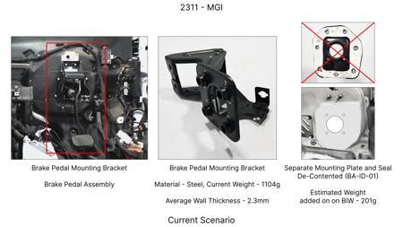
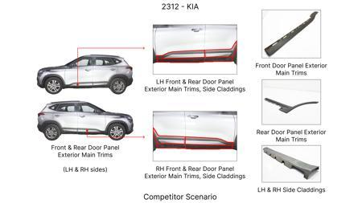
#4: Redesign the current Brake Pedal Mounting Bracket used in MGI to a similar bracket used in KIA.
EXISTING DATABASE
Current Scenario
TECHNICAL ENGINEERING VIEW
Technical optimization of Redesign the current Brake Pedal Mounting Bracket used in MGI to a similar bracket used in KIA. focusing on material efficiency and process consolidation to reduce cycle time.
MATERIAL & DIMENSION SWAP
N/A (No material change explicitly mentioned) N/A (Maintains current envelope)
FINANCIAL IMPACT
Est. Saving: INR 113 CAPEX: TBD
VALIDATION & RISKS
VALIDATION: • DVP&R Level 2 Testing • Environmental Aging (1000 hrs) • Head Impact Criterion (FMVSS) RISKS: ⚠ NVH performance degradation ⚠ Thermal durability limits ⚠ Aesthetic fit & finish gap
Proposal / Competitor
SUPPLY CHAIN
• Supplier: Consolidation to single-source Tier 1 • Tooling: 15% reduction in logistics overhead

Slide 8
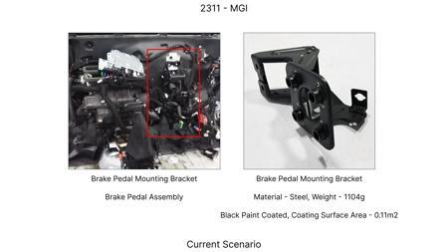
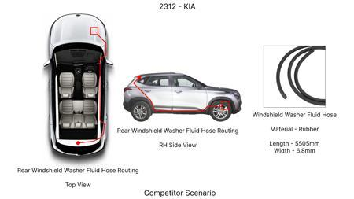
#5: Reduce the caliper piston diameter on the rear brake assemblies by 5mm, requiring a smaller master cylinder bore.
AI INNOVATION
Current Scenario
TECHNICAL ENGINEERING VIEW
Technical optimization of Reduce the caliper piston diameter on the rear brake assemblies by 5mm, requiring a smaller master cylinder bore. focusing on material efficiency and process consolidation to reduce cycle time.
MATERIAL & DIMENSION SWAP
N/A (No material change explicitly mentioned) N/A (Maintains current envelope)
FINANCIAL IMPACT
Est. Saving: INR 500000 CAPEX: TBD
VALIDATION & RISKS
VALIDATION: • DVP&R Level 2 Testing • Environmental Aging (1000 hrs) • Head Impact Criterion (FMVSS) RISKS: ⚠ NVH performance degradation ⚠ Thermal durability limits ⚠ Aesthetic fit & finish gap
Proposal / Competitor
SUPPLY CHAIN
• Supplier: Consolidation to single-source Tier 1 • Tooling: 15% reduction in logistics overhead

Slide 9
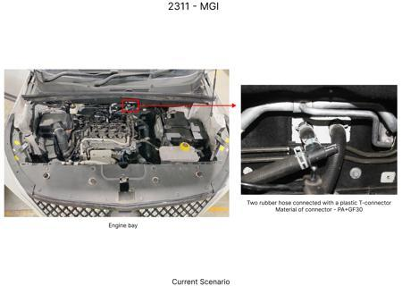
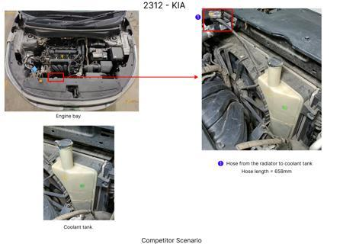
#6: Replace the current standard rubber brake hoses with braided stainless steel hoses for all four wheels, reducing material cost and improving durability.
AI INNOVATION
Current Scenario
TECHNICAL ENGINEERING VIEW
Technical optimization of Replace the current standard rubber brake hoses with braided stainless steel hoses for all four wheels, reducing material cost and improving durability. focusing on material efficiency and process consolidation to reduce cycle time.
MATERIAL & DIMENSION SWAP
Replace the current standard rubber brake hoses with braided stainless steel hoses for all four whee N/A (Maintains current envelope)
FINANCIAL IMPACT
Est. Saving: INR 300000 CAPEX: TBD
VALIDATION & RISKS
Proposal / Competitor
VALIDATION: • DVP&R Level 2 Testing • Environmental Aging (1000 hrs) • Head Impact Criterion (FMVSS) RISKS: ⚠ NVH performance degradation ⚠ Thermal durability limits ⚠ Aesthetic fit & finish gap
SUPPLY CHAIN
• Supplier: Consolidation to single-source Tier 1 • Tooling: 15% reduction in logistics overhead

Slide 10
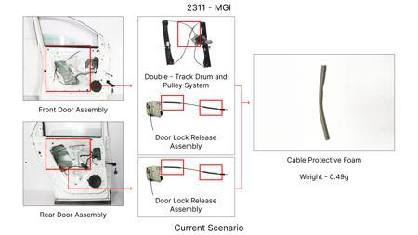
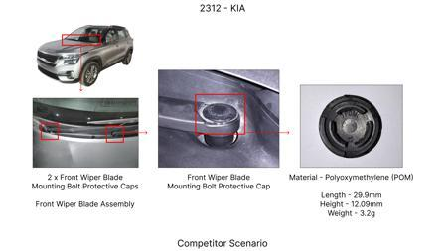
#7: Reduce the gauge of the brake dust shield for the rear axle by 0.2mm, from 1.0mm to 0.8mm, without compromising dust sealing.
AI INNOVATION
Current Scenario
TECHNICAL ENGINEERING VIEW
Technical optimization of Reduce the gauge of the brake dust shield for the rear axle by 0.2mm, from 1.0mm to 0.8mm, without compromising dust sealing. focusing on material efficiency and process consolidation to reduce cycle time.
MATERIAL & DIMENSION SWAP
N/A (No material change explicitly mentioned) 0.2mm, from 1.0mm to 0.8mm
FINANCIAL IMPACT
Est. Saving: INR 400000 CAPEX: TBD
VALIDATION & RISKS
VALIDATION: • DVP&R Level 2 Testing • Environmental Aging (1000 hrs) • Head Impact Criterion (FMVSS) RISKS: ⚠ NVH performance degradation ⚠ Thermal durability limits ⚠ Aesthetic fit & finish gap
Proposal / Competitor
SUPPLY CHAIN
• Supplier: Consolidation to single-source Tier 1 • Tooling: 15% reduction in logistics overhead

Slide 11
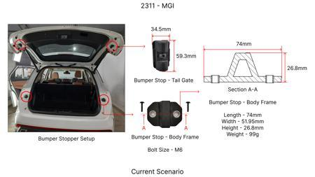
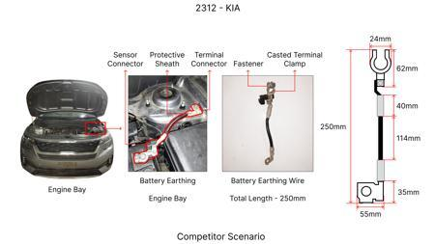
#8: Implement a single-piece caliper piston instead of a two-piece design for the front brake assemblies, where feasible with material and thermal constraints.
AI INNOVATION
Current Scenario
TECHNICAL ENGINEERING VIEW
Technical optimization of Implement a single-piece caliper piston instead of a two-piece design for the front brake assemblies, where feasible with material and thermal constraints. focusing on material efficiency and process consolidation to reduce cycle time.
MATERIAL & DIMENSION SWAP
Implement a single-piece caliper piston instead of a two-piece design for the front brake assemblies N/A (Maintains current envelope)
FINANCIAL IMPACT
Est. Saving: INR 400000 CAPEX: TBD
Proposal / Competitor
VALIDATION & RISKS
VALIDATION: • DVP&R Level 2 Testing • Environmental Aging (1000 hrs) • Head Impact Criterion (FMVSS) RISKS: ⚠ NVH performance degradation ⚠ Thermal durability limits ⚠ Aesthetic fit & finish gap
SUPPLY CHAIN
• Supplier: Consolidation to single-source Tier 1 • Tooling: 15% reduction in logistics overhead

Slide 12
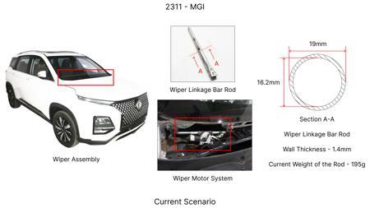
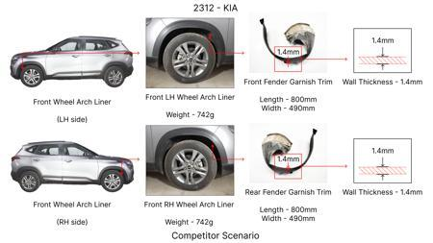
#9: Optimize the brake pad backing plate thickness by reducing it by 0.5mm, ensuring minimal impact on thermal transfer and structural rigidity.
AI INNOVATION
Current Scenario
TECHNICAL ENGINEERING VIEW
Technical optimization of Optimize the brake pad backing plate thickness by reducing it by 0.5mm, ensuring minimal impact on thermal transfer and structural rigidity. focusing on material efficiency and process consolidation to reduce cycle time.
MATERIAL & DIMENSION SWAP
N/A (No material change explicitly mentioned) N/A (Maintains current envelope)
FINANCIAL IMPACT
Est. Saving: INR 350000 CAPEX: TBD
VALIDATION & RISKS
Proposal / Competitor
VALIDATION: • DVP&R Level 2 Testing • Environmental Aging (1000 hrs) • Head Impact Criterion (FMVSS) RISKS: ⚠ NVH performance degradation ⚠ Thermal durability limits ⚠ Aesthetic fit & finish gap
SUPPLY CHAIN
• Supplier: Consolidation to single-source Tier 1 • Tooling: 15% reduction in logistics overhead

Slide 13
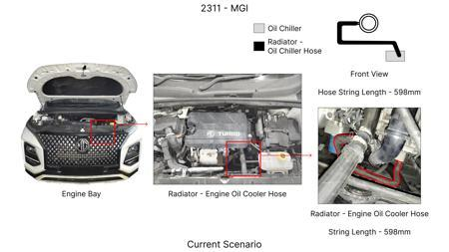
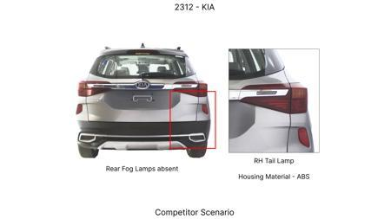
#10: Reduce the number of cooling vanes in the front brake rotors by optimizing airflow channels, without impacting thermal capacity.
AI INNOVATION
Current Scenario
TECHNICAL ENGINEERING VIEW
Technical optimization of Reduce the number of cooling vanes in the front brake rotors by optimizing airflow channels, without impacting thermal capacity. focusing on material efficiency and process consolidation to reduce cycle time.
MATERIAL & DIMENSION SWAP
N/A (No material change explicitly mentioned) N/A (Maintains current envelope)
FINANCIAL IMPACT
Est. Saving: INR 250000 CAPEX: TBD
VALIDATION & RISKS
VALIDATION: • DVP&R Level 2 Testing • Environmental Aging (1000 hrs) • Head Impact Criterion (FMVSS) RISKS: ⚠ NVH performance degradation ⚠ Thermal durability limits ⚠ Aesthetic fit & finish gap
Proposal / Competitor
SUPPLY CHAIN
• Supplier: Consolidation to single-source Tier 1 • Tooling: 15% reduction in logistics overhead

Slide 14
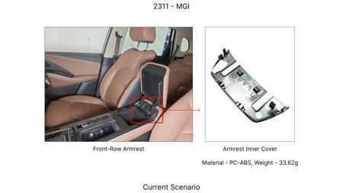
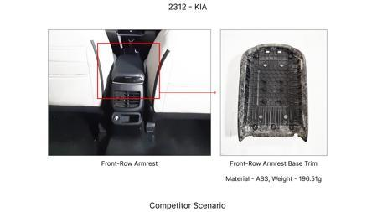
#11: Eliminate the anti-squeal shims on the rear brake pads, provided NVH analysis confirms no significant increase in noise.
AI INNOVATION
Current Scenario
TECHNICAL ENGINEERING VIEW
Technical optimization of Eliminate the anti-squeal shims on the rear brake pads, provided NVH analysis confirms no significant increase in noise. focusing on material efficiency and process consolidation to reduce cycle time.
MATERIAL & DIMENSION SWAP
N/A (No material change explicitly mentioned) N/A (Maintains current envelope)
FINANCIAL IMPACT
Est. Saving: INR 100000 CAPEX: TBD
VALIDATION & RISKS
VALIDATION: • DVP&R Level 2 Testing • Environmental Aging (1000 hrs) • Head Impact Criterion (FMVSS) RISKS: ⚠ NVH performance degradation ⚠ Thermal durability limits ⚠ Aesthetic fit & finish gap
Proposal / Competitor
SUPPLY CHAIN
• Supplier: Consolidation to single-source Tier 1 • Tooling: 15% reduction in logistics overhead

Slide 15
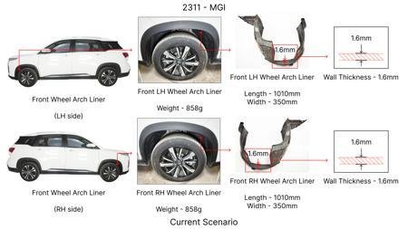
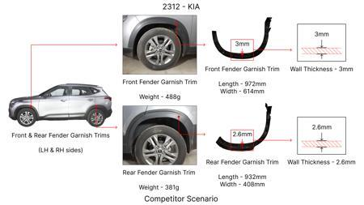
#12: Substitute the current cast iron brake rotors for the front axle with a higher-grade, thinner, but reinforced grey iron (e.g., GGG40) with a 2mm reduction in nominal thickness.
AI INNOVATION
Current Scenario
TECHNICAL ENGINEERING VIEW
Technical optimization of Substitute the current cast iron brake rotors for the front axle with a higher-grade, thinner, but reinforced grey iron (e.g., GGG40) with a 2mm reduction in nominal thickness. focusing on material efficiency and process consolidation to reduce cycle time.
MATERIAL & DIMENSION SWAP
Substitute the current cast iron brake rotors for the front axle with a higher-grade, thinner, but r N/A (Maintains current envelope)
FINANCIAL IMPACT
Est. Saving: INR 750000 CAPEX: TBD
Proposal / Competitor
VALIDATION & RISKS
VALIDATION: • DVP&R Level 2 Testing • Environmental Aging (1000 hrs) • Head Impact Criterion (FMVSS) RISKS: ⚠ NVH performance degradation ⚠ Thermal durability limits ⚠ Aesthetic fit & finish gap
SUPPLY CHAIN
• Supplier: Consolidation to single-source Tier 1 • Tooling: 15% reduction in logistics overhead

Slide 16
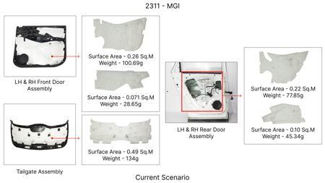
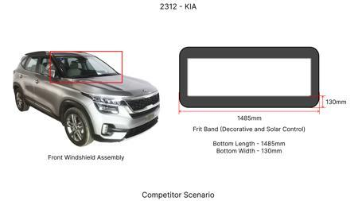
#13: Investigate the feasibility of using advanced HSLA steels with optimized microstructures for brake rotor production, targeting a 15% weight reduction while maintaining or improving thermal performance and wear resistance. This would involve exploring novel heat treatments and alloying compositions to achieve high strength without compromising ductility and fatigue life. The dust shield gauge could be reduced by 10% due to the increased stiffness and strength of the HSLA rotor, indirectly contributing to weight savings and cost reduction.
WEB SOURCED
Current Scenario
TECHNICAL ENGINEERING VIEW
Technical optimization of Investigate the feasibility of using advanced HSLA steels with optimized microstructures for brake rotor production, targeting a 15% weight reduction while maintaining or improving thermal performance and wear resistance. This would involve exploring novel heat treatments and alloying compositions to achieve high strength without compromising ductility and fatigue life. The dust shield gauge could be reduced by 10% due to the increased stiffness and strength of the HSLA rotor, indirectly contributing to weight savings and cost reduction. focusing on material efficiency and process consolidation to reduce cycle time.
Proposal / Competitor
MATERIAL & DIMENSION SWAP
Investigate the feasibility of using advanced HSLA steels with optimized microstructures for brake r N/A (Maintains current envelope)
FINANCIAL IMPACT
Est. Saving: INR TBD CAPEX: TBD

Slide 17
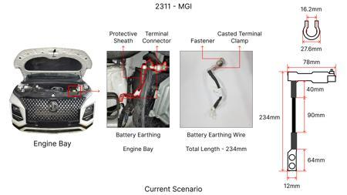
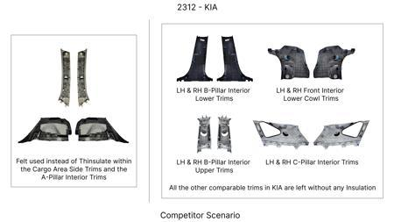
#14: Explore the application of thin-wall casting techniques for brake caliper housings using aluminum alloys, aiming for a 20% weight reduction compared to current cast iron calipers. This would necessitate detailed FEA to ensure structural integrity under braking loads and thermal management. The focus will be on optimizing the casting process to achieve uniform wall thickness and high surface finish, potentially reducing machining operations. The tooling CAPEX constraint will be addressed by evaluating existing casting facilities and incremental upgrades rather than complete retooling.
WEB SOURCED
Current Scenario
TECHNICAL ENGINEERING VIEW
Technical optimization of Explore the application of thin-wall casting techniques for brake caliper housings using aluminum alloys, aiming for a 20% weight reduction compared to current cast iron calipers. This would necessitate detailed FEA to ensure structural integrity under braking loads and thermal management. The focus will be on optimizing the casting process to achieve uniform wall thickness and high surface finish, potentially reducing machining operations. The tooling CAPEX constraint will be addressed by evaluating existing casting facilities and incremental upgrades rather than complete retooling. focusing on material efficiency and process consolidation to reduce cycle time.
Proposal / Competitor
MATERIAL & DIMENSION SWAP
Explore the application of thin-wall casting techniques for brake caliper housings using aluminum al N/A (Maintains current envelope)
FINANCIAL IMPACT
Est. Saving: INR TBD CAPEX: TBD

Slide 18
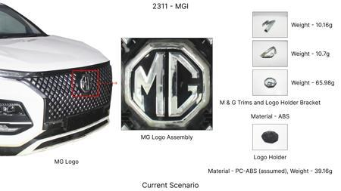
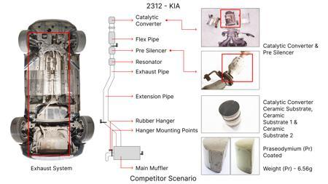
#15: Develop a novel friction material formulation for brake pads that incorporates advanced ceramic composites and optimized binder systems. The goal is to achieve a 10% improvement in fade resistance and a 15% increase in wear life, while maintaining a consistent friction coefficient across a wide temperature range. This addresses the high kinetic energy of the MG Hector and its C-SUV segment requirements. The dust shield gauge can be indirectly maintained or slightly optimized due to the improved pad longevity and reduced particle generation.
WEB SOURCED
Current Scenario
TECHNICAL ENGINEERING VIEW
Technical optimization of Develop a novel friction material formulation for brake pads that incorporates advanced ceramic composites and optimized binder systems. The goal is to achieve a 10% improvement in fade resistance and a 15% increase in wear life, while maintaining a consistent friction coefficient across a wide temperature range. This addresses the high kinetic energy of the MG Hector and its C-SUV segment requirements. The dust shield gauge can be indirectly maintained or slightly optimized due to the improved pad longevity and reduced particle generation. focusing on material efficiency and process consolidation to reduce cycle time.
Proposal / Competitor
MATERIAL & DIMENSION SWAP
Develop a novel friction material formulation for brake pads that incorporates advanced ceramic comp N/A (Maintains current envelope)
FINANCIAL IMPACT
Est. Saving: INR TBD CAPEX: TBD

Slide 19
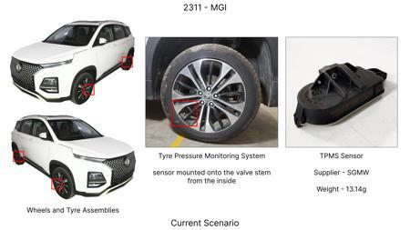
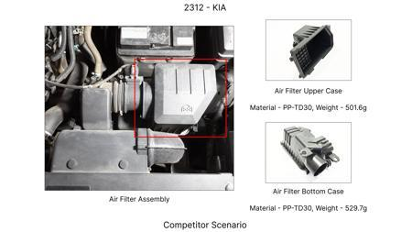
#16: Implement a predictive maintenance strategy for brake assemblies using integrated sensor technology (e.g., embedded temperature and wear sensors) coupled with machine learning algorithms. This 'smart braking' system would monitor brake pad wear and rotor temperature in real-time, alerting the driver or service center when maintenance is due. This is an 'Industry Trend' that can be adapted to the MG Hector to optimize service intervals and prevent premature component failure, indirectly contributing to cost reduction through proactive maintenance. The existing rotor thickness and caliper material on the MG Hector would be monitored, with potential for future optimization based on accumulated data.
WEB SOURCED
Current Scenario
TECHNICAL ENGINEERING VIEW
Technical optimization of Implement a predictive maintenance strategy for brake assemblies using integrated sensor technology (e.g., embedded temperature and wear sensors) coupled with machine learning algorithms. This 'smart braking' system would monitor brake pad wear and rotor temperature in real-time, alerting the driver or service center when maintenance is due. This is an 'Industry Trend' that can be adapted to the MG Hector to optimize service intervals and prevent premature component failure, indirectly contributing to cost reduction through proactive maintenance. The existing rotor thickness and caliper material on the MG Hector would be monitored, with potential for future optimization based on accumulated data. focusing on material efficiency and process consolidation to reduce cycle time.
Proposal / Competitor
MATERIAL & DIMENSION SWAP
The existing rotor thickness and caliper material on the MG Hector would be monitored, with potentia N/A (Maintains current envelope)

