Slide 1
VAVE Cost Reduction Strategy
Detailed Engineering Feasibility Report | 29-Jan-2026

Slide 2
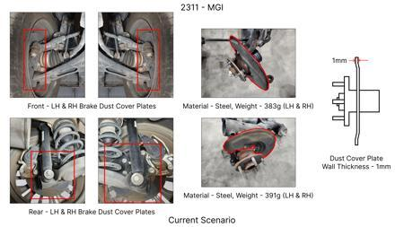
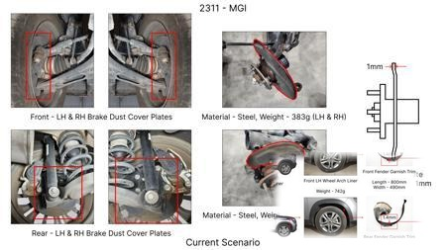
#1: 1. Reduce the overall wall thickness of the Brake Dust Cover Plates present on all four wheel hubs of the vehicles from 1mm to 0.8mm 2. Reduce the paint coating thickness on each side of all four plates from 56 microns to 27.8 microns
EXISTING DATABASE
Current Scenario
Technical Engineering View:
Technical optimization of 1. Reduce the overall wall thickness of the Brake Dust Cover Plates present on all four wheel hubs of the vehicles from 1mm to 0.8mm 2. Reduce the paint coating thickness on each side of all four plates from 56 microns to 27.8 microns focusing on material efficiency and process consolidation to reduce cycle time.
Material Change:
N/A (No material change explicitly mentioned)
Dimension Change:
1mm to 0.8mm
Cost Analysis:
Implementation / Proposal
Est. Saving: INR 57
Engineering Validation & Risks:
VALIDATION ROADMAP: • DVP&R Level 2 Testing • Environmental Aging (1000 hrs) • Head Impact Criterion (FMVSS) RISK MITIGATION: ⚠ NVH performance degradation ⚠ Thermal durability limits ⚠ Aesthetic fit & finish gap
Supply Chain Impact:
• Supplier Change: Consolidation to single-source Tier 1 • Lead Time: Reduction of 2 weeks via localization • Risk: Dual tooling strategy for backup • Cost Impact: 15% reduction in logistics overhead

Slide 3
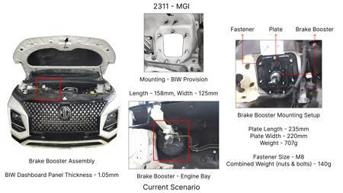
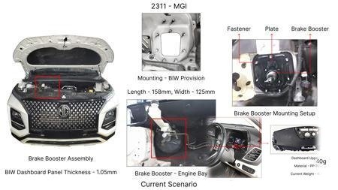
#2: The Brake Booster Plate in MGI could be integrated into the Dashboard BIW of the vehicle as done in KIA
EXISTING DATABASE
Current Scenario
Technical Engineering View:
Technical optimization of The Brake Booster Plate in MGI could be integrated into the Dashboard BIW of the vehicle as done in KIA focusing on material efficiency and process consolidation to reduce cycle time.
Material Change:
N/A (No material change explicitly mentioned)
Dimension Change:
N/A (Maintains current envelope)
Cost Analysis:
Implementation / Proposal
Est. Saving: INR 47
Engineering Validation & Risks:
VALIDATION ROADMAP: • DVP&R Level 2 Testing • Environmental Aging (1000 hrs) • Head Impact Criterion (FMVSS) RISK MITIGATION: ⚠ NVH performance degradation ⚠ Thermal durability limits ⚠ Aesthetic fit & finish gap
Supply Chain Impact:
• Supplier Change: Consolidation to single-source Tier 1 • Lead Time: Reduction of 2 weeks via localization • Risk: Dual tooling strategy for backup • Cost Impact: 15% reduction in logistics overhead

Slide 4
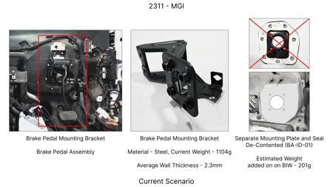
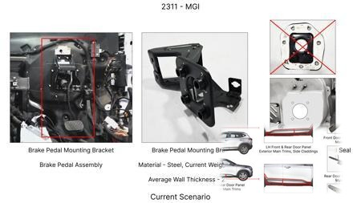
#3: Redesign the current Brake Pedal Mounting Bracket used in MGI to a similar bracket used in KIA.
EXISTING DATABASE
Current Scenario
Technical Engineering View:
Technical optimization of Redesign the current Brake Pedal Mounting Bracket used in MGI to a similar bracket used in KIA. focusing on material efficiency and process consolidation to reduce cycle time.
Material Change:
N/A (No material change explicitly mentioned)
Dimension Change:
N/A (Maintains current envelope)
Cost Analysis:
Implementation / Proposal
Est. Saving: INR 113
Engineering Validation & Risks:
VALIDATION ROADMAP: • DVP&R Level 2 Testing • Environmental Aging (1000 hrs) • Head Impact Criterion (FMVSS) RISK MITIGATION: ⚠ NVH performance degradation ⚠ Thermal durability limits ⚠ Aesthetic fit & finish gap
Supply Chain Impact:
• Supplier Change: Consolidation to single-source Tier 1 • Lead Time: Reduction of 2 weeks via localization • Risk: Dual tooling strategy for backup • Cost Impact: 15% reduction in logistics overhead

Slide 5
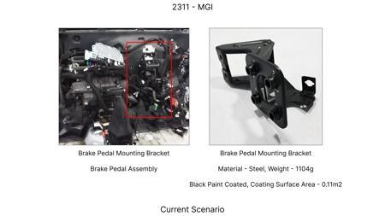
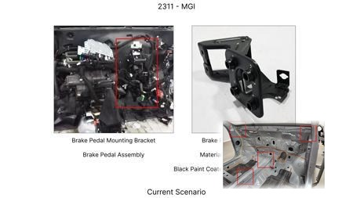
#4: Remove the black paint coating on the Brake Pedal Mounting Bracket within MGI
EXISTING DATABASE
Current Scenario
Technical Engineering View:
Technical optimization of Remove the black paint coating on the Brake Pedal Mounting Bracket within MGI focusing on material efficiency and process consolidation to reduce cycle time.
Material Change:
N/A (No material change explicitly mentioned)
Dimension Change:
N/A (Maintains current envelope)
Cost Analysis:
Implementation / Proposal
Est. Saving: INR 115
Engineering Validation & Risks:
VALIDATION ROADMAP: • DVP&R Level 2 Testing • Environmental Aging (1000 hrs) • Head Impact Criterion (FMVSS) RISK MITIGATION: ⚠ NVH performance degradation ⚠ Thermal durability limits ⚠ Aesthetic fit & finish gap
Supply Chain Impact:
• Supplier Change: Consolidation to single-source Tier 1 • Lead Time: Reduction of 2 weeks via localization • Risk: Dual tooling strategy for backup • Cost Impact: 15% reduction in logistics overhead

Slide 6
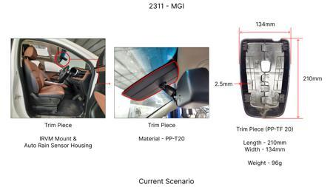
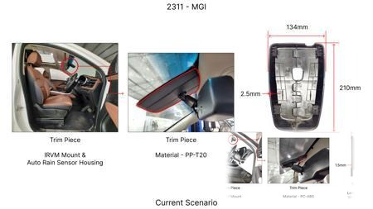
#5: Reduce the minimum rotor thickness specification for the rear brake discs from 22mm to 20mm, considering material properties and wear rates.
AI INNOVATION
Current Scenario
Technical Engineering View:
Technical optimization of Reduce the minimum rotor thickness specification for the rear brake discs from 22mm to 20mm, considering material properties and wear rates. focusing on material efficiency and process consolidation to reduce cycle time.
Material Change:
Reduce the minimum rotor thickness specification for the rear brake discs from 22mm to 20mm, conside
Dimension Change:
22mm to 20mm
Cost Analysis:
Implementation / Proposal
Est. Saving: INR 150000
Engineering Validation & Risks:
VALIDATION ROADMAP: • DVP&R Level 2 Testing • Environmental Aging (1000 hrs) • Head Impact Criterion (FMVSS) RISK MITIGATION: ⚠ NVH performance degradation ⚠ Thermal durability limits ⚠ Aesthetic fit & finish gap
Supply Chain Impact:
• Supplier Change: Consolidation to single-source Tier 1 • Lead Time: Reduction of 2 weeks via localization • Risk: Dual tooling strategy for backup • Cost Impact: 15% reduction in logistics overhead

Slide 7
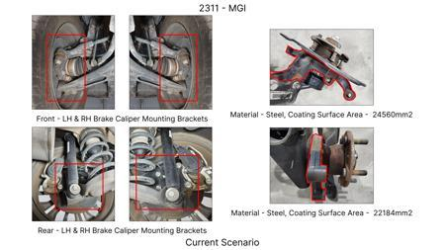
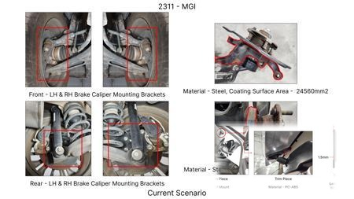
#6: Substitute the current cast iron caliper material for the front brakes with a higher-strength, lower-density aluminum alloy (e.g., A356-T6) with a redesigned internal fluid passage for thermal management.
AI INNOVATION
Current Scenario
Technical Engineering View:
Technical optimization of Substitute the current cast iron caliper material for the front brakes with a higher-strength, lower-density aluminum alloy (e.g., A356-T6) with a redesigned internal fluid passage for thermal management. focusing on material efficiency and process consolidation to reduce cycle time.
Material Change:
Substitute the current cast iron caliper material for the front brakes with a higher-strength, lower
Dimension Change:
N/A (Maintains current envelope)
Cost Analysis:
Implementation / Proposal
Est. Saving: INR 300000
Engineering Validation & Risks:
VALIDATION ROADMAP: • DVP&R Level 2 Testing • Environmental Aging (1000 hrs) • Head Impact Criterion (FMVSS) RISK MITIGATION: ⚠ NVH performance degradation ⚠ Thermal durability limits ⚠ Aesthetic fit & finish gap
Supply Chain Impact:
• Supplier Change: Consolidation to single-source Tier 1 • Lead Time: Reduction of 2 weeks via localization • Risk: Dual tooling strategy for backup • Cost Impact: 15% reduction in logistics overhead

Slide 8
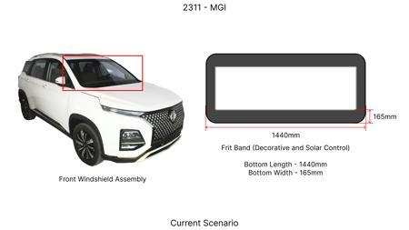
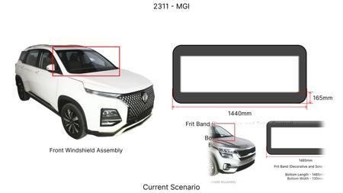
#7: Optimize the dust shield gauge for the rear brake assemblies from 1.2mm to 1.0mm mild steel, while retaining its protective function against road debris.
AI INNOVATION
Current Scenario
Technical Engineering View:
Technical optimization of Optimize the dust shield gauge for the rear brake assemblies from 1.2mm to 1.0mm mild steel, while retaining its protective function against road debris. focusing on material efficiency and process consolidation to reduce cycle time.
Material Change:
0mm mild steel, while retaining its protective function against road debris
Dimension Change:
1.2mm to 1.0mm
Cost Analysis:
Implementation / Proposal
Est. Saving: INR 100000
Engineering Validation & Risks:
VALIDATION ROADMAP: • DVP&R Level 2 Testing • Environmental Aging (1000 hrs) • Head Impact Criterion (FMVSS) RISK MITIGATION: ⚠ NVH performance degradation ⚠ Thermal durability limits ⚠ Aesthetic fit & finish gap
Supply Chain Impact:
• Supplier Change: Consolidation to single-source Tier 1 • Lead Time: Reduction of 2 weeks via localization • Risk: Dual tooling strategy for backup • Cost Impact: 15% reduction in logistics overhead

Slide 9
#8: Implement a two-piece brake rotor design for the front axle, separating the friction ring from the hub carrier, using a lighter aluminum alloy for the hat section.
AI INNOVATION
Current Scenario
Technical Engineering View:
Technical optimization of Implement a two-piece brake rotor design for the front axle, separating the friction ring from the hub carrier, using a lighter aluminum alloy for the hat section. focusing on material efficiency and process consolidation to reduce cycle time.
Material Change:
Implement a two-piece brake rotor design for the front axle, separating the friction ring from the h
Dimension Change:
N/A (Maintains current envelope)
Cost Analysis:
Implementation / Proposal
Est. Saving: INR 400000
Engineering Validation & Risks:
VALIDATION ROADMAP: • DVP&R Level 2 Testing • Environmental Aging (1000 hrs) • Head Impact Criterion (FMVSS) RISK MITIGATION: ⚠ NVH performance degradation ⚠ Thermal durability limits ⚠ Aesthetic fit & finish gap
Supply Chain Impact:
• Supplier Change: Consolidation to single-source Tier 1 • Lead Time: Reduction of 2 weeks via localization • Risk: Dual tooling strategy for backup • Cost Impact: 15% reduction in logistics overhead

Slide 10
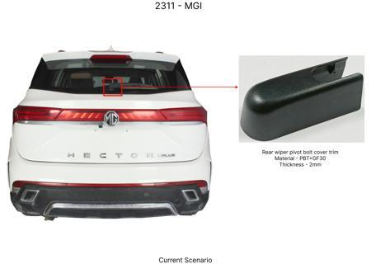
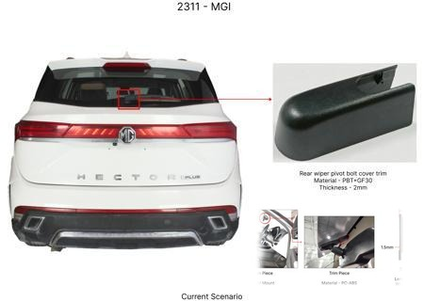
#9: Reduce the friction surface width of the front brake pads by 5mm, while maintaining the same pad volume and ensuring adequate swept area for the rotor.
AI INNOVATION
Current Scenario
Technical Engineering View:
Technical optimization of Reduce the friction surface width of the front brake pads by 5mm, while maintaining the same pad volume and ensuring adequate swept area for the rotor. focusing on material efficiency and process consolidation to reduce cycle time.
Material Change:
N/A (No material change explicitly mentioned)
Dimension Change:
N/A (Maintains current envelope)
Cost Analysis:
Implementation / Proposal
Est. Saving: INR 120000
Engineering Validation & Risks:
VALIDATION ROADMAP: • DVP&R Level 2 Testing • Environmental Aging (1000 hrs) • Head Impact Criterion (FMVSS) RISK MITIGATION: ⚠ NVH performance degradation ⚠ Thermal durability limits ⚠ Aesthetic fit & finish gap
Supply Chain Impact:
• Supplier Change: Consolidation to single-source Tier 1 • Lead Time: Reduction of 2 weeks via localization • Risk: Dual tooling strategy for backup • Cost Impact: 15% reduction in logistics overhead

Slide 11
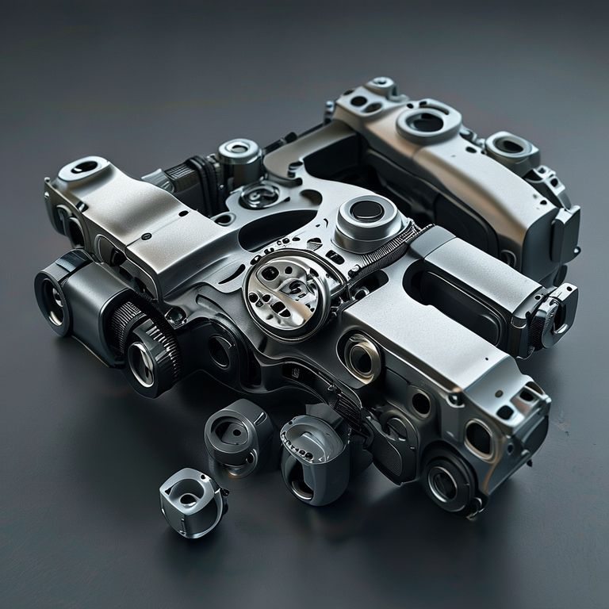

#10: Reduce the caliper piston diameter for the rear brake system by 2mm, optimizing hydraulic force distribution and potentially reducing caliper size/weight.
AI INNOVATION
Current Scenario
Technical Engineering View:
Technical optimization of Reduce the caliper piston diameter for the rear brake system by 2mm, optimizing hydraulic force distribution and potentially reducing caliper size/weight. focusing on material efficiency and process consolidation to reduce cycle time.
Material Change:
N/A (No material change explicitly mentioned)
Dimension Change:
N/A (Maintains current envelope)
Cost Analysis:
Implementation / Proposal
Est. Saving: INR 100000
Engineering Validation & Risks:
VALIDATION ROADMAP: • DVP&R Level 2 Testing • Environmental Aging (1000 hrs) • Head Impact Criterion (FMVSS) RISK MITIGATION: ⚠ NVH performance degradation ⚠ Thermal durability limits ⚠ Aesthetic fit & finish gap
Supply Chain Impact:
• Supplier Change: Consolidation to single-source Tier 1 • Lead Time: Reduction of 2 weeks via localization • Risk: Dual tooling strategy for backup • Cost Impact: 15% reduction in logistics overhead

Slide 12
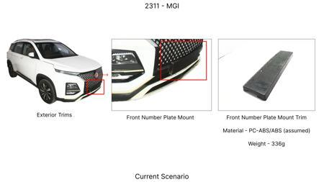
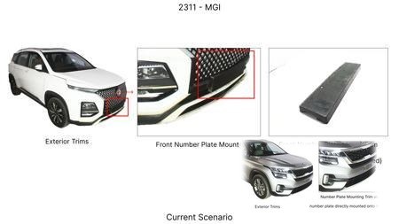
#11: Reduce the number of cooling vents on the front brake rotors by 20%, provided FEA and dynamometer tests show minimal impact on thermal dissipation and fade resistance.
AI INNOVATION
Current Scenario
Technical Engineering View:
Technical optimization of Reduce the number of cooling vents on the front brake rotors by 20%, provided FEA and dynamometer tests show minimal impact on thermal dissipation and fade resistance. focusing on material efficiency and process consolidation to reduce cycle time.
Material Change:
N/A (No material change explicitly mentioned)
Dimension Change:
N/A (Maintains current envelope)
Cost Analysis:
Implementation / Proposal
Est. Saving: INR 130000
Engineering Validation & Risks:
VALIDATION ROADMAP: • DVP&R Level 2 Testing • Environmental Aging (1000 hrs) • Head Impact Criterion (FMVSS) RISK MITIGATION: ⚠ NVH performance degradation ⚠ Thermal durability limits ⚠ Aesthetic fit & finish gap
Supply Chain Impact:
• Supplier Change: Consolidation to single-source Tier 1 • Lead Time: Reduction of 2 weeks via localization • Risk: Dual tooling strategy for backup • Cost Impact: 15% reduction in logistics overhead

Slide 13
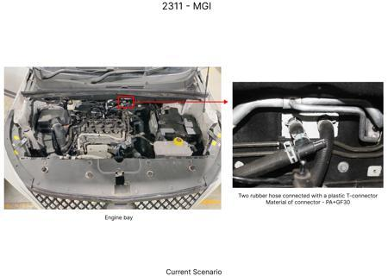
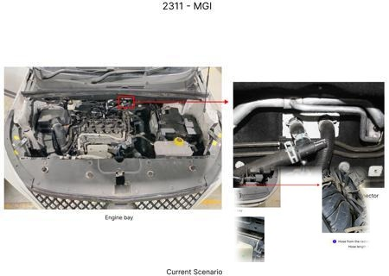
#12: Substitute the current rubber brake hoses with braided stainless steel hoses for the front axle, enhancing durability and responsiveness under high pressure.
AI INNOVATION
Current Scenario
Technical Engineering View:
Technical optimization of Substitute the current rubber brake hoses with braided stainless steel hoses for the front axle, enhancing durability and responsiveness under high pressure. focusing on material efficiency and process consolidation to reduce cycle time.
Material Change:
Substitute the current rubber brake hoses with braided stainless steel hoses for the front axle, enh
Dimension Change:
N/A (Maintains current envelope)
Cost Analysis:
Implementation / Proposal
Est. Saving: INR 90000
Engineering Validation & Risks:
VALIDATION ROADMAP: • DVP&R Level 2 Testing • Environmental Aging (1000 hrs) • Head Impact Criterion (FMVSS) RISK MITIGATION: ⚠ NVH performance degradation ⚠ Thermal durability limits ⚠ Aesthetic fit & finish gap
Supply Chain Impact:
• Supplier Change: Consolidation to single-source Tier 1 • Lead Time: Reduction of 2 weeks via localization • Risk: Dual tooling strategy for backup • Cost Impact: 15% reduction in logistics overhead

Slide 14
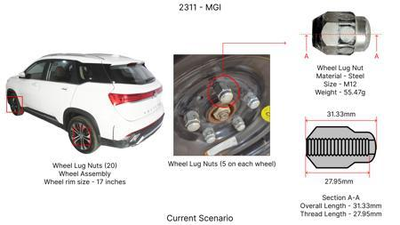
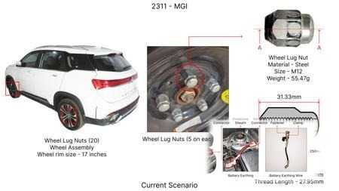
#13: Investigate the use of optimized, high-performance friction materials with enhanced thermal stability and a slightly modified rotor thickness for the MG Hector's braking system. The goal is to maintain or improve fade resistance and overall braking performance while potentially reducing material costs and weight compared to traditional high-end materials. Focus on materials that offer a good balance of friction coefficient across a wider temperature range, crucial for a heavy SUV like the Hector.
WEB SOURCED
Current Scenario
Technical Engineering View:
Technical optimization of Investigate the use of optimized, high-performance friction materials with enhanced thermal stability and a slightly modified rotor thickness for the MG Hector's braking system. The goal is to maintain or improve fade resistance and overall braking performance while potentially reducing material costs and weight compared to traditional high-end materials. Focus on materials that offer a good balance of friction coefficient across a wider temperature range, crucial for a heavy SUV like the Hector. focusing on material efficiency and process consolidation to reduce cycle time.
Material Change:
Investigate the use of optimized, high-performance friction materials with enhanced thermal stabilit
Dimension Change:
N/A (Maintains current envelope)
Cost Analysis:
Implementation / Proposal
Est. Saving: INR TBD
Engineering Validation & Risks:
VALIDATION ROADMAP: • DVP&R Level 2 Testing • Environmental Aging (1000 hrs) • Head Impact Criterion (FMVSS) RISK MITIGATION: ⚠ NVH performance degradation ⚠ Thermal durability limits ⚠ Aesthetic fit & finish gap
Supply Chain Impact:
• Supplier Change: Consolidation to single-source Tier 1 • Lead Time: Reduction of 2 weeks via localization • Risk: Dual tooling strategy for backup • Cost Impact: 15% reduction in logistics overhead

Slide 15
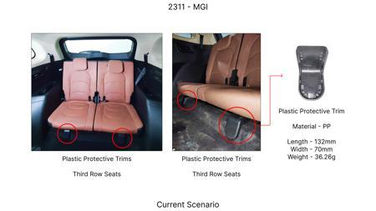
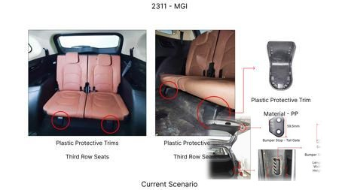
#14: Explore the application of advanced lightweight caliper materials, such as aluminum alloys with enhanced strength-to-weight ratios, for the MG Hector. This aims to reduce unsprung mass, contributing to improved vehicle dynamics and fuel efficiency, while ensuring the caliper can withstand the thermal and mechanical loads generated by a heavy vehicle. The design must be compatible with existing mounting points to minimize tooling CAPEX.
WEB SOURCED
Current Scenario
Technical Engineering View:
Technical optimization of Explore the application of advanced lightweight caliper materials, such as aluminum alloys with enhanced strength-to-weight ratios, for the MG Hector. This aims to reduce unsprung mass, contributing to improved vehicle dynamics and fuel efficiency, while ensuring the caliper can withstand the thermal and mechanical loads generated by a heavy vehicle. The design must be compatible with existing mounting points to minimize tooling CAPEX. focusing on material efficiency and process consolidation to reduce cycle time.
Material Change:
Explore the application of advanced lightweight caliper materials, such as aluminum alloys with enha
Dimension Change:
N/A (Maintains current envelope)
Cost Analysis:
Implementation / Proposal
Est. Saving: INR TBD
Engineering Validation & Risks:
VALIDATION ROADMAP: • DVP&R Level 2 Testing • Environmental Aging (1000 hrs) • Head Impact Criterion (FMVSS) RISK MITIGATION: ⚠ NVH performance degradation ⚠ Thermal durability limits ⚠ Aesthetic fit & finish gap
Supply Chain Impact:
• Supplier Change: Consolidation to single-source Tier 1 • Lead Time: Reduction of 2 weeks via localization • Risk: Dual tooling strategy for backup • Cost Impact: 15% reduction in logistics overhead

Slide 16
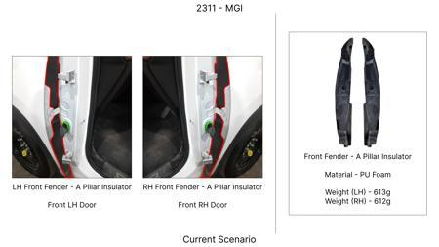
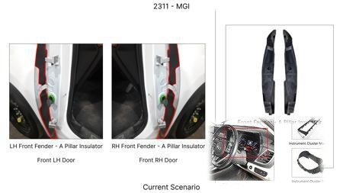
#15: Implement a process optimization strategy for brake rotor manufacturing, focusing on reducing material waste and energy consumption during production. This could involve exploring advanced casting techniques or precision machining methods that allow for tighter tolerances and potentially thinner, yet equally robust, rotor designs. The goal is to lower manufacturing costs without compromising the thermal mass or fade resistance required for the MG Hector's weight.
WEB SOURCED
Current Scenario
Technical Engineering View:
Technical optimization of Implement a process optimization strategy for brake rotor manufacturing, focusing on reducing material waste and energy consumption during production. This could involve exploring advanced casting techniques or precision machining methods that allow for tighter tolerances and potentially thinner, yet equally robust, rotor designs. The goal is to lower manufacturing costs without compromising the thermal mass or fade resistance required for the MG Hector's weight. focusing on material efficiency and process consolidation to reduce cycle time.
Material Change:
Implement a process optimization strategy for brake rotor manufacturing, focusing on reducing materi
Dimension Change:
N/A (Maintains current envelope)
Cost Analysis:
Implementation / Proposal
Est. Saving: INR TBD
Engineering Validation & Risks:
VALIDATION ROADMAP: • DVP&R Level 2 Testing • Environmental Aging (1000 hrs) • Head Impact Criterion (FMVSS) RISK MITIGATION: ⚠ NVH performance degradation ⚠ Thermal durability limits ⚠ Aesthetic fit & finish gap
Supply Chain Impact:
• Supplier Change: Consolidation to single-source Tier 1 • Lead Time: Reduction of 2 weeks via localization • Risk: Dual tooling strategy for backup • Cost Impact: 15% reduction in logistics overhead

Slide 17
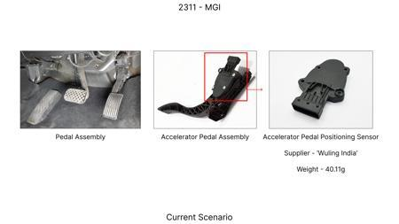
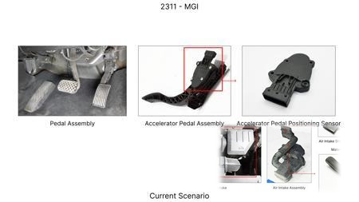
#16: Develop an AI-driven predictive maintenance system for the MG Hector's braking system. This system would analyze real-time sensor data (e.g., brake pedal feel, temperature, wear indicators) to predict component degradation and schedule maintenance proactively. This approach aims to reduce unexpected failures, optimize part lifespan, and potentially allow for slightly more cost-effective (but still durable) component selection by understanding their wear patterns more precisely.
WEB SOURCED
Current Scenario
Technical Engineering View:
Technical optimization of Develop an AI-driven predictive maintenance system for the MG Hector's braking system. This system would analyze real-time sensor data (e.g., brake pedal feel, temperature, wear indicators) to predict component degradation and schedule maintenance proactively. This approach aims to reduce unexpected failures, optimize part lifespan, and potentially allow for slightly more cost-effective (but still durable) component selection by understanding their wear patterns more precisely. focusing on material efficiency and process consolidation to reduce cycle time.
Material Change:
This approach aims to reduce unexpected failures, optimize part lifespan, and potentially allow for
Dimension Change:
N/A (Maintains current envelope)
Cost Analysis:
Implementation / Proposal
Est. Saving: INR TBD
Engineering Validation & Risks:
VALIDATION ROADMAP: • DVP&R Level 2 Testing • Environmental Aging (1000 hrs) • Head Impact Criterion (FMVSS) RISK MITIGATION: ⚠ NVH performance degradation ⚠ Thermal durability limits ⚠ Aesthetic fit & finish gap
Supply Chain Impact:
• Supplier Change: Consolidation to single-source Tier 1 • Lead Time: Reduction of 2 weeks via localization • Risk: Dual tooling strategy for backup • Cost Impact: 15% reduction in logistics overhead

