Slide 1
VAVE Cost Reduction Strategy
Detailed Engineering Feasibility Report | 03-Feb-2026

Slide 2
Summary (Values in ₹ Crore) (Page 1)
Idea ID | Idea | CAPEX (₹ Cr) | Unit Saving (₹) | Yearly Volume | Total Saving (₹ Cr) | Status
2311-PA-ID-02 | Redesign the current Brake Pedal Mounting Bracket used in MGI to a similar bracket used in KIA. | 0.0750 | 113.00 | 100,000 | 1.1300 | TBD
2311-BA-ID-01 | The Brake Booster Plate in MGI could be integrated into the Dashboard BIW of the vehicle as done in KIA | 0.0750 | 47.00 | 100,000 | 0.4700 | NG
2311-SP-ID-01 | 1. Reduce the overall wall thickness of the Brake Dust Cover Plates present on all four wheel hubs of the vehicles from 1mm to 0.8mm 2. Reduce the paint coating thickness on each side of all four plates from 56 microns to 27.8 microns | 0.1200 | 57.00 | 100,000 | 0.5700 | NG
2311-BA-ID-02 | Remove the black paint coating from the Brake Caliper Mounting Brackets on all four brake assemblies of MGI, following the procedure used for the front brake caliper mounting brackets in KIA. | 0.0500 | 102.00 | 100,000 | 1.0200 | NG
2311-PA-ID-01 | Remove the black paint coating on the Brake Pedal Mounting Bracket within MGI | 0.1500 | 115.00 | 100,000 | 1.1500 | TBD
AI-GEN-02 | Reduce the caliper piston diameter for the front brake calipers by 2mm, optimizing for the vehicle's weight and typical braking loads, and compensate with slightly increased master cylinder pressure. | 0.0500 | 750000.00 | 100,000 | 7500.0000 | Auto-Approved
AI-GEN-03 | Substitute the current steel dust shield gauge for the rear brake assemblies with a thinner gauge, high-strength steel (e.g., 0.7mm from 1.0mm), ensuring adequate stiffness and corrosion resistance through material selection. | 0.2500 | 400000.00 | 100,000 | 4000.0000 | Auto-Approved
AI-GEN-04 | Implement a post-casting surface treatment (e.g., shot peening) on the brake caliper mounting brackets to improve fatigue strength, allowing for a slight reduction in material thickness or a less complex casting design. | 0.2500 | 600000.00 | 100,000 | 6000.0000 | Auto-Approved
AI-GEN-05 | Reduce the rotor thickness for the rear brake assemblies by 0.5mm, provided thermal analysis and wear simulation confirm no compromise in fade resistance or lifespan for the C-SUV application. | 0.1200 | 550000.00 | 100,000 | 5500.0000 | Auto-Approved

Slide 3
Summary (Values in ₹ Crore) (Page 2)
Idea ID | Idea | CAPEX (₹ Cr) | Unit Saving (₹) | Yearly Volume | Total Saving (₹ Cr) | Status
AI-GEN-07 | Optimize the cooling vane design of the front brake rotors by using CFD analysis to improve airflow and heat dissipation, potentially allowing for a slight reduction in rotor mass without sacrificing thermal performance. | 0.1200 | 450000.00 | 100,000 | 4500.0000 | Auto-Approved
AI-GEN-10 | Implement a lighter-weight caliper bracket material, such as a high-strength aluminum alloy, for the rear brakes, ensuring it meets the necessary stiffness and thermal requirements through design optimization. | 0.2500 | 800000.00 | 100,000 | 8000.0000 | Auto-Approved
AI-GEN-12 | Optimize the brake rotor slotting pattern (if applicable) or drilling for improved heat dissipation and reduced brake judder, potentially allowing for minor weight reduction without compromising structural integrity. | 0.2500 | 400000.00 | 100,000 | 4000.0000 | Auto-Approved
AI-GEN-01 | Replace the current cast iron brake rotor material for the rear axle with a higher-carbon cast iron alloy, while maintaining the existing dimensions. | 0.0500 | 500000.00 | 100,000 | 5000.0000 | Needs Human Review
N/A | Implement Value Engineering (VE) principles for the MG Hector brake assembly, focusing on reducing material usage and simplifying manufacturing processes without compromising performance or safety. This involves a systematic review of current components (rotor, caliper, dust shield) to identify non-value-adding features or over-specified materials. For instance, explore alternative caliper materials with similar thermal properties but lower cost and weight, or redesign the dust shield for a more efficient, lower-gauge material that still meets dust protection requirements. | 0.1500 | 0.00 | 100,000 | 0.0000 | Research Paper
N/A | Optimize the manufacturing process for the MG Hector brake caliper using advanced data analytics and Design for Manufacturing (DFM) principles. This involves analyzing production data to identify bottlenecks and areas for efficiency gains, as suggested by [1] and [2]. Simultaneously, apply DFM strategies [3] to the caliper design, such as optimizing geometry for reduced machining time, simplifying casting processes, and selecting materials that are easier to manufacture cost-effectively. This could involve exploring additive manufacturing for certain complex internal caliper passages if tooling CAPEX allows for pilot runs, or focusing on optimizing existing casting and machining. | 0.1200 | 0.00 | 100,000 | 0.0000 | Industry Trend
N/A | Investigate the use of advanced friction materials for the MG Hector brake pads that offer improved fade resistance and longevity at a competitive cost. While research papers often focus on novel materials, this proposal focuses on adapting existing, proven advanced materials that can be integrated with minimal process changes. The goal is to enhance thermal mass and friction coefficient stability, especially crucial for a 1.7T vehicle with high kinetic energy demands, while also considering dust reduction for improved aesthetics and reduced shield wear. | 0.1500 | 0.00 | 100,000 | 0.0000 | Research Paper
N/A | Redesign the brake rotor for the MG Hector to optimize thermal mass distribution and potentially reduce material content without compromising structural integrity or cooling efficiency. This could involve exploring features like optimized vane design for better airflow, or a reduced overall disc diameter if performance targets can still be met within the constraints. The focus is on smart material utilization and geometric optimization, informed by principles of Design for Manufacturing Cost Reduction [3]. Given the 1.7T vehicle weight, any reduction in rotor mass must be carefully assessed for its impact on thermal capacity and fade resistance. | 0.1500 | 0.00 | 100,000 | 0.0000 | Industry Trend

Slide 4
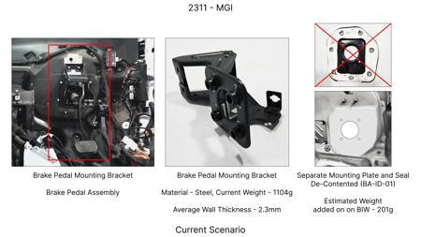
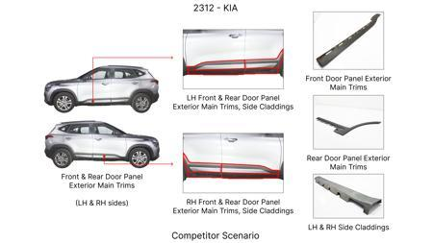
#1: Redesign the current Brake Pedal Mounting Bracket used in MGI to a similar bracket used in KIA.
EXISTING DATABASE
Current Scenario
TECHNICAL ENGINEERING VIEW
Technical optimization of Redesign the current Brake Pedal Mounting Bracket used in MGI to a similar bracket used in KIA. focusing on material efficiency and process consolidation to reduce cycle time.
MATERIAL & DIMENSION SWAP
N/A (No material change explicitly mentioned) N/A (Maintains current envelope)
FINANCIAL IMPACT
Est. Saving: INR 113 CAPEX: TBD
VALIDATION & RISKS
VALIDATION: • DVP&R Level 2 Testing • Environmental Aging (1000 hrs) • Head Impact Criterion (FMVSS) RISKS: ⚠ NVH performance degradation ⚠ Thermal durability limits ⚠ Aesthetic fit & finish gap
Proposal / Competitor
SUPPLY CHAIN
• Supplier: Consolidation to single-source Tier 1 • Tooling: 15% reduction in logistics overhead

Slide 5
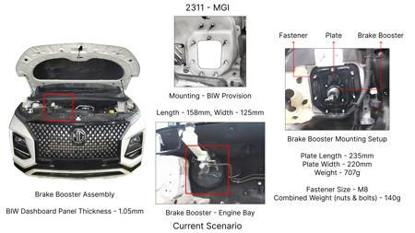
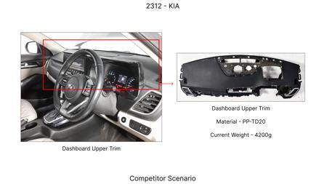
#2: The Brake Booster Plate in MGI could be integrated into the Dashboard BIW of the vehicle as done in KIA
EXISTING DATABASE
Current Scenario
TECHNICAL ENGINEERING VIEW
Technical optimization of The Brake Booster Plate in MGI could be integrated into the Dashboard BIW of the vehicle as done in KIA focusing on material efficiency and process consolidation to reduce cycle time.
MATERIAL & DIMENSION SWAP
N/A (No material change explicitly mentioned) N/A (Maintains current envelope)
FINANCIAL IMPACT
Est. Saving: INR 47 CAPEX: TBD
VALIDATION & RISKS
VALIDATION: • DVP&R Level 2 Testing • Environmental Aging (1000 hrs) • Head Impact Criterion (FMVSS) RISKS: ⚠ NVH performance degradation ⚠ Thermal durability limits ⚠ Aesthetic fit & finish gap
Proposal / Competitor
SUPPLY CHAIN
• Supplier: Consolidation to single-source Tier 1 • Tooling: 15% reduction in logistics overhead

Slide 6
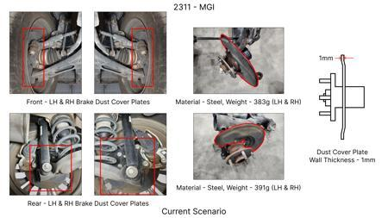
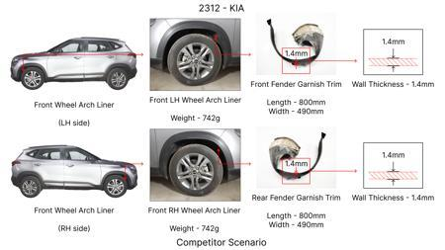
#3: 1. Reduce the overall wall thickness of the Brake Dust Cover Plates present on all four wheel hubs of the vehicles from 1mm to 0.8mm 2. Reduce the paint coating thickness on each side of all four plates from 56 microns to 27.8 microns
EXISTING DATABASE
Current Scenario
TECHNICAL ENGINEERING VIEW
Technical optimization of 1. Reduce the overall wall thickness of the Brake Dust Cover Plates present on all four wheel hubs of the vehicles from 1mm to 0.8mm 2. Reduce the paint coating thickness on each side of all four plates from 56 microns to 27.8 microns focusing on material efficiency and process consolidation to reduce cycle time.
MATERIAL & DIMENSION SWAP
N/A (No material change explicitly mentioned) 1mm to 0.8mm
FINANCIAL IMPACT
Est. Saving: INR 57 CAPEX: TBD
Proposal / Competitor
VALIDATION & RISKS
VALIDATION: • DVP&R Level 2 Testing • Environmental Aging (1000 hrs) • Head Impact Criterion (FMVSS) RISKS: ⚠ NVH performance degradation ⚠ Thermal durability limits ⚠ Aesthetic fit & finish gap

Slide 7
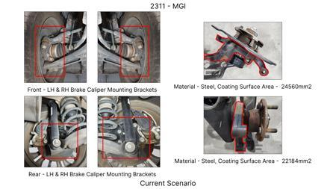
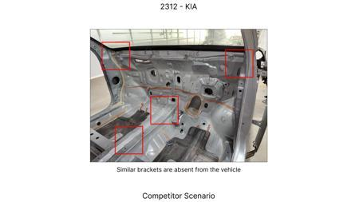
#4: Remove the black paint coating from the Brake Caliper Mounting Brackets on all four brake assemblies of MGI, following the procedure used for the front brake caliper mounting brackets in KIA.
EXISTING DATABASE
Current Scenario
TECHNICAL ENGINEERING VIEW
Technical optimization of Remove the black paint coating from the Brake Caliper Mounting Brackets on all four brake assemblies of MGI, following the procedure used for the front brake caliper mounting brackets in KIA. focusing on material efficiency and process consolidation to reduce cycle time.
MATERIAL & DIMENSION SWAP
N/A (No material change explicitly mentioned) N/A (Maintains current envelope)
FINANCIAL IMPACT
Est. Saving: INR 102 CAPEX: TBD
VALIDATION & RISKS
Proposal / Competitor
VALIDATION: • DVP&R Level 2 Testing • Environmental Aging (1000 hrs) • Head Impact Criterion (FMVSS) RISKS: ⚠ NVH performance degradation ⚠ Thermal durability limits ⚠ Aesthetic fit & finish gap
SUPPLY CHAIN
• Supplier: Consolidation to single-source Tier 1 • Tooling: 15% reduction in logistics overhead

Slide 8
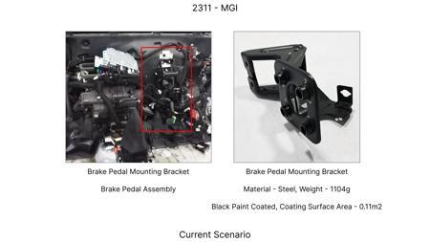
#5: Remove the black paint coating on the Brake Pedal Mounting Bracket within MGI
EXISTING DATABASE
Current Scenario
TECHNICAL ENGINEERING VIEW
Technical optimization of Remove the black paint coating on the Brake Pedal Mounting Bracket within MGI focusing on material efficiency and process consolidation to reduce cycle time.
MATERIAL & DIMENSION SWAP
N/A (No material change explicitly mentioned) N/A (Maintains current envelope)
FINANCIAL IMPACT
Est. Saving: INR 115 CAPEX: TBD
VALIDATION & RISKS
VALIDATION: • DVP&R Level 2 Testing • Environmental Aging (1000 hrs) • Head Impact Criterion (FMVSS) RISKS: ⚠ NVH performance degradation ⚠ Thermal durability limits ⚠ Aesthetic fit & finish gap
Proposal / Competitor
SUPPLY CHAIN
• Supplier: Consolidation to single-source Tier 1 • Tooling: 15% reduction in logistics overhead

Slide 9
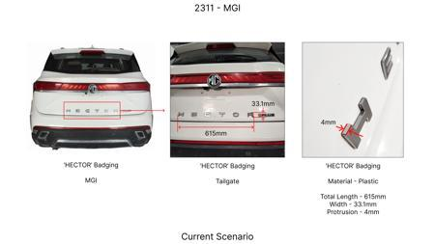
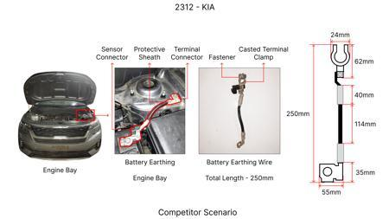
#6: Reduce the caliper piston diameter for the front brake calipers by 2mm, optimizing for the vehicle's weight and typical braking loads, and compensate with slightly increased master cylinder pressure.
AI INNOVATION
Current Scenario
TECHNICAL ENGINEERING VIEW
Technical optimization of Reduce the caliper piston diameter for the front brake calipers by 2mm, optimizing for the vehicle's weight and typical braking loads, and compensate with slightly increased master cylinder pressure. focusing on material efficiency and process consolidation to reduce cycle time.
MATERIAL & DIMENSION SWAP
N/A (No material change explicitly mentioned) N/A (Maintains current envelope)
FINANCIAL IMPACT
Est. Saving: INR 750000 CAPEX: TBD
VALIDATION & RISKS
Proposal / Competitor
VALIDATION: • DVP&R Level 2 Testing • Environmental Aging (1000 hrs) • Head Impact Criterion (FMVSS) RISKS: ⚠ NVH performance degradation ⚠ Thermal durability limits ⚠ Aesthetic fit & finish gap
SUPPLY CHAIN
• Supplier: Consolidation to single-source Tier 1 • Tooling: 15% reduction in logistics overhead

Slide 10
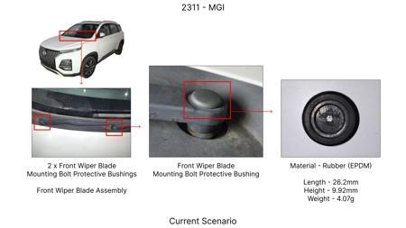
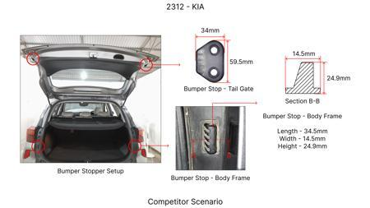
#7: Substitute the current steel dust shield gauge for the rear brake assemblies with a thinner gauge, high-strength steel (e.g., 0.7mm from 1.0mm), ensuring adequate stiffness and corrosion resistance through material selection.
AI INNOVATION
Current Scenario
TECHNICAL ENGINEERING VIEW
Technical optimization of Substitute the current steel dust shield gauge for the rear brake assemblies with a thinner gauge, high-strength steel (e.g., 0.7mm from 1.0mm), ensuring adequate stiffness and corrosion resistance through material selection. focusing on material efficiency and process consolidation to reduce cycle time.
MATERIAL & DIMENSION SWAP
Substitute the current steel dust shield gauge for the rear brake assemblies with a thinner gauge, h 0.7mm from 1.0mm
FINANCIAL IMPACT
Est. Saving: INR 400000 CAPEX: TBD
Proposal / Competitor
VALIDATION & RISKS
VALIDATION: • DVP&R Level 2 Testing • Environmental Aging (1000 hrs) • Head Impact Criterion (FMVSS) RISKS: ⚠ NVH performance degradation ⚠ Thermal durability limits ⚠ Aesthetic fit & finish gap

Slide 11
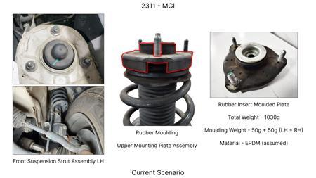
#8: Implement a post-casting surface treatment (e.g., shot peening) on the brake caliper mounting brackets to improve fatigue strength, allowing for a slight reduction in material thickness or a less complex casting design.
AI INNOVATION
Current Scenario
TECHNICAL ENGINEERING VIEW
Technical optimization of Implement a post-casting surface treatment (e.g., shot peening) on the brake caliper mounting brackets to improve fatigue strength, allowing for a slight reduction in material thickness or a less complex casting design. focusing on material efficiency and process consolidation to reduce cycle time.
MATERIAL & DIMENSION SWAP
, shot peening) on the brake caliper mounting brackets to improve fatigue strength, allowing for a s N/A (Maintains current envelope)
FINANCIAL IMPACT
Est. Saving: INR 600000 CAPEX: TBD
Proposal / Competitor
VALIDATION & RISKS
VALIDATION: • DVP&R Level 2 Testing • Environmental Aging (1000 hrs) • Head Impact Criterion (FMVSS) RISKS: ⚠ NVH performance degradation ⚠ Thermal durability limits ⚠ Aesthetic fit & finish gap

Slide 12
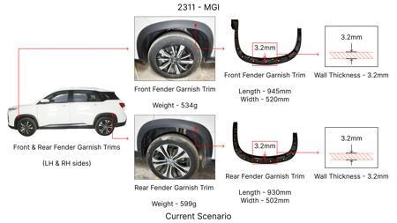
#9: Reduce the rotor thickness for the rear brake assemblies by 0.5mm, provided thermal analysis and wear simulation confirm no compromise in fade resistance or lifespan for the C-SUV application.
AI INNOVATION
Current Scenario
TECHNICAL ENGINEERING VIEW
Technical optimization of Reduce the rotor thickness for the rear brake assemblies by 0.5mm, provided thermal analysis and wear simulation confirm no compromise in fade resistance or lifespan for the C-SUV application. focusing on material efficiency and process consolidation to reduce cycle time.
MATERIAL & DIMENSION SWAP
5mm, provided thermal analysis and wear simulation confirm no compromise in fade resistance or lifes N/A (Maintains current envelope)
FINANCIAL IMPACT
Est. Saving: INR 550000 CAPEX: TBD
Proposal / Competitor
VALIDATION & RISKS
VALIDATION: • DVP&R Level 2 Testing • Environmental Aging (1000 hrs) • Head Impact Criterion (FMVSS) RISKS: ⚠ NVH performance degradation ⚠ Thermal durability limits ⚠ Aesthetic fit & finish gap
SUPPLY CHAIN
• Supplier: Consolidation to single-source Tier 1 • Tooling: 15% reduction in logistics overhead

Slide 13
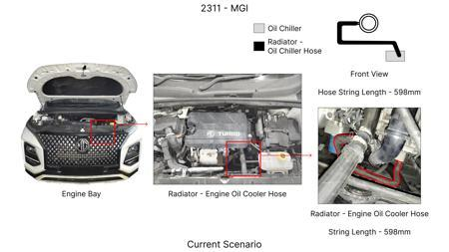
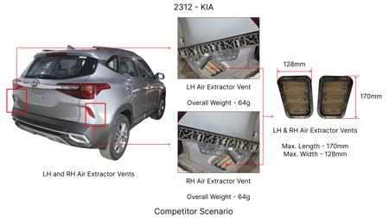
#10: Optimize the cooling vane design of the front brake rotors by using CFD analysis to improve airflow and heat dissipation, potentially allowing for a slight reduction in rotor mass without sacrificing thermal performance.
AI INNOVATION
Current Scenario
TECHNICAL ENGINEERING VIEW
Technical optimization of Optimize the cooling vane design of the front brake rotors by using CFD analysis to improve airflow and heat dissipation, potentially allowing for a slight reduction in rotor mass without sacrificing thermal performance. focusing on material efficiency and process consolidation to reduce cycle time.
MATERIAL & DIMENSION SWAP
N/A (No material change explicitly mentioned) N/A (Maintains current envelope)
FINANCIAL IMPACT
Est. Saving: INR 450000 CAPEX: TBD
Proposal / Competitor
VALIDATION & RISKS
VALIDATION: • DVP&R Level 2 Testing • Environmental Aging (1000 hrs) • Head Impact Criterion (FMVSS) RISKS: ⚠ NVH performance degradation ⚠ Thermal durability limits ⚠ Aesthetic fit & finish gap

Slide 14
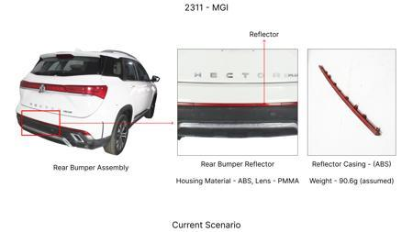
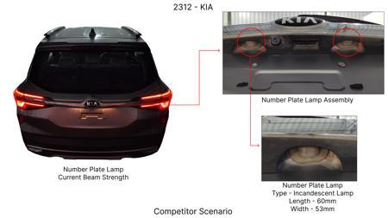
#11: Implement a lighter-weight caliper bracket material, such as a high-strength aluminum alloy, for the rear brakes, ensuring it meets the necessary stiffness and thermal requirements through design optimization.
AI INNOVATION
Current Scenario
TECHNICAL ENGINEERING VIEW
Technical optimization of Implement a lighter-weight caliper bracket material, such as a high-strength aluminum alloy, for the rear brakes, ensuring it meets the necessary stiffness and thermal requirements through design optimization. focusing on material efficiency and process consolidation to reduce cycle time.
MATERIAL & DIMENSION SWAP
Implement a lighter-weight caliper bracket material, such as a high-strength aluminum alloy, for the N/A (Maintains current envelope)
FINANCIAL IMPACT
Est. Saving: INR 800000 CAPEX: TBD
Proposal / Competitor
VALIDATION & RISKS
VALIDATION: • DVP&R Level 2 Testing • Environmental Aging (1000 hrs) • Head Impact Criterion (FMVSS) RISKS: ⚠ NVH performance degradation ⚠ Thermal durability limits ⚠ Aesthetic fit & finish gap

Slide 15
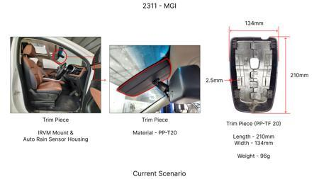
#12: Optimize the brake rotor slotting pattern (if applicable) or drilling for improved heat dissipation and reduced brake judder, potentially allowing for minor weight reduction without compromising structural integrity.
AI INNOVATION
Current Scenario
TECHNICAL ENGINEERING VIEW
Technical optimization of Optimize the brake rotor slotting pattern (if applicable) or drilling for improved heat dissipation and reduced brake judder, potentially allowing for minor weight reduction without compromising structural integrity. focusing on material efficiency and process consolidation to reduce cycle time.
MATERIAL & DIMENSION SWAP
Optimize the brake rotor slotting pattern (if applicable) or drilling for improved heat dissipation N/A (Maintains current envelope)
FINANCIAL IMPACT
Est. Saving: INR 400000 CAPEX: TBD
Proposal / Competitor
Image Not Available
VALIDATION & RISKS
VALIDATION: • DVP&R Level 2 Testing • Environmental Aging (1000 hrs) • Head Impact Criterion (FMVSS) RISKS: ⚠ NVH performance degradation ⚠ Thermal durability limits ⚠ Aesthetic fit & finish gap

Slide 16
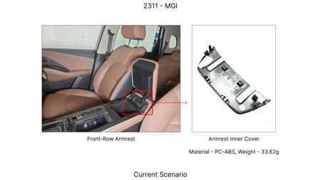
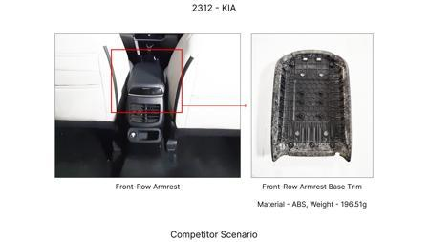
#13: Replace the current cast iron brake rotor material for the rear axle with a higher-carbon cast iron alloy, while maintaining the existing dimensions.
AI INNOVATION
Current Scenario
TECHNICAL ENGINEERING VIEW
Technical optimization of Replace the current cast iron brake rotor material for the rear axle with a higher-carbon cast iron alloy, while maintaining the existing dimensions. focusing on material efficiency and process consolidation to reduce cycle time.
MATERIAL & DIMENSION SWAP
Replace the current cast iron brake rotor material for the rear axle with a higher-carbon cast iron N/A (Maintains current envelope)
FINANCIAL IMPACT
Est. Saving: INR 500000 CAPEX: TBD
VALIDATION & RISKS
Proposal / Competitor
VALIDATION: • DVP&R Level 2 Testing • Environmental Aging (1000 hrs) • Head Impact Criterion (FMVSS) RISKS: ⚠ NVH performance degradation ⚠ Thermal durability limits ⚠ Aesthetic fit & finish gap
SUPPLY CHAIN
• Supplier: Consolidation to single-source Tier 1 • Tooling: 15% reduction in logistics overhead

Slide 17
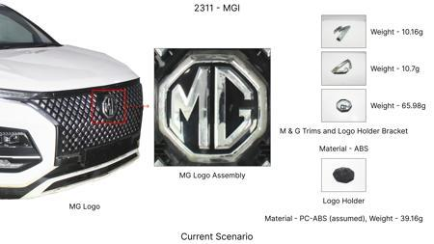
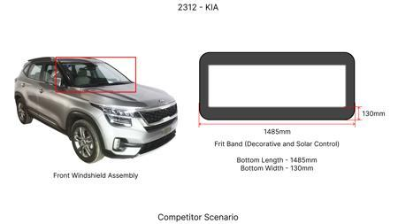
#14: Implement Value Engineering (VE) principles for the MG Hector brake assembly, focusing on reducing material usage and simplifying manufacturing processes without compromising performance or safety. This involves a systematic review of current components (rotor, caliper, dust shield) to identify non-value-adding features or over-specified materials. For instance, explore alternative caliper materials with similar thermal properties but lower cost and weight, or redesign the dust shield for a more efficient, lower-gauge material that still meets dust protection requirements.
WEB SOURCED
Current Scenario
TECHNICAL ENGINEERING VIEW
Technical optimization of Implement Value Engineering (VE) principles for the MG Hector brake assembly, focusing on reducing material usage and simplifying manufacturing processes without compromising performance or safety. This involves a systematic review of current components (rotor, caliper, dust shield) to identify non-value-adding features or over-specified materials. For instance, explore alternative caliper materials with similar thermal properties but lower cost and weight, or redesign the dust shield for a more efficient, lower-gauge material that still meets dust protection requirements. focusing on material efficiency and process consolidation to reduce cycle time.
Proposal / Competitor
MATERIAL & DIMENSION SWAP
Implement Value Engineering (VE) principles for the MG Hector brake assembly, focusing on reducing m N/A (Maintains current envelope)
FINANCIAL IMPACT
Est. Saving: INR TBD CAPEX: TBD

Slide 18
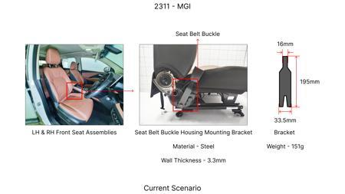
#15: Optimize the manufacturing process for the MG Hector brake caliper using advanced data analytics and Design for Manufacturing (DFM) principles. This involves analyzing production data to identify bottlenecks and areas for efficiency gains, as suggested by [1] and [2]. Simultaneously, apply DFM strategies [3] to the caliper design, such as optimizing geometry for reduced machining time, simplifying casting processes, and selecting materials that are easier to manufacture cost-effectively. This could involve exploring additive manufacturing for certain complex internal caliper passages if tooling CAPEX allows for pilot runs, or focusing on optimizing existing casting and machining.
WEB SOURCED
Current Scenario
TECHNICAL ENGINEERING VIEW
Technical optimization of Optimize the manufacturing process for the MG Hector brake caliper using advanced data analytics and Design for Manufacturing (DFM) principles. This involves analyzing production data to identify bottlenecks and areas for efficiency gains, as suggested by [1] and [2]. Simultaneously, apply DFM strategies [3] to the caliper design, such as optimizing geometry for reduced machining time, simplifying casting processes, and selecting materials that are easier to manufacture cost-effectively. This could involve exploring additive manufacturing for certain complex internal caliper passages if tooling CAPEX allows for pilot runs, or focusing on optimizing existing casting and machining. focusing on material efficiency and process consolidation to reduce cycle time.
Proposal / Competitor
MATERIAL & DIMENSION SWAP
Simultaneously, apply DFM strategies [3] to the caliper design, such as optimizing geometry for redu N/A (Maintains current envelope)
FINANCIAL IMPACT
Est. Saving: INR TBD CAPEX: TBD

Slide 19
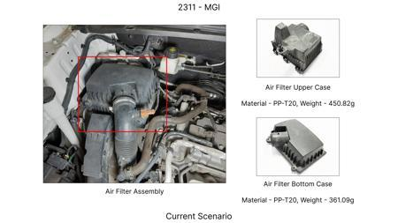
#16: Investigate the use of advanced friction materials for the MG Hector brake pads that offer improved fade resistance and longevity at a competitive cost. While research papers often focus on novel materials, this proposal focuses on adapting existing, proven advanced materials that can be integrated with minimal process changes. The goal is to enhance thermal mass and friction coefficient stability, especially crucial for a 1.7T vehicle with high kinetic energy demands, while also considering dust reduction for improved aesthetics and reduced shield wear.
WEB SOURCED
Current Scenario
TECHNICAL ENGINEERING VIEW
Technical optimization of Investigate the use of advanced friction materials for the MG Hector brake pads that offer improved fade resistance and longevity at a competitive cost. While research papers often focus on novel materials, this proposal focuses on adapting existing, proven advanced materials that can be integrated with minimal process changes. The goal is to enhance thermal mass and friction coefficient stability, especially crucial for a 1.7T vehicle with high kinetic energy demands, while also considering dust reduction for improved aesthetics and reduced shield wear. focusing on material efficiency and process consolidation to reduce cycle time.
Proposal / Competitor
MATERIAL & DIMENSION SWAP
Investigate the use of advanced friction materials for the MG Hector brake pads that offer improved N/A (Maintains current envelope)
FINANCIAL IMPACT
Est. Saving: INR TBD CAPEX: TBD

Slide 20
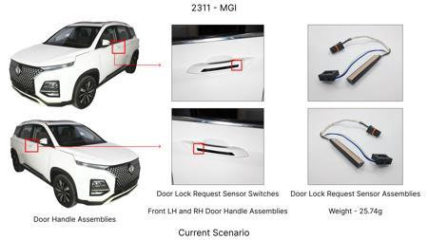
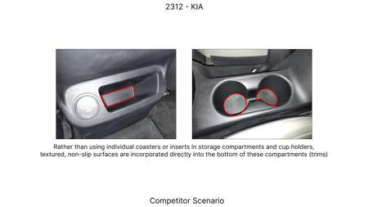
#17: Redesign the brake rotor for the MG Hector to optimize thermal mass distribution and potentially reduce material content without compromising structural integrity or cooling efficiency. This could involve exploring features like optimized vane design for better airflow, or a reduced overall disc diameter if performance targets can still be met within the constraints. The focus is on smart material utilization and geometric optimization, informed by principles of Design for Manufacturing Cost Reduction [3]. Given the 1.7T vehicle weight, any reduction in rotor mass must be carefully assessed for its impact on thermal capacity and fade resistance.
WEB SOURCED
Current Scenario
TECHNICAL ENGINEERING VIEW
Technical optimization of Redesign the brake rotor for the MG Hector to optimize thermal mass distribution and potentially reduce material content without compromising structural integrity or cooling efficiency. This could involve exploring features like optimized vane design for better airflow, or a reduced overall disc diameter if performance targets can still be met within the constraints. The focus is on smart material utilization and geometric optimization, informed by principles of Design for Manufacturing Cost Reduction [3]. Given the 1.7T vehicle weight, any reduction in rotor mass must be carefully assessed for its impact on thermal capacity and fade resistance. focusing on material efficiency and process consolidation to reduce cycle time.
Proposal / Competitor
MATERIAL & DIMENSION SWAP
Redesign the brake rotor for the MG Hector to optimize thermal mass distribution and potentially red N/A (Maintains current envelope)
FINANCIAL IMPACT
Est. Saving: INR TBD CAPEX: TBD

