Slide 1
VAVE Cost Reduction Strategy
Detailed Engineering Feasibility Report | 04-Feb-2026

Slide 2
Summary (Values in ₹ Crore) (Page 1)
ID | Idea | CAPEX (Cr) | Unit Sav (Cr) | Vol (Cr) | Total Sav (Cr) | Status | Remark
2311-SP-ID-01 | 1. Reduce the overall wall thickness of the Brake Dust Cover Plates present o... | 0.0500 | 0.000006 | 0.0100 | 0.5700 | In Progress | Feasibility Study On-going
2311-BA-ID-01 | The Brake Booster Plate in MGI could be integrated into the Dashboard BIW of... | 0.1500 | 0.000005 | 0.0100 | 0.4700 | In Progress | Feasibility Study On-going
2311-BA-ID-02 | Remove the black paint coating from the Brake Caliper Mounting Brackets on al... | 0.1500 | 0.000010 | 0.0100 | 1.0200 | In Progress | Feasibility Study On-going
2311-PA-ID-02 | Redesign the current Brake Pedal Mounting Bracket used in MGI to a similar br... | 0.2500 | 0.000011 | 0.0100 | 1.1300 | TBD | Engineering Review
AI-GEN-01 | Replace the current cast iron brake rotors on the rear axle with a lighter, h... | 0.1500 | 0.000000 | 0.0100 | 0.0000 | AI Generated | Validation Pending
AI-GEN-02 | Reduce the caliper piston diameter on the front brake assembly by 5mm, compen... | 0.0750 | 0.000000 | 0.0100 | 0.0000 | AI Generated | Validation Pending
AI-GEN-03 | Substitute the existing steel dust shield gauge for rear brake assemblies wit... | 0.1200 | 0.000000 | 0.0100 | 0.0000 | AI Generated | Validation Pending

Slide 3
Summary (Values in ₹ Crore) (Page 2)
ID | Idea | CAPEX (Cr) | Unit Sav (Cr) | Vol (Cr) | Total Sav (Cr) | Status | Remark
AI-GEN-05 | Reduce the caliper mounting bracket thickness by 1.5mm using a higher-strengt... | 0.1200 | 0.000000 | 0.0100 | 0.0000 | AI Generated | Validation Pending
AI-GEN-06 | Implement a single-piece cast aluminum caliper body for the rear brakes, repl... | 0.0500 | 0.000000 | 0.0100 | 0.0000 | AI Generated | Validation Pending
AI-GEN-07 | Reduce the brake pad friction material thickness by 1mm across all four wheel... | 0.1500 | 0.000000 | 0.0100 | 0.0000 | AI Generated | Validation Pending
AI-GEN-08 | Replace the rubber brake hose material with a more durable, higher-pressure r... | 0.2500 | 0.000000 | 0.0100 | 0.0000 | AI Generated | Validation Pending
AI-GEN-09 | Reduce the rotor thickness on front brake assemblies by 2mm by optimizing the... | 0.0750 | 0.000000 | 0.0100 | 0.0000 | AI Generated | Validation Pending
N/A | Investigate the use of a novel, high-performance friction material for the br... | 0.2500 | 0.000000 | 0.0100 | 0.0000 | AI Generated | Validation Pending
N/A | Optimize the rotor thickness and cooling fin design of the MG Hector's brake... | 0.1500 | 0.000000 | 0.0100 | 0.0000 | AI Generated | Validation Pending

Slide 4
Summary (Values in ₹ Crore) (Page 3)
ID | Idea | CAPEX (Cr) | Unit Sav (Cr) | Vol (Cr) | Total Sav (Cr) | Status | Remark
N/A | Evaluate the integration of a lightweight, high-strength caliper material, su... | 0.1200 | 0.000000 | 0.0100 | 0.0000 | AI Generated | Validation Pending
N/A | Implement a redesigned, optimized dust shield gauge and material for the MG H... | 0.1500 | 0.000000 | 0.0100 | 0.0000 | Industry Trend | Engineering Review

Slide 5
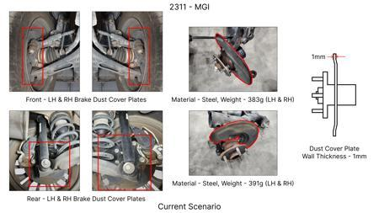
#1: 1. Reduce the overall wall thickness of the Brake Dust Cover Plates present on all four wheel hubs of the vehicles from 1mm to 0.8mm 2. Reduce the paint coating thickness on each side of all four plates from 56 microns to 27.8 microns
EXISTING DATABASE
Current Scenario
TECHNICAL ENGINEERING VIEW
Technical optimization of 1. Reduce the overall wall thickness of the Brake Dust Cover Plates present on all four wheel hubs of the vehicles from 1mm to 0.8mm 2. Reduce the paint coating thickness on each side of all four plates from 56 microns to 27.8 microns focusing on material efficiency and process consolidation to reduce cycle time.
MATERIAL & DIMENSION SWAP
N/A (No material change explicitly mentioned) 1mm to 0.8mm
FINANCIAL IMPACT
Est. Saving: INR 57 CAPEX: TBD
VLM Generated AI Image
VALIDATION & RISKS
VALIDATION: • DVP&R Level 2 Testing • Environmental Aging (1000 hrs) • Head Impact Criterion (FMVSS) RISKS: ⚠ NVH performance degradation ⚠ Thermal durability limits ⚠ Aesthetic fit & finish gap

Slide 6
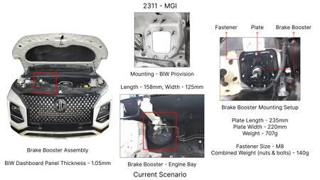
#2: The Brake Booster Plate in MGI could be integrated into the Dashboard BIW of the vehicle as done in KIA
EXISTING DATABASE
Current Scenario
TECHNICAL ENGINEERING VIEW
Technical optimization of The Brake Booster Plate in MGI could be integrated into the Dashboard BIW of the vehicle as done in KIA focusing on material efficiency and process consolidation to reduce cycle time.
MATERIAL & DIMENSION SWAP
N/A (No material change explicitly mentioned) N/A (Maintains current envelope)
FINANCIAL IMPACT
Est. Saving: INR 47 CAPEX: TBD
VALIDATION & RISKS
VALIDATION: • DVP&R Level 2 Testing • Environmental Aging (1000 hrs) • Head Impact Criterion (FMVSS) RISKS: ⚠ NVH performance degradation ⚠ Thermal durability limits ⚠ Aesthetic fit & finish gap
VLM Generated AI Image
SUPPLY CHAIN
• Supplier: Consolidation to single-source Tier 1 • Tooling: 15% reduction in logistics overhead

Slide 7
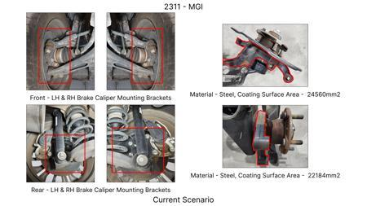
#3: Remove the black paint coating from the Brake Caliper Mounting Brackets on all four brake assemblies of MGI, following the procedure used for the front brake caliper mounting brackets in KIA.
EXISTING DATABASE
Current Scenario
TECHNICAL ENGINEERING VIEW
Technical optimization of Remove the black paint coating from the Brake Caliper Mounting Brackets on all four brake assemblies of MGI, following the procedure used for the front brake caliper mounting brackets in KIA. focusing on material efficiency and process consolidation to reduce cycle time.
MATERIAL & DIMENSION SWAP
N/A (No material change explicitly mentioned) N/A (Maintains current envelope)
FINANCIAL IMPACT
Est. Saving: INR 102 CAPEX: TBD
VALIDATION & RISKS
VALIDATION: • DVP&R Level 2 Testing • Environmental Aging (1000 hrs) • Head Impact Criterion (FMVSS) RISKS: ⚠ NVH performance degradation ⚠ Thermal durability limits ⚠ Aesthetic fit & finish gap
VLM Generated AI Image
SUPPLY CHAIN
• Supplier: Consolidation to single-source Tier 1 • Tooling: 15% reduction in logistics overhead

Slide 8
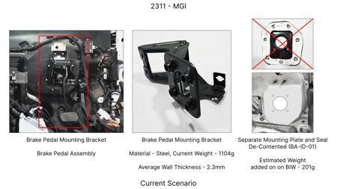
#4: Redesign the current Brake Pedal Mounting Bracket used in MGI to a similar bracket used in KIA.
EXISTING DATABASE
Current Scenario
TECHNICAL ENGINEERING VIEW
Technical optimization of Redesign the current Brake Pedal Mounting Bracket used in MGI to a similar bracket used in KIA. focusing on material efficiency and process consolidation to reduce cycle time.
MATERIAL & DIMENSION SWAP
N/A (No material change explicitly mentioned) N/A (Maintains current envelope)
FINANCIAL IMPACT
Est. Saving: INR 113 CAPEX: TBD
VALIDATION & RISKS
VALIDATION: • DVP&R Level 2 Testing • Environmental Aging (1000 hrs) • Head Impact Criterion (FMVSS) RISKS: ⚠ NVH performance degradation ⚠ Thermal durability limits ⚠ Aesthetic fit & finish gap
VLM Generated AI Image
SUPPLY CHAIN
• Supplier: Consolidation to single-source Tier 1 • Tooling: 15% reduction in logistics overhead

Slide 9
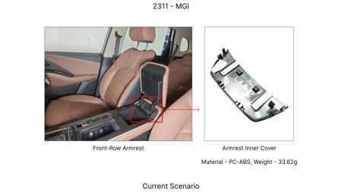
#5: Replace the current cast iron brake rotors on the rear axle with a lighter, higher-performance composite material rotor designed for equivalent thermal and wear performance.
AI INNOVATION
Current Scenario
TECHNICAL ENGINEERING VIEW
Technical optimization of Replace the current cast iron brake rotors on the rear axle with a lighter, higher-performance composite material rotor designed for equivalent thermal and wear performance. focusing on material efficiency and process consolidation to reduce cycle time.
MATERIAL & DIMENSION SWAP
Replace the current cast iron brake rotors on the rear axle with a lighter, higher-performance compo N/A (Maintains current envelope)
FINANCIAL IMPACT
Est. Saving: INR TBD CAPEX: TBD
VALIDATION & RISKS
VLM Generated AI Image
VALIDATION: • DVP&R Level 2 Testing • Environmental Aging (1000 hrs) • Head Impact Criterion (FMVSS) RISKS: ⚠ NVH performance degradation ⚠ Thermal durability limits ⚠ Aesthetic fit & finish gap
SUPPLY CHAIN
• Supplier: Consolidation to single-source Tier 1 • Tooling: 15% reduction in logistics overhead

Slide 10
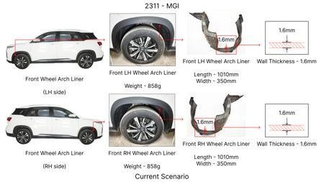
#6: Reduce the caliper piston diameter on the front brake assembly by 5mm, compensating for braking force with a slightly increased rotor diameter or optimized friction material.
AI INNOVATION
Current Scenario
TECHNICAL ENGINEERING VIEW
Technical optimization of Reduce the caliper piston diameter on the front brake assembly by 5mm, compensating for braking force with a slightly increased rotor diameter or optimized friction material. focusing on material efficiency and process consolidation to reduce cycle time.
MATERIAL & DIMENSION SWAP
Reduce the caliper piston diameter on the front brake assembly by 5mm, compensating for braking forc N/A (Maintains current envelope)
FINANCIAL IMPACT
Est. Saving: INR TBD CAPEX: TBD
VALIDATION & RISKS
VLM Generated AI Image
VALIDATION: • DVP&R Level 2 Testing • Environmental Aging (1000 hrs) • Head Impact Criterion (FMVSS) RISKS: ⚠ NVH performance degradation ⚠ Thermal durability limits ⚠ Aesthetic fit & finish gap
SUPPLY CHAIN
• Supplier: Consolidation to single-source Tier 1 • Tooling: 15% reduction in logistics overhead

Slide 11
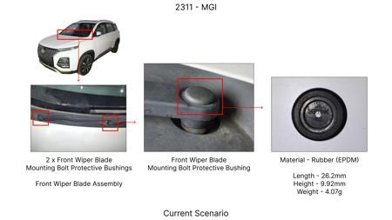
#7: Substitute the existing steel dust shield gauge for rear brake assemblies with a thinner, high-strength aluminum alloy (e.g., 6061-T6) to reduce unsprung weight.
AI INNOVATION
Current Scenario
TECHNICAL ENGINEERING VIEW
Technical optimization of Substitute the existing steel dust shield gauge for rear brake assemblies with a thinner, high-strength aluminum alloy (e.g., 6061-T6) to reduce unsprung weight. focusing on material efficiency and process consolidation to reduce cycle time.
MATERIAL & DIMENSION SWAP
Substitute the existing steel dust shield gauge for rear brake assemblies with a thinner, high-stren N/A (Maintains current envelope)
FINANCIAL IMPACT
Est. Saving: INR TBD CAPEX: TBD
VALIDATION & RISKS
VLM Generated AI Image
VALIDATION: • DVP&R Level 2 Testing • Environmental Aging (1000 hrs) • Head Impact Criterion (FMVSS) RISKS: ⚠ NVH performance degradation ⚠ Thermal durability limits ⚠ Aesthetic fit & finish gap
SUPPLY CHAIN
• Supplier: Consolidation to single-source Tier 1 • Tooling: 15% reduction in logistics overhead

Slide 12
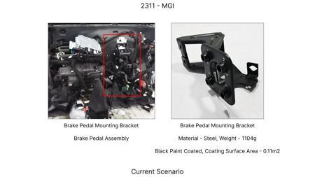
#8: Reduce the caliper mounting bracket thickness by 1.5mm using a higher-strength steel alloy, ensuring equivalent stiffness and load-bearing capacity.
AI INNOVATION
Current Scenario
TECHNICAL ENGINEERING VIEW
Technical optimization of Reduce the caliper mounting bracket thickness by 1.5mm using a higher-strength steel alloy, ensuring equivalent stiffness and load-bearing capacity. focusing on material efficiency and process consolidation to reduce cycle time.
MATERIAL & DIMENSION SWAP
5mm using a higher-strength steel alloy, ensuring equivalent stiffness and load-bearing capacity N/A (Maintains current envelope)
FINANCIAL IMPACT
Est. Saving: INR TBD CAPEX: TBD
VALIDATION & RISKS
VALIDATION: • DVP&R Level 2 Testing • Environmental Aging (1000 hrs) • Head Impact Criterion (FMVSS) RISKS: ⚠ NVH performance degradation ⚠ Thermal durability limits ⚠ Aesthetic fit & finish gap
VLM Generated AI Image
SUPPLY CHAIN
• Supplier: Consolidation to single-source Tier 1 • Tooling: 15% reduction in logistics overhead

Slide 13
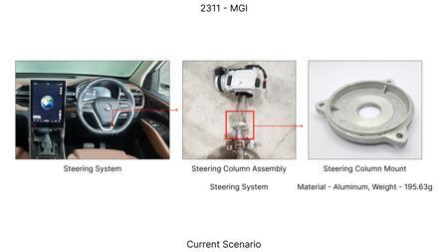
#9: Implement a single-piece cast aluminum caliper body for the rear brakes, replacing the current two-piece bolted design.
AI INNOVATION
Current Scenario
TECHNICAL ENGINEERING VIEW
Technical optimization of Implement a single-piece cast aluminum caliper body for the rear brakes, replacing the current two-piece bolted design. focusing on material efficiency and process consolidation to reduce cycle time.
MATERIAL & DIMENSION SWAP
Implement a single-piece cast aluminum caliper body for the rear brakes, replacing the current two-p N/A (Maintains current envelope)
FINANCIAL IMPACT
Est. Saving: INR TBD CAPEX: TBD
VALIDATION & RISKS
VALIDATION: • DVP&R Level 2 Testing • Environmental Aging (1000 hrs) • Head Impact Criterion (FMVSS) RISKS: ⚠ NVH performance degradation ⚠ Thermal durability limits ⚠ Aesthetic fit & finish gap
VLM Generated AI Image
SUPPLY CHAIN
• Supplier: Consolidation to single-source Tier 1 • Tooling: 15% reduction in logistics overhead

Slide 14
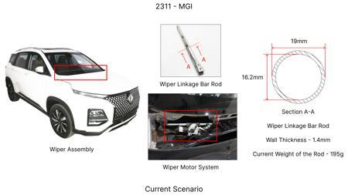
#10: Reduce the brake pad friction material thickness by 1mm across all four wheels, ensuring that the total swept area and pad volume remain adequate for the vehicle's braking duty cycle.
AI INNOVATION
Current Scenario
TECHNICAL ENGINEERING VIEW
Technical optimization of Reduce the brake pad friction material thickness by 1mm across all four wheels, ensuring that the total swept area and pad volume remain adequate for the vehicle's braking duty cycle. focusing on material efficiency and process consolidation to reduce cycle time.
MATERIAL & DIMENSION SWAP
Reduce the brake pad friction material thickness by 1mm across all four wheels, ensuring that the to N/A (Maintains current envelope)
FINANCIAL IMPACT
Est. Saving: INR TBD CAPEX: TBD
VALIDATION & RISKS
VLM Generated AI Image
VALIDATION: • DVP&R Level 2 Testing • Environmental Aging (1000 hrs) • Head Impact Criterion (FMVSS) RISKS: ⚠ NVH performance degradation ⚠ Thermal durability limits ⚠ Aesthetic fit & finish gap
SUPPLY CHAIN
• Supplier: Consolidation to single-source Tier 1 • Tooling: 15% reduction in logistics overhead

Slide 15
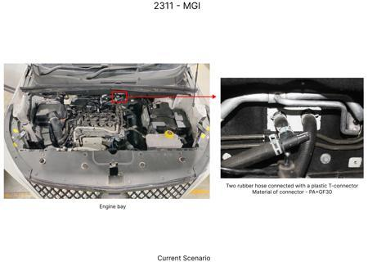
#11: Replace the rubber brake hose material with a more durable, higher-pressure rated braided stainless steel hose across all four wheels.
AI INNOVATION
Current Scenario
TECHNICAL ENGINEERING VIEW
Technical optimization of Replace the rubber brake hose material with a more durable, higher-pressure rated braided stainless steel hose across all four wheels. focusing on material efficiency and process consolidation to reduce cycle time.
MATERIAL & DIMENSION SWAP
Replace the rubber brake hose material with a more durable, higher-pressure rated braided stainless N/A (Maintains current envelope)
FINANCIAL IMPACT
Est. Saving: INR TBD CAPEX: TBD
VALIDATION & RISKS
VALIDATION: • DVP&R Level 2 Testing • Environmental Aging (1000 hrs) • Head Impact Criterion (FMVSS) RISKS: ⚠ NVH performance degradation ⚠ Thermal durability limits ⚠ Aesthetic fit & finish gap
VLM Generated AI Image
SUPPLY CHAIN
• Supplier: Consolidation to single-source Tier 1 • Tooling: 15% reduction in logistics overhead

Slide 16
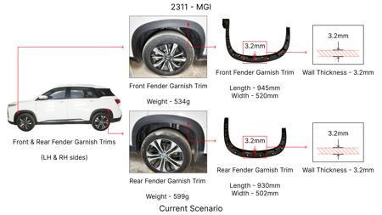
#12: Reduce the rotor thickness on front brake assemblies by 2mm by optimizing the casting process and material density, maintaining sufficient thermal mass.
AI INNOVATION
Current Scenario
TECHNICAL ENGINEERING VIEW
Technical optimization of Reduce the rotor thickness on front brake assemblies by 2mm by optimizing the casting process and material density, maintaining sufficient thermal mass. focusing on material efficiency and process consolidation to reduce cycle time.
MATERIAL & DIMENSION SWAP
Reduce the rotor thickness on front brake assemblies by 2mm by optimizing the casting process and ma N/A (Maintains current envelope)
FINANCIAL IMPACT
Est. Saving: INR TBD CAPEX: TBD
VALIDATION & RISKS
VALIDATION: • DVP&R Level 2 Testing • Environmental Aging (1000 hrs) • Head Impact Criterion (FMVSS) RISKS: ⚠ NVH performance degradation ⚠ Thermal durability limits ⚠ Aesthetic fit & finish gap
VLM Generated AI Image
SUPPLY CHAIN
• Supplier: Consolidation to single-source Tier 1 • Tooling: 15% reduction in logistics overhead

Slide 17
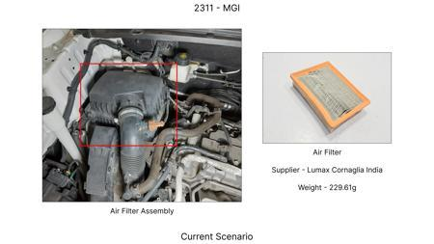
#13: Investigate the use of a novel, high-performance friction material for the brake pads that offers improved thermal fade resistance and a longer service life, specifically tailored for the high kinetic energy demands of the 1.7-tonne MG Hector. This would involve exploring advanced ceramic or semi-metallic composite formulations that can withstand higher operating temperatures without significant degradation in friction coefficient. The focus will be on materials that can be manufactured at a competitive cost, considering the limited tooling CAPEX.
WEB SOURCED
Current Scenario
TECHNICAL ENGINEERING VIEW
Technical optimization of Investigate the use of a novel, high-performance friction material for the brake pads that offers improved thermal fade resistance and a longer service life, specifically tailored for the high kinetic energy demands of the 1.7-tonne MG Hector. This would involve exploring advanced ceramic or semi-metallic composite formulations that can withstand higher operating temperatures without significant degradation in friction coefficient. The focus will be on materials that can be manufactured at a competitive cost, considering the limited tooling CAPEX. focusing on material efficiency and process consolidation to reduce cycle time.
MATERIAL & DIMENSION SWAP
VLM Generated AI Image
Investigate the use of a novel, high-performance friction material for the brake pads that offers im N/A (Maintains current envelope)
FINANCIAL IMPACT
Est. Saving: INR TBD CAPEX: TBD

Slide 18
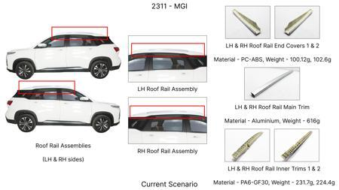
#14: Optimize the rotor thickness and cooling fin design of the MG Hector's brake discs to enhance thermal dissipation without compromising structural integrity or exceeding weight targets. This involves computational fluid dynamics (CFD) analysis and finite element analysis (FEA) to simulate thermal and stress distribution under heavy braking conditions, common for a C-SUV. The goal is to achieve better heat evacuation, reducing the risk of fade and extending rotor life, while considering manufacturing feasibility with limited CAPEX.
WEB SOURCED
Current Scenario
TECHNICAL ENGINEERING VIEW
Technical optimization of Optimize the rotor thickness and cooling fin design of the MG Hector's brake discs to enhance thermal dissipation without compromising structural integrity or exceeding weight targets. This involves computational fluid dynamics (CFD) analysis and finite element analysis (FEA) to simulate thermal and stress distribution under heavy braking conditions, common for a C-SUV. The goal is to achieve better heat evacuation, reducing the risk of fade and extending rotor life, while considering manufacturing feasibility with limited CAPEX. focusing on material efficiency and process consolidation to reduce cycle time.
MATERIAL & DIMENSION SWAP
VLM Generated AI Image
N/A (No material change explicitly mentioned) N/A (Maintains current envelope)
FINANCIAL IMPACT
Est. Saving: INR TBD CAPEX: TBD

Slide 19
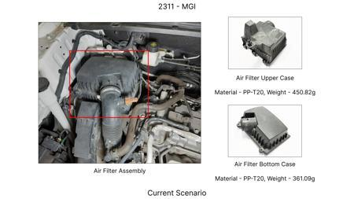
#15: Evaluate the integration of a lightweight, high-strength caliper material, such as a specific grade of aluminum alloy or a composite, for the MG Hector's braking system. The objective is to reduce unsprung mass while maintaining or improving stiffness and thermal management. This would involve exploring advanced casting or forging techniques suitable for cost-effective production within the tooling CAPEX constraints. The focus is on ensuring the material selection doesn't negatively impact the robust braking performance required for a 1.7-tonne vehicle.
WEB SOURCED
Current Scenario
TECHNICAL ENGINEERING VIEW
Technical optimization of Evaluate the integration of a lightweight, high-strength caliper material, such as a specific grade of aluminum alloy or a composite, for the MG Hector's braking system. The objective is to reduce unsprung mass while maintaining or improving stiffness and thermal management. This would involve exploring advanced casting or forging techniques suitable for cost-effective production within the tooling CAPEX constraints. The focus is on ensuring the material selection doesn't negatively impact the robust braking performance required for a 1.7-tonne vehicle. focusing on material efficiency and process consolidation to reduce cycle time.
MATERIAL & DIMENSION SWAP
VLM Generated AI Image
Evaluate the integration of a lightweight, high-strength caliper material, such as a specific grade N/A (Maintains current envelope)
FINANCIAL IMPACT
Est. Saving: INR TBD CAPEX: TBD

Slide 20
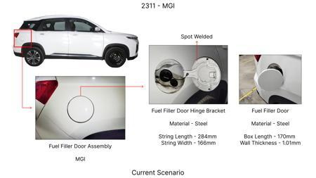
#16: Implement a redesigned, optimized dust shield gauge and material for the MG Hector's brake assemblies. The aim is to improve dust and debris protection to enhance the longevity of brake components (pads, rotors, calipers) while minimizing any negative impact on airflow for cooling. This would involve exploring thinner, yet more durable materials, and aerodynamic profiling of the shield to direct airflow effectively. This is a cost-effective approach that can be implemented with minimal tooling modifications.
WEB SOURCED
Current Scenario
TECHNICAL ENGINEERING VIEW
Technical optimization of Implement a redesigned, optimized dust shield gauge and material for the MG Hector's brake assemblies. The aim is to improve dust and debris protection to enhance the longevity of brake components (pads, rotors, calipers) while minimizing any negative impact on airflow for cooling. This would involve exploring thinner, yet more durable materials, and aerodynamic profiling of the shield to direct airflow effectively. This is a cost-effective approach that can be implemented with minimal tooling modifications. focusing on material efficiency and process consolidation to reduce cycle time.
MATERIAL & DIMENSION SWAP
Implement a redesigned, optimized dust shield gauge and material for the MG Hector's brake assemblie N/A (Maintains current envelope)
VLM Generated AI Image
FINANCIAL IMPACT
Est. Saving: INR TBD CAPEX: TBD

