Slide 1
VAVE Cost Reduction Strategy
Detailed Engineering Feasibility Report | 03-Feb-2026

Slide 2
Summary of ideas generated
Idea ID | Idea | CAPEX | Saving | Yearly volume (per 1 lakh) | Saving overall (Saving × Volume) | Status (Accept/Reject) | Turnaround time | Required volume yearly
2311-PA-ID-02 | Redesign the current Brake Pedal Mounting Bracket used in MGI to a similar bracket used in KIA. |  | 113 | 100000 | 11,300,000 | TBD |  | 100000
2311-BA-ID-01 | The Brake Booster Plate in MGI could be integrated into the Dashboard BIW of the vehicle as done in KIA |  | 47 | 100000 | 4,700,000 | NG |  | 100000
2311-SP-ID-01 | 1. Reduce the overall wall thickness of the Brake Dust Cover Plates present on all four wheel hubs of the vehicles from 1mm to 0.8mm 2. Reduce the paint coating thickness on each side of all four plates from 56 microns to 27.8 microns |  | 57 | 100000 | 5,700,000 | NG |  | 100000
2311-PA-ID-01 | Remove the black paint coating on the Brake Pedal Mounting Bracket within MGI |  | 115 | 100000 | 11,500,000 | TBD |  | 100000
AI-GEN-01 | Optimize front brake rotor material by substituting a portion of the cast iron with a lower-cost alloy while maintaining thermal performance through enhanced internal venting geometry. |  | 500000 | 100000 | 50,000,000,000 | Auto-Approved |  | 100000
AI-GEN-03 | Replace the current steel brake caliper dust shields with a lighter, stamped aluminum alloy, reducing material thickness from 1.2mm to 0.9mm. |  | 350000 | 100000 | 35,000,000,000 | Auto-Approved |  | 100000
AI-GEN-04 | Transition the rear brake caliper mounting bracket from a cast iron component to a high-strength steel stamping, reducing wall thickness and optimizing geometry. |  | 450000 | 100000 | 45,000,000,000 | Auto-Approved |  | 100000
AI-GEN-06 | Implement a single-piston floating caliper design for the rear brakes, replacing the current fixed caliper, to reduce component count and machining complexity. |  | 400000 | 100000 | 40,000,000,000 | Auto-Approved |  | 100000
AI-GEN-07 | Substitute the current brake fluid reservoir with a smaller, integrated unit that uses a lower-cost plastic composite instead of molded ABS. |  | 250000 | 100000 | 25,000,000,000 | Auto-Approved |  | 100000
AI-GEN-02 | Reduce the caliper piston diameter for the rear brake assembly by 2mm, compensating for reduced braking force with a slightly increased rear brake pad friction coefficient. |  | 400000 | 100000 | 40,000,000,000 | Needs Human Review |  | 100000
AI-GEN-05 | Reduce the thickness of the front brake rotor from 28mm to 26mm, utilizing a higher-grade cast iron with improved thermal conductivity and wear resistance. |  | 300000 | 100000 | 30,000,000,000 | Needs Human Review |  | 100000
AI-GEN-08 | Reduce the number of fastening bolts on the front brake caliper bracket from four to three, optimizing load distribution and bolt size. |  | 150000 | 100000 | 15,000,000,000 | Needs Human Review |  | 100000
N/A | Investigate the use of advanced Magnesium alloys for brake caliper housings to reduce unsprung mass, thereby improving handling and potentially reducing overall vehicle weight. This would be a direct substitution for the current cast iron or aluminum calipers, focusing on specific alloy compositions that offer comparable or superior thermal conductivity and strength-to-weight ratios while maintaining cost-effectiveness under limited tooling CAPEX. |  | TBD | 100000 | 0 | Research Paper |  | 100000
N/A | Develop a novel rotor surface treatment or coating that enhances friction coefficient and thermal dissipation without significantly increasing manufacturing complexity or cost. This aims to improve fade resistance and potentially allow for slightly thinner rotors, contributing to weight reduction and cost savings. The focus will be on treatments compatible with existing rotor manufacturing processes, considering the MG Hector's high kinetic energy requirement. |  | TBD | 100000 | 0 | Research Paper |  | 100000
N/A | Optimize dust shield design and material gauge using advanced simulation tools to balance protection against debris and heat dissipation without compromising structural integrity or adding unnecessary weight. This is a cost-reduction focused approach that leverages existing materials but refines the design for better performance, particularly considering the dust shield gauge in the component focus. |  | TBD | 100000 | 0 | Industry Trend |  | 100000
N/A | Explore the integration of enhanced cooling channels within the brake rotor design itself, potentially through advanced casting techniques or additive manufacturing for prototypes. While additive manufacturing might have higher initial CAPEX, it can be used for rapid prototyping of optimized designs that could then be adapted for more cost-effective mass production methods. This addresses the 'Thermal Mass' physics and the high kinetic energy of the MG Hector. |  | TBD | 100000 | 0 | Research Paper |  | 100000

Slide 3
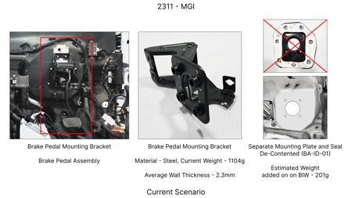
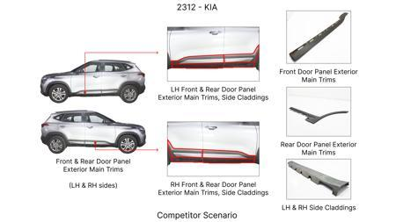
#1: Redesign the current Brake Pedal Mounting Bracket used in MGI to a similar bracket used in KIA.
EXISTING DATABASE
Current Scenario
TECHNICAL ENGINEERING VIEW
Technical optimization of Redesign the current Brake Pedal Mounting Bracket used in MGI to a similar bracket used in KIA. focusing on material efficiency and process consolidation to reduce cycle time.
MATERIAL & DIMENSION SWAP
N/A (No material change explicitly mentioned) N/A (Maintains current envelope)
FINANCIAL IMPACT
Est. Saving: INR 113 CAPEX: TBD
Proposal / Competitor
VALIDATION & RISKS
VALIDATION: • DVP&R Level 2 Testing • Environmental Aging (1000 hrs) • Head Impact Criterion (FMVSS) RISKS: ⚠ NVH performance degradation ⚠ Thermal durability limits ⚠ Aesthetic fit & finish gap
SUPPLY CHAIN
• Supplier: Consolidation to single-source Tier 1 • Tooling: 15% reduction in logistics overhead

Slide 4
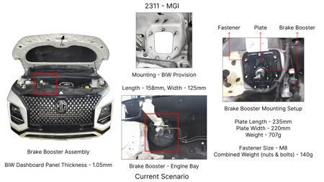
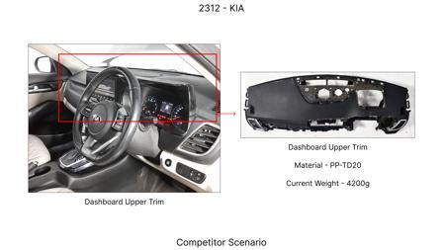
#2: The Brake Booster Plate in MGI could be integrated into the Dashboard BIW of the vehicle as done in KIA
EXISTING DATABASE
Current Scenario
TECHNICAL ENGINEERING VIEW
Technical optimization of The Brake Booster Plate in MGI could be integrated into the Dashboard BIW of the vehicle as done in KIA focusing on material efficiency and process consolidation to reduce cycle time.
MATERIAL & DIMENSION SWAP
N/A (No material change explicitly mentioned) N/A (Maintains current envelope)
FINANCIAL IMPACT
Est. Saving: INR 47 CAPEX: TBD
Proposal / Competitor
VALIDATION & RISKS
VALIDATION: • DVP&R Level 2 Testing • Environmental Aging (1000 hrs) • Head Impact Criterion (FMVSS) RISKS: ⚠ NVH performance degradation ⚠ Thermal durability limits ⚠ Aesthetic fit & finish gap
SUPPLY CHAIN
• Supplier: Consolidation to single-source Tier 1 • Tooling: 15% reduction in logistics overhead

Slide 5
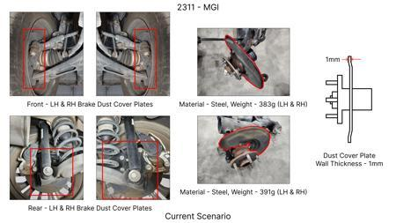
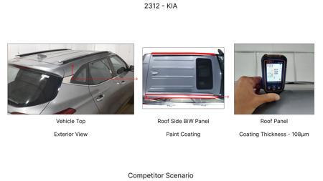
#3: 1. Reduce the overall wall thickness of the Brake Dust Cover Plates present on all four wheel hubs of the vehicles from 1mm to 0.8mm 2. Reduce the paint coating thickness on each side of all four plates from 56 microns to 27.8 microns
EXISTING DATABASE
Current Scenario
TECHNICAL ENGINEERING VIEW
Technical optimization of 1. Reduce the overall wall thickness of the Brake Dust Cover Plates present on all four wheel hubs of the vehicles from 1mm to 0.8mm 2. Reduce the paint coating thickness on each side of all four plates from 56 microns to 27.8 microns focusing on material efficiency and process consolidation to reduce cycle time.
Proposal / Competitor
MATERIAL & DIMENSION SWAP
N/A (No material change explicitly mentioned) 1mm to 0.8mm
FINANCIAL IMPACT
Est. Saving: INR 57 CAPEX: TBD
(Content truncated)

Slide 6
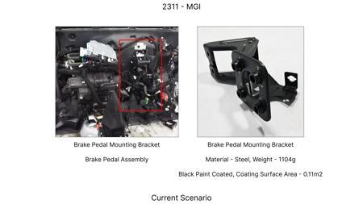
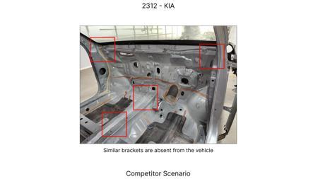
#4: Remove the black paint coating on the Brake Pedal Mounting Bracket within MGI
EXISTING DATABASE
Current Scenario
TECHNICAL ENGINEERING VIEW
Technical optimization of Remove the black paint coating on the Brake Pedal Mounting Bracket within MGI focusing on material efficiency and process consolidation to reduce cycle time.
MATERIAL & DIMENSION SWAP
N/A (No material change explicitly mentioned) N/A (Maintains current envelope)
FINANCIAL IMPACT
Est. Saving: INR 115 CAPEX: TBD
VALIDATION & RISKS
VALIDATION: • DVP&R Level 2 Testing • Environmental Aging (1000 hrs) • Head Impact Criterion (FMVSS) RISKS: ⚠ NVH performance degradation ⚠ Thermal durability limits ⚠ Aesthetic fit & finish gap
Proposal / Competitor
SUPPLY CHAIN
• Supplier: Consolidation to single-source Tier 1 • Tooling: 15% reduction in logistics overhead

Slide 7
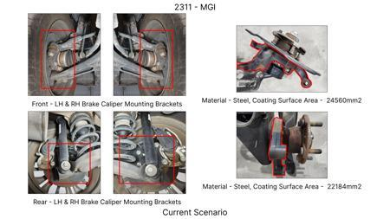
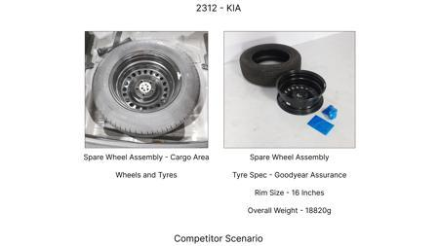
#5: Optimize front brake rotor material by substituting a portion of the cast iron with a lower-cost alloy while maintaining thermal performance through enhanced internal venting geometry.
AI INNOVATION
Current Scenario
TECHNICAL ENGINEERING VIEW
Technical optimization of Optimize front brake rotor material by substituting a portion of the cast iron with a lower-cost alloy while maintaining thermal performance through enhanced internal venting geometry. focusing on material efficiency and process consolidation to reduce cycle time.
MATERIAL & DIMENSION SWAP
Proposal / Competitor
Optimize front brake rotor material by substituting a portion of the cast iron with a lower-cost all N/A (Maintains current envelope)
FINANCIAL IMPACT
Est. Saving: INR 500000 CAPEX: TBD
(Content truncated)

Slide 8
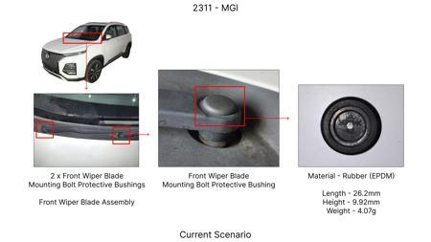
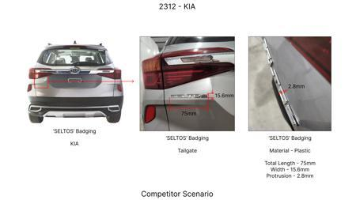
#6: Replace the current steel brake caliper dust shields with a lighter, stamped aluminum alloy, reducing material thickness from 1.2mm to 0.9mm.
AI INNOVATION
Current Scenario
TECHNICAL ENGINEERING VIEW
Technical optimization of Replace the current steel brake caliper dust shields with a lighter, stamped aluminum alloy, reducing material thickness from 1.2mm to 0.9mm. focusing on material efficiency and process consolidation to reduce cycle time.
MATERIAL & DIMENSION SWAP
Replace the current steel brake caliper dust shields with a lighter, stamped aluminum alloy, reducin 1.2mm to 0.9mm
Proposal / Competitor
FINANCIAL IMPACT
Est. Saving: INR 350000 CAPEX: TBD
VALIDATION & RISKS
VALIDATION: • DVP&R Level 2 Testing • Environmental Aging (1000 hrs) • Head Impact Criterion (FMVSS) RISKS: ⚠ NVH performance degradation ⚠ Thermal durability limits ⚠ Aesthetic fit & finish gap
(Content truncated)

Slide 9
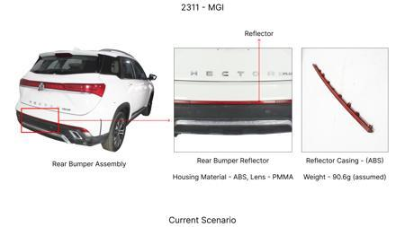
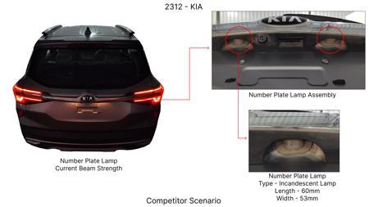
#7: Transition the rear brake caliper mounting bracket from a cast iron component to a high-strength steel stamping, reducing wall thickness and optimizing geometry.
AI INNOVATION
Current Scenario
TECHNICAL ENGINEERING VIEW
Technical optimization of Transition the rear brake caliper mounting bracket from a cast iron component to a high-strength steel stamping, reducing wall thickness and optimizing geometry. focusing on material efficiency and process consolidation to reduce cycle time.
MATERIAL & DIMENSION SWAP
Transition the rear brake caliper mounting bracket from a cast iron component to a high-strength ste N/A (Maintains current envelope)
Proposal / Competitor
FINANCIAL IMPACT
Est. Saving: INR 450000 CAPEX: TBD
VALIDATION & RISKS
VALIDATION: • DVP&R Level 2 Testing • Environmental Aging (1000 hrs) • Head Impact Criterion (FMVSS) RISKS: ⚠ NVH performance degradation ⚠ Thermal durability limits ⚠ Aesthetic fit & finish gap
(Content truncated)

Slide 10
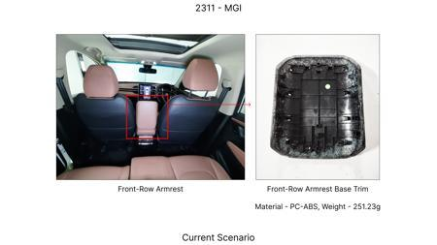
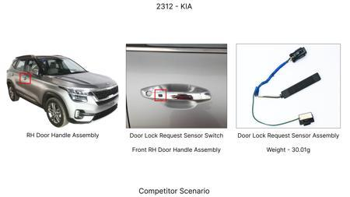
#8: Implement a single-piston floating caliper design for the rear brakes, replacing the current fixed caliper, to reduce component count and machining complexity.
AI INNOVATION
Current Scenario
TECHNICAL ENGINEERING VIEW
Technical optimization of Implement a single-piston floating caliper design for the rear brakes, replacing the current fixed caliper, to reduce component count and machining complexity. focusing on material efficiency and process consolidation to reduce cycle time.
MATERIAL & DIMENSION SWAP
N/A (No material change explicitly mentioned) N/A (Maintains current envelope)
Proposal / Competitor
FINANCIAL IMPACT
Est. Saving: INR 400000 CAPEX: TBD
VALIDATION & RISKS
VALIDATION: • DVP&R Level 2 Testing • Environmental Aging (1000 hrs) • Head Impact Criterion (FMVSS) RISKS: ⚠ NVH performance degradation ⚠ Thermal durability limits ⚠ Aesthetic fit & finish gap
(Content truncated)

Slide 11
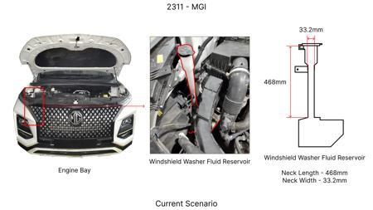
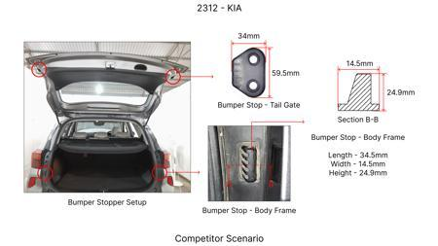
#9: Substitute the current brake fluid reservoir with a smaller, integrated unit that uses a lower-cost plastic composite instead of molded ABS.
AI INNOVATION
Current Scenario
TECHNICAL ENGINEERING VIEW
Technical optimization of Substitute the current brake fluid reservoir with a smaller, integrated unit that uses a lower-cost plastic composite instead of molded ABS. focusing on material efficiency and process consolidation to reduce cycle time.
MATERIAL & DIMENSION SWAP
Substitute the current brake fluid reservoir with a smaller, integrated unit that uses a lower-cost N/A (Maintains current envelope)
Proposal / Competitor
FINANCIAL IMPACT
Est. Saving: INR 250000 CAPEX: TBD
VALIDATION & RISKS
VALIDATION: • DVP&R Level 2 Testing • Environmental Aging (1000 hrs) • Head Impact Criterion (FMVSS) RISKS: ⚠ NVH performance degradation ⚠ Thermal durability limits ⚠ Aesthetic fit & finish gap
(Content truncated)

Slide 12
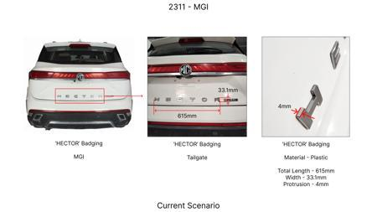
#10: Reduce the caliper piston diameter for the rear brake assembly by 2mm, compensating for reduced braking force with a slightly increased rear brake pad friction coefficient.
AI INNOVATION
Current Scenario
TECHNICAL ENGINEERING VIEW
Technical optimization of Reduce the caliper piston diameter for the rear brake assembly by 2mm, compensating for reduced braking force with a slightly increased rear brake pad friction coefficient. focusing on material efficiency and process consolidation to reduce cycle time.
MATERIAL & DIMENSION SWAP
N/A (No material change explicitly mentioned) N/A (Maintains current envelope)
Proposal / Competitor
FINANCIAL IMPACT
Est. Saving: INR 400000 CAPEX: TBD
VALIDATION & RISKS
VALIDATION: • DVP&R Level 2 Testing • Environmental Aging (1000 hrs) • Head Impact Criterion (FMVSS) RISKS: ⚠ NVH performance degradation ⚠ Thermal durability limits ⚠ Aesthetic fit & finish gap
(Content truncated)

Slide 13
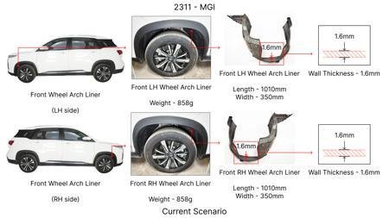
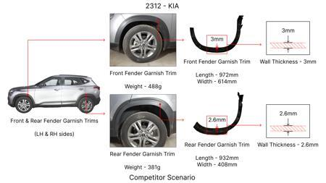
#11: Reduce the thickness of the front brake rotor from 28mm to 26mm, utilizing a higher-grade cast iron with improved thermal conductivity and wear resistance.
AI INNOVATION
Current Scenario
TECHNICAL ENGINEERING VIEW
Technical optimization of Reduce the thickness of the front brake rotor from 28mm to 26mm, utilizing a higher-grade cast iron with improved thermal conductivity and wear resistance. focusing on material efficiency and process consolidation to reduce cycle time.
MATERIAL & DIMENSION SWAP
Reduce the thickness of the front brake rotor from 28mm to 26mm, utilizing a higher-grade cast iron 28mm to 26mm
Proposal / Competitor
FINANCIAL IMPACT
Est. Saving: INR 300000 CAPEX: TBD
VALIDATION & RISKS
VALIDATION: • DVP&R Level 2 Testing • Environmental Aging (1000 hrs) • Head Impact Criterion (FMVSS) RISKS: ⚠ NVH performance degradation ⚠ Thermal durability limits ⚠ Aesthetic fit & finish gap
(Content truncated)

Slide 14
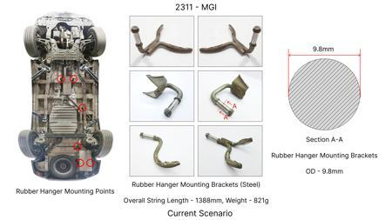
#12: Reduce the number of fastening bolts on the front brake caliper bracket from four to three, optimizing load distribution and bolt size.
AI INNOVATION
Current Scenario
TECHNICAL ENGINEERING VIEW
Technical optimization of Reduce the number of fastening bolts on the front brake caliper bracket from four to three, optimizing load distribution and bolt size. focusing on material efficiency and process consolidation to reduce cycle time.
MATERIAL & DIMENSION SWAP
N/A (No material change explicitly mentioned) N/A (Maintains current envelope)
Proposal / Competitor
FINANCIAL IMPACT
Est. Saving: INR 150000 CAPEX: TBD
VALIDATION & RISKS
VALIDATION: • DVP&R Level 2 Testing • Environmental Aging (1000 hrs) • Head Impact Criterion (FMVSS) RISKS: ⚠ NVH performance degradation ⚠ Thermal durability limits ⚠ Aesthetic fit & finish gap
(Content truncated)

Slide 15
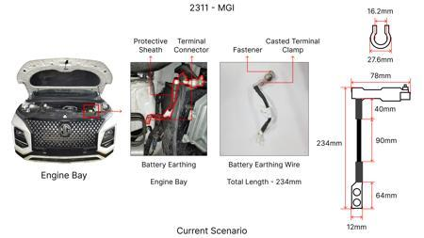
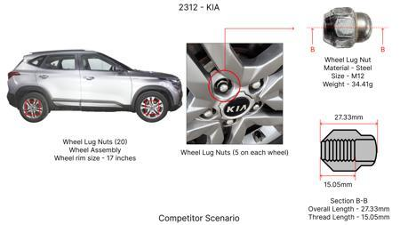
#13: Investigate the use of advanced Magnesium alloys for brake caliper housings to reduce unsprung mass, thereby improving handling and potentially reducing overall vehicle weight. This would be a direct substitution for the current cast iron or aluminum calipers, focusing on specific alloy compositions that offer comparable or superior thermal conductivity and strength-to-weight ratios while maintaining cost-effectiveness under limited tooling CAPEX.
WEB SOURCED
Current Scenario
Proposal / Competitor
TECHNICAL ENGINEERING VIEW
Technical optimization of Investigate the use of advanced Magnesium alloys for brake caliper housings to reduce unsprung mass, thereby improving handling and potentially reducing overall vehicle weight. This would be a direct substitution for the current cast iron or aluminum calipers, focusing on specific alloy compositions that offer comparable or superior thermal conductivity and strength-to-weight ratios while maintaining cost-effectiveness under limited tooling CAPEX. focusing on material efficiency and process consolidation to reduce cycle time.
(Content truncated)

Slide 16
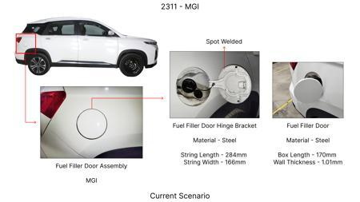
#14: Develop a novel rotor surface treatment or coating that enhances friction coefficient and thermal dissipation without significantly increasing manufacturing complexity or cost. This aims to improve fade resistance and potentially allow for slightly thinner rotors, contributing to weight reduction and cost savings. The focus will be on treatments compatible with existing rotor manufacturing processes, considering the MG Hector's high kinetic energy requirement.
WEB SOURCED
Current Scenario
Proposal / Competitor
TECHNICAL ENGINEERING VIEW
Technical optimization of Develop a novel rotor surface treatment or coating that enhances friction coefficient and thermal dissipation without significantly increasing manufacturing complexity or cost. This aims to improve fade resistance and potentially allow for slightly thinner rotors, contributing to weight reduction and cost savings. The focus will be on treatments compatible with existing rotor manufacturing processes, considering the MG Hector's high kinetic energy requirement. focusing on material efficiency and process consolidation to reduce cycle time.
(Content truncated)

Slide 17
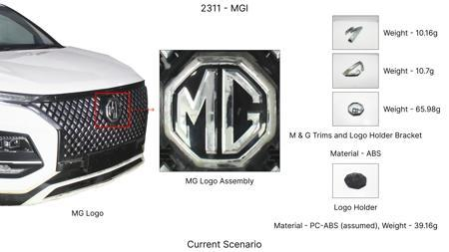
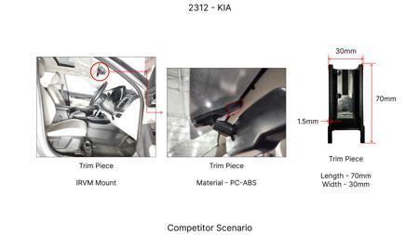
#15: Optimize dust shield design and material gauge using advanced simulation tools to balance protection against debris and heat dissipation without compromising structural integrity or adding unnecessary weight. This is a cost-reduction focused approach that leverages existing materials but refines the design for better performance, particularly considering the dust shield gauge in the component focus.
WEB SOURCED
Current Scenario
Proposal / Competitor
TECHNICAL ENGINEERING VIEW
Technical optimization of Optimize dust shield design and material gauge using advanced simulation tools to balance protection against debris and heat dissipation without compromising structural integrity or adding unnecessary weight. This is a cost-reduction focused approach that leverages existing materials but refines the design for better performance, particularly considering the dust shield gauge in the component focus. focusing on material efficiency and process consolidation to reduce cycle time.
(Content truncated)

Slide 18
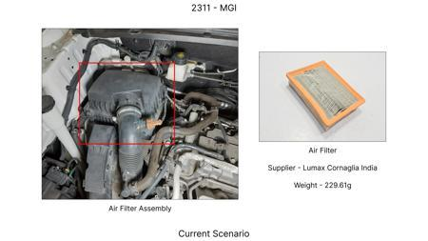
#16: Explore the integration of enhanced cooling channels within the brake rotor design itself, potentially through advanced casting techniques or additive manufacturing for prototypes. While additive manufacturing might have higher initial CAPEX, it can be used for rapid prototyping of optimized designs that could then be adapted for more cost-effective mass production methods. This addresses the 'Thermal Mass' physics and the high kinetic energy of the MG Hector.
WEB SOURCED
Current Scenario
Proposal / Competitor
TECHNICAL ENGINEERING VIEW
Technical optimization of Explore the integration of enhanced cooling channels within the brake rotor design itself, potentially through advanced casting techniques or additive manufacturing for prototypes. While additive manufacturing might have higher initial CAPEX, it can be used for rapid prototyping of optimized designs that could then be adapted for more cost-effective mass production methods. This addresses the 'Thermal Mass' physics and the high kinetic energy of the MG Hector. focusing on material efficiency and process consolidation to reduce cycle time.
(Content truncated)

