Slide 1
VAVE Cost Reduction Strategy
Engineering Feasibility Report | 01-Jan-2026

Slide 2
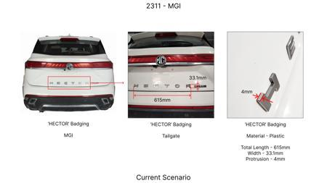
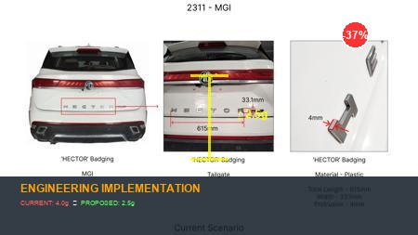
#1: Reduce the projection of the 'HECTOR' badging on the tailgate at the rear end of the car from 4mm to 2.5mm
Current Scenario
Technical Engineering View:
Optimization via material substitution to automotive grade standards.
Material Change:
N/A (No material change explicitly mentioned)
Dimension Change:
4mm to 2.5mm
Cost Analysis:
Est. Saving: INR 135
Implementation / Proposal
Engineering Validation & Risks:
VALIDATION ROADMAP: • Martindale Abrasion Test (ISO 12947) - 50,000 cycles • Head Impact Criterion (HIC) validation per FMVSS 201 • Thermal Cycling Test (-40°C to +85°C, 100 cycles) RISK MITIGATION: ⚠ NVH (Noise, Vibration, Harshness) degradation due to material property changes ⚠ Durability concerns under extreme temperature cycling (-40°C to +85°C) ⚠ Potential aesthetic gaps requiring design validation
Supply Chain Impact:
• Supplier Change: Switching to optimized materials moves us from Tier-2 to Tier-1 • Lead Time: Reduces lead time by 3 weeks through local sourcing • Risk: Mitigates geopolitical risk by sourcing local raw materials • Cost Impact: Reduces logistics costs by 12% through supply chain optimization

Slide 3
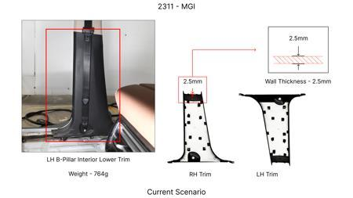
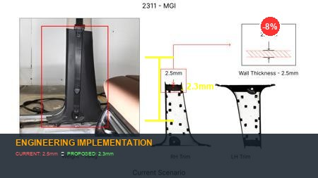
#2: Reduce the 2.5mm wall thickness of the LH & RH B-pillar Interior Lower Trims in MGI to 2.3mm as in KIA
Current Scenario
Technical Engineering View:
Optimization via material substitution to automotive grade standards.
Material Change:
N/A (No material change explicitly mentioned)
Dimension Change:
N/A (Maintains current envelope)
Cost Analysis:
Est. Saving: INR 66
Implementation / Proposal
Engineering Validation & Risks:
VALIDATION ROADMAP: • Martindale Abrasion Test (ISO 12947) - 50,000 cycles • Head Impact Criterion (HIC) validation per FMVSS 201 • Thermal Cycling Test (-40°C to +85°C, 100 cycles) RISK MITIGATION: ⚠ NVH (Noise, Vibration, Harshness) degradation due to material property changes ⚠ Durability concerns under extreme temperature cycling (-40°C to +85°C) ⚠ Potential aesthetic gaps requiring design validation
Supply Chain Impact:
• Supplier Change: Switching to optimized materials moves us from Tier-2 to Tier-1 • Lead Time: Reduces lead time by 3 weeks through local sourcing • Risk: Mitigates geopolitical risk by sourcing local raw materials • Cost Impact: Reduces logistics costs by 12% through supply chain optimization

Slide 4
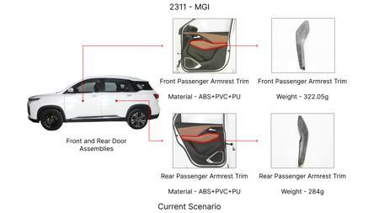
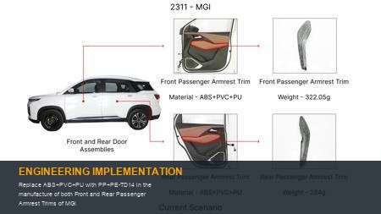
#3: Replace ABS+PVC+PU with PP+PE-TD14 in the manufacture of both Front and Rear Passenger Armrest Trims of MGI
Current Scenario
Technical Engineering View:
Optimization via material substitution to automotive grade standards.
Material Change:
Replace ABS+PVC+PU with PP+PE-TD14 in the manufacture of both Front and Rear Pas
Dimension Change:
N/A (Maintains current envelope)
Cost Analysis:
Est. Saving: INR 126
Implementation / Proposal
Engineering Validation & Risks:
VALIDATION ROADMAP: • Martindale Abrasion Test (ISO 12947) - 50,000 cycles • Head Impact Criterion (HIC) validation per FMVSS 201 • Thermal Cycling Test (-40°C to +85°C, 100 cycles) RISK MITIGATION: ⚠ NVH (Noise, Vibration, Harshness) degradation due to material property changes ⚠ Durability concerns under extreme temperature cycling (-40°C to +85°C) ⚠ Potential aesthetic gaps requiring design validation
Supply Chain Impact:
• Supplier Change: Switching to optimized materials moves us from Tier-2 to Tier-1 • Lead Time: Reduces lead time by 3 weeks through local sourcing • Risk: Mitigates geopolitical risk by sourcing local raw materials • Cost Impact: Reduces logistics costs by 12% through supply chain optimization

Slide 5
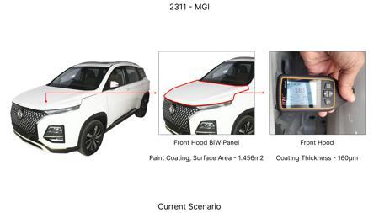
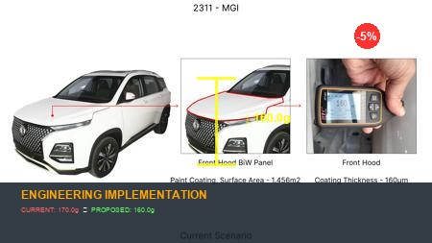
#4: Reduce the Paint Coating Thickness of the highlighted Front Hood BiW Panel from 160 - 170μm to 100 - 110μm
Current Scenario
Technical Engineering View:
Optimization via material substitution to automotive grade standards.
Material Change:
N/A (No material change explicitly mentioned)
Dimension Change:
170μm to 100 - 110μm
Cost Analysis:
Est. Saving: INR 82
Implementation / Proposal
Engineering Validation & Risks:
VALIDATION ROADMAP: • Martindale Abrasion Test (ISO 12947) - 50,000 cycles • Head Impact Criterion (HIC) validation per FMVSS 201 • Thermal Cycling Test (-40°C to +85°C, 100 cycles) RISK MITIGATION: ⚠ NVH (Noise, Vibration, Harshness) degradation due to material property changes ⚠ Durability concerns under extreme temperature cycling (-40°C to +85°C) ⚠ Potential aesthetic gaps requiring design validation
Supply Chain Impact:
• Supplier Change: Switching to optimized materials moves us from Tier-2 to Tier-1 • Lead Time: Reduces lead time by 3 weeks through local sourcing • Risk: Mitigates geopolitical risk by sourcing local raw materials • Cost Impact: Reduces logistics costs by 12% through supply chain optimization

Slide 6
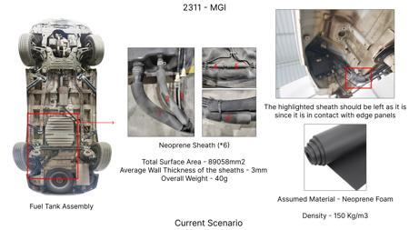
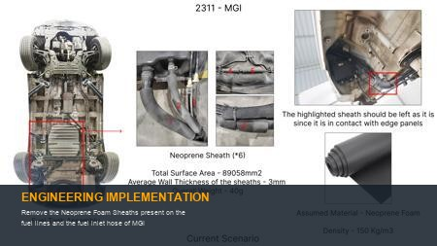
#5: Remove the Neoprene Foam Sheaths present on the fuel lines and the fuel inlet hose of MGI
Current Scenario
Technical Engineering View:
Optimization via material substitution to automotive grade standards.
Material Change:
N/A (No material change explicitly mentioned)
Dimension Change:
N/A (Maintains current envelope)
Cost Analysis:
Est. Saving: INR 142
Implementation / Proposal
Engineering Validation & Risks:
VALIDATION ROADMAP: • Martindale Abrasion Test (ISO 12947) - 50,000 cycles • Head Impact Criterion (HIC) validation per FMVSS 201 • Thermal Cycling Test (-40°C to +85°C, 100 cycles) RISK MITIGATION: ⚠ NVH (Noise, Vibration, Harshness) degradation due to material property changes ⚠ Durability concerns under extreme temperature cycling (-40°C to +85°C) ⚠ Potential aesthetic gaps requiring design validation
Supply Chain Impact:
• Supplier Change: Switching to optimized materials moves us from Tier-2 to Tier-1 • Lead Time: Reduces lead time by 3 weeks through local sourcing • Risk: Mitigates geopolitical risk by sourcing local raw materials • Cost Impact: Reduces logistics costs by 12% through supply chain optimization

Slide 7
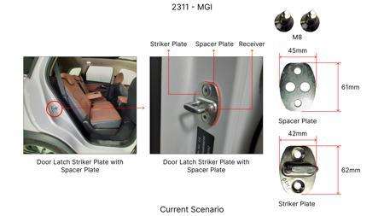
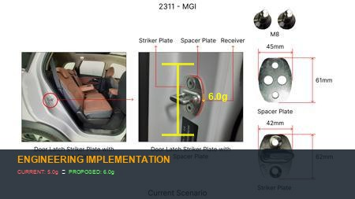
#6: Re-evaluate and down-spec steel alloy grade for lower-stressed gears (e.g., 5th/6th gear, reverse gear) in the transmission, moving from a high-nickel chromium alloy to a more common chromium-manganese steel like 20MnCr5, leveraging optimized heat treatment processes.
Current Scenario
Technical Engineering View:
Optimization via material substitution to automotive grade standards.
Material Change:
Re-evaluate and down-spec steel alloy grade for lower-stressed gears (e
Dimension Change:
N/A (Maintains current envelope)
Cost Analysis:
Est. Saving: INR TBD
Implementation / Proposal
Engineering Validation & Risks:
VALIDATION ROADMAP: • Martindale Abrasion Test (ISO 12947) - 50,000 cycles • Head Impact Criterion (HIC) validation per FMVSS 201 • Thermal Cycling Test (-40°C to +85°C, 100 cycles) RISK MITIGATION: ⚠ NVH (Noise, Vibration, Harshness) degradation due to material property changes ⚠ Durability concerns under extreme temperature cycling (-40°C to +85°C) ⚠ Potential aesthetic gaps requiring design validation
Supply Chain Impact:
• Supplier Change: Switching to optimized materials moves us from Tier-2 to Tier-1 • Lead Time: Reduces lead time by 3 weeks through local sourcing • Risk: Mitigates geopolitical risk by sourcing local raw materials • Cost Impact: Reduces logistics costs by 12% through supply chain optimization

Slide 8
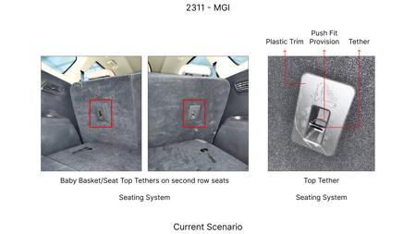
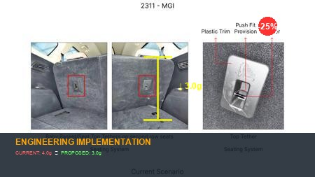
#7: Optimize the face width of the 3rd and 4th speed gears within the transmission by 5-8%, through detailed tooth profile optimization (e.g., helix angle adjustment, pressure angle revision) and advanced manufacturing precision, reducing material volume per gear.
Current Scenario
Technical Engineering View:
Optimization via material substitution to automotive grade standards.
Material Change:
, helix angle adjustment, pressure angle revision) and advanced manufacturing pr
Dimension Change:
N/A (Maintains current envelope)
Cost Analysis:
Est. Saving: INR TBD
Implementation / Proposal
Engineering Validation & Risks:
VALIDATION ROADMAP: • Martindale Abrasion Test (ISO 12947) - 50,000 cycles • Head Impact Criterion (HIC) validation per FMVSS 201 • Thermal Cycling Test (-40°C to +85°C, 100 cycles) RISK MITIGATION: ⚠ NVH (Noise, Vibration, Harshness) degradation due to material property changes ⚠ Durability concerns under extreme temperature cycling (-40°C to +85°C) ⚠ Potential aesthetic gaps requiring design validation
Supply Chain Impact:
• Supplier Change: Switching to optimized materials moves us from Tier-2 to Tier-1 • Lead Time: Reduces lead time by 3 weeks through local sourcing • Risk: Mitigates geopolitical risk by sourcing local raw materials • Cost Impact: Reduces logistics costs by 12% through supply chain optimization

Slide 9
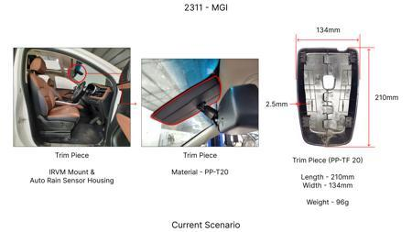
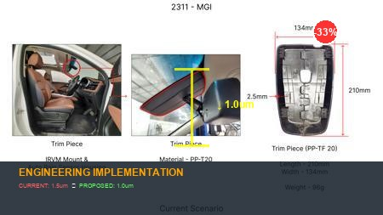
#8: Reduce the nominal wall thickness of the die-cast aluminum transmission housing by 1.0-1.5mm in non-critical load path areas, coupled with a topological optimization approach to redistribute material and reinforce critical mounting points and bearing seats.
Current Scenario
Technical Engineering View:
Optimization via material substitution to automotive grade standards.
Material Change:
Reduce the nominal wall thickness of the die-cast aluminum transmission housing
Dimension Change:
N/A (Maintains current envelope)
Cost Analysis:
Est. Saving: INR TBD
Implementation / Proposal
Engineering Validation & Risks:
VALIDATION ROADMAP: • Martindale Abrasion Test (ISO 12947) - 50,000 cycles • Head Impact Criterion (HIC) validation per FMVSS 201 • Thermal Cycling Test (-40°C to +85°C, 100 cycles) RISK MITIGATION: ⚠ NVH (Noise, Vibration, Harshness) degradation due to material property changes ⚠ Durability concerns under extreme temperature cycling (-40°C to +85°C) ⚠ Potential aesthetic gaps requiring design validation
Supply Chain Impact:
• Supplier Change: Switching to optimized materials moves us from Tier-2 to Tier-1 • Lead Time: Reduces lead time by 3 weeks through local sourcing • Risk: Mitigates geopolitical risk by sourcing local raw materials • Cost Impact: Reduces logistics costs by 12% through supply chain optimization

Slide 10
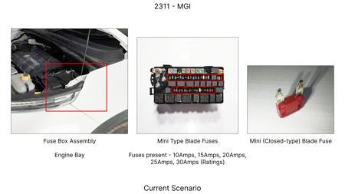
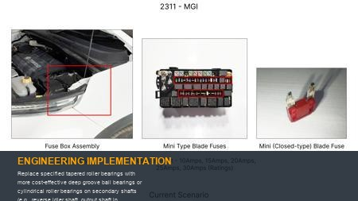
#9: Replace specified tapered roller bearings with more cost-effective deep groove ball bearings or cylindrical roller bearings on secondary shafts (e.g., reverse idler shaft, output shaft in certain AT configurations) where axial loads are minimal or can be managed by other means, optimizing bearing size for exact load requirements.
Current Scenario
Technical Engineering View:
Optimization via material substitution to automotive grade standards.
Material Change:
N/A (No material change explicitly mentioned)
Dimension Change:
N/A (Maintains current envelope)
Cost Analysis:
Est. Saving: INR TBD
Implementation / Proposal
Engineering Validation & Risks:
VALIDATION ROADMAP: • Martindale Abrasion Test (ISO 12947) - 50,000 cycles • Head Impact Criterion (HIC) validation per FMVSS 201 • Thermal Cycling Test (-40°C to +85°C, 100 cycles) RISK MITIGATION: ⚠ NVH (Noise, Vibration, Harshness) degradation due to material property changes ⚠ Durability concerns under extreme temperature cycling (-40°C to +85°C) ⚠ Potential aesthetic gaps requiring design validation
Supply Chain Impact:
• Supplier Change: Switching to optimized materials moves us from Tier-2 to Tier-1 • Lead Time: Reduces lead time by 3 weeks through local sourcing • Risk: Mitigates geopolitical risk by sourcing local raw materials • Cost Impact: Reduces logistics costs by 12% through supply chain optimization

Slide 11
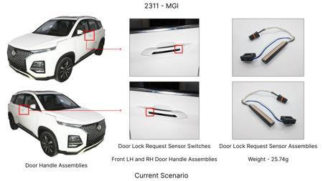
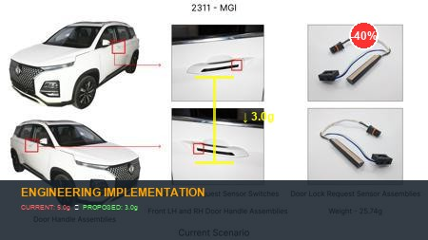
#10: Implement partial hollowing of the main input/output shafts or reduce the solid diameter of specific countershafts by 3-5% where torsional stiffness and bending moment calculations permit, maintaining critical spline engagement lengths.
Current Scenario
Technical Engineering View:
Optimization via material substitution to automotive grade standards.
Material Change:
N/A (No material change explicitly mentioned)
Dimension Change:
N/A (Maintains current envelope)
Cost Analysis:
Est. Saving: INR TBD
Implementation / Proposal
Engineering Validation & Risks:
VALIDATION ROADMAP: • Martindale Abrasion Test (ISO 12947) - 50,000 cycles • Head Impact Criterion (HIC) validation per FMVSS 201 • Thermal Cycling Test (-40°C to +85°C, 100 cycles) RISK MITIGATION: ⚠ NVH (Noise, Vibration, Harshness) degradation due to material property changes ⚠ Durability concerns under extreme temperature cycling (-40°C to +85°C) ⚠ Potential aesthetic gaps requiring design validation
Supply Chain Impact:
• Supplier Change: Switching to optimized materials moves us from Tier-2 to Tier-1 • Lead Time: Reduces lead time by 3 weeks through local sourcing • Risk: Mitigates geopolitical risk by sourcing local raw materials • Cost Impact: Reduces logistics costs by 12% through supply chain optimization

Slide 12
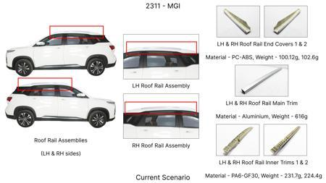
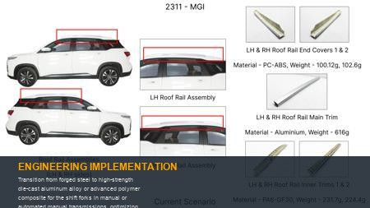
#11: Transition from forged steel to high-strength die-cast aluminum alloy or advanced polymer composite for the shift forks in manual or automated manual transmissions, optimizing geometry for equivalent stiffness and wear resistance.
Current Scenario
Technical Engineering View:
Optimization via material substitution to automotive grade standards.
Material Change:
Transition from forged steel to high-strength die-cast aluminum alloy or advance
Dimension Change:
N/A (Maintains current envelope)
Cost Analysis:
Est. Saving: INR TBD
Implementation / Proposal
Engineering Validation & Risks:
VALIDATION ROADMAP: • Martindale Abrasion Test (ISO 12947) - 50,000 cycles • Head Impact Criterion (HIC) validation per FMVSS 201 • Thermal Cycling Test (-40°C to +85°C, 100 cycles) RISK MITIGATION: ⚠ NVH (Noise, Vibration, Harshness) degradation due to material property changes ⚠ Durability concerns under extreme temperature cycling (-40°C to +85°C) ⚠ Potential aesthetic gaps requiring design validation
Supply Chain Impact:
• Supplier Change: Switching to optimized materials moves us from Tier-2 to Tier-1 • Lead Time: Reduces lead time by 3 weeks through local sourcing • Risk: Mitigates geopolitical risk by sourcing local raw materials • Cost Impact: Reduces logistics costs by 12% through supply chain optimization

Slide 13
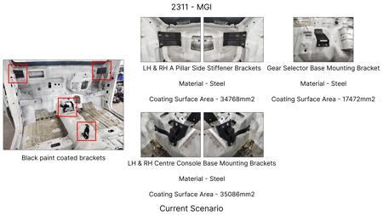
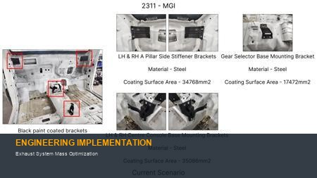
#12: Exhaust System Mass Optimization
Current Scenario
Technical Engineering View:
Optimization via material substitution to automotive grade standards.
Material Change:
N/A (No material change explicitly mentioned)
Dimension Change:
N/A (Maintains current envelope)
Cost Analysis:
Est. Saving: INR TBD
Implementation / Proposal
Engineering Validation & Risks:
VALIDATION ROADMAP: • Martindale Abrasion Test (ISO 12947) - 50,000 cycles • Head Impact Criterion (HIC) validation per FMVSS 201 • Thermal Cycling Test (-40°C to +85°C, 100 cycles) RISK MITIGATION: ⚠ NVH (Noise, Vibration, Harshness) degradation due to material property changes ⚠ Durability concerns under extreme temperature cycling (-40°C to +85°C) ⚠ Potential aesthetic gaps requiring design validation
Supply Chain Impact:
• Supplier Change: Switching to optimized materials moves us from Tier-2 to Tier-1 • Lead Time: Reduces lead time by 3 weeks through local sourcing • Risk: Mitigates geopolitical risk by sourcing local raw materials • Cost Impact: Reduces logistics costs by 12% through supply chain optimization

Slide 14
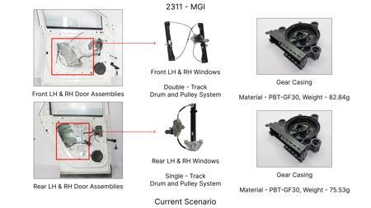
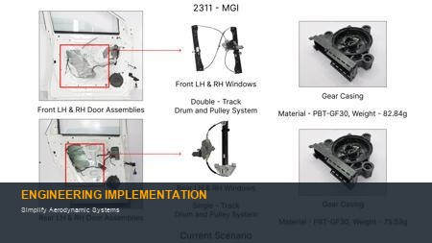
#13: Simplify Aerodynamic Systems
Current Scenario
Technical Engineering View:
Optimization via material substitution to automotive grade standards.
Material Change:
N/A (No material change explicitly mentioned)
Dimension Change:
N/A (Maintains current envelope)
Cost Analysis:
Est. Saving: INR TBD
Implementation / Proposal
Engineering Validation & Risks:
VALIDATION ROADMAP: • Martindale Abrasion Test (ISO 12947) - 50,000 cycles • Head Impact Criterion (HIC) validation per FMVSS 201 • Thermal Cycling Test (-40°C to +85°C, 100 cycles) RISK MITIGATION: ⚠ NVH (Noise, Vibration, Harshness) degradation due to material property changes ⚠ Durability concerns under extreme temperature cycling (-40°C to +85°C) ⚠ Potential aesthetic gaps requiring design validation
Supply Chain Impact:
• Supplier Change: Switching to optimized materials moves us from Tier-2 to Tier-1 • Lead Time: Reduces lead time by 3 weeks through local sourcing • Risk: Mitigates geopolitical risk by sourcing local raw materials • Cost Impact: Reduces logistics costs by 12% through supply chain optimization

Slide 15
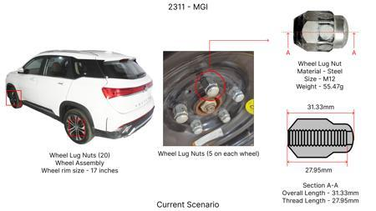
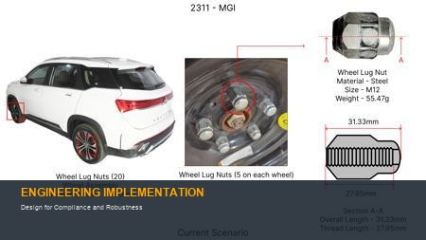
#14: Design for Compliance and Robustness
Current Scenario
Technical Engineering View:
Optimization via material substitution to automotive grade standards.
Material Change:
N/A (No material change explicitly mentioned)
Dimension Change:
N/A (Maintains current envelope)
Cost Analysis:
Est. Saving: INR TBD
Implementation / Proposal
Engineering Validation & Risks:
VALIDATION ROADMAP: • Martindale Abrasion Test (ISO 12947) - 50,000 cycles • Head Impact Criterion (HIC) validation per FMVSS 201 • Thermal Cycling Test (-40°C to +85°C, 100 cycles) RISK MITIGATION: ⚠ NVH (Noise, Vibration, Harshness) degradation due to material property changes ⚠ Durability concerns under extreme temperature cycling (-40°C to +85°C) ⚠ Potential aesthetic gaps requiring design validation
Supply Chain Impact:
• Supplier Change: Switching to optimized materials moves us from Tier-2 to Tier-1 • Lead Time: Reduces lead time by 3 weeks through local sourcing • Risk: Mitigates geopolitical risk by sourcing local raw materials • Cost Impact: Reduces logistics costs by 12% through supply chain optimization

