Slide 1
VAVE Cost Reduction Strategy
Engineering Feasibility Report | 01-Jan-2026

Slide 2
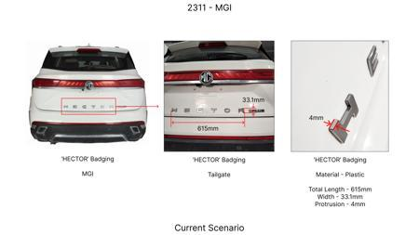
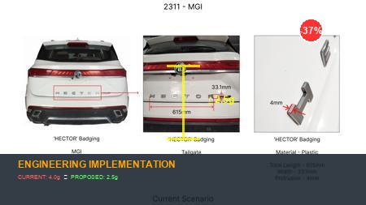
#1: Reduce the projection of the 'HECTOR' badging on the tailgate at the rear end of the car from 4mm to 2.5mm
Current Scenario
Technical Engineering View:
Optimization of Reduce the projection of the 'HECTOR' badging on the tailgate at the rear end of the car from 4mm to 2.5mm via material substitution and process efficiency.
Material Change:
N/A (No material change explicitly mentioned)
Dimension Change:
4mm to 2.5mm
Cost Analysis:
Est. Saving: INR 135
Implementation / Proposal
Engineering Validation:
DVP&R Level 1 • Environmental Cycling
Supply Chain Impact:
Assess supplier capability and lead time impact.

Slide 3
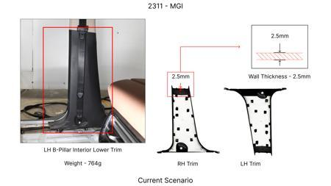
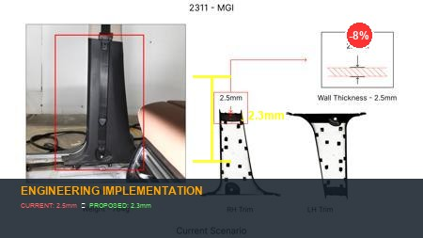
#2: Reduce the 2.5mm wall thickness of the LH & RH B-pillar Interior Lower Trims in MGI to 2.3mm as in KIA
Current Scenario
Technical Engineering View:
Optimization of Reduce the 2.5mm wall thickness of the LH & RH B-pillar Interior Lower Trims in MGI to 2.3mm as in KIA via material substitution and process efficiency.
Material Change:
N/A (No material change explicitly mentioned)
Dimension Change:
N/A (Maintains current envelope)
Cost Analysis:
Est. Saving: INR 66
Implementation / Proposal
Engineering Validation:
DVP&R Level 1 • Environmental Cycling
Supply Chain Impact:
Assess supplier capability and lead time impact.

Slide 4
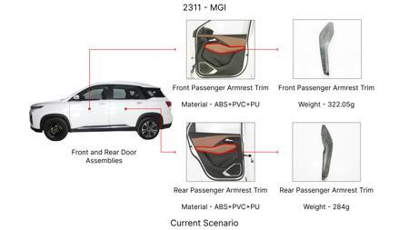
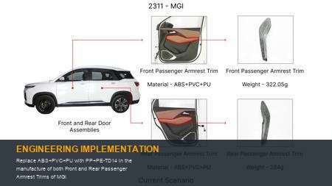
#3: Replace ABS+PVC+PU with PP+PE-TD14 in the manufacture of both Front and Rear Passenger Armrest Trims of MGI
Current Scenario
Technical Engineering View:
Optimization of Replace ABS+PVC+PU with PP+PE-TD14 in the manufacture of both Front and Rear Passenger Armrest Trims of MGI via material substitution and process efficiency.
Material Change:
Replace ABS+PVC+PU with PP+PE-TD14 in the manufacture of both Front and Rear Pas
Dimension Change:
N/A (Maintains current envelope)
Cost Analysis:
Est. Saving: INR 126
Implementation / Proposal
Engineering Validation:
DVP&R Level 1 • Environmental Cycling
Supply Chain Impact:
Assess supplier capability and lead time impact.

Slide 5
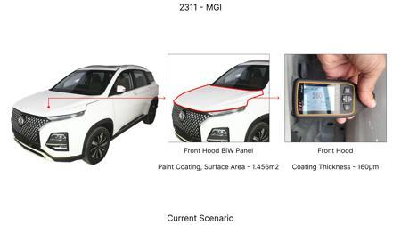
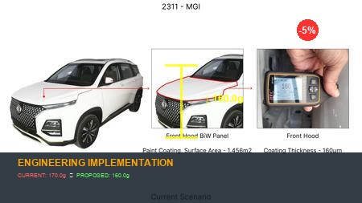
#4: Reduce the Paint Coating Thickness of the highlighted Front Hood BiW Panel from 160 - 170μm to 100 - 110μm
Current Scenario
Technical Engineering View:
Optimization of Reduce the Paint Coating Thickness of the highlighted Front Hood BiW Panel from 160 - 170μm to 100 - 110μm via material substitution and process efficiency.
Material Change:
N/A (No material change explicitly mentioned)
Dimension Change:
170μm to 100 - 110μm
Cost Analysis:
Est. Saving: INR 82
Implementation / Proposal
Engineering Validation:
DVP&R Level 1 • Environmental Cycling
Supply Chain Impact:
Assess supplier capability and lead time impact.

Slide 6
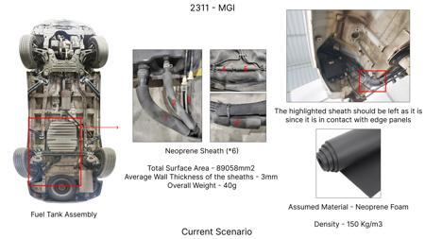
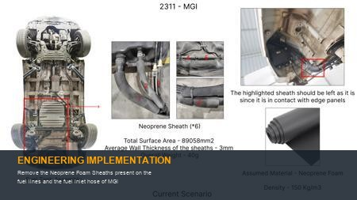
#5: Remove the Neoprene Foam Sheaths present on the fuel lines and the fuel inlet hose of MGI
Current Scenario
Technical Engineering View:
Optimization of Remove the Neoprene Foam Sheaths present on the fuel lines and the fuel inlet hose of MGI via material substitution and process efficiency.
Material Change:
N/A (No material change explicitly mentioned)
Dimension Change:
N/A (Maintains current envelope)
Cost Analysis:
Est. Saving: INR 142
Implementation / Proposal
Engineering Validation:
DVP&R Level 1 • Environmental Cycling
Supply Chain Impact:
Assess supplier capability and lead time impact.

Slide 7
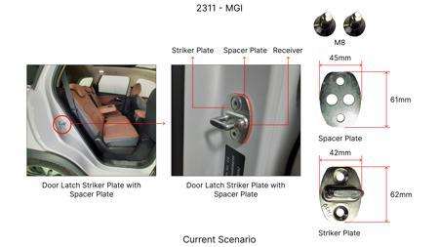
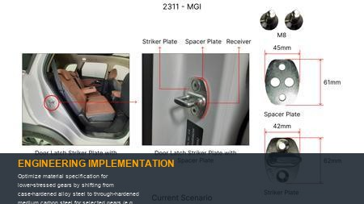
#6: Optimize material specification for lower-stressed gears by shifting from case-hardened alloy steel to through-hardened medium carbon steel for selected gears (e.g., reverse gear, first gear in a manual transmission or specific planetary elements in an automatic). This leverages the sufficient core strength of through-hardened steel for components not subjected to extreme surface contact fatigue, common in higher-stress gears.
Current Scenario
Technical Engineering View:
Optimization of Optimize material specification for lower-stressed gears by shifting from case-hardened alloy steel to through-hardened medium carbon steel for selected gears (e.g., reverse gear, first gear in a manual transmission or specific planetary elements in an automatic). This leverages the sufficient core strength of through-hardened steel for components not subjected to extreme surface contact fatigue, common in higher-stress gears. via material substitution and process efficiency.
Material Change:
Optimize material specification for lower-stressed gears by shifting from case-h
Dimension Change:
N/A (Maintains current envelope)
Cost Analysis:
Est. Saving: INR TBD
Implementation / Proposal
Engineering Validation:
DVP&R Level 1 • Environmental Cycling
Supply Chain Impact:
Assess supplier capability and lead time impact.

Slide 8
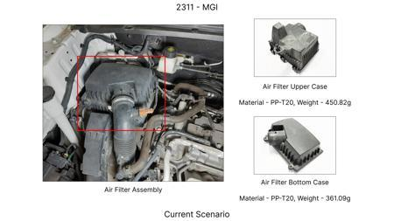
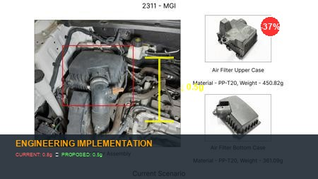
#7: Reduce the average wall thickness of the cast aluminum transmission casing by 0.5mm to 0.8mm in non-critical load-bearing areas and sections primarily designed for oil containment. This targets areas identified through topology optimization where structural rigidity is over-engineered.
Current Scenario
Technical Engineering View:
Optimization of Reduce the average wall thickness of the cast aluminum transmission casing by 0.5mm to 0.8mm in non-critical load-bearing areas and sections primarily designed for oil containment. This targets areas identified through topology optimization where structural rigidity is over-engineered. via material substitution and process efficiency.
Material Change:
Reduce the average wall thickness of the cast aluminum transmission casing by 0
Dimension Change:
0.5mm to 0.8mm
Cost Analysis:
Est. Saving: INR TBD
Implementation / Proposal
Engineering Validation:
DVP&R Level 1 • Environmental Cycling
Supply Chain Impact:
Assess supplier capability and lead time impact.

Slide 9
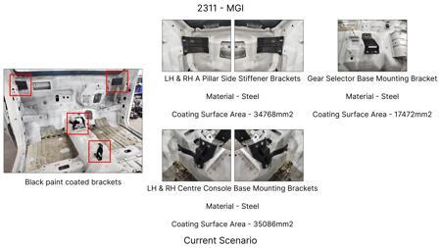
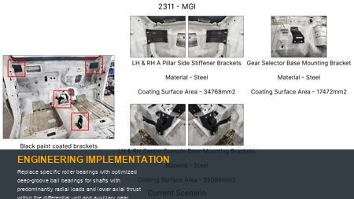
#8: Replace specific roller bearings with optimized deep-groove ball bearings for shafts with predominantly radial loads and lower axial thrust within the differential unit and auxiliary gear sets. This leverages the lower cost and simpler installation of ball bearings where their load capacity and stiffness are adequate.
Current Scenario
Technical Engineering View:
Optimization of Replace specific roller bearings with optimized deep-groove ball bearings for shafts with predominantly radial loads and lower axial thrust within the differential unit and auxiliary gear sets. This leverages the lower cost and simpler installation of ball bearings where their load capacity and stiffness are adequate. via material substitution and process efficiency.
Material Change:
N/A (No material change explicitly mentioned)
Dimension Change:
N/A (Maintains current envelope)
Cost Analysis:
Est. Saving: INR TBD
Implementation / Proposal
Engineering Validation:
DVP&R Level 1 • Environmental Cycling
Supply Chain Impact:
Assess supplier capability and lead time impact.

Slide 10
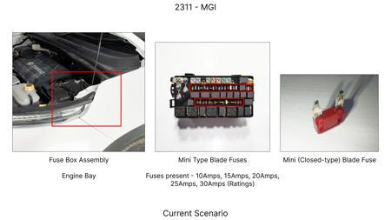
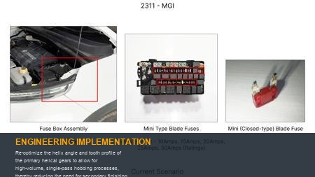
#9: Re-optimize the helix angle and tooth profile of the primary helical gears to allow for high-volume, single-pass hobbing processes, thereby reducing the need for secondary finishing operations like grinding or honing for specific gears where NVH targets permit a slight increase in tooth surface roughness.
Current Scenario
Technical Engineering View:
Optimization of Re-optimize the helix angle and tooth profile of the primary helical gears to allow for high-volume, single-pass hobbing processes, thereby reducing the need for secondary finishing operations like grinding or honing for specific gears where NVH targets permit a slight increase in tooth surface roughness. via material substitution and process efficiency.
Material Change:
N/A (No material change explicitly mentioned)
Dimension Change:
N/A (Maintains current envelope)
Cost Analysis:
Est. Saving: INR TBD
Implementation / Proposal
Engineering Validation:
DVP&R Level 1 • Environmental Cycling
Supply Chain Impact:
Assess supplier capability and lead time impact.

Slide 11
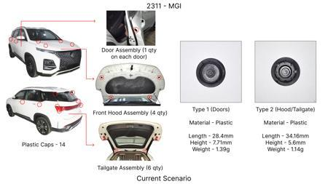
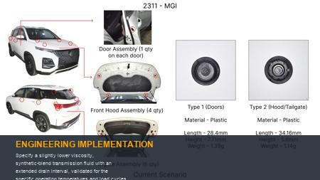
#10: Specify a slightly lower viscosity, synthetic-blend transmission fluid with an extended drain interval, validated for the specific operating temperatures and load cycles of the Hector's powertrain. This reduces both the initial fill cost and long-term service costs for the customer.
Current Scenario
Technical Engineering View:
Optimization of Specify a slightly lower viscosity, synthetic-blend transmission fluid with an extended drain interval, validated for the specific operating temperatures and load cycles of the Hector's powertrain. This reduces both the initial fill cost and long-term service costs for the customer. via material substitution and process efficiency.
Material Change:
N/A (No material change explicitly mentioned)
Dimension Change:
N/A (Maintains current envelope)
Cost Analysis:
Est. Saving: INR TBD
Implementation / Proposal
Engineering Validation:
DVP&R Level 1 • Environmental Cycling
Supply Chain Impact:
Assess supplier capability and lead time impact.

Slide 12
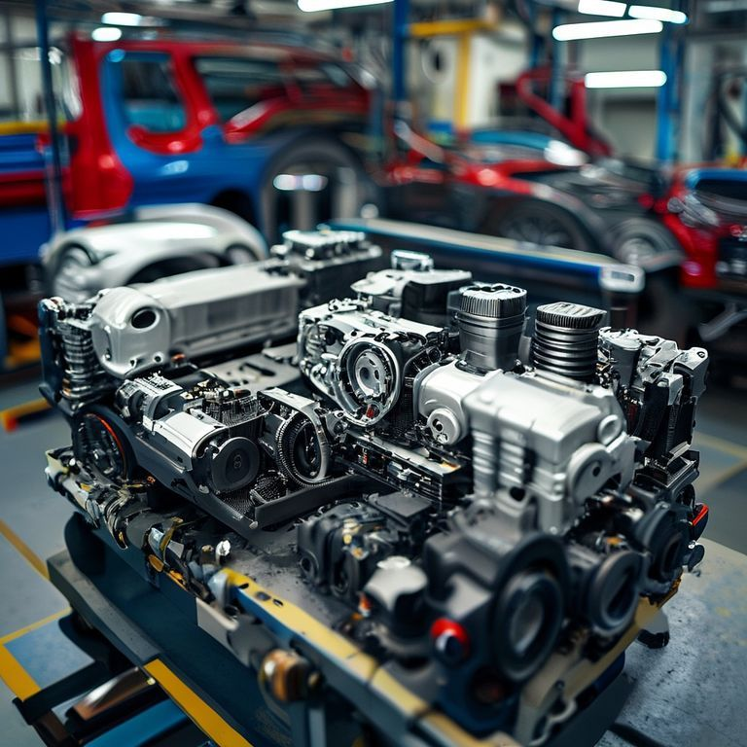
#11: Integrate the output shaft bearing carrier directly into the main transmission casing casting, eliminating a separate machined component and its associated fasteners. This reduces part count, assembly complexity, and potential leak paths.
Current Scenario
Technical Engineering View:
No Image
Optimization of Integrate the output shaft bearing carrier directly into the main transmission casing casting, eliminating a separate machined component and its associated fasteners. This reduces part count, assembly complexity, and potential leak paths. via material substitution and process efficiency.
Material Change:
N/A (No material change explicitly mentioned)
Dimension Change:
N/A (Maintains current envelope)
Cost Analysis:
Est. Saving: INR TBD
Implementation / Proposal
Engineering Validation:
DVP&R Level 1 • Environmental Cycling
Supply Chain Impact:
Assess supplier capability and lead time impact.

Slide 13
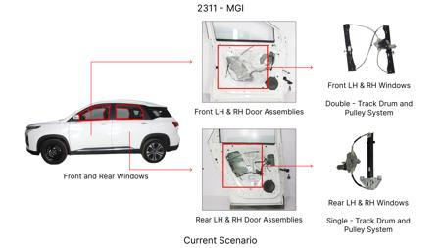
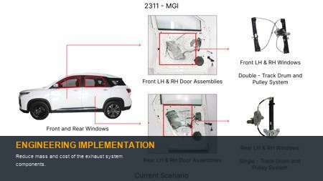
#12: Reduce mass and cost of the exhaust system components.
Current Scenario
Technical Engineering View:
Optimization of Reduce mass and cost of the exhaust system components. via material substitution and process efficiency.
Material Change:
N/A (No material change explicitly mentioned)
Dimension Change:
N/A (Maintains current envelope)
Cost Analysis:
Est. Saving: INR TBD
Implementation / Proposal
Engineering Validation:
DVP&R Level 1 • Environmental Cycling
Supply Chain Impact:
Assess supplier capability and lead time impact.

Slide 14
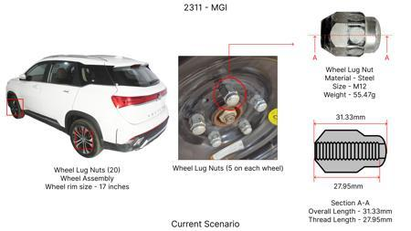
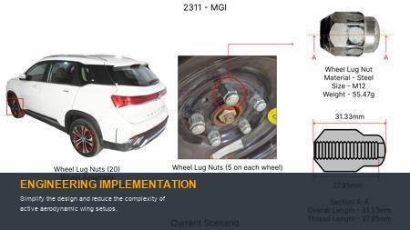
#13: Simplify the design and reduce the complexity of active aerodynamic wing setups.
Current Scenario
Technical Engineering View:
Optimization of Simplify the design and reduce the complexity of active aerodynamic wing setups. via material substitution and process efficiency.
Material Change:
N/A (No material change explicitly mentioned)
Dimension Change:
N/A (Maintains current envelope)
Cost Analysis:
Est. Saving: INR TBD
Implementation / Proposal
Engineering Validation:
DVP&R Level 1 • Environmental Cycling
Supply Chain Impact:
Assess supplier capability and lead time impact.

Slide 15
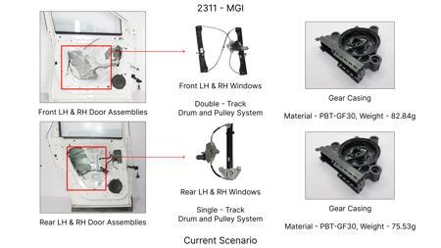
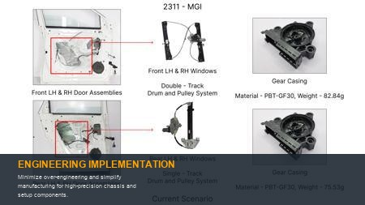
#14: Minimize over-engineering and simplify manufacturing for high-precision chassis and setup components.
Current Scenario
Technical Engineering View:
Optimization of Minimize over-engineering and simplify manufacturing for high-precision chassis and setup components. via material substitution and process efficiency.
Material Change:
N/A (No material change explicitly mentioned)
Dimension Change:
N/A (Maintains current envelope)
Cost Analysis:
Est. Saving: INR TBD
Implementation / Proposal
Engineering Validation:
DVP&R Level 1 • Environmental Cycling
Supply Chain Impact:
Assess supplier capability and lead time impact.

