Slide 1
VAVE Cost Reduction Strategy
Detailed Engineering Feasibility Report | 07-Jan-2026

Slide 2
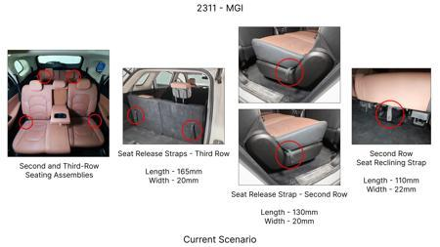
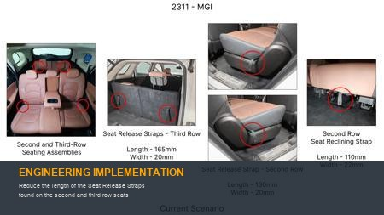
#1: Reduce the length of the Seat Release Straps found on the second and third-row seats
EXISTING DATABASE
Current Scenario
Technical Engineering View:
Technical optimization of Reduce the length of the Seat Release Straps found on the second and third-row seats focusing on material efficiency and process consolidation to reduce cycle time.
Material Change:
N/A (No material change explicitly mentioned)
Dimension Change:
N/A (Maintains current envelope)
Cost Analysis:
Implementation / Proposal
Est. Saving: INR 86
Engineering Validation & Risks:
VALIDATION ROADMAP: • DVP&R Level 2 Testing • Environmental Aging (1000 hrs) • Head Impact Criterion (FMVSS) RISK MITIGATION: ⚠ NVH performance degradation ⚠ Thermal durability limits ⚠ Aesthetic fit & finish gap
Supply Chain Impact:
• Supplier Change: Consolidation to single-source Tier 1 • Lead Time: Reduction of 2 weeks via localization • Risk: Dual tooling strategy for backup • Cost Impact: 15% reduction in logistics overhead

Slide 3
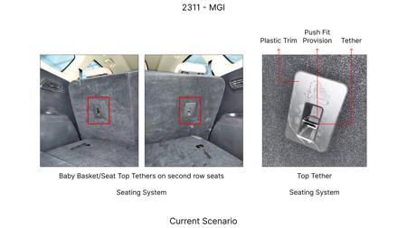
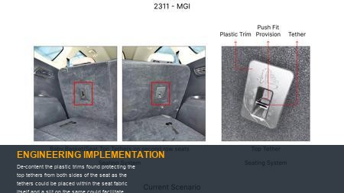
#2: De-content the plastic trims found protecting the top tethers from both sides of the seat as the tethers could be placed within the seat fabric itself and a slit on the same could facilitate easy access
EXISTING DATABASE
Current Scenario
Technical Engineering View:
Technical optimization of De-content the plastic trims found protecting the top tethers from both sides of the seat as the tethers could be placed within the seat fabric itself and a slit on the same could facilitate easy access focusing on material efficiency and process consolidation to reduce cycle time.
Material Change:
De-content the plastic trims found protecting the top tethers from both sides of the seat as the tet
Dimension Change:
N/A (Maintains current envelope)
Cost Analysis:
Implementation / Proposal
Est. Saving: INR 115
Engineering Validation & Risks:
VALIDATION ROADMAP: • DVP&R Level 2 Testing • Environmental Aging (1000 hrs) • Head Impact Criterion (FMVSS) RISK MITIGATION: ⚠ NVH performance degradation ⚠ Thermal durability limits ⚠ Aesthetic fit & finish gap
Supply Chain Impact:
• Supplier Change: Consolidation to single-source Tier 1 • Lead Time: Reduction of 2 weeks via localization • Risk: Dual tooling strategy for backup • Cost Impact: 15% reduction in logistics overhead

Slide 4
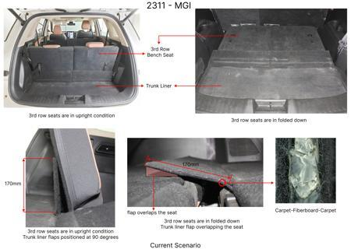
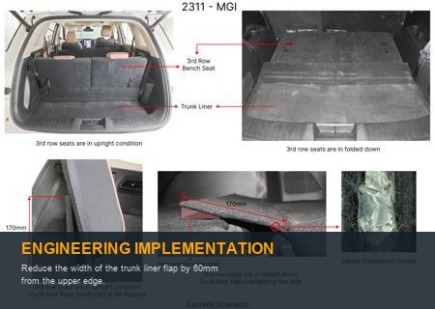
#3: Reduce the width of the trunk liner flap by 60mm from the upper edge.
EXISTING DATABASE
Current Scenario
Technical Engineering View:
Technical optimization of Reduce the width of the trunk liner flap by 60mm from the upper edge. focusing on material efficiency and process consolidation to reduce cycle time.
Material Change:
Reduce the width of the trunk liner flap by 60mm from the upper edge
Dimension Change:
N/A (Maintains current envelope)
Cost Analysis:
Implementation / Proposal
Est. Saving: INR 89
Engineering Validation & Risks:
VALIDATION ROADMAP: • DVP&R Level 2 Testing • Environmental Aging (1000 hrs) • Head Impact Criterion (FMVSS) RISK MITIGATION: ⚠ NVH performance degradation ⚠ Thermal durability limits ⚠ Aesthetic fit & finish gap
Supply Chain Impact:
• Supplier Change: Consolidation to single-source Tier 1 • Lead Time: Reduction of 2 weeks via localization • Risk: Dual tooling strategy for backup • Cost Impact: 15% reduction in logistics overhead

Slide 5
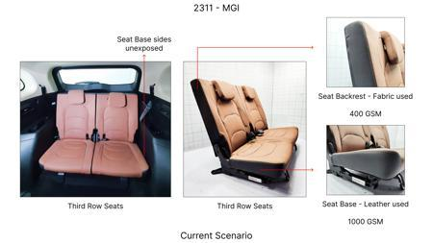
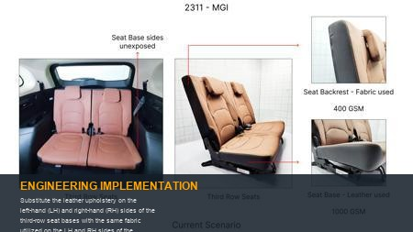
#4: Substitute the leather upholstery on the left-hand (LH) and right-hand (RH) sides of the third-row seat bases with the same fabric utilized on the LH and RH sides of the corresponding backrests
EXISTING DATABASE
Current Scenario
Technical Engineering View:
Technical optimization of Substitute the leather upholstery on the left-hand (LH) and right-hand (RH) sides of the third-row seat bases with the same fabric utilized on the LH and RH sides of the corresponding backrests focusing on material efficiency and process consolidation to reduce cycle time.
Material Change:
N/A (No material change explicitly mentioned)
Dimension Change:
N/A (Maintains current envelope)
Cost Analysis:
Implementation / Proposal
Est. Saving: INR 48
Engineering Validation & Risks:
VALIDATION ROADMAP: • DVP&R Level 2 Testing • Environmental Aging (1000 hrs) • Head Impact Criterion (FMVSS) RISK MITIGATION: ⚠ NVH performance degradation ⚠ Thermal durability limits ⚠ Aesthetic fit & finish gap
Supply Chain Impact:
• Supplier Change: Consolidation to single-source Tier 1 • Lead Time: Reduction of 2 weeks via localization • Risk: Dual tooling strategy for backup • Cost Impact: 15% reduction in logistics overhead

Slide 6
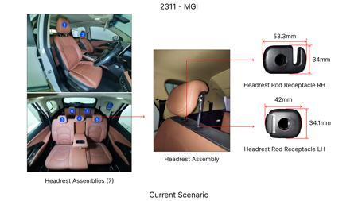
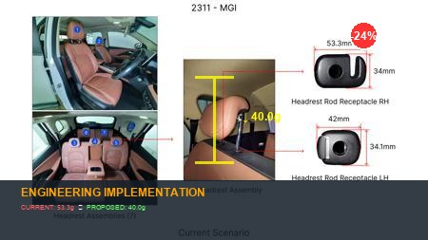
#5: Eliminate the hooks from the receptacle trims found on the RH side of the headrest assemblies reducing the overall length from 53.3mm to 40mm
EXISTING DATABASE
Current Scenario
Technical Engineering View:
Technical optimization of Eliminate the hooks from the receptacle trims found on the RH side of the headrest assemblies reducing the overall length from 53.3mm to 40mm focusing on material efficiency and process consolidation to reduce cycle time.
Material Change:
N/A (No material change explicitly mentioned)
Dimension Change:
53.3mm to 40mm
Cost Analysis:
Implementation / Proposal
Est. Saving: INR 64
Engineering Validation & Risks:
VALIDATION ROADMAP: • DVP&R Level 2 Testing • Environmental Aging (1000 hrs) • Head Impact Criterion (FMVSS) RISK MITIGATION: ⚠ NVH performance degradation ⚠ Thermal durability limits ⚠ Aesthetic fit & finish gap
Supply Chain Impact:
• Supplier Change: Consolidation to single-source Tier 1 • Lead Time: Reduction of 2 weeks via localization • Risk: Dual tooling strategy for backup • Cost Impact: 15% reduction in logistics overhead

Slide 7
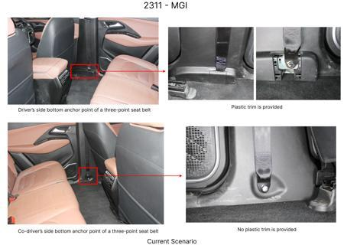
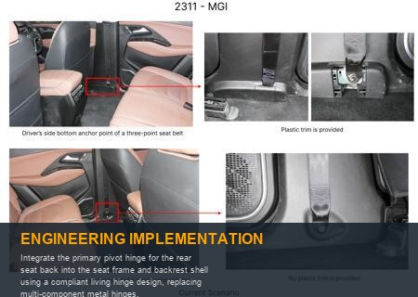
#6: Integrate the primary pivot hinge for the rear seat back into the seat frame and backrest shell using a compliant living hinge design, replacing multi-component metal hinges.
AI INNOVATION
Current Scenario
Technical Engineering View:
Technical optimization of Integrate the primary pivot hinge for the rear seat back into the seat frame and backrest shell using a compliant living hinge design, replacing multi-component metal hinges. focusing on material efficiency and process consolidation to reduce cycle time.
Material Change:
N/A (No material change explicitly mentioned)
Dimension Change:
N/A (Maintains current envelope)
Cost Analysis:
Implementation / Proposal
Est. Saving: INR TBD
Engineering Validation & Risks:
VALIDATION ROADMAP: • DVP&R Level 2 Testing • Environmental Aging (1000 hrs) • Head Impact Criterion (FMVSS) RISK MITIGATION: ⚠ NVH performance degradation ⚠ Thermal durability limits ⚠ Aesthetic fit & finish gap
Supply Chain Impact:
• Supplier Change: Consolidation to single-source Tier 1 • Lead Time: Reduction of 2 weeks via localization • Risk: Dual tooling strategy for backup • Cost Impact: 15% reduction in logistics overhead

Slide 8
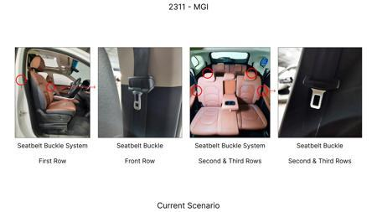
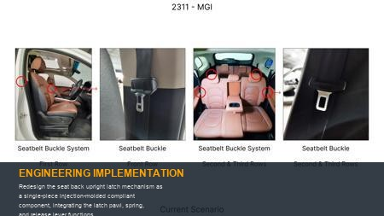
#7: Redesign the seat back upright latch mechanism as a single-piece injection-molded compliant component, integrating the latch pawl, spring, and release lever functions.
AI INNOVATION
Current Scenario
Technical Engineering View:
Technical optimization of Redesign the seat back upright latch mechanism as a single-piece injection-molded compliant component, integrating the latch pawl, spring, and release lever functions. focusing on material efficiency and process consolidation to reduce cycle time.
Material Change:
N/A (No material change explicitly mentioned)
Dimension Change:
N/A (Maintains current envelope)
Cost Analysis:
Implementation / Proposal
Est. Saving: INR TBD
Engineering Validation & Risks:
VALIDATION ROADMAP: • DVP&R Level 2 Testing • Environmental Aging (1000 hrs) • Head Impact Criterion (FMVSS) RISK MITIGATION: ⚠ NVH performance degradation ⚠ Thermal durability limits ⚠ Aesthetic fit & finish gap
Supply Chain Impact:
• Supplier Change: Consolidation to single-source Tier 1 • Lead Time: Reduction of 2 weeks via localization • Risk: Dual tooling strategy for backup • Cost Impact: 15% reduction in logistics overhead

Slide 9
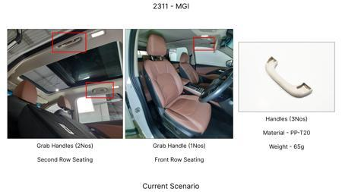
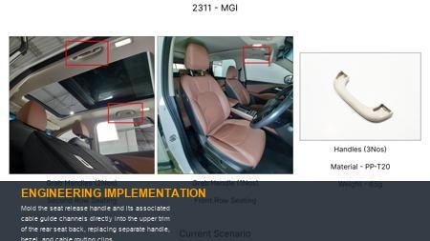
#8: Mold the seat release handle and its associated cable guide channels directly into the upper trim of the rear seat back, replacing separate handle, bezel, and cable routing clips.
AI INNOVATION
Current Scenario
Technical Engineering View:
Technical optimization of Mold the seat release handle and its associated cable guide channels directly into the upper trim of the rear seat back, replacing separate handle, bezel, and cable routing clips. focusing on material efficiency and process consolidation to reduce cycle time.
Material Change:
Mold the seat release handle and its associated cable guide channels directly into the upper trim of
Dimension Change:
N/A (Maintains current envelope)
Cost Analysis:
Implementation / Proposal
Est. Saving: INR TBD
Engineering Validation & Risks:
VALIDATION ROADMAP: • DVP&R Level 2 Testing • Environmental Aging (1000 hrs) • Head Impact Criterion (FMVSS) RISK MITIGATION: ⚠ NVH performance degradation ⚠ Thermal durability limits ⚠ Aesthetic fit & finish gap
Supply Chain Impact:
• Supplier Change: Consolidation to single-source Tier 1 • Lead Time: Reduction of 2 weeks via localization • Risk: Dual tooling strategy for backup • Cost Impact: 15% reduction in logistics overhead

Slide 10
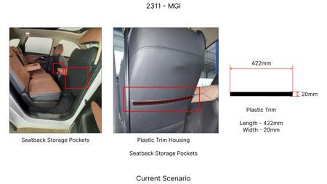
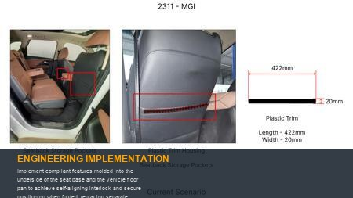
#9: Implement compliant features molded into the underside of the seat base and the vehicle floor pan to achieve self-aligning interlock and secure positioning when folded, replacing separate locator pins, brackets, and latches.
AI INNOVATION
Current Scenario
Technical Engineering View:
Technical optimization of Implement compliant features molded into the underside of the seat base and the vehicle floor pan to achieve self-aligning interlock and secure positioning when folded, replacing separate locator pins, brackets, and latches. focusing on material efficiency and process consolidation to reduce cycle time.
Material Change:
N/A (No material change explicitly mentioned)
Dimension Change:
N/A (Maintains current envelope)
Cost Analysis:
Implementation / Proposal
Est. Saving: INR TBD
Engineering Validation & Risks:
VALIDATION ROADMAP: • DVP&R Level 2 Testing • Environmental Aging (1000 hrs) • Head Impact Criterion (FMVSS) RISK MITIGATION: ⚠ NVH performance degradation ⚠ Thermal durability limits ⚠ Aesthetic fit & finish gap
Supply Chain Impact:
• Supplier Change: Consolidation to single-source Tier 1 • Lead Time: Reduction of 2 weeks via localization • Risk: Dual tooling strategy for backup • Cost Impact: 15% reduction in logistics overhead

Slide 11
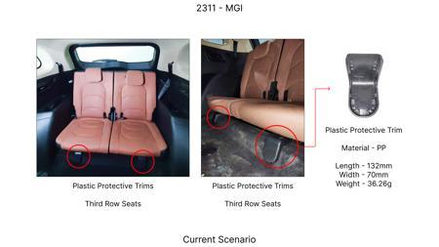
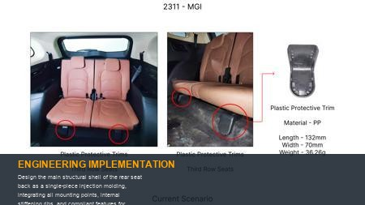
#10: Design the main structural shell of the rear seat back as a single-piece injection molding, integrating all mounting points, internal stiffening ribs, and compliant features for upholstery attachment, replacing multiple metal stampings and brackets.
AI INNOVATION
Current Scenario
Technical Engineering View:
Technical optimization of Design the main structural shell of the rear seat back as a single-piece injection molding, integrating all mounting points, internal stiffening ribs, and compliant features for upholstery attachment, replacing multiple metal stampings and brackets. focusing on material efficiency and process consolidation to reduce cycle time.
Material Change:
N/A (No material change explicitly mentioned)
Dimension Change:
N/A (Maintains current envelope)
Cost Analysis:
Implementation / Proposal
Est. Saving: INR TBD
Engineering Validation & Risks:
VALIDATION ROADMAP: • DVP&R Level 2 Testing • Environmental Aging (1000 hrs) • Head Impact Criterion (FMVSS) RISK MITIGATION: ⚠ NVH performance degradation ⚠ Thermal durability limits ⚠ Aesthetic fit & finish gap
Supply Chain Impact:
• Supplier Change: Consolidation to single-source Tier 1 • Lead Time: Reduction of 2 weeks via localization • Risk: Dual tooling strategy for backup • Cost Impact: 15% reduction in logistics overhead

Slide 12
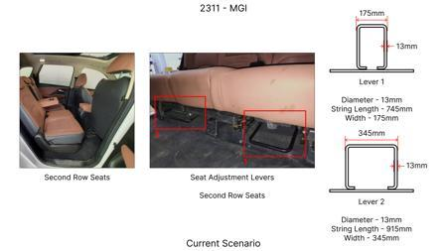
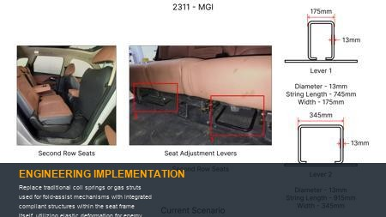
#11: Replace traditional coil springs or gas struts used for fold-assist mechanisms with integrated compliant structures within the seat frame itself, utilizing elastic deformation for energy storage and release.
AI INNOVATION
Current Scenario
Technical Engineering View:
Technical optimization of Replace traditional coil springs or gas struts used for fold-assist mechanisms with integrated compliant structures within the seat frame itself, utilizing elastic deformation for energy storage and release. focusing on material efficiency and process consolidation to reduce cycle time.
Material Change:
N/A (No material change explicitly mentioned)
Dimension Change:
N/A (Maintains current envelope)
Cost Analysis:
Implementation / Proposal
Est. Saving: INR TBD
Engineering Validation & Risks:
VALIDATION ROADMAP: • DVP&R Level 2 Testing • Environmental Aging (1000 hrs) • Head Impact Criterion (FMVSS) RISK MITIGATION: ⚠ NVH performance degradation ⚠ Thermal durability limits ⚠ Aesthetic fit & finish gap
Supply Chain Impact:
• Supplier Change: Consolidation to single-source Tier 1 • Lead Time: Reduction of 2 weeks via localization • Risk: Dual tooling strategy for backup • Cost Impact: 15% reduction in logistics overhead

Slide 13
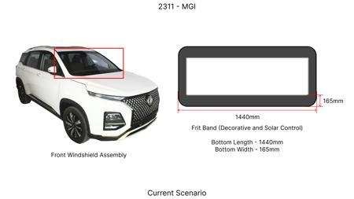
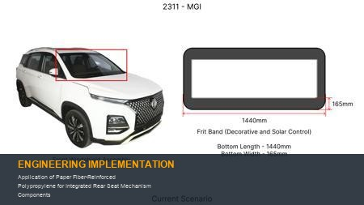
#12: Application of Paper Fiber-Reinforced Polypropylene for Integrated Rear Seat Mechanism Components
WEB SOURCED
Current Scenario
Technical Engineering View:
Technical optimization of Application of Paper Fiber-Reinforced Polypropylene for Integrated Rear Seat Mechanism Components focusing on material efficiency and process consolidation to reduce cycle time.
Material Change:
Application of Paper Fiber-Reinforced Polypropylene for Integrated Rear Seat Mechanism Components
Dimension Change:
N/A (Maintains current envelope)
Cost Analysis:
Implementation / Proposal
Est. Saving: INR TBD
Engineering Validation & Risks:
VALIDATION ROADMAP: • DVP&R Level 2 Testing • Environmental Aging (1000 hrs) • Head Impact Criterion (FMVSS) RISK MITIGATION: ⚠ NVH performance degradation ⚠ Thermal durability limits ⚠ Aesthetic fit & finish gap
Supply Chain Impact:
• Supplier Change: Consolidation to single-source Tier 1 • Lead Time: Reduction of 2 weeks via localization • Risk: Dual tooling strategy for backup • Cost Impact: 15% reduction in logistics overhead

Slide 14
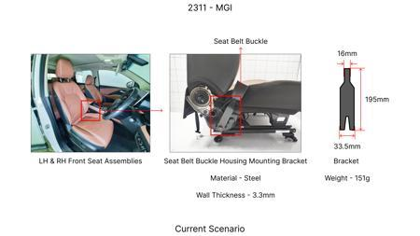
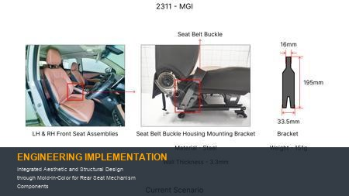
#13: Integrated Aesthetic and Structural Design through Mold-In-Color for Rear Seat Mechanism Components
WEB SOURCED
Current Scenario
Technical Engineering View:
Technical optimization of Integrated Aesthetic and Structural Design through Mold-In-Color for Rear Seat Mechanism Components focusing on material efficiency and process consolidation to reduce cycle time.
Material Change:
N/A (No material change explicitly mentioned)
Dimension Change:
N/A (Maintains current envelope)
Cost Analysis:
Implementation / Proposal
Est. Saving: INR TBD
Engineering Validation & Risks:
VALIDATION ROADMAP: • DVP&R Level 2 Testing • Environmental Aging (1000 hrs) • Head Impact Criterion (FMVSS) RISK MITIGATION: ⚠ NVH performance degradation ⚠ Thermal durability limits ⚠ Aesthetic fit & finish gap
Supply Chain Impact:
• Supplier Change: Consolidation to single-source Tier 1 • Lead Time: Reduction of 2 weeks via localization • Risk: Dual tooling strategy for backup • Cost Impact: 15% reduction in logistics overhead

