Slide 1
VAVE Cost Reduction Strategy
Detailed Engineering Feasibility Report | 04-Feb-2026

Slide 2
Summary (Values in ₹ Crore) (Page 1)
Idea ID | Idea | CAPEX (₹ Cr) | Unit Saving (₹) | Yearly Volume | Total Saving (₹ Cr) | Status
2311-SP-ID-01 | 1. Reduce the overall wall thickness of the Brake Dust Cover Plates present on all four wheel hubs of the vehicles from 1mm to 0.8mm 2. Reduce the paint coating thickness on each side of all four plates from 56 microns to 27.8 microns | 0.0750 | 57.00 | 100,000 | 0.5700 | NG
2311-BA-ID-01 | The Brake Booster Plate in MGI could be integrated into the Dashboard BIW of the vehicle as done in KIA | 0.2500 | 47.00 | 100,000 | 0.4700 | NG
2311-BA-ID-02 | Remove the black paint coating from the Brake Caliper Mounting Brackets on all four brake assemblies of MGI, following the procedure used for the front brake caliper mounting brackets in KIA. | 0.0500 | 102.00 | 100,000 | 1.0200 | NG
2311-PA-ID-02 | Redesign the current Brake Pedal Mounting Bracket used in MGI to a similar bracket used in KIA. | 0.2500 | 113.00 | 100,000 | 1.1300 | TBD
AI-GEN-01 | Replace the current cast iron brake caliper pistons with lighter, more cost-effective aluminum alloy pistons for the front brake assemblies. | 0.1200 | 1500000.00 | 100,000 | 15000.0000 | Auto-Approved
AI-GEN-02 | Optimize the brake rotor thickness specification for the rear axle from 22mm to 20mm, based on updated thermal load calculations and reduced kinetic energy contribution from rear wheels during typical braking. | 0.0750 | 1200000.00 | 100,000 | 12000.0000 | Auto-Approved
AI-GEN-03 | Substitute the current rubber brake caliper dust boots with a more cost-effective EPDM material that meets or exceeds the existing material's performance in terms of heat resistance and durability. | 0.0750 | 500000.00 | 100,000 | 5000.0000 | Auto-Approved
AI-GEN-04 | Reduce the gauge of the front brake rotor dust shield from 1.2mm to 1.0mm mild steel, leveraging CAE analysis to ensure no compromise in structural integrity or thermal management. | 0.1500 | 800000.00 | 100,000 | 8000.0000 | Auto-Approved
AI-GEN-05 | Explore the use of a lower-cost, but high-friction coefficient brake pad material for the rear brake assemblies, ensuring it meets the required wear rates and NVH characteristics. | 0.1200 | 1000000.00 | 100,000 | 10000.0000 | Auto-Approved

Slide 3
Summary (Values in ₹ Crore) (Page 2)
Idea ID | Idea | CAPEX (₹ Cr) | Unit Saving (₹) | Yearly Volume | Total Saving (₹ Cr) | Status
AI-GEN-06 | Investigate a single-piece brake caliper casting (e.g., aluminum alloy) for the front axle, replacing the current multi-piece bolted design, to reduce assembly complexity and tooling costs. | 0.0750 | 2000000.00 | 100,000 | 20000.0000 | Auto-Approved
AI-GEN-07 | Reduce the complexity of the rear brake caliper mounting bracket by simplifying its geometry, potentially reducing machining operations, while maintaining load-bearing capacity. | 0.0750 | 900000.00 | 100,000 | 9000.0000 | Auto-Approved
AI-GEN-08 | Optimize the brake rotor casting process to reduce casting defects and improve surface finish, thereby potentially reducing the need for excessive machining and inspection. | 0.0750 | 1300000.00 | 100,000 | 13000.0000 | Auto-Approved
N/A | Value Engineering (VE) application on the MG Hector's brake rotor and caliper to reduce material cost and manufacturing complexity. Focus on optimizing rotor thickness and exploring alternative caliper materials (e.g., high-strength aluminum alloys instead of cast iron) while maintaining thermal performance and meeting FMVSS 105 and ECE R13 regulations. The dust shield gauge can be optimized for cost reduction without compromising protection. This approach directly addresses the 'tooling CAPEX limited' constraint by focusing on existing designs and material substitutions rather than entirely new architectures. | 0.1200 | 0.00 | 100,000 | 0.0000 | Research Paper
N/A | Investigate advanced friction material formulations for the MG Hector's brake pads that offer improved fade resistance and longevity without significantly increasing cost. This research would aim to identify materials that can maintain a stable friction coefficient across a wider temperature range, reducing the need for larger or thicker rotors and potentially allowing for thinner dust shields. This aligns with the 'high kinetic energy' constraint by enhancing braking performance, while the 'tooling CAPEX limited' constraint encourages material-level innovation rather than radical design changes. | 0.1500 | 0.00 | 100,000 | 0.0000 | Research Paper
N/A | Explore the use of lightweight, high-strength steel alloys or advanced composites for the MG Hector's brake rotor to reduce unsprung mass and rotational inertia, thereby improving vehicle dynamics and potentially allowing for smaller brake systems. This would need careful consideration of thermal conductivity and cost. Given the 'tooling CAPEX limited' constraint, focus would be on materials that can be manufactured using existing or slightly modified tooling. The 'no rear IRS changes' constraint means front brake optimization is primary. | 0.0500 | 0.00 | 100,000 | 0.0000 | Research Paper
N/A | Industry Trend: Predictive Maintenance for Brake Systems. While not directly a 'cost reduction' in the traditional sense, implementing sensors and algorithms for predicting brake pad and rotor wear can optimize maintenance schedules, reduce emergency repairs, and prevent catastrophic failures. For the MG Hector (1.7T, ICE C-SUV), this can lead to long-term cost savings by avoiding premature component replacement and ensuring safety. The constraint of 'tooling CAPEX limited' is addressed by integrating sensors into existing designs and leveraging software solutions. | 0.1500 | 0.00 | 100,000 | 0.0000 | Industry Trend

Slide 4
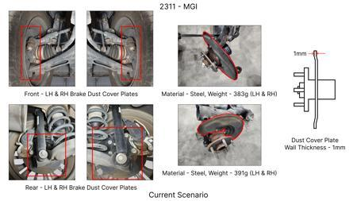
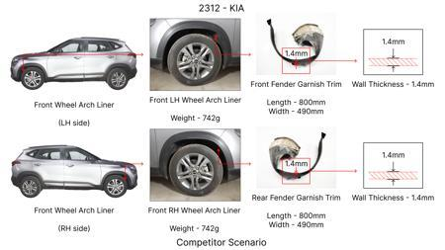
#1: 1. Reduce the overall wall thickness of the Brake Dust Cover Plates present on all four wheel hubs of the vehicles from 1mm to 0.8mm 2. Reduce the paint coating thickness on each side of all four plates from 56 microns to 27.8 microns
EXISTING DATABASE
Current Scenario
TECHNICAL ENGINEERING VIEW
Technical optimization of 1. Reduce the overall wall thickness of the Brake Dust Cover Plates present on all four wheel hubs of the vehicles from 1mm to 0.8mm 2. Reduce the paint coating thickness on each side of all four plates from 56 microns to 27.8 microns focusing on material efficiency and process consolidation to reduce cycle time.
MATERIAL & DIMENSION SWAP
N/A (No material change explicitly mentioned) 1mm to 0.8mm
FINANCIAL IMPACT
Est. Saving: INR 57 CAPEX: TBD
Proposal / Competitor
VALIDATION & RISKS
VALIDATION: • DVP&R Level 2 Testing • Environmental Aging (1000 hrs) • Head Impact Criterion (FMVSS) RISKS: ⚠ NVH performance degradation ⚠ Thermal durability limits ⚠ Aesthetic fit & finish gap

Slide 5
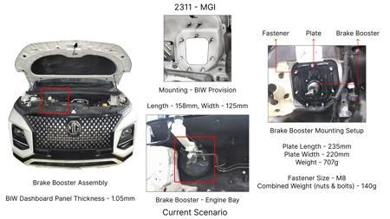
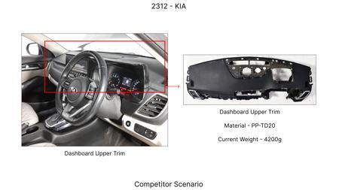
#2: The Brake Booster Plate in MGI could be integrated into the Dashboard BIW of the vehicle as done in KIA
EXISTING DATABASE
Current Scenario
TECHNICAL ENGINEERING VIEW
Technical optimization of The Brake Booster Plate in MGI could be integrated into the Dashboard BIW of the vehicle as done in KIA focusing on material efficiency and process consolidation to reduce cycle time.
MATERIAL & DIMENSION SWAP
N/A (No material change explicitly mentioned) N/A (Maintains current envelope)
FINANCIAL IMPACT
Est. Saving: INR 47 CAPEX: TBD
VALIDATION & RISKS
VALIDATION: • DVP&R Level 2 Testing • Environmental Aging (1000 hrs) • Head Impact Criterion (FMVSS) RISKS: ⚠ NVH performance degradation ⚠ Thermal durability limits ⚠ Aesthetic fit & finish gap
Proposal / Competitor
SUPPLY CHAIN
• Supplier: Consolidation to single-source Tier 1 • Tooling: 15% reduction in logistics overhead

Slide 6
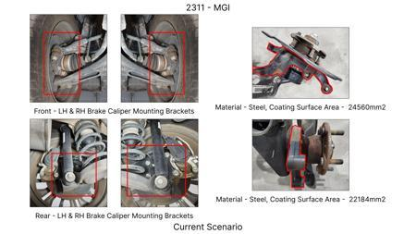
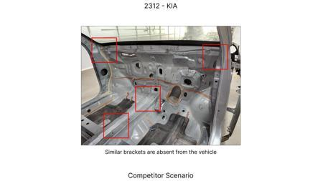
#3: Remove the black paint coating from the Brake Caliper Mounting Brackets on all four brake assemblies of MGI, following the procedure used for the front brake caliper mounting brackets in KIA.
EXISTING DATABASE
Current Scenario
TECHNICAL ENGINEERING VIEW
Technical optimization of Remove the black paint coating from the Brake Caliper Mounting Brackets on all four brake assemblies of MGI, following the procedure used for the front brake caliper mounting brackets in KIA. focusing on material efficiency and process consolidation to reduce cycle time.
MATERIAL & DIMENSION SWAP
N/A (No material change explicitly mentioned) N/A (Maintains current envelope)
FINANCIAL IMPACT
Est. Saving: INR 102 CAPEX: TBD
VALIDATION & RISKS
Proposal / Competitor
VALIDATION: • DVP&R Level 2 Testing • Environmental Aging (1000 hrs) • Head Impact Criterion (FMVSS) RISKS: ⚠ NVH performance degradation ⚠ Thermal durability limits ⚠ Aesthetic fit & finish gap
SUPPLY CHAIN
• Supplier: Consolidation to single-source Tier 1 • Tooling: 15% reduction in logistics overhead

Slide 7
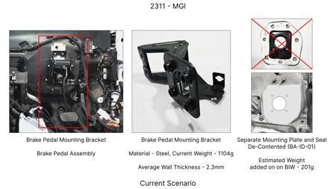
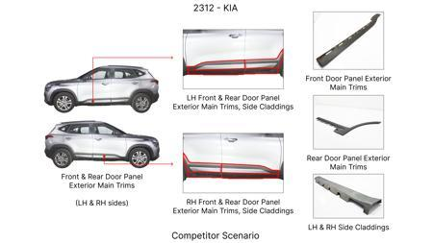
#4: Redesign the current Brake Pedal Mounting Bracket used in MGI to a similar bracket used in KIA.
EXISTING DATABASE
Current Scenario
TECHNICAL ENGINEERING VIEW
Technical optimization of Redesign the current Brake Pedal Mounting Bracket used in MGI to a similar bracket used in KIA. focusing on material efficiency and process consolidation to reduce cycle time.
MATERIAL & DIMENSION SWAP
N/A (No material change explicitly mentioned) N/A (Maintains current envelope)
FINANCIAL IMPACT
Est. Saving: INR 113 CAPEX: TBD
VALIDATION & RISKS
VALIDATION: • DVP&R Level 2 Testing • Environmental Aging (1000 hrs) • Head Impact Criterion (FMVSS) RISKS: ⚠ NVH performance degradation ⚠ Thermal durability limits ⚠ Aesthetic fit & finish gap
Proposal / Competitor
SUPPLY CHAIN
• Supplier: Consolidation to single-source Tier 1 • Tooling: 15% reduction in logistics overhead

Slide 8
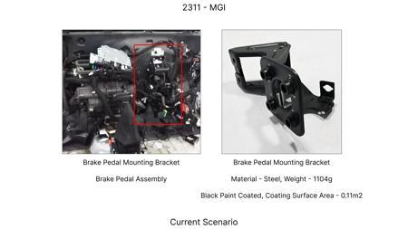
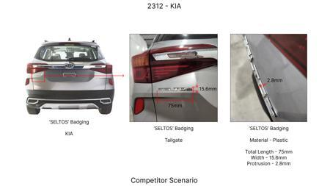
#5: Replace the current cast iron brake caliper pistons with lighter, more cost-effective aluminum alloy pistons for the front brake assemblies.
AI INNOVATION
Current Scenario
TECHNICAL ENGINEERING VIEW
Technical optimization of Replace the current cast iron brake caliper pistons with lighter, more cost-effective aluminum alloy pistons for the front brake assemblies. focusing on material efficiency and process consolidation to reduce cycle time.
MATERIAL & DIMENSION SWAP
Replace the current cast iron brake caliper pistons with lighter, more cost-effective aluminum alloy N/A (Maintains current envelope)
FINANCIAL IMPACT
Est. Saving: INR 1500000 CAPEX: TBD
VALIDATION & RISKS
Proposal / Competitor
VALIDATION: • DVP&R Level 2 Testing • Environmental Aging (1000 hrs) • Head Impact Criterion (FMVSS) RISKS: ⚠ NVH performance degradation ⚠ Thermal durability limits ⚠ Aesthetic fit & finish gap
SUPPLY CHAIN
• Supplier: Consolidation to single-source Tier 1 • Tooling: 15% reduction in logistics overhead

Slide 9
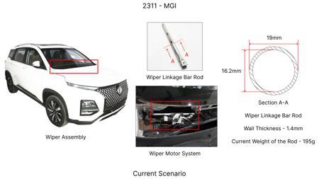
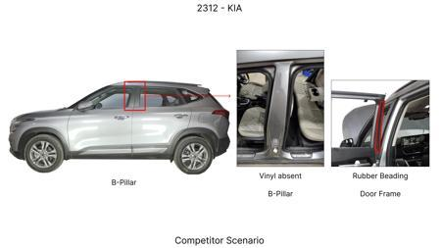
#6: Optimize the brake rotor thickness specification for the rear axle from 22mm to 20mm, based on updated thermal load calculations and reduced kinetic energy contribution from rear wheels during typical braking.
AI INNOVATION
Current Scenario
TECHNICAL ENGINEERING VIEW
Technical optimization of Optimize the brake rotor thickness specification for the rear axle from 22mm to 20mm, based on updated thermal load calculations and reduced kinetic energy contribution from rear wheels during typical braking. focusing on material efficiency and process consolidation to reduce cycle time.
MATERIAL & DIMENSION SWAP
N/A (No material change explicitly mentioned) 22mm to 20mm
FINANCIAL IMPACT
Est. Saving: INR 1200000 CAPEX: TBD
Proposal / Competitor
VALIDATION & RISKS
VALIDATION: • DVP&R Level 2 Testing • Environmental Aging (1000 hrs) • Head Impact Criterion (FMVSS) RISKS: ⚠ NVH performance degradation ⚠ Thermal durability limits ⚠ Aesthetic fit & finish gap

Slide 10
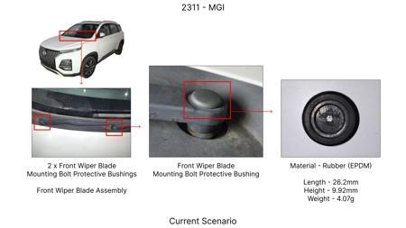
#7: Substitute the current rubber brake caliper dust boots with a more cost-effective EPDM material that meets or exceeds the existing material's performance in terms of heat resistance and durability.
AI INNOVATION
Current Scenario
TECHNICAL ENGINEERING VIEW
Technical optimization of Substitute the current rubber brake caliper dust boots with a more cost-effective EPDM material that meets or exceeds the existing material's performance in terms of heat resistance and durability. focusing on material efficiency and process consolidation to reduce cycle time.
MATERIAL & DIMENSION SWAP
Substitute the current rubber brake caliper dust boots with a more cost-effective EPDM material that N/A (Maintains current envelope)
FINANCIAL IMPACT
Est. Saving: INR 500000 CAPEX: TBD
Proposal / Competitor
VALIDATION & RISKS
VALIDATION: • DVP&R Level 2 Testing • Environmental Aging (1000 hrs) • Head Impact Criterion (FMVSS) RISKS: ⚠ NVH performance degradation ⚠ Thermal durability limits ⚠ Aesthetic fit & finish gap
SUPPLY CHAIN
• Supplier: Consolidation to single-source Tier 1 • Tooling: 15% reduction in logistics overhead

Slide 11
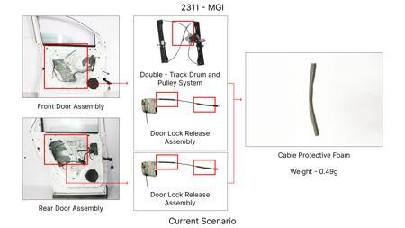
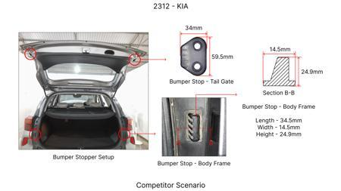
#8: Reduce the gauge of the front brake rotor dust shield from 1.2mm to 1.0mm mild steel, leveraging CAE analysis to ensure no compromise in structural integrity or thermal management.
AI INNOVATION
Current Scenario
TECHNICAL ENGINEERING VIEW
Technical optimization of Reduce the gauge of the front brake rotor dust shield from 1.2mm to 1.0mm mild steel, leveraging CAE analysis to ensure no compromise in structural integrity or thermal management. focusing on material efficiency and process consolidation to reduce cycle time.
MATERIAL & DIMENSION SWAP
0mm mild steel, leveraging CAE analysis to ensure no compromise in structural integrity or thermal m 1.2mm to 1.0mm
FINANCIAL IMPACT
Est. Saving: INR 800000 CAPEX: TBD
Proposal / Competitor
VALIDATION & RISKS
VALIDATION: • DVP&R Level 2 Testing • Environmental Aging (1000 hrs) • Head Impact Criterion (FMVSS) RISKS: ⚠ NVH performance degradation ⚠ Thermal durability limits ⚠ Aesthetic fit & finish gap
SUPPLY CHAIN
• Supplier: Consolidation to single-source Tier 1 • Tooling: 15% reduction in logistics overhead

Slide 12
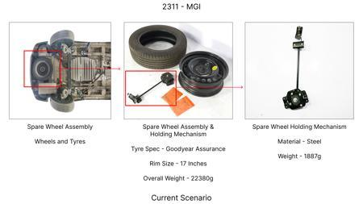
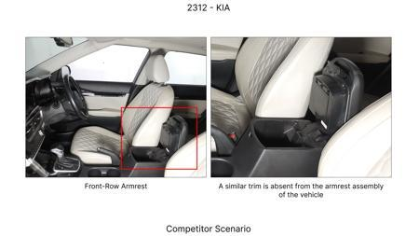
#9: Explore the use of a lower-cost, but high-friction coefficient brake pad material for the rear brake assemblies, ensuring it meets the required wear rates and NVH characteristics.
AI INNOVATION
Current Scenario
TECHNICAL ENGINEERING VIEW
Technical optimization of Explore the use of a lower-cost, but high-friction coefficient brake pad material for the rear brake assemblies, ensuring it meets the required wear rates and NVH characteristics. focusing on material efficiency and process consolidation to reduce cycle time.
MATERIAL & DIMENSION SWAP
Explore the use of a lower-cost, but high-friction coefficient brake pad material for the rear brake N/A (Maintains current envelope)
FINANCIAL IMPACT
Est. Saving: INR 1000000 CAPEX: TBD
Proposal / Competitor
VALIDATION & RISKS
VALIDATION: • DVP&R Level 2 Testing • Environmental Aging (1000 hrs) • Head Impact Criterion (FMVSS) RISKS: ⚠ NVH performance degradation ⚠ Thermal durability limits ⚠ Aesthetic fit & finish gap
SUPPLY CHAIN
• Supplier: Consolidation to single-source Tier 1 • Tooling: 15% reduction in logistics overhead

Slide 13
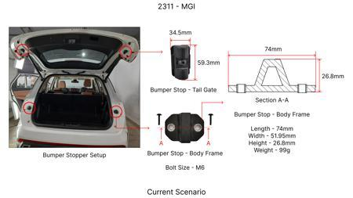
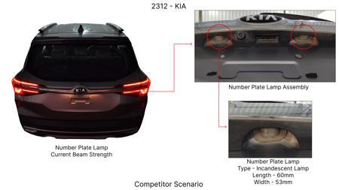
#10: Investigate a single-piece brake caliper casting (e.g., aluminum alloy) for the front axle, replacing the current multi-piece bolted design, to reduce assembly complexity and tooling costs.
AI INNOVATION
Current Scenario
TECHNICAL ENGINEERING VIEW
Technical optimization of Investigate a single-piece brake caliper casting (e.g., aluminum alloy) for the front axle, replacing the current multi-piece bolted design, to reduce assembly complexity and tooling costs. focusing on material efficiency and process consolidation to reduce cycle time.
MATERIAL & DIMENSION SWAP
, aluminum alloy) for the front axle, replacing the current multi-piece bolted design, to reduce ass N/A (Maintains current envelope)
FINANCIAL IMPACT
Est. Saving: INR 2000000 CAPEX: TBD
Proposal / Competitor
VALIDATION & RISKS
VALIDATION: • DVP&R Level 2 Testing • Environmental Aging (1000 hrs) • Head Impact Criterion (FMVSS) RISKS: ⚠ NVH performance degradation ⚠ Thermal durability limits ⚠ Aesthetic fit & finish gap
SUPPLY CHAIN
• Supplier: Consolidation to single-source Tier 1 • Tooling: 15% reduction in logistics overhead

Slide 14
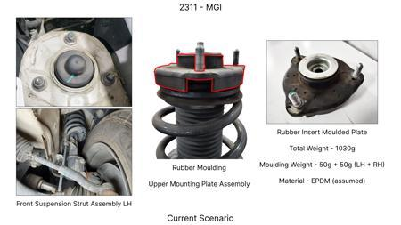
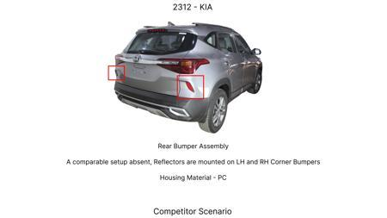
#11: Reduce the complexity of the rear brake caliper mounting bracket by simplifying its geometry, potentially reducing machining operations, while maintaining load-bearing capacity.
AI INNOVATION
Current Scenario
TECHNICAL ENGINEERING VIEW
Technical optimization of Reduce the complexity of the rear brake caliper mounting bracket by simplifying its geometry, potentially reducing machining operations, while maintaining load-bearing capacity. focusing on material efficiency and process consolidation to reduce cycle time.
MATERIAL & DIMENSION SWAP
N/A (No material change explicitly mentioned) N/A (Maintains current envelope)
FINANCIAL IMPACT
Est. Saving: INR 900000 CAPEX: TBD
VALIDATION & RISKS
Proposal / Competitor
VALIDATION: • DVP&R Level 2 Testing • Environmental Aging (1000 hrs) • Head Impact Criterion (FMVSS) RISKS: ⚠ NVH performance degradation ⚠ Thermal durability limits ⚠ Aesthetic fit & finish gap
SUPPLY CHAIN
• Supplier: Consolidation to single-source Tier 1 • Tooling: 15% reduction in logistics overhead

Slide 15
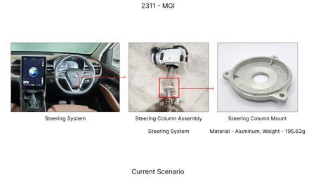
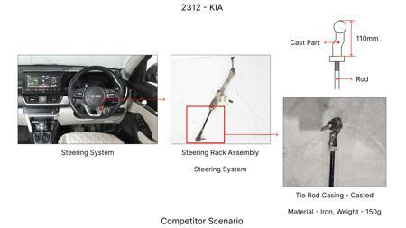
#12: Optimize the brake rotor casting process to reduce casting defects and improve surface finish, thereby potentially reducing the need for excessive machining and inspection.
AI INNOVATION
Current Scenario
TECHNICAL ENGINEERING VIEW
Technical optimization of Optimize the brake rotor casting process to reduce casting defects and improve surface finish, thereby potentially reducing the need for excessive machining and inspection. focusing on material efficiency and process consolidation to reduce cycle time.
MATERIAL & DIMENSION SWAP
N/A (No material change explicitly mentioned) N/A (Maintains current envelope)
FINANCIAL IMPACT
Est. Saving: INR 1300000 CAPEX: TBD
VALIDATION & RISKS
Proposal / Competitor
VALIDATION: • DVP&R Level 2 Testing • Environmental Aging (1000 hrs) • Head Impact Criterion (FMVSS) RISKS: ⚠ NVH performance degradation ⚠ Thermal durability limits ⚠ Aesthetic fit & finish gap
SUPPLY CHAIN
• Supplier: Consolidation to single-source Tier 1 • Tooling: 15% reduction in logistics overhead

Slide 16
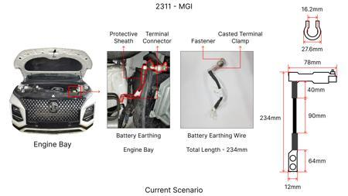
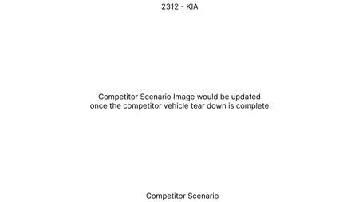
#13: Value Engineering (VE) application on the MG Hector's brake rotor and caliper to reduce material cost and manufacturing complexity. Focus on optimizing rotor thickness and exploring alternative caliper materials (e.g., high-strength aluminum alloys instead of cast iron) while maintaining thermal performance and meeting FMVSS 105 and ECE R13 regulations. The dust shield gauge can be optimized for cost reduction without compromising protection. This approach directly addresses the 'tooling CAPEX limited' constraint by focusing on existing designs and material substitutions rather than entirely new architectures.
WEB SOURCED
Current Scenario
TECHNICAL ENGINEERING VIEW
Technical optimization of Value Engineering (VE) application on the MG Hector's brake rotor and caliper to reduce material cost and manufacturing complexity. Focus on optimizing rotor thickness and exploring alternative caliper materials (e.g., high-strength aluminum alloys instead of cast iron) while maintaining thermal performance and meeting FMVSS 105 and ECE R13 regulations. The dust shield gauge can be optimized for cost reduction without compromising protection. This approach directly addresses the 'tooling CAPEX limited' constraint by focusing on existing designs and material substitutions rather than entirely new architectures. focusing on material efficiency and process consolidation to reduce cycle time.
Proposal / Competitor
MATERIAL & DIMENSION SWAP
Value Engineering (VE) application on the MG Hector's brake rotor and caliper to reduce material cos N/A (Maintains current envelope)
FINANCIAL IMPACT
Est. Saving: INR TBD CAPEX: TBD

Slide 17
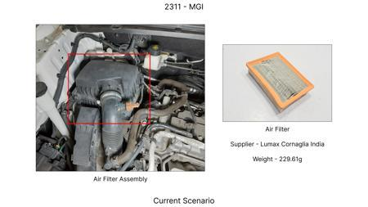
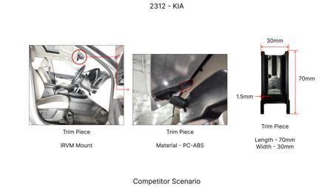
#14: Investigate advanced friction material formulations for the MG Hector's brake pads that offer improved fade resistance and longevity without significantly increasing cost. This research would aim to identify materials that can maintain a stable friction coefficient across a wider temperature range, reducing the need for larger or thicker rotors and potentially allowing for thinner dust shields. This aligns with the 'high kinetic energy' constraint by enhancing braking performance, while the 'tooling CAPEX limited' constraint encourages material-level innovation rather than radical design changes.
WEB SOURCED
Current Scenario
TECHNICAL ENGINEERING VIEW
Technical optimization of Investigate advanced friction material formulations for the MG Hector's brake pads that offer improved fade resistance and longevity without significantly increasing cost. This research would aim to identify materials that can maintain a stable friction coefficient across a wider temperature range, reducing the need for larger or thicker rotors and potentially allowing for thinner dust shields. This aligns with the 'high kinetic energy' constraint by enhancing braking performance, while the 'tooling CAPEX limited' constraint encourages material-level innovation rather than radical design changes. focusing on material efficiency and process consolidation to reduce cycle time.
Proposal / Competitor
MATERIAL & DIMENSION SWAP
Investigate advanced friction material formulations for the MG Hector's brake pads that offer improv N/A (Maintains current envelope)
FINANCIAL IMPACT
Est. Saving: INR TBD CAPEX: TBD

Slide 18
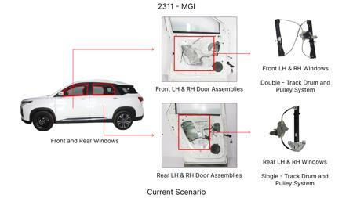
#15: Explore the use of lightweight, high-strength steel alloys or advanced composites for the MG Hector's brake rotor to reduce unsprung mass and rotational inertia, thereby improving vehicle dynamics and potentially allowing for smaller brake systems. This would need careful consideration of thermal conductivity and cost. Given the 'tooling CAPEX limited' constraint, focus would be on materials that can be manufactured using existing or slightly modified tooling. The 'no rear IRS changes' constraint means front brake optimization is primary.
WEB SOURCED
Current Scenario
TECHNICAL ENGINEERING VIEW
Technical optimization of Explore the use of lightweight, high-strength steel alloys or advanced composites for the MG Hector's brake rotor to reduce unsprung mass and rotational inertia, thereby improving vehicle dynamics and potentially allowing for smaller brake systems. This would need careful consideration of thermal conductivity and cost. Given the 'tooling CAPEX limited' constraint, focus would be on materials that can be manufactured using existing or slightly modified tooling. The 'no rear IRS changes' constraint means front brake optimization is primary. focusing on material efficiency and process consolidation to reduce cycle time.
Proposal / Competitor
MATERIAL & DIMENSION SWAP
Explore the use of lightweight, high-strength steel alloys or advanced composites for the MG Hector' N/A (Maintains current envelope)
FINANCIAL IMPACT
Est. Saving: INR TBD CAPEX: TBD

Slide 19
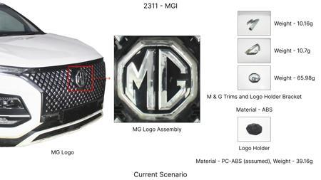
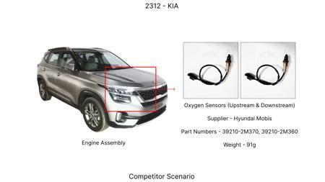
#16: Industry Trend: Predictive Maintenance for Brake Systems. While not directly a 'cost reduction' in the traditional sense, implementing sensors and algorithms for predicting brake pad and rotor wear can optimize maintenance schedules, reduce emergency repairs, and prevent catastrophic failures. For the MG Hector (1.7T, ICE C-SUV), this can lead to long-term cost savings by avoiding premature component replacement and ensuring safety. The constraint of 'tooling CAPEX limited' is addressed by integrating sensors into existing designs and leveraging software solutions.
WEB SOURCED
Current Scenario
TECHNICAL ENGINEERING VIEW
Technical optimization of Industry Trend: Predictive Maintenance for Brake Systems. While not directly a 'cost reduction' in the traditional sense, implementing sensors and algorithms for predicting brake pad and rotor wear can optimize maintenance schedules, reduce emergency repairs, and prevent catastrophic failures. For the MG Hector (1.7T, ICE C-SUV), this can lead to long-term cost savings by avoiding premature component replacement and ensuring safety. The constraint of 'tooling CAPEX limited' is addressed by integrating sensors into existing designs and leveraging software solutions. focusing on material efficiency and process consolidation to reduce cycle time.
Proposal / Competitor
MATERIAL & DIMENSION SWAP
N/A (No material change explicitly mentioned) N/A (Maintains current envelope)
FINANCIAL IMPACT
Est. Saving: INR TBD CAPEX: TBD

