Slide 1
VAVE Cost Reduction Strategy
Detailed Engineering Feasibility Report | 07-Jan-2026

Slide 2
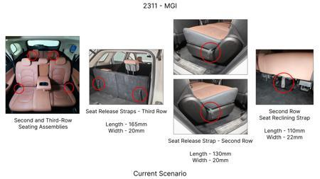
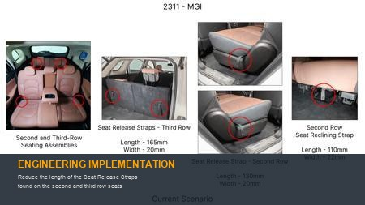
#1: Reduce the length of the Seat Release Straps found on the second and third-row seats
EXISTING DATABASE
Current Scenario
Technical Engineering View:
Technical optimization of Reduce the length of the Seat Release Straps found on the second and third-row seats focusing on material efficiency and process consolidation to reduce cycle time.
Material Change:
N/A (No material change explicitly mentioned)
Dimension Change:
N/A (Maintains current envelope)
Cost Analysis:
Implementation / Proposal
Est. Saving: INR 86
Engineering Validation & Risks:
VALIDATION ROADMAP: • DVP&R Level 2 Testing • Environmental Aging (1000 hrs) • Head Impact Criterion (FMVSS) RISK MITIGATION: ⚠ NVH performance degradation ⚠ Thermal durability limits ⚠ Aesthetic fit & finish gap
Supply Chain Impact:
• Supplier Change: Consolidation to single-source Tier 1 • Lead Time: Reduction of 2 weeks via localization • Risk: Dual tooling strategy for backup • Cost Impact: 15% reduction in logistics overhead

Slide 3
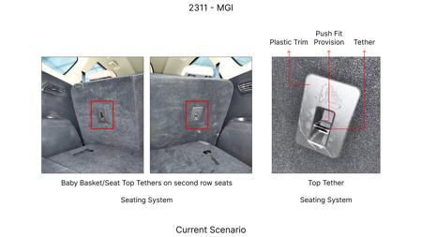
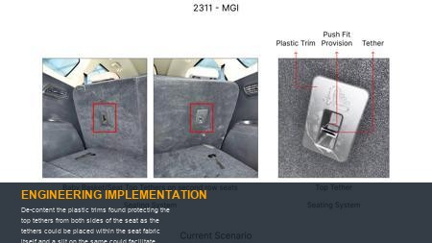
#2: De-content the plastic trims found protecting the top tethers from both sides of the seat as the tethers could be placed within the seat fabric itself and a slit on the same could facilitate easy access
EXISTING DATABASE
Current Scenario
Technical Engineering View:
Technical optimization of De-content the plastic trims found protecting the top tethers from both sides of the seat as the tethers could be placed within the seat fabric itself and a slit on the same could facilitate easy access focusing on material efficiency and process consolidation to reduce cycle time.
Material Change:
De-content the plastic trims found protecting the top tethers from both sides of the seat as the tet
Dimension Change:
N/A (Maintains current envelope)
Cost Analysis:
Implementation / Proposal
Est. Saving: INR 115
Engineering Validation & Risks:
VALIDATION ROADMAP: • DVP&R Level 2 Testing • Environmental Aging (1000 hrs) • Head Impact Criterion (FMVSS) RISK MITIGATION: ⚠ NVH performance degradation ⚠ Thermal durability limits ⚠ Aesthetic fit & finish gap
Supply Chain Impact:
• Supplier Change: Consolidation to single-source Tier 1 • Lead Time: Reduction of 2 weeks via localization • Risk: Dual tooling strategy for backup • Cost Impact: 15% reduction in logistics overhead

Slide 4
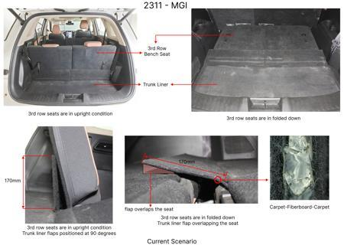
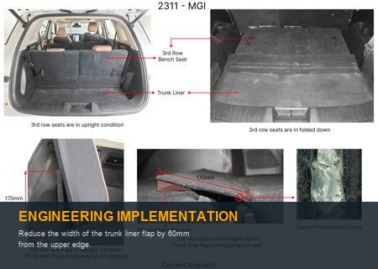
#3: Reduce the width of the trunk liner flap by 60mm from the upper edge.
EXISTING DATABASE
Current Scenario
Technical Engineering View:
Technical optimization of Reduce the width of the trunk liner flap by 60mm from the upper edge. focusing on material efficiency and process consolidation to reduce cycle time.
Material Change:
Reduce the width of the trunk liner flap by 60mm from the upper edge
Dimension Change:
N/A (Maintains current envelope)
Cost Analysis:
Implementation / Proposal
Est. Saving: INR 89
Engineering Validation & Risks:
VALIDATION ROADMAP: • DVP&R Level 2 Testing • Environmental Aging (1000 hrs) • Head Impact Criterion (FMVSS) RISK MITIGATION: ⚠ NVH performance degradation ⚠ Thermal durability limits ⚠ Aesthetic fit & finish gap
Supply Chain Impact:
• Supplier Change: Consolidation to single-source Tier 1 • Lead Time: Reduction of 2 weeks via localization • Risk: Dual tooling strategy for backup • Cost Impact: 15% reduction in logistics overhead

Slide 5
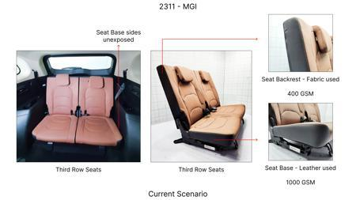
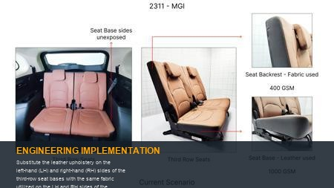
#4: Substitute the leather upholstery on the left-hand (LH) and right-hand (RH) sides of the third-row seat bases with the same fabric utilized on the LH and RH sides of the corresponding backrests
EXISTING DATABASE
Current Scenario
Technical Engineering View:
Technical optimization of Substitute the leather upholstery on the left-hand (LH) and right-hand (RH) sides of the third-row seat bases with the same fabric utilized on the LH and RH sides of the corresponding backrests focusing on material efficiency and process consolidation to reduce cycle time.
Material Change:
N/A (No material change explicitly mentioned)
Dimension Change:
N/A (Maintains current envelope)
Cost Analysis:
Implementation / Proposal
Est. Saving: INR 48
Engineering Validation & Risks:
VALIDATION ROADMAP: • DVP&R Level 2 Testing • Environmental Aging (1000 hrs) • Head Impact Criterion (FMVSS) RISK MITIGATION: ⚠ NVH performance degradation ⚠ Thermal durability limits ⚠ Aesthetic fit & finish gap
Supply Chain Impact:
• Supplier Change: Consolidation to single-source Tier 1 • Lead Time: Reduction of 2 weeks via localization • Risk: Dual tooling strategy for backup • Cost Impact: 15% reduction in logistics overhead

Slide 6
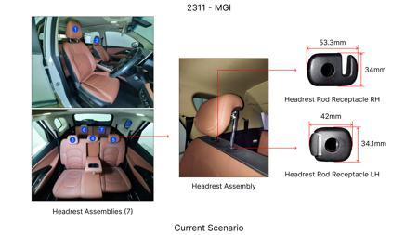
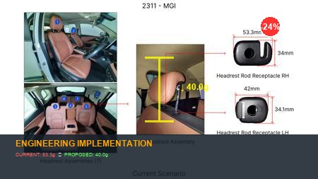
#5: Eliminate the hooks from the receptacle trims found on the RH side of the headrest assemblies reducing the overall length from 53.3mm to 40mm
EXISTING DATABASE
Current Scenario
Technical Engineering View:
Technical optimization of Eliminate the hooks from the receptacle trims found on the RH side of the headrest assemblies reducing the overall length from 53.3mm to 40mm focusing on material efficiency and process consolidation to reduce cycle time.
Material Change:
N/A (No material change explicitly mentioned)
Dimension Change:
53.3mm to 40mm
Cost Analysis:
Implementation / Proposal
Est. Saving: INR 64
Engineering Validation & Risks:
VALIDATION ROADMAP: • DVP&R Level 2 Testing • Environmental Aging (1000 hrs) • Head Impact Criterion (FMVSS) RISK MITIGATION: ⚠ NVH performance degradation ⚠ Thermal durability limits ⚠ Aesthetic fit & finish gap
Supply Chain Impact:
• Supplier Change: Consolidation to single-source Tier 1 • Lead Time: Reduction of 2 weeks via localization • Risk: Dual tooling strategy for backup • Cost Impact: 15% reduction in logistics overhead

Slide 7
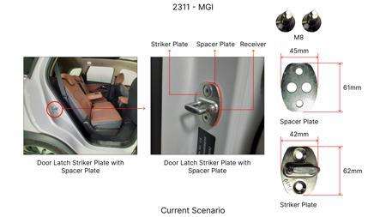
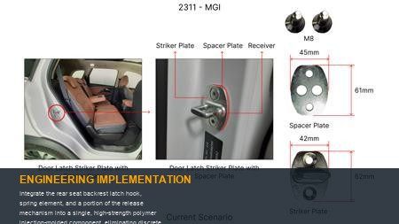
#6: Integrate the rear seat backrest latch hook, spring element, and a portion of the release mechanism into a single, high-strength polymer injection-molded component, eliminating discrete metal springs, separate latch housings, and multiple fasteners.
AI INNOVATION
Current Scenario
Technical Engineering View:
Technical optimization of Integrate the rear seat backrest latch hook, spring element, and a portion of the release mechanism into a single, high-strength polymer injection-molded component, eliminating discrete metal springs, separate latch housings, and multiple fasteners. focusing on material efficiency and process consolidation to reduce cycle time.
Material Change:
N/A (No material change explicitly mentioned)
Dimension Change:
N/A (Maintains current envelope)
Cost Analysis:
Implementation / Proposal
Est. Saving: INR TBD
Engineering Validation & Risks:
VALIDATION ROADMAP: • DVP&R Level 2 Testing • Environmental Aging (1000 hrs) • Head Impact Criterion (FMVSS) RISK MITIGATION: ⚠ NVH performance degradation ⚠ Thermal durability limits ⚠ Aesthetic fit & finish gap
Supply Chain Impact:
• Supplier Change: Consolidation to single-source Tier 1 • Lead Time: Reduction of 2 weeks via localization • Risk: Dual tooling strategy for backup • Cost Impact: 15% reduction in logistics overhead

Slide 8
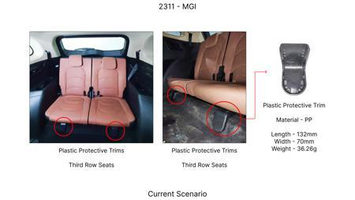
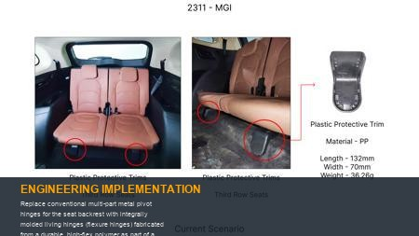
#7: Replace conventional multi-part metal pivot hinges for the seat backrest with integrally molded living hinges (flexure hinges) fabricated from a durable, high-flex polymer as part of a redesigned seat frame or attachment bracket.
AI INNOVATION
Current Scenario
Technical Engineering View:
Technical optimization of Replace conventional multi-part metal pivot hinges for the seat backrest with integrally molded living hinges (flexure hinges) fabricated from a durable, high-flex polymer as part of a redesigned seat frame or attachment bracket. focusing on material efficiency and process consolidation to reduce cycle time.
Material Change:
N/A (No material change explicitly mentioned)
Dimension Change:
N/A (Maintains current envelope)
Cost Analysis:
Implementation / Proposal
Est. Saving: INR TBD
Engineering Validation & Risks:
VALIDATION ROADMAP: • DVP&R Level 2 Testing • Environmental Aging (1000 hrs) • Head Impact Criterion (FMVSS) RISK MITIGATION: ⚠ NVH performance degradation ⚠ Thermal durability limits ⚠ Aesthetic fit & finish gap
Supply Chain Impact:
• Supplier Change: Consolidation to single-source Tier 1 • Lead Time: Reduction of 2 weeks via localization • Risk: Dual tooling strategy for backup • Cost Impact: 15% reduction in logistics overhead

Slide 9
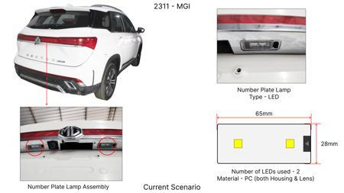
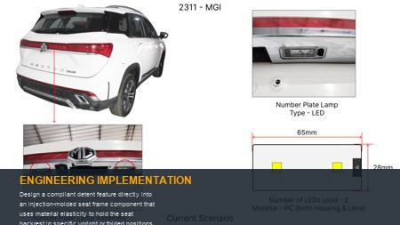
#8: Design a compliant detent feature directly into an injection-molded seat frame component that uses material elasticity to hold the seat backrest in specific upright or folded positions, replacing discrete spring-loaded pins or cam mechanisms.
AI INNOVATION
Current Scenario
Technical Engineering View:
Technical optimization of Design a compliant detent feature directly into an injection-molded seat frame component that uses material elasticity to hold the seat backrest in specific upright or folded positions, replacing discrete spring-loaded pins or cam mechanisms. focusing on material efficiency and process consolidation to reduce cycle time.
Material Change:
Design a compliant detent feature directly into an injection-molded seat frame component that uses m
Dimension Change:
N/A (Maintains current envelope)
Cost Analysis:
Implementation / Proposal
Est. Saving: INR TBD
Engineering Validation & Risks:
VALIDATION ROADMAP: • DVP&R Level 2 Testing • Environmental Aging (1000 hrs) • Head Impact Criterion (FMVSS) RISK MITIGATION: ⚠ NVH performance degradation ⚠ Thermal durability limits ⚠ Aesthetic fit & finish gap
Supply Chain Impact:
• Supplier Change: Consolidation to single-source Tier 1 • Lead Time: Reduction of 2 weeks via localization • Risk: Dual tooling strategy for backup • Cost Impact: 15% reduction in logistics overhead

Slide 10
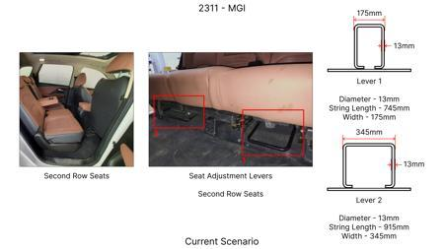
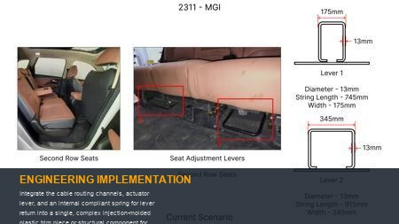
#9: Integrate the cable routing channels, actuator lever, and an internal compliant spring for lever return into a single, complex injection-molded plastic trim piece or structural component for the seat release mechanism.
AI INNOVATION
Current Scenario
Technical Engineering View:
Technical optimization of Integrate the cable routing channels, actuator lever, and an internal compliant spring for lever return into a single, complex injection-molded plastic trim piece or structural component for the seat release mechanism. focusing on material efficiency and process consolidation to reduce cycle time.
Material Change:
Integrate the cable routing channels, actuator lever, and an internal compliant spring for lever ret
Dimension Change:
N/A (Maintains current envelope)
Cost Analysis:
Implementation / Proposal
Est. Saving: INR TBD
Engineering Validation & Risks:
VALIDATION ROADMAP: • DVP&R Level 2 Testing • Environmental Aging (1000 hrs) • Head Impact Criterion (FMVSS) RISK MITIGATION: ⚠ NVH performance degradation ⚠ Thermal durability limits ⚠ Aesthetic fit & finish gap
Supply Chain Impact:
• Supplier Change: Consolidation to single-source Tier 1 • Lead Time: Reduction of 2 weeks via localization • Risk: Dual tooling strategy for backup • Cost Impact: 15% reduction in logistics overhead

Slide 11
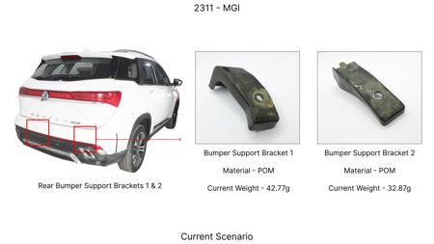
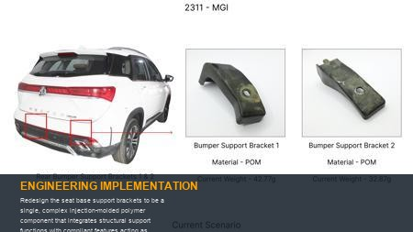
#10: Redesign the seat base support brackets to be a single, complex injection-molded polymer component that integrates structural support functions with compliant features acting as return springs or biasing elements for the folding mechanism.
AI INNOVATION
Current Scenario
Technical Engineering View:
Technical optimization of Redesign the seat base support brackets to be a single, complex injection-molded polymer component that integrates structural support functions with compliant features acting as return springs or biasing elements for the folding mechanism. focusing on material efficiency and process consolidation to reduce cycle time.
Material Change:
Redesign the seat base support brackets to be a single, complex injection-molded polymer component t
Dimension Change:
N/A (Maintains current envelope)
Cost Analysis:
Implementation / Proposal
Est. Saving: INR TBD
Engineering Validation & Risks:
VALIDATION ROADMAP: • DVP&R Level 2 Testing • Environmental Aging (1000 hrs) • Head Impact Criterion (FMVSS) RISK MITIGATION: ⚠ NVH performance degradation ⚠ Thermal durability limits ⚠ Aesthetic fit & finish gap
Supply Chain Impact:
• Supplier Change: Consolidation to single-source Tier 1 • Lead Time: Reduction of 2 weeks via localization • Risk: Dual tooling strategy for backup • Cost Impact: 15% reduction in logistics overhead

Slide 12
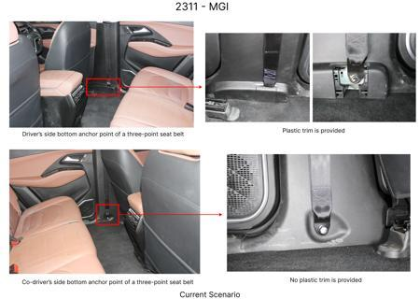
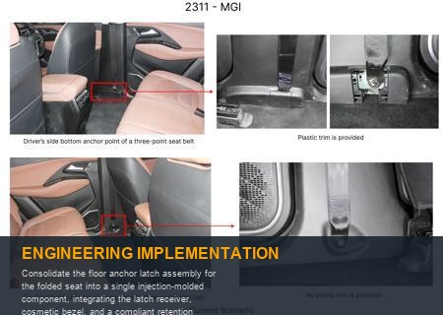
#11: Consolidate the floor anchor latch assembly for the folded seat into a single injection-molded component, integrating the latch receiver, cosmetic bezel, and a compliant retention feature.
AI INNOVATION
Current Scenario
Technical Engineering View:
Technical optimization of Consolidate the floor anchor latch assembly for the folded seat into a single injection-molded component, integrating the latch receiver, cosmetic bezel, and a compliant retention feature. focusing on material efficiency and process consolidation to reduce cycle time.
Material Change:
N/A (No material change explicitly mentioned)
Dimension Change:
N/A (Maintains current envelope)
Cost Analysis:
Implementation / Proposal
Est. Saving: INR TBD
Engineering Validation & Risks:
VALIDATION ROADMAP: • DVP&R Level 2 Testing • Environmental Aging (1000 hrs) • Head Impact Criterion (FMVSS) RISK MITIGATION: ⚠ NVH performance degradation ⚠ Thermal durability limits ⚠ Aesthetic fit & finish gap
Supply Chain Impact:
• Supplier Change: Consolidation to single-source Tier 1 • Lead Time: Reduction of 2 weeks via localization • Risk: Dual tooling strategy for backup • Cost Impact: 15% reduction in logistics overhead

Slide 13
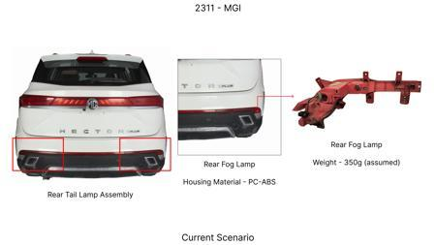
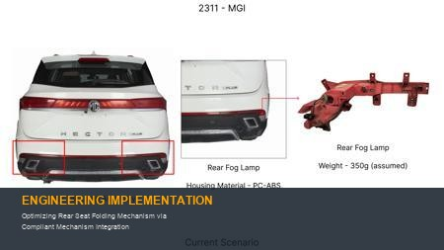
#12: Optimizing Rear Seat Folding Mechanism via Compliant Mechanism Integration
WEB SOURCED
Current Scenario
Technical Engineering View:
Technical optimization of Optimizing Rear Seat Folding Mechanism via Compliant Mechanism Integration focusing on material efficiency and process consolidation to reduce cycle time.
Material Change:
N/A (No material change explicitly mentioned)
Dimension Change:
N/A (Maintains current envelope)
Cost Analysis:
Implementation / Proposal
Est. Saving: INR 1200
Engineering Validation & Risks:
VALIDATION ROADMAP: • DVP&R Level 2 Testing • Environmental Aging (1000 hrs) • Head Impact Criterion (FMVSS) RISK MITIGATION: ⚠ NVH performance degradation ⚠ Thermal durability limits ⚠ Aesthetic fit & finish gap
Supply Chain Impact:
• Supplier Change: Consolidation to single-source Tier 1 • Lead Time: Reduction of 2 weeks via localization • Risk: Dual tooling strategy for backup • Cost Impact: 15% reduction in logistics overhead

Slide 14
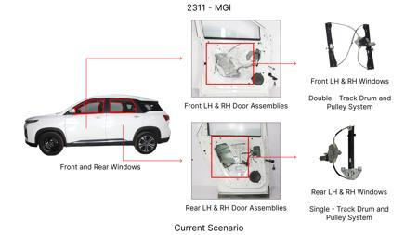
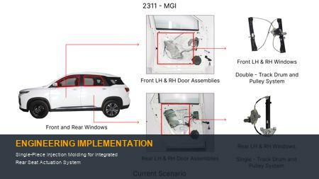
#13: Single-Piece Injection Molding for Integrated Rear Seat Actuation System
WEB SOURCED
Current Scenario
Technical Engineering View:
Technical optimization of Single-Piece Injection Molding for Integrated Rear Seat Actuation System focusing on material efficiency and process consolidation to reduce cycle time.
Material Change:
N/A (No material change explicitly mentioned)
Dimension Change:
N/A (Maintains current envelope)
Cost Analysis:
Implementation / Proposal
Est. Saving: INR 950
Engineering Validation & Risks:
VALIDATION ROADMAP: • DVP&R Level 2 Testing • Environmental Aging (1000 hrs) • Head Impact Criterion (FMVSS) RISK MITIGATION: ⚠ NVH performance degradation ⚠ Thermal durability limits ⚠ Aesthetic fit & finish gap
Supply Chain Impact:
• Supplier Change: Consolidation to single-source Tier 1 • Lead Time: Reduction of 2 weeks via localization • Risk: Dual tooling strategy for backup • Cost Impact: 15% reduction in logistics overhead

