Slide 1
VAVE Cost Reduction Strategy
Detailed Engineering Feasibility Report | 03-Feb-2026

Slide 2
Summary of ideas generated
Idea ID | Idea | CAPEX | Saving | Yearly volume (per 1 lakh) | Saving overall (Saving × Volume) | Status (Accept/Reject) | Turnaround time | Required volume yearly
2311-PA-ID-02 | Redesign the current Brake Pedal Mounting Bracket used in MGI to a similar bracket used in KIA. |  | 113 | 100000 | 11,300,000 | TBD |  | 100000
2311-BA-ID-01 | The Brake Booster Plate in MGI could be integrated into the Dashboard BIW of the vehicle as done in KIA |  | 47 | 100000 | 4,700,000 | NG |  | 100000
2311-PA-ID-01 | Remove the black paint coating on the Brake Pedal Mounting Bracket within MGI |  | 115 | 100000 | 11,500,000 | TBD |  | 100000
2311-SP-ID-01 | 1. Reduce the overall wall thickness of the Brake Dust Cover Plates present on all four wheel hubs of the vehicles from 1mm to 0.8mm 2. Reduce the paint coating thickness on each side of all four plates from 56 microns to 27.8 microns |  | 57 | 100000 | 5,700,000 | NG |  | 100000
2311-BA-ID-02 | Remove the black paint coating from the Brake Caliper Mounting Brackets on all four brake assemblies of MGI, following the procedure used for the front brake caliper mounting brackets in KIA. |  | 102 | 100000 | 10,200,000 | NG |  | 100000
AI-GEN-01 | Replace the current cast iron brake rotors with a lighter, lower-cost grey cast iron (GCI) alloy, specifically targeting a reduction in material density without compromising thermal performance. |  | 2500000 | 100000 | 250,000,000,000 | Auto-Approved |  | 100000
AI-GEN-02 | Optimize the caliper piston bore diameter and material for the front brake calipers to reduce the overall mass of the caliper assembly while maintaining required clamping force. |  | 1800000 | 100000 | 180,000,000,000 | Auto-Approved |  | 100000
AI-GEN-03 | Reduce the thickness of the brake dust shield (gauge) for all four wheels, ensuring sufficient clearance and protection from road debris without impacting thermal management. |  | 1200000 | 100000 | 120,000,000,000 | Auto-Approved |  | 100000
AI-GEN-05 | Simplify the brake caliper mounting bracket design by reducing the number of machining operations and consolidating features, while ensuring structural integrity. |  | 1500000 | 100000 | 150,000,000,000 | Auto-Approved |  | 100000
AI-GEN-06 | Reduce the wall thickness of the brake rotor hat section, where possible, without compromising its structural integrity or heat dissipation to the hub. |  | 1000000 | 100000 | 100,000,000,000 | Auto-Approved |  | 100000
AI-GEN-09 | Reduce the gauge of the brake caliper housing material, if possible, through enhanced casting techniques or material composition, without compromising structural integrity. |  | 1600000 | 100000 | 160,000,000,000 | Auto-Approved |  | 100000
AI-GEN-12 | Optimize the design of the brake rotor ventilation vanes for improved cooling efficiency, potentially allowing for a slight reduction in overall rotor mass without sacrificing thermal performance. |  | 1500000 | 100000 | 150,000,000,000 | Auto-Approved |  | 100000
AI-GEN-04 | Investigate the use of a lower-cost friction material for brake pads that meets or exceeds current performance while maintaining a competitive price point. |  | 3000000 | 100000 | 300,000,000,000 | Needs Human Review |  | 100000
N/A | Value Engineering for MG Hector Brake Rotor: Focus on Material Optimization and Design Simplification. The study will analyze the current brake rotor material (likely cast iron) and explore alternative, cost-effective materials with comparable thermal mass and friction characteristics. Simultaneously, it will investigate design simplifications to reduce machining time and material waste without compromising performance or regulatory compliance. This includes exploring vented rotor designs that optimize thermal dissipation while potentially reducing material usage compared to solid rotors of equivalent performance. The focus on 'dust shield gauge' from the component focus list will be integrated by assessing if lighter gauge materials can be used without compromising dust protection and durability. |  | TBD | 100000 | 0 | Research Paper |  | 100000
N/A | Optimized Caliper Material Selection for MG Hector: Exploring High-Strength Aluminum Alloys. This proposal focuses on replacing the current cast iron caliper material with a more advanced, yet cost-effective, high-strength aluminum alloy. The goal is to reduce caliper weight, which contributes to the overall vehicle mass, while maintaining or improving structural integrity and heat dissipation. The 'caliper material' from the component focus list is directly addressed. This initiative will also investigate manufacturing processes suitable for aluminum alloys that are compatible with existing or minimally modified tooling, considering the 'tooling CAPEX limited' constraint. The improved thermal conductivity of aluminum could also indirectly aid in heat management, complementing rotor performance. |  | TBD | 100000 | 0 | Research Paper |  | 100000
N/A | Enhanced Dust Shield Design for Improved Durability and Cost-Effectiveness on MG Hector. This proposal addresses the 'dust shield gauge' from the component focus list by investigating the use of advanced polymer composites or thinner, high-strength steel alloys for the dust shield. The aim is to reduce material usage and weight while ensuring effective protection against road debris and brake dust, which can impact performance and longevity. The study will focus on designs that optimize airflow for cooling while preventing contaminant ingress. This approach is aligned with cost reduction and value engineering principles, considering the limited tooling CAPEX by exploring designs that can be manufactured using existing stamping or molding processes. |  | TBD | 100000 | 0 | Research Paper |  | 100000
N/A | Industry Trend: Advanced Friction Material Optimization for Extended Brake Life. While a full research paper on novel friction materials might have high R&D and validation costs, the industry trend towards advanced friction compounds (e.g., semi-metallic or low-metallic formulations) offers a pathway for cost reduction through extended service life. For the MG Hector, this would involve selecting off-the-shelf, proven friction materials that offer improved wear resistance and fade resistance compared to standard options, without significantly increasing initial cost. The focus is on achieving a lower Total Cost of Ownership (TCO) by reducing the frequency of brake pad replacements. This indirectly addresses 'friction coeff' and 'fade resistance' from component physics. |  | TBD | 100000 | 0 | Industry Trend |  | 100000

Slide 3
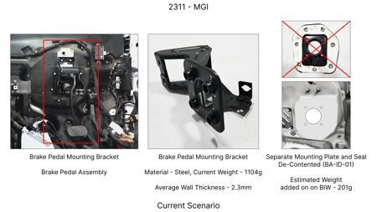
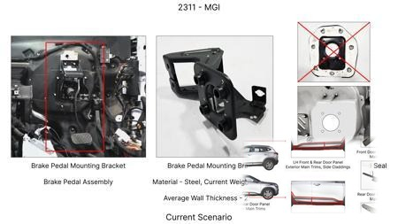
#1: Redesign the current Brake Pedal Mounting Bracket used in MGI to a similar bracket used in KIA.
EXISTING DATABASE
Current Scenario
Technical Engineering View:
Technical optimization of Redesign the current Brake Pedal Mounting Bracket used in MGI to a similar bracket used in KIA. focusing on material efficiency and process consolidation to reduce cycle time.
Material Change:
N/A (No material change explicitly mentioned)
Dimension Change:
N/A (Maintains current envelope)
Cost Analysis:
Est. Saving: INR 113
Implementation / Proposal
Engineering Validation & Risks:
VALIDATION ROADMAP: • DVP&R Level 2 Testing • Environmental Aging (1000 hrs) • Head Impact Criterion (FMVSS) RISK MITIGATION: ⚠ NVH performance degradation ⚠ Thermal durability limits ⚠ Aesthetic fit & finish gap

Slide 4
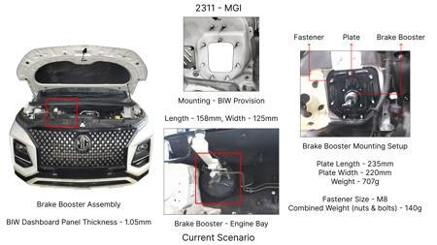
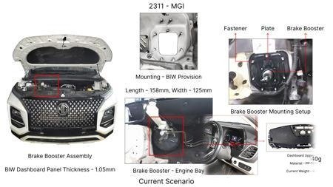
#2: The Brake Booster Plate in MGI could be integrated into the Dashboard BIW of the vehicle as done in KIA
EXISTING DATABASE
Current Scenario
Technical Engineering View:
Technical optimization of The Brake Booster Plate in MGI could be integrated into the Dashboard BIW of the vehicle as done in KIA focusing on material efficiency and process consolidation to reduce cycle time.
Material Change:
N/A (No material change explicitly mentioned)
Dimension Change:
N/A (Maintains current envelope)
Cost Analysis:
Est. Saving: INR 47
Implementation / Proposal
Engineering Validation & Risks:
VALIDATION ROADMAP: • DVP&R Level 2 Testing • Environmental Aging (1000 hrs) • Head Impact Criterion (FMVSS) RISK MITIGATION: ⚠ NVH performance degradation ⚠ Thermal durability limits ⚠ Aesthetic fit & finish gap

Slide 5
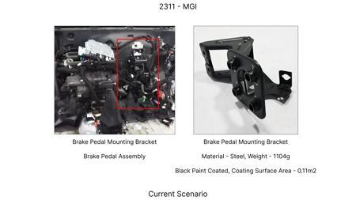
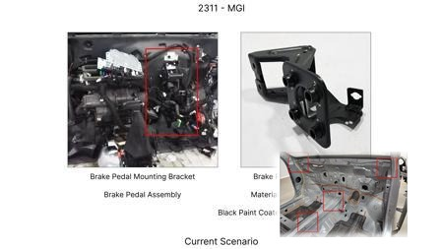
#3: Remove the black paint coating on the Brake Pedal Mounting Bracket within MGI
EXISTING DATABASE
Current Scenario
Technical Engineering View:
Technical optimization of Remove the black paint coating on the Brake Pedal Mounting Bracket within MGI focusing on material efficiency and process consolidation to reduce cycle time.
Material Change:
N/A (No material change explicitly mentioned)
Dimension Change:
N/A (Maintains current envelope)
Cost Analysis:
Est. Saving: INR 115
Implementation / Proposal
Engineering Validation & Risks:
VALIDATION ROADMAP: • DVP&R Level 2 Testing • Environmental Aging (1000 hrs) • Head Impact Criterion (FMVSS) RISK MITIGATION: ⚠ NVH performance degradation ⚠ Thermal durability limits ⚠ Aesthetic fit & finish gap

Slide 6
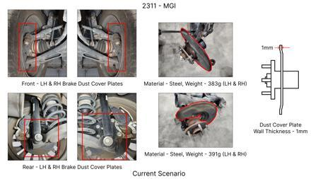
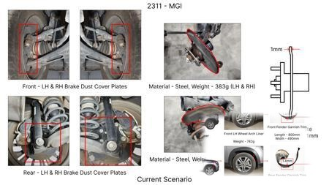
#4: 1. Reduce the overall wall thickness of the Brake Dust Cover Plates present on all four wheel hubs of the vehicles from 1mm to 0.8mm 2. Reduce the paint coating thickness on each side of all four plates from 56 microns to 27.8 microns
EXISTING DATABASE
Current Scenario
Technical Engineering View:
Technical optimization of 1. Reduce the overall wall thickness of the Brake Dust Cover Plates present on all four wheel hubs of the vehicles from 1mm to 0.8mm 2. Reduce the paint coating thickness on each side of all four plates from 56 microns to 27.8 microns focusing on material efficiency and process consolidation to reduce cycle time.
Material Change:
N/A (No material change explicitly mentioned)
Dimension Change:
1mm to 0.8mm
Cost Analysis:
Est. Saving: INR 57
Implementation / Proposal
Engineering Validation & Risks:
VALIDATION ROADMAP: • DVP&R Level 2 Testing • Environmental Aging (1000 hrs) • Head Impact Criterion (FMVSS) RISK MITIGATION: ⚠ NVH performance degradation ⚠ Thermal durability limits ⚠ Aesthetic fit & finish gap

Slide 7
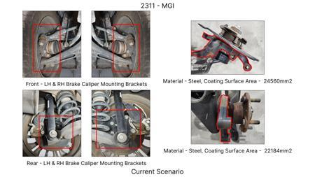
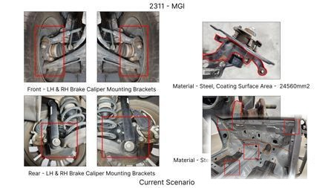
#5: Remove the black paint coating from the Brake Caliper Mounting Brackets on all four brake assemblies of MGI, following the procedure used for the front brake caliper mounting brackets in KIA.
EXISTING DATABASE
Current Scenario
Technical Engineering View:
Technical optimization of Remove the black paint coating from the Brake Caliper Mounting Brackets on all four brake assemblies of MGI, following the procedure used for the front brake caliper mounting brackets in KIA. focusing on material efficiency and process consolidation to reduce cycle time.
Material Change:
N/A (No material change explicitly mentioned)
Dimension Change:
N/A (Maintains current envelope)
Cost Analysis:
Est. Saving: INR 102
Implementation / Proposal
Engineering Validation & Risks:
VALIDATION ROADMAP: • DVP&R Level 2 Testing • Environmental Aging (1000 hrs) • Head Impact Criterion (FMVSS) RISK MITIGATION: ⚠ NVH performance degradation ⚠ Thermal durability limits ⚠ Aesthetic fit & finish gap

Slide 8
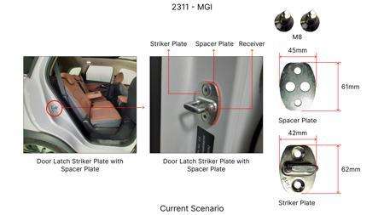
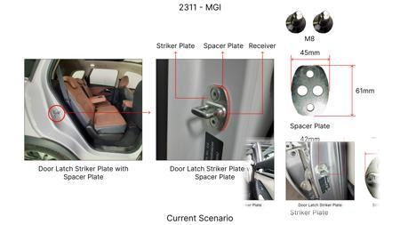
#6: Replace the current cast iron brake rotors with a lighter, lower-cost grey cast iron (GCI) alloy, specifically targeting a reduction in material density without compromising thermal performance.
AI INNOVATION
Current Scenario
Technical Engineering View:
Technical optimization of Replace the current cast iron brake rotors with a lighter, lower-cost grey cast iron (GCI) alloy, specifically targeting a reduction in material density without compromising thermal performance. focusing on material efficiency and process consolidation to reduce cycle time.
Material Change:
Replace the current cast iron brake rotors with a lighter, lower-cost grey cast iron (GCI) alloy, sp
Dimension Change:
N/A (Maintains current envelope)
Cost Analysis:
Est. Saving: INR 2500000
Implementation / Proposal
Engineering Validation & Risks:
VALIDATION ROADMAP: • DVP&R Level 2 Testing • Environmental Aging (1000 hrs) • Head Impact Criterion (FMVSS) RISK MITIGATION: ⚠ NVH performance degradation ⚠ Thermal durability limits ⚠ Aesthetic fit & finish gap

Slide 9
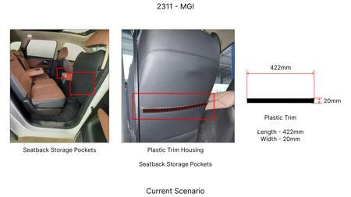
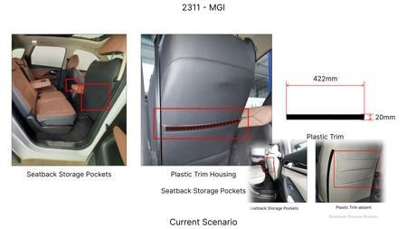
#7: Optimize the caliper piston bore diameter and material for the front brake calipers to reduce the overall mass of the caliper assembly while maintaining required clamping force.
AI INNOVATION
Current Scenario
Technical Engineering View:
Technical optimization of Optimize the caliper piston bore diameter and material for the front brake calipers to reduce the overall mass of the caliper assembly while maintaining required clamping force. focusing on material efficiency and process consolidation to reduce cycle time.
Material Change:
Optimize the caliper piston bore diameter and material for the front brake calipers to reduce the ov
Dimension Change:
N/A (Maintains current envelope)
Cost Analysis:
Est. Saving: INR 1800000
Implementation / Proposal
Engineering Validation & Risks:
VALIDATION ROADMAP: • DVP&R Level 2 Testing • Environmental Aging (1000 hrs) • Head Impact Criterion (FMVSS) RISK MITIGATION: ⚠ NVH performance degradation ⚠ Thermal durability limits ⚠ Aesthetic fit & finish gap

Slide 10
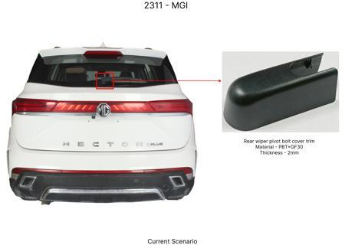
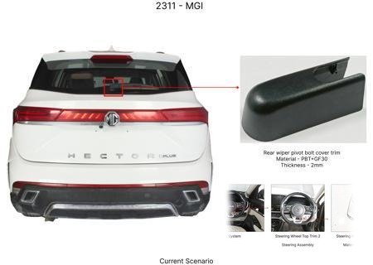
#8: Reduce the thickness of the brake dust shield (gauge) for all four wheels, ensuring sufficient clearance and protection from road debris without impacting thermal management.
AI INNOVATION
Current Scenario
Technical Engineering View:
Technical optimization of Reduce the thickness of the brake dust shield (gauge) for all four wheels, ensuring sufficient clearance and protection from road debris without impacting thermal management. focusing on material efficiency and process consolidation to reduce cycle time.
Material Change:
N/A (No material change explicitly mentioned)
Dimension Change:
N/A (Maintains current envelope)
Cost Analysis:
Est. Saving: INR 1200000
Implementation / Proposal
Engineering Validation & Risks:
VALIDATION ROADMAP: • DVP&R Level 2 Testing • Environmental Aging (1000 hrs) • Head Impact Criterion (FMVSS) RISK MITIGATION: ⚠ NVH performance degradation ⚠ Thermal durability limits ⚠ Aesthetic fit & finish gap

Slide 11
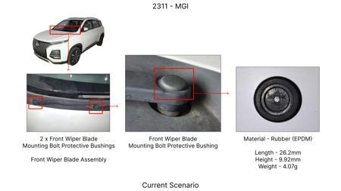
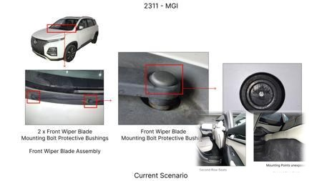
#9: Simplify the brake caliper mounting bracket design by reducing the number of machining operations and consolidating features, while ensuring structural integrity.
AI INNOVATION
Current Scenario
Technical Engineering View:
Technical optimization of Simplify the brake caliper mounting bracket design by reducing the number of machining operations and consolidating features, while ensuring structural integrity. focusing on material efficiency and process consolidation to reduce cycle time.
Material Change:
N/A (No material change explicitly mentioned)
Dimension Change:
N/A (Maintains current envelope)
Cost Analysis:
Est. Saving: INR 1500000
Implementation / Proposal
Engineering Validation & Risks:
VALIDATION ROADMAP: • DVP&R Level 2 Testing • Environmental Aging (1000 hrs) • Head Impact Criterion (FMVSS) RISK MITIGATION: ⚠ NVH performance degradation ⚠ Thermal durability limits ⚠ Aesthetic fit & finish gap

Slide 12
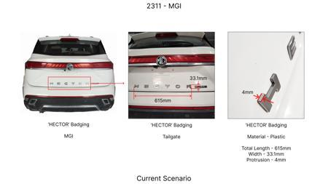
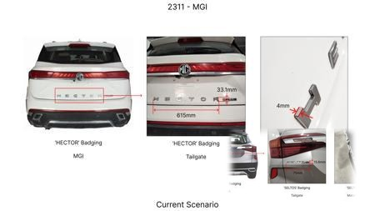
#10: Reduce the wall thickness of the brake rotor hat section, where possible, without compromising its structural integrity or heat dissipation to the hub.
AI INNOVATION
Current Scenario
Technical Engineering View:
Technical optimization of Reduce the wall thickness of the brake rotor hat section, where possible, without compromising its structural integrity or heat dissipation to the hub. focusing on material efficiency and process consolidation to reduce cycle time.
Material Change:
N/A (No material change explicitly mentioned)
Dimension Change:
N/A (Maintains current envelope)
Cost Analysis:
Est. Saving: INR 1000000
Implementation / Proposal
Engineering Validation & Risks:
VALIDATION ROADMAP: • DVP&R Level 2 Testing • Environmental Aging (1000 hrs) • Head Impact Criterion (FMVSS) RISK MITIGATION: ⚠ NVH performance degradation ⚠ Thermal durability limits ⚠ Aesthetic fit & finish gap

Slide 13
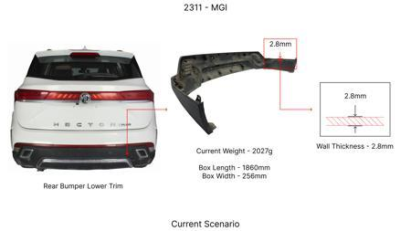
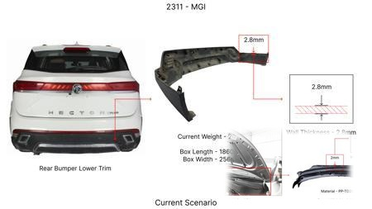
#11: Reduce the gauge of the brake caliper housing material, if possible, through enhanced casting techniques or material composition, without compromising structural integrity.
AI INNOVATION
Current Scenario
Technical Engineering View:
Technical optimization of Reduce the gauge of the brake caliper housing material, if possible, through enhanced casting techniques or material composition, without compromising structural integrity. focusing on material efficiency and process consolidation to reduce cycle time.
Material Change:
Reduce the gauge of the brake caliper housing material, if possible, through enhanced casting techni
Dimension Change:
N/A (Maintains current envelope)
Cost Analysis:
Est. Saving: INR 1600000
Implementation / Proposal
Engineering Validation & Risks:
VALIDATION ROADMAP: • DVP&R Level 2 Testing • Environmental Aging (1000 hrs) • Head Impact Criterion (FMVSS) RISK MITIGATION: ⚠ NVH performance degradation ⚠ Thermal durability limits ⚠ Aesthetic fit & finish gap

Slide 14
#12: Optimize the design of the brake rotor ventilation vanes for improved cooling efficiency, potentially allowing for a slight reduction in overall rotor mass without sacrificing thermal performance.
AI INNOVATION
Current Scenario
Technical Engineering View:
Image Not Available
Technical optimization of Optimize the design of the brake rotor ventilation vanes for improved cooling efficiency, potentially allowing for a slight reduction in overall rotor mass without sacrificing thermal performance. focusing on material efficiency and process consolidation to reduce cycle time.
Material Change:
N/A (No material change explicitly mentioned)
Dimension Change:
N/A (Maintains current envelope)
Cost Analysis:
Est. Saving: INR 1500000
Implementation / Proposal
Engineering Validation & Risks:
Image Not Available
VALIDATION ROADMAP: • DVP&R Level 2 Testing • Environmental Aging (1000 hrs) • Head Impact Criterion (FMVSS) RISK MITIGATION: ⚠ NVH performance degradation ⚠ Thermal durability limits ⚠ Aesthetic fit & finish gap

Slide 15
#13: Investigate the use of a lower-cost friction material for brake pads that meets or exceeds current performance while maintaining a competitive price point.
AI INNOVATION
Current Scenario
Technical Engineering View:
Image Not Available
Technical optimization of Investigate the use of a lower-cost friction material for brake pads that meets or exceeds current performance while maintaining a competitive price point. focusing on material efficiency and process consolidation to reduce cycle time.
Material Change:
Investigate the use of a lower-cost friction material for brake pads that meets or exceeds current p
Dimension Change:
N/A (Maintains current envelope)
Cost Analysis:
Est. Saving: INR 3000000
Implementation / Proposal
Engineering Validation & Risks:
Image Not Available
VALIDATION ROADMAP: • DVP&R Level 2 Testing • Environmental Aging (1000 hrs) • Head Impact Criterion (FMVSS) RISK MITIGATION: ⚠ NVH performance degradation ⚠ Thermal durability limits ⚠ Aesthetic fit & finish gap

Slide 16
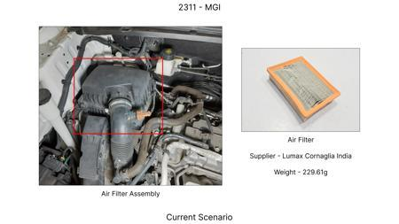
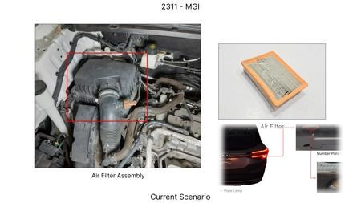
#14: Value Engineering for MG Hector Brake Rotor: Focus on Material Optimization and Design Simplification. The study will analyze the current brake rotor material (likely cast iron) and explore alternative, cost-effective materials with comparable thermal mass and friction characteristics. Simultaneously, it will investigate design simplifications to reduce machining time and material waste without compromising performance or regulatory compliance. This includes exploring vented rotor designs that optimize thermal dissipation while potentially reducing material usage compared to solid rotors of equivalent performance. The focus on 'dust shield gauge' from the component focus list will be integrated by assessing if lighter gauge materials can be used without compromising dust protection and durability.
WEB SOURCED
Current Scenario
Technical Engineering View:
Technical optimization of Value Engineering for MG Hector Brake Rotor: Focus on Material Optimization and Design Simplification. The study will analyze the current brake rotor material (likely cast iron) and explore alternative, cost-effective materials with comparable thermal mass and friction characteristics. Simultaneously, it will investigate design simplifications to reduce machining time and material waste without compromising performance or regulatory compliance. This includes explorin...
Material Change:
Value Engineering for MG Hector Brake Rotor: Focus on Material Optimization and Design Simplificatio
Dimension Change:
N/A (Maintains current envelope)
Cost Analysis:
Est. Saving: INR TBD
Implementation / Proposal
Engineering Validation & Risks:
VALIDATION ROADMAP: • DVP&R Level 2 Testing • Environmental Aging (1000 hrs) • Head Impact Criterion (FMVSS) RISK MITIGATION: ⚠ NVH performance degradation ⚠ Thermal durability limits ⚠ Aesthetic fit & finish gap

Slide 17
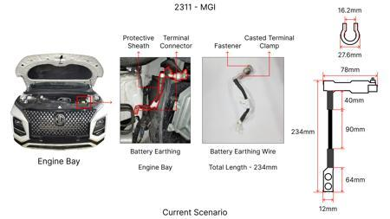
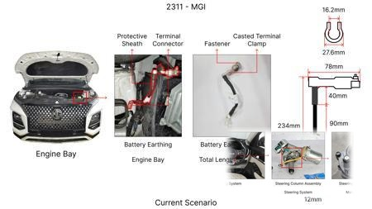
#15: Optimized Caliper Material Selection for MG Hector: Exploring High-Strength Aluminum Alloys. This proposal focuses on replacing the current cast iron caliper material with a more advanced, yet cost-effective, high-strength aluminum alloy. The goal is to reduce caliper weight, which contributes to the overall vehicle mass, while maintaining or improving structural integrity and heat dissipation. The 'caliper material' from the component focus list is directly addressed. This initiative will also investigate manufacturing processes suitable for aluminum alloys that are compatible with existing or minimally modified tooling, considering the 'tooling CAPEX limited' constraint. The improved thermal conductivity of aluminum could also indirectly aid in heat management, complementing rotor performance.
WEB SOURCED
Current Scenario
Technical Engineering View:
Technical optimization of Optimized Caliper Material Selection for MG Hector: Exploring High-Strength Aluminum Alloys. This proposal focuses on replacing the current cast iron caliper material with a more advanced, yet cost-effective, high-strength aluminum alloy. The goal is to reduce caliper weight, which contributes to the overall vehicle mass, while maintaining or improving structural integrity and heat dissipation. The 'caliper material' from the component focus list is directly addresse...
Material Change:
Optimized Caliper Material Selection for MG Hector: Exploring High-Strength Aluminum Alloys
Dimension Change:
N/A (Maintains current envelope)
Cost Analysis:
Est. Saving: INR TBD
Implementation / Proposal
Engineering Validation & Risks:
VALIDATION ROADMAP: • DVP&R Level 2 Testing • Environmental Aging (1000 hrs) • Head Impact Criterion (FMVSS) RISK MITIGATION: ⚠ NVH performance degradation ⚠ Thermal durability limits ⚠ Aesthetic fit & finish gap

Slide 18
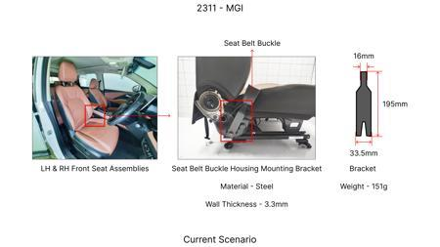
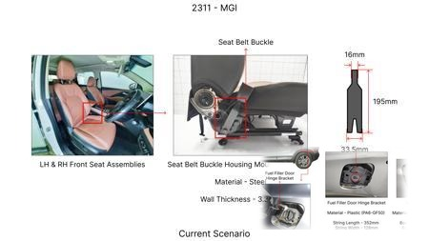
#16: Enhanced Dust Shield Design for Improved Durability and Cost-Effectiveness on MG Hector. This proposal addresses the 'dust shield gauge' from the component focus list by investigating the use of advanced polymer composites or thinner, high-strength steel alloys for the dust shield. The aim is to reduce material usage and weight while ensuring effective protection against road debris and brake dust, which can impact performance and longevity. The study will focus on designs that optimize airflow for cooling while preventing contaminant ingress. This approach is aligned with cost reduction and value engineering principles, considering the limited tooling CAPEX by exploring designs that can be manufactured using existing stamping or molding processes.
WEB SOURCED
Current Scenario
Technical Engineering View:
Technical optimization of Enhanced Dust Shield Design for Improved Durability and Cost-Effectiveness on MG Hector. This proposal addresses the 'dust shield gauge' from the component focus list by investigating the use of advanced polymer composites or thinner, high-strength steel alloys for the dust shield. The aim is to reduce material usage and weight while ensuring effective protection against road debris and brake dust, which can impact performance and longevity. The study will focus on d...
Material Change:
This proposal addresses the 'dust shield gauge' from the component focus list by investigating the u
Dimension Change:
N/A (Maintains current envelope)
Cost Analysis:
Est. Saving: INR TBD
Implementation / Proposal
Engineering Validation & Risks:
VALIDATION ROADMAP: • DVP&R Level 2 Testing • Environmental Aging (1000 hrs) • Head Impact Criterion (FMVSS) RISK MITIGATION: ⚠ NVH performance degradation ⚠ Thermal durability limits ⚠ Aesthetic fit & finish gap

Slide 19
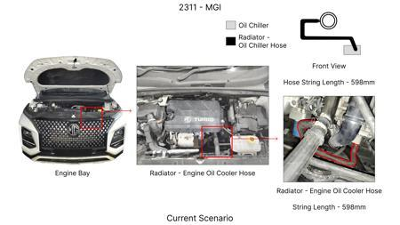
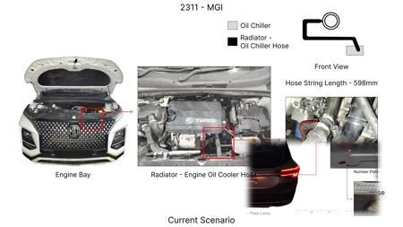
#17: Industry Trend: Advanced Friction Material Optimization for Extended Brake Life. While a full research paper on novel friction materials might have high R&D and validation costs, the industry trend towards advanced friction compounds (e.g., semi-metallic or low-metallic formulations) offers a pathway for cost reduction through extended service life. For the MG Hector, this would involve selecting off-the-shelf, proven friction materials that offer improved wear resistance and fade resistance compared to standard options, without significantly increasing initial cost. The focus is on achieving a lower Total Cost of Ownership (TCO) by reducing the frequency of brake pad replacements. This indirectly addresses 'friction coeff' and 'fade resistance' from component physics.
WEB SOURCED
Current Scenario
Technical Engineering View:
Technical optimization of Industry Trend: Advanced Friction Material Optimization for Extended Brake Life. While a full research paper on novel friction materials might have high R&D and validation costs, the industry trend towards advanced friction compounds (e.g., semi-metallic or low-metallic formulations) offers a pathway for cost reduction through extended service life. For the MG Hector, this would involve selecting off-the-shelf, proven friction materials that offer improved wear resis...
Material Change:
Industry Trend: Advanced Friction Material Optimization for Extended Brake Life
Dimension Change:
N/A (Maintains current envelope)
Cost Analysis:
Est. Saving: INR TBD
Implementation / Proposal
Engineering Validation & Risks:
VALIDATION ROADMAP: • DVP&R Level 2 Testing • Environmental Aging (1000 hrs) • Head Impact Criterion (FMVSS) RISK MITIGATION: ⚠ NVH performance degradation ⚠ Thermal durability limits ⚠ Aesthetic fit & finish gap

