Slide 1
VAVE Cost Reduction Strategy
Detailed Engineering Feasibility Report | 02-Jan-2026

Slide 2
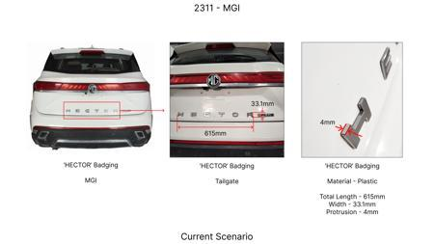
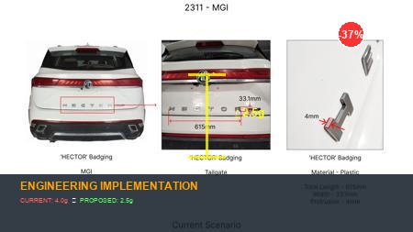
#1: Reduce the projection of the 'HECTOR' badging on the tailgate at the rear end of the car from 4mm to 2.5mm
EXISTING DATABASE
Current Scenario
Technical Engineering View:
Technical optimization of Reduce the projection of the 'HECTOR' badging on the tailgate at the rear end of the car from 4mm to 2.5mm focusing on material efficiency and process consolidation to reduce cycle time.
Material Change:
N/A (No material change explicitly mentioned)
Dimension Change:
4mm to 2.5mm
Cost Analysis:
Implementation / Proposal
Est. Saving: INR 135
Engineering Validation & Risks:
VALIDATION ROADMAP: • DVP&R Level 2 Testing • Environmental Aging (1000 hrs) • Head Impact Criterion (FMVSS) RISK MITIGATION: ⚠ NVH performance degradation ⚠ Thermal durability limits ⚠ Aesthetic fit & finish gap
Supply Chain Impact:
• Supplier Change: Consolidation to single-source Tier 1 • Lead Time: Reduction of 2 weeks via localization • Risk: Dual tooling strategy for backup • Cost Impact: 15% reduction in logistics overhead

Slide 3
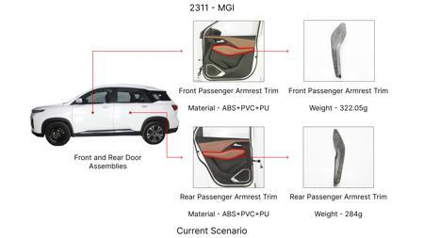
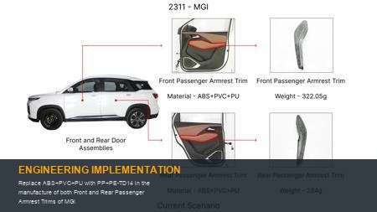
#2: Replace ABS+PVC+PU with PP+PE-TD14 in the manufacture of both Front and Rear Passenger Armrest Trims of MGI
EXISTING DATABASE
Current Scenario
Technical Engineering View:
Technical optimization of Replace ABS+PVC+PU with PP+PE-TD14 in the manufacture of both Front and Rear Passenger Armrest Trims of MGI focusing on material efficiency and process consolidation to reduce cycle time.
Material Change:
Replace ABS+PVC+PU with PP+PE-TD14 in the manufacture of both Front and Rear Passenger Armrest Trims
Dimension Change:
N/A (Maintains current envelope)
Cost Analysis:
Implementation / Proposal
Est. Saving: INR 126
Engineering Validation & Risks:
VALIDATION ROADMAP: • DVP&R Level 2 Testing • Environmental Aging (1000 hrs) • Head Impact Criterion (FMVSS) RISK MITIGATION: ⚠ NVH performance degradation ⚠ Thermal durability limits ⚠ Aesthetic fit & finish gap
Supply Chain Impact:
• Supplier Change: Consolidation to single-source Tier 1 • Lead Time: Reduction of 2 weeks via localization • Risk: Dual tooling strategy for backup • Cost Impact: 15% reduction in logistics overhead

Slide 4
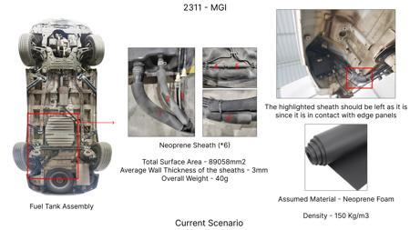
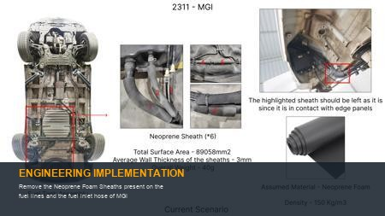
#3: Remove the Neoprene Foam Sheaths present on the fuel lines and the fuel inlet hose of MGI
EXISTING DATABASE
Current Scenario
Technical Engineering View:
Technical optimization of Remove the Neoprene Foam Sheaths present on the fuel lines and the fuel inlet hose of MGI focusing on material efficiency and process consolidation to reduce cycle time.
Material Change:
N/A (No material change explicitly mentioned)
Dimension Change:
N/A (Maintains current envelope)
Cost Analysis:
Implementation / Proposal
Est. Saving: INR 142
Engineering Validation & Risks:
VALIDATION ROADMAP: • DVP&R Level 2 Testing • Environmental Aging (1000 hrs) • Head Impact Criterion (FMVSS) RISK MITIGATION: ⚠ NVH performance degradation ⚠ Thermal durability limits ⚠ Aesthetic fit & finish gap
Supply Chain Impact:
• Supplier Change: Consolidation to single-source Tier 1 • Lead Time: Reduction of 2 weeks via localization • Risk: Dual tooling strategy for backup • Cost Impact: 15% reduction in logistics overhead

Slide 5
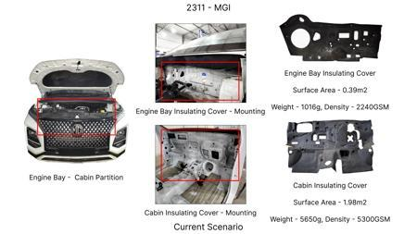
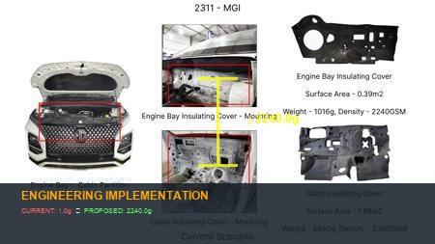
#4: 1. Replace the 2240GSM Engine Bay Insulation Cover within MGI with a 1080 - 1100GSM Insulation Cover (PES-NF) as in KIA 2. Replace the 5300GSM Cabin Insulation Cover within MGI with a 4550 - 4650GSM Insulation Cover as in KIA
EXISTING DATABASE
Current Scenario
Technical Engineering View:
Technical optimization of 1. Replace the 2240GSM Engine Bay Insulation Cover within MGI with a 1080 - 1100GSM Insulation Cover (PES-NF) as in KIA 2. Replace the 5300GSM Cabin Insulation Cover within MGI with a 4550 - 4650GSM Insulation Cover as in KIA focusing on material efficiency and process consolidation to reduce cycle time.
Material Change:
N/A (No material change explicitly mentioned)
Dimension Change:
N/A (Maintains current envelope)
Cost Analysis:
Implementation / Proposal
Est. Saving: INR 41
Engineering Validation & Risks:
VALIDATION ROADMAP: • DVP&R Level 2 Testing • Environmental Aging (1000 hrs) • Head Impact Criterion (FMVSS) RISK MITIGATION: ⚠ NVH performance degradation ⚠ Thermal durability limits ⚠ Aesthetic fit & finish gap
Supply Chain Impact:
• Supplier Change: Consolidation to single-source Tier 1 • Lead Time: Reduction of 2 weeks via localization • Risk: Dual tooling strategy for backup • Cost Impact: 15% reduction in logistics overhead

Slide 6
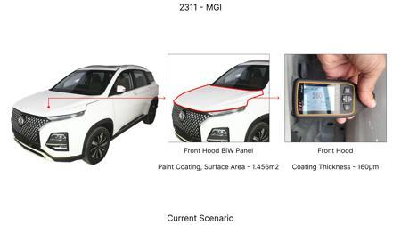
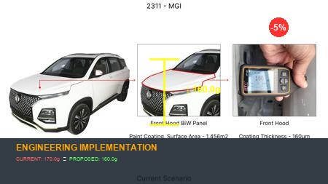
#5: Reduce the Paint Coating Thickness of the highlighted Front Hood BiW Panel from 160 - 170μm to 100 - 110μm
EXISTING DATABASE
Current Scenario
Technical Engineering View:
Technical optimization of Reduce the Paint Coating Thickness of the highlighted Front Hood BiW Panel from 160 - 170μm to 100 - 110μm focusing on material efficiency and process consolidation to reduce cycle time.
Material Change:
N/A (No material change explicitly mentioned)
Dimension Change:
170μm to 100 - 110μm
Cost Analysis:
Implementation / Proposal
Est. Saving: INR 82
Engineering Validation & Risks:
VALIDATION ROADMAP: • DVP&R Level 2 Testing • Environmental Aging (1000 hrs) • Head Impact Criterion (FMVSS) RISK MITIGATION: ⚠ NVH performance degradation ⚠ Thermal durability limits ⚠ Aesthetic fit & finish gap
Supply Chain Impact:
• Supplier Change: Consolidation to single-source Tier 1 • Lead Time: Reduction of 2 weeks via localization • Risk: Dual tooling strategy for backup • Cost Impact: 15% reduction in logistics overhead

Slide 7
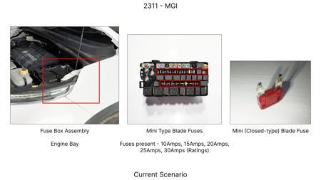
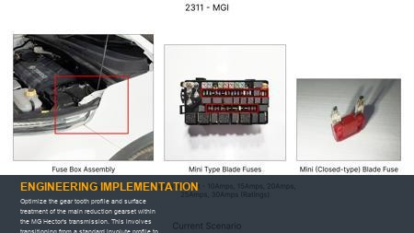
#6: Optimize the gear tooth profile and surface treatment of the main reduction gearset within the MG Hector's transmission. This involves transitioning from a standard involute profile to a modified involute or trochoidal profile to reduce sliding friction and improve load-carrying capacity, coupled with a case hardening and polishing process instead of a standard heat treatment.
AI INNOVATION
Current Scenario
Technical Engineering View:
Technical optimization of Optimize the gear tooth profile and surface treatment of the main reduction gearset within the MG Hector's transmission. This involves transitioning from a standard involute profile to a modified involute or trochoidal profile to reduce sliding friction and improve load-carrying capacity, coupled with a case hardening and polishing process instead of a standard heat treatment. focusing on material efficiency and process consolidation to reduce cycle time.
Material Change:
N/A (No material change explicitly mentioned)
Dimension Change:
N/A (Maintains current envelope)
Cost Analysis:
Implementation / Proposal
Est. Saving: INR TBD
Engineering Validation & Risks:
VALIDATION ROADMAP: • DVP&R Level 2 Testing • Environmental Aging (1000 hrs) • Head Impact Criterion (FMVSS) RISK MITIGATION: ⚠ NVH performance degradation ⚠ Thermal durability limits ⚠ Aesthetic fit & finish gap
Supply Chain Impact:
• Supplier Change: Consolidation to single-source Tier 1 • Lead Time: Reduction of 2 weeks via localization • Risk: Dual tooling strategy for backup • Cost Impact: 15% reduction in logistics overhead

Slide 8
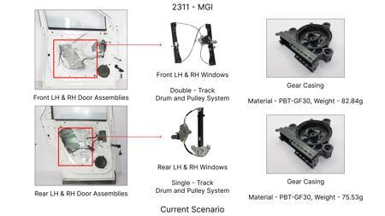
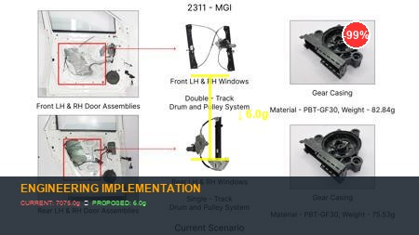
#7: Substitute the current forged steel planetary gear carriers with a lightweight, high-strength aluminum alloy (e.g., 7075-T6) or a composite material for the reduction gear assembly. This requires redesigning the carrier to maintain structural integrity and thermal dissipation properties while leveraging material density advantages.
AI INNOVATION
Current Scenario
Technical Engineering View:
Technical optimization of Substitute the current forged steel planetary gear carriers with a lightweight, high-strength aluminum alloy (e.g., 7075-T6) or a composite material for the reduction gear assembly. This requires redesigning the carrier to maintain structural integrity and thermal dissipation properties while leveraging material density advantages. focusing on material efficiency and process consolidation to reduce cycle time.
Material Change:
Substitute the current forged steel planetary gear carriers with a lightweight, high-strength alumin
Dimension Change:
N/A (Maintains current envelope)
Cost Analysis:
Implementation / Proposal
Est. Saving: INR TBD
Engineering Validation & Risks:
VALIDATION ROADMAP: • DVP&R Level 2 Testing • Environmental Aging (1000 hrs) • Head Impact Criterion (FMVSS) RISK MITIGATION: ⚠ NVH performance degradation ⚠ Thermal durability limits ⚠ Aesthetic fit & finish gap
Supply Chain Impact:
• Supplier Change: Consolidation to single-source Tier 1 • Lead Time: Reduction of 2 weeks via localization • Risk: Dual tooling strategy for backup • Cost Impact: 15% reduction in logistics overhead

Slide 9
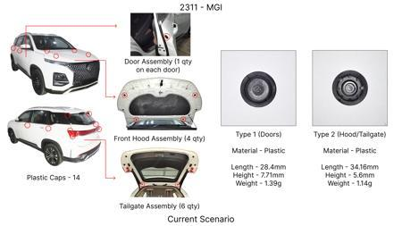
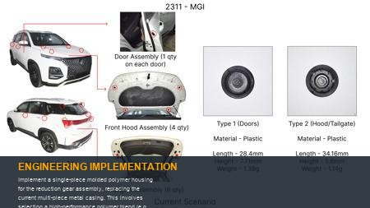
#8: Implement a single-piece molded polymer housing for the reduction gear assembly, replacing the current multi-piece metal casing. This involves selecting a high-performance polymer blend (e.g., glass-fiber reinforced nylon or PPA) capable of withstanding operational temperatures and pressures, with integrated mounting points and bearing seats.
AI INNOVATION
Current Scenario
Technical Engineering View:
Technical optimization of Implement a single-piece molded polymer housing for the reduction gear assembly, replacing the current multi-piece metal casing. This involves selecting a high-performance polymer blend (e.g., glass-fiber reinforced nylon or PPA) capable of withstanding operational temperatures and pressures, with integrated mounting points and bearing seats. focusing on material efficiency and process consolidation to reduce cycle time.
Material Change:
, glass-fiber reinforced nylon or PPA) capable of withstanding operational temperatures and pressure
Dimension Change:
N/A (Maintains current envelope)
Cost Analysis:
Implementation / Proposal
Est. Saving: INR TBD
Engineering Validation & Risks:
VALIDATION ROADMAP: • DVP&R Level 2 Testing • Environmental Aging (1000 hrs) • Head Impact Criterion (FMVSS) RISK MITIGATION: ⚠ NVH performance degradation ⚠ Thermal durability limits ⚠ Aesthetic fit & finish gap
Supply Chain Impact:
• Supplier Change: Consolidation to single-source Tier 1 • Lead Time: Reduction of 2 weeks via localization • Risk: Dual tooling strategy for backup • Cost Impact: 15% reduction in logistics overhead

Slide 10
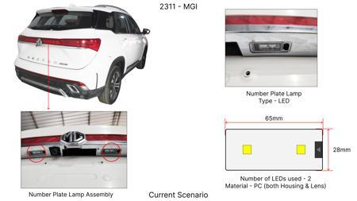
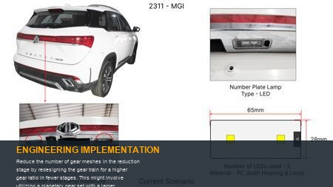
#9: Reduce the number of gear meshes in the reduction stage by redesigning the gear train for a higher gear ratio in fewer stages. This might involve utilizing a planetary gear set with a larger diameter or a different configuration to achieve the desired reduction, thereby simplifying the overall assembly and reducing component count.
AI INNOVATION
Current Scenario
Technical Engineering View:
Technical optimization of Reduce the number of gear meshes in the reduction stage by redesigning the gear train for a higher gear ratio in fewer stages. This might involve utilizing a planetary gear set with a larger diameter or a different configuration to achieve the desired reduction, thereby simplifying the overall assembly and reducing component count. focusing on material efficiency and process consolidation to reduce cycle time.
Material Change:
N/A (No material change explicitly mentioned)
Dimension Change:
N/A (Maintains current envelope)
Cost Analysis:
Implementation / Proposal
Est. Saving: INR TBD
Engineering Validation & Risks:
VALIDATION ROADMAP: • DVP&R Level 2 Testing • Environmental Aging (1000 hrs) • Head Impact Criterion (FMVSS) RISK MITIGATION: ⚠ NVH performance degradation ⚠ Thermal durability limits ⚠ Aesthetic fit & finish gap
Supply Chain Impact:
• Supplier Change: Consolidation to single-source Tier 1 • Lead Time: Reduction of 2 weeks via localization • Risk: Dual tooling strategy for backup • Cost Impact: 15% reduction in logistics overhead

Slide 11

#10: Opt for a direct-drive electric motor integrated within the reduction gear housing for electric or hybrid variants, eliminating the need for a separate reduction gear assembly and its associated components. This involves designing a compact, high-torque density electric motor that directly drives the output shaft.
AI INNOVATION
Current Scenario
Technical Engineering View:
Image Not Available
Technical optimization of Opt for a direct-drive electric motor integrated within the reduction gear housing for electric or hybrid variants, eliminating the need for a separate reduction gear assembly and its associated components. This involves designing a compact, high-torque density electric motor that directly drives the output shaft. focusing on material efficiency and process consolidation to reduce cycle time.
Material Change:
N/A (No material change explicitly mentioned)
Dimension Change:
N/A (Maintains current envelope)
Cost Analysis:
Implementation / Proposal
Est. Saving: INR TBD
Engineering Validation & Risks:
VALIDATION ROADMAP: • DVP&R Level 2 Testing • Environmental Aging (1000 hrs) • Head Impact Criterion (FMVSS) RISK MITIGATION: ⚠ NVH performance degradation ⚠ Thermal durability limits ⚠ Aesthetic fit & finish gap
Supply Chain Impact:
• Supplier Change: Consolidation to single-source Tier 1 • Lead Time: Reduction of 2 weeks via localization • Risk: Dual tooling strategy for backup • Cost Impact: 15% reduction in logistics overhead

Slide 12
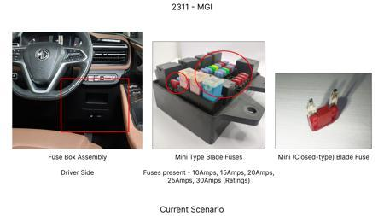
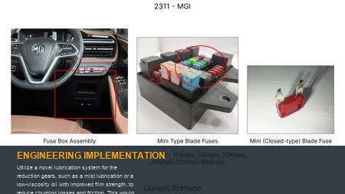
#11: Utilize a novel lubrication system for the reduction gears, such as a mist lubrication or a low-viscosity oil with improved film strength, to reduce churning losses and friction. This would involve redesigning oil pathways and potentially using specialized bearing materials that perform well with minimal lubrication.
AI INNOVATION
Current Scenario
Technical Engineering View:
Technical optimization of Utilize a novel lubrication system for the reduction gears, such as a mist lubrication or a low-viscosity oil with improved film strength, to reduce churning losses and friction. This would involve redesigning oil pathways and potentially using specialized bearing materials that perform well with minimal lubrication. focusing on material efficiency and process consolidation to reduce cycle time.
Material Change:
This would involve redesigning oil pathways and potentially using specialized bearing materials that
Dimension Change:
N/A (Maintains current envelope)
Cost Analysis:
Implementation / Proposal
Est. Saving: INR TBD
Engineering Validation & Risks:
VALIDATION ROADMAP: • DVP&R Level 2 Testing • Environmental Aging (1000 hrs) • Head Impact Criterion (FMVSS) RISK MITIGATION: ⚠ NVH performance degradation ⚠ Thermal durability limits ⚠ Aesthetic fit & finish gap
Supply Chain Impact:
• Supplier Change: Consolidation to single-source Tier 1 • Lead Time: Reduction of 2 weeks via localization • Risk: Dual tooling strategy for backup • Cost Impact: 15% reduction in logistics overhead

Slide 13
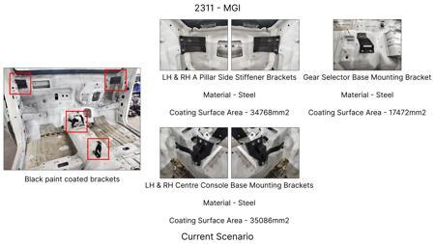
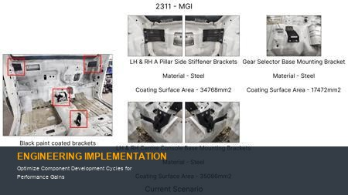
#12: Optimize Component Development Cycles for Performance Gains
WEB SOURCED
Current Scenario
Technical Engineering View:
Technical optimization of Optimize Component Development Cycles for Performance Gains focusing on material efficiency and process consolidation to reduce cycle time.
Material Change:
N/A (No material change explicitly mentioned)
Dimension Change:
N/A (Maintains current envelope)
Cost Analysis:
Implementation / Proposal
Est. Saving: INR TBD
Engineering Validation & Risks:
VALIDATION ROADMAP: • DVP&R Level 2 Testing • Environmental Aging (1000 hrs) • Head Impact Criterion (FMVSS) RISK MITIGATION: ⚠ NVH performance degradation ⚠ Thermal durability limits ⚠ Aesthetic fit & finish gap
Supply Chain Impact:
• Supplier Change: Consolidation to single-source Tier 1 • Lead Time: Reduction of 2 weeks via localization • Risk: Dual tooling strategy for backup • Cost Impact: 15% reduction in logistics overhead

Slide 14
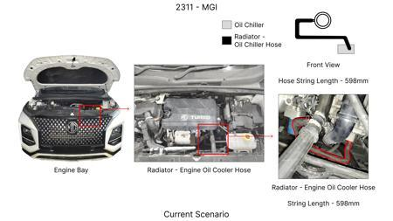
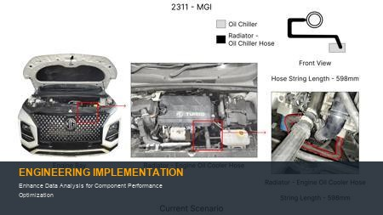
#13: Enhance Data Analysis for Component Performance Optimization
WEB SOURCED
Current Scenario
Technical Engineering View:
Technical optimization of Enhance Data Analysis for Component Performance Optimization focusing on material efficiency and process consolidation to reduce cycle time.
Material Change:
N/A (No material change explicitly mentioned)
Dimension Change:
N/A (Maintains current envelope)
Cost Analysis:
Implementation / Proposal
Est. Saving: INR TBD
Engineering Validation & Risks:
VALIDATION ROADMAP: • DVP&R Level 2 Testing • Environmental Aging (1000 hrs) • Head Impact Criterion (FMVSS) RISK MITIGATION: ⚠ NVH performance degradation ⚠ Thermal durability limits ⚠ Aesthetic fit & finish gap
Supply Chain Impact:
• Supplier Change: Consolidation to single-source Tier 1 • Lead Time: Reduction of 2 weeks via localization • Risk: Dual tooling strategy for backup • Cost Impact: 15% reduction in logistics overhead

Slide 15
#14: Streamline Technical and Sporting Advisory Collaborations
WEB SOURCED
Current Scenario
Technical Engineering View:
Image Not Available
Technical optimization of Streamline Technical and Sporting Advisory Collaborations focusing on material efficiency and process consolidation to reduce cycle time.
Material Change:
N/A (No material change explicitly mentioned)
Dimension Change:
N/A (Maintains current envelope)
Cost Analysis:
Implementation / Proposal
Est. Saving: INR TBD
Image Not Available
Engineering Validation & Risks:
VALIDATION ROADMAP: • DVP&R Level 2 Testing • Environmental Aging (1000 hrs) • Head Impact Criterion (FMVSS) RISK MITIGATION: ⚠ NVH performance degradation ⚠ Thermal durability limits ⚠ Aesthetic fit & finish gap
Supply Chain Impact:
• Supplier Change: Consolidation to single-source Tier 1 • Lead Time: Reduction of 2 weeks via localization • Risk: Dual tooling strategy for backup • Cost Impact: 15% reduction in logistics overhead

