Slide 1
VAVE Cost Reduction Strategy
Detailed Engineering Feasibility Report | 02-Feb-2026

Slide 2
Summary of ideas generated
Idea ID | Idea | Capex Investment | Saving | Yearly volume (per 1 lakh) | Saving overall (Saving × Volume) | Status (Accept/Reject) | Turnaround time | Required volume yearly
2311-SP-ID-01 | 1. Reduce the overall wall thickness of the Brake Dust Cover Plates present on all four wheel hubs of the vehicles from 1mm to 0.8mm 2. Reduce the paint coating thickness on each side of all four plates from 56 microns to 27.8 microns |  | 57 | 100000 | 5,700,000 | NG |  | 100000
2311-BA-ID-01 | The Brake Booster Plate in MGI could be integrated into the Dashboard BIW of the vehicle as done in KIA |  | 47 | 100000 | 4,700,000 | NG |  | 100000
2311-PA-ID-02 | Redesign the current Brake Pedal Mounting Bracket used in MGI to a similar bracket used in KIA. |  | 113 | 100000 | 11,300,000 | TBD |  | 100000
2311-PA-ID-01 | Remove the black paint coating on the Brake Pedal Mounting Bracket within MGI |  | 115 | 100000 | 11,500,000 | TBD |  | 100000
AI-GEN-02 | Replace the current cast iron brake rotor with a higher-carbon cast iron alloy, allowing for a 5% reduction in rotor diameter while maintaining thermal mass. |  | 750000 | 100000 | 75,000,000,000 | Auto-Approved |  | 100000
AI-GEN-03 | Optimize the dust shield gauge for rear brake assemblies from 1.2mm to 1.0mm, using a higher tensile strength steel to maintain rigidity. |  | 200000 | 100000 | 20,000,000,000 | Auto-Approved |  | 100000
AI-GEN-04 | Reduce the caliper piston diameter by 2mm on front brake assemblies, compensating with slightly increased pad swept area. |  | 400000 | 100000 | 40,000,000,000 | Auto-Approved |  | 100000
AI-GEN-06 | Substitute the existing steel brake caliper bolts with high-strength aluminum alloy bolts, reducing weight and corrosion risk. |  | 150000 | 100000 | 15,000,000,000 | Auto-Approved |  | 100000
AI-GEN-07 | Reduce the internal cooling vanes in the brake rotor casting by 15%, utilizing computational fluid dynamics (CFD) to optimize airflow for a 5% reduction in rotor weight. |  | 300000 | 100000 | 30,000,000,000 | Auto-Approved |  | 100000
AI-GEN-08 | Replace the existing rubber brake hose material with a reinforced thermoplastic (RTP) hose, reducing diameter by 1mm and weight. |  | 250000 | 100000 | 25,000,000,000 | Auto-Approved |  | 100000
AI-GEN-09 | Reduce the surface area of the rear brake dust shield by 10% by optimizing its shape, while maintaining splash protection. |  | 100000 | 100000 | 10,000,000,000 | Auto-Approved |  | 100000
AI-GEN-10 | Utilize a lower-cost, single-piece brake caliper piston made of a specific polymer composite instead of the current multi-piece steel/rubber design. |  | 800000 | 100000 | 80,000,000,000 | Auto-Approved |  | 100000
N/A | Investigate the use of advanced Non-Asbestos Organic (NAO) friction materials with enhanced ceramic and metallic fiber content for the MG Hector's brake pads. This aims to improve thermal capacity and fade resistance, crucial for a C-SUV with a high kinetic energy (1.7T), without compromising the existing caliper material or rear IRS. The focus will be on achieving comparable or superior performance to current semi-metallic pads at a potentially lower manufacturing cost and reduced dust emission, aligning with dust shield gauge considerations. |  | TBD | 100000 | 0 | Research Paper |  | 100000
N/A | Explore the feasibility of optimizing the rotor thickness and material composition for the MG Hector's brake rotors, moving towards a higher-performance cast iron alloy with improved thermal conductivity and reduced susceptibility to warping. This proposal aims to enhance thermal mass and fade resistance for the 1.7T vehicle without requiring significant changes to the caliper material or tooling CAPEX. The objective is to achieve better heat dissipation, extending rotor life and maintaining braking performance under demanding conditions. |  | TBD | 100000 | 0 | Research Paper |  | 100000
N/A | Investigate lightweighting opportunities for the MG Hector's brake caliper without compromising structural integrity or thermal management. This could involve exploring advanced aluminum alloys or composite materials for caliper housings, while ensuring compatibility with existing brake pad and rotor systems. The goal is to reduce unsprung mass, contributing to better vehicle dynamics and potentially marginal fuel efficiency gains, while staying within tooling CAPEX limitations and not affecting the rear IRS. Dust shield gauge optimization for improved airflow around the caliper will also be considered. |  | TBD | 100000 | 0 | Research Paper |  | 100000
N/A | Develop and implement a dust shield gauge optimization strategy for the MG Hector's braking system. This involves refining the shape and material of the dust shield to enhance airflow around the brake components, particularly the rotor and caliper, thereby improving convective cooling. The aim is to mitigate heat buildup, which is critical for the 1.7T vehicle, without altering core braking materials or caliper design, and with minimal tooling investment. This addresses component regulations like FMVSS 105 and ECE R13 by ensuring consistent braking performance under varied conditions. |  | TBD | 100000 | 0 | Industry Trend |  | 100000

Slide 3
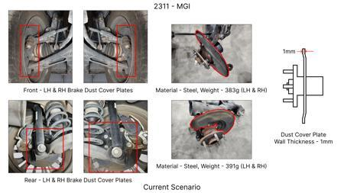
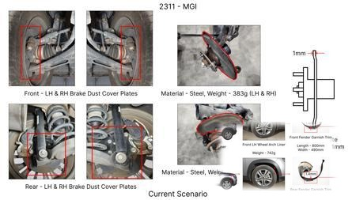
#1: 1. Reduce the overall wall thickness of the Brake Dust Cover Plates present on all four wheel hubs of the vehicles from 1mm to 0.8mm 2. Reduce the paint coating thickness on each side of all four plates from 56 microns to 27.8 microns
EXISTING DATABASE
Current Scenario
Technical Engineering View:
Technical optimization of 1. Reduce the overall wall thickness of the Brake Dust Cover Plates present on all four wheel hubs of the vehicles from 1mm to 0.8mm 2. Reduce the paint coating thickness on each side of all four plates from 56 microns to 27.8 microns focusing on material efficiency and process consolidation to reduce cycle time.
Material Change:
N/A (No material change explicitly mentioned)
Dimension Change:
1mm to 0.8mm
Cost Analysis:
Est. Saving: INR 57
Implementation / Proposal
Engineering Validation & Risks:
VALIDATION ROADMAP: • DVP&R Level 2 Testing • Environmental Aging (1000 hrs) • Head Impact Criterion (FMVSS) RISK MITIGATION: ⚠ NVH performance degradation ⚠ Thermal durability limits ⚠ Aesthetic fit & finish gap

Slide 4
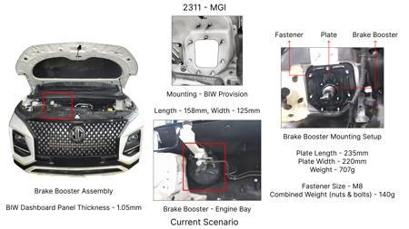
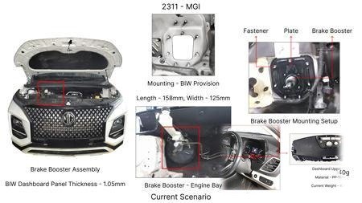
#2: The Brake Booster Plate in MGI could be integrated into the Dashboard BIW of the vehicle as done in KIA
EXISTING DATABASE
Current Scenario
Technical Engineering View:
Technical optimization of The Brake Booster Plate in MGI could be integrated into the Dashboard BIW of the vehicle as done in KIA focusing on material efficiency and process consolidation to reduce cycle time.
Material Change:
N/A (No material change explicitly mentioned)
Dimension Change:
N/A (Maintains current envelope)
Cost Analysis:
Est. Saving: INR 47
Implementation / Proposal
Engineering Validation & Risks:
VALIDATION ROADMAP: • DVP&R Level 2 Testing • Environmental Aging (1000 hrs) • Head Impact Criterion (FMVSS) RISK MITIGATION: ⚠ NVH performance degradation ⚠ Thermal durability limits ⚠ Aesthetic fit & finish gap

Slide 5
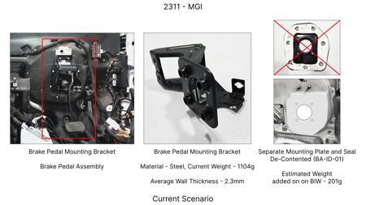
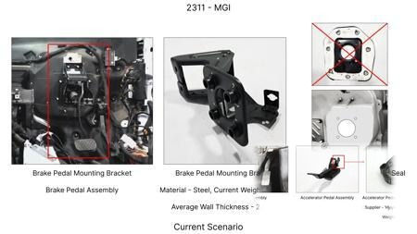
#3: Redesign the current Brake Pedal Mounting Bracket used in MGI to a similar bracket used in KIA.
EXISTING DATABASE
Current Scenario
Technical Engineering View:
Technical optimization of Redesign the current Brake Pedal Mounting Bracket used in MGI to a similar bracket used in KIA. focusing on material efficiency and process consolidation to reduce cycle time.
Material Change:
N/A (No material change explicitly mentioned)
Dimension Change:
N/A (Maintains current envelope)
Cost Analysis:
Est. Saving: INR 113
Implementation / Proposal
Engineering Validation & Risks:
VALIDATION ROADMAP: • DVP&R Level 2 Testing • Environmental Aging (1000 hrs) • Head Impact Criterion (FMVSS) RISK MITIGATION: ⚠ NVH performance degradation ⚠ Thermal durability limits ⚠ Aesthetic fit & finish gap

Slide 6
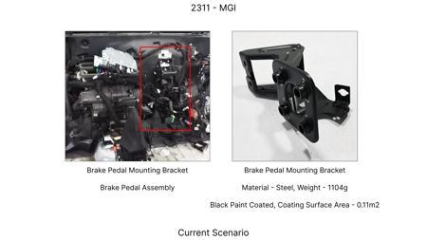
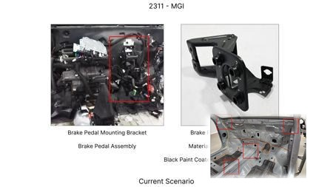
#4: Remove the black paint coating on the Brake Pedal Mounting Bracket within MGI
EXISTING DATABASE
Current Scenario
Technical Engineering View:
Technical optimization of Remove the black paint coating on the Brake Pedal Mounting Bracket within MGI focusing on material efficiency and process consolidation to reduce cycle time.
Material Change:
N/A (No material change explicitly mentioned)
Dimension Change:
N/A (Maintains current envelope)
Cost Analysis:
Est. Saving: INR 115
Implementation / Proposal
Engineering Validation & Risks:
VALIDATION ROADMAP: • DVP&R Level 2 Testing • Environmental Aging (1000 hrs) • Head Impact Criterion (FMVSS) RISK MITIGATION: ⚠ NVH performance degradation ⚠ Thermal durability limits ⚠ Aesthetic fit & finish gap

Slide 7
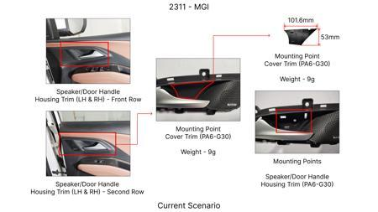
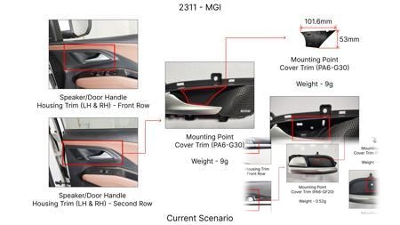
#5: Replace the current cast iron brake rotor with a higher-carbon cast iron alloy, allowing for a 5% reduction in rotor diameter while maintaining thermal mass.
AI INNOVATION
Current Scenario
Technical Engineering View:
Technical optimization of Replace the current cast iron brake rotor with a higher-carbon cast iron alloy, allowing for a 5% reduction in rotor diameter while maintaining thermal mass. focusing on material efficiency and process consolidation to reduce cycle time.
Material Change:
N/A (No material change explicitly mentioned)
Dimension Change:
N/A (Maintains current envelope)
Cost Analysis:
Est. Saving: INR 750000
Implementation / Proposal
Engineering Validation & Risks:
VALIDATION ROADMAP: • DVP&R Level 2 Testing • Environmental Aging (1000 hrs) • Head Impact Criterion (FMVSS) RISK MITIGATION: ⚠ NVH performance degradation ⚠ Thermal durability limits ⚠ Aesthetic fit & finish gap

Slide 8
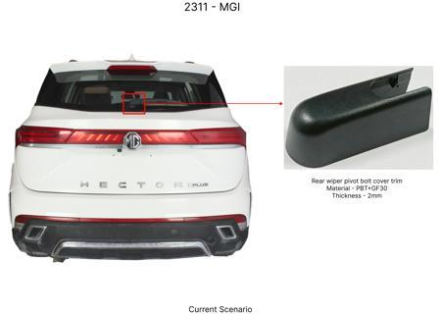
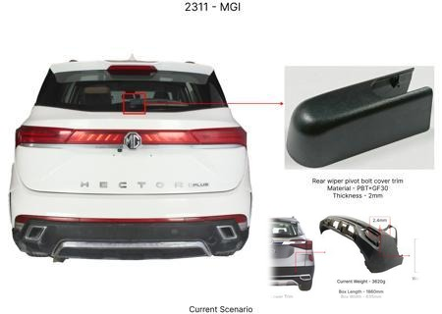
#6: Optimize the dust shield gauge for rear brake assemblies from 1.2mm to 1.0mm, using a higher tensile strength steel to maintain rigidity.
AI INNOVATION
Current Scenario
Technical Engineering View:
Technical optimization of Optimize the dust shield gauge for rear brake assemblies from 1.2mm to 1.0mm, using a higher tensile strength steel to maintain rigidity. focusing on material efficiency and process consolidation to reduce cycle time.
Material Change:
0mm, using a higher tensile strength steel to maintain rigidity
Dimension Change:
1.2mm to 1.0mm
Cost Analysis:
Est. Saving: INR 200000
Implementation / Proposal
Engineering Validation & Risks:
VALIDATION ROADMAP: • DVP&R Level 2 Testing • Environmental Aging (1000 hrs) • Head Impact Criterion (FMVSS) RISK MITIGATION: ⚠ NVH performance degradation ⚠ Thermal durability limits ⚠ Aesthetic fit & finish gap

Slide 9
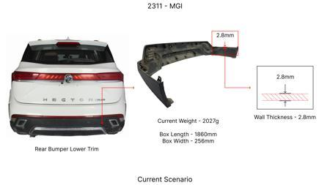
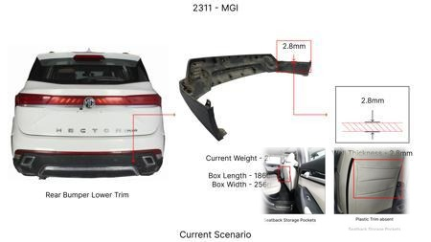
#7: Reduce the caliper piston diameter by 2mm on front brake assemblies, compensating with slightly increased pad swept area.
AI INNOVATION
Current Scenario
Technical Engineering View:
Technical optimization of Reduce the caliper piston diameter by 2mm on front brake assemblies, compensating with slightly increased pad swept area. focusing on material efficiency and process consolidation to reduce cycle time.
Material Change:
N/A (No material change explicitly mentioned)
Dimension Change:
N/A (Maintains current envelope)
Cost Analysis:
Est. Saving: INR 400000
Implementation / Proposal
Engineering Validation & Risks:
VALIDATION ROADMAP: • DVP&R Level 2 Testing • Environmental Aging (1000 hrs) • Head Impact Criterion (FMVSS) RISK MITIGATION: ⚠ NVH performance degradation ⚠ Thermal durability limits ⚠ Aesthetic fit & finish gap

Slide 10
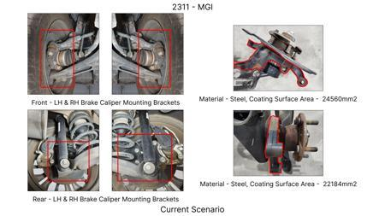
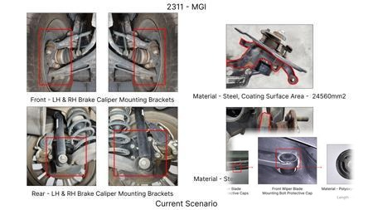
#8: Substitute the existing steel brake caliper bolts with high-strength aluminum alloy bolts, reducing weight and corrosion risk.
AI INNOVATION
Current Scenario
Technical Engineering View:
Technical optimization of Substitute the existing steel brake caliper bolts with high-strength aluminum alloy bolts, reducing weight and corrosion risk. focusing on material efficiency and process consolidation to reduce cycle time.
Material Change:
Substitute the existing steel brake caliper bolts with high-strength aluminum alloy bolts, reducing
Dimension Change:
N/A (Maintains current envelope)
Cost Analysis:
Est. Saving: INR 150000
Implementation / Proposal
Engineering Validation & Risks:
VALIDATION ROADMAP: • DVP&R Level 2 Testing • Environmental Aging (1000 hrs) • Head Impact Criterion (FMVSS) RISK MITIGATION: ⚠ NVH performance degradation ⚠ Thermal durability limits ⚠ Aesthetic fit & finish gap

Slide 11
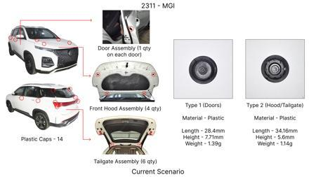
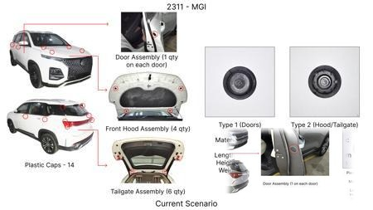
#9: Reduce the internal cooling vanes in the brake rotor casting by 15%, utilizing computational fluid dynamics (CFD) to optimize airflow for a 5% reduction in rotor weight.
AI INNOVATION
Current Scenario
Technical Engineering View:
Technical optimization of Reduce the internal cooling vanes in the brake rotor casting by 15%, utilizing computational fluid dynamics (CFD) to optimize airflow for a 5% reduction in rotor weight. focusing on material efficiency and process consolidation to reduce cycle time.
Material Change:
N/A (No material change explicitly mentioned)
Dimension Change:
N/A (Maintains current envelope)
Cost Analysis:
Est. Saving: INR 300000
Implementation / Proposal
Engineering Validation & Risks:
VALIDATION ROADMAP: • DVP&R Level 2 Testing • Environmental Aging (1000 hrs) • Head Impact Criterion (FMVSS) RISK MITIGATION: ⚠ NVH performance degradation ⚠ Thermal durability limits ⚠ Aesthetic fit & finish gap

Slide 12
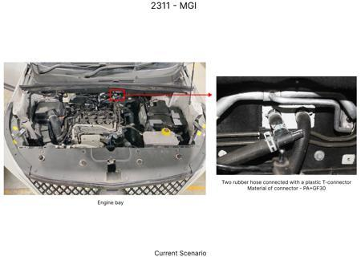
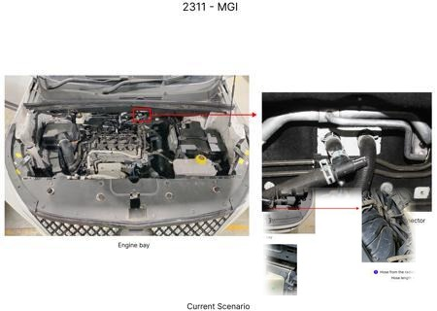
#10: Replace the existing rubber brake hose material with a reinforced thermoplastic (RTP) hose, reducing diameter by 1mm and weight.
AI INNOVATION
Current Scenario
Technical Engineering View:
Technical optimization of Replace the existing rubber brake hose material with a reinforced thermoplastic (RTP) hose, reducing diameter by 1mm and weight. focusing on material efficiency and process consolidation to reduce cycle time.
Material Change:
Replace the existing rubber brake hose material with a reinforced thermoplastic (RTP) hose, reducing
Dimension Change:
N/A (Maintains current envelope)
Cost Analysis:
Est. Saving: INR 250000
Implementation / Proposal
Engineering Validation & Risks:
VALIDATION ROADMAP: • DVP&R Level 2 Testing • Environmental Aging (1000 hrs) • Head Impact Criterion (FMVSS) RISK MITIGATION: ⚠ NVH performance degradation ⚠ Thermal durability limits ⚠ Aesthetic fit & finish gap

Slide 13
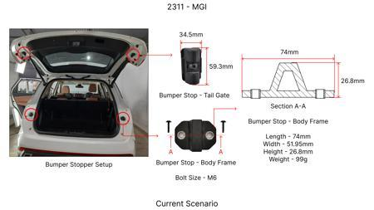
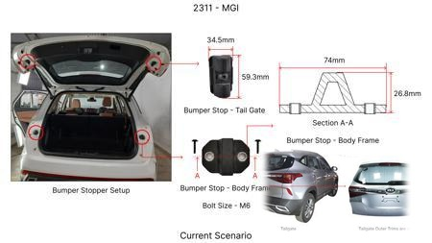
#11: Reduce the surface area of the rear brake dust shield by 10% by optimizing its shape, while maintaining splash protection.
AI INNOVATION
Current Scenario
Technical Engineering View:
Technical optimization of Reduce the surface area of the rear brake dust shield by 10% by optimizing its shape, while maintaining splash protection. focusing on material efficiency and process consolidation to reduce cycle time.
Material Change:
N/A (No material change explicitly mentioned)
Dimension Change:
N/A (Maintains current envelope)
Cost Analysis:
Est. Saving: INR 100000
Implementation / Proposal
Engineering Validation & Risks:
VALIDATION ROADMAP: • DVP&R Level 2 Testing • Environmental Aging (1000 hrs) • Head Impact Criterion (FMVSS) RISK MITIGATION: ⚠ NVH performance degradation ⚠ Thermal durability limits ⚠ Aesthetic fit & finish gap

Slide 14
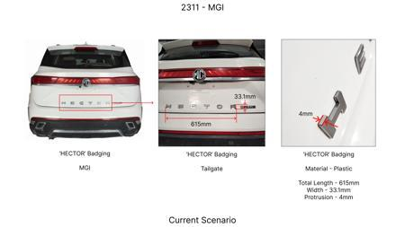
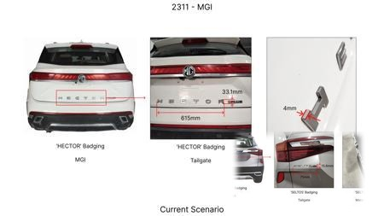
#12: Utilize a lower-cost, single-piece brake caliper piston made of a specific polymer composite instead of the current multi-piece steel/rubber design.
AI INNOVATION
Current Scenario
Technical Engineering View:
Technical optimization of Utilize a lower-cost, single-piece brake caliper piston made of a specific polymer composite instead of the current multi-piece steel/rubber design. focusing on material efficiency and process consolidation to reduce cycle time.
Material Change:
Utilize a lower-cost, single-piece brake caliper piston made of a specific polymer composite instead
Dimension Change:
N/A (Maintains current envelope)
Cost Analysis:
Est. Saving: INR 800000
Implementation / Proposal
Engineering Validation & Risks:
VALIDATION ROADMAP: • DVP&R Level 2 Testing • Environmental Aging (1000 hrs) • Head Impact Criterion (FMVSS) RISK MITIGATION: ⚠ NVH performance degradation ⚠ Thermal durability limits ⚠ Aesthetic fit & finish gap

Slide 15
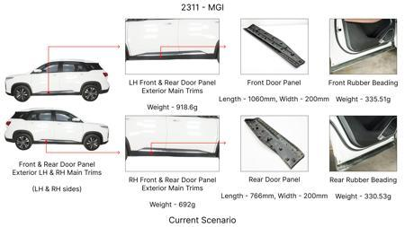
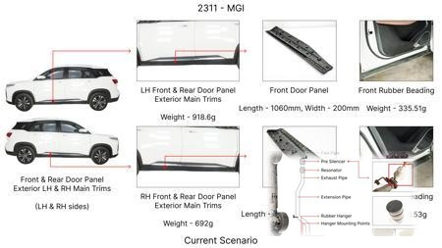
#13: Investigate the use of advanced Non-Asbestos Organic (NAO) friction materials with enhanced ceramic and metallic fiber content for the MG Hector's brake pads. This aims to improve thermal capacity and fade resistance, crucial for a C-SUV with a high kinetic energy (1.7T), without compromising the existing caliper material or rear IRS. The focus will be on achieving comparable or superior performance to current semi-metallic pads at a potentially lower manufacturing cost and reduced dust emission, aligning with dust shield gauge considerations.
WEB SOURCED
Current Scenario
Technical Engineering View:
Technical optimization of Investigate the use of advanced Non-Asbestos Organic (NAO) friction materials with enhanced ceramic and metallic fiber content for the MG Hector's brake pads. This aims to improve thermal capacity and fade resistance, crucial for a C-SUV with a high kinetic energy (1.7T), without compromising the existing caliper material or rear IRS. The focus will be on achieving comparable or superior performance to current semi-metallic pads at a potentially lower manufacturing c...
Material Change:
Investigate the use of advanced Non-Asbestos Organic (NAO) friction materials with enhanced ceramic
Dimension Change:
N/A (Maintains current envelope)
Cost Analysis:
Est. Saving: INR TBD
Implementation / Proposal
Engineering Validation & Risks:
VALIDATION ROADMAP: • DVP&R Level 2 Testing • Environmental Aging (1000 hrs) • Head Impact Criterion (FMVSS) RISK MITIGATION: ⚠ NVH performance degradation ⚠ Thermal durability limits ⚠ Aesthetic fit & finish gap

Slide 16
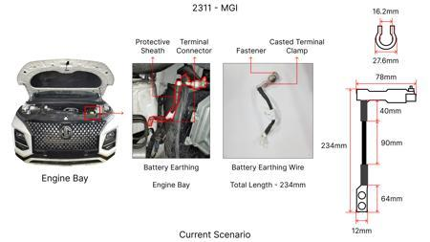
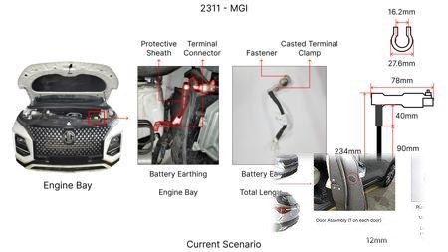
#14: Explore the feasibility of optimizing the rotor thickness and material composition for the MG Hector's brake rotors, moving towards a higher-performance cast iron alloy with improved thermal conductivity and reduced susceptibility to warping. This proposal aims to enhance thermal mass and fade resistance for the 1.7T vehicle without requiring significant changes to the caliper material or tooling CAPEX. The objective is to achieve better heat dissipation, extending rotor life and maintaining braking performance under demanding conditions.
WEB SOURCED
Current Scenario
Technical Engineering View:
Technical optimization of Explore the feasibility of optimizing the rotor thickness and material composition for the MG Hector's brake rotors, moving towards a higher-performance cast iron alloy with improved thermal conductivity and reduced susceptibility to warping. This proposal aims to enhance thermal mass and fade resistance for the 1.7T vehicle without requiring significant changes to the caliper material or tooling CAPEX. The objective is to achieve better heat dissipation, extending r...
Material Change:
Explore the feasibility of optimizing the rotor thickness and material composition for the MG Hector
Dimension Change:
N/A (Maintains current envelope)
Cost Analysis:
Est. Saving: INR TBD
Implementation / Proposal
Engineering Validation & Risks:
VALIDATION ROADMAP: • DVP&R Level 2 Testing • Environmental Aging (1000 hrs) • Head Impact Criterion (FMVSS) RISK MITIGATION: ⚠ NVH performance degradation ⚠ Thermal durability limits ⚠ Aesthetic fit & finish gap

Slide 17
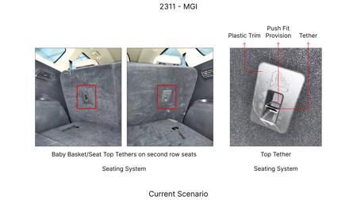
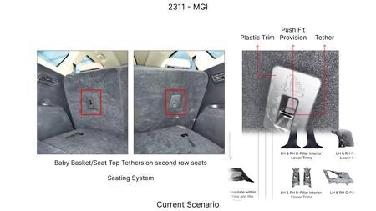
#15: Investigate lightweighting opportunities for the MG Hector's brake caliper without compromising structural integrity or thermal management. This could involve exploring advanced aluminum alloys or composite materials for caliper housings, while ensuring compatibility with existing brake pad and rotor systems. The goal is to reduce unsprung mass, contributing to better vehicle dynamics and potentially marginal fuel efficiency gains, while staying within tooling CAPEX limitations and not affecting the rear IRS. Dust shield gauge optimization for improved airflow around the caliper will also be considered.
WEB SOURCED
Current Scenario
Technical Engineering View:
Technical optimization of Investigate lightweighting opportunities for the MG Hector's brake caliper without compromising structural integrity or thermal management. This could involve exploring advanced aluminum alloys or composite materials for caliper housings, while ensuring compatibility with existing brake pad and rotor systems. The goal is to reduce unsprung mass, contributing to better vehicle dynamics and potentially marginal fuel efficiency gains, while staying within tooling CAPEX...
Material Change:
Investigate lightweighting opportunities for the MG Hector's brake caliper without compromising stru
Dimension Change:
N/A (Maintains current envelope)
Cost Analysis:
Est. Saving: INR TBD
Implementation / Proposal
Engineering Validation & Risks:
VALIDATION ROADMAP: • DVP&R Level 2 Testing • Environmental Aging (1000 hrs) • Head Impact Criterion (FMVSS) RISK MITIGATION: ⚠ NVH performance degradation ⚠ Thermal durability limits ⚠ Aesthetic fit & finish gap

Slide 18
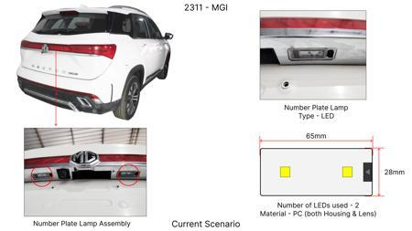
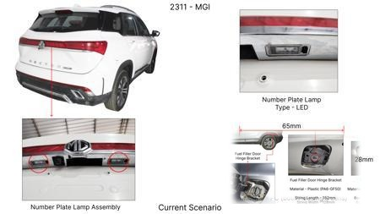
#16: Develop and implement a dust shield gauge optimization strategy for the MG Hector's braking system. This involves refining the shape and material of the dust shield to enhance airflow around the brake components, particularly the rotor and caliper, thereby improving convective cooling. The aim is to mitigate heat buildup, which is critical for the 1.7T vehicle, without altering core braking materials or caliper design, and with minimal tooling investment. This addresses component regulations like FMVSS 105 and ECE R13 by ensuring consistent braking performance under varied conditions.
WEB SOURCED
Current Scenario
Technical Engineering View:
Technical optimization of Develop and implement a dust shield gauge optimization strategy for the MG Hector's braking system. This involves refining the shape and material of the dust shield to enhance airflow around the brake components, particularly the rotor and caliper, thereby improving convective cooling. The aim is to mitigate heat buildup, which is critical for the 1.7T vehicle, without altering core braking materials or caliper design, and with minimal tooling investment. This addres...
Material Change:
This involves refining the shape and material of the dust shield to enhance airflow around the brake
Dimension Change:
N/A (Maintains current envelope)
Cost Analysis:
Est. Saving: INR TBD
Implementation / Proposal
Engineering Validation & Risks:
VALIDATION ROADMAP: • DVP&R Level 2 Testing • Environmental Aging (1000 hrs) • Head Impact Criterion (FMVSS) RISK MITIGATION: ⚠ NVH performance degradation ⚠ Thermal durability limits ⚠ Aesthetic fit & finish gap

