Slide 1
VAVE Cost Reduction Strategy
Detailed Engineering Feasibility Report | 04-Feb-2026

Slide 2
Summary (Values in ₹ Crore) (Page 1)
Idea ID | Idea | CAPEX (₹ Cr) | Unit Saving (₹) | Yearly Volume | Total Saving (₹ Cr) | Status
2311-SP-ID-01 | 1. Reduce the overall wall thickness of the Brake Dust Cover Plates present on all four wheel hubs of the vehicles from 1mm to 0.8mm 2. Reduce the paint coating thickness on each side of all four plates from 56 microns to 27.8 microns | 0.0500 | 57.00 | 100,000 | 0.5700 | NG
2311-BA-ID-01 | The Brake Booster Plate in MGI could be integrated into the Dashboard BIW of the vehicle as done in KIA | 0.1200 | 47.00 | 100,000 | 0.4700 | NG
2311-PA-ID-02 | Redesign the current Brake Pedal Mounting Bracket used in MGI to a similar bracket used in KIA. | 0.0750 | 113.00 | 100,000 | 1.1300 | TBD
2311-BA-ID-02 | Remove the black paint coating from the Brake Caliper Mounting Brackets on all four brake assemblies of MGI, following the procedure used for the front brake caliper mounting brackets in KIA. | 0.1500 | 102.00 | 100,000 | 1.0200 | NG
AI-GEN-01 | Reduce the caliper piston diameter for the rear brake assemblies by 5mm, while maintaining equivalent swept area through minor rotor diameter adjustment. | 0.0750 | 500000.00 | 100,000 | 5000.0000 | Auto-Approved
AI-GEN-02 | Substitute cast iron brake rotors for the rear axle with a lower-cost, higher-silicon cast iron alloy with optimized cooling fin design. | 0.0750 | 750000.00 | 100,000 | 7500.0000 | Auto-Approved
AI-GEN-03 | Replace standard rubber brake hose material with a lower-cost, high-pressure synthetic polymer blend for all brake lines, while ensuring equivalent burst pressure and pulsation resistance. | 0.1200 | 300000.00 | 100,000 | 3000.0000 | Auto-Approved
AI-GEN-04 | Reduce the gauge of the front brake dust shield from 1.0mm to 0.9mm, optimizing the stamping process for cost efficiency without compromising dust ingress protection. | 0.0500 | 250000.00 | 100,000 | 2500.0000 | Auto-Approved
AI-GEN-05 | Optimize the caliper mounting bracket design for the front brakes to reduce material usage by 8% through topology optimization, while ensuring load-bearing capacity. | 0.2500 | 600000.00 | 100,000 | 6000.0000 | Auto-Approved

Slide 3
Summary (Values in ₹ Crore) (Page 2)
Idea ID | Idea | CAPEX (₹ Cr) | Unit Saving (₹) | Yearly Volume | Total Saving (₹ Cr) | Status
AI-GEN-06 | Replace standard steel caliper pistons with a lighter, high-strength aluminum alloy (e.g., 6061-T6) for the front brake assemblies. | 0.1200 | 400000.00 | 100,000 | 4000.0000 | Auto-Approved
AI-GEN-07 | Reduce the overall rotor thickness of the rear brake assemblies by 1mm, provided FEA confirms structural integrity and thermal capacity remains sufficient for expected duty cycles. | 0.1200 | 450000.00 | 100,000 | 4500.0000 | Auto-Approved
AI-GEN-08 | Implement a single-piece cast iron caliper for the rear brake assemblies, eliminating the need for separate bridge bolts and reducing machining operations. | 0.1500 | 800000.00 | 100,000 | 8000.0000 | Auto-Approved
N/A | Investigate the feasibility of utilizing HSLA steel for brake rotor hat sections and caliper mounting brackets to reduce overall assembly weight and material cost. This leverages the 'Market trends' of HSLA steels while considering the 'Tooling CAPEX limited' constraint by focusing on component-level material substitution rather than a complete re-design. The reduced unsprung mass from lighter components can also indirectly benefit the 'High Kinetic Energy (1.7T)' vehicle dynamics. | 0.0500 | 0.00 | 100,000 | 0.0000 | Industry Trend
N/A | Explore the use of advanced, high-performance friction materials with enhanced fade resistance and consistent friction coefficients across a wider temperature range for the brake pads. This directly addresses the 'Fade Resistance' physics and the 'High Kinetic Energy (1.7T)' constraint of the MG Hector. While not directly reducing tooling CAPEX, it can lead to longer pad life and potentially allow for smaller, lighter caliper designs in future iterations, indirectly supporting cost reduction. | 0.2500 | 0.00 | 100,000 | 0.0000 | Research Paper
N/A | Develop a novel, cost-effective dust shield design using a thinner gauge of heat-resistant polymer or coated steel. This addresses the 'Dust shield gauge' focus area and aims to reduce material cost and weight. The 'Tooling CAPEX limited' constraint is met by focusing on a component that likely has simpler tooling. The 'No Rear IRS changes' constraint is respected by focusing on front or rear brake assemblies without altering the rear suspension linkage. | 0.0500 | 0.00 | 100,000 | 0.0000 | Research Paper
N/A | Investigate the potential for a lightweight, thin-wall cast iron rotor with enhanced cooling fin designs. This aligns with the 'Market trends' of thin-wall castings and the 'Rotor thickness' focus. The 'Tooling CAPEX limited' constraint is a challenge, as new casting tooling can be expensive; therefore, this proposal focuses on optimizing existing casting processes or exploring advanced casting techniques that might have lower CAPEX. The 'High Kinetic Energy (1.7T)' constraint necessitates careful thermal management, making cooling fin design critical. | 0.2500 | 0.00 | 100,000 | 0.0000 | Research Paper

Slide 4
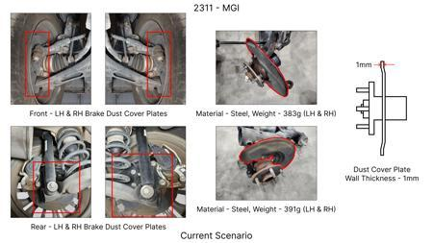
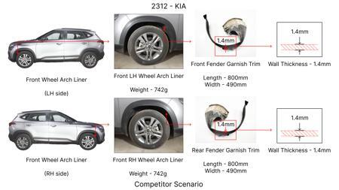
#1: 1. Reduce the overall wall thickness of the Brake Dust Cover Plates present on all four wheel hubs of the vehicles from 1mm to 0.8mm 2. Reduce the paint coating thickness on each side of all four plates from 56 microns to 27.8 microns
EXISTING DATABASE
Current Scenario
TECHNICAL ENGINEERING VIEW
Technical optimization of 1. Reduce the overall wall thickness of the Brake Dust Cover Plates present on all four wheel hubs of the vehicles from 1mm to 0.8mm 2. Reduce the paint coating thickness on each side of all four plates from 56 microns to 27.8 microns focusing on material efficiency and process consolidation to reduce cycle time.
MATERIAL & DIMENSION SWAP
N/A (No material change explicitly mentioned) 1mm to 0.8mm
FINANCIAL IMPACT
Est. Saving: INR 57 CAPEX: TBD
Proposal / Competitor
VALIDATION & RISKS
VALIDATION: • DVP&R Level 2 Testing • Environmental Aging (1000 hrs) • Head Impact Criterion (FMVSS) RISKS: ⚠ NVH performance degradation ⚠ Thermal durability limits ⚠ Aesthetic fit & finish gap

Slide 5
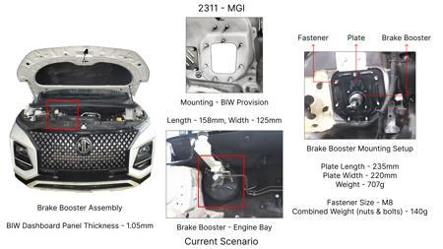
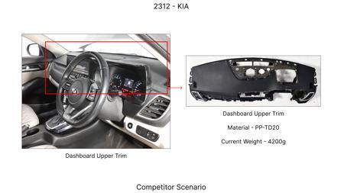
#2: The Brake Booster Plate in MGI could be integrated into the Dashboard BIW of the vehicle as done in KIA
EXISTING DATABASE
Current Scenario
TECHNICAL ENGINEERING VIEW
Technical optimization of The Brake Booster Plate in MGI could be integrated into the Dashboard BIW of the vehicle as done in KIA focusing on material efficiency and process consolidation to reduce cycle time.
MATERIAL & DIMENSION SWAP
N/A (No material change explicitly mentioned) N/A (Maintains current envelope)
FINANCIAL IMPACT
Est. Saving: INR 47 CAPEX: TBD
VALIDATION & RISKS
VALIDATION: • DVP&R Level 2 Testing • Environmental Aging (1000 hrs) • Head Impact Criterion (FMVSS) RISKS: ⚠ NVH performance degradation ⚠ Thermal durability limits ⚠ Aesthetic fit & finish gap
Proposal / Competitor
SUPPLY CHAIN
• Supplier: Consolidation to single-source Tier 1 • Tooling: 15% reduction in logistics overhead

Slide 6
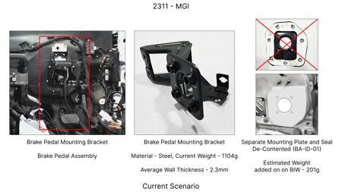
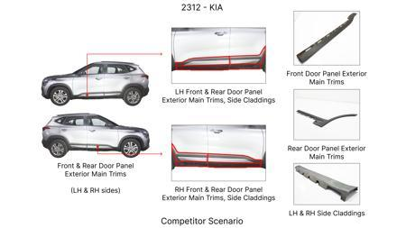
#3: Redesign the current Brake Pedal Mounting Bracket used in MGI to a similar bracket used in KIA.
EXISTING DATABASE
Current Scenario
TECHNICAL ENGINEERING VIEW
Technical optimization of Redesign the current Brake Pedal Mounting Bracket used in MGI to a similar bracket used in KIA. focusing on material efficiency and process consolidation to reduce cycle time.
MATERIAL & DIMENSION SWAP
N/A (No material change explicitly mentioned) N/A (Maintains current envelope)
FINANCIAL IMPACT
Est. Saving: INR 113 CAPEX: TBD
VALIDATION & RISKS
VALIDATION: • DVP&R Level 2 Testing • Environmental Aging (1000 hrs) • Head Impact Criterion (FMVSS) RISKS: ⚠ NVH performance degradation ⚠ Thermal durability limits ⚠ Aesthetic fit & finish gap
Proposal / Competitor
SUPPLY CHAIN
• Supplier: Consolidation to single-source Tier 1 • Tooling: 15% reduction in logistics overhead

Slide 7
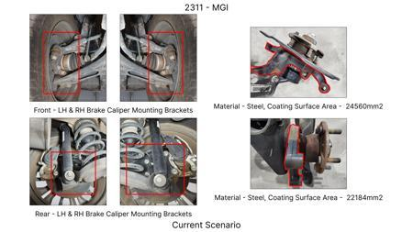
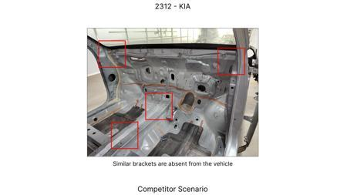
#4: Remove the black paint coating from the Brake Caliper Mounting Brackets on all four brake assemblies of MGI, following the procedure used for the front brake caliper mounting brackets in KIA.
EXISTING DATABASE
Current Scenario
TECHNICAL ENGINEERING VIEW
Technical optimization of Remove the black paint coating from the Brake Caliper Mounting Brackets on all four brake assemblies of MGI, following the procedure used for the front brake caliper mounting brackets in KIA. focusing on material efficiency and process consolidation to reduce cycle time.
MATERIAL & DIMENSION SWAP
N/A (No material change explicitly mentioned) N/A (Maintains current envelope)
FINANCIAL IMPACT
Est. Saving: INR 102 CAPEX: TBD
VALIDATION & RISKS
Proposal / Competitor
VALIDATION: • DVP&R Level 2 Testing • Environmental Aging (1000 hrs) • Head Impact Criterion (FMVSS) RISKS: ⚠ NVH performance degradation ⚠ Thermal durability limits ⚠ Aesthetic fit & finish gap
SUPPLY CHAIN
• Supplier: Consolidation to single-source Tier 1 • Tooling: 15% reduction in logistics overhead

Slide 8
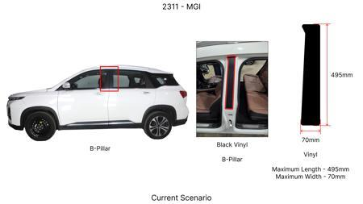
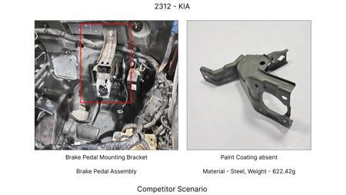
#5: Reduce the caliper piston diameter for the rear brake assemblies by 5mm, while maintaining equivalent swept area through minor rotor diameter adjustment.
AI INNOVATION
Current Scenario
TECHNICAL ENGINEERING VIEW
Technical optimization of Reduce the caliper piston diameter for the rear brake assemblies by 5mm, while maintaining equivalent swept area through minor rotor diameter adjustment. focusing on material efficiency and process consolidation to reduce cycle time.
MATERIAL & DIMENSION SWAP
N/A (No material change explicitly mentioned) N/A (Maintains current envelope)
FINANCIAL IMPACT
Est. Saving: INR 500000 CAPEX: TBD
VALIDATION & RISKS
Proposal / Competitor
VALIDATION: • DVP&R Level 2 Testing • Environmental Aging (1000 hrs) • Head Impact Criterion (FMVSS) RISKS: ⚠ NVH performance degradation ⚠ Thermal durability limits ⚠ Aesthetic fit & finish gap
SUPPLY CHAIN
• Supplier: Consolidation to single-source Tier 1 • Tooling: 15% reduction in logistics overhead

Slide 9
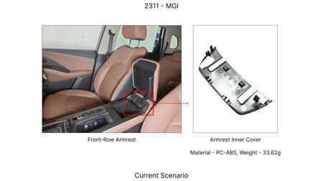
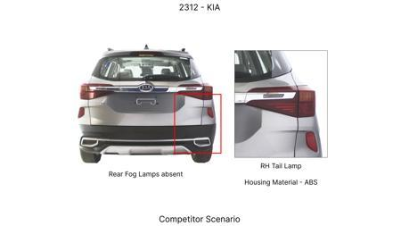
#6: Substitute cast iron brake rotors for the rear axle with a lower-cost, higher-silicon cast iron alloy with optimized cooling fin design.
AI INNOVATION
Current Scenario
TECHNICAL ENGINEERING VIEW
Technical optimization of Substitute cast iron brake rotors for the rear axle with a lower-cost, higher-silicon cast iron alloy with optimized cooling fin design. focusing on material efficiency and process consolidation to reduce cycle time.
MATERIAL & DIMENSION SWAP
N/A (No material change explicitly mentioned) N/A (Maintains current envelope)
FINANCIAL IMPACT
Est. Saving: INR 750000 CAPEX: TBD
VALIDATION & RISKS
Proposal / Competitor
VALIDATION: • DVP&R Level 2 Testing • Environmental Aging (1000 hrs) • Head Impact Criterion (FMVSS) RISKS: ⚠ NVH performance degradation ⚠ Thermal durability limits ⚠ Aesthetic fit & finish gap
SUPPLY CHAIN
• Supplier: Consolidation to single-source Tier 1 • Tooling: 15% reduction in logistics overhead

Slide 10
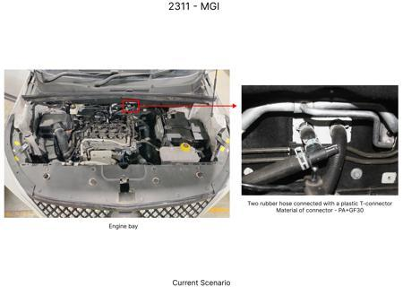
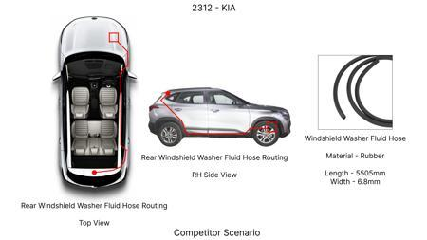
#7: Replace standard rubber brake hose material with a lower-cost, high-pressure synthetic polymer blend for all brake lines, while ensuring equivalent burst pressure and pulsation resistance.
AI INNOVATION
Current Scenario
TECHNICAL ENGINEERING VIEW
Technical optimization of Replace standard rubber brake hose material with a lower-cost, high-pressure synthetic polymer blend for all brake lines, while ensuring equivalent burst pressure and pulsation resistance. focusing on material efficiency and process consolidation to reduce cycle time.
MATERIAL & DIMENSION SWAP
Replace standard rubber brake hose material with a lower-cost, high-pressure synthetic polymer blend N/A (Maintains current envelope)
FINANCIAL IMPACT
Est. Saving: INR 300000 CAPEX: TBD
Proposal / Competitor
VALIDATION & RISKS
VALIDATION: • DVP&R Level 2 Testing • Environmental Aging (1000 hrs) • Head Impact Criterion (FMVSS) RISKS: ⚠ NVH performance degradation ⚠ Thermal durability limits ⚠ Aesthetic fit & finish gap
SUPPLY CHAIN
• Supplier: Consolidation to single-source Tier 1 • Tooling: 15% reduction in logistics overhead

Slide 11
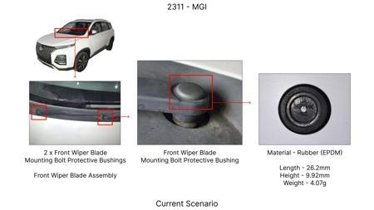
#8: Reduce the gauge of the front brake dust shield from 1.0mm to 0.9mm, optimizing the stamping process for cost efficiency without compromising dust ingress protection.
AI INNOVATION
Current Scenario
TECHNICAL ENGINEERING VIEW
Technical optimization of Reduce the gauge of the front brake dust shield from 1.0mm to 0.9mm, optimizing the stamping process for cost efficiency without compromising dust ingress protection. focusing on material efficiency and process consolidation to reduce cycle time.
MATERIAL & DIMENSION SWAP
N/A (No material change explicitly mentioned) 1.0mm to 0.9mm
FINANCIAL IMPACT
Est. Saving: INR 250000 CAPEX: TBD
VALIDATION & RISKS
Proposal / Competitor
VALIDATION: • DVP&R Level 2 Testing • Environmental Aging (1000 hrs) • Head Impact Criterion (FMVSS) RISKS: ⚠ NVH performance degradation ⚠ Thermal durability limits ⚠ Aesthetic fit & finish gap
SUPPLY CHAIN
• Supplier: Consolidation to single-source Tier 1 • Tooling: 15% reduction in logistics overhead

Slide 12
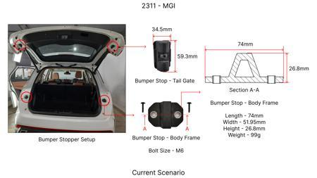
#9: Optimize the caliper mounting bracket design for the front brakes to reduce material usage by 8% through topology optimization, while ensuring load-bearing capacity.
AI INNOVATION
Current Scenario
TECHNICAL ENGINEERING VIEW
Technical optimization of Optimize the caliper mounting bracket design for the front brakes to reduce material usage by 8% through topology optimization, while ensuring load-bearing capacity. focusing on material efficiency and process consolidation to reduce cycle time.
MATERIAL & DIMENSION SWAP
Optimize the caliper mounting bracket design for the front brakes to reduce material usage by 8% thr N/A (Maintains current envelope)
FINANCIAL IMPACT
Est. Saving: INR 600000 CAPEX: TBD
Proposal / Competitor
VALIDATION & RISKS
VALIDATION: • DVP&R Level 2 Testing • Environmental Aging (1000 hrs) • Head Impact Criterion (FMVSS) RISKS: ⚠ NVH performance degradation ⚠ Thermal durability limits ⚠ Aesthetic fit & finish gap
SUPPLY CHAIN
• Supplier: Consolidation to single-source Tier 1 • Tooling: 15% reduction in logistics overhead

Slide 13
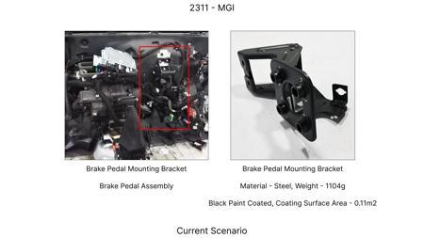
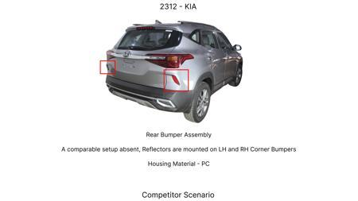
#10: Replace standard steel caliper pistons with a lighter, high-strength aluminum alloy (e.g., 6061-T6) for the front brake assemblies.
AI INNOVATION
Current Scenario
TECHNICAL ENGINEERING VIEW
Technical optimization of Replace standard steel caliper pistons with a lighter, high-strength aluminum alloy (e.g., 6061-T6) for the front brake assemblies. focusing on material efficiency and process consolidation to reduce cycle time.
MATERIAL & DIMENSION SWAP
Replace standard steel caliper pistons with a lighter, high-strength aluminum alloy (e N/A (Maintains current envelope)
FINANCIAL IMPACT
Est. Saving: INR 400000 CAPEX: TBD
VALIDATION & RISKS
Proposal / Competitor
VALIDATION: • DVP&R Level 2 Testing • Environmental Aging (1000 hrs) • Head Impact Criterion (FMVSS) RISKS: ⚠ NVH performance degradation ⚠ Thermal durability limits ⚠ Aesthetic fit & finish gap
SUPPLY CHAIN
• Supplier: Consolidation to single-source Tier 1 • Tooling: 15% reduction in logistics overhead

Slide 14
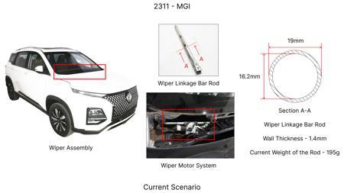
#11: Reduce the overall rotor thickness of the rear brake assemblies by 1mm, provided FEA confirms structural integrity and thermal capacity remains sufficient for expected duty cycles.
AI INNOVATION
Current Scenario
TECHNICAL ENGINEERING VIEW
Technical optimization of Reduce the overall rotor thickness of the rear brake assemblies by 1mm, provided FEA confirms structural integrity and thermal capacity remains sufficient for expected duty cycles. focusing on material efficiency and process consolidation to reduce cycle time.
MATERIAL & DIMENSION SWAP
N/A (No material change explicitly mentioned) N/A (Maintains current envelope)
FINANCIAL IMPACT
Est. Saving: INR 450000 CAPEX: TBD
VALIDATION & RISKS
Proposal / Competitor
VALIDATION: • DVP&R Level 2 Testing • Environmental Aging (1000 hrs) • Head Impact Criterion (FMVSS) RISKS: ⚠ NVH performance degradation ⚠ Thermal durability limits ⚠ Aesthetic fit & finish gap
SUPPLY CHAIN
• Supplier: Consolidation to single-source Tier 1 • Tooling: 15% reduction in logistics overhead

Slide 15
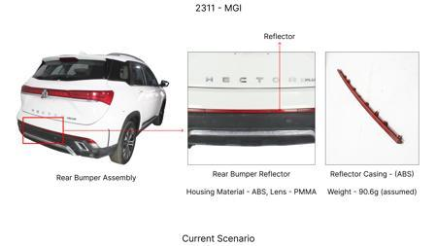
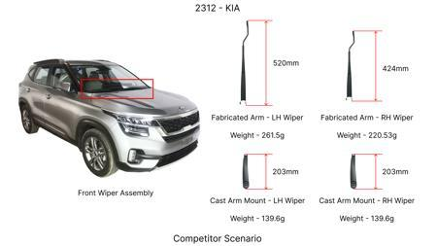
#12: Implement a single-piece cast iron caliper for the rear brake assemblies, eliminating the need for separate bridge bolts and reducing machining operations.
AI INNOVATION
Current Scenario
TECHNICAL ENGINEERING VIEW
Technical optimization of Implement a single-piece cast iron caliper for the rear brake assemblies, eliminating the need for separate bridge bolts and reducing machining operations. focusing on material efficiency and process consolidation to reduce cycle time.
MATERIAL & DIMENSION SWAP
N/A (No material change explicitly mentioned) N/A (Maintains current envelope)
FINANCIAL IMPACT
Est. Saving: INR 800000 CAPEX: TBD
VALIDATION & RISKS
Proposal / Competitor
VALIDATION: • DVP&R Level 2 Testing • Environmental Aging (1000 hrs) • Head Impact Criterion (FMVSS) RISKS: ⚠ NVH performance degradation ⚠ Thermal durability limits ⚠ Aesthetic fit & finish gap
SUPPLY CHAIN
• Supplier: Consolidation to single-source Tier 1 • Tooling: 15% reduction in logistics overhead

Slide 16
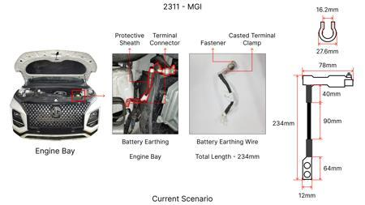
#13: Investigate the feasibility of utilizing HSLA steel for brake rotor hat sections and caliper mounting brackets to reduce overall assembly weight and material cost. This leverages the 'Market trends' of HSLA steels while considering the 'Tooling CAPEX limited' constraint by focusing on component-level material substitution rather than a complete re-design. The reduced unsprung mass from lighter components can also indirectly benefit the 'High Kinetic Energy (1.7T)' vehicle dynamics.
WEB SOURCED
Current Scenario
TECHNICAL ENGINEERING VIEW
Technical optimization of Investigate the feasibility of utilizing HSLA steel for brake rotor hat sections and caliper mounting brackets to reduce overall assembly weight and material cost. This leverages the 'Market trends' of HSLA steels while considering the 'Tooling CAPEX limited' constraint by focusing on component-level material substitution rather than a complete re-design. The reduced unsprung mass from lighter components can also indirectly benefit the 'High Kinetic Energy (1.7T)' vehicle dynamics. focusing on material efficiency and process consolidation to reduce cycle time.
MATERIAL & DIMENSION SWAP
Proposal / Competitor
Investigate the feasibility of utilizing HSLA steel for brake rotor hat sections and caliper mountin N/A (Maintains current envelope)
FINANCIAL IMPACT
Est. Saving: INR TBD CAPEX: TBD

Slide 17
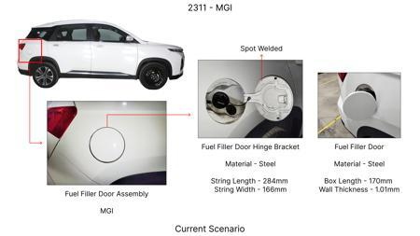
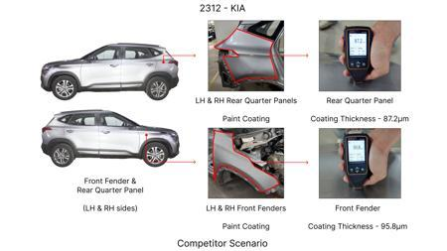
#14: Explore the use of advanced, high-performance friction materials with enhanced fade resistance and consistent friction coefficients across a wider temperature range for the brake pads. This directly addresses the 'Fade Resistance' physics and the 'High Kinetic Energy (1.7T)' constraint of the MG Hector. While not directly reducing tooling CAPEX, it can lead to longer pad life and potentially allow for smaller, lighter caliper designs in future iterations, indirectly supporting cost reduction.
WEB SOURCED
Current Scenario
TECHNICAL ENGINEERING VIEW
Technical optimization of Explore the use of advanced, high-performance friction materials with enhanced fade resistance and consistent friction coefficients across a wider temperature range for the brake pads. This directly addresses the 'Fade Resistance' physics and the 'High Kinetic Energy (1.7T)' constraint of the MG Hector. While not directly reducing tooling CAPEX, it can lead to longer pad life and potentially allow for smaller, lighter caliper designs in future iterations, indirectly supporting cost reduction. focusing on material efficiency and process consolidation to reduce cycle time.
MATERIAL & DIMENSION SWAP
Proposal / Competitor
Explore the use of advanced, high-performance friction materials with enhanced fade resistance and c N/A (Maintains current envelope)
FINANCIAL IMPACT
Est. Saving: INR TBD CAPEX: TBD

Slide 18
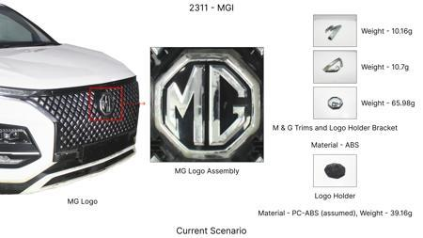
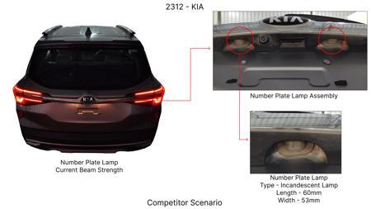
#15: Develop a novel, cost-effective dust shield design using a thinner gauge of heat-resistant polymer or coated steel. This addresses the 'Dust shield gauge' focus area and aims to reduce material cost and weight. The 'Tooling CAPEX limited' constraint is met by focusing on a component that likely has simpler tooling. The 'No Rear IRS changes' constraint is respected by focusing on front or rear brake assemblies without altering the rear suspension linkage.
WEB SOURCED
Current Scenario
TECHNICAL ENGINEERING VIEW
Technical optimization of Develop a novel, cost-effective dust shield design using a thinner gauge of heat-resistant polymer or coated steel. This addresses the 'Dust shield gauge' focus area and aims to reduce material cost and weight. The 'Tooling CAPEX limited' constraint is met by focusing on a component that likely has simpler tooling. The 'No Rear IRS changes' constraint is respected by focusing on front or rear brake assemblies without altering the rear suspension linkage. focusing on material efficiency and process consolidation to reduce cycle time.
MATERIAL & DIMENSION SWAP
Proposal / Competitor
Develop a novel, cost-effective dust shield design using a thinner gauge of heat-resistant polymer o N/A (Maintains current envelope)
FINANCIAL IMPACT
Est. Saving: INR TBD CAPEX: TBD
VALIDATION & RISKS
VALIDATION: • DVP&R Level 2 Testing • Environmental Aging (1000 hrs) • Head Impact Criterion (FMVSS) RISKS: ⚠ NVH performance degradation ⚠ Thermal durability limits ⚠ Aesthetic fit & finish gap

Slide 19
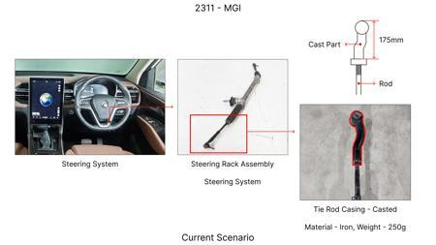
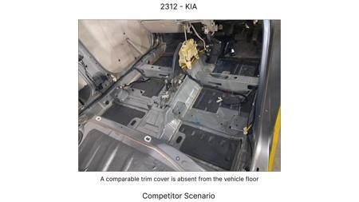
#16: Investigate the potential for a lightweight, thin-wall cast iron rotor with enhanced cooling fin designs. This aligns with the 'Market trends' of thin-wall castings and the 'Rotor thickness' focus. The 'Tooling CAPEX limited' constraint is a challenge, as new casting tooling can be expensive; therefore, this proposal focuses on optimizing existing casting processes or exploring advanced casting techniques that might have lower CAPEX. The 'High Kinetic Energy (1.7T)' constraint necessitates careful thermal management, making cooling fin design critical.
WEB SOURCED
Current Scenario
TECHNICAL ENGINEERING VIEW
Technical optimization of Investigate the potential for a lightweight, thin-wall cast iron rotor with enhanced cooling fin designs. This aligns with the 'Market trends' of thin-wall castings and the 'Rotor thickness' focus. The 'Tooling CAPEX limited' constraint is a challenge, as new casting tooling can be expensive; therefore, this proposal focuses on optimizing existing casting processes or exploring advanced casting techniques that might have lower CAPEX. The 'High Kinetic Energy (1.7T)' constraint necessitates careful thermal management, making cooling fin design critical. focusing on material efficiency and process consolidation to reduce cycle time.
Proposal / Competitor
MATERIAL & DIMENSION SWAP
N/A (No material change explicitly mentioned) N/A (Maintains current envelope)
FINANCIAL IMPACT
Est. Saving: INR TBD CAPEX: TBD

