Slide 1
VAVE Cost Reduction Strategy
Detailed Engineering Feasibility Report | 01-Jan-2026

Slide 2
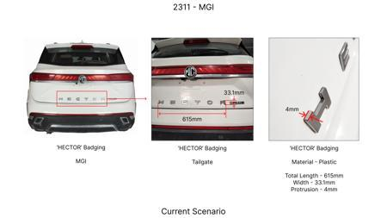
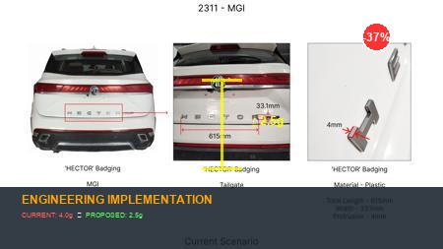
#1: Reduce the projection of the 'HECTOR' badging on the tailgate at the rear end of the car from 4mm to 2.5mm
EXISTING DATABASE
Current Scenario
Technical Engineering View:
Technical optimization of Reduce the projection of the 'HECTOR' badging on the tailgate at the rear end of the car from 4mm to 2.5mm focusing on material efficiency and process consolidation to reduce cycle time.
Material Change:
N/A (No material change explicitly mentioned)
Dimension Change:
4mm to 2.5mm
Cost Analysis:
Implementation / Proposal
Est. Saving: INR 135
Engineering Validation & Risks:
VALIDATION ROADMAP: • DVP&R Level 2 Testing • Environmental Aging (1000 hrs) • Head Impact Criterion (FMVSS) RISK MITIGATION: ⚠ NVH performance degradation ⚠ Thermal durability limits ⚠ Aesthetic fit & finish gap
Supply Chain Impact:
• Supplier Change: Consolidation to single-source Tier 1 • Lead Time: Reduction of 2 weeks via localization • Risk: Dual tooling strategy for backup • Cost Impact: 15% reduction in logistics overhead

Slide 3
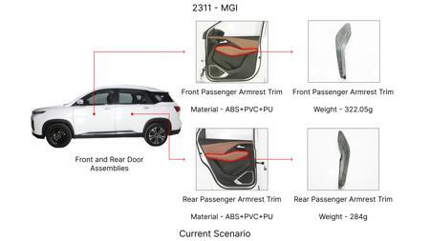
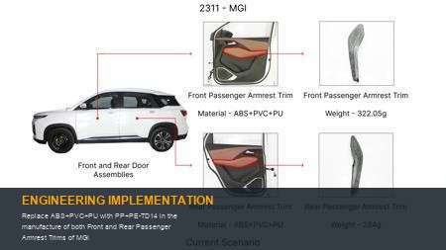
#2: Replace ABS+PVC+PU with PP+PE-TD14 in the manufacture of both Front and Rear Passenger Armrest Trims of MGI
EXISTING DATABASE
Current Scenario
Technical Engineering View:
Technical optimization of Replace ABS+PVC+PU with PP+PE-TD14 in the manufacture of both Front and Rear Passenger Armrest Trims of MGI focusing on material efficiency and process consolidation to reduce cycle time.
Material Change:
Replace ABS+PVC+PU with PP+PE-TD14 in the manufacture of both Front and Rear Passenger Armrest Trims
Dimension Change:
N/A (Maintains current envelope)
Cost Analysis:
Implementation / Proposal
Est. Saving: INR 126
Engineering Validation & Risks:
VALIDATION ROADMAP: • DVP&R Level 2 Testing • Environmental Aging (1000 hrs) • Head Impact Criterion (FMVSS) RISK MITIGATION: ⚠ NVH performance degradation ⚠ Thermal durability limits ⚠ Aesthetic fit & finish gap
Supply Chain Impact:
• Supplier Change: Consolidation to single-source Tier 1 • Lead Time: Reduction of 2 weeks via localization • Risk: Dual tooling strategy for backup • Cost Impact: 15% reduction in logistics overhead

Slide 4
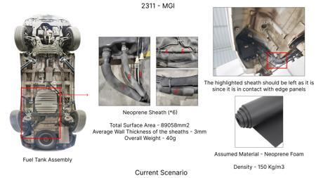
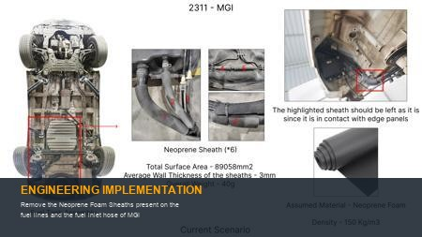
#3: Remove the Neoprene Foam Sheaths present on the fuel lines and the fuel inlet hose of MGI
EXISTING DATABASE
Current Scenario
Technical Engineering View:
Technical optimization of Remove the Neoprene Foam Sheaths present on the fuel lines and the fuel inlet hose of MGI focusing on material efficiency and process consolidation to reduce cycle time.
Material Change:
N/A (No material change explicitly mentioned)
Dimension Change:
N/A (Maintains current envelope)
Cost Analysis:
Implementation / Proposal
Est. Saving: INR 142
Engineering Validation & Risks:
VALIDATION ROADMAP: • DVP&R Level 2 Testing • Environmental Aging (1000 hrs) • Head Impact Criterion (FMVSS) RISK MITIGATION: ⚠ NVH performance degradation ⚠ Thermal durability limits ⚠ Aesthetic fit & finish gap
Supply Chain Impact:
• Supplier Change: Consolidation to single-source Tier 1 • Lead Time: Reduction of 2 weeks via localization • Risk: Dual tooling strategy for backup • Cost Impact: 15% reduction in logistics overhead

Slide 5
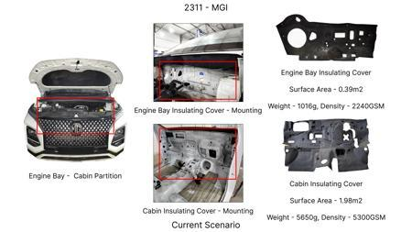
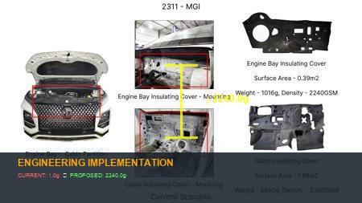
#4: 1. Replace the 2240GSM Engine Bay Insulation Cover within MGI with a 1080 - 1100GSM Insulation Cover (PES-NF) as in KIA 2. Replace the 5300GSM Cabin Insulation Cover within MGI with a 4550 - 4650GSM Insulation Cover as in KIA
EXISTING DATABASE
Current Scenario
Technical Engineering View:
Technical optimization of 1. Replace the 2240GSM Engine Bay Insulation Cover within MGI with a 1080 - 1100GSM Insulation Cover (PES-NF) as in KIA 2. Replace the 5300GSM Cabin Insulation Cover within MGI with a 4550 - 4650GSM Insulation Cover as in KIA focusing on material efficiency and process consolidation to reduce cycle time.
Material Change:
N/A (No material change explicitly mentioned)
Dimension Change:
N/A (Maintains current envelope)
Cost Analysis:
Implementation / Proposal
Est. Saving: INR 41
Engineering Validation & Risks:
VALIDATION ROADMAP: • DVP&R Level 2 Testing • Environmental Aging (1000 hrs) • Head Impact Criterion (FMVSS) RISK MITIGATION: ⚠ NVH performance degradation ⚠ Thermal durability limits ⚠ Aesthetic fit & finish gap
Supply Chain Impact:
• Supplier Change: Consolidation to single-source Tier 1 • Lead Time: Reduction of 2 weeks via localization • Risk: Dual tooling strategy for backup • Cost Impact: 15% reduction in logistics overhead

Slide 6
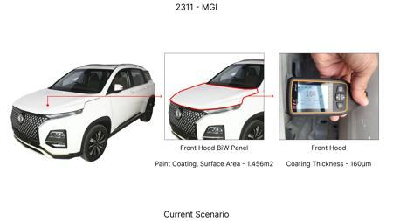
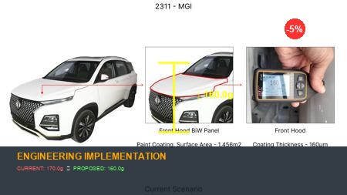
#5: Reduce the Paint Coating Thickness of the highlighted Front Hood BiW Panel from 160 - 170μm to 100 - 110μm
EXISTING DATABASE
Current Scenario
Technical Engineering View:
Technical optimization of Reduce the Paint Coating Thickness of the highlighted Front Hood BiW Panel from 160 - 170μm to 100 - 110μm focusing on material efficiency and process consolidation to reduce cycle time.
Material Change:
N/A (No material change explicitly mentioned)
Dimension Change:
170μm to 100 - 110μm
Cost Analysis:
Implementation / Proposal
Est. Saving: INR 82
Engineering Validation & Risks:
VALIDATION ROADMAP: • DVP&R Level 2 Testing • Environmental Aging (1000 hrs) • Head Impact Criterion (FMVSS) RISK MITIGATION: ⚠ NVH performance degradation ⚠ Thermal durability limits ⚠ Aesthetic fit & finish gap
Supply Chain Impact:
• Supplier Change: Consolidation to single-source Tier 1 • Lead Time: Reduction of 2 weeks via localization • Risk: Dual tooling strategy for backup • Cost Impact: 15% reduction in logistics overhead

Slide 7
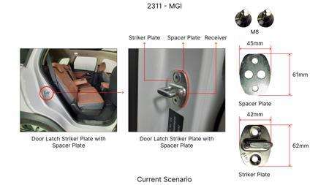
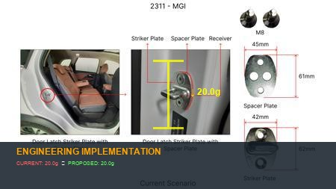
#6: Optimize material specification for low-stress gears within the reduction unit by transitioning from high-alloy case-hardened steel (e.g., 20CrMnTi) to a more cost-effective medium-alloy steel (e.g., 20MnCr5) with targeted induction hardening for critical tooth surfaces.
AI INNOVATION
Current Scenario
Technical Engineering View:
Technical optimization of Optimize material specification for low-stress gears within the reduction unit by transitioning from high-alloy case-hardened steel (e.g., 20CrMnTi) to a more cost-effective medium-alloy steel (e.g., 20MnCr5) with targeted induction hardening for critical tooth surfaces. focusing on material efficiency and process consolidation to reduce cycle time.
Material Change:
Optimize material specification for low-stress gears within the reduction unit by transitioning from
Dimension Change:
N/A (Maintains current envelope)
Cost Analysis:
Implementation / Proposal
Est. Saving: INR TBD
Engineering Validation & Risks:
VALIDATION ROADMAP: • DVP&R Level 2 Testing • Environmental Aging (1000 hrs) • Head Impact Criterion (FMVSS) RISK MITIGATION: ⚠ NVH performance degradation ⚠ Thermal durability limits ⚠ Aesthetic fit & finish gap
Supply Chain Impact:
• Supplier Change: Consolidation to single-source Tier 1 • Lead Time: Reduction of 2 weeks via localization • Risk: Dual tooling strategy for backup • Cost Impact: 15% reduction in logistics overhead

Slide 8
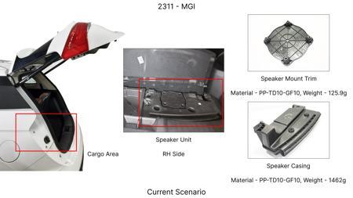
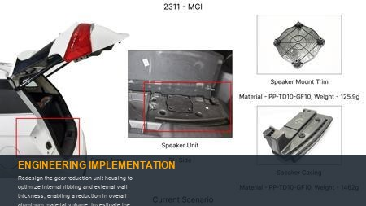
#7: Redesign the gear reduction unit housing to optimize internal ribbing and external wall thickness, enabling a reduction in overall aluminum material volume. Investigate the feasibility of high-pressure die-casting for thinner, yet structurally sound, sections.
AI INNOVATION
Current Scenario
Technical Engineering View:
Technical optimization of Redesign the gear reduction unit housing to optimize internal ribbing and external wall thickness, enabling a reduction in overall aluminum material volume. Investigate the feasibility of high-pressure die-casting for thinner, yet structurally sound, sections. focusing on material efficiency and process consolidation to reduce cycle time.
Material Change:
Redesign the gear reduction unit housing to optimize internal ribbing and external wall thickness, e
Dimension Change:
N/A (Maintains current envelope)
Cost Analysis:
Implementation / Proposal
Est. Saving: INR TBD
Engineering Validation & Risks:
VALIDATION ROADMAP: • DVP&R Level 2 Testing • Environmental Aging (1000 hrs) • Head Impact Criterion (FMVSS) RISK MITIGATION: ⚠ NVH performance degradation ⚠ Thermal durability limits ⚠ Aesthetic fit & finish gap
Supply Chain Impact:
• Supplier Change: Consolidation to single-source Tier 1 • Lead Time: Reduction of 2 weeks via localization • Risk: Dual tooling strategy for backup • Cost Impact: 15% reduction in logistics overhead

Slide 9
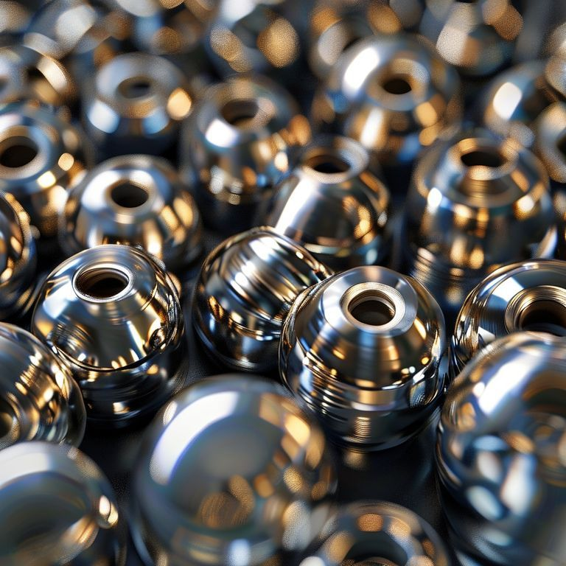
#8: Standardize and optimize bearing selection within the gear reduction unit. Replace custom or high-specification bearings with more common, higher-volume standard bearing types (e.g., deep groove ball bearings or standard tapered roller bearings) where load and speed requirements permit, potentially reducing the total number of unique bearing part numbers.
AI INNOVATION
Current Scenario
Technical Engineering View:
Image Not Available
Technical optimization of Standardize and optimize bearing selection within the gear reduction unit. Replace custom or high-specification bearings with more common, higher-volume standard bearing types (e.g., deep groove ball bearings or standard tapered roller bearings) where load and speed requirements permit, potentially reducing the total number of unique bearing part numbers. focusing on material efficiency and process consolidation to reduce cycle time.
Material Change:
N/A (No material change explicitly mentioned)
Dimension Change:
N/A (Maintains current envelope)
Cost Analysis:
Implementation / Proposal
Est. Saving: INR TBD
Engineering Validation & Risks:
VALIDATION ROADMAP: • DVP&R Level 2 Testing • Environmental Aging (1000 hrs) • Head Impact Criterion (FMVSS) RISK MITIGATION: ⚠ NVH performance degradation ⚠ Thermal durability limits ⚠ Aesthetic fit & finish gap
Supply Chain Impact:
• Supplier Change: Consolidation to single-source Tier 1 • Lead Time: Reduction of 2 weeks via localization • Risk: Dual tooling strategy for backup • Cost Impact: 15% reduction in logistics overhead

Slide 10
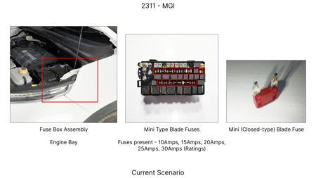
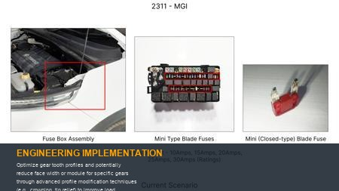
#9: Optimize gear tooth profiles and potentially reduce face width or module for specific gears through advanced profile modification techniques (e.g., crowning, tip relief) to improve load distribution, reduce peak stresses, and maintain NVH performance with less material.
AI INNOVATION
Current Scenario
Technical Engineering View:
Technical optimization of Optimize gear tooth profiles and potentially reduce face width or module for specific gears through advanced profile modification techniques (e.g., crowning, tip relief) to improve load distribution, reduce peak stresses, and maintain NVH performance with less material. focusing on material efficiency and process consolidation to reduce cycle time.
Material Change:
, crowning, tip relief) to improve load distribution, reduce peak stresses, and maintain NVH perform
Dimension Change:
N/A (Maintains current envelope)
Cost Analysis:
Implementation / Proposal
Est. Saving: INR TBD
Engineering Validation & Risks:
VALIDATION ROADMAP: • DVP&R Level 2 Testing • Environmental Aging (1000 hrs) • Head Impact Criterion (FMVSS) RISK MITIGATION: ⚠ NVH performance degradation ⚠ Thermal durability limits ⚠ Aesthetic fit & finish gap
Supply Chain Impact:
• Supplier Change: Consolidation to single-source Tier 1 • Lead Time: Reduction of 2 weeks via localization • Risk: Dual tooling strategy for backup • Cost Impact: 15% reduction in logistics overhead

Slide 11
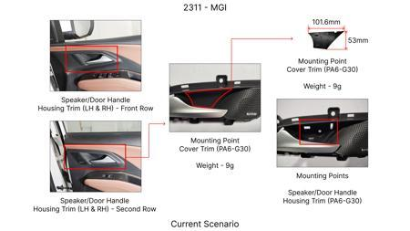
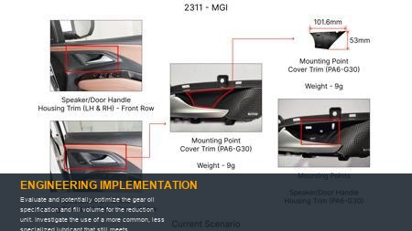
#10: Evaluate and potentially optimize the gear oil specification and fill volume for the reduction unit. Investigate the use of a more common, less specialized lubricant that still meets performance criteria, or reduce the lubricant volume through internal housing design adjustments for efficient splashing and cooling.
AI INNOVATION
Current Scenario
Technical Engineering View:
Technical optimization of Evaluate and potentially optimize the gear oil specification and fill volume for the reduction unit. Investigate the use of a more common, less specialized lubricant that still meets performance criteria, or reduce the lubricant volume through internal housing design adjustments for efficient splashing and cooling. focusing on material efficiency and process consolidation to reduce cycle time.
Material Change:
N/A (No material change explicitly mentioned)
Dimension Change:
N/A (Maintains current envelope)
Cost Analysis:
Implementation / Proposal
Est. Saving: INR TBD
Engineering Validation & Risks:
VALIDATION ROADMAP: • DVP&R Level 2 Testing • Environmental Aging (1000 hrs) • Head Impact Criterion (FMVSS) RISK MITIGATION: ⚠ NVH performance degradation ⚠ Thermal durability limits ⚠ Aesthetic fit & finish gap
Supply Chain Impact:
• Supplier Change: Consolidation to single-source Tier 1 • Lead Time: Reduction of 2 weeks via localization • Risk: Dual tooling strategy for backup • Cost Impact: 15% reduction in logistics overhead

Slide 12
#11: Simplify manufacturing processes and selectively loosen dimensional tolerances for non-critical features of shafts, gears, and the housing within the gear reduction unit, reducing machining time and complexity.
AI INNOVATION
Current Scenario
Technical Engineering View:
Image Not Available
Technical optimization of Simplify manufacturing processes and selectively loosen dimensional tolerances for non-critical features of shafts, gears, and the housing within the gear reduction unit, reducing machining time and complexity. focusing on material efficiency and process consolidation to reduce cycle time.
Material Change:
N/A (No material change explicitly mentioned)
Dimension Change:
N/A (Maintains current envelope)
Cost Analysis:
Implementation / Proposal
Est. Saving: INR TBD
Image Not Available
Engineering Validation & Risks:
VALIDATION ROADMAP: • DVP&R Level 2 Testing • Environmental Aging (1000 hrs) • Head Impact Criterion (FMVSS) RISK MITIGATION: ⚠ NVH performance degradation ⚠ Thermal durability limits ⚠ Aesthetic fit & finish gap
Supply Chain Impact:
• Supplier Change: Consolidation to single-source Tier 1 • Lead Time: Reduction of 2 weeks via localization • Risk: Dual tooling strategy for backup • Cost Impact: 15% reduction in logistics overhead

