Slide 1
VAVE Cost Reduction Strategy
Detailed Engineering Feasibility Report | 02-Feb-2026

Slide 2
Summary of ideas generated
Idea ID | Idea | Capex Investment | Saving | Yearly volume (per 1 lakh) | Saving overall (Saving × Volume) | Status (Accept/Reject) | Turnaround time | Required volume yearly
2311-PA-ID-02 | Redesign the current Brake Pedal Mounting Bracket used in MGI to a similar bracket used in KIA. |  | 113 | 100000 | 11,300,000 | TBD |  | 100000
2311-BA-ID-01 | The Brake Booster Plate in MGI could be integrated into the Dashboard BIW of the vehicle as done in KIA |  | 47 | 100000 | 4,700,000 | NG |  | 100000
2311-PA-ID-01 | Remove the black paint coating on the Brake Pedal Mounting Bracket within MGI |  | 115 | 100000 | 11,500,000 | TBD |  | 100000
2311-SP-ID-01 | 1. Reduce the overall wall thickness of the Brake Dust Cover Plates present on all four wheel hubs of the vehicles from 1mm to 0.8mm 2. Reduce the paint coating thickness on each side of all four plates from 56 microns to 27.8 microns |  | 57 | 100000 | 5,700,000 | NG |  | 100000
2311-BA-ID-02 | Remove the black paint coating from the Brake Caliper Mounting Brackets on all four brake assemblies of MGI, following the procedure used for the front brake caliper mounting brackets in KIA. |  | 102 | 100000 | 10,200,000 | NG |  | 100000
N/A | Investigate the use of advanced friction materials with higher thermal stability and consistent friction coefficient across a wider temperature range for the MG Hector's brake pads. This aims to improve fade resistance and potentially allow for slightly thinner pads without compromising performance, contributing to weight reduction and cost savings. Focus on materials that offer good performance with existing rotor specifications to minimize tooling CAPEX. |  | TBD | 100000 | 0 | Research Paper |  | 100000
N/A | Explore the optimization of the dust shield gauge and material for the MG Hector's brake system. While not directly impacting thermal mass or friction coefficient, a lighter yet robust dust shield can contribute to overall vehicle weight reduction. Investigate high-strength steel alloys or advanced polymer composites that meet structural integrity and corrosion resistance requirements while offering a cost-effective solution and potentially simplifying manufacturing processes, aligning with limited tooling CAPEX. |  | TBD | 100000 | 0 | Industry Trend |  | 100000
N/A | Evaluate the feasibility of using a single-piece cast iron brake rotor with enhanced internal cooling channels for the MG Hector. This approach aims to improve thermal management and fade resistance without necessitating a change in caliper material or IRS. The design would focus on maximizing thermal mass and heat dissipation through optimized channel geometry, potentially allowing for a slightly reduced rotor diameter or thickness while maintaining performance, thus contributing to weight and cost reduction within tooling CAPEX constraints. |  | TBD | 100000 | 0 | Research Paper |  | 100000
N/A | Explore the application of a high-performance, cost-effective caliper material such as a reinforced aluminum alloy or a specialized cast iron for the MG Hector's braking system. The goal is to achieve a balance between thermal conductivity, stiffness, and manufacturing cost. While avoiding complex IRS modifications, this could allow for a slightly more compact caliper design or improved heat dissipation from the caliper body itself, contributing to overall system efficiency and potentially minor weight savings, while respecting tooling CAPEX limitations. |  | TBD | 100000 | 0 | Research Paper |  | 100000

Slide 3
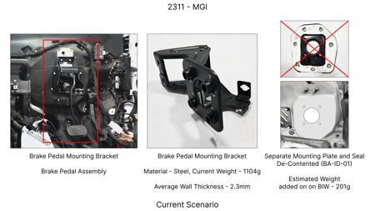
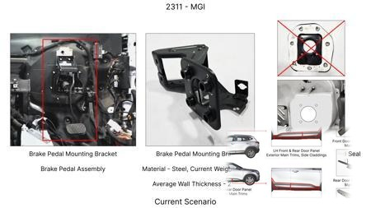
#1: Redesign the current Brake Pedal Mounting Bracket used in MGI to a similar bracket used in KIA.
EXISTING DATABASE
Current Scenario
Technical Engineering View:
Technical optimization of Redesign the current Brake Pedal Mounting Bracket used in MGI to a similar bracket used in KIA. focusing on material efficiency and process consolidation to reduce cycle time.
Material Change:
N/A (No material change explicitly mentioned)
Dimension Change:
N/A (Maintains current envelope)
Cost Analysis:
Est. Saving: INR 113
Implementation / Proposal
Engineering Validation & Risks:
VALIDATION ROADMAP: • DVP&R Level 2 Testing • Environmental Aging (1000 hrs) • Head Impact Criterion (FMVSS) RISK MITIGATION: ⚠ NVH performance degradation ⚠ Thermal durability limits ⚠ Aesthetic fit & finish gap

Slide 4
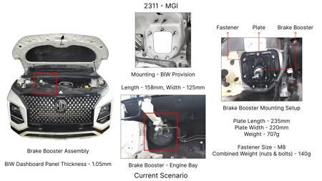
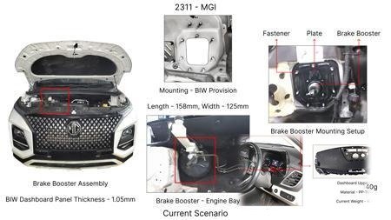
#2: The Brake Booster Plate in MGI could be integrated into the Dashboard BIW of the vehicle as done in KIA
EXISTING DATABASE
Current Scenario
Technical Engineering View:
Technical optimization of The Brake Booster Plate in MGI could be integrated into the Dashboard BIW of the vehicle as done in KIA focusing on material efficiency and process consolidation to reduce cycle time.
Material Change:
N/A (No material change explicitly mentioned)
Dimension Change:
N/A (Maintains current envelope)
Cost Analysis:
Est. Saving: INR 47
Implementation / Proposal
Engineering Validation & Risks:
VALIDATION ROADMAP: • DVP&R Level 2 Testing • Environmental Aging (1000 hrs) • Head Impact Criterion (FMVSS) RISK MITIGATION: ⚠ NVH performance degradation ⚠ Thermal durability limits ⚠ Aesthetic fit & finish gap

Slide 5
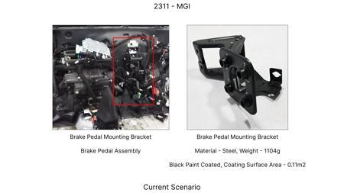
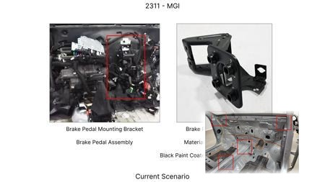
#3: Remove the black paint coating on the Brake Pedal Mounting Bracket within MGI
EXISTING DATABASE
Current Scenario
Technical Engineering View:
Technical optimization of Remove the black paint coating on the Brake Pedal Mounting Bracket within MGI focusing on material efficiency and process consolidation to reduce cycle time.
Material Change:
N/A (No material change explicitly mentioned)
Dimension Change:
N/A (Maintains current envelope)
Cost Analysis:
Est. Saving: INR 115
Implementation / Proposal
Engineering Validation & Risks:
VALIDATION ROADMAP: • DVP&R Level 2 Testing • Environmental Aging (1000 hrs) • Head Impact Criterion (FMVSS) RISK MITIGATION: ⚠ NVH performance degradation ⚠ Thermal durability limits ⚠ Aesthetic fit & finish gap

Slide 6
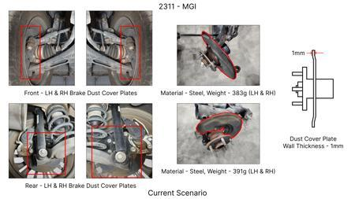
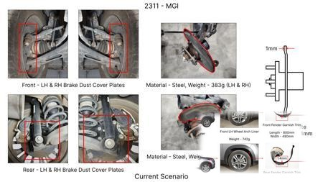
#4: 1. Reduce the overall wall thickness of the Brake Dust Cover Plates present on all four wheel hubs of the vehicles from 1mm to 0.8mm 2. Reduce the paint coating thickness on each side of all four plates from 56 microns to 27.8 microns
EXISTING DATABASE
Current Scenario
Technical Engineering View:
Technical optimization of 1. Reduce the overall wall thickness of the Brake Dust Cover Plates present on all four wheel hubs of the vehicles from 1mm to 0.8mm 2. Reduce the paint coating thickness on each side of all four plates from 56 microns to 27.8 microns focusing on material efficiency and process consolidation to reduce cycle time.
Material Change:
N/A (No material change explicitly mentioned)
Dimension Change:
1mm to 0.8mm
Cost Analysis:
Est. Saving: INR 57
Implementation / Proposal
Engineering Validation & Risks:
VALIDATION ROADMAP: • DVP&R Level 2 Testing • Environmental Aging (1000 hrs) • Head Impact Criterion (FMVSS) RISK MITIGATION: ⚠ NVH performance degradation ⚠ Thermal durability limits ⚠ Aesthetic fit & finish gap

Slide 7
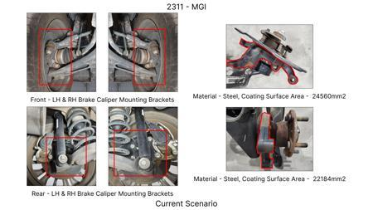
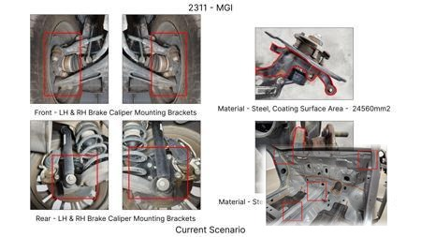
#5: Remove the black paint coating from the Brake Caliper Mounting Brackets on all four brake assemblies of MGI, following the procedure used for the front brake caliper mounting brackets in KIA.
EXISTING DATABASE
Current Scenario
Technical Engineering View:
Technical optimization of Remove the black paint coating from the Brake Caliper Mounting Brackets on all four brake assemblies of MGI, following the procedure used for the front brake caliper mounting brackets in KIA. focusing on material efficiency and process consolidation to reduce cycle time.
Material Change:
N/A (No material change explicitly mentioned)
Dimension Change:
N/A (Maintains current envelope)
Cost Analysis:
Est. Saving: INR 102
Implementation / Proposal
Engineering Validation & Risks:
VALIDATION ROADMAP: • DVP&R Level 2 Testing • Environmental Aging (1000 hrs) • Head Impact Criterion (FMVSS) RISK MITIGATION: ⚠ NVH performance degradation ⚠ Thermal durability limits ⚠ Aesthetic fit & finish gap

Slide 8
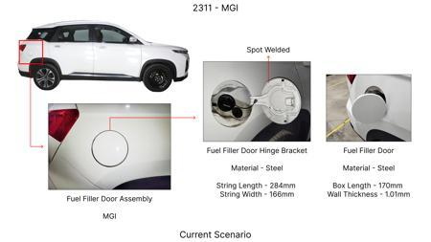
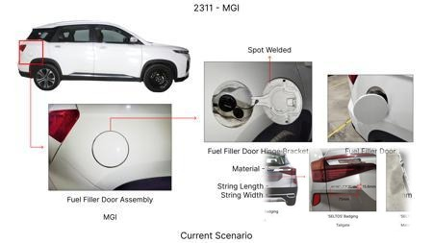
#6: Investigate the use of advanced friction materials with higher thermal stability and consistent friction coefficient across a wider temperature range for the MG Hector's brake pads. This aims to improve fade resistance and potentially allow for slightly thinner pads without compromising performance, contributing to weight reduction and cost savings. Focus on materials that offer good performance with existing rotor specifications to minimize tooling CAPEX.
WEB SOURCED
Current Scenario
Technical Engineering View:
Technical optimization of Investigate the use of advanced friction materials with higher thermal stability and consistent friction coefficient across a wider temperature range for the MG Hector's brake pads. This aims to improve fade resistance and potentially allow for slightly thinner pads without compromising performance, contributing to weight reduction and cost savings. Focus on materials that offer good performance with existing rotor specifications to minimize tooling CAPEX. focusing o...
Material Change:
Investigate the use of advanced friction materials with higher thermal stability and consistent fric
Dimension Change:
N/A (Maintains current envelope)
Cost Analysis:
Est. Saving: INR TBD
Implementation / Proposal
Engineering Validation & Risks:
VALIDATION ROADMAP: • DVP&R Level 2 Testing • Environmental Aging (1000 hrs) • Head Impact Criterion (FMVSS) RISK MITIGATION: ⚠ NVH performance degradation ⚠ Thermal durability limits ⚠ Aesthetic fit & finish gap

Slide 9
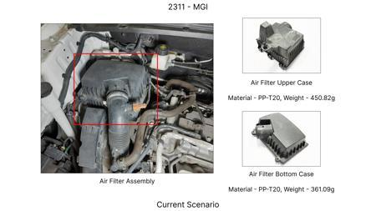
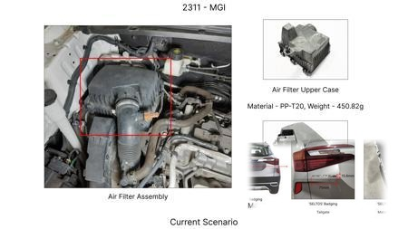
#7: Explore the optimization of the dust shield gauge and material for the MG Hector's brake system. While not directly impacting thermal mass or friction coefficient, a lighter yet robust dust shield can contribute to overall vehicle weight reduction. Investigate high-strength steel alloys or advanced polymer composites that meet structural integrity and corrosion resistance requirements while offering a cost-effective solution and potentially simplifying manufacturing processes, aligning with limited tooling CAPEX.
WEB SOURCED
Current Scenario
Technical Engineering View:
Technical optimization of Explore the optimization of the dust shield gauge and material for the MG Hector's brake system. While not directly impacting thermal mass or friction coefficient, a lighter yet robust dust shield can contribute to overall vehicle weight reduction. Investigate high-strength steel alloys or advanced polymer composites that meet structural integrity and corrosion resistance requirements while offering a cost-effective solution and potentially simplifying manufacturing...
Material Change:
Explore the optimization of the dust shield gauge and material for the MG Hector's brake system
Dimension Change:
N/A (Maintains current envelope)
Cost Analysis:
Est. Saving: INR TBD
Implementation / Proposal
Engineering Validation & Risks:
VALIDATION ROADMAP: • DVP&R Level 2 Testing • Environmental Aging (1000 hrs) • Head Impact Criterion (FMVSS) RISK MITIGATION: ⚠ NVH performance degradation ⚠ Thermal durability limits ⚠ Aesthetic fit & finish gap

Slide 10
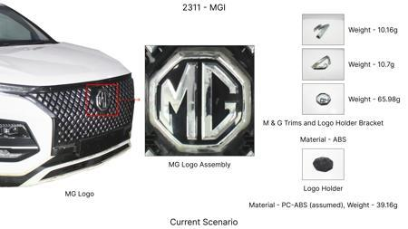
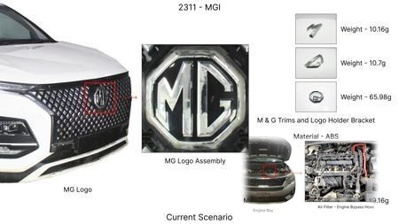
#8: Evaluate the feasibility of using a single-piece cast iron brake rotor with enhanced internal cooling channels for the MG Hector. This approach aims to improve thermal management and fade resistance without necessitating a change in caliper material or IRS. The design would focus on maximizing thermal mass and heat dissipation through optimized channel geometry, potentially allowing for a slightly reduced rotor diameter or thickness while maintaining performance, thus contributing to weight and cost reduction within tooling CAPEX constraints.
WEB SOURCED
Current Scenario
Technical Engineering View:
Technical optimization of Evaluate the feasibility of using a single-piece cast iron brake rotor with enhanced internal cooling channels for the MG Hector. This approach aims to improve thermal management and fade resistance without necessitating a change in caliper material or IRS. The design would focus on maximizing thermal mass and heat dissipation through optimized channel geometry, potentially allowing for a slightly reduced rotor diameter or thickness while maintaining performance, thu...
Material Change:
This approach aims to improve thermal management and fade resistance without necessitating a change
Dimension Change:
N/A (Maintains current envelope)
Cost Analysis:
Est. Saving: INR TBD
Implementation / Proposal
Engineering Validation & Risks:
VALIDATION ROADMAP: • DVP&R Level 2 Testing • Environmental Aging (1000 hrs) • Head Impact Criterion (FMVSS) RISK MITIGATION: ⚠ NVH performance degradation ⚠ Thermal durability limits ⚠ Aesthetic fit & finish gap

Slide 11
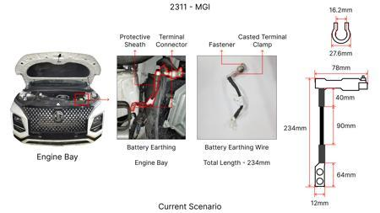
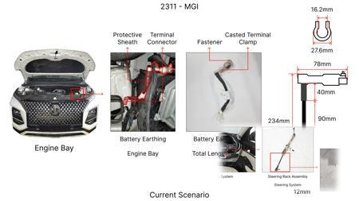
#9: Explore the application of a high-performance, cost-effective caliper material such as a reinforced aluminum alloy or a specialized cast iron for the MG Hector's braking system. The goal is to achieve a balance between thermal conductivity, stiffness, and manufacturing cost. While avoiding complex IRS modifications, this could allow for a slightly more compact caliper design or improved heat dissipation from the caliper body itself, contributing to overall system efficiency and potentially minor weight savings, while respecting tooling CAPEX limitations.
WEB SOURCED
Current Scenario
Technical Engineering View:
Technical optimization of Explore the application of a high-performance, cost-effective caliper material such as a reinforced aluminum alloy or a specialized cast iron for the MG Hector's braking system. The goal is to achieve a balance between thermal conductivity, stiffness, and manufacturing cost. While avoiding complex IRS modifications, this could allow for a slightly more compact caliper design or improved heat dissipation from the caliper body itself, contributing to overall system eff...
Material Change:
Explore the application of a high-performance, cost-effective caliper material such as a reinforced
Dimension Change:
N/A (Maintains current envelope)
Cost Analysis:
Est. Saving: INR TBD
Implementation / Proposal
Engineering Validation & Risks:
VALIDATION ROADMAP: • DVP&R Level 2 Testing • Environmental Aging (1000 hrs) • Head Impact Criterion (FMVSS) RISK MITIGATION: ⚠ NVH performance degradation ⚠ Thermal durability limits ⚠ Aesthetic fit & finish gap

