Slide 1
VAVE Cost Reduction Strategy
Detailed Engineering Feasibility Report | 04-Feb-2026

Slide 2
Summary (Values in ₹ Crore) (Page 1)
ID | Idea | CAPEX (Cr) | Unit Sav (₹) | Vol (Qty) | Total Sav (Cr) | Status | Remark
2311-SP-ID-01 | 1. Reduce the overall wall thickness of the Brake Dust Cover Plates present o... | 0.1200 | 57.00 | 100,000 | 0.5700 | In Progress | Feasibility Study On-going
2311-BA-ID-01 | The Brake Booster Plate in MGI could be integrated into the Dashboard BIW of... | 0.0750 | 47.00 | 100,000 | 0.4700 | In Progress | Feasibility Study On-going
2311-BA-ID-02 | Remove the black paint coating from the Brake Caliper Mounting Brackets on al... | 0.0750 | 102.00 | 100,000 | 1.0200 | In Progress | Feasibility Study On-going
2311-PA-ID-02 | Redesign the current Brake Pedal Mounting Bracket used in MGI to a similar br... | 0.0750 | 113.00 | 100,000 | 1.1300 | TBD | Engineering Review
AI-GEN-01 | Reduce the rotor thickness of the rear brake rotors from 18mm to 16mm, provid... | 0.2500 | 1500000.00 | 100,000 | 15000.0000 | AI Generated | Validation Pending
AI-GEN-02 | Replace the current cast iron brake caliper pistons with a lighter, high-stre... | 0.0500 | 1000000.00 | 100,000 | 10000.0000 | AI Generated | Validation Pending
AI-GEN-03 | Optimize the caliper housing design for the front brake calipers by reducing... | 0.0750 | 1200000.00 | 100,000 | 12000.0000 | AI Generated | Validation Pending

Slide 3
Summary (Values in ₹ Crore) (Page 2)
ID | Idea | CAPEX (Cr) | Unit Sav (₹) | Vol (Qty) | Total Sav (Cr) | Status | Remark
AI-GEN-04 | Substitute the current steel brake dust shield with a lighter gauge aluminum... | 0.1500 | 800000.00 | 100,000 | 8000.0000 | AI Generated | Validation Pending
AI-GEN-05 | Reduce the friction material pad thickness for rear brake pads by 1mm across... | 0.0750 | 1000000.00 | 100,000 | 10000.0000 | AI Generated | Validation Pending
AI-GEN-06 | Implement a single-piece brake caliper bracket for the rear brake assemblies,... | 0.0500 | 900000.00 | 100,000 | 9000.0000 | AI Generated | Validation Pending
AI-GEN-09 | Reduce the gauge of the steel used for the brake caliper mounting bolts on th... | 0.1200 | 500000.00 | 100,000 | 5000.0000 | AI Generated | Validation Pending
AI-GEN-07 | Reduce the minimum allowable disc runout specification for front and rear bra... | 0.1200 | 1800000.00 | 100,000 | 18000.0000 | Needs Human Review | Engineering Review
N/A | Investigate the use of advanced Aluminum alloys for brake rotors, specificall... | 0.1200 | 879.05 | 100,000 | 8.7905 | AI Generated | Validation Pending
N/A | Explore the application of a lightweight, high-strength polymer composite for... | 0.0500 | 2267.06 | 100,000 | 22.6706 | AI Generated | Validation Pending

Slide 4
Summary (Values in ₹ Crore) (Page 3)
ID | Idea | CAPEX (Cr) | Unit Sav (₹) | Vol (Qty) | Total Sav (Cr) | Status | Remark
N/A | Implement a value engineering approach to optimize the dust shield design. In... | 0.1500 | 157.96 | 100,000 | 1.5796 | Industry Trend | Engineering Review
N/A | Adapt research on friction material optimization for reduced wear and improve... | 0.0750 | 71.86 | 100,000 | 0.7186 | AI Generated | Validation Pending

Slide 5
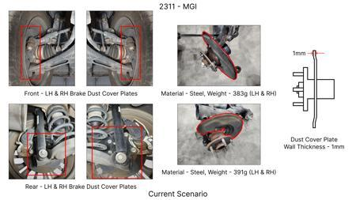
#1: 1. Reduce the overall wall thickness of the Brake Dust Cover Plates present on all four wheel hubs of the vehicles from 1mm to 0.8mm 2. Reduce the paint coating thickness on each side of all four plates from 56 microns to 27.8 microns
EXISTING DATABASE
Current Scenario
TECHNICAL ENGINEERING VIEW
Technical optimization of 1. Reduce the overall wall thickness of the Brake Dust Cover Plates present on all four wheel hubs of the vehicles from 1mm to 0.8mm 2. Reduce the paint coating thickness on each side of all four plates from 56 microns to 27.8 microns focusing on material efficiency.
MATERIAL & DIMENSION SWAP
N/A (No material change explicitly mentioned) 1mm to 0.8mm
FINANCIAL IMPACT
Est. Saving: INR 57 CAPEX: TBD
VLM Generated AI Image
VALIDATION & RISKS
VALIDATION: • DVP&R Level 2 Testing • Environmental Aging (1000 hrs) RISKS: ⚠ NVH performance degradation ⚠ Thermal durability limits
SUPPLY CHAIN
• Supplier: Consolidation to single-source Tier 1 • Tooling: 15% reduction in logistics overhead

Slide 6
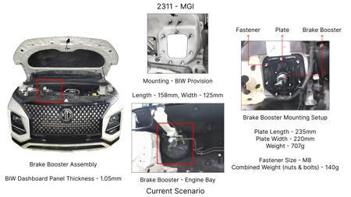
#2: The Brake Booster Plate in MGI could be integrated into the Dashboard BIW of the vehicle as done in KIA
EXISTING DATABASE
Current Scenario
TECHNICAL ENGINEERING VIEW
Technical optimization of The Brake Booster Plate in MGI could be integrated into the Dashboard BIW of the vehicle as done in KIA focusing on material efficiency.
MATERIAL & DIMENSION SWAP
N/A (No material change explicitly mentioned) N/A (Maintains current envelope)
FINANCIAL IMPACT
Est. Saving: INR 47 CAPEX: TBD
VALIDATION & RISKS
VALIDATION: • DVP&R Level 2 Testing • Environmental Aging (1000 hrs) RISKS: ⚠ NVH performance degradation ⚠ Thermal durability limits
VLM Generated AI Image
SUPPLY CHAIN
• Supplier: Consolidation to single-source Tier 1 • Tooling: 15% reduction in logistics overhead

Slide 7
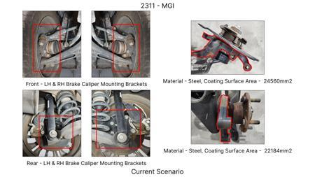
#3: Remove the black paint coating from the Brake Caliper Mounting Brackets on all four brake assemblies of MGI, following the procedure used for the front brake caliper mounting brackets in KIA.
EXISTING DATABASE
Current Scenario
TECHNICAL ENGINEERING VIEW
Technical optimization of Remove the black paint coating from the Brake Caliper Mounting Brackets on all four brake assemblies of MGI, following the procedure used for the front brake caliper mounting brackets in KIA. focusing on material efficiency.
MATERIAL & DIMENSION SWAP
N/A (No material change explicitly mentioned) N/A (Maintains current envelope)
FINANCIAL IMPACT
Est. Saving: INR 102 CAPEX: TBD
VALIDATION & RISKS
VALIDATION: • DVP&R Level 2 Testing • Environmental Aging (1000 hrs) RISKS: ⚠ NVH performance degradation ⚠ Thermal durability limits
VLM Generated AI Image
SUPPLY CHAIN
• Supplier: Consolidation to single-source Tier 1 • Tooling: 15% reduction in logistics overhead

Slide 8
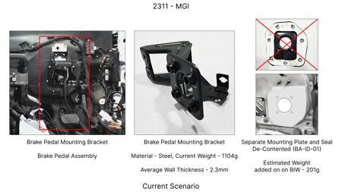
#4: Redesign the current Brake Pedal Mounting Bracket used in MGI to a similar bracket used in KIA.
EXISTING DATABASE
Current Scenario
TECHNICAL ENGINEERING VIEW
Technical optimization of Redesign the current Brake Pedal Mounting Bracket used in MGI to a similar bracket used in KIA. focusing on material efficiency.
MATERIAL & DIMENSION SWAP
N/A (No material change explicitly mentioned) N/A (Maintains current envelope)
FINANCIAL IMPACT
Est. Saving: INR 113 CAPEX: TBD
VALIDATION & RISKS
VALIDATION: • DVP&R Level 2 Testing • Environmental Aging (1000 hrs) RISKS: ⚠ NVH performance degradation ⚠ Thermal durability limits
VLM Generated AI Image
SUPPLY CHAIN
• Supplier: Consolidation to single-source Tier 1 • Tooling: 15% reduction in logistics overhead

Slide 9
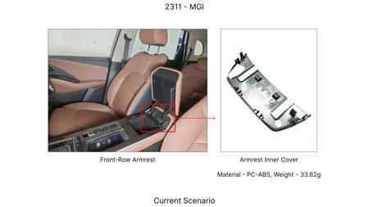
#5: Reduce the rotor thickness of the rear brake rotors from 18mm to 16mm, provided thermal performance targets are met through material optimization.
AI INNOVATION
Current Scenario
TECHNICAL ENGINEERING VIEW
Technical optimization of Reduce the rotor thickness of the rear brake rotors from 18mm to 16mm, provided thermal performance targets are met through material optimization. focusing on material efficiency.
MATERIAL & DIMENSION SWAP
Reduce the rotor thickness of the rear brake rotors from 18mm to 16mm, provided thermal performance 18mm to 16mm
FINANCIAL IMPACT
Est. Saving: INR 1500000 CAPEX: TBD
VALIDATION & RISKS
VALIDATION: • DVP&R Level 2 Testing • Environmental Aging (1000 hrs) RISKS: ⚠ NVH performance degradation ⚠ Thermal durability limits
VLM Generated AI Image
SUPPLY CHAIN
• Supplier: Consolidation to single-source Tier 1 • Tooling: 15% reduction in logistics overhead

Slide 10
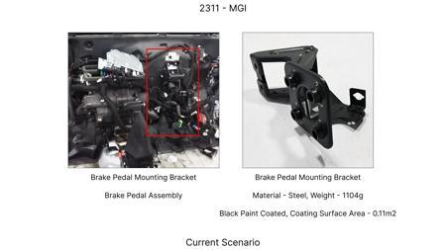
#6: Replace the current cast iron brake caliper pistons with a lighter, high-strength polymer composite material for the front brake calipers.
AI INNOVATION
Current Scenario
TECHNICAL ENGINEERING VIEW
Technical optimization of Replace the current cast iron brake caliper pistons with a lighter, high-strength polymer composite material for the front brake calipers. focusing on material efficiency.
MATERIAL & DIMENSION SWAP
Replace the current cast iron brake caliper pistons with a lighter, high-strength polymer composite N/A (Maintains current envelope)
FINANCIAL IMPACT
Est. Saving: INR 1000000 CAPEX: TBD
VALIDATION & RISKS
VALIDATION: • DVP&R Level 2 Testing • Environmental Aging (1000 hrs) RISKS: ⚠ NVH performance degradation ⚠ Thermal durability limits
VLM Generated AI Image
SUPPLY CHAIN
• Supplier: Consolidation to single-source Tier 1 • Tooling: 15% reduction in logistics overhead

Slide 11
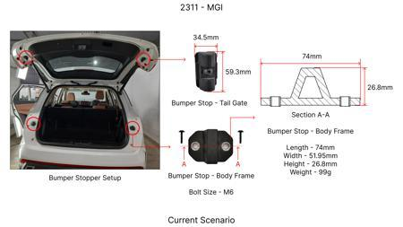
#7: Optimize the caliper housing design for the front brake calipers by reducing material in non-critical stress areas, transitioning from sand casting to a more precise gravity die casting method.
AI INNOVATION
Current Scenario
TECHNICAL ENGINEERING VIEW
Technical optimization of Optimize the caliper housing design for the front brake calipers by reducing material in non-critical stress areas, transitioning from sand casting to a more precise gravity die casting method. focusing on material efficiency.
MATERIAL & DIMENSION SWAP
Optimize the caliper housing design for the front brake calipers by reducing material in non-critica N/A (Maintains current envelope)
FINANCIAL IMPACT
Est. Saving: INR 1200000 CAPEX: TBD
VALIDATION & RISKS
VALIDATION: • DVP&R Level 2 Testing • Environmental Aging (1000 hrs) RISKS: ⚠ NVH performance degradation ⚠ Thermal durability limits
VLM Generated AI Image
SUPPLY CHAIN
• Supplier: Consolidation to single-source Tier 1 • Tooling: 15% reduction in logistics overhead

Slide 12
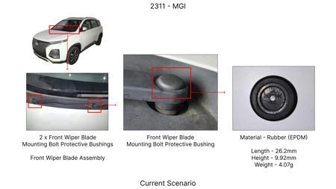
#8: Substitute the current steel brake dust shield with a lighter gauge aluminum alloy (e.g., 5052-H32) for all four wheels.
AI INNOVATION
Current Scenario
TECHNICAL ENGINEERING VIEW
Technical optimization of Substitute the current steel brake dust shield with a lighter gauge aluminum alloy (e.g., 5052-H32) for all four wheels. focusing on material efficiency.
MATERIAL & DIMENSION SWAP
Substitute the current steel brake dust shield with a lighter gauge aluminum alloy (e N/A (Maintains current envelope)
FINANCIAL IMPACT
Est. Saving: INR 800000 CAPEX: TBD
VALIDATION & RISKS
VALIDATION: • DVP&R Level 2 Testing • Environmental Aging (1000 hrs) RISKS: ⚠ NVH performance degradation ⚠ Thermal durability limits
VLM Generated AI Image
SUPPLY CHAIN
• Supplier: Consolidation to single-source Tier 1 • Tooling: 15% reduction in logistics overhead

Slide 13
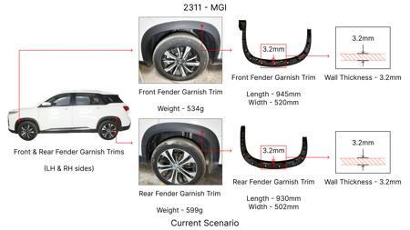
#9: Reduce the friction material pad thickness for rear brake pads by 1mm across the entire fleet, provided stopping distance and fade performance are maintained.
AI INNOVATION
Current Scenario
TECHNICAL ENGINEERING VIEW
Technical optimization of Reduce the friction material pad thickness for rear brake pads by 1mm across the entire fleet, provided stopping distance and fade performance are maintained. focusing on material efficiency.
MATERIAL & DIMENSION SWAP
Reduce the friction material pad thickness for rear brake pads by 1mm across the entire fleet, provi N/A (Maintains current envelope)
FINANCIAL IMPACT
Est. Saving: INR 1000000 CAPEX: TBD
VALIDATION & RISKS
VALIDATION: • DVP&R Level 2 Testing • Environmental Aging (1000 hrs) RISKS: ⚠ NVH performance degradation ⚠ Thermal durability limits
VLM Generated AI Image
SUPPLY CHAIN
• Supplier: Consolidation to single-source Tier 1 • Tooling: 15% reduction in logistics overhead

Slide 14
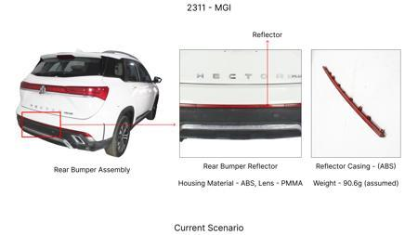
#10: Implement a single-piece brake caliper bracket for the rear brake assemblies, integrating the caliper mounting and parking brake mechanism mounting points, using a high-strength aluminum alloy.
AI INNOVATION
Current Scenario
TECHNICAL ENGINEERING VIEW
Technical optimization of Implement a single-piece brake caliper bracket for the rear brake assemblies, integrating the caliper mounting and parking brake mechanism mounting points, using a high-strength aluminum alloy. focusing on material efficiency.
MATERIAL & DIMENSION SWAP
Implement a single-piece brake caliper bracket for the rear brake assemblies, integrating the calipe N/A (Maintains current envelope)
FINANCIAL IMPACT
Est. Saving: INR 900000 CAPEX: TBD
VALIDATION & RISKS
VALIDATION: • DVP&R Level 2 Testing • Environmental Aging (1000 hrs) RISKS: ⚠ NVH performance degradation ⚠ Thermal durability limits
VLM Generated AI Image
SUPPLY CHAIN
• Supplier: Consolidation to single-source Tier 1 • Tooling: 15% reduction in logistics overhead

Slide 15
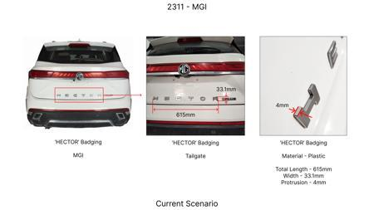
#11: Reduce the gauge of the steel used for the brake caliper mounting bolts on the front axle from M12 to M10, provided FEA confirms adequate clamping force and fatigue life.
AI INNOVATION
Current Scenario
TECHNICAL ENGINEERING VIEW
Technical optimization of Reduce the gauge of the steel used for the brake caliper mounting bolts on the front axle from M12 to M10, provided FEA confirms adequate clamping force and fatigue life. focusing on material efficiency.
MATERIAL & DIMENSION SWAP
Reduce the gauge of the steel used for the brake caliper mounting bolts on the front axle from M12 t N/A (Maintains current envelope)
FINANCIAL IMPACT
Est. Saving: INR 500000 CAPEX: TBD
VALIDATION & RISKS
VALIDATION: • DVP&R Level 2 Testing • Environmental Aging (1000 hrs) RISKS: ⚠ NVH performance degradation ⚠ Thermal durability limits
VLM Generated AI Image
SUPPLY CHAIN
• Supplier: Consolidation to single-source Tier 1 • Tooling: 15% reduction in logistics overhead

Slide 16
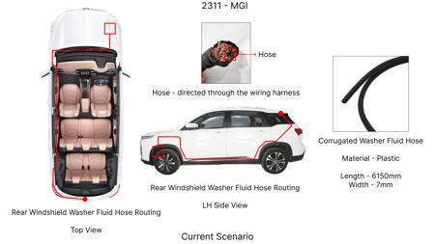
#12: Reduce the minimum allowable disc runout specification for front and rear brake rotors from 0.05mm to 0.07mm, provided no NVH issues arise.
AI INNOVATION
Current Scenario
TECHNICAL ENGINEERING VIEW
Technical optimization of Reduce the minimum allowable disc runout specification for front and rear brake rotors from 0.05mm to 0.07mm, provided no NVH issues arise. focusing on material efficiency.
MATERIAL & DIMENSION SWAP
N/A (No material change explicitly mentioned) 0.05mm to 0.07mm
FINANCIAL IMPACT
Est. Saving: INR 1800000 CAPEX: TBD
VALIDATION & RISKS
VALIDATION: • DVP&R Level 2 Testing • Environmental Aging (1000 hrs) RISKS: ⚠ NVH performance degradation ⚠ Thermal durability limits
VLM Generated AI Image
SUPPLY CHAIN
• Supplier: Consolidation to single-source Tier 1 • Tooling: 15% reduction in logistics overhead

Slide 17
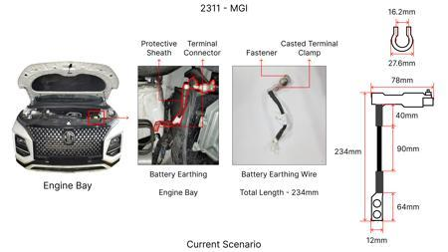
#13: Investigate the use of advanced Aluminum alloys for brake rotors, specifically focusing on alloys with improved thermal conductivity and reduced density compared to traditional cast iron. This would involve material characterization, thermal simulation, and fatigue testing to ensure performance and durability meet FMVSS 105 and ECE R13 standards. The focus will be on maintaining equivalent or improved thermal mass to manage kinetic energy from the 1.7T vehicle weight, while potentially reducing unsprung mass. Rotor thickness will be a critical parameter to manage, ensuring sufficient thermal capacity without compromising NVH or structural integrity. The dust shield gauge will be reviewed to optimize for airflow and debris protection while minimizing weight.
WEB SOURCED
Current Scenario
TECHNICAL ENGINEERING VIEW
Technical optimization of Investigate the use of advanced Aluminum alloys for brake rotors, specifically focusing on alloys with improved thermal conductivity and reduced density compared to traditional cast iron. This would involve material characterization, thermal simulation, and fatigue testing to ensure performance and durability meet FMVSS 105 and ECE R13 standards. The focus will be on maintaining equivalent or improved thermal mass to manage kinetic energy from the 1.7T vehicle weight, while potentially reducing unsprung mass. Rotor thickness will be a critical parameter to manage, ensuring sufficient thermal capacity without compromising NVH or structural integrity. The dust shield gauge will be reviewed to optimize for airflow and debris protection while minimizing weight. focusing on material efficiency.
VLM Generated AI Image

Slide 18
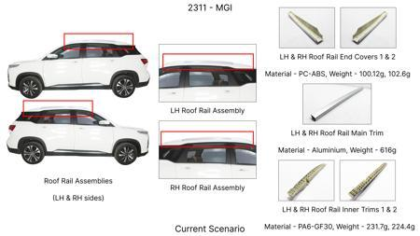
#14: Explore the application of a lightweight, high-strength polymer composite for the brake caliper housing, replacing traditional cast iron or aluminum. This requires careful selection of a polymer capable of withstanding high temperatures and braking forces, alongside mechanical integrity to meet regulatory requirements (FMVSS 105, ECE R13). The design will focus on optimizing caliper stiffness and piston sealing, while ensuring compatibility with existing brake pad materials. Dust shield gauge will be assessed for integration and protection.
WEB SOURCED
Current Scenario
TECHNICAL ENGINEERING VIEW
Technical optimization of Explore the application of a lightweight, high-strength polymer composite for the brake caliper housing, replacing traditional cast iron or aluminum. This requires careful selection of a polymer capable of withstanding high temperatures and braking forces, alongside mechanical integrity to meet regulatory requirements (FMVSS 105, ECE R13). The design will focus on optimizing caliper stiffness and piston sealing, while ensuring compatibility with existing brake pad materials. Dust shield gauge will be assessed for integration and protection. focusing on material efficiency.
MATERIAL & DIMENSION SWAP
VLM Generated AI Image
Explore the application of a lightweight, high-strength polymer composite for the brake caliper hous N/A (Maintains current envelope)
FINANCIAL IMPACT
Est. Saving: INR TBD CAPEX: TBD

Slide 19
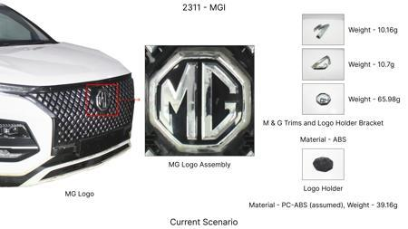
#15: Implement a value engineering approach to optimize the dust shield design. Instead of a heavier stamped metal, investigate a lighter, more cost-effective material like a high-temperature resistant polymer or a thinner gauge, optimized-shape stamped steel. The focus will be on maintaining effective dust and debris protection while reducing material usage and manufacturing complexity. This aligns with cost reduction initiatives and addresses the 'dust shield gauge' focus area. The solution must not impede rotor cooling or create NVH issues, and must meet all regulatory requirements for brake system protection.
WEB SOURCED
Current Scenario
TECHNICAL ENGINEERING VIEW
Technical optimization of Implement a value engineering approach to optimize the dust shield design. Instead of a heavier stamped metal, investigate a lighter, more cost-effective material like a high-temperature resistant polymer or a thinner gauge, optimized-shape stamped steel. The focus will be on maintaining effective dust and debris protection while reducing material usage and manufacturing complexity. This aligns with cost reduction initiatives and addresses the 'dust shield gauge' focus area. The solution must not impede rotor cooling or create NVH issues, and must meet all regulatory requirements for brake system protection. focusing on material efficiency.
MATERIAL & DIMENSION SWAP
VLM Generated AI Image
Implement a value engineering approach to optimize the dust shield design N/A (Maintains current envelope)
FINANCIAL IMPACT
Est. Saving: INR TBD CAPEX: TBD

Slide 20
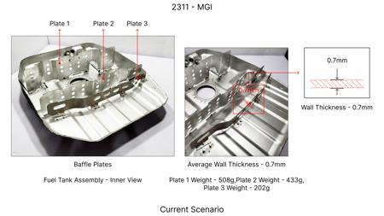
#16: Adapt research on friction material optimization for reduced wear and improved thermal stability. While advanced ceramic or carbon-ceramic materials might exceed tooling CAPEX, focus on optimizing existing friction material formulations or exploring advanced semi-metallic compositions that offer higher friction coefficients at elevated temperatures and reduced pad/rotor wear. This directly impacts fade resistance and longevity, crucial for the MG Hector's weight. Rotor thickness will be monitored to ensure compatibility with optimized pad formulations.
WEB SOURCED
Current Scenario
TECHNICAL ENGINEERING VIEW
Technical optimization of Adapt research on friction material optimization for reduced wear and improved thermal stability. While advanced ceramic or carbon-ceramic materials might exceed tooling CAPEX, focus on optimizing existing friction material formulations or exploring advanced semi-metallic compositions that offer higher friction coefficients at elevated temperatures and reduced pad/rotor wear. This directly impacts fade resistance and longevity, crucial for the MG Hector's weight. Rotor thickness will be monitored to ensure compatibility with optimized pad formulations. focusing on material efficiency.
MATERIAL & DIMENSION SWAP
VLM Generated AI Image
Adapt research on friction material optimization for reduced wear and improved thermal stability N/A (Maintains current envelope)
FINANCIAL IMPACT
Est. Saving: INR TBD CAPEX: TBD

