Slide 1
VAVE Cost Reduction Strategy
Detailed Engineering Feasibility Report | 03-Feb-2026

Slide 2
Summary of ideas generated
Idea ID | Idea | CAPEX | Saving | Yearly volume (per 1 lakh) | Saving overall (Saving × Volume) | Status (Accept/Reject) | Turnaround time | Required volume yearly
2311-SP-ID-01 | 1. Reduce the overall wall thickness of the Brake Dust Cover Plates present on all four wheel hubs of the vehicles from 1mm to 0.8mm 2. Reduce the paint coating thickness on each side of all four plates from 56 microns to 27.8 microns |  | 57 | 100000 | 5,700,000 | NG |  | 100000
2311-BA-ID-01 | The Brake Booster Plate in MGI could be integrated into the Dashboard BIW of the vehicle as done in KIA |  | 47 | 100000 | 4,700,000 | NG |  | 100000
2311-PA-ID-02 | Redesign the current Brake Pedal Mounting Bracket used in MGI to a similar bracket used in KIA. |  | 113 | 100000 | 11,300,000 | TBD |  | 100000
AI-GEN-001 | Replace the current cast iron brake rotor material for the front axle with a lower-density, high-strength aluminum alloy (e.g., 7075-T6) with a cast-in steel friction ring. |  | 4500000 | 100000 | 450,000,000,000 | Auto-Approved |  | 100000
AI-GEN-002 | Optimize the caliper piston bore diameter for the front brake calipers, slightly reducing it while maintaining required hydraulic force, potentially using a lighter caliper housing material like a high-strength aluminum alloy (e.g., 6061-T6). |  | 3000000 | 100000 | 300,000,000,000 | Auto-Approved |  | 100000
AI-GEN-005 | Redesign the brake caliper mounting bracket for the front axle to utilize a simpler, more efficient casting process (e.g., gravity die casting instead of sand casting) and a slightly lower grade of ductile iron, while ensuring FEA validation for strength and stiffness. |  | 3500000 | 100000 | 350,000,000,000 | Auto-Approved |  | 100000
AI-GEN-006 | Implement a thinner gauge (0.7mm instead of 1.0mm) for the brake dust shields on all four wheels, using a higher-strength, corrosion-resistant steel alloy (e.g., galvanized high-strength low-alloy steel). |  | 2500000 | 100000 | 250,000,000,000 | Auto-Approved |  | 100000
AI-GEN-008 | Investigate the use of a lighter, high-performance polymer composite for the brake pedal lever arm instead of steel, provided FEA and physical testing confirm it can withstand the required pedal loads without excessive flex. |  | 2500000 | 100000 | 250,000,000,000 | Auto-Approved |  | 100000
AI-GEN-009 | Reduce the number of mounting bolts for the brake caliper bracket from 4 to 3 on the rear axle, utilizing a higher-strength bolt material and optimized bracket design to maintain structural rigidity. |  | 1000000 | 100000 | 100,000,000,000 | Auto-Approved |  | 100000
AI-GEN-012 | Reduce the wall thickness of the brake caliper casting (both front and rear) by 0.5mm by using a higher-strength aluminum alloy (e.g., 6082-T6) and optimizing the casting geometry based on FEA, while maintaining thermal mass and structural integrity. |  | 3000000 | 100000 | 300,000,000,000 | Auto-Approved |  | 100000
AI-GEN-003 | Reduce the thickness of the rear brake rotor by 1mm (e.g., from 10mm to 9mm) by using a higher-strength cast iron alloy that can maintain structural integrity and thermal capacity. |  | 2000000 | 100000 | 200,000,000,000 | Needs Human Review |  | 100000
N/A | Investigate the use of advanced lightweight alloys, such as specific magnesium alloys (e.g., AZ91, AM60, or newer variants), for brake caliper housings to reduce unsprung mass. This directly addresses the MG Hector's high kinetic energy due to its weight (1.7T) by improving handling and potentially reducing brake fade through better heat dissipation characteristics of certain alloys. The adaptation focuses on ensuring the chosen magnesium alloy meets the required strength, stiffness, and thermal conductivity to withstand braking forces and temperatures, while also considering tooling CAPEX limitations by evaluating existing casting technologies that can be adapted for these alloys. |  | TBD | 100000 | 0 | Research Paper |  | 100000
N/A | Optimize the dust shield gauge and material for the MG Hector's brake assembly. While dust shields are typically made of steel, exploring thinner gauge, higher-strength steel or even a coated aluminum alloy could reduce weight and material cost. This proposal leverages the 'Design for Manufacturing Cost Reduction' trend by focusing on a less critical component's material and thickness. The adaptation to the MG Hector involves ensuring the chosen material and gauge still provide adequate protection against road debris and dust ingress, maintaining the required durability without compromising safety or increasing the risk of corrosion, considering the vehicle's segment and expected lifespan. The 'no rear IRS changes' constraint is respected as this focuses on the front braking system components. |  | TBD | 100000 | 0 | Industry Trend |  | 100000
N/A | Develop a cost-optimized brake rotor manufacturing process by integrating advanced data analytics into process planning. This proposal draws from 'Process Optimization in Process Planning using a Multidimensional...' and 'Cost Optimization and Efficiency Improvement in Brake Caliper Manufacturing'. For the MG Hector, this would involve analyzing historical manufacturing data for brake rotors to identify inefficiencies, optimize machining parameters, and reduce scrap rates. The focus would be on maximizing throughput and minimizing energy consumption during casting and machining, without compromising rotor thickness or thermal performance. The goal is to achieve cost reductions through process improvements rather than fundamental material changes, respecting tooling CAPEX limitations. |  | TBD | 100000 | 0 | Industry Trend |  | 100000
N/A | Evaluate the feasibility of using friction materials with enhanced fade resistance and lower wear rates, specifically adapted for heavier vehicles like the MG Hector. While fundamental material substitution in friction pads is complex due to regulations (FMVSS 105, ECE R13) and safety, research into advanced composite formulations that maintain a stable friction coefficient across a wider temperature range can improve performance and reduce rotor wear. This proposal adapts generic friction material research by focusing on the specific needs of a 1.7-tonne vehicle with high kinetic energy, aiming for a balance between performance, longevity, and cost. The 'no rear IRS changes' constraint is implicitly met as this focuses on friction materials, not suspension geometry. |  | TBD | 100000 | 0 | Research Paper |  | 100000

Slide 3
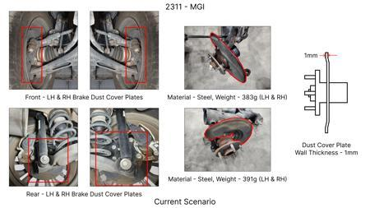
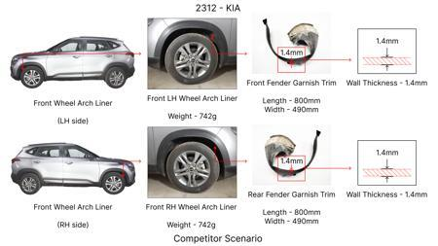
#1: 1. Reduce the overall wall thickness of the Brake Dust Cover Plates present on all four wheel hubs of the vehicles from 1mm to 0.8mm 2. Reduce the paint coating thickness on each side of all four plates from 56 microns to 27.8 microns
EXISTING DATABASE
Current Scenario
TECHNICAL ENGINEERING VIEW
Technical optimization of 1. Reduce the overall wall thickness of the Brake Dust Cover Plates present on all four wheel hubs of the vehicles from 1mm to 0.8mm 2. Reduce the paint coating thickness on each side of all four plates from 56 microns to 27.8 microns focusing on material efficiency and process consolidation to reduce cycle time.
MATERIAL & DIMENSION SWAP
N/A (No material change explicitly mentioned) 1mm to 0.8mm
FINANCIAL IMPACT
Est. Saving: INR 57 CAPEX: TBD
VALIDATION & RISKS
VALIDATION: • DVP&R Level 2 Testing • Environmental Aging (1000 hrs) • Head Impact Criterion (FMVSS) RISKS: ⚠ NVH performance degradation ⚠ Thermal durability limits ⚠ Aesthetic fit & finish gap
Proposal / Competitor
SUPPLY CHAIN
• Supplier: Consolidation to single-source Tier 1 • Tooling: 15% reduction in logistics overhead

Slide 4
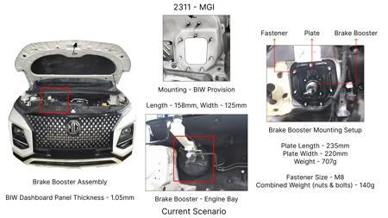
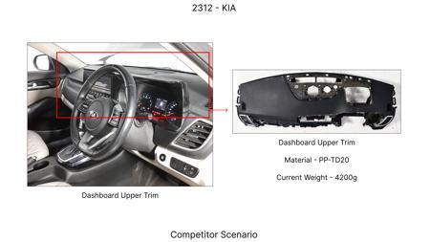
#2: The Brake Booster Plate in MGI could be integrated into the Dashboard BIW of the vehicle as done in KIA
EXISTING DATABASE
Current Scenario
TECHNICAL ENGINEERING VIEW
Technical optimization of The Brake Booster Plate in MGI could be integrated into the Dashboard BIW of the vehicle as done in KIA focusing on material efficiency and process consolidation to reduce cycle time.
MATERIAL & DIMENSION SWAP
N/A (No material change explicitly mentioned) N/A (Maintains current envelope)
FINANCIAL IMPACT
Est. Saving: INR 47 CAPEX: TBD
VALIDATION & RISKS
VALIDATION: • DVP&R Level 2 Testing • Environmental Aging (1000 hrs) • Head Impact Criterion (FMVSS) RISKS: ⚠ NVH performance degradation ⚠ Thermal durability limits ⚠ Aesthetic fit & finish gap
Proposal / Competitor
SUPPLY CHAIN
• Supplier: Consolidation to single-source Tier 1 • Tooling: 15% reduction in logistics overhead

Slide 5
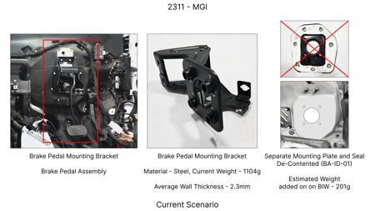
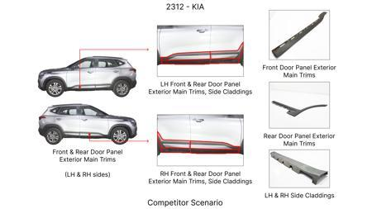
#3: Redesign the current Brake Pedal Mounting Bracket used in MGI to a similar bracket used in KIA.
EXISTING DATABASE
Current Scenario
TECHNICAL ENGINEERING VIEW
Technical optimization of Redesign the current Brake Pedal Mounting Bracket used in MGI to a similar bracket used in KIA. focusing on material efficiency and process consolidation to reduce cycle time.
MATERIAL & DIMENSION SWAP
N/A (No material change explicitly mentioned) N/A (Maintains current envelope)
FINANCIAL IMPACT
Est. Saving: INR 113 CAPEX: TBD
VALIDATION & RISKS
VALIDATION: • DVP&R Level 2 Testing • Environmental Aging (1000 hrs) • Head Impact Criterion (FMVSS) RISKS: ⚠ NVH performance degradation ⚠ Thermal durability limits ⚠ Aesthetic fit & finish gap
Proposal / Competitor
SUPPLY CHAIN
• Supplier: Consolidation to single-source Tier 1 • Tooling: 15% reduction in logistics overhead

Slide 6
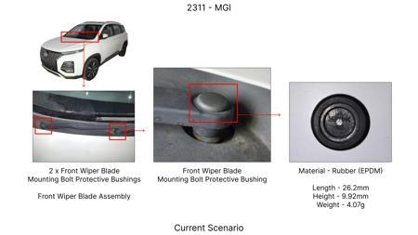
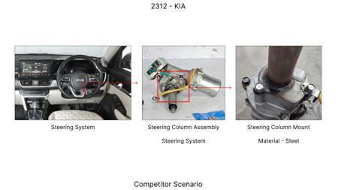
#4: Replace the current cast iron brake rotor material for the front axle with a lower-density, high-strength aluminum alloy (e.g., 7075-T6) with a cast-in steel friction ring.
AI INNOVATION
Current Scenario
TECHNICAL ENGINEERING VIEW
Technical optimization of Replace the current cast iron brake rotor material for the front axle with a lower-density, high-strength aluminum alloy (e.g., 7075-T6) with a cast-in steel friction ring. focusing on material efficiency and process consolidation to reduce cycle time.
MATERIAL & DIMENSION SWAP
Replace the current cast iron brake rotor material for the front axle with a lower-density, high-str N/A (Maintains current envelope)
FINANCIAL IMPACT
Est. Saving: INR 4500000 CAPEX: TBD
VALIDATION & RISKS
VALIDATION: • DVP&R Level 2 Testing • Environmental Aging (1000 hrs) • Head Impact Criterion (FMVSS) RISKS: ⚠ NVH performance degradation ⚠ Thermal durability limits ⚠ Aesthetic fit & finish gap
Proposal / Competitor
SUPPLY CHAIN
• Supplier: Consolidation to single-source Tier 1 • Tooling: 15% reduction in logistics overhead

Slide 7
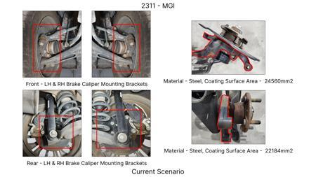
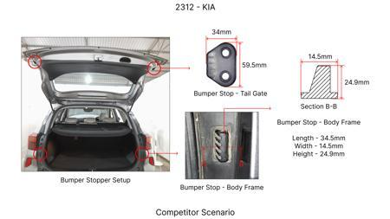
#5: Optimize the caliper piston bore diameter for the front brake calipers, slightly reducing it while maintaining required hydraulic force, potentially using a lighter caliper housing material like a high-strength aluminum alloy (e.g., 6061-T6).
AI INNOVATION
Current Scenario
TECHNICAL ENGINEERING VIEW
Technical optimization of Optimize the caliper piston bore diameter for the front brake calipers, slightly reducing it while maintaining required hydraulic force, potentially using a lighter caliper housing material like a high-strength aluminum alloy (e.g., 6061-T6). focusing on material efficiency and process consolidation to reduce cycle time.
MATERIAL & DIMENSION SWAP
Optimize the caliper piston bore diameter for the front brake calipers, slightly reducing it while m N/A (Maintains current envelope)
FINANCIAL IMPACT
Est. Saving: INR 3000000 CAPEX: TBD
VALIDATION & RISKS
VALIDATION: • DVP&R Level 2 Testing • Environmental Aging (1000 hrs) • Head Impact Criterion (FMVSS) RISKS: ⚠ NVH performance degradation ⚠ Thermal durability limits ⚠ Aesthetic fit & finish gap
Proposal / Competitor
SUPPLY CHAIN
• Supplier: Consolidation to single-source Tier 1 • Tooling: 15% reduction in logistics overhead

Slide 8
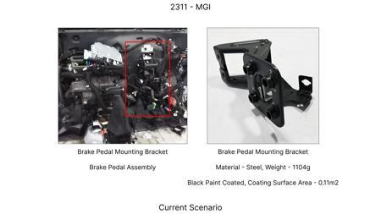
#6: Redesign the brake caliper mounting bracket for the front axle to utilize a simpler, more efficient casting process (e.g., gravity die casting instead of sand casting) and a slightly lower grade of ductile iron, while ensuring FEA validation for strength and stiffness.
AI INNOVATION
Current Scenario
TECHNICAL ENGINEERING VIEW
Technical optimization of Redesign the brake caliper mounting bracket for the front axle to utilize a simpler, more efficient casting process (e.g., gravity die casting instead of sand casting) and a slightly lower grade of ductile iron, while ensuring FEA validation for strength and stiffness. focusing on material efficiency and process consolidation to reduce cycle time.
MATERIAL & DIMENSION SWAP
, gravity die casting instead of sand casting) and a slightly lower grade of ductile iron, while ens N/A (Maintains current envelope)
FINANCIAL IMPACT
Est. Saving: INR 3500000 CAPEX: TBD
VALIDATION & RISKS
VALIDATION: • DVP&R Level 2 Testing • Environmental Aging (1000 hrs) • Head Impact Criterion (FMVSS) RISKS: ⚠ NVH performance degradation ⚠ Thermal durability limits ⚠ Aesthetic fit & finish gap
Proposal / Competitor
SUPPLY CHAIN
• Supplier: Consolidation to single-source Tier 1 • Tooling: 15% reduction in logistics overhead

Slide 9
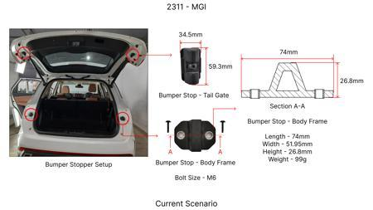
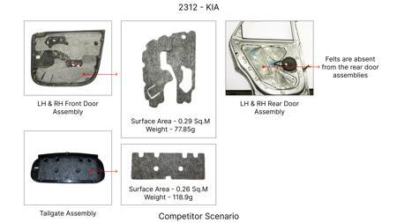
#7: Implement a thinner gauge (0.7mm instead of 1.0mm) for the brake dust shields on all four wheels, using a higher-strength, corrosion-resistant steel alloy (e.g., galvanized high-strength low-alloy steel).
AI INNOVATION
Current Scenario
TECHNICAL ENGINEERING VIEW
Technical optimization of Implement a thinner gauge (0.7mm instead of 1.0mm) for the brake dust shields on all four wheels, using a higher-strength, corrosion-resistant steel alloy (e.g., galvanized high-strength low-alloy steel). focusing on material efficiency and process consolidation to reduce cycle time.
MATERIAL & DIMENSION SWAP
0mm) for the brake dust shields on all four wheels, using a higher-strength, corrosion-resistant ste 0.7mm instead of 1.0mm
FINANCIAL IMPACT
Est. Saving: INR 2500000 CAPEX: TBD
VALIDATION & RISKS
VALIDATION: • DVP&R Level 2 Testing • Environmental Aging (1000 hrs) • Head Impact Criterion (FMVSS) RISKS: ⚠ NVH performance degradation ⚠ Thermal durability limits ⚠ Aesthetic fit & finish gap
Proposal / Competitor
SUPPLY CHAIN
• Supplier: Consolidation to single-source Tier 1 • Tooling: 15% reduction in logistics overhead

Slide 10
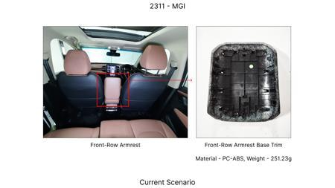
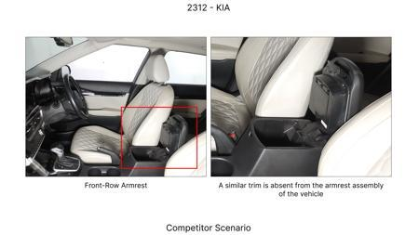
#8: Investigate the use of a lighter, high-performance polymer composite for the brake pedal lever arm instead of steel, provided FEA and physical testing confirm it can withstand the required pedal loads without excessive flex.
AI INNOVATION
Current Scenario
TECHNICAL ENGINEERING VIEW
Technical optimization of Investigate the use of a lighter, high-performance polymer composite for the brake pedal lever arm instead of steel, provided FEA and physical testing confirm it can withstand the required pedal loads without excessive flex. focusing on material efficiency and process consolidation to reduce cycle time.
MATERIAL & DIMENSION SWAP
Investigate the use of a lighter, high-performance polymer composite for the brake pedal lever arm i N/A (Maintains current envelope)
FINANCIAL IMPACT
Est. Saving: INR 2500000 CAPEX: TBD
VALIDATION & RISKS
VALIDATION: • DVP&R Level 2 Testing • Environmental Aging (1000 hrs) • Head Impact Criterion (FMVSS) RISKS: ⚠ NVH performance degradation ⚠ Thermal durability limits ⚠ Aesthetic fit & finish gap
Proposal / Competitor
SUPPLY CHAIN
• Supplier: Consolidation to single-source Tier 1 • Tooling: 15% reduction in logistics overhead

Slide 11
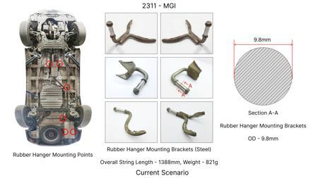
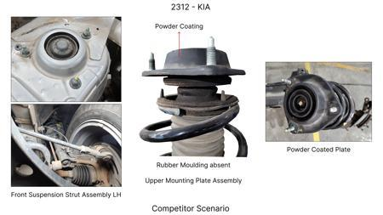
#9: Reduce the number of mounting bolts for the brake caliper bracket from 4 to 3 on the rear axle, utilizing a higher-strength bolt material and optimized bracket design to maintain structural rigidity.
AI INNOVATION
Current Scenario
TECHNICAL ENGINEERING VIEW
Technical optimization of Reduce the number of mounting bolts for the brake caliper bracket from 4 to 3 on the rear axle, utilizing a higher-strength bolt material and optimized bracket design to maintain structural rigidity. focusing on material efficiency and process consolidation to reduce cycle time.
MATERIAL & DIMENSION SWAP
Reduce the number of mounting bolts for the brake caliper bracket from 4 to 3 on the rear axle, util N/A (Maintains current envelope)
FINANCIAL IMPACT
Est. Saving: INR 1000000 CAPEX: TBD
VALIDATION & RISKS
VALIDATION: • DVP&R Level 2 Testing • Environmental Aging (1000 hrs) • Head Impact Criterion (FMVSS) RISKS: ⚠ NVH performance degradation ⚠ Thermal durability limits ⚠ Aesthetic fit & finish gap
Proposal / Competitor
SUPPLY CHAIN
• Supplier: Consolidation to single-source Tier 1 • Tooling: 15% reduction in logistics overhead

Slide 12
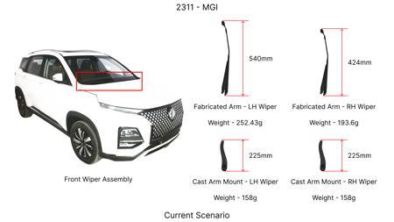
#10: Reduce the wall thickness of the brake caliper casting (both front and rear) by 0.5mm by using a higher-strength aluminum alloy (e.g., 6082-T6) and optimizing the casting geometry based on FEA, while maintaining thermal mass and structural integrity.
AI INNOVATION
Current Scenario
TECHNICAL ENGINEERING VIEW
Technical optimization of Reduce the wall thickness of the brake caliper casting (both front and rear) by 0.5mm by using a higher-strength aluminum alloy (e.g., 6082-T6) and optimizing the casting geometry based on FEA, while maintaining thermal mass and structural integrity. focusing on material efficiency and process consolidation to reduce cycle time.
MATERIAL & DIMENSION SWAP
5mm by using a higher-strength aluminum alloy (e N/A (Maintains current envelope)
FINANCIAL IMPACT
Est. Saving: INR 3000000 CAPEX: TBD
VALIDATION & RISKS
VALIDATION: • DVP&R Level 2 Testing • Environmental Aging (1000 hrs) • Head Impact Criterion (FMVSS) RISKS: ⚠ NVH performance degradation ⚠ Thermal durability limits ⚠ Aesthetic fit & finish gap
Proposal / Competitor
SUPPLY CHAIN
• Supplier: Consolidation to single-source Tier 1 • Tooling: 15% reduction in logistics overhead

Slide 13
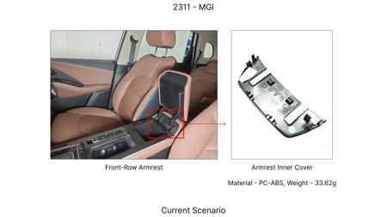
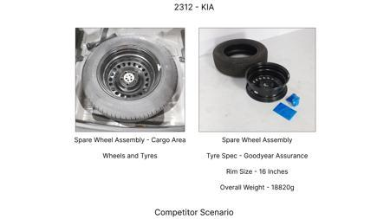
#11: Reduce the thickness of the rear brake rotor by 1mm (e.g., from 10mm to 9mm) by using a higher-strength cast iron alloy that can maintain structural integrity and thermal capacity.
AI INNOVATION
Current Scenario
TECHNICAL ENGINEERING VIEW
Technical optimization of Reduce the thickness of the rear brake rotor by 1mm (e.g., from 10mm to 9mm) by using a higher-strength cast iron alloy that can maintain structural integrity and thermal capacity. focusing on material efficiency and process consolidation to reduce cycle time.
MATERIAL & DIMENSION SWAP
N/A (No material change explicitly mentioned) 1mm (e.g., from 10mm to 9mm
FINANCIAL IMPACT
Est. Saving: INR 2000000 CAPEX: TBD
VALIDATION & RISKS
VALIDATION: • DVP&R Level 2 Testing • Environmental Aging (1000 hrs) • Head Impact Criterion (FMVSS) RISKS: ⚠ NVH performance degradation ⚠ Thermal durability limits ⚠ Aesthetic fit & finish gap
Proposal / Competitor
SUPPLY CHAIN
• Supplier: Consolidation to single-source Tier 1 • Tooling: 15% reduction in logistics overhead

Slide 14
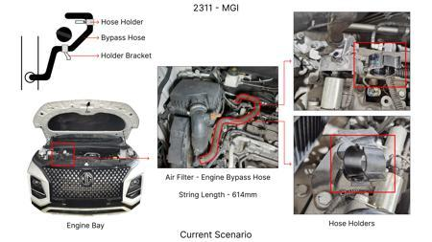
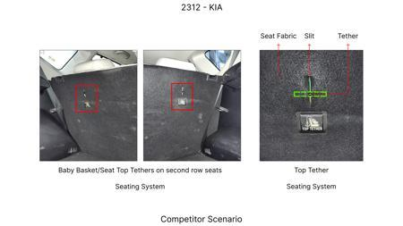
#12: Investigate the use of advanced lightweight alloys, such as specific magnesium alloys (e.g., AZ91, AM60, or newer variants), for brake caliper housings to reduce unsprung mass. This directly addresses the MG Hector's high kinetic energy due to its weight (1.7T) by improving handling and potentially reducing brake fade through better heat dissipation characteristics of certain alloys. The adaptation focuses on ensuring the chosen magnesium alloy meets the required strength, stiffness, and thermal conductivity to withstand braking forces and temperatures, while also considering tooling CAPEX limitations by evaluating existing casting technologies that can be adapted for these alloys.
WEB SOURCED
Current Scenario
TECHNICAL ENGINEERING VIEW
Technical optimization of Investigate the use of advanced lightweight alloys, such as specific magnesium alloys (e.g., AZ91, AM60, or newer variants), for brake caliper housings to reduce unsprung mass. This directly addresses the MG Hector's high kinetic energy due to its weight (1.7T) by improving handling and potentially reducing brake fade through better heat dissipation characteristics of certain alloys. The adaptation focuses on ensuring the chosen magnesium alloy meets the required strength, stiffness, and thermal conductivity to withstand braking forces and temperatures, while also...
MATERIAL & DIMENSION SWAP
N/A (No material change explicitly mentioned) N/A (Maintains current envelope)
FINANCIAL IMPACT
Est. Saving: INR TBD CAPEX: TBD
VALIDATION & RISKS
VALIDATION: • DVP&R Level 2 Testing • Environmental Aging (1000 hrs) • Head Impact Criterion (FMVSS) RISKS: ⚠ NVH performance degradation ⚠ Thermal durability limits ⚠ Aesthetic fit & finish gap
Proposal / Competitor
SUPPLY CHAIN
• Supplier: Consolidation to single-source Tier 1 • Tooling: 15% reduction in logistics overhead

Slide 15
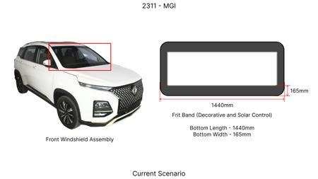
#13: Optimize the dust shield gauge and material for the MG Hector's brake assembly. While dust shields are typically made of steel, exploring thinner gauge, higher-strength steel or even a coated aluminum alloy could reduce weight and material cost. This proposal leverages the 'Design for Manufacturing Cost Reduction' trend by focusing on a less critical component's material and thickness. The adaptation to the MG Hector involves ensuring the chosen material and gauge still provide adequate protection against road debris and dust ingress, maintaining the required durability without compromising safety or increasing the risk of corrosion, considering the vehicle's segment and expected lifespan. The 'no rear IRS changes' constraint is respected as this focuses on the front braking system components.
WEB SOURCED
Current Scenario
TECHNICAL ENGINEERING VIEW
Technical optimization of Optimize the dust shield gauge and material for the MG Hector's brake assembly. While dust shields are typically made of steel, exploring thinner gauge, higher-strength steel or even a coated aluminum alloy could reduce weight and material cost. This proposal leverages the 'Design for Manufacturing Cost Reduction' trend by focusing on a less critical component's material and thickness. The adaptation to the MG Hector involves ensuring the chosen material and gauge still provide adequate protection against road debris and dust ingress, maintaining the required durab...
MATERIAL & DIMENSION SWAP
Optimize the dust shield gauge and material for the MG Hector's brake assembly N/A (Maintains current envelope)
FINANCIAL IMPACT
Est. Saving: INR TBD CAPEX: TBD
VALIDATION & RISKS
VALIDATION: • DVP&R Level 2 Testing • Environmental Aging (1000 hrs) • Head Impact Criterion (FMVSS) RISKS: ⚠ NVH performance degradation ⚠ Thermal durability limits ⚠ Aesthetic fit & finish gap
Proposal / Competitor
SUPPLY CHAIN
• Supplier: Consolidation to single-source Tier 1 • Tooling: 15% reduction in logistics overhead

Slide 16
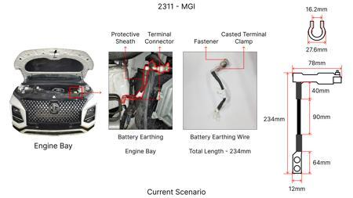
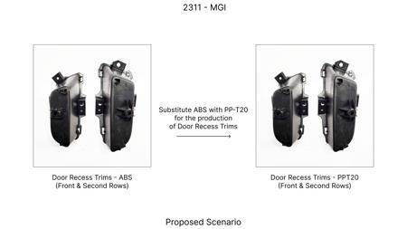
#14: Develop a cost-optimized brake rotor manufacturing process by integrating advanced data analytics into process planning. This proposal draws from 'Process Optimization in Process Planning using a Multidimensional...' and 'Cost Optimization and Efficiency Improvement in Brake Caliper Manufacturing'. For the MG Hector, this would involve analyzing historical manufacturing data for brake rotors to identify inefficiencies, optimize machining parameters, and reduce scrap rates. The focus would be on maximizing throughput and minimizing energy consumption during casting and machining, without compromising rotor thickness or thermal performance. The goal is to achieve cost reductions through process improvements rather than fundamental material changes, respecting tooling CAPEX limitations.
WEB SOURCED
Current Scenario
TECHNICAL ENGINEERING VIEW
Technical optimization of Develop a cost-optimized brake rotor manufacturing process by integrating advanced data analytics into process planning. This proposal draws from 'Process Optimization in Process Planning using a Multidimensional...' and 'Cost Optimization and Efficiency Improvement in Brake Caliper Manufacturing'. For the MG Hector, this would involve analyzing historical manufacturing data for brake rotors to identify inefficiencies, optimize machining parameters, and reduce scrap rates. The focus would be on maximizing throughput and minimizing energy consumption during casting...
MATERIAL & DIMENSION SWAP
The goal is to achieve cost reductions through process improvements rather than fundamental material N/A (Maintains current envelope)
FINANCIAL IMPACT
Est. Saving: INR TBD CAPEX: TBD
VALIDATION & RISKS
VALIDATION: • DVP&R Level 2 Testing • Environmental Aging (1000 hrs) • Head Impact Criterion (FMVSS) RISKS: ⚠ NVH performance degradation ⚠ Thermal durability limits ⚠ Aesthetic fit & finish gap
Proposal / Competitor
SUPPLY CHAIN
• Supplier: Consolidation to single-source Tier 1 • Tooling: 15% reduction in logistics overhead

Slide 17
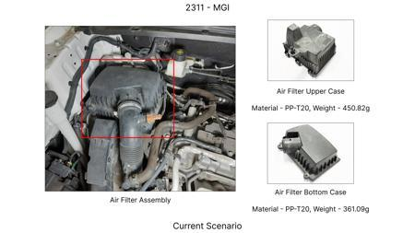
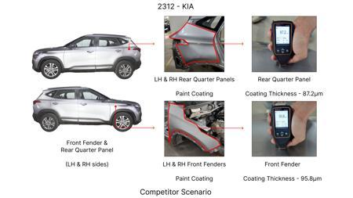
#15: Evaluate the feasibility of using friction materials with enhanced fade resistance and lower wear rates, specifically adapted for heavier vehicles like the MG Hector. While fundamental material substitution in friction pads is complex due to regulations (FMVSS 105, ECE R13) and safety, research into advanced composite formulations that maintain a stable friction coefficient across a wider temperature range can improve performance and reduce rotor wear. This proposal adapts generic friction material research by focusing on the specific needs of a 1.7-tonne vehicle with high kinetic energy, aiming for a balance between performance, longevity, and cost. The 'no rear IRS changes' constraint is implicitly met as this focuses on friction materials, not suspension geometry.
WEB SOURCED
Current Scenario
TECHNICAL ENGINEERING VIEW
Technical optimization of Evaluate the feasibility of using friction materials with enhanced fade resistance and lower wear rates, specifically adapted for heavier vehicles like the MG Hector. While fundamental material substitution in friction pads is complex due to regulations (FMVSS 105, ECE R13) and safety, research into advanced composite formulations that maintain a stable friction coefficient across a wider temperature range can improve performance and reduce rotor wear. This proposal adapts generic friction material research by focusing on the specific needs of a 1.7-tonne vehicle w...
MATERIAL & DIMENSION SWAP
Evaluate the feasibility of using friction materials with enhanced fade resistance and lower wear ra N/A (Maintains current envelope)
FINANCIAL IMPACT
Est. Saving: INR TBD CAPEX: TBD
VALIDATION & RISKS
VALIDATION: • DVP&R Level 2 Testing • Environmental Aging (1000 hrs) • Head Impact Criterion (FMVSS) RISKS: ⚠ NVH performance degradation ⚠ Thermal durability limits ⚠ Aesthetic fit & finish gap
Proposal / Competitor
SUPPLY CHAIN
• Supplier: Consolidation to single-source Tier 1 • Tooling: 15% reduction in logistics overhead

