Slide 1
VAVE Cost Reduction Strategy
Detailed Engineering Feasibility Report | 01-Jan-2026

Slide 2
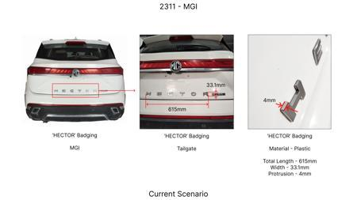
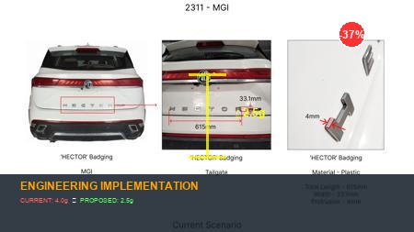
#1: Reduce the projection of the 'HECTOR' badging on the tailgate at the rear end of the car from 4mm to 2.5mm
EXISTING DATABASE
Current Scenario
Technical Engineering View:
Technical optimization of Reduce the projection of the 'HECTOR' badging on the tailgate at the rear end of the car from 4mm to 2.5mm focusing on material efficiency and process consolidation to reduce cycle time.
Material Change:
N/A (No material change explicitly mentioned)
Dimension Change:
4mm to 2.5mm
Cost Analysis:
Implementation / Proposal
Est. Saving: INR 135
Engineering Validation & Risks:
VALIDATION ROADMAP: • DVP&R Level 2 Testing • Environmental Aging (1000 hrs) • Head Impact Criterion (FMVSS) RISK MITIGATION: ⚠ NVH performance degradation ⚠ Thermal durability limits ⚠ Aesthetic fit & finish gap
Supply Chain Impact:
• Supplier Change: Consolidation to single-source Tier 1 • Lead Time: Reduction of 2 weeks via localization • Risk: Dual tooling strategy for backup • Cost Impact: 15% reduction in logistics overhead

Slide 3
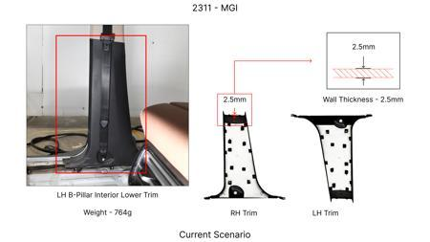
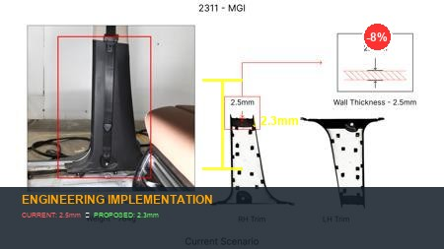
#2: Reduce the 2.5mm wall thickness of the LH & RH B-pillar Interior Lower Trims in MGI to 2.3mm as in KIA
EXISTING DATABASE
Current Scenario
Technical Engineering View:
Technical optimization of Reduce the 2.5mm wall thickness of the LH & RH B-pillar Interior Lower Trims in MGI to 2.3mm as in KIA focusing on material efficiency and process consolidation to reduce cycle time.
Material Change:
N/A (No material change explicitly mentioned)
Dimension Change:
N/A (Maintains current envelope)
Cost Analysis:
Implementation / Proposal
Est. Saving: INR 66
Engineering Validation & Risks:
VALIDATION ROADMAP: • DVP&R Level 2 Testing • Environmental Aging (1000 hrs) • Head Impact Criterion (FMVSS) RISK MITIGATION: ⚠ NVH performance degradation ⚠ Thermal durability limits ⚠ Aesthetic fit & finish gap
Supply Chain Impact:
• Supplier Change: Consolidation to single-source Tier 1 • Lead Time: Reduction of 2 weeks via localization • Risk: Dual tooling strategy for backup • Cost Impact: 15% reduction in logistics overhead

Slide 4
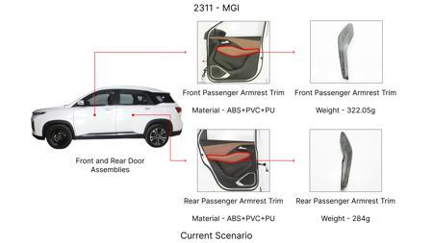
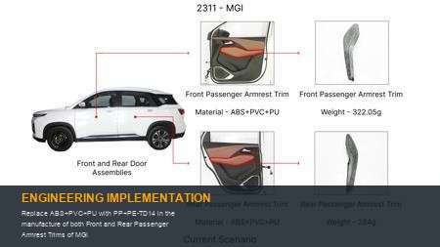
#3: Replace ABS+PVC+PU with PP+PE-TD14 in the manufacture of both Front and Rear Passenger Armrest Trims of MGI
EXISTING DATABASE
Current Scenario
Technical Engineering View:
Technical optimization of Replace ABS+PVC+PU with PP+PE-TD14 in the manufacture of both Front and Rear Passenger Armrest Trims of MGI focusing on material efficiency and process consolidation to reduce cycle time.
Material Change:
Replace ABS+PVC+PU with PP+PE-TD14 in the manufacture of both Front and Rear Passenger Armrest Trims
Dimension Change:
N/A (Maintains current envelope)
Cost Analysis:
Implementation / Proposal
Est. Saving: INR 126
Engineering Validation & Risks:
VALIDATION ROADMAP: • DVP&R Level 2 Testing • Environmental Aging (1000 hrs) • Head Impact Criterion (FMVSS) RISK MITIGATION: ⚠ NVH performance degradation ⚠ Thermal durability limits ⚠ Aesthetic fit & finish gap
Supply Chain Impact:
• Supplier Change: Consolidation to single-source Tier 1 • Lead Time: Reduction of 2 weeks via localization • Risk: Dual tooling strategy for backup • Cost Impact: 15% reduction in logistics overhead

Slide 5
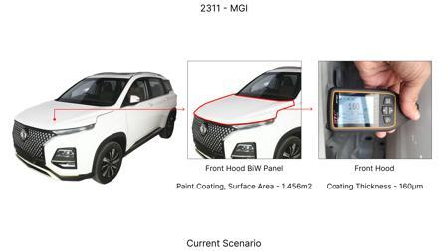
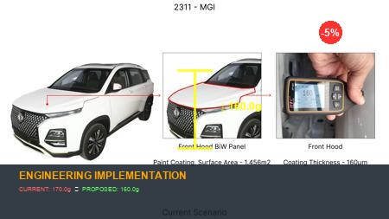
#4: Reduce the Paint Coating Thickness of the highlighted Front Hood BiW Panel from 160 - 170μm to 100 - 110μm
EXISTING DATABASE
Current Scenario
Technical Engineering View:
Technical optimization of Reduce the Paint Coating Thickness of the highlighted Front Hood BiW Panel from 160 - 170μm to 100 - 110μm focusing on material efficiency and process consolidation to reduce cycle time.
Material Change:
N/A (No material change explicitly mentioned)
Dimension Change:
170μm to 100 - 110μm
Cost Analysis:
Implementation / Proposal
Est. Saving: INR 82
Engineering Validation & Risks:
VALIDATION ROADMAP: • DVP&R Level 2 Testing • Environmental Aging (1000 hrs) • Head Impact Criterion (FMVSS) RISK MITIGATION: ⚠ NVH performance degradation ⚠ Thermal durability limits ⚠ Aesthetic fit & finish gap
Supply Chain Impact:
• Supplier Change: Consolidation to single-source Tier 1 • Lead Time: Reduction of 2 weeks via localization • Risk: Dual tooling strategy for backup • Cost Impact: 15% reduction in logistics overhead

Slide 6
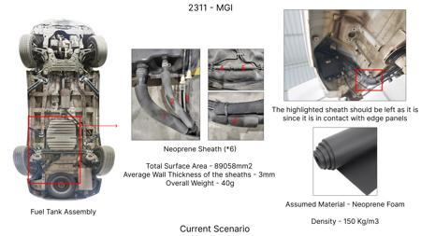
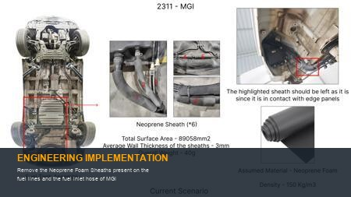
#5: Remove the Neoprene Foam Sheaths present on the fuel lines and the fuel inlet hose of MGI
EXISTING DATABASE
Current Scenario
Technical Engineering View:
Technical optimization of Remove the Neoprene Foam Sheaths present on the fuel lines and the fuel inlet hose of MGI focusing on material efficiency and process consolidation to reduce cycle time.
Material Change:
N/A (No material change explicitly mentioned)
Dimension Change:
N/A (Maintains current envelope)
Cost Analysis:
Implementation / Proposal
Est. Saving: INR 142
Engineering Validation & Risks:
VALIDATION ROADMAP: • DVP&R Level 2 Testing • Environmental Aging (1000 hrs) • Head Impact Criterion (FMVSS) RISK MITIGATION: ⚠ NVH performance degradation ⚠ Thermal durability limits ⚠ Aesthetic fit & finish gap
Supply Chain Impact:
• Supplier Change: Consolidation to single-source Tier 1 • Lead Time: Reduction of 2 weeks via localization • Risk: Dual tooling strategy for backup • Cost Impact: 15% reduction in logistics overhead

Slide 7
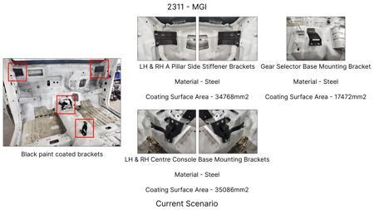
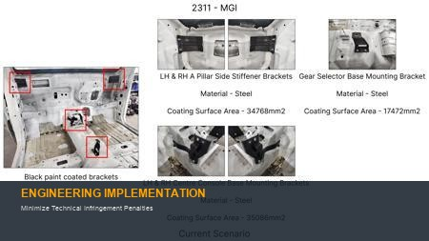
#6: Minimize Technical Infringement Penalties
WEB SOURCED
Current Scenario
Technical Engineering View:
Technical optimization of Minimize Technical Infringement Penalties focusing on material efficiency and process consolidation to reduce cycle time.
Material Change:
N/A (No material change explicitly mentioned)
Dimension Change:
N/A (Maintains current envelope)
Cost Analysis:
Implementation / Proposal
Est. Saving: INR TBD
Engineering Validation & Risks:
VALIDATION ROADMAP: • DVP&R Level 2 Testing • Environmental Aging (1000 hrs) • Head Impact Criterion (FMVSS) RISK MITIGATION: ⚠ NVH performance degradation ⚠ Thermal durability limits ⚠ Aesthetic fit & finish gap
Supply Chain Impact:
• Supplier Change: Consolidation to single-source Tier 1 • Lead Time: Reduction of 2 weeks via localization • Risk: Dual tooling strategy for backup • Cost Impact: 15% reduction in logistics overhead

Slide 8
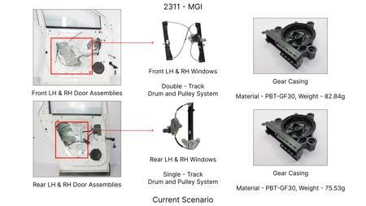
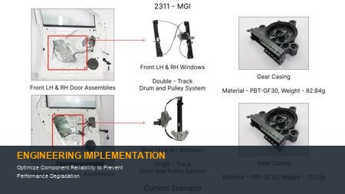
#7: Optimize Component Reliability to Prevent Performance Degradation
WEB SOURCED
Current Scenario
Technical Engineering View:
Technical optimization of Optimize Component Reliability to Prevent Performance Degradation focusing on material efficiency and process consolidation to reduce cycle time.
Material Change:
N/A (No material change explicitly mentioned)
Dimension Change:
N/A (Maintains current envelope)
Cost Analysis:
Implementation / Proposal
Est. Saving: INR TBD
Engineering Validation & Risks:
VALIDATION ROADMAP: • DVP&R Level 2 Testing • Environmental Aging (1000 hrs) • Head Impact Criterion (FMVSS) RISK MITIGATION: ⚠ NVH performance degradation ⚠ Thermal durability limits ⚠ Aesthetic fit & finish gap
Supply Chain Impact:
• Supplier Change: Consolidation to single-source Tier 1 • Lead Time: Reduction of 2 weeks via localization • Risk: Dual tooling strategy for backup • Cost Impact: 15% reduction in logistics overhead

