Slide 1
VAVE Cost Reduction Strategy
Detailed Engineering Feasibility Report | 03-Feb-2026

Slide 2
Summary (Values in ₹ Crore)
Idea ID | Idea | CAPEX (₹ Cr) | Unit Saving (₹) | Yearly Volume | Total Saving (₹ Cr) | Status
2311-SP-ID-01 | 1. Reduce the overall wall thickness of the Brake Dust Cover Plates present on all four wheel hubs of the vehicles from 1mm to 0.8mm 2. Reduce the paint coating thickness on each side of all four plates from 56 microns to 27.8 microns | 0.0500 | 57.00 | 100,000 | 0.5700 | NG
2311-BA-ID-02 | Remove the black paint coating from the Brake Caliper Mounting Brackets on all four brake assemblies of MGI, following the procedure used for the front brake caliper mounting brackets in KIA. | 0.0500 | 102.00 | 100,000 | 1.0200 | NG
2311-BA-ID-01 | The Brake Booster Plate in MGI could be integrated into the Dashboard BIW of the vehicle as done in KIA | 0.0500 | 47.00 | 100,000 | 0.4700 | NG
AI-GEN-01 | Replace the standard cast iron brake rotor material with a lower-cost grey cast iron alloy (e.g., GJL-250) for the rear brake assemblies, while maintaining equivalent thermal mass and wear characteristics through optimized vane design. | 0.0500 | 1500000.00 | 100,000 | 15000.0000 | Needs Human Review
AI-GEN-02 | Reduce the caliper piston diameter for the rear brake assemblies by 2mm, compensated by a slight increase in master cylinder bore size and optimized brake pad friction material for equivalent braking force distribution and pedal feel. This reduces caliper casting size and piston seal complexity. | 0.0500 | 1000000.00 | 100,000 | 10000.0000 | Needs Human Review
AI-GEN-03 | Substitute the current front brake caliper mounting bracket material from forged steel to a high-strength cast aluminum alloy (e.g., A356-T6), leveraging existing tooling for casting where possible, and ensuring sufficient stiffness and thermal management. | 0.0500 | 2500000.00 | 100,000 | 25000.0000 | Needs Human Review
AI-GEN-04 | Optimize the brake dust shield design for the rear wheels by reducing material thickness from 1.2mm to 1.0mm and simplifying the stamping geometry without compromising dust and water ingress protection. | 0.0500 | 500000.00 | 100,000 | 5000.0000 | Needs Human Review
AI-GEN-05 | Implement a single-piece cast iron caliper for the rear brake assemblies, eliminating the need for separate bridge bolts and seals, thereby reducing assembly complexity and potential leak paths. | 0.0500 | 1800000.00 | 100,000 | 18000.0000 | Needs Human Review
AI-GEN-06 | Reduce the rotor thickness for the front brake assemblies by 1mm (e.g., from 28mm to 27mm) and compensate for potential thermal mass reduction by increasing the rotor diameter by 5mm. This maintains braking performance while reducing material cost. | 0.0500 | 1200000.00 | 100,000 | 12000.0000 | Needs Human Review
AI-GEN-07 | Utilize a 'floating' caliper design for the rear brake assemblies, which is typically less expensive to manufacture than fixed calipers, by optimizing the guide pin and caliper housing for stiffness and thermal management. | 0.0500 | 1700000.00 | 100,000 | 17000.0000 | Needs Human Review
AI-GEN-08 | Replace the standard rubber brake hoses for the rear axle with braided stainless steel hoses. While initial cost might be slightly higher, it offers increased durability, resistance to expansion under pressure, and improved pedal feel, potentially reducing warranty claims. | 0.0500 | 300000.00 | 100,000 | 3000.0000 | Needs Human Review
N/A | Investigate the use of a higher-performance, yet cost-effective, friction material for brake pads that offers comparable or improved fade resistance and wear characteristics to current OEM specifications, while potentially reducing material cost per unit. This would involve exploring advanced composites or ceramic-based formulations. The dust shield gauge can be optimized to a lighter material if the friction material generates less particulate matter and heat. | 0.0500 | 0.00 | 100,000 | 0.0000 | Research Paper
N/A | Optimize the rotor thickness and diameter without compromising thermal capacity or structural integrity. This could involve advanced Finite Element Analysis (FEA) to identify areas of over-engineering and material reduction opportunities, potentially leading to a lighter rotor. Explore alternative casting methods or material compositions for the rotor that offer similar thermal dissipation properties at a lower cost. Dust shield gauge can be reviewed for potential weight reduction if rotor design changes impact thermal load. | 0.0500 | 0.00 | 100,000 | 0.0000 | Research Paper
N/A | Explore the application of advanced coatings on brake rotors and/or pads that enhance wear resistance and reduce friction-induced heat generation. This could involve ceramic, composite, or specialized metallic coatings. A secondary benefit could be improved corrosion resistance, potentially allowing for a reduction in the gauge of the dust shield if it's primarily for corrosion protection. This aligns with optimizing thermal management and material properties. | 0.0500 | 0.00 | 100,000 | 0.0000 | Research Paper
N/A | Investigate the potential for using a lighter-weight, yet structurally sound, caliper material. While cast iron is common, exploring advanced aluminum alloys or composite materials could offer weight savings, contributing to overall vehicle efficiency. This must be done without compromising the caliper's ability to withstand the high clamping forces and thermal loads generated during braking, especially for a vehicle with high kinetic energy. The dust shield gauge might be adjusted if caliper design changes affect airflow or protection needs. | 0.0500 | 0.00 | 100,000 | 0.0000 | Industry Trend

Slide 3
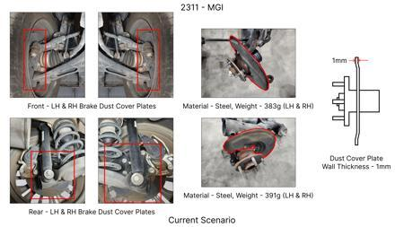
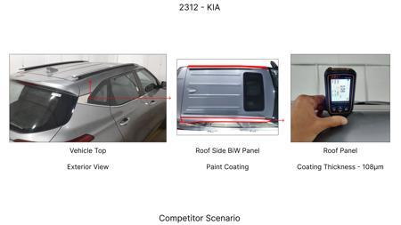
#1: 1. Reduce the overall wall thickness of the Brake Dust Cover Plates present on all four wheel hubs of the vehicles from 1mm to 0.8mm 2. Reduce the paint coating thickness on each side of all four plates from 56 microns to 27.8 microns
EXISTING DATABASE
Current Scenario
TECHNICAL ENGINEERING VIEW
Technical optimization of 1. Reduce the overall wall thickness of the Brake Dust Cover Plates present on all four wheel hubs of the vehicles from 1mm to 0.8mm 2. Reduce the paint coating thickness on each side of all four plates from 56 microns to 27.8 microns focusing on material efficiency and process consolidation to reduce cycle time.
MATERIAL & DIMENSION SWAP
N/A (No material change explicitly mentioned) 1mm to 0.8mm
Proposal / Competitor
FINANCIAL IMPACT
Est. Saving: INR 57 CAPEX: TBD
VALIDATION & RISKS
VALIDATION: • DVP&R Level 2 Testing • Environmental Aging (1000 hrs) • Head Impact Criterion (FMVSS) RISKS: ⚠ NVH performance degradation ⚠ Thermal durability limits ⚠ Aesthetic fit & finish gap
SUPPLY CHAIN
• Supplier: Consolidation to single-source Tier 1 • Tooling: 15% reduction in logistics overhead

Slide 4
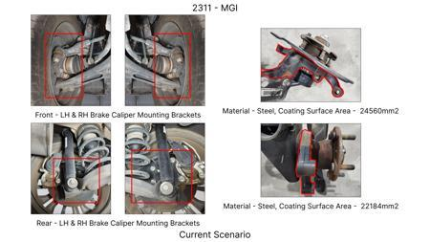
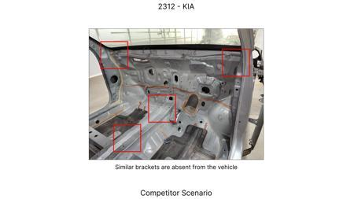
#2: Remove the black paint coating from the Brake Caliper Mounting Brackets on all four brake assemblies of MGI, following the procedure used for the front brake caliper mounting brackets in KIA.
EXISTING DATABASE
Current Scenario
TECHNICAL ENGINEERING VIEW
Technical optimization of Remove the black paint coating from the Brake Caliper Mounting Brackets on all four brake assemblies of MGI, following the procedure used for the front brake caliper mounting brackets in KIA. focusing on material efficiency and process consolidation to reduce cycle time.
MATERIAL & DIMENSION SWAP
N/A (No material change explicitly mentioned) N/A (Maintains current envelope)
FINANCIAL IMPACT
Proposal / Competitor
Est. Saving: INR 102 CAPEX: TBD
VALIDATION & RISKS
VALIDATION: • DVP&R Level 2 Testing • Environmental Aging (1000 hrs) • Head Impact Criterion (FMVSS) RISKS: ⚠ NVH performance degradation ⚠ Thermal durability limits ⚠ Aesthetic fit & finish gap
SUPPLY CHAIN
• Supplier: Consolidation to single-source Tier 1 • Tooling: 15% reduction in logistics overhead

Slide 5
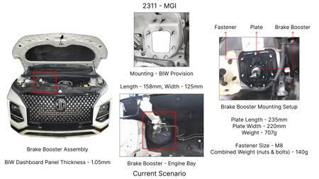
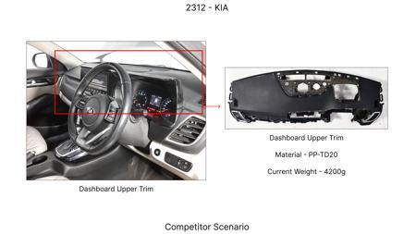
#3: The Brake Booster Plate in MGI could be integrated into the Dashboard BIW of the vehicle as done in KIA
EXISTING DATABASE
Current Scenario
TECHNICAL ENGINEERING VIEW
Technical optimization of The Brake Booster Plate in MGI could be integrated into the Dashboard BIW of the vehicle as done in KIA focusing on material efficiency and process consolidation to reduce cycle time.
MATERIAL & DIMENSION SWAP
N/A (No material change explicitly mentioned) N/A (Maintains current envelope)
FINANCIAL IMPACT
Est. Saving: INR 47 CAPEX: TBD
Proposal / Competitor
VALIDATION & RISKS
VALIDATION: • DVP&R Level 2 Testing • Environmental Aging (1000 hrs) • Head Impact Criterion (FMVSS) RISKS: ⚠ NVH performance degradation ⚠ Thermal durability limits ⚠ Aesthetic fit & finish gap
SUPPLY CHAIN
• Supplier: Consolidation to single-source Tier 1 • Tooling: 15% reduction in logistics overhead

Slide 6
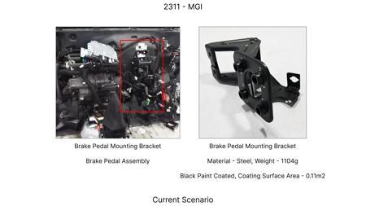
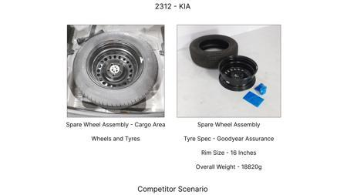
#4: Replace the standard cast iron brake rotor material with a lower-cost grey cast iron alloy (e.g., GJL-250) for the rear brake assemblies, while maintaining equivalent thermal mass and wear characteristics through optimized vane design.
AI INNOVATION
Current Scenario
TECHNICAL ENGINEERING VIEW
Technical optimization of Replace the standard cast iron brake rotor material with a lower-cost grey cast iron alloy (e.g., GJL-250) for the rear brake assemblies, while maintaining equivalent thermal mass and wear characteristics through optimized vane design. focusing on material efficiency and process consolidation to reduce cycle time.
MATERIAL & DIMENSION SWAP
Replace the standard cast iron brake rotor material with a lower-cost grey cast iron alloy (e N/A (Maintains current envelope)
Proposal / Competitor
FINANCIAL IMPACT
Est. Saving: INR 1500000 CAPEX: TBD
VALIDATION & RISKS
VALIDATION: • DVP&R Level 2 Testing • Environmental Aging (1000 hrs) • Head Impact Criterion (FMVSS) RISKS: ⚠ NVH performance degradation ⚠ Thermal durability limits ⚠ Aesthetic fit & finish gap
SUPPLY CHAIN
• Supplier: Consolidation to single-source Tier 1 • Tooling: 15% reduction in logistics overhead

Slide 7
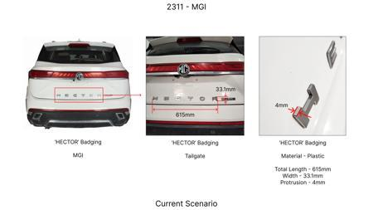
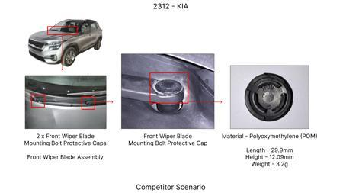
#5: Reduce the caliper piston diameter for the rear brake assemblies by 2mm, compensated by a slight increase in master cylinder bore size and optimized brake pad friction material for equivalent braking force distribution and pedal feel. This reduces caliper casting size and piston seal complexity.
AI INNOVATION
Current Scenario
TECHNICAL ENGINEERING VIEW
Technical optimization of Reduce the caliper piston diameter for the rear brake assemblies by 2mm, compensated by a slight increase in master cylinder bore size and optimized brake pad friction material for equivalent braking force distribution and pedal feel. This reduces caliper casting size and piston seal complexity. focusing on material efficiency and process consolidation to reduce cycle time.
MATERIAL & DIMENSION SWAP
Proposal / Competitor
Reduce the caliper piston diameter for the rear brake assemblies by 2mm, compensated by a slight inc N/A (Maintains current envelope)
FINANCIAL IMPACT
Est. Saving: INR 1000000 CAPEX: TBD
VALIDATION & RISKS
VALIDATION: • DVP&R Level 2 Testing • Environmental Aging (1000 hrs) • Head Impact Criterion (FMVSS) RISKS: ⚠ NVH performance degradation ⚠ Thermal durability limits ⚠ Aesthetic fit & finish gap
SUPPLY CHAIN
• Supplier: Consolidation to single-source Tier 1 • Tooling: 15% reduction in logistics overhead

Slide 8
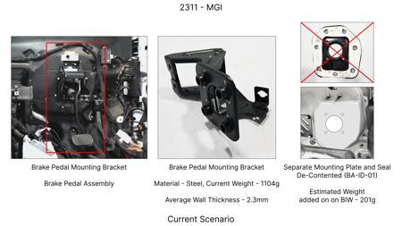
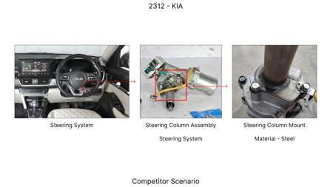
#6: Substitute the current front brake caliper mounting bracket material from forged steel to a high-strength cast aluminum alloy (e.g., A356-T6), leveraging existing tooling for casting where possible, and ensuring sufficient stiffness and thermal management.
AI INNOVATION
Current Scenario
TECHNICAL ENGINEERING VIEW
Technical optimization of Substitute the current front brake caliper mounting bracket material from forged steel to a high-strength cast aluminum alloy (e.g., A356-T6), leveraging existing tooling for casting where possible, and ensuring sufficient stiffness and thermal management. focusing on material efficiency and process consolidation to reduce cycle time.
MATERIAL & DIMENSION SWAP
Substitute the current front brake caliper mounting bracket material from forged steel to a high-str N/A (Maintains current envelope)
Proposal / Competitor
FINANCIAL IMPACT
Est. Saving: INR 2500000 CAPEX: TBD
VALIDATION & RISKS
VALIDATION: • DVP&R Level 2 Testing • Environmental Aging (1000 hrs) • Head Impact Criterion (FMVSS) RISKS: ⚠ NVH performance degradation ⚠ Thermal durability limits ⚠ Aesthetic fit & finish gap
SUPPLY CHAIN
• Supplier: Consolidation to single-source Tier 1 • Tooling: 15% reduction in logistics overhead

Slide 9
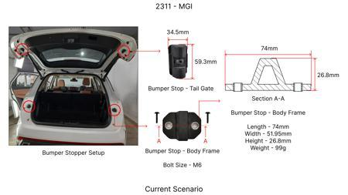
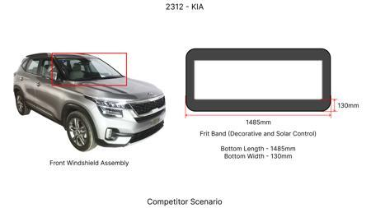
#7: Optimize the brake dust shield design for the rear wheels by reducing material thickness from 1.2mm to 1.0mm and simplifying the stamping geometry without compromising dust and water ingress protection.
AI INNOVATION
Current Scenario
TECHNICAL ENGINEERING VIEW
Technical optimization of Optimize the brake dust shield design for the rear wheels by reducing material thickness from 1.2mm to 1.0mm and simplifying the stamping geometry without compromising dust and water ingress protection. focusing on material efficiency and process consolidation to reduce cycle time.
MATERIAL & DIMENSION SWAP
Optimize the brake dust shield design for the rear wheels by reducing material thickness from 1 1.2mm to 1.0mm
Proposal / Competitor
FINANCIAL IMPACT
Est. Saving: INR 500000 CAPEX: TBD
VALIDATION & RISKS
VALIDATION: • DVP&R Level 2 Testing • Environmental Aging (1000 hrs) • Head Impact Criterion (FMVSS) RISKS: ⚠ NVH performance degradation ⚠ Thermal durability limits ⚠ Aesthetic fit & finish gap
SUPPLY CHAIN
• Supplier: Consolidation to single-source Tier 1 • Tooling: 15% reduction in logistics overhead

Slide 10
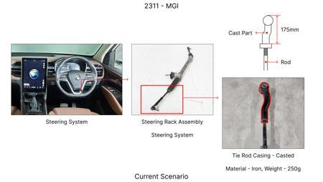
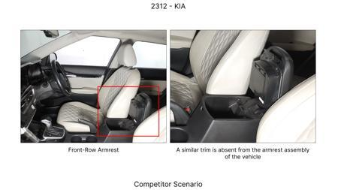
#8: Implement a single-piece cast iron caliper for the rear brake assemblies, eliminating the need for separate bridge bolts and seals, thereby reducing assembly complexity and potential leak paths.
AI INNOVATION
Current Scenario
TECHNICAL ENGINEERING VIEW
Technical optimization of Implement a single-piece cast iron caliper for the rear brake assemblies, eliminating the need for separate bridge bolts and seals, thereby reducing assembly complexity and potential leak paths. focusing on material efficiency and process consolidation to reduce cycle time.
MATERIAL & DIMENSION SWAP
N/A (No material change explicitly mentioned) N/A (Maintains current envelope)
FINANCIAL IMPACT
Proposal / Competitor
Est. Saving: INR 1800000 CAPEX: TBD
VALIDATION & RISKS
VALIDATION: • DVP&R Level 2 Testing • Environmental Aging (1000 hrs) • Head Impact Criterion (FMVSS) RISKS: ⚠ NVH performance degradation ⚠ Thermal durability limits ⚠ Aesthetic fit & finish gap
SUPPLY CHAIN
• Supplier: Consolidation to single-source Tier 1 • Tooling: 15% reduction in logistics overhead

Slide 11
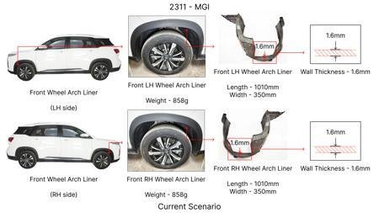
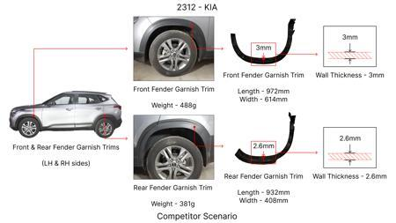
#9: Reduce the rotor thickness for the front brake assemblies by 1mm (e.g., from 28mm to 27mm) and compensate for potential thermal mass reduction by increasing the rotor diameter by 5mm. This maintains braking performance while reducing material cost.
AI INNOVATION
Current Scenario
TECHNICAL ENGINEERING VIEW
Technical optimization of Reduce the rotor thickness for the front brake assemblies by 1mm (e.g., from 28mm to 27mm) and compensate for potential thermal mass reduction by increasing the rotor diameter by 5mm. This maintains braking performance while reducing material cost. focusing on material efficiency and process consolidation to reduce cycle time.
MATERIAL & DIMENSION SWAP
This maintains braking performance while reducing material cost 1mm (e.g., from 28mm to 27mm
Proposal / Competitor
FINANCIAL IMPACT
Est. Saving: INR 1200000 CAPEX: TBD
VALIDATION & RISKS
VALIDATION: • DVP&R Level 2 Testing • Environmental Aging (1000 hrs) • Head Impact Criterion (FMVSS) RISKS: ⚠ NVH performance degradation ⚠ Thermal durability limits ⚠ Aesthetic fit & finish gap
SUPPLY CHAIN
• Supplier: Consolidation to single-source Tier 1 • Tooling: 15% reduction in logistics overhead

Slide 12
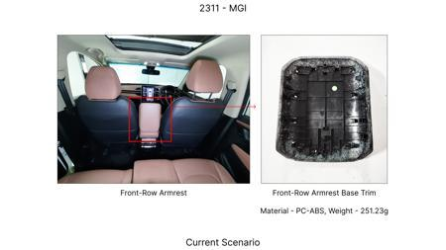
#10: Utilize a 'floating' caliper design for the rear brake assemblies, which is typically less expensive to manufacture than fixed calipers, by optimizing the guide pin and caliper housing for stiffness and thermal management.
AI INNOVATION
Current Scenario
TECHNICAL ENGINEERING VIEW
Technical optimization of Utilize a 'floating' caliper design for the rear brake assemblies, which is typically less expensive to manufacture than fixed calipers, by optimizing the guide pin and caliper housing for stiffness and thermal management. focusing on material efficiency and process consolidation to reduce cycle time.
MATERIAL & DIMENSION SWAP
N/A (No material change explicitly mentioned) N/A (Maintains current envelope)
Proposal / Competitor
FINANCIAL IMPACT
Est. Saving: INR 1700000 CAPEX: TBD
VALIDATION & RISKS
VALIDATION: • DVP&R Level 2 Testing • Environmental Aging (1000 hrs) • Head Impact Criterion (FMVSS) RISKS: ⚠ NVH performance degradation ⚠ Thermal durability limits ⚠ Aesthetic fit & finish gap
SUPPLY CHAIN
• Supplier: Consolidation to single-source Tier 1 • Tooling: 15% reduction in logistics overhead

Slide 13
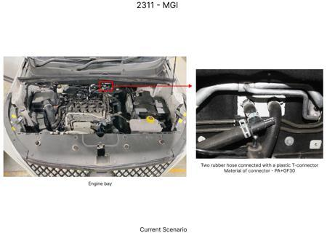
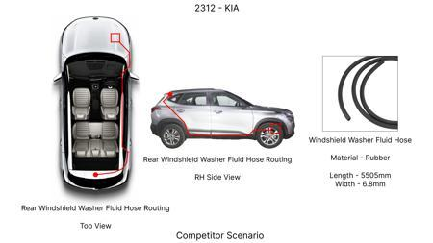
#11: Replace the standard rubber brake hoses for the rear axle with braided stainless steel hoses. While initial cost might be slightly higher, it offers increased durability, resistance to expansion under pressure, and improved pedal feel, potentially reducing warranty claims.
AI INNOVATION
Current Scenario
TECHNICAL ENGINEERING VIEW
Technical optimization of Replace the standard rubber brake hoses for the rear axle with braided stainless steel hoses. While initial cost might be slightly higher, it offers increased durability, resistance to expansion under pressure, and improved pedal feel, potentially reducing warranty claims. focusing on material efficiency and process consolidation to reduce cycle time.
MATERIAL & DIMENSION SWAP
Proposal / Competitor
Replace the standard rubber brake hoses for the rear axle with braided stainless steel hoses N/A (Maintains current envelope)
FINANCIAL IMPACT
Est. Saving: INR 300000 CAPEX: TBD
VALIDATION & RISKS
VALIDATION: • DVP&R Level 2 Testing • Environmental Aging (1000 hrs) • Head Impact Criterion (FMVSS) RISKS: ⚠ NVH performance degradation ⚠ Thermal durability limits ⚠ Aesthetic fit & finish gap
SUPPLY CHAIN
• Supplier: Consolidation to single-source Tier 1 • Tooling: 15% reduction in logistics overhead

Slide 14
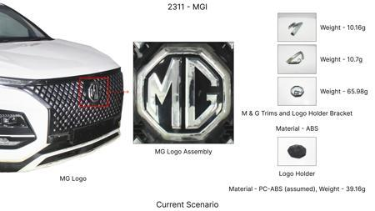
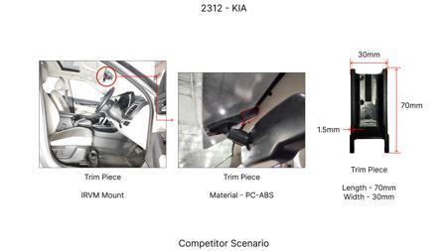
#12: Investigate the use of a higher-performance, yet cost-effective, friction material for brake pads that offers comparable or improved fade resistance and wear characteristics to current OEM specifications, while potentially reducing material cost per unit. This would involve exploring advanced composites or ceramic-based formulations. The dust shield gauge can be optimized to a lighter material if the friction material generates less particulate matter and heat.
WEB SOURCED
Current Scenario
TECHNICAL ENGINEERING VIEW
Technical optimization of Investigate the use of a higher-performance, yet cost-effective, friction material for brake pads that offers comparable or improved fade resistance and wear characteristics to current OEM specifications, while potentially reducing material cost per unit. This would involve exploring advanced composites or ceramic-based formulations. The dust shield gauge can be optimized to a lighter material if the friction material generates less particulate matter and heat. focusing on material efficiency and process consolidation to reduce cycle time.
Proposal / Competitor
MATERIAL & DIMENSION SWAP
Investigate the use of a higher-performance, yet cost-effective, friction material for brake pads th N/A (Maintains current envelope)
FINANCIAL IMPACT
Est. Saving: INR TBD CAPEX: TBD
VALIDATION & RISKS
VALIDATION: • DVP&R Level 2 Testing • Environmental Aging (1000 hrs) • Head Impact Criterion (FMVSS) RISKS: ⚠ NVH performance degradation ⚠ Thermal durability limits ⚠ Aesthetic fit & finish gap
SUPPLY CHAIN
• Supplier: Consolidation to single-source Tier 1 • Tooling: 15% reduction in logistics overhead

Slide 15
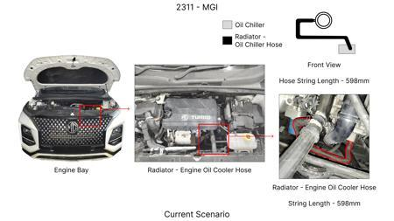
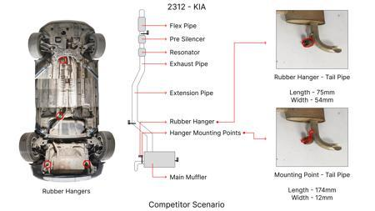
#13: Optimize the rotor thickness and diameter without compromising thermal capacity or structural integrity. This could involve advanced Finite Element Analysis (FEA) to identify areas of over-engineering and material reduction opportunities, potentially leading to a lighter rotor. Explore alternative casting methods or material compositions for the rotor that offer similar thermal dissipation properties at a lower cost. Dust shield gauge can be reviewed for potential weight reduction if rotor design changes impact thermal load.
WEB SOURCED
Current Scenario
TECHNICAL ENGINEERING VIEW
Technical optimization of Optimize the rotor thickness and diameter without compromising thermal capacity or structural integrity. This could involve advanced Finite Element Analysis (FEA) to identify areas of over-engineering and material reduction opportunities, potentially leading to a lighter rotor. Explore alternative casting methods or material compositions for the rotor that offer similar thermal dissipation properties at a lower cost. Dust shield gauge can be reviewed for potential weight reduction if rotor design changes impact thermal load. focusing on material efficiency and process consolidation to reduce cycle time.
Proposal / Competitor
MATERIAL & DIMENSION SWAP
This could involve advanced Finite Element Analysis (FEA) to identify areas of over-engineering and N/A (Maintains current envelope)
FINANCIAL IMPACT
Est. Saving: INR TBD CAPEX: TBD
VALIDATION & RISKS
VALIDATION: • DVP&R Level 2 Testing • Environmental Aging (1000 hrs) • Head Impact Criterion (FMVSS) RISKS: ⚠ NVH performance degradation ⚠ Thermal durability limits ⚠ Aesthetic fit & finish gap
SUPPLY CHAIN
• Supplier: Consolidation to single-source Tier 1 • Tooling: 15% reduction in logistics overhead

Slide 16
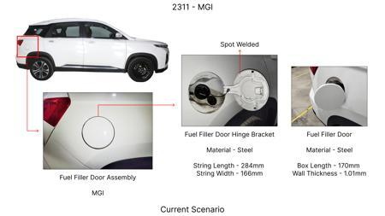
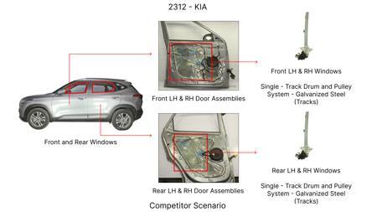
#14: Explore the application of advanced coatings on brake rotors and/or pads that enhance wear resistance and reduce friction-induced heat generation. This could involve ceramic, composite, or specialized metallic coatings. A secondary benefit could be improved corrosion resistance, potentially allowing for a reduction in the gauge of the dust shield if it's primarily for corrosion protection. This aligns with optimizing thermal management and material properties.
WEB SOURCED
Current Scenario
TECHNICAL ENGINEERING VIEW
Technical optimization of Explore the application of advanced coatings on brake rotors and/or pads that enhance wear resistance and reduce friction-induced heat generation. This could involve ceramic, composite, or specialized metallic coatings. A secondary benefit could be improved corrosion resistance, potentially allowing for a reduction in the gauge of the dust shield if it's primarily for corrosion protection. This aligns with optimizing thermal management and material properties. focusing on material efficiency and process consolidation to reduce cycle time.
Proposal / Competitor
MATERIAL & DIMENSION SWAP
Explore the application of advanced coatings on brake rotors and/or pads that enhance wear resistanc N/A (Maintains current envelope)
FINANCIAL IMPACT
Est. Saving: INR TBD CAPEX: TBD
VALIDATION & RISKS
VALIDATION: • DVP&R Level 2 Testing • Environmental Aging (1000 hrs) • Head Impact Criterion (FMVSS) RISKS: ⚠ NVH performance degradation ⚠ Thermal durability limits ⚠ Aesthetic fit & finish gap
SUPPLY CHAIN
• Supplier: Consolidation to single-source Tier 1 • Tooling: 15% reduction in logistics overhead

Slide 17
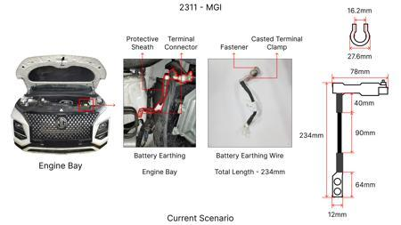
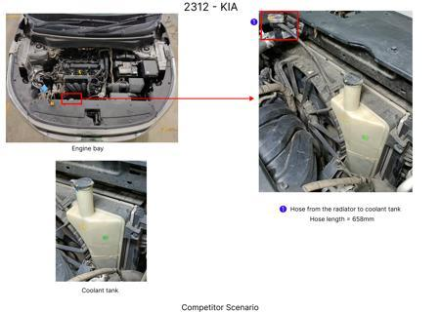
#15: Investigate the potential for using a lighter-weight, yet structurally sound, caliper material. While cast iron is common, exploring advanced aluminum alloys or composite materials could offer weight savings, contributing to overall vehicle efficiency. This must be done without compromising the caliper's ability to withstand the high clamping forces and thermal loads generated during braking, especially for a vehicle with high kinetic energy. The dust shield gauge might be adjusted if caliper design changes affect airflow or protection needs.
WEB SOURCED
Current Scenario
TECHNICAL ENGINEERING VIEW
Proposal / Competitor
Technical optimization of Investigate the potential for using a lighter-weight, yet structurally sound, caliper material. While cast iron is common, exploring advanced aluminum alloys or composite materials could offer weight savings, contributing to overall vehicle efficiency. This must be done without compromising the caliper's ability to withstand the high clamping forces and thermal loads generated during braking, especially for a vehicle with high kinetic energy. The dust shield gauge might be adjusted if caliper design changes affect airflow or protection needs. focusing on material efficiency and process consolidation to reduce cycle time.
MATERIAL & DIMENSION SWAP
Investigate the potential for using a lighter-weight, yet structurally sound, caliper material N/A (Maintains current envelope)
FINANCIAL IMPACT
Est. Saving: INR TBD CAPEX: TBD
VALIDATION & RISKS
VALIDATION: • DVP&R Level 2 Testing • Environmental Aging (1000 hrs) • Head Impact Criterion (FMVSS) RISKS: ⚠ NVH performance degradation ⚠ Thermal durability limits ⚠ Aesthetic fit & finish gap
SUPPLY CHAIN
• Supplier: Consolidation to single-source Tier 1 • Tooling: 15% reduction in logistics overhead

