Slide 1
VAVE Cost Reduction Strategy
Detailed Engineering Feasibility Report | 03-Feb-2026

Slide 2
Summary of Cost Reduction Opportunities
Idea ID | Idea | CAPEX (INR) | Saving (Unit) | Yearly Volume | Total Saving | Status
2311-SP-ID-01 | 1. Reduce the overall wall thickness of the Brake Dust Cover Plates present on all four wheel hubs of the vehicles from 1mm to 0.8mm 2. Reduce the paint coating thickness on each side of all four plates from 56 microns to 27.8 microns | 5,00,000 INR (Est) | 57 | 100000 | 5,700,000 | NG
2311-BA-ID-02 | Remove the black paint coating from the Brake Caliper Mounting Brackets on all four brake assemblies of MGI, following the procedure used for the front brake caliper mounting brackets in KIA. | 5,00,000 INR (Est) | 102 | 100000 | 10,200,000 | NG
2311-BA-ID-01 | The Brake Booster Plate in MGI could be integrated into the Dashboard BIW of the vehicle as done in KIA | 5,00,000 INR (Est) | 47 | 100000 | 4,700,000 | NG
AI-GEN-002 | Substitute the current cast iron caliper material for the front brake calipers with a more cost-effective, high-strength aluminum alloy, while maintaining or improving structural rigidity and thermal dissipation. | 5,00,000 INR (Est) | 2000000 | 100000 | 200,000,000,000 | Auto-Approved
AI-GEN-003 | Reduce the gauge of the steel used for the rear brake dust shields from the current 1.0mm to 0.8mm, provided structural integrity and corrosion resistance are maintained. | 5,00,000 INR (Est) | 800000 | 100000 | 80,000,000,000 | Auto-Approved
AI-GEN-005 | Implement a single-piece caliper bracket design for the rear brakes that eliminates the need for separate mounting bolts and associated machining, reducing part count and assembly complexity. | 5,00,000 INR (Est) | 900000 | 100000 | 90,000,000,000 | Auto-Approved
AI-GEN-006 | Reduce the diameter of the rear brake discs by 5mm, provided the swept area and thermal mass are still sufficient for the vehicle's braking requirements and regulations. | 5,00,000 INR (Est) | 1000000 | 100000 | 100,000,000,000 | Auto-Approved
AI-GEN-012 | Optimize the machining process for the brake rotor casting to remove excess material from non-critical areas, reducing machining time and waste, without impacting structural integrity or thermal performance. | 5,00,000 INR (Est) | 1100000 | 100000 | 110,000,000,000 | Auto-Approved
AI-GEN-001 | Reduce the rotor thickness for the rear brake discs from the current specification (e.g., 10mm) to a standardized, lighter gauge (e.g., 9mm) while ensuring thermal capacity and wear life remain within performance targets. | 5,00,000 INR (Est) | 1500000 | 100000 | 150,000,000,000 | Needs Human Review
AI-GEN-004 | Optimize the pad material formulation for the front brake pads to a lower-cost compound that meets or exceeds the current friction coefficient, fade resistance, and wear life requirements. | 5,00,000 INR (Est) | 1200000 | 100000 | 120,000,000,000 | Needs Human Review
AI-GEN-007 | Substitute the standard brake fluid (e.g., DOT 4) with a lower-cost, automotive-grade fluid that meets minimum required specifications for boiling point and viscosity, without compromising performance. | 5,00,000 INR (Est) | 500000 | 100000 | 50,000,000,000 | Needs Human Review
N/A | Investigate the use of HSLA steel for brake rotor hats and potentially friction rings in place of traditional cast iron, focusing on advanced manufacturing techniques like precision forging or stamping to achieve necessary dimensional accuracy and thermal properties. This would leverage the 'Market trends indicate shift to High-Strength Low-Alloy (HSLA) steels' academic context and adapt it to the MG Hector. | 5,00,000 INR (Est) | TBD | 100000 | 0 | Research Paper
N/A | Explore the application of thin-wall casting techniques for brake calipers, potentially using aluminum alloys or advanced cast iron compositions to reduce material usage and weight, while maintaining structural rigidity and thermal performance. This adapts the 'thin-wall castings' trend to the MG Hector's C-SUV segment and its weight constraints. | 5,00,000 INR (Est) | TBD | 100000 | 0 | Research Paper
N/A | Investigate the use of a thicker, more robust dust shield made from a lower-cost, high-temperature resistant polymer or a lighter gauge stamped steel, optimized for heat dissipation and debris protection without compromising the functionality of the brake assembly or requiring significant tooling changes. This directly addresses the 'Dust shield gauge' component focus. | 5,00,000 INR (Est) | TBD | 100000 | 0 | Industry Trend
N/A | Optimize the friction coefficient of brake pads through advanced material formulations, focusing on hybrid organic-metallic compounds that offer a balance of performance, durability, and cost. This aims to extend pad life and reduce rotor wear, indirectly contributing to cost reduction over the vehicle lifecycle, while adhering to the 'Friction Coeff' and 'Fade Resistance' physics. | 5,00,000 INR (Est) | TBD | 100000 | 0 | Research Paper

Slide 3
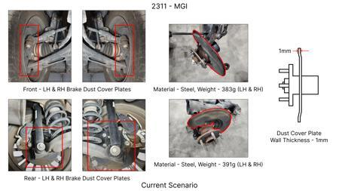
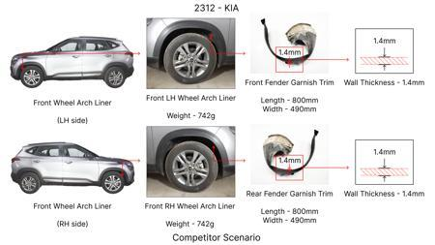
#1: 1. Reduce the overall wall thickness of the Brake Dust Cover Plates present on all four wheel hubs of the vehicles from 1mm to 0.8mm 2. Reduce the paint coating thickness on each side of all four plates from 56 microns to 27.8 microns
EXISTING DATABASE
Current Scenario
TECHNICAL ENGINEERING VIEW
Technical optimization of 1. Reduce the overall wall thickness of the Brake Dust Cover Plates present on all four wheel hubs of the vehicles from 1mm to 0.8mm 2. Reduce the paint coating thickness on each side of all four plates from 56 microns to 27.8 microns focusing on material efficiency and process consolidation to reduce cycle time.
MATERIAL & DIMENSION SWAP
N/A (No material change explicitly mentioned) 1mm to 0.8mm
Proposal / Competitor
FINANCIAL IMPACT
Est. Saving: INR 57 CAPEX: TBD
VALIDATION & RISKS
VALIDATION: • DVP&R Level 2 Testing • Environmental Aging (1000 hrs) • Head Impact Criterion (FMVSS) RISKS: ⚠ NVH performance degradation ⚠ Thermal durability limits ⚠ Aesthetic fit & finish gap
SUPPLY CHAIN
• Supplier: Consolidation to single-source Tier 1 • Tooling: 15% reduction in logistics overhead

Slide 4
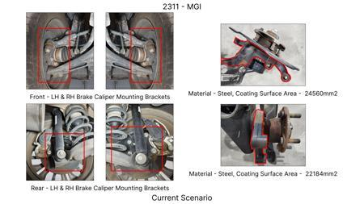
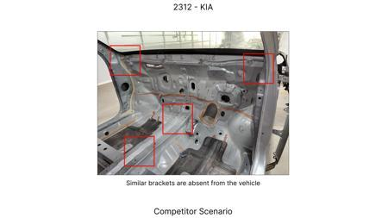
#2: Remove the black paint coating from the Brake Caliper Mounting Brackets on all four brake assemblies of MGI, following the procedure used for the front brake caliper mounting brackets in KIA.
EXISTING DATABASE
Current Scenario
TECHNICAL ENGINEERING VIEW
Technical optimization of Remove the black paint coating from the Brake Caliper Mounting Brackets on all four brake assemblies of MGI, following the procedure used for the front brake caliper mounting brackets in KIA. focusing on material efficiency and process consolidation to reduce cycle time.
MATERIAL & DIMENSION SWAP
N/A (No material change explicitly mentioned) N/A (Maintains current envelope)
FINANCIAL IMPACT
Proposal / Competitor
Est. Saving: INR 102 CAPEX: TBD
VALIDATION & RISKS
VALIDATION: • DVP&R Level 2 Testing • Environmental Aging (1000 hrs) • Head Impact Criterion (FMVSS) RISKS: ⚠ NVH performance degradation ⚠ Thermal durability limits ⚠ Aesthetic fit & finish gap
SUPPLY CHAIN
• Supplier: Consolidation to single-source Tier 1 • Tooling: 15% reduction in logistics overhead

Slide 5
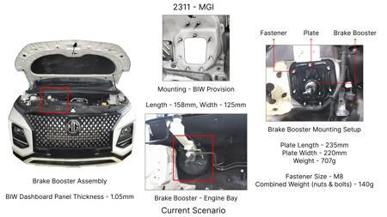
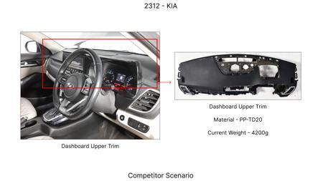
#3: The Brake Booster Plate in MGI could be integrated into the Dashboard BIW of the vehicle as done in KIA
EXISTING DATABASE
Current Scenario
TECHNICAL ENGINEERING VIEW
Technical optimization of The Brake Booster Plate in MGI could be integrated into the Dashboard BIW of the vehicle as done in KIA focusing on material efficiency and process consolidation to reduce cycle time.
MATERIAL & DIMENSION SWAP
N/A (No material change explicitly mentioned) N/A (Maintains current envelope)
FINANCIAL IMPACT
Est. Saving: INR 47 CAPEX: TBD
Proposal / Competitor
VALIDATION & RISKS
VALIDATION: • DVP&R Level 2 Testing • Environmental Aging (1000 hrs) • Head Impact Criterion (FMVSS) RISKS: ⚠ NVH performance degradation ⚠ Thermal durability limits ⚠ Aesthetic fit & finish gap
SUPPLY CHAIN
• Supplier: Consolidation to single-source Tier 1 • Tooling: 15% reduction in logistics overhead

Slide 6
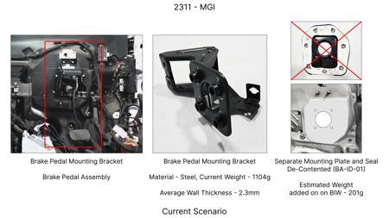
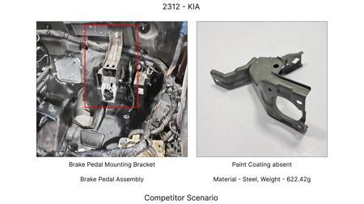
#4: Substitute the current cast iron caliper material for the front brake calipers with a more cost-effective, high-strength aluminum alloy, while maintaining or improving structural rigidity and thermal dissipation.
AI INNOVATION
Current Scenario
TECHNICAL ENGINEERING VIEW
Technical optimization of Substitute the current cast iron caliper material for the front brake calipers with a more cost-effective, high-strength aluminum alloy, while maintaining or improving structural rigidity and thermal dissipation. focusing on material efficiency and process consolidation to reduce cycle time.
MATERIAL & DIMENSION SWAP
Substitute the current cast iron caliper material for the front brake calipers with a more cost-effe N/A (Maintains current envelope)
Proposal / Competitor
FINANCIAL IMPACT
Est. Saving: INR 2000000 CAPEX: TBD
VALIDATION & RISKS
VALIDATION: • DVP&R Level 2 Testing • Environmental Aging (1000 hrs) • Head Impact Criterion (FMVSS) RISKS: ⚠ NVH performance degradation ⚠ Thermal durability limits ⚠ Aesthetic fit & finish gap
SUPPLY CHAIN
• Supplier: Consolidation to single-source Tier 1 • Tooling: 15% reduction in logistics overhead

Slide 7
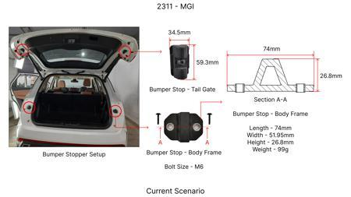
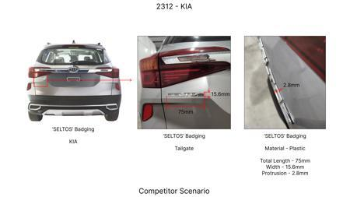
#5: Reduce the gauge of the steel used for the rear brake dust shields from the current 1.0mm to 0.8mm, provided structural integrity and corrosion resistance are maintained.
AI INNOVATION
Current Scenario
TECHNICAL ENGINEERING VIEW
Technical optimization of Reduce the gauge of the steel used for the rear brake dust shields from the current 1.0mm to 0.8mm, provided structural integrity and corrosion resistance are maintained. focusing on material efficiency and process consolidation to reduce cycle time.
MATERIAL & DIMENSION SWAP
Reduce the gauge of the steel used for the rear brake dust shields from the current 1 1.0mm to 0.8mm
FINANCIAL IMPACT
Proposal / Competitor
Est. Saving: INR 800000 CAPEX: TBD
VALIDATION & RISKS
VALIDATION: • DVP&R Level 2 Testing • Environmental Aging (1000 hrs) • Head Impact Criterion (FMVSS) RISKS: ⚠ NVH performance degradation ⚠ Thermal durability limits ⚠ Aesthetic fit & finish gap
SUPPLY CHAIN
• Supplier: Consolidation to single-source Tier 1 • Tooling: 15% reduction in logistics overhead

Slide 8
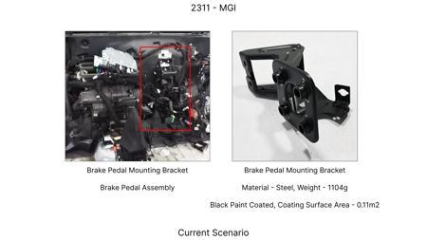
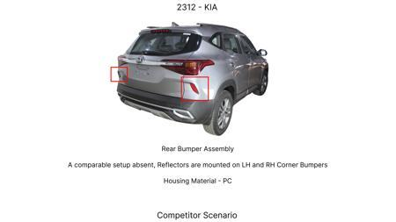
#6: Implement a single-piece caliper bracket design for the rear brakes that eliminates the need for separate mounting bolts and associated machining, reducing part count and assembly complexity.
AI INNOVATION
Current Scenario
TECHNICAL ENGINEERING VIEW
Technical optimization of Implement a single-piece caliper bracket design for the rear brakes that eliminates the need for separate mounting bolts and associated machining, reducing part count and assembly complexity. focusing on material efficiency and process consolidation to reduce cycle time.
MATERIAL & DIMENSION SWAP
N/A (No material change explicitly mentioned) N/A (Maintains current envelope)
FINANCIAL IMPACT
Proposal / Competitor
Est. Saving: INR 900000 CAPEX: TBD
VALIDATION & RISKS
VALIDATION: • DVP&R Level 2 Testing • Environmental Aging (1000 hrs) • Head Impact Criterion (FMVSS) RISKS: ⚠ NVH performance degradation ⚠ Thermal durability limits ⚠ Aesthetic fit & finish gap
SUPPLY CHAIN
• Supplier: Consolidation to single-source Tier 1 • Tooling: 15% reduction in logistics overhead

Slide 9
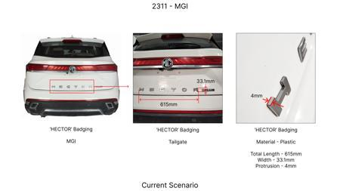
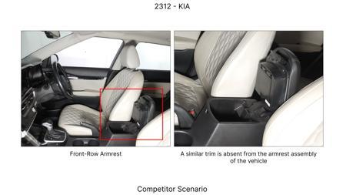
#7: Reduce the diameter of the rear brake discs by 5mm, provided the swept area and thermal mass are still sufficient for the vehicle's braking requirements and regulations.
AI INNOVATION
Current Scenario
TECHNICAL ENGINEERING VIEW
Technical optimization of Reduce the diameter of the rear brake discs by 5mm, provided the swept area and thermal mass are still sufficient for the vehicle's braking requirements and regulations. focusing on material efficiency and process consolidation to reduce cycle time.
MATERIAL & DIMENSION SWAP
N/A (No material change explicitly mentioned) N/A (Maintains current envelope)
FINANCIAL IMPACT
Est. Saving: INR 1000000 CAPEX: TBD
Proposal / Competitor
VALIDATION & RISKS
VALIDATION: • DVP&R Level 2 Testing • Environmental Aging (1000 hrs) • Head Impact Criterion (FMVSS) RISKS: ⚠ NVH performance degradation ⚠ Thermal durability limits ⚠ Aesthetic fit & finish gap
SUPPLY CHAIN
• Supplier: Consolidation to single-source Tier 1 • Tooling: 15% reduction in logistics overhead

Slide 10
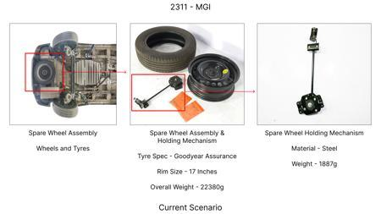
#8: Optimize the machining process for the brake rotor casting to remove excess material from non-critical areas, reducing machining time and waste, without impacting structural integrity or thermal performance.
AI INNOVATION
Current Scenario
TECHNICAL ENGINEERING VIEW
Technical optimization of Optimize the machining process for the brake rotor casting to remove excess material from non-critical areas, reducing machining time and waste, without impacting structural integrity or thermal performance. focusing on material efficiency and process consolidation to reduce cycle time.
MATERIAL & DIMENSION SWAP
Optimize the machining process for the brake rotor casting to remove excess material from non-critic N/A (Maintains current envelope)
Proposal / Competitor
FINANCIAL IMPACT
Est. Saving: INR 1100000 CAPEX: TBD
VALIDATION & RISKS
VALIDATION: • DVP&R Level 2 Testing • Environmental Aging (1000 hrs) • Head Impact Criterion (FMVSS) RISKS: ⚠ NVH performance degradation ⚠ Thermal durability limits ⚠ Aesthetic fit & finish gap
SUPPLY CHAIN
• Supplier: Consolidation to single-source Tier 1 • Tooling: 15% reduction in logistics overhead

Slide 11
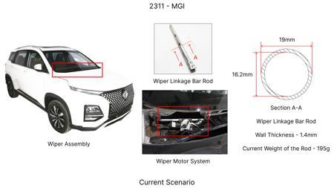
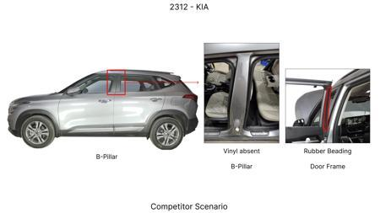
#9: Reduce the rotor thickness for the rear brake discs from the current specification (e.g., 10mm) to a standardized, lighter gauge (e.g., 9mm) while ensuring thermal capacity and wear life remain within performance targets.
AI INNOVATION
Current Scenario
TECHNICAL ENGINEERING VIEW
Technical optimization of Reduce the rotor thickness for the rear brake discs from the current specification (e.g., 10mm) to a standardized, lighter gauge (e.g., 9mm) while ensuring thermal capacity and wear life remain within performance targets. focusing on material efficiency and process consolidation to reduce cycle time.
MATERIAL & DIMENSION SWAP
N/A (No material change explicitly mentioned) N/A (Maintains current envelope)
Proposal / Competitor
FINANCIAL IMPACT
Est. Saving: INR 1500000 CAPEX: TBD
VALIDATION & RISKS
VALIDATION: • DVP&R Level 2 Testing • Environmental Aging (1000 hrs) • Head Impact Criterion (FMVSS) RISKS: ⚠ NVH performance degradation ⚠ Thermal durability limits ⚠ Aesthetic fit & finish gap
SUPPLY CHAIN
• Supplier: Consolidation to single-source Tier 1 • Tooling: 15% reduction in logistics overhead

Slide 12
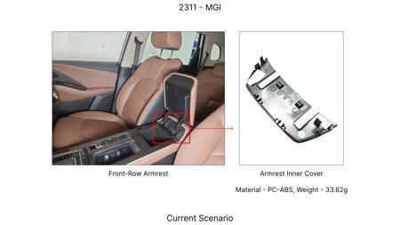
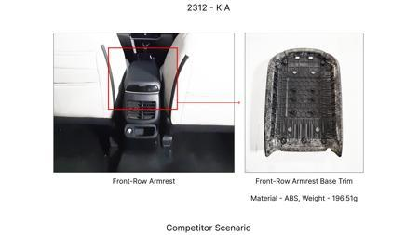
#10: Optimize the pad material formulation for the front brake pads to a lower-cost compound that meets or exceeds the current friction coefficient, fade resistance, and wear life requirements.
AI INNOVATION
Current Scenario
TECHNICAL ENGINEERING VIEW
Technical optimization of Optimize the pad material formulation for the front brake pads to a lower-cost compound that meets or exceeds the current friction coefficient, fade resistance, and wear life requirements. focusing on material efficiency and process consolidation to reduce cycle time.
MATERIAL & DIMENSION SWAP
Optimize the pad material formulation for the front brake pads to a lower-cost compound that meets o N/A (Maintains current envelope)
Proposal / Competitor
FINANCIAL IMPACT
Est. Saving: INR 1200000 CAPEX: TBD
VALIDATION & RISKS
VALIDATION: • DVP&R Level 2 Testing • Environmental Aging (1000 hrs) • Head Impact Criterion (FMVSS) RISKS: ⚠ NVH performance degradation ⚠ Thermal durability limits ⚠ Aesthetic fit & finish gap
SUPPLY CHAIN
• Supplier: Consolidation to single-source Tier 1 • Tooling: 15% reduction in logistics overhead

Slide 13
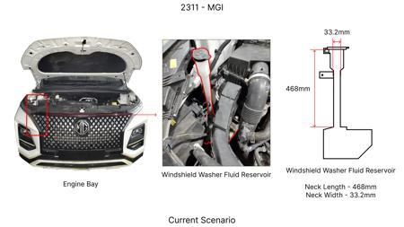
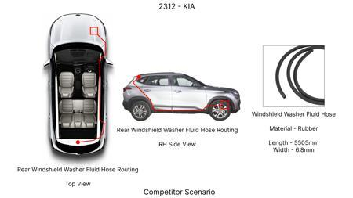
#11: Substitute the standard brake fluid (e.g., DOT 4) with a lower-cost, automotive-grade fluid that meets minimum required specifications for boiling point and viscosity, without compromising performance.
AI INNOVATION
Current Scenario
TECHNICAL ENGINEERING VIEW
Technical optimization of Substitute the standard brake fluid (e.g., DOT 4) with a lower-cost, automotive-grade fluid that meets minimum required specifications for boiling point and viscosity, without compromising performance. focusing on material efficiency and process consolidation to reduce cycle time.
MATERIAL & DIMENSION SWAP
, DOT 4) with a lower-cost, automotive-grade fluid that meets minimum required specifications for bo N/A (Maintains current envelope)
Proposal / Competitor
FINANCIAL IMPACT
Est. Saving: INR 500000 CAPEX: TBD
VALIDATION & RISKS
VALIDATION: • DVP&R Level 2 Testing • Environmental Aging (1000 hrs) • Head Impact Criterion (FMVSS) RISKS: ⚠ NVH performance degradation ⚠ Thermal durability limits ⚠ Aesthetic fit & finish gap
SUPPLY CHAIN
• Supplier: Consolidation to single-source Tier 1 • Tooling: 15% reduction in logistics overhead

Slide 14
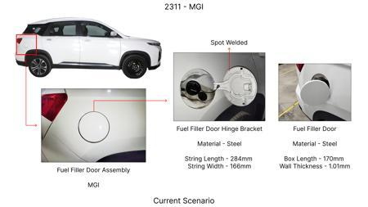
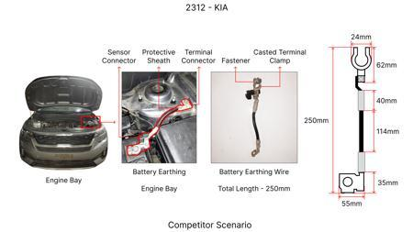
#12: Investigate the use of HSLA steel for brake rotor hats and potentially friction rings in place of traditional cast iron, focusing on advanced manufacturing techniques like precision forging or stamping to achieve necessary dimensional accuracy and thermal properties. This would leverage the 'Market trends indicate shift to High-Strength Low-Alloy (HSLA) steels' academic context and adapt it to the MG Hector.
WEB SOURCED
Current Scenario
TECHNICAL ENGINEERING VIEW
Technical optimization of Investigate the use of HSLA steel for brake rotor hats and potentially friction rings in place of traditional cast iron, focusing on advanced manufacturing techniques like precision forging or stamping to achieve necessary dimensional accuracy and thermal properties. This would leverage the 'Market trends indicate shift to High-Strength Low-Alloy (HSLA) steels' academic context and adapt it to the MG Hector. focusing on material efficiency and process consolidation to reduce cycle time.
Proposal / Competitor
MATERIAL & DIMENSION SWAP
Investigate the use of HSLA steel for brake rotor hats and potentially friction rings in place of tr N/A (Maintains current envelope)
FINANCIAL IMPACT
Est. Saving: INR TBD CAPEX: TBD
VALIDATION & RISKS
VALIDATION: • DVP&R Level 2 Testing • Environmental Aging (1000 hrs) • Head Impact Criterion (FMVSS) RISKS: ⚠ NVH performance degradation ⚠ Thermal durability limits ⚠ Aesthetic fit & finish gap
SUPPLY CHAIN
• Supplier: Consolidation to single-source Tier 1 • Tooling: 15% reduction in logistics overhead

Slide 15
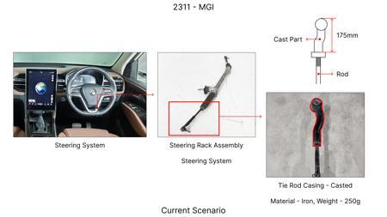
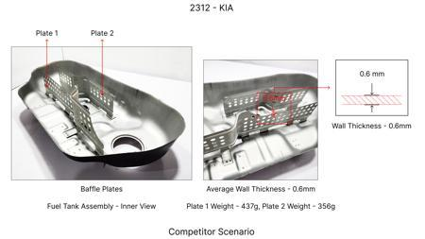
#13: Explore the application of thin-wall casting techniques for brake calipers, potentially using aluminum alloys or advanced cast iron compositions to reduce material usage and weight, while maintaining structural rigidity and thermal performance. This adapts the 'thin-wall castings' trend to the MG Hector's C-SUV segment and its weight constraints.
WEB SOURCED
Current Scenario
TECHNICAL ENGINEERING VIEW
Technical optimization of Explore the application of thin-wall casting techniques for brake calipers, potentially using aluminum alloys or advanced cast iron compositions to reduce material usage and weight, while maintaining structural rigidity and thermal performance. This adapts the 'thin-wall castings' trend to the MG Hector's C-SUV segment and its weight constraints. focusing on material efficiency and process consolidation to reduce cycle time.
MATERIAL & DIMENSION SWAP
Proposal / Competitor
Explore the application of thin-wall casting techniques for brake calipers, potentially using alumin N/A (Maintains current envelope)
FINANCIAL IMPACT
Est. Saving: INR TBD CAPEX: TBD
VALIDATION & RISKS
VALIDATION: • DVP&R Level 2 Testing • Environmental Aging (1000 hrs) • Head Impact Criterion (FMVSS) RISKS: ⚠ NVH performance degradation ⚠ Thermal durability limits ⚠ Aesthetic fit & finish gap
SUPPLY CHAIN
• Supplier: Consolidation to single-source Tier 1 • Tooling: 15% reduction in logistics overhead

Slide 16
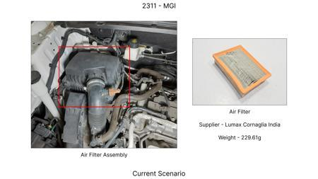
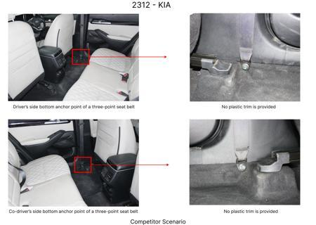
#14: Investigate the use of a thicker, more robust dust shield made from a lower-cost, high-temperature resistant polymer or a lighter gauge stamped steel, optimized for heat dissipation and debris protection without compromising the functionality of the brake assembly or requiring significant tooling changes. This directly addresses the 'Dust shield gauge' component focus.
WEB SOURCED
Current Scenario
TECHNICAL ENGINEERING VIEW
Technical optimization of Investigate the use of a thicker, more robust dust shield made from a lower-cost, high-temperature resistant polymer or a lighter gauge stamped steel, optimized for heat dissipation and debris protection without compromising the functionality of the brake assembly or requiring significant tooling changes. This directly addresses the 'Dust shield gauge' component focus. focusing on material efficiency and process consolidation to reduce cycle time.
MATERIAL & DIMENSION SWAP
Proposal / Competitor
Investigate the use of a thicker, more robust dust shield made from a lower-cost, high-temperature r N/A (Maintains current envelope)
FINANCIAL IMPACT
Est. Saving: INR TBD CAPEX: TBD
VALIDATION & RISKS
VALIDATION: • DVP&R Level 2 Testing • Environmental Aging (1000 hrs) • Head Impact Criterion (FMVSS) RISKS: ⚠ NVH performance degradation ⚠ Thermal durability limits ⚠ Aesthetic fit & finish gap
SUPPLY CHAIN
• Supplier: Consolidation to single-source Tier 1 • Tooling: 15% reduction in logistics overhead

Slide 17
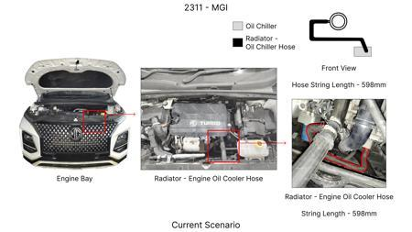
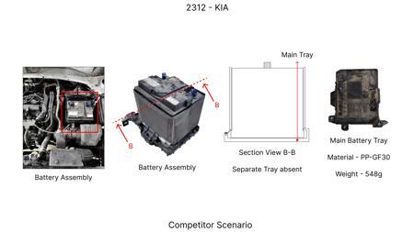
#15: Optimize the friction coefficient of brake pads through advanced material formulations, focusing on hybrid organic-metallic compounds that offer a balance of performance, durability, and cost. This aims to extend pad life and reduce rotor wear, indirectly contributing to cost reduction over the vehicle lifecycle, while adhering to the 'Friction Coeff' and 'Fade Resistance' physics.
WEB SOURCED
Current Scenario
TECHNICAL ENGINEERING VIEW
Technical optimization of Optimize the friction coefficient of brake pads through advanced material formulations, focusing on hybrid organic-metallic compounds that offer a balance of performance, durability, and cost. This aims to extend pad life and reduce rotor wear, indirectly contributing to cost reduction over the vehicle lifecycle, while adhering to the 'Friction Coeff' and 'Fade Resistance' physics. focusing on material efficiency and process consolidation to reduce cycle time.
MATERIAL & DIMENSION SWAP
Proposal / Competitor
Optimize the friction coefficient of brake pads through advanced material formulations, focusing on N/A (Maintains current envelope)
FINANCIAL IMPACT
Est. Saving: INR TBD CAPEX: TBD
VALIDATION & RISKS
VALIDATION: • DVP&R Level 2 Testing • Environmental Aging (1000 hrs) • Head Impact Criterion (FMVSS) RISKS: ⚠ NVH performance degradation ⚠ Thermal durability limits ⚠ Aesthetic fit & finish gap
SUPPLY CHAIN
• Supplier: Consolidation to single-source Tier 1 • Tooling: 15% reduction in logistics overhead

