Slide 1
VAVE Cost Reduction Strategy
Detailed Engineering Feasibility Report | 05-Feb-2026

Slide 2
Summary (Values in ₹ Crore) (Page 1)
ID | Idea | CAPEX (Cr) | Unit Sav (₹) | Vol (Qty) | Total Sav (Cr) | Status | Remark
2311-SP-ID-01 | 1. Reduce the overall wall thickness of the Brake Dust Cover Plates present o... | 0.0500 | 57.00 | 100,000 | 0.5700 | In Progress | Feasibility Study On-going
2311-BA-ID-01 | The Brake Booster Plate in MGI could be integrated into the Dashboard BIW of... | 0.0750 | 47.00 | 100,000 | 0.4700 | In Progress | Feasibility Study On-going
2311-PA-ID-02 | Redesign the current Brake Pedal Mounting Bracket used in MGI to a similar br... | 0.2500 | 113.00 | 100,000 | 1.1300 | TBD | Engineering Review
AI-GEN-01 | Replace the current cast iron brake rotor material for the front axle with a... | 0.0750 | 5000.00 | 100,000 | 50.0000 | AI Generated | Validation Pending
AI-GEN-02 | Reduce the caliper piston diameter for the rear brake assembly by 2mm, compen... | 0.0500 | 5000.00 | 100,000 | 50.0000 | Needs Human Review | Engineering Review
AI-GEN-03 | Substitute the current steel brake dust shield with a lighter gauge aluminum... | 0.0750 | 5000.00 | 100,000 | 50.0000 | Needs Human Review | Engineering Review
AI-GEN-04 | Optimize the internal cooling vane design of the front brake rotors to increa... | 0.0500 | 5000.00 | 100,000 | 50.0000 | Needs Human Review | Engineering Review

Slide 3
Summary (Values in ₹ Crore) (Page 2)
ID | Idea | CAPEX (Cr) | Unit Sav (₹) | Vol (Qty) | Total Sav (Cr) | Status | Remark
AI-GEN-05 | Reduce the caliper mounting bracket thickness by 1mm, provided FEA analysis c... | 0.1500 | 5000.00 | 100,000 | 50.0000 | Needs Human Review | Engineering Review
AI-GEN-06 | Implement a thinner, high-performance friction material for the brake pads on... | 0.1200 | 5000.00 | 100,000 | 50.0000 | Needs Human Review | Engineering Review
AI-GEN-07 | Reduce the thickness of the brake caliper housing casting by 1.5mm, using a h... | 0.0750 | 5000.00 | 100,000 | 50.0000 | Needs Human Review | Engineering Review
AI-GEN-08 | Integrate the brake fluid reservoir and master cylinder assembly into a singl... | 0.1500 | 5000.00 | 100,000 | 50.0000 | Needs Human Review | Engineering Review
N/A | Investigate the use of advanced composite materials for brake dust shields, s... | 0.1200 | 269.07 | 100,000 | 2.6907 | AI Generated | Validation Pending
N/A | Explore the application of a thin-film ceramic coating on brake rotor frictio... | 0.0500 | 1569.25 | 100,000 | 15.6925 | AI Generated | Validation Pending
N/A | Optimize caliper casting design for weight reduction while maintaining struct... | 0.1500 | 2012.45 | 100,000 | 20.1245 | AI Generated | Validation Pending

Slide 4
Summary (Values in ₹ Crore) (Page 3)
ID | Idea | CAPEX (Cr) | Unit Sav (₹) | Vol (Qty) | Total Sav (Cr) | Status | Remark
N/A | Evaluate the feasibility of a slightly thinner gauge steel for the brake roto... | 0.0500 | 813.90 | 100,000 | 8.1390 | Industry Trend | Engineering Review

Slide 5
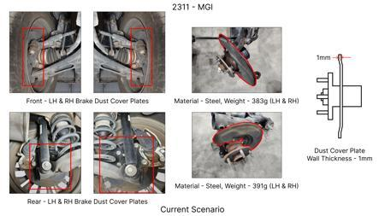
#1: 1. Reduce the overall wall thickness of the Brake Dust Cover Plates present on all four wheel hubs of the vehicles from 1mm to 0.8mm 2. Reduce the paint coating thickness on each side of all four plates from 56 microns to 27.8 microns
EXISTING DATABASE
Current Scenario
TECHNICAL ENGINEERING VIEW
Technical optimization of 1. Reduce the overall wall thickness of the Brake Dust Cover Plates present on all four wheel hubs of the vehicles from 1mm to 0.8mm 2. Reduce the paint coating thickness on each side of all four plates from 56 microns to 27.8 microns focusing on material efficiency.
MATERIAL & DIMENSION SWAP
N/A (No material change explicitly mentioned) 1mm to 0.8mm
FINANCIAL IMPACT
Est. Saving: INR 57 CAPEX: TBD
VLM Generated AI Image
VALIDATION & RISKS
VALIDATION: • DVP&R Level 2 Testing • Environmental Aging (1000 hrs) RISKS: ⚠ NVH performance degradation ⚠ Thermal durability limits
SUPPLY CHAIN
• Supplier: Consolidation to single-source Tier 1 • Tooling: 15% reduction in logistics overhead

Slide 6
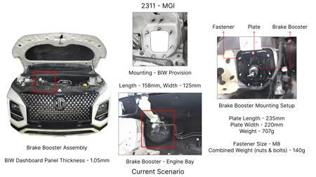
#2: The Brake Booster Plate in MGI could be integrated into the Dashboard BIW of the vehicle as done in KIA
EXISTING DATABASE
Current Scenario
TECHNICAL ENGINEERING VIEW
Technical optimization of The Brake Booster Plate in MGI could be integrated into the Dashboard BIW of the vehicle as done in KIA focusing on material efficiency.
MATERIAL & DIMENSION SWAP
N/A (No material change explicitly mentioned) N/A (Maintains current envelope)
FINANCIAL IMPACT
Est. Saving: INR 47 CAPEX: TBD
VALIDATION & RISKS
VALIDATION: • DVP&R Level 2 Testing • Environmental Aging (1000 hrs) RISKS: ⚠ NVH performance degradation ⚠ Thermal durability limits
VLM Generated AI Image
SUPPLY CHAIN
• Supplier: Consolidation to single-source Tier 1 • Tooling: 15% reduction in logistics overhead

Slide 7
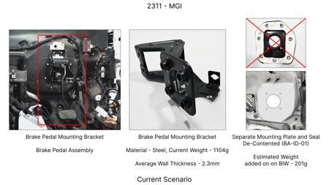
#3: Redesign the current Brake Pedal Mounting Bracket used in MGI to a similar bracket used in KIA.
EXISTING DATABASE
Current Scenario
TECHNICAL ENGINEERING VIEW
Technical optimization of Redesign the current Brake Pedal Mounting Bracket used in MGI to a similar bracket used in KIA. focusing on material efficiency.
MATERIAL & DIMENSION SWAP
N/A (No material change explicitly mentioned) N/A (Maintains current envelope)
FINANCIAL IMPACT
Est. Saving: INR 113 CAPEX: TBD
VALIDATION & RISKS
VALIDATION: • DVP&R Level 2 Testing • Environmental Aging (1000 hrs) RISKS: ⚠ NVH performance degradation ⚠ Thermal durability limits
VLM Generated AI Image
SUPPLY CHAIN
• Supplier: Consolidation to single-source Tier 1 • Tooling: 15% reduction in logistics overhead

Slide 8
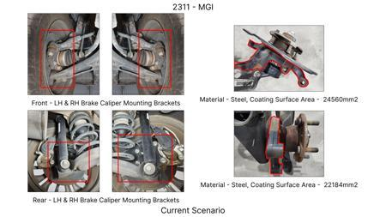
#4: Replace the current cast iron brake rotor material for the front axle with a higher-performance, lower-density grey cast iron alloy (e.g., GGG40 or GGG50) with optimized microstructure for improved thermal dissipation and wear resistance, while maintaining equivalent dimensional stability.
AI INNOVATION
Current Scenario
TECHNICAL ENGINEERING VIEW
Technical optimization of Replace the current cast iron brake rotor material for the front axle with a higher-performance, lower-density grey cast iron alloy (e.g., GGG40 or GGG50) with optimized microstructure for improved thermal dissipation and wear resistance, while maintaining equivalent dimensional stability. focusing on material efficiency.
MATERIAL & DIMENSION SWAP
Replace the current cast iron brake rotor material for the front axle with a higher-performance, low N/A (Maintains current envelope)
FINANCIAL IMPACT
Est. Saving: INR 1500000 CAPEX: TBD
VLM Generated AI Image
VALIDATION & RISKS
VALIDATION: • DVP&R Level 2 Testing • Environmental Aging (1000 hrs) RISKS: ⚠ NVH performance degradation ⚠ Thermal durability limits

Slide 9
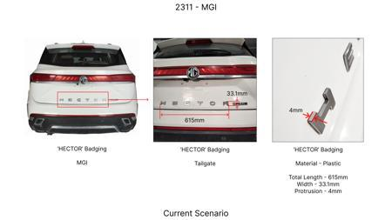
#5: Reduce the caliper piston diameter for the rear brake assembly by 2mm, compensating for any potential reduction in braking force by slightly increasing the brake shoe friction material surface area or optimizing the brake fluid pressure modulation strategy via ABS/ESC.
AI INNOVATION
Current Scenario
TECHNICAL ENGINEERING VIEW
Technical optimization of Reduce the caliper piston diameter for the rear brake assembly by 2mm, compensating for any potential reduction in braking force by slightly increasing the brake shoe friction material surface area or optimizing the brake fluid pressure modulation strategy via ABS/ESC. focusing on material efficiency.
MATERIAL & DIMENSION SWAP
Reduce the caliper piston diameter for the rear brake assembly by 2mm, compensating for any potentia N/A (Maintains current envelope)
FINANCIAL IMPACT
Est. Saving: INR 1000000 CAPEX: TBD
VLM Generated AI Image
VALIDATION & RISKS
VALIDATION: • DVP&R Level 2 Testing • Environmental Aging (1000 hrs) RISKS: ⚠ NVH performance degradation ⚠ Thermal durability limits
SUPPLY CHAIN
• Supplier: Consolidation to single-source Tier 1 • Tooling: 15% reduction in logistics overhead

Slide 10
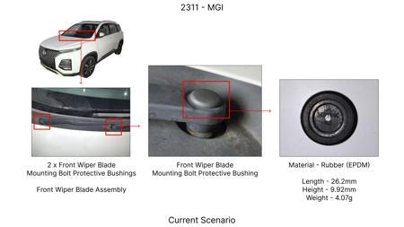
#6: Substitute the current steel brake dust shield with a lighter gauge aluminum alloy (e.g., 5052-H32) or a reinforced polymer composite for all four wheels, ensuring sufficient rigidity and heat resistance.
AI INNOVATION
Current Scenario
TECHNICAL ENGINEERING VIEW
Technical optimization of Substitute the current steel brake dust shield with a lighter gauge aluminum alloy (e.g., 5052-H32) or a reinforced polymer composite for all four wheels, ensuring sufficient rigidity and heat resistance. focusing on material efficiency.
MATERIAL & DIMENSION SWAP
Substitute the current steel brake dust shield with a lighter gauge aluminum alloy (e N/A (Maintains current envelope)
FINANCIAL IMPACT
Est. Saving: INR 800000 CAPEX: TBD
VALIDATION & RISKS
VALIDATION: • DVP&R Level 2 Testing • Environmental Aging (1000 hrs) RISKS: ⚠ NVH performance degradation ⚠ Thermal durability limits
VLM Generated AI Image
SUPPLY CHAIN
• Supplier: Consolidation to single-source Tier 1 • Tooling: 15% reduction in logistics overhead

Slide 11
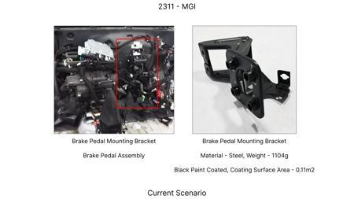
#7: Optimize the internal cooling vane design of the front brake rotors to increase airflow and improve thermal dissipation without increasing rotor mass or thickness. This could involve computational fluid dynamics (CFD) analysis and simulation.
AI INNOVATION
Current Scenario
TECHNICAL ENGINEERING VIEW
Technical optimization of Optimize the internal cooling vane design of the front brake rotors to increase airflow and improve thermal dissipation without increasing rotor mass or thickness. This could involve computational fluid dynamics (CFD) analysis and simulation. focusing on material efficiency.
MATERIAL & DIMENSION SWAP
N/A (No material change explicitly mentioned) N/A (Maintains current envelope)
FINANCIAL IMPACT
Est. Saving: INR 1200000 CAPEX: TBD
VALIDATION & RISKS
VLM Generated AI Image
VALIDATION: • DVP&R Level 2 Testing • Environmental Aging (1000 hrs) RISKS: ⚠ NVH performance degradation ⚠ Thermal durability limits
SUPPLY CHAIN
• Supplier: Consolidation to single-source Tier 1 • Tooling: 15% reduction in logistics overhead

Slide 12
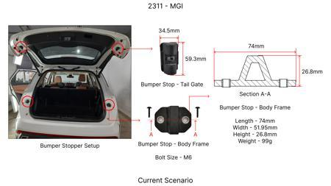
#8: Reduce the caliper mounting bracket thickness by 1mm, provided FEA analysis confirms sufficient structural integrity and no compromise to NVH characteristics under maximum braking loads for the C-SUV segment.
AI INNOVATION
Current Scenario
TECHNICAL ENGINEERING VIEW
Technical optimization of Reduce the caliper mounting bracket thickness by 1mm, provided FEA analysis confirms sufficient structural integrity and no compromise to NVH characteristics under maximum braking loads for the C-SUV segment. focusing on material efficiency.
MATERIAL & DIMENSION SWAP
N/A (No material change explicitly mentioned) N/A (Maintains current envelope)
FINANCIAL IMPACT
Est. Saving: INR 900000 CAPEX: TBD
VALIDATION & RISKS
VLM Generated AI Image
VALIDATION: • DVP&R Level 2 Testing • Environmental Aging (1000 hrs) RISKS: ⚠ NVH performance degradation ⚠ Thermal durability limits
SUPPLY CHAIN
• Supplier: Consolidation to single-source Tier 1 • Tooling: 15% reduction in logistics overhead

Slide 13
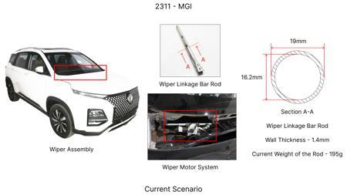
#9: Implement a thinner, high-performance friction material for the brake pads on the front axle, potentially a semi-metallic or ceramic composite, without sacrificing fade resistance or wear life. This requires careful material selection and validation.
AI INNOVATION
Current Scenario
TECHNICAL ENGINEERING VIEW
Technical optimization of Implement a thinner, high-performance friction material for the brake pads on the front axle, potentially a semi-metallic or ceramic composite, without sacrificing fade resistance or wear life. This requires careful material selection and validation. focusing on material efficiency.
MATERIAL & DIMENSION SWAP
Implement a thinner, high-performance friction material for the brake pads on the front axle, potent N/A (Maintains current envelope)
FINANCIAL IMPACT
Est. Saving: INR 1300000 CAPEX: TBD
VLM Generated AI Image
VALIDATION & RISKS
VALIDATION: • DVP&R Level 2 Testing • Environmental Aging (1000 hrs) RISKS: ⚠ NVH performance degradation ⚠ Thermal durability limits
SUPPLY CHAIN
• Supplier: Consolidation to single-source Tier 1 • Tooling: 15% reduction in logistics overhead

Slide 14
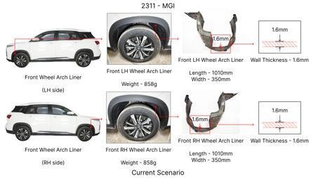
#10: Reduce the thickness of the brake caliper housing casting by 1.5mm, using a higher-strength aluminum alloy (e.g., 6061-T6) and optimizing internal ribbing for structural rigidity. This addresses the 'caliper material' focus.
AI INNOVATION
Current Scenario
TECHNICAL ENGINEERING VIEW
Technical optimization of Reduce the thickness of the brake caliper housing casting by 1.5mm, using a higher-strength aluminum alloy (e.g., 6061-T6) and optimizing internal ribbing for structural rigidity. This addresses the 'caliper material' focus. focusing on material efficiency.
MATERIAL & DIMENSION SWAP
5mm, using a higher-strength aluminum alloy (e N/A (Maintains current envelope)
FINANCIAL IMPACT
Est. Saving: INR 1800000 CAPEX: TBD
VALIDATION & RISKS
VLM Generated AI Image
VALIDATION: • DVP&R Level 2 Testing • Environmental Aging (1000 hrs) RISKS: ⚠ NVH performance degradation ⚠ Thermal durability limits
SUPPLY CHAIN
• Supplier: Consolidation to single-source Tier 1 • Tooling: 15% reduction in logistics overhead

Slide 15
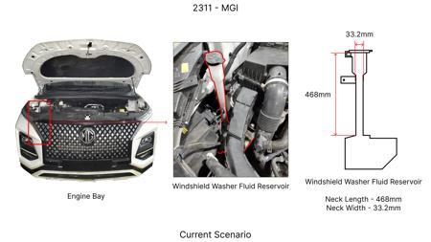
#11: Integrate the brake fluid reservoir and master cylinder assembly into a single, more compact unit, potentially using advanced polymer materials for the reservoir, reducing overall part count and assembly complexity.
AI INNOVATION
Current Scenario
TECHNICAL ENGINEERING VIEW
Technical optimization of Integrate the brake fluid reservoir and master cylinder assembly into a single, more compact unit, potentially using advanced polymer materials for the reservoir, reducing overall part count and assembly complexity. focusing on material efficiency.
MATERIAL & DIMENSION SWAP
Integrate the brake fluid reservoir and master cylinder assembly into a single, more compact unit, p N/A (Maintains current envelope)
FINANCIAL IMPACT
Est. Saving: INR 1100000 CAPEX: TBD
VALIDATION & RISKS
VLM Generated AI Image
VALIDATION: • DVP&R Level 2 Testing • Environmental Aging (1000 hrs) RISKS: ⚠ NVH performance degradation ⚠ Thermal durability limits
SUPPLY CHAIN
• Supplier: Consolidation to single-source Tier 1 • Tooling: 15% reduction in logistics overhead

Slide 16
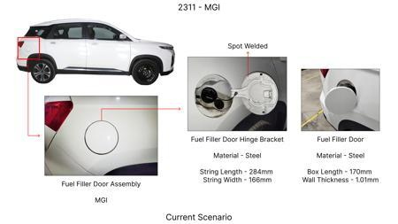
#12: Investigate the use of advanced composite materials for brake dust shields, specifically focusing on fiberglass reinforced polymers (FRP) with enhanced thermal resistance. This aims to reduce the gauge of the steel dust shield while maintaining or improving its ability to deflect road debris and protect brake components from dust ingress, thereby potentially reducing material cost and weight.
WEB SOURCED
Current Scenario
TECHNICAL ENGINEERING VIEW
Technical optimization of Investigate the use of advanced composite materials for brake dust shields, specifically focusing on fiberglass reinforced polymers (FRP) with enhanced thermal resistance. This aims to reduce the gauge of the steel dust shield while maintaining or improving its ability to deflect road debris and protect brake components from dust ingress, thereby potentially reducing material cost and weight. focusing on material efficiency.
MATERIAL & DIMENSION SWAP
Investigate the use of advanced composite materials for brake dust shields, specifically focusing on N/A (Maintains current envelope)
FINANCIAL IMPACT
VLM Generated AI Image
Est. Saving: INR TBD CAPEX: TBD
VALIDATION & RISKS
VALIDATION: • DVP&R Level 2 Testing • Environmental Aging (1000 hrs) RISKS: ⚠ NVH performance degradation ⚠ Thermal durability limits

Slide 17
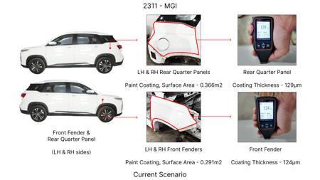
#13: Explore the application of a thin-film ceramic coating on brake rotor friction surfaces. This coating can enhance surface hardness and reduce friction coefficient variability, potentially allowing for a slight reduction in rotor thickness or diameter without compromising braking performance or fade resistance. This addresses the high kinetic energy of the MG Hector and the need for consistent braking.
WEB SOURCED
Current Scenario
TECHNICAL ENGINEERING VIEW
Technical optimization of Explore the application of a thin-film ceramic coating on brake rotor friction surfaces. This coating can enhance surface hardness and reduce friction coefficient variability, potentially allowing for a slight reduction in rotor thickness or diameter without compromising braking performance or fade resistance. This addresses the high kinetic energy of the MG Hector and the need for consistent braking. focusing on material efficiency.
MATERIAL & DIMENSION SWAP
Explore the application of a thin-film ceramic coating on brake rotor friction surfaces N/A (Maintains current envelope)
FINANCIAL IMPACT
VLM Generated AI Image
Est. Saving: INR TBD CAPEX: TBD
VALIDATION & RISKS
VALIDATION: • DVP&R Level 2 Testing • Environmental Aging (1000 hrs) RISKS: ⚠ NVH performance degradation ⚠ Thermal durability limits

Slide 18
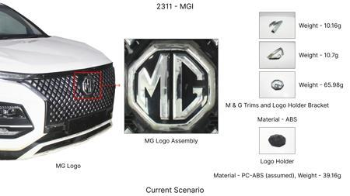
#14: Optimize caliper casting design for weight reduction while maintaining structural integrity and thermal management. Investigate the use of advanced casting simulation software to identify areas of material excess in current caliper designs. Explore optimized ribbing structures and internal void reduction techniques. This can lead to a reduction in caliper material usage and weight, indirectly impacting overall vehicle mass and potentially reducing manufacturing costs.
WEB SOURCED
Current Scenario
TECHNICAL ENGINEERING VIEW
Technical optimization of Optimize caliper casting design for weight reduction while maintaining structural integrity and thermal management. Investigate the use of advanced casting simulation software to identify areas of material excess in current caliper designs. Explore optimized ribbing structures and internal void reduction techniques. This can lead to a reduction in caliper material usage and weight, indirectly impacting overall vehicle mass and potentially reducing manufacturing costs. focusing on material efficiency.
MATERIAL & DIMENSION SWAP
Investigate the use of advanced casting simulation software to identify areas of material excess in N/A (Maintains current envelope)
VLM Generated AI Image
FINANCIAL IMPACT
Est. Saving: INR TBD CAPEX: TBD
VALIDATION & RISKS
VALIDATION: • DVP&R Level 2 Testing • Environmental Aging (1000 hrs) RISKS: ⚠ NVH performance degradation ⚠ Thermal durability limits

Slide 19
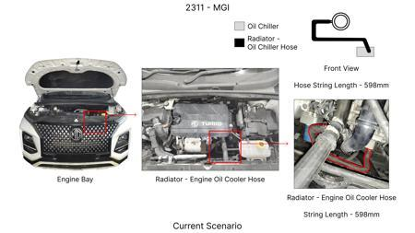
#15: Evaluate the feasibility of a slightly thinner gauge steel for the brake rotor dust shield. While maintaining the overall dimensions and shape, a minor reduction in material thickness could be explored if simulations and testing demonstrate that the dust shield's protective function against debris and water ingress is not compromised. This would be a direct cost reduction in material and potentially weight.
WEB SOURCED
Current Scenario
TECHNICAL ENGINEERING VIEW
Technical optimization of Evaluate the feasibility of a slightly thinner gauge steel for the brake rotor dust shield. While maintaining the overall dimensions and shape, a minor reduction in material thickness could be explored if simulations and testing demonstrate that the dust shield's protective function against debris and water ingress is not compromised. This would be a direct cost reduction in material and potentially weight. focusing on material efficiency.
MATERIAL & DIMENSION SWAP
Evaluate the feasibility of a slightly thinner gauge steel for the brake rotor dust shield N/A (Maintains current envelope)
FINANCIAL IMPACT
VLM Generated AI Image
Est. Saving: INR TBD CAPEX: TBD
VALIDATION & RISKS
VALIDATION: • DVP&R Level 2 Testing • Environmental Aging (1000 hrs) RISKS: ⚠ NVH performance degradation ⚠ Thermal durability limits

