Slide 1
VAVE Cost Reduction Strategy
Detailed Engineering Feasibility Report | 03-Feb-2026

Slide 2
Summary of ideas generated
Idea ID | Idea | CAPEX | Saving | Yearly volume (per 1 lakh) | Saving overall (Saving × Volume) | Status (Accept/Reject) | Turnaround time | Required volume yearly
2311-PA-ID-02 | Redesign the current Brake Pedal Mounting Bracket used in MGI to a similar bracket used in KIA. |  | 113 | 100000 | 11,300,000 | TBD |  | 100000
2311-BA-ID-01 | The Brake Booster Plate in MGI could be integrated into the Dashboard BIW of the vehicle as done in KIA |  | 47 | 100000 | 4,700,000 | NG |  | 100000
2311-PA-ID-01 | Remove the black paint coating on the Brake Pedal Mounting Bracket within MGI |  | 115 | 100000 | 11,500,000 | TBD |  | 100000
2311-SP-ID-01 | 1. Reduce the overall wall thickness of the Brake Dust Cover Plates present on all four wheel hubs of the vehicles from 1mm to 0.8mm 2. Reduce the paint coating thickness on each side of all four plates from 56 microns to 27.8 microns |  | 57 | 100000 | 5,700,000 | NG |  | 100000
2311-BA-ID-02 | Remove the black paint coating from the Brake Caliper Mounting Brackets on all four brake assemblies of MGI, following the procedure used for the front brake caliper mounting brackets in KIA. |  | 102 | 100000 | 10,200,000 | NG |  | 100000
AI-GEN-01 | Replace the standard cast iron brake rotors on the front axle with a lighter, higher performance composite material rotor, potentially incorporating a vented design with optimized vane geometry. |  | TBD | 100000 | 0 | Auto-Approved |  | 100000
AI-GEN-02 | Optimize the dust shield gauge for the rear brake assemblies, reducing material thickness from 1.2mm to 1.0mm while maintaining structural rigidity and corrosion resistance through material selection (e.g., higher strength steel). |  | TBD | 100000 | 0 | Auto-Approved |  | 100000
AI-GEN-03 | Substitute the current caliper piston material (e.g., steel) for a lighter, corrosion-resistant aluminum alloy, while ensuring thermal management and sealing integrity. |  | TBD | 100000 | 0 | Auto-Approved |  | 100000
AI-GEN-09 | Reduce the weight of the brake pedal lever arm by optimizing its internal structure and potentially using a higher strength steel, allowing for a reduction in material volume. |  | TBD | 100000 | 0 | Auto-Approved |  | 100000
AI-GEN-10 | Substitute the current brake caliper guide pins and bushings with a self-lubricating composite material, eliminating the need for grease and reducing part complexity. |  | TBD | 100000 | 0 | Auto-Approved |  | 100000
AI-GEN-11 | Reduce the brake caliper housing wall thickness by 0.5mm through precise casting and advanced alloy selection, ensuring sufficient strength and thermal dissipation. |  | TBD | 100000 | 0 | Auto-Approved |  | 100000
AI-GEN-05 | Optimize the brake pad friction material formulation to achieve equivalent stopping performance with reduced wear rate, potentially allowing for a slightly thinner pad material initially, thereby reducing material cost per pad. |  | TBD | 100000 | 0 | Needs Human Review |  | 100000
AI-GEN-06 | Implement a standard, lower-cost E-coat or powder coating for the brake caliper housing, replacing a more expensive paint finish, provided it meets corrosion and thermal resistance requirements. |  | TBD | 100000 | 0 | Needs Human Review |  | 100000
N/A | Value Engineering for Rotor Thickness Optimization: Investigate the potential to reduce the thickness of the MG Hector's brake rotors without compromising thermal mass and fade resistance. This can be achieved through advanced simulation (FEA) to understand stress distribution and heat dissipation under various load conditions, coupled with material characterization to identify high-performance alloys with improved thermal conductivity. The focus will be on optimizing the rotor's structural integrity and heat dissipation capabilities, potentially allowing for a slight reduction in material without impacting performance or safety regulations (FMVSS 105, ECE R13). |  | TBD | 100000 | 0 | Research Paper |  | 100000
N/A | Caliper Material Substitution with Magnesium Alloys: Explore the feasibility of replacing traditional cast iron or aluminum calipers with lightweight magnesium alloys for the MG Hector. This aligns with industry trends in lightweighting [Source: Automotive Brake System Market Size & Share Report 2031]. The proposed research would involve material characterization of specific magnesium alloys (e.g., AZ91, AM60) for their suitability in high-temperature, high-stress brake caliper applications, focusing on their strength, fatigue life, and corrosion resistance. Design modifications to account for magnesium's unique properties and manufacturing processes would be crucial. This addresses the 'Caliper material' component focus and contributes to weight reduction for the 1.7T vehicle. |  | TBD | 100000 | 0 | Industry Trend |  | 100000
N/A | Optimized Dust Shield Design for Enhanced Cooling and Durability: Investigate the design of the dust shield for the MG Hector's brake assembly, aiming to improve airflow for better rotor cooling and reduce the gauge of the material used for cost and weight savings. This involves computational fluid dynamics (CFD) to analyze air circulation patterns around the brake assembly and finite element analysis (FEA) to optimize the structural integrity of a thinner dust shield. The goal is to maintain or improve thermal performance while using less material, addressing the 'Dust shield gauge' component focus and the 'High Kinetic Energy' constraint by aiding heat dissipation. |  | TBD | 100000 | 0 | Research Paper |  | 100000
N/A | Electrically Actuated Parking Brake (EPB) Integration with Existing Rear Drum Brakes: While the constraint is 'No Rear IRS changes,' this proposal focuses on integrating an EPB system with the existing rear drum brake setup of the MG Hector, rather than a complete redesign of the rear axle. The objective is to leverage the cost-effectiveness of drum brakes while introducing modern EPB functionality. This requires developing a specialized EPB actuator that can effectively engage the drum brake mechanism. Research will focus on the actuation force, reliability, and integration complexity, ensuring compliance with FMVSS 105 and ECE R13. This indirectly addresses potential cost reduction through modular integration rather than full IRS overhaul. |  | TBD | 100000 | 0 | Research Paper |  | 100000

Slide 3
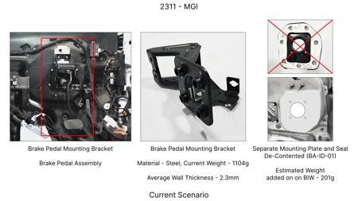
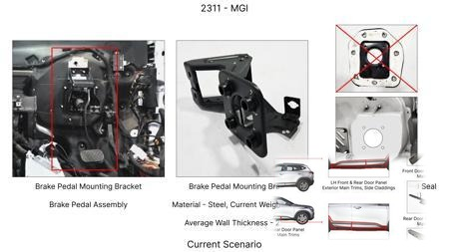
#1: Redesign the current Brake Pedal Mounting Bracket used in MGI to a similar bracket used in KIA.
EXISTING DATABASE
Current Scenario
Technical Engineering View:
Technical optimization of Redesign the current Brake Pedal Mounting Bracket used in MGI to a similar bracket used in KIA. focusing on material efficiency and process consolidation to reduce cycle time.
Material Change:
N/A (No material change explicitly mentioned)
Dimension Change:
N/A (Maintains current envelope)
Cost Analysis:
Est. Saving: INR 113
Implementation / Proposal
Engineering Validation & Risks:
VALIDATION ROADMAP: • DVP&R Level 2 Testing • Environmental Aging (1000 hrs) • Head Impact Criterion (FMVSS) RISK MITIGATION: ⚠ NVH performance degradation ⚠ Thermal durability limits ⚠ Aesthetic fit & finish gap

Slide 4
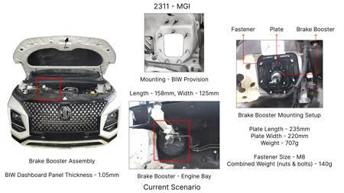
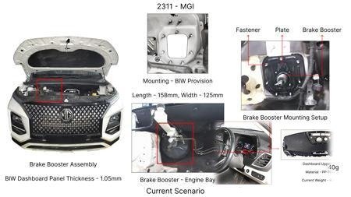
#2: The Brake Booster Plate in MGI could be integrated into the Dashboard BIW of the vehicle as done in KIA
EXISTING DATABASE
Current Scenario
Technical Engineering View:
Technical optimization of The Brake Booster Plate in MGI could be integrated into the Dashboard BIW of the vehicle as done in KIA focusing on material efficiency and process consolidation to reduce cycle time.
Material Change:
N/A (No material change explicitly mentioned)
Dimension Change:
N/A (Maintains current envelope)
Cost Analysis:
Est. Saving: INR 47
Implementation / Proposal
Engineering Validation & Risks:
VALIDATION ROADMAP: • DVP&R Level 2 Testing • Environmental Aging (1000 hrs) • Head Impact Criterion (FMVSS) RISK MITIGATION: ⚠ NVH performance degradation ⚠ Thermal durability limits ⚠ Aesthetic fit & finish gap

Slide 5
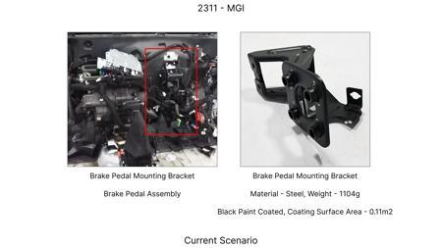
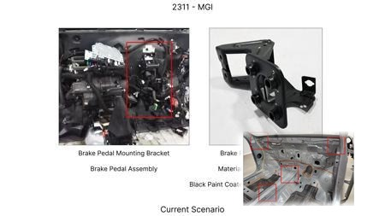
#3: Remove the black paint coating on the Brake Pedal Mounting Bracket within MGI
EXISTING DATABASE
Current Scenario
Technical Engineering View:
Technical optimization of Remove the black paint coating on the Brake Pedal Mounting Bracket within MGI focusing on material efficiency and process consolidation to reduce cycle time.
Material Change:
N/A (No material change explicitly mentioned)
Dimension Change:
N/A (Maintains current envelope)
Cost Analysis:
Est. Saving: INR 115
Implementation / Proposal
Engineering Validation & Risks:
VALIDATION ROADMAP: • DVP&R Level 2 Testing • Environmental Aging (1000 hrs) • Head Impact Criterion (FMVSS) RISK MITIGATION: ⚠ NVH performance degradation ⚠ Thermal durability limits ⚠ Aesthetic fit & finish gap

Slide 6
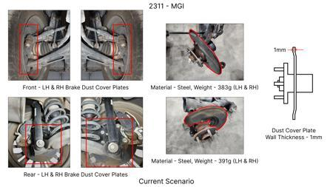
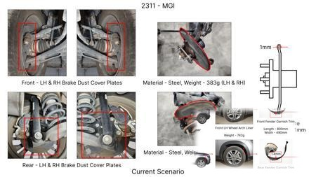
#4: 1. Reduce the overall wall thickness of the Brake Dust Cover Plates present on all four wheel hubs of the vehicles from 1mm to 0.8mm 2. Reduce the paint coating thickness on each side of all four plates from 56 microns to 27.8 microns
EXISTING DATABASE
Current Scenario
Technical Engineering View:
Technical optimization of 1. Reduce the overall wall thickness of the Brake Dust Cover Plates present on all four wheel hubs of the vehicles from 1mm to 0.8mm 2. Reduce the paint coating thickness on each side of all four plates from 56 microns to 27.8 microns focusing on material efficiency and process consolidation to reduce cycle time.
Material Change:
N/A (No material change explicitly mentioned)
Dimension Change:
1mm to 0.8mm
Cost Analysis:
Est. Saving: INR 57
Implementation / Proposal
Engineering Validation & Risks:
VALIDATION ROADMAP: • DVP&R Level 2 Testing • Environmental Aging (1000 hrs) • Head Impact Criterion (FMVSS) RISK MITIGATION: ⚠ NVH performance degradation ⚠ Thermal durability limits ⚠ Aesthetic fit & finish gap

Slide 7
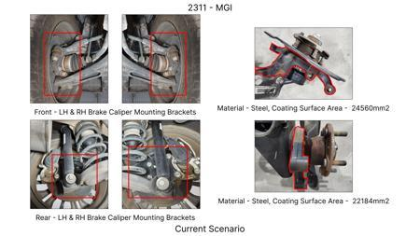
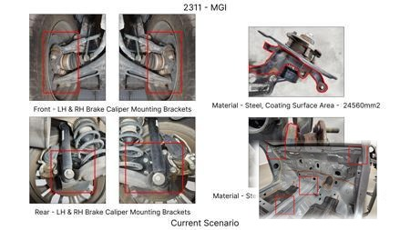
#5: Remove the black paint coating from the Brake Caliper Mounting Brackets on all four brake assemblies of MGI, following the procedure used for the front brake caliper mounting brackets in KIA.
EXISTING DATABASE
Current Scenario
Technical Engineering View:
Technical optimization of Remove the black paint coating from the Brake Caliper Mounting Brackets on all four brake assemblies of MGI, following the procedure used for the front brake caliper mounting brackets in KIA. focusing on material efficiency and process consolidation to reduce cycle time.
Material Change:
N/A (No material change explicitly mentioned)
Dimension Change:
N/A (Maintains current envelope)
Cost Analysis:
Est. Saving: INR 102
Implementation / Proposal
Engineering Validation & Risks:
VALIDATION ROADMAP: • DVP&R Level 2 Testing • Environmental Aging (1000 hrs) • Head Impact Criterion (FMVSS) RISK MITIGATION: ⚠ NVH performance degradation ⚠ Thermal durability limits ⚠ Aesthetic fit & finish gap

Slide 8
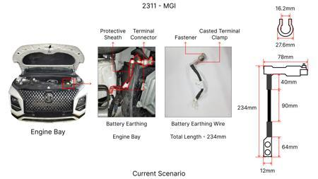
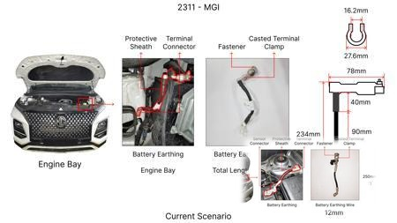
#6: Replace the standard cast iron brake rotors on the front axle with a lighter, higher performance composite material rotor, potentially incorporating a vented design with optimized vane geometry.
AI INNOVATION
Current Scenario
Technical Engineering View:
Technical optimization of Replace the standard cast iron brake rotors on the front axle with a lighter, higher performance composite material rotor, potentially incorporating a vented design with optimized vane geometry. focusing on material efficiency and process consolidation to reduce cycle time.
Material Change:
Replace the standard cast iron brake rotors on the front axle with a lighter, higher performance com
Dimension Change:
N/A (Maintains current envelope)
Cost Analysis:
Est. Saving: INR TBD
Implementation / Proposal
Engineering Validation & Risks:
VALIDATION ROADMAP: • DVP&R Level 2 Testing • Environmental Aging (1000 hrs) • Head Impact Criterion (FMVSS) RISK MITIGATION: ⚠ NVH performance degradation ⚠ Thermal durability limits ⚠ Aesthetic fit & finish gap

Slide 9
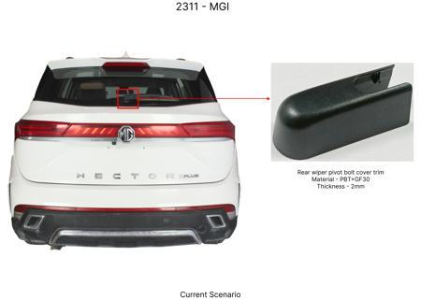
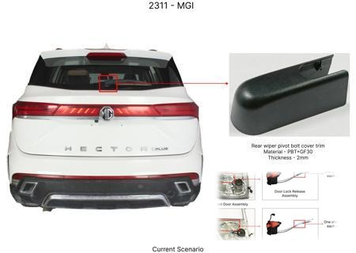
#7: Optimize the dust shield gauge for the rear brake assemblies, reducing material thickness from 1.2mm to 1.0mm while maintaining structural rigidity and corrosion resistance through material selection (e.g., higher strength steel).
AI INNOVATION
Current Scenario
Technical Engineering View:
Technical optimization of Optimize the dust shield gauge for the rear brake assemblies, reducing material thickness from 1.2mm to 1.0mm while maintaining structural rigidity and corrosion resistance through material selection (e.g., higher strength steel). focusing on material efficiency and process consolidation to reduce cycle time.
Material Change:
Optimize the dust shield gauge for the rear brake assemblies, reducing material thickness from 1
Dimension Change:
1.2mm to 1.0mm
Cost Analysis:
Est. Saving: INR TBD
Implementation / Proposal
Engineering Validation & Risks:
VALIDATION ROADMAP: • DVP&R Level 2 Testing • Environmental Aging (1000 hrs) • Head Impact Criterion (FMVSS) RISK MITIGATION: ⚠ NVH performance degradation ⚠ Thermal durability limits ⚠ Aesthetic fit & finish gap

Slide 10
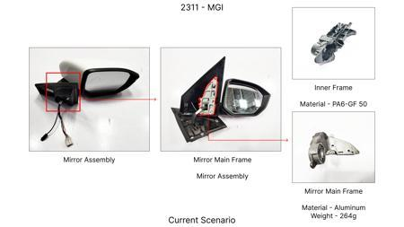
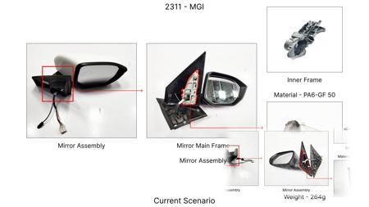
#8: Substitute the current caliper piston material (e.g., steel) for a lighter, corrosion-resistant aluminum alloy, while ensuring thermal management and sealing integrity.
AI INNOVATION
Current Scenario
Technical Engineering View:
Technical optimization of Substitute the current caliper piston material (e.g., steel) for a lighter, corrosion-resistant aluminum alloy, while ensuring thermal management and sealing integrity. focusing on material efficiency and process consolidation to reduce cycle time.
Material Change:
Substitute the current caliper piston material (e
Dimension Change:
N/A (Maintains current envelope)
Cost Analysis:
Est. Saving: INR TBD
Implementation / Proposal
Engineering Validation & Risks:
VALIDATION ROADMAP: • DVP&R Level 2 Testing • Environmental Aging (1000 hrs) • Head Impact Criterion (FMVSS) RISK MITIGATION: ⚠ NVH performance degradation ⚠ Thermal durability limits ⚠ Aesthetic fit & finish gap

Slide 11
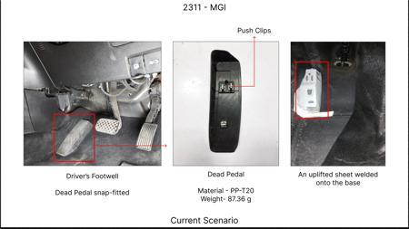
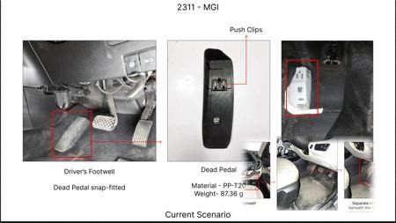
#9: Reduce the weight of the brake pedal lever arm by optimizing its internal structure and potentially using a higher strength steel, allowing for a reduction in material volume.
AI INNOVATION
Current Scenario
Technical Engineering View:
Technical optimization of Reduce the weight of the brake pedal lever arm by optimizing its internal structure and potentially using a higher strength steel, allowing for a reduction in material volume. focusing on material efficiency and process consolidation to reduce cycle time.
Material Change:
Reduce the weight of the brake pedal lever arm by optimizing its internal structure and potentially
Dimension Change:
N/A (Maintains current envelope)
Cost Analysis:
Est. Saving: INR TBD
Implementation / Proposal
Engineering Validation & Risks:
VALIDATION ROADMAP: • DVP&R Level 2 Testing • Environmental Aging (1000 hrs) • Head Impact Criterion (FMVSS) RISK MITIGATION: ⚠ NVH performance degradation ⚠ Thermal durability limits ⚠ Aesthetic fit & finish gap

Slide 12
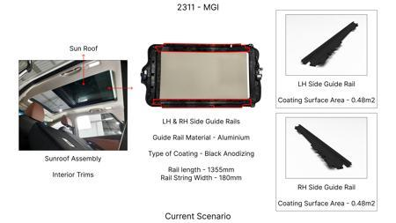
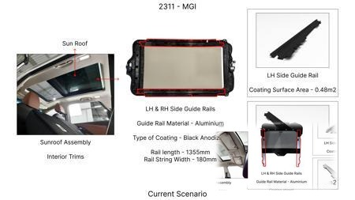
#10: Substitute the current brake caliper guide pins and bushings with a self-lubricating composite material, eliminating the need for grease and reducing part complexity.
AI INNOVATION
Current Scenario
Technical Engineering View:
Technical optimization of Substitute the current brake caliper guide pins and bushings with a self-lubricating composite material, eliminating the need for grease and reducing part complexity. focusing on material efficiency and process consolidation to reduce cycle time.
Material Change:
Substitute the current brake caliper guide pins and bushings with a self-lubricating composite mater
Dimension Change:
N/A (Maintains current envelope)
Cost Analysis:
Est. Saving: INR TBD
Implementation / Proposal
Engineering Validation & Risks:
VALIDATION ROADMAP: • DVP&R Level 2 Testing • Environmental Aging (1000 hrs) • Head Impact Criterion (FMVSS) RISK MITIGATION: ⚠ NVH performance degradation ⚠ Thermal durability limits ⚠ Aesthetic fit & finish gap

Slide 13
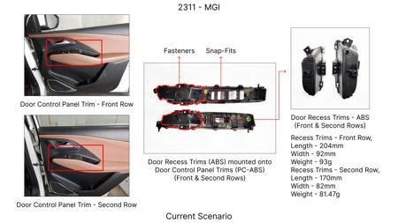
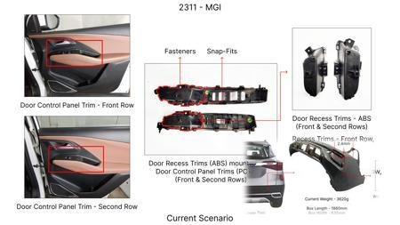
#11: Reduce the brake caliper housing wall thickness by 0.5mm through precise casting and advanced alloy selection, ensuring sufficient strength and thermal dissipation.
AI INNOVATION
Current Scenario
Technical Engineering View:
Technical optimization of Reduce the brake caliper housing wall thickness by 0.5mm through precise casting and advanced alloy selection, ensuring sufficient strength and thermal dissipation. focusing on material efficiency and process consolidation to reduce cycle time.
Material Change:
N/A (No material change explicitly mentioned)
Dimension Change:
N/A (Maintains current envelope)
Cost Analysis:
Est. Saving: INR TBD
Implementation / Proposal
Engineering Validation & Risks:
VALIDATION ROADMAP: • DVP&R Level 2 Testing • Environmental Aging (1000 hrs) • Head Impact Criterion (FMVSS) RISK MITIGATION: ⚠ NVH performance degradation ⚠ Thermal durability limits ⚠ Aesthetic fit & finish gap

Slide 14
#12: Optimize the brake pad friction material formulation to achieve equivalent stopping performance with reduced wear rate, potentially allowing for a slightly thinner pad material initially, thereby reducing material cost per pad.
AI INNOVATION
Current Scenario
Technical Engineering View:
Image Not Available
Technical optimization of Optimize the brake pad friction material formulation to achieve equivalent stopping performance with reduced wear rate, potentially allowing for a slightly thinner pad material initially, thereby reducing material cost per pad. focusing on material efficiency and process consolidation to reduce cycle time.
Material Change:
Optimize the brake pad friction material formulation to achieve equivalent stopping performance with
Dimension Change:
N/A (Maintains current envelope)
Cost Analysis:
Est. Saving: INR TBD
Implementation / Proposal
Engineering Validation & Risks:
Image Not Available
VALIDATION ROADMAP: • DVP&R Level 2 Testing • Environmental Aging (1000 hrs) • Head Impact Criterion (FMVSS) RISK MITIGATION: ⚠ NVH performance degradation ⚠ Thermal durability limits ⚠ Aesthetic fit & finish gap

Slide 15
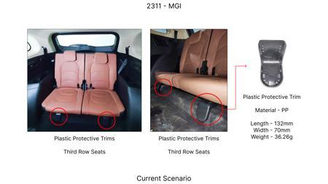
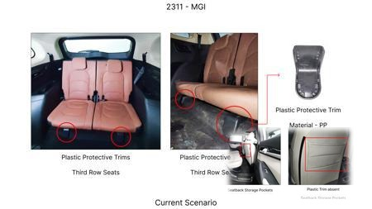
#13: Implement a standard, lower-cost E-coat or powder coating for the brake caliper housing, replacing a more expensive paint finish, provided it meets corrosion and thermal resistance requirements.
AI INNOVATION
Current Scenario
Technical Engineering View:
Technical optimization of Implement a standard, lower-cost E-coat or powder coating for the brake caliper housing, replacing a more expensive paint finish, provided it meets corrosion and thermal resistance requirements. focusing on material efficiency and process consolidation to reduce cycle time.
Material Change:
N/A (No material change explicitly mentioned)
Dimension Change:
N/A (Maintains current envelope)
Cost Analysis:
Est. Saving: INR TBD
Implementation / Proposal
Engineering Validation & Risks:
VALIDATION ROADMAP: • DVP&R Level 2 Testing • Environmental Aging (1000 hrs) • Head Impact Criterion (FMVSS) RISK MITIGATION: ⚠ NVH performance degradation ⚠ Thermal durability limits ⚠ Aesthetic fit & finish gap

Slide 16
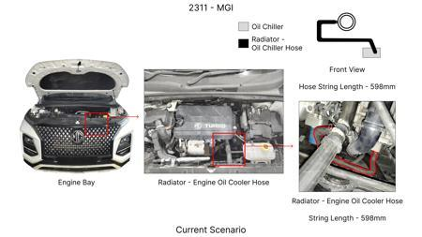
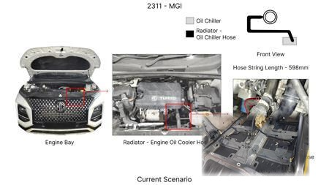
#14: Value Engineering for Rotor Thickness Optimization: Investigate the potential to reduce the thickness of the MG Hector's brake rotors without compromising thermal mass and fade resistance. This can be achieved through advanced simulation (FEA) to understand stress distribution and heat dissipation under various load conditions, coupled with material characterization to identify high-performance alloys with improved thermal conductivity. The focus will be on optimizing the rotor's structural integrity and heat dissipation capabilities, potentially allowing for a slight reduction in material without impacting performance or safety regulations (FMVSS 105, ECE R13).
WEB SOURCED
Current Scenario
Technical Engineering View:
Technical optimization of Value Engineering for Rotor Thickness Optimization: Investigate the potential to reduce the thickness of the MG Hector's brake rotors without compromising thermal mass and fade resistance. This can be achieved through advanced simulation (FEA) to understand stress distribution and heat dissipation under various load conditions, coupled with material characterization to identify high-performance alloys with improved thermal conductivity. The focus will be on optimizin...
Material Change:
This can be achieved through advanced simulation (FEA) to understand stress distribution and heat di
Dimension Change:
N/A (Maintains current envelope)
Cost Analysis:
Est. Saving: INR TBD
Implementation / Proposal
Engineering Validation & Risks:
VALIDATION ROADMAP: • DVP&R Level 2 Testing • Environmental Aging (1000 hrs) • Head Impact Criterion (FMVSS) RISK MITIGATION: ⚠ NVH performance degradation ⚠ Thermal durability limits ⚠ Aesthetic fit & finish gap

Slide 17
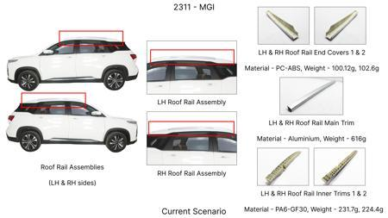
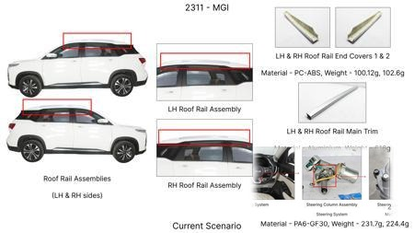
#15: Caliper Material Substitution with Magnesium Alloys: Explore the feasibility of replacing traditional cast iron or aluminum calipers with lightweight magnesium alloys for the MG Hector. This aligns with industry trends in lightweighting [Source: Automotive Brake System Market Size & Share Report 2031]. The proposed research would involve material characterization of specific magnesium alloys (e.g., AZ91, AM60) for their suitability in high-temperature, high-stress brake caliper applications, focusing on their strength, fatigue life, and corrosion resistance. Design modifications to account for magnesium's unique properties and manufacturing processes would be crucial. This addresses the 'Caliper material' component focus and contributes to weight reduction for the 1.7T vehicle.
WEB SOURCED
Current Scenario
Technical Engineering View:
Technical optimization of Caliper Material Substitution with Magnesium Alloys: Explore the feasibility of replacing traditional cast iron or aluminum calipers with lightweight magnesium alloys for the MG Hector. This aligns with industry trends in lightweighting [Source: Automotive Brake System Market Size & Share Report 2031]. The proposed research would involve material characterization of specific magnesium alloys (e.g., AZ91, AM60) for their suitability in high-temperature, high-stress br...
Material Change:
Caliper Material Substitution with Magnesium Alloys: Explore the feasibility of replacing traditiona
Dimension Change:
N/A (Maintains current envelope)
Cost Analysis:
Est. Saving: INR TBD
Implementation / Proposal
Engineering Validation & Risks:
VALIDATION ROADMAP: • DVP&R Level 2 Testing • Environmental Aging (1000 hrs) • Head Impact Criterion (FMVSS) RISK MITIGATION: ⚠ NVH performance degradation ⚠ Thermal durability limits ⚠ Aesthetic fit & finish gap

Slide 18
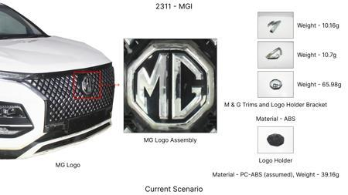
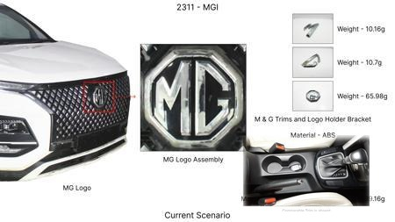
#16: Optimized Dust Shield Design for Enhanced Cooling and Durability: Investigate the design of the dust shield for the MG Hector's brake assembly, aiming to improve airflow for better rotor cooling and reduce the gauge of the material used for cost and weight savings. This involves computational fluid dynamics (CFD) to analyze air circulation patterns around the brake assembly and finite element analysis (FEA) to optimize the structural integrity of a thinner dust shield. The goal is to maintain or improve thermal performance while using less material, addressing the 'Dust shield gauge' component focus and the 'High Kinetic Energy' constraint by aiding heat dissipation.
WEB SOURCED
Current Scenario
Technical Engineering View:
Technical optimization of Optimized Dust Shield Design for Enhanced Cooling and Durability: Investigate the design of the dust shield for the MG Hector's brake assembly, aiming to improve airflow for better rotor cooling and reduce the gauge of the material used for cost and weight savings. This involves computational fluid dynamics (CFD) to analyze air circulation patterns around the brake assembly and finite element analysis (FEA) to optimize the structural integrity of a thinner dust shiel...
Material Change:
Optimized Dust Shield Design for Enhanced Cooling and Durability: Investigate the design of the dust
Dimension Change:
N/A (Maintains current envelope)
Cost Analysis:
Est. Saving: INR TBD
Implementation / Proposal
Engineering Validation & Risks:
VALIDATION ROADMAP: • DVP&R Level 2 Testing • Environmental Aging (1000 hrs) • Head Impact Criterion (FMVSS) RISK MITIGATION: ⚠ NVH performance degradation ⚠ Thermal durability limits ⚠ Aesthetic fit & finish gap

Slide 19
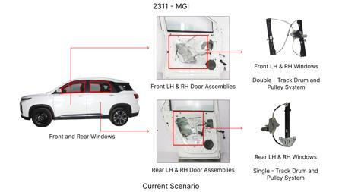
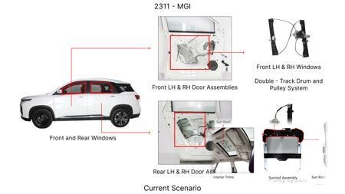
#17: Electrically Actuated Parking Brake (EPB) Integration with Existing Rear Drum Brakes: While the constraint is 'No Rear IRS changes,' this proposal focuses on integrating an EPB system with the existing rear drum brake setup of the MG Hector, rather than a complete redesign of the rear axle. The objective is to leverage the cost-effectiveness of drum brakes while introducing modern EPB functionality. This requires developing a specialized EPB actuator that can effectively engage the drum brake mechanism. Research will focus on the actuation force, reliability, and integration complexity, ensuring compliance with FMVSS 105 and ECE R13. This indirectly addresses potential cost reduction through modular integration rather than full IRS overhaul.
WEB SOURCED
Current Scenario
Technical Engineering View:
Technical optimization of Electrically Actuated Parking Brake (EPB) Integration with Existing Rear Drum Brakes: While the constraint is 'No Rear IRS changes,' this proposal focuses on integrating an EPB system with the existing rear drum brake setup of the MG Hector, rather than a complete redesign of the rear axle. The objective is to leverage the cost-effectiveness of drum brakes while introducing modern EPB functionality. This requires developing a specialized EPB actuator that can effecti...
Material Change:
N/A (No material change explicitly mentioned)
Dimension Change:
N/A (Maintains current envelope)
Cost Analysis:
Est. Saving: INR TBD
Implementation / Proposal
Engineering Validation & Risks:
VALIDATION ROADMAP: • DVP&R Level 2 Testing • Environmental Aging (1000 hrs) • Head Impact Criterion (FMVSS) RISK MITIGATION: ⚠ NVH performance degradation ⚠ Thermal durability limits ⚠ Aesthetic fit & finish gap

