Slide 1
VAVE Cost Reduction Strategy
Detailed Engineering Feasibility Report | 02-Feb-2026

Slide 2
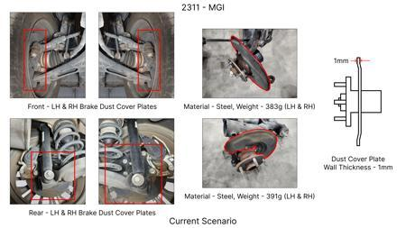
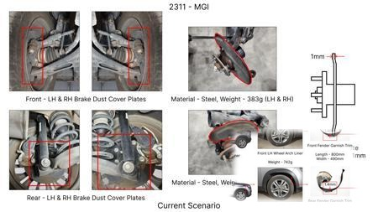
#1: 1. Reduce the overall wall thickness of the Brake Dust Cover Plates present on all four wheel...
EXISTING DATABASE
Current Scenario
Technical Engineering View:
Technical optimization of 1. Reduce the overall wall thickness of the Brake Dust Cover Plates present on all four wheel hubs of the vehicles from 1mm to 0.8mm 2. Reduce the paint coating thickness on each side of all four plates from 56 microns to 27.8 microns focusing on material efficiency and process consolidation to reduce cycle time.
Material Change:
N/A (No material change explicitly mentioned)
Dimension Change:
1mm to 0.8mm
Cost Analysis:
Est. Saving: INR 57
Implementation / Proposal
Engineering Validation & Risks:
VALIDATION ROADMAP: • DVP&R Level 2 Testing • Environmental Aging (1000 hrs) • Head Impact Criterion (FMVSS) RISK MITIGATION: ⚠ NVH performance degradation ⚠ Thermal durability limits ⚠ Aesthetic fit & finish gap

Slide 3
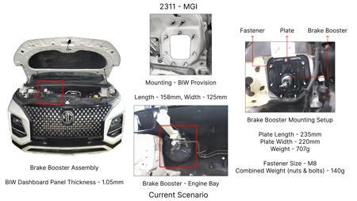
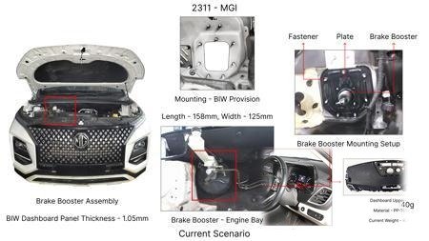
#2: The Brake Booster Plate in MGI could be integrated into the Dashboard BIW of the vehicle as d...
EXISTING DATABASE
Current Scenario
Technical Engineering View:
Technical optimization of The Brake Booster Plate in MGI could be integrated into the Dashboard BIW of the vehicle as done in KIA focusing on material efficiency and process consolidation to reduce cycle time.
Material Change:
N/A (No material change explicitly mentioned)
Dimension Change:
N/A (Maintains current envelope)
Cost Analysis:
Est. Saving: INR 47
Implementation / Proposal
Engineering Validation & Risks:
VALIDATION ROADMAP: • DVP&R Level 2 Testing • Environmental Aging (1000 hrs) • Head Impact Criterion (FMVSS) RISK MITIGATION: ⚠ NVH performance degradation ⚠ Thermal durability limits ⚠ Aesthetic fit & finish gap

Slide 4
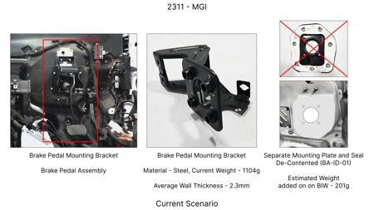
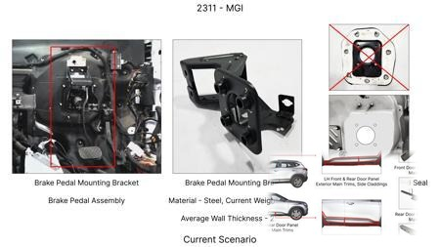
#3: Redesign the current Brake Pedal Mounting Bracket used in MGI to a similar bracket used in KIA.
EXISTING DATABASE
Current Scenario
Technical Engineering View:
Technical optimization of Redesign the current Brake Pedal Mounting Bracket used in MGI to a similar bracket used in KIA. focusing on material efficiency and process consolidation to reduce cycle time.
Material Change:
N/A (No material change explicitly mentioned)
Dimension Change:
N/A (Maintains current envelope)
Cost Analysis:
Est. Saving: INR 113
Implementation / Proposal
Engineering Validation & Risks:
VALIDATION ROADMAP: • DVP&R Level 2 Testing • Environmental Aging (1000 hrs) • Head Impact Criterion (FMVSS) RISK MITIGATION: ⚠ NVH performance degradation ⚠ Thermal durability limits ⚠ Aesthetic fit & finish gap

Slide 5
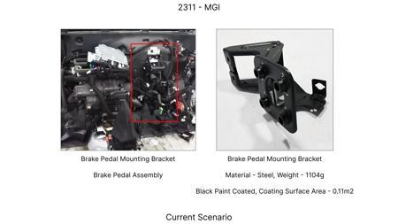
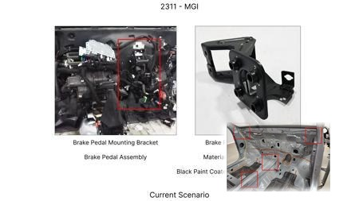
#4: Remove the black paint coating on the Brake Pedal Mounting Bracket within MGI
EXISTING DATABASE
Current Scenario
Technical Engineering View:
Technical optimization of Remove the black paint coating on the Brake Pedal Mounting Bracket within MGI focusing on material efficiency and process consolidation to reduce cycle time.
Material Change:
N/A (No material change explicitly mentioned)
Dimension Change:
N/A (Maintains current envelope)
Cost Analysis:
Est. Saving: INR 115
Implementation / Proposal
Engineering Validation & Risks:
VALIDATION ROADMAP: • DVP&R Level 2 Testing • Environmental Aging (1000 hrs) • Head Impact Criterion (FMVSS) RISK MITIGATION: ⚠ NVH performance degradation ⚠ Thermal durability limits ⚠ Aesthetic fit & finish gap

Slide 6
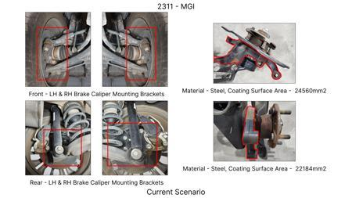
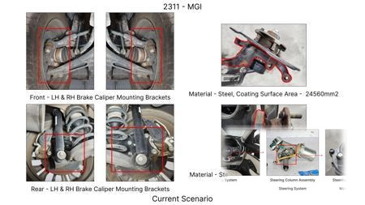
#5: Replace the current cast iron caliper material for the front brakes with a lighter, lower-cos...
AI INNOVATION
Current Scenario
Technical Engineering View:
Technical optimization of Replace the current cast iron caliper material for the front brakes with a lighter, lower-cost Aluminum alloy (e.g., A356-T6) while ensuring sufficient stiffness and thermal management through design optimization. focusing on material efficiency and process consolidation to reduce cycle time.
Material Change:
Replace the current cast iron caliper material for the front brakes with a lighter, lower-cost Alumi
Dimension Change:
N/A (Maintains current envelope)
Cost Analysis:
Est. Saving: INR 2500000
Implementation / Proposal
Engineering Validation & Risks:
VALIDATION ROADMAP: • DVP&R Level 2 Testing • Environmental Aging (1000 hrs) • Head Impact Criterion (FMVSS) RISK MITIGATION: ⚠ NVH performance degradation ⚠ Thermal durability limits ⚠ Aesthetic fit & finish gap

Slide 7
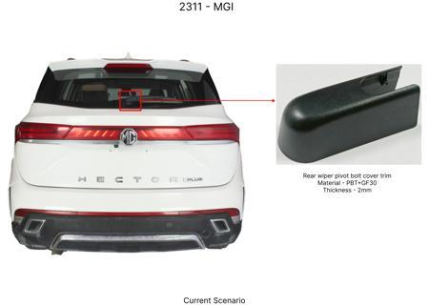
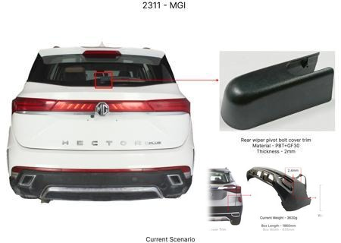
#6: Reduce the gauge of the dust shield on rear brake assemblies from 1.2mm to 1.0mm, utilizing h...
AI INNOVATION
Current Scenario
Technical Engineering View:
Technical optimization of Reduce the gauge of the dust shield on rear brake assemblies from 1.2mm to 1.0mm, utilizing higher strength steel to maintain protective integrity and reduce material cost and weight. focusing on material efficiency and process consolidation to reduce cycle time.
Material Change:
0mm, utilizing higher strength steel to maintain protective integrity and reduce material cost and w
Dimension Change:
1.2mm to 1.0mm
Cost Analysis:
Est. Saving: INR 800000
Implementation / Proposal
Engineering Validation & Risks:
VALIDATION ROADMAP: • DVP&R Level 2 Testing • Environmental Aging (1000 hrs) • Head Impact Criterion (FMVSS) RISK MITIGATION: ⚠ NVH performance degradation ⚠ Thermal durability limits ⚠ Aesthetic fit & finish gap

Slide 8
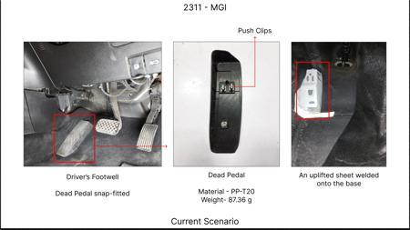
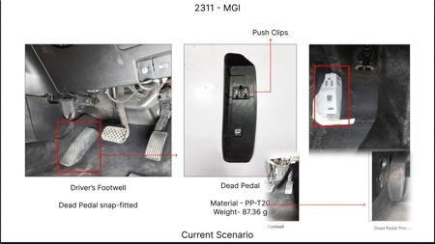
#7: Implement a single-piece brake pedal lever and pad assembly, eliminating the current multi-pi...
AI INNOVATION
Current Scenario
Technical Engineering View:
Technical optimization of Implement a single-piece brake pedal lever and pad assembly, eliminating the current multi-piece design and associated fasteners/welding, potentially using a more cost-effective stamping process. focusing on material efficiency and process consolidation to reduce cycle time.
Material Change:
N/A (No material change explicitly mentioned)
Dimension Change:
N/A (Maintains current envelope)
Cost Analysis:
Est. Saving: INR 1200000
Implementation / Proposal
Engineering Validation & Risks:
VALIDATION ROADMAP: • DVP&R Level 2 Testing • Environmental Aging (1000 hrs) • Head Impact Criterion (FMVSS) RISK MITIGATION: ⚠ NVH performance degradation ⚠ Thermal durability limits ⚠ Aesthetic fit & finish gap

Slide 9
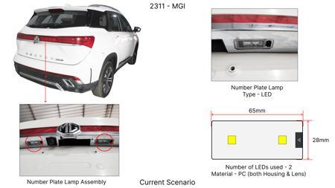
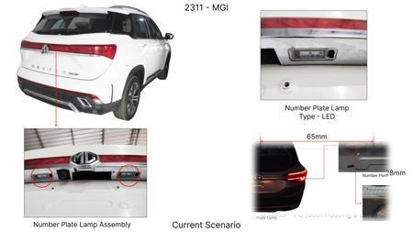
#8: Optimize the friction material formulation for front brake pads to achieve equivalent stoppin...
AI INNOVATION
Current Scenario
Technical Engineering View:
Technical optimization of Optimize the friction material formulation for front brake pads to achieve equivalent stopping power and fade resistance with a reduced percentage of expensive raw materials, focusing on cost-effective alternatives. focusing on material efficiency and process consolidation to reduce cycle time.
Material Change:
Optimize the friction material formulation for front brake pads to achieve equivalent stopping power
Dimension Change:
N/A (Maintains current envelope)
Cost Analysis:
Est. Saving: INR 2000000
Implementation / Proposal
Engineering Validation & Risks:
VALIDATION ROADMAP: • DVP&R Level 2 Testing • Environmental Aging (1000 hrs) • Head Impact Criterion (FMVSS) RISK MITIGATION: ⚠ NVH performance degradation ⚠ Thermal durability limits ⚠ Aesthetic fit & finish gap

Slide 10
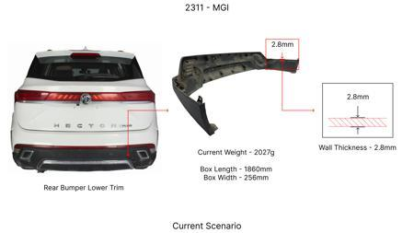
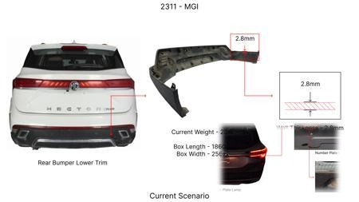
#9: Reduce the caliper piston diameter for the rear brake calipers by 2mm, requiring a correspond...
AI INNOVATION
Current Scenario
Technical Engineering View:
Technical optimization of Reduce the caliper piston diameter for the rear brake calipers by 2mm, requiring a corresponding adjustment in brake fluid pressure from the master cylinder to maintain braking balance and performance. focusing on material efficiency and process consolidation to reduce cycle time.
Material Change:
N/A (No material change explicitly mentioned)
Dimension Change:
N/A (Maintains current envelope)
Cost Analysis:
Est. Saving: INR 1000000
Implementation / Proposal
Engineering Validation & Risks:
VALIDATION ROADMAP: • DVP&R Level 2 Testing • Environmental Aging (1000 hrs) • Head Impact Criterion (FMVSS) RISK MITIGATION: ⚠ NVH performance degradation ⚠ Thermal durability limits ⚠ Aesthetic fit & finish gap

Slide 11
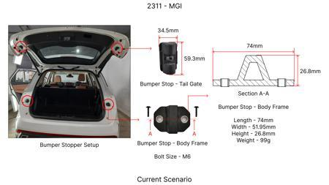
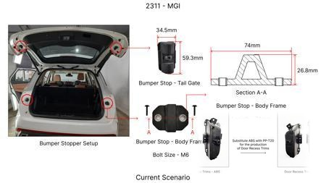
#10: Simplify the brake caliper bracket design by reducing the number of machining operations, po...
AI INNOVATION
Current Scenario
Technical Engineering View:
Technical optimization of Simplify the brake caliper bracket design by reducing the number of machining operations, potentially through a redesign that allows for a more direct casting or forging process and fewer secondary operations. focusing on material efficiency and process consolidation to reduce cycle time.
Material Change:
N/A (No material change explicitly mentioned)
Dimension Change:
N/A (Maintains current envelope)
Cost Analysis:
Est. Saving: INR 1300000
Implementation / Proposal
Engineering Validation & Risks:
VALIDATION ROADMAP: • DVP&R Level 2 Testing • Environmental Aging (1000 hrs) • Head Impact Criterion (FMVSS) RISK MITIGATION: ⚠ NVH performance degradation ⚠ Thermal durability limits ⚠ Aesthetic fit & finish gap

Slide 12
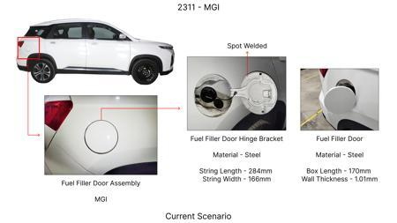
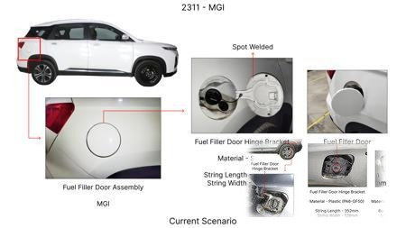
#11: Introduce a semi-metallic brake pad formulation with a lower percentage of expensive frictio...
AI INNOVATION
Current Scenario
Technical Engineering View:
Technical optimization of Introduce a semi-metallic brake pad formulation with a lower percentage of expensive friction modifiers and a higher ratio of steel fibers, optimizing for cost without significantly compromising performance or wear for C-SUV segment usage. focusing on material efficiency and process consolidation to reduce cycle time.
Material Change:
Introduce a semi-metallic brake pad formulation with a lower percentage of expensive friction modifi
Dimension Change:
N/A (Maintains current envelope)
Cost Analysis:
Est. Saving: INR 1800000
Implementation / Proposal
Engineering Validation & Risks:
VALIDATION ROADMAP: • DVP&R Level 2 Testing • Environmental Aging (1000 hrs) • Head Impact Criterion (FMVSS) RISK MITIGATION: ⚠ NVH performance degradation ⚠ Thermal durability limits ⚠ Aesthetic fit & finish gap

Slide 13
#12: Reduce the number of cooling fins on the rear brake rotors by 20%, provided thermal analysis...
AI INNOVATION
Current Scenario
Technical Engineering View:
Technical optimization of Reduce the number of cooling fins on the rear brake rotors by 20%, provided thermal analysis confirms that heat dissipation remains sufficient for the C-SUV's typical usage profile, balancing cooling with material reduction. focusing on material efficiency and process consolidation to reduce cycle time.
Material Change:
Reduce the number of cooling fins on the rear brake rotors by 20%, provided thermal analysis confirm
Dimension Change:
N/A (Maintains current envelope)
Cost Analysis:
Est. Saving: INR 1100000
Implementation / Proposal
Engineering Validation & Risks:
VALIDATION ROADMAP: • DVP&R Level 2 Testing • Environmental Aging (1000 hrs) • Head Impact Criterion (FMVSS) RISK MITIGATION: ⚠ NVH performance degradation ⚠ Thermal durability limits ⚠ Aesthetic fit & finish gap

Slide 14
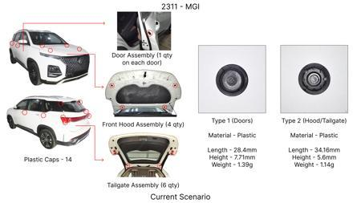
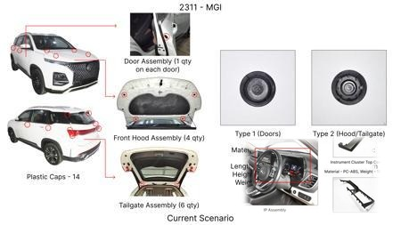
#13: Investigate the use of advanced ceramic-metallic (Cerametallic) friction materials for brake...
WEB SOURCED
Current Scenario
Technical Engineering View:
Technical optimization of Investigate the use of advanced ceramic-metallic (Cerametallic) friction materials for brake pads, focusing on achieving a balance between high friction coefficient, excellent thermal fade resistance, and extended pad/rotor life. This would involve evaluating specific Cerametallic formulations to optimize for the MG Hector's weight (1650 kg) and C-SUV segment requirements, ensuring compliance with FMVSS 105 and ECE R13 regulations. The goal is to reduce unsprung mass...
Material Change:
Investigate the use of advanced ceramic-metallic (Cerametallic) friction materials for brake pads, f
Dimension Change:
N/A (Maintains current envelope)
Cost Analysis:
Est. Saving: INR TBD
Implementation / Proposal
Engineering Validation & Risks:
VALIDATION ROADMAP: • DVP&R Level 2 Testing • Environmental Aging (1000 hrs) • Head Impact Criterion (FMVSS) RISK MITIGATION: ⚠ NVH performance degradation ⚠ Thermal durability limits ⚠ Aesthetic fit & finish gap

Slide 15
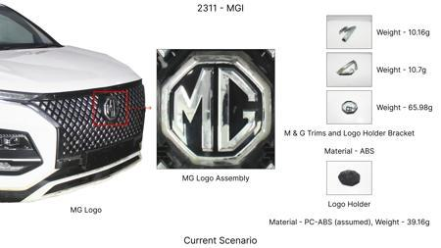
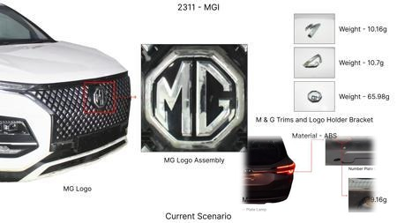
#14: Explore the feasibility of optimizing rotor thickness and cooling fin design for the MG Hect...
WEB SOURCED
Current Scenario
Technical Engineering View:
Technical optimization of Explore the feasibility of optimizing rotor thickness and cooling fin design for the MG Hector's brake rotors. The current 1.7T kinetic energy necessitates robust thermal management. This proposal focuses on using computational fluid dynamics (CFD) to simulate thermal loads during typical and extreme braking scenarios for the Hector. The objective is to identify optimal rotor thickness and internal vane/fin geometry that enhances heat dissipation without significantl...
Material Change:
N/A (No material change explicitly mentioned)
Dimension Change:
N/A (Maintains current envelope)
Cost Analysis:
Est. Saving: INR TBD
Implementation / Proposal
Engineering Validation & Risks:
VALIDATION ROADMAP: • DVP&R Level 2 Testing • Environmental Aging (1000 hrs) • Head Impact Criterion (FMVSS) RISK MITIGATION: ⚠ NVH performance degradation ⚠ Thermal durability limits ⚠ Aesthetic fit & finish gap

Slide 16
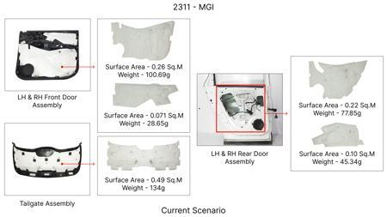
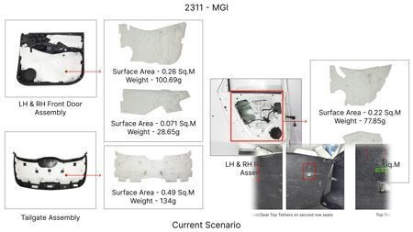
#15: Investigate the use of a high-performance, temperature-resistant coating for brake rotors. T...
WEB SOURCED
Current Scenario
Technical Engineering View:
Technical optimization of Investigate the use of a high-performance, temperature-resistant coating for brake rotors. This coating would aim to improve thermal conductivity, reduce oxidation, and potentially decrease friction coefficient variation over a wider temperature range. The focus would be on coatings that can be applied using existing or minimally modified plating/coating lines to stay within the 'Tooling CAPEX limited' constraint. For the MG Hector (1650 kg, C-SUV), this could lead t...
Material Change:
The focus would be on coatings that can be applied using existing or minimally modified plating/coat
Dimension Change:
N/A (Maintains current envelope)
Cost Analysis:
Est. Saving: INR TBD
Implementation / Proposal
Engineering Validation & Risks:
VALIDATION ROADMAP: • DVP&R Level 2 Testing • Environmental Aging (1000 hrs) • Head Impact Criterion (FMVSS) RISK MITIGATION: ⚠ NVH performance degradation ⚠ Thermal durability limits ⚠ Aesthetic fit & finish gap

Slide 17
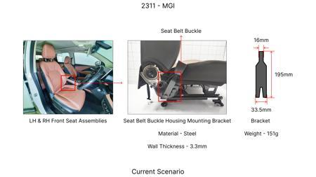
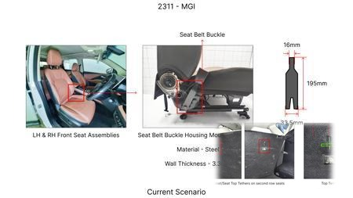
#16: Evaluate the impact of enhanced dust shield gauge and material selection on brake system lon...
WEB SOURCED
Current Scenario
Technical Engineering View:
Technical optimization of Evaluate the impact of enhanced dust shield gauge and material selection on brake system longevity and maintenance for the MG Hector. While dust shields are often overlooked, a thicker gauge or a more robust material could offer better protection against road debris and corrosive elements, potentially preventing premature wear or contamination of brake components. This is an 'Industry Trend' that can be adapted to the MG Hector's C-SUV segment, considering its potent...
Material Change:
Evaluate the impact of enhanced dust shield gauge and material selection on brake system longevity a
Dimension Change:
N/A (Maintains current envelope)
Cost Analysis:
Est. Saving: INR TBD
Implementation / Proposal
Engineering Validation & Risks:
VALIDATION ROADMAP: • DVP&R Level 2 Testing • Environmental Aging (1000 hrs) • Head Impact Criterion (FMVSS) RISK MITIGATION: ⚠ NVH performance degradation ⚠ Thermal durability limits ⚠ Aesthetic fit & finish gap

