Slide 1
REAL-TIME WEATHER DATA PIPELINE
Team members:
Manikanta reddy Reddyeddy
Nevil Pabbineedi
Jaivinay gudiveka
Under the guidance of
PROF. TIMOTHY SMITH

Slide 2
Problem Statement
Why Do We Need Weather Data?
Weather conditions impact transportation, energy usage, agriculture, safety, planning, event management, and many real-world decisions. Organizations rely on accurate historical trends and real-time updates to:
Predict severe weather and issue alerts
Optimize operations (e.g., logistics, power grid balancing)
Analyze long-term climate patterns
Support reporting, dashboards, and data-driven planning

Slide 3
The Problem
Weather APIs provide raw, unstructured JSON that is not analytics-ready. The data is inconsistent and requires significant cleaning, transformation, and aggregation before it can support meaningful insights.
Key Challenges
Raw API responses are messy and inconsistent
Need to support both historical (batch) and real-time (streaming) ingestion
High data volume from multiple cities requires scalable processing
Reliability issues: API limits, failures, retries, duplicates
Requires automated end-to-end data processing and loading

Slide 4
Technology Stack
Languages: Python, SQL Frameworks: Apache Spark, PySpark Streaming: Apache Kafka Orchestration: Apache Airflow (Scheduler + Webserver) Storage: MinIO (S3-compatible, Opensource) Data Warehouse: Snowflake Tools & Libraries: Docker, Parquet, Pandas

Slide 5
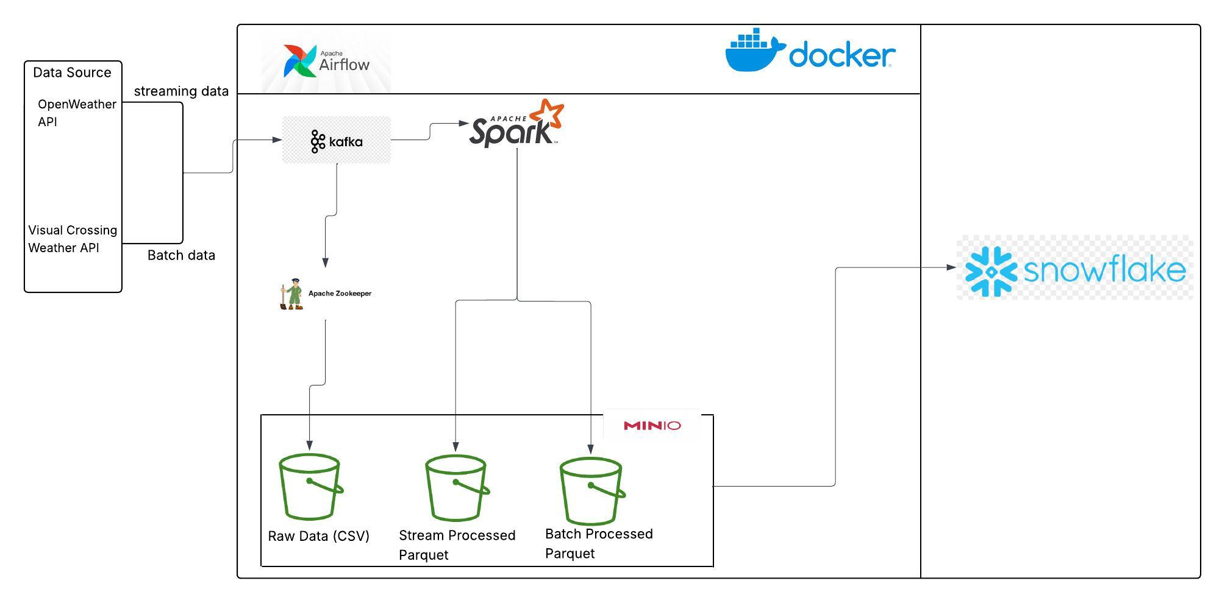
Pipeline architecture

Slide 6
End-to-End Data Flow
1. Data Sources (Weather APIs)
Historical (Visual Crossing API) and real-time weather data (OpenWeather API) fetched from external API endpoints
JSON responses pulled periodically or continuously
2. Ingestion Layer
Batch Ingestion
Scheduled fetch → writes raw JSON to MinIO
Triggered daily by Airflow

Slide 7
Streaming Ingestion (Kafka Architecture)
Kafka Producer
Fetches real-time weather every 60 seconds
Publishes events to topic weather-realtime (key = city, value = JSON)
Kafka Broker
Stores messages durably
Provides partitioned, fault-tolerant streaming
Kafka Consumer
Reads messages from topic
Writes raw events to MinIO (raw zone)
3. Raw Storage (MinIO)
All incoming data stored in S3-compatible buckets
Organized by batch and streaming folders
Supports scalable and durable object storage

Slide 8
4. Processing Layer (Spark Architecture)
Spark Batch Processing
Spark reads raw Parquet/JSON
Performs cleaning, schema standardization, daily aggregations
Writes processed city/date partitions to MinIO
Spark Streaming Architecture
Runs micro-batches or continuous mode
Window-based computations (e.g., 1-minute windows)
Aggregates metrics (avg temp, humidity, pressure)
Maintains state, handles late arrivals, ensures exactly-once output
Writes processed real-time files to MinIO
5. Processed Storage (MinIO – Stagine Layer)
Structured Parquet files
Partitioned for performance
Separate historical and realtime folders

Slide 9
6. Orchestration Layer (Airflow)
Batch Data Flow:
Airflow Orchestrates and automates the batch data pipeline
Airflow Manages scheduling, dependencies, retries, and monitoring
Daily DAG for historical weather data
Orchestrates fetch → consume → Spark processing → Snowflake load
Streaming Flow:
Kafka producer runs continuously every 60 seconds
Stream ingestion operates independently of Airflow
7 Data Warehouse (Snowflake)
Stores processed batch and streaming weather data
Uses incremental MERGE operations for efficient updates
Tables:
DAILY_WEATHER_METRICS (Historical batch data)
STREAM_WEATHER_METRICS (realtime)
Provides clean, analytics-ready datasets for fast querying and reporting

Slide 10
Challenges faced
Resolving dependencies to ensure seamless communication between components
Connecting Kafka from local machine vs. Docker network
Handling schema mismatches during Snowflake MERGE operations
Managing streaming window alignment and late-arriving data
Dealing with API rate limits, failures, and retries
Partitioning and organizing data correctly in MinIO
Preventing duplicate records during incremental loads
Maintaining reliable batch execution through Airflow

Slide 11
Conclusion
Built a complete end-to-end weather data pipeline combining batch and real-time processing
Integrated Kafka, Spark, MinIO, Snowflake, and Airflow to automate ETL workflows
Achieved scalable, reliable ingestion with analytics-ready datasets for historical and streaming insights

Slide 12
Future Enhancements
Add anomaly detection and ML-based weather forecasting
Expand coverage to more cities and include additional weather metrics
Deploy the full pipeline to cloud services (AWS or Microsoft Fabric) for scalability
Build real-time dashboards on top of Snowflake for live monitoring
Introduce automated data quality checks and validation rules
Improve monitoring and alerting for pipeline health and data freshness

Slide 13
Any questions?

Slide 14
Thank you!

