Slide 1
Blindly Assess Image Quality in the Wild Guided by A Self-Adaptive Hyper Network
논문 이해도 60% + 뇌피셜 40%

Slide 2

1. Introduction
Hyper
IQA
IQA 목표
사람이 보는 것과 유사하게 컴퓨터가 image quality를 판단
Synthetically distorted image에 대한 평가는 잘함.
실제로는 NR-IQA가 중요하다.
NR-IQA가 어려운 이유
부분적인 distortion이 많다.
기존의 모델은 classification과 image quality를 같이 판단한다.

Slide 3
2. Related Work
Hyper
IQA
2.1. IQA for Synthetically Distorted Images
hand-crafted feature based IQA
require expertly design and are time-consuming
Global view에서만 image quality를 측정.
learning feature based IQA
CNN 이용해서 성능이 좋아짐.
synthetic databases에만 성능이 좋다.
content variation, diverse distortion types 고려 안함.

Slide 4
2. Related Work
Hyper
IQA
2.2. IQA for Authentically Distorted Images
semantic features가 image quality에 영향을 주는 것처럼 보임.
최근 모델은 semantic features를 quality prediction에 사용.
두 가지 단점이 존재.
Image semantics와 quality perception 관계를 고려 안함.
(사람은 image content 판단 후 quality를 판단)
global scale에서 image feature를 정하기 때문에 local distortion을 판단 못함.
image semantic features are learned first,
quality is predicted based upon what content the image delivers.

Slide 5
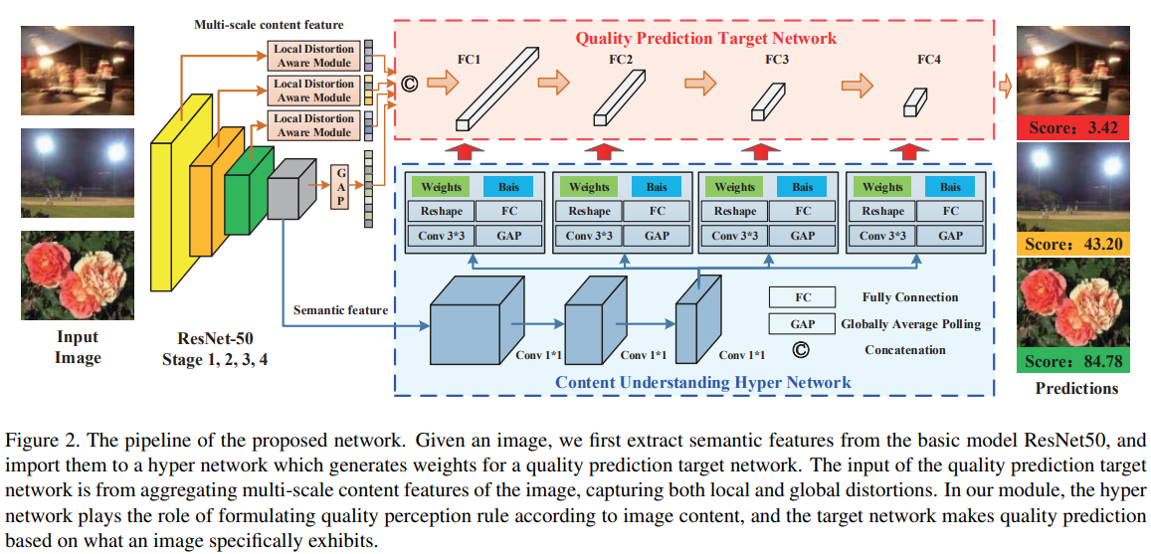
3. Proposed Method
Hyper
IQA

Slide 6



3. Proposed Method
Hyper
IQA
3.1. Self-Adaptive IQA Model
Φ = network model
X = input image
Θ = weight parameters
Θx = network parameters
(dependent on the image itself instead of being fixed for all inputs)
H = a hyper network mapping function
γ = hyper network parameters
S(x) = semantic features extracted from the input image x

Slide 7

3. Proposed Method
Hyper
IQA
3.1. Self-Adaptive IQA Model
content aware vector Vx = Sms(x)

Slide 8
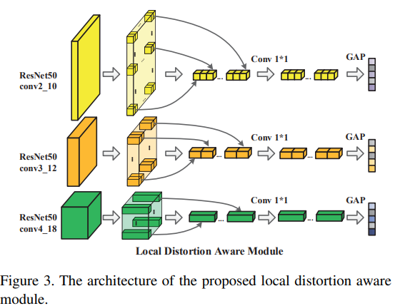
3. Proposed Method
Hyper
IQA
3.2. Semantic Feature Extraction Network
ResNet50
S(x) ( semantic feature )
directly fed to hyper network for weight generation
Sms(x) (multi-scale content feature )
input of the target network

Slide 9
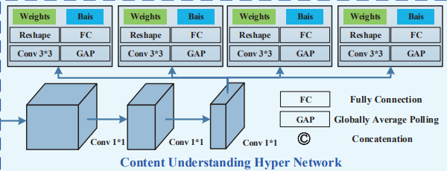
3. Proposed Method
Hyper
IQA
3.3. Hyper Network for Learning Perception Rule
consists of three 1×1 convolution layers
several weight generating branches
fully connected layers are used as basic target network component
The generated weights are regarded as the rule of perceiving image quality

Slide 10
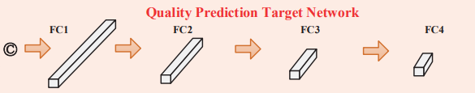
3. Proposed Method
Hyper
IQA
3.4. Target Network for Quality Prediction
the function of the target network is simply mapping learned image contents to a quality score.
consists of four fully connected layers
sigmoid function as the activation function

Slide 11
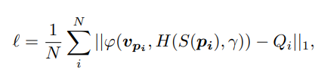
3. Proposed Method
Hyper
IQA
3.5. Implementation Details
randomly sample and horizontally flipping 25 patches with size 224×224 pixels from each training image for augmentation.
pi = i-th training patch
Qi = ground truth score
Adam optimizer with weight decay 5 × 10−4 to train our model for 15 epochs
mini-batch size = 96
Learning rate = 2 × 10−5 reduced by 10 after every 5 epochs.
Xavier initialized

Slide 12
4. Experiments
Hyper
IQA
4.1. Datasets
LIVE Challenge (LIVEC)
1162 images
complex and composite distortions
KonIQ-10k
10073 images
sense of brightness, colorfulness, contrast and sharpness
BID
586 images
realistic blur distortions such as motion blur and out of focus
LIVE and CSIQ
779 and 866 synthetically distorted images

Slide 13
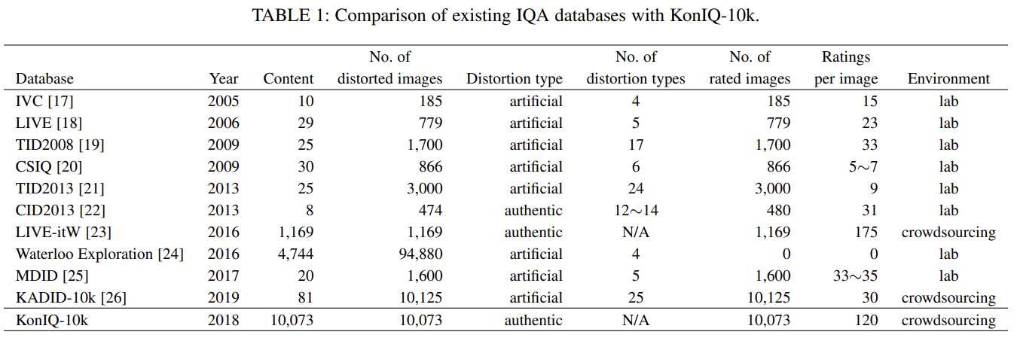
4. Experiments
Hyper
IQA
4.1. Datasets
KonIQ-10k
10073 images
sense of brightness, colorfulness, contrast and sharpness

Slide 14
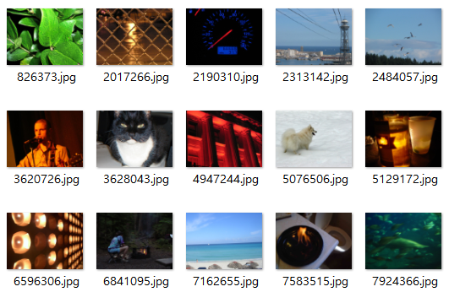
4. Experiments
Hyper
IQA
4.1. Datasets
KonIQ-10k
10073 images
sense of brightness, colorfulness, contrast and sharpness

Slide 15
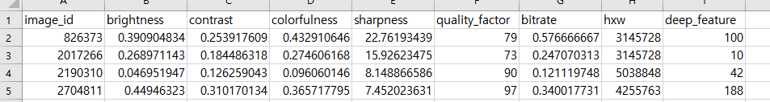
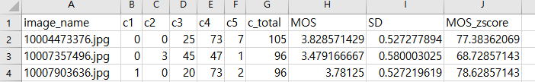
4. Experiments
Hyper
IQA
4.1. Datasets
KonIQ-10k
10073 images
sense of brightness, colorfulness, contrast and sharpness

Slide 16
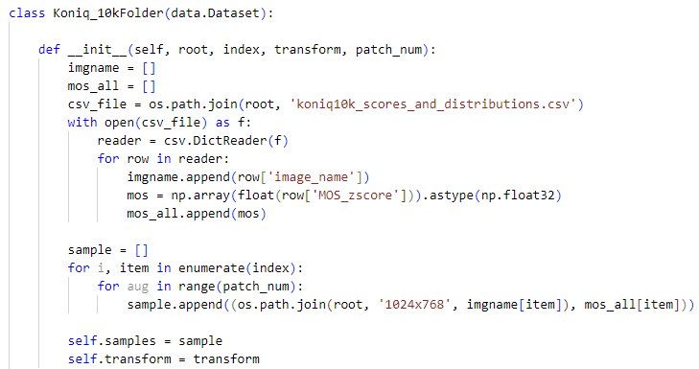
4. Experiments
Hyper
IQA
4.1. Datasets
KonIQ-10k
10073 images
sense of brightness, colorfulness, contrast and sharpness

Slide 17

4. Experiments
Hyper
IQA
4.2. Evaluation Metrics
Spearman’s rank order correlation coefficient (SRCC)
Pearson’s linear correlation coefficient (PLCC)
80% images are used for training
rest 20% are used for testing
synthetic image databases LIVE and CSIQ
run 10 and the median SRCC and PLCC values

Slide 18
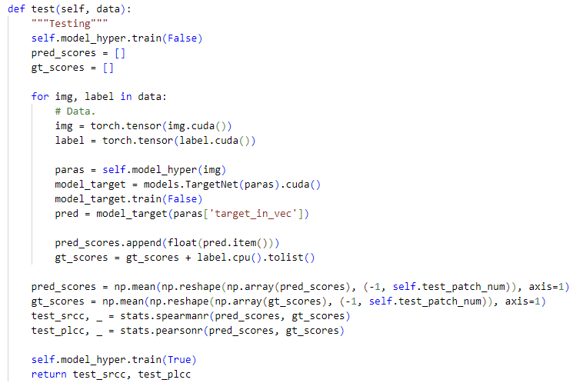
4. Experiments
Hyper
IQA
4.2. Evaluation Metrics
Spearman’s rank order correlation coefficient (SRCC)
Pearson’s linear correlation coefficient (PLCC)
80% images are used for training
rest 20% are used for testing
synthetic image databases LIVE and CSIQ
run 10 and the median SRCC and PLCC values

Slide 19
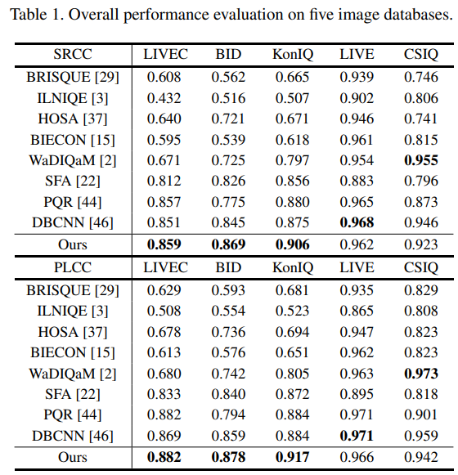
4. Experiments
Hyper
IQA
4.3. Comparison with the State-of-the-art Methods

Slide 20
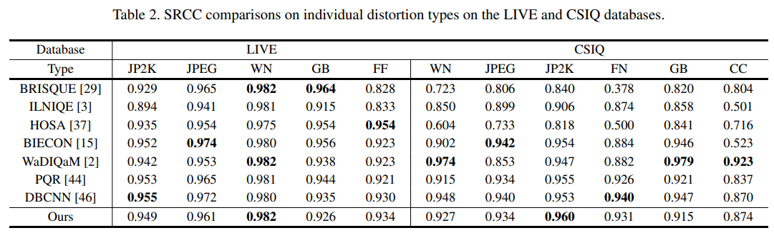
4. Experiments
Hyper
IQA
4.3. Comparison with the State-of-the-art Methods

Slide 21
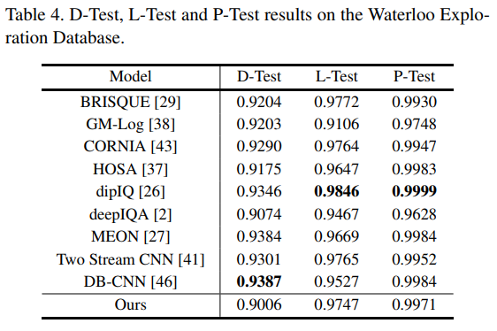
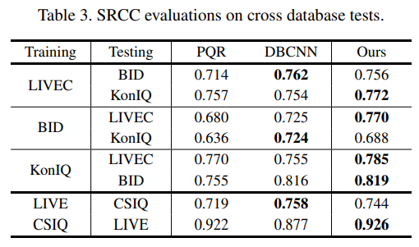
4. Experiments
Hyper
IQA
4.3. Comparison with the State-of-the-art Methods

Slide 22
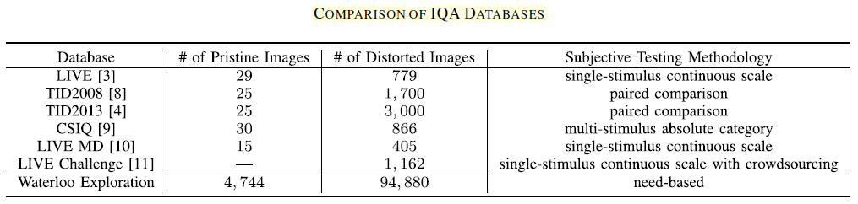
4. Experiments
Hyper
IQA
Waterloo Exploration Database
기존의 IQA 데이터베이스
너무 제한된 content variation
4744개의 원본 이미지
94880개의 왜곡 이미지
원본 이미지는 4개의 왜곡 유형
5개의 왜곡 레벨로 왜곡
https://bskyvision.com/entry/%EB%85%BC%EB%AC%B8-%EC%A0%95%EB%A6%AC-Ma-Waterloo-Exploration-Database-New-Challenges-for-Image-Quality-Assessment-Models-TIP2017

Slide 23
4. Experiments
Hyper
IQA
Waterloo Exploration Database
D-test (pristine/distorted image discriminability test)
IQA 모델이 왜곡 이미지로부터 원본 이미지를 잘 분리했는지를 시험
L-test (listwise ranking consistency test)
IQA 모델이 같은 콘텐츠 및 같은 왜곡 유형이지만 다른 정도로 왜곡된 이미지들의 순위를 잘 매길 수 있는지를 시험
같은 콘텐츠 및 같은 왜곡 유형이지만 다른 왜곡 정도를 가진 이미지들을 모아서 SRCC와 KRCC를 구한 것을 평균
P-test (pairwise preference consistency test)
품질차이를 느낄 수 있는 이미지 쌍(quality-discriminable image pair, DIP)을 제시했을 때 IQA 모델이 더 나은 품질의 것을 잘 선택할 수 있는지를 시험
https://bskyvision.com/entry/%EB%85%BC%EB%AC%B8-%EC%A0%95%EB%A6%AC-Ma-Waterloo-Exploration-Database-New-Challenges-for-Image-Quality-Assessment-Models-TIP2017

Slide 24
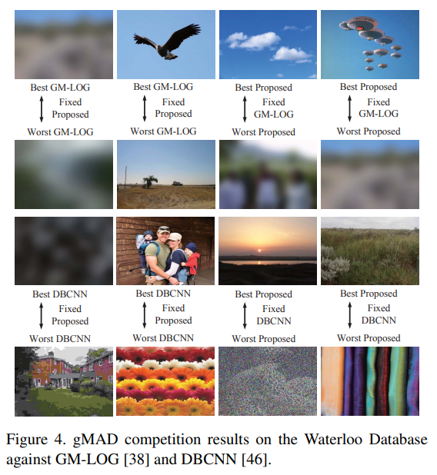
4. Experiments
Hyper
IQA
4.3. Comparison with the State-of-the-art Methods

Slide 25
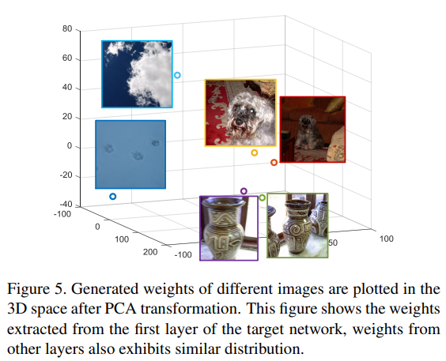
4. Experiments
Hyper
IQA
4.4. Visualization of Self-Adaptive Weights

Slide 26
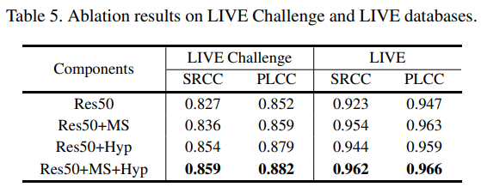
4. Experiments
Hyper
IQA
4.5. Ablation Study

Slide 27
5. Conclusion
Hyper
IQA
다른 모델이 image feature와 image quality를 함께 고려할 때,
우리 모델은 global image feature를 먼저 고려하고
Local image feature를 image quality를 계산하는데 적용하여
사람이 image quality를 판단하는 기준과 유사한 모델을 만들었다.

Slide 28
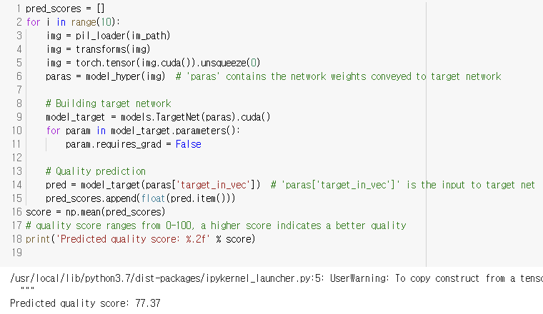
5. Conclusion
Hyper
IQA

