Slide 1

Boston House Prices
Luis Kevin Olan Javier

Slide 2
Task | Member
1. Definition | All of us
2. Dataset & Variables
3. Variables
4. Descriptive Analysis
5. Data Preprocessing
6. Modeling - Architecture
7. Modeling - Metrics
8. Modeling - Benchmark
9. Conclusions

Slide 3
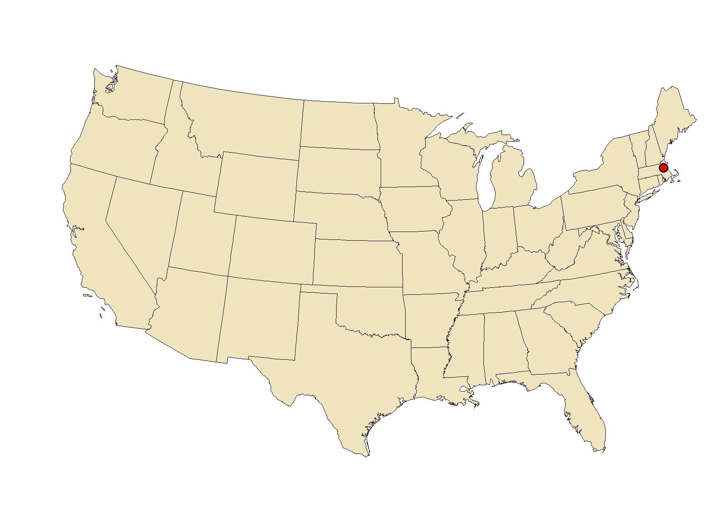
Problem Statement
Creation of a Neural Network model to predict the house’ price in Boston using different 13 attributes
What .. Why was this dataset collected?
To investigate the problems associated with the use of

Slide 4
Dataset
Data concerning housing in the area of Boston Massachusetts
506 rows and 14 attributes
Year? Month?
70’s

Slide 5
Dataset
Variables | Example
CRIM - per capita crime rate by town | 0.00632
ZN - proportion of residential land zoned for lots over 25,000 sq.ft. | 18.0
INDUS - proportion of non-retail business acres per town. | 2.31
CHAS - Charles River dummy variable (1 if tract bounds river; 0 otherwise) | 0
NOX - nitric oxides concentration (parts per 10 million) | 0.538
RM - average number of rooms per dwelling | 6.575
AGE - proportion of owner-occupied units built prior to 1940 | 65.2
DIS - weighted distances to five Boston employment centres | 4.0900
RAD - index of accessibility to radial highways | 1
TAX - full-value property-tax rate per $10,000 | 296.0
PTRATIO - pupil-teacher ratio by town | 15.3
B - 1000(Bk - 0.63)^2 where Bk is the proportion of blacks by town | 396.90
LSTAT - % lower status of the population | 4.98
MEDV - Median value of owner-occupied homes in $1000's | 24.0*
*24.0 corresponding to a median price of $24,000

Slide 6
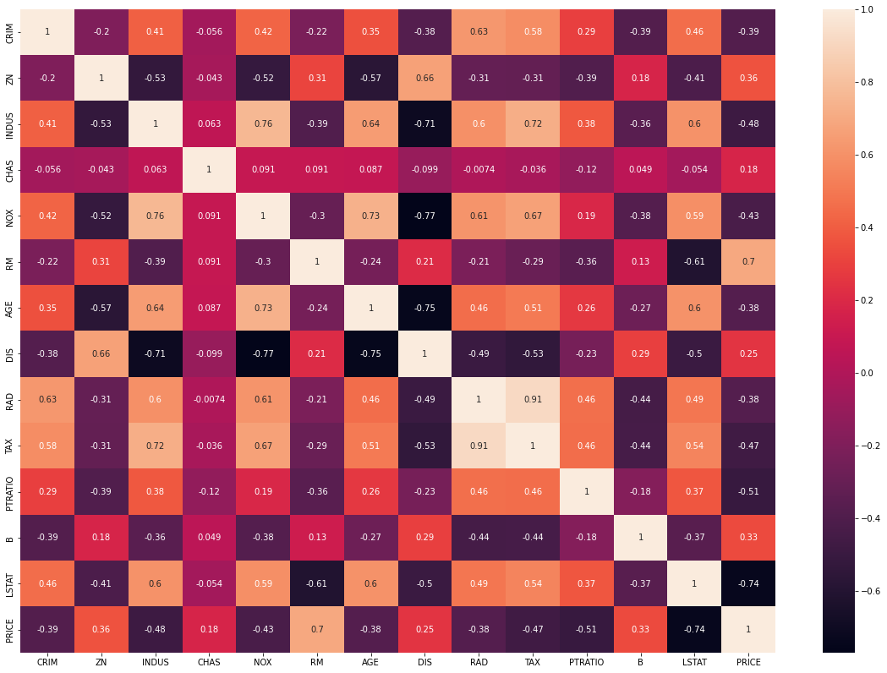
Correlation

Slide 7
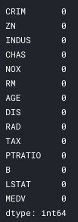
Data Preprocessing
Missing values

Slide 8
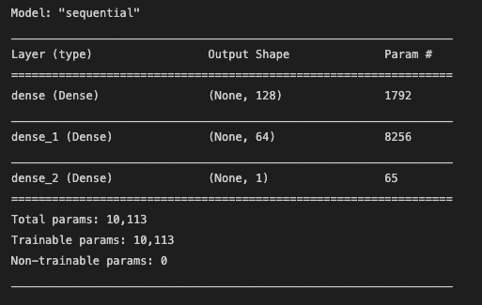
Modeling
Arquitecture

Slide 9
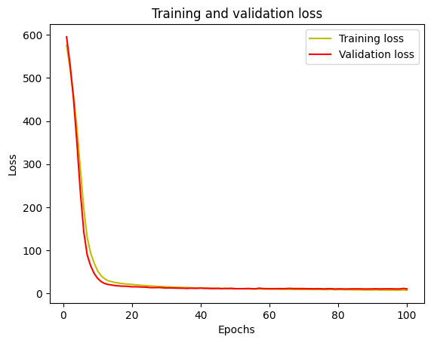
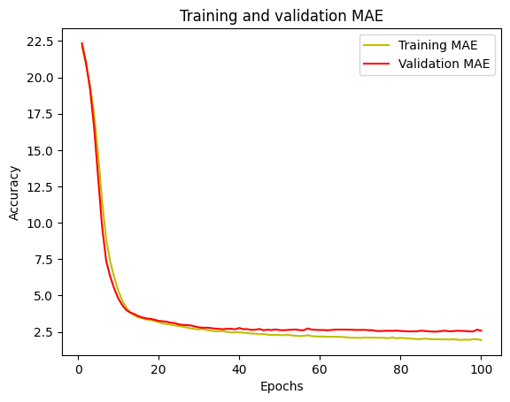

Slide 10
Modeling
Predictions
PRICES
Real | Predicted
21.2 | 18.51
20.6 | 20.62
21.5 | 20.94
21.7 | 21.00
13.4 | 12.63

Slide 11
Modeling
Benchmark

Slide 12
Conclusions
Summary

Slide 13

References
Harrison, David & Rubinfeld, Daniel. (1978). Hedonic housing prices and the demand for clean air. Journal of Environmental Economics and Management. https://www.researchgate.net/profile/Daniel-Rubinfeld/publication/4974606_Hedonic_housing_prices_and_the_demand_for_clean_air/links/5c38ce85458515a4c71e3a64/Hedonic-housing-prices-and-the-demand-for-clean-air.pdf
https://www.kaggle.com/omrshahid/deep-learning-regression
https://www.cs.toronto.edu/~delve/data/boston/bostonDetail.html
https://github.com/bnsreenu/python_for_microscopists/blob/master/141-regression_housing_example.py

Slide 14
Thank you!

