Slide 1

Boston House Prices
Luis Kevin Olan Javier

Slide 2
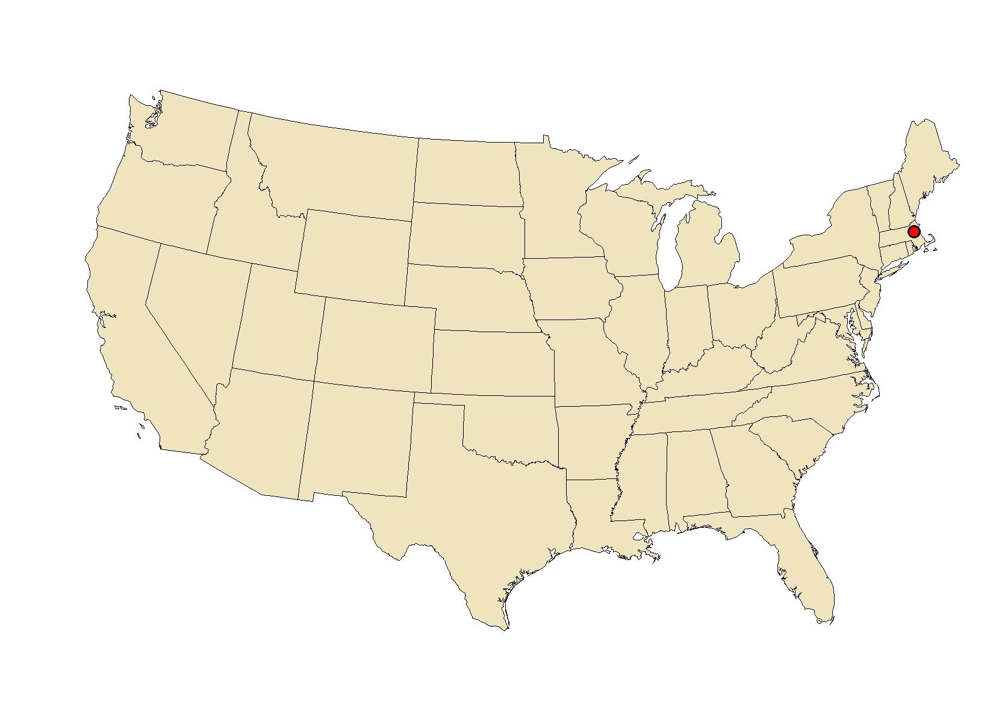
Project Definition
Creation of a Neural Network model to predict the house’ price in Boston using different 13 attributes
Comparison of the Neural Network model performance with other models seen in previous classes

Slide 3
Data Source
Data collected by the U.S Census Service concerning housing in the area of Boston in 1970
The dataset contains 506 rows and 14 attributes
Originally used to solve problems associated with the willingness to pay for clean air.
The independent variables include two structural attribute variables (S), eight neighborhood variables (N), two accessibility variables (A), and one air pollution variable (P).

Slide 4
Dataset
Variables | Example | Type
CRIM - per capita crime rate by town | 0.00632 | neighborhood
ZN - proportion of residential land zoned for lots over 25,000 sq.ft. | 18.0 | neighborhood
INDUS - proportion of non-retail business acres per town. | 2.31 | neighborhood
CHAS - Charles River dummy variable (1 if tract bounds river; 0 otherwise) | 0 | neighborhood
NOX - nitric oxides concentration (parts per 10 million) | 0.538 | pollution
RM - average number of rooms per dwelling | 6.575 | structural
AGE - proportion of owner-occupied units built prior to 1940 | 65.2 | structural
DIS - weighted distances to five Boston employment centres | 4.0900 | accessibility
RAD - index of accessibility to radial highways | 1 | accessibility
TAX - full-value property-tax rate per $10,000 | 296.0 | neighborhood
PTRATIO - pupil-teacher ratio by town | 15.3 | neighborhood
B - 1000(Bk - 0.63)^2 where Bk is the proportion of blacks by town | 396.90 | neighborhood
LSTAT - % lower status of the population | 4.98 | neighborhood
MEDV - Median value of owner-occupied homes in $1000's | 24.0* | target
*24.0 corresponding to a median price of $24,000 – ($24,000 in 1970 is worth $172,454 approx. today 2022)

Slide 5
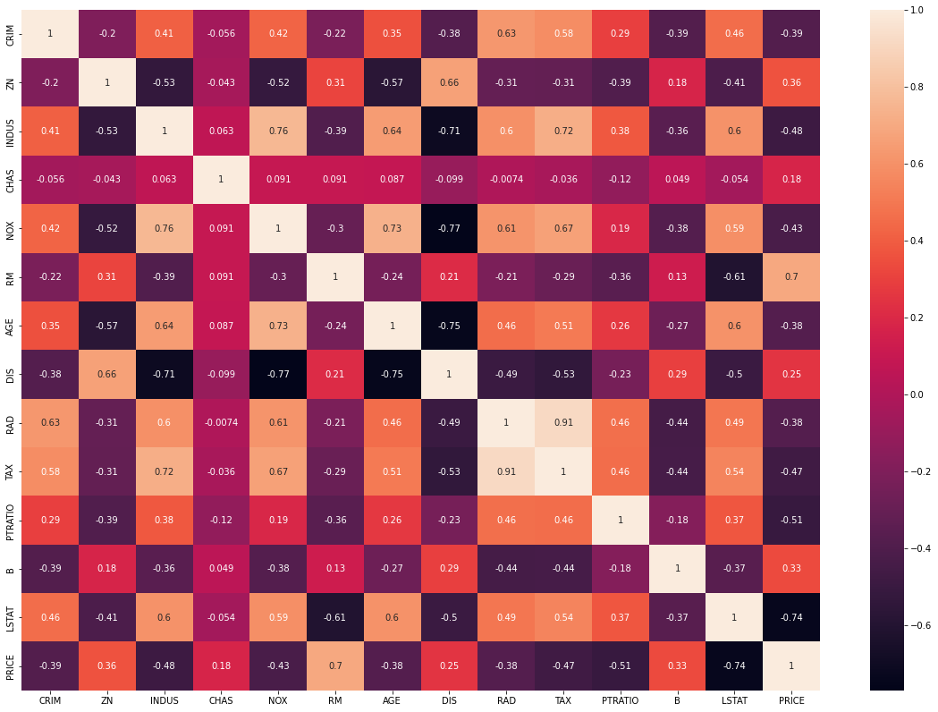
Correlation
Highly Correlated

Slide 6
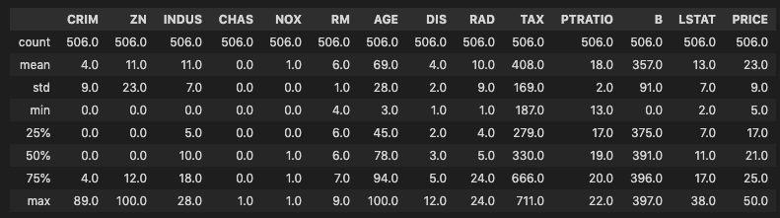
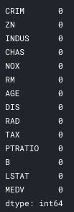
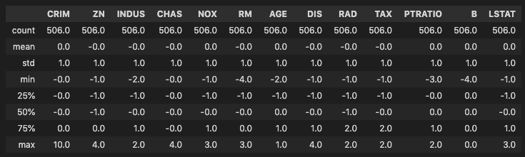
Data Preprocessing
Scaling
Missing values

Slide 7
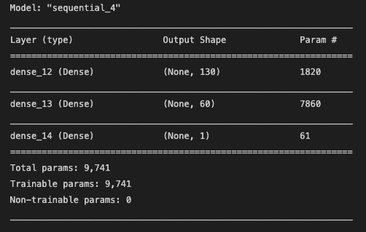
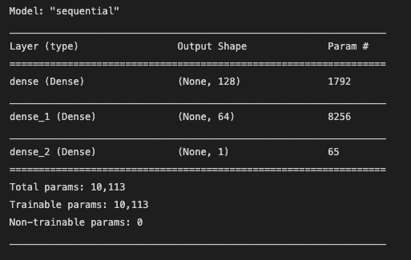
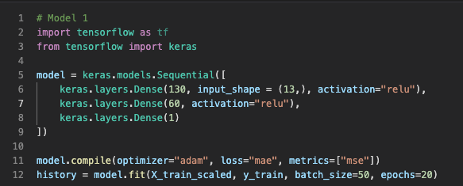
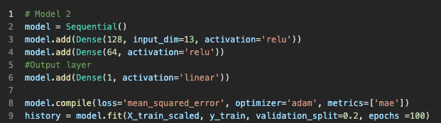
Modeling
Architecture
Model 1
Model 2

Slide 8
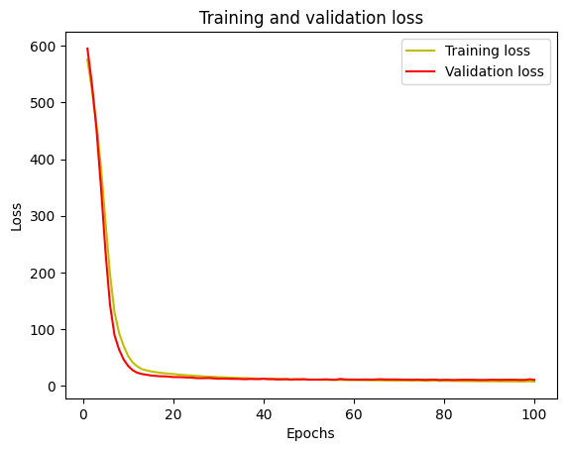
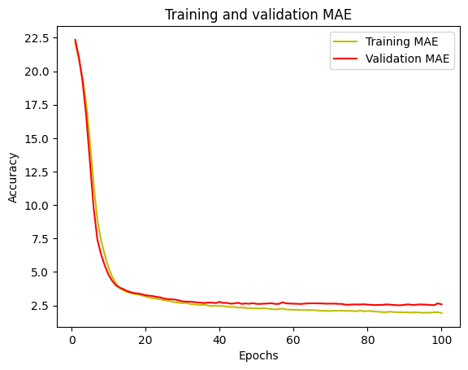
Modeling
Neural Network Model 2
enough

Slide 9
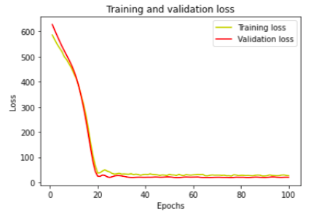
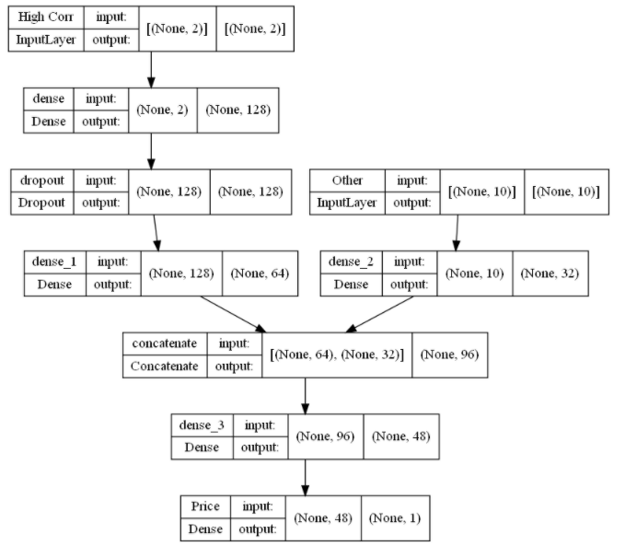
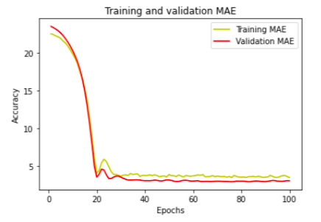
Modeling
Neural Network Model 3

Slide 10
Modeling
Predictions - Neural Network Model 2
PRICES
Real ($) | Predicted ($) in 1970 | Predicted ($) in 2022
21.2 | 18.51 | 152,335
20.6 | 20.62 | 148,023
21.5 | 20.94 | 154,490
21.7 | 21.00 | 155,927
13.4 | 12.63 | 96,287
* 5 different houses from the test dataset

Slide 11



Modeling
Benchmark
Model | Mean Absolute Error | Parameters
Neural Network Model 1 | 2.938
Neural Network Model 2 | 2.975
Neural Network Model 3 | 3.065
Linear Regression | 3.055
Decision Tree | 3.183
Random Forest | 2.408

Slide 12
Conclusions
Model 2 performed better than model 1 by adding more neurons to each layer and including a linear activation in the output layer.
In general, Neural Network model performs as well as other models.
Neural Network did not allow us to see the ranking feature. This kind of models are more complex to interpret than others.

Slide 13

References
Harrison, David & Rubinfeld, Daniel. (1978). Hedonic housing prices and the demand for clean air. Journal of Environmental Economics and Management. https://www.researchgate.net/profile/Daniel-Rubinfeld/publication/4974606_Hedonic_housing_prices_and_the_demand_for_clean_air/links/5c38ce85458515a4c71e3a64/Hedonic-housing-prices-and-the-demand-for-clean-air.pdf
https://www.kaggle.com/omrshahid/deep-learning-regression
https://www.cs.toronto.edu/~delve/data/boston/bostonDetail.html
https://github.com/bnsreenu/python_for_microscopists/blob/master/141-regression_housing_example.py

Slide 14
Thank you!

Slide 15
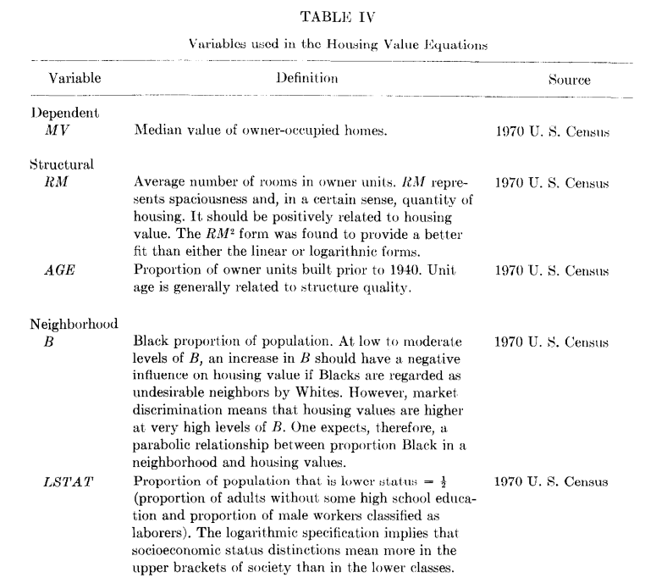
Dataset

Slide 16
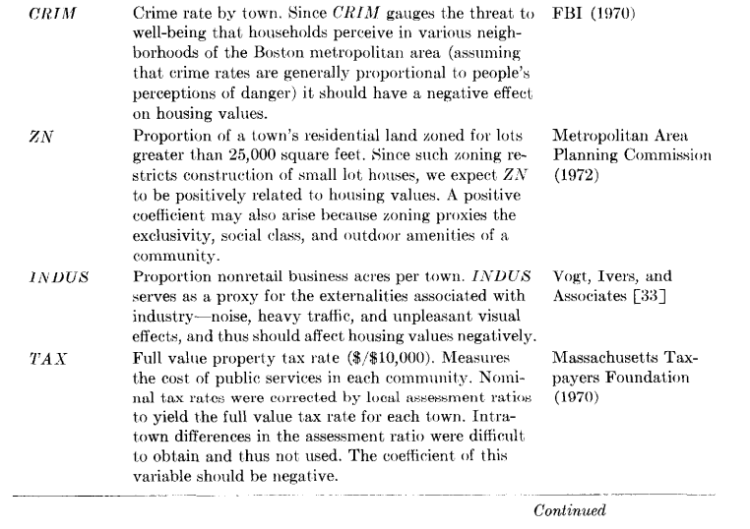
Dataset

Slide 17
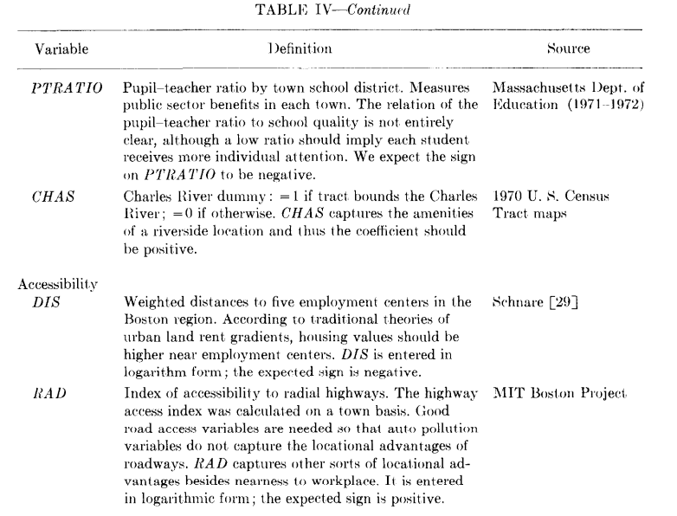
Dataset

Slide 18
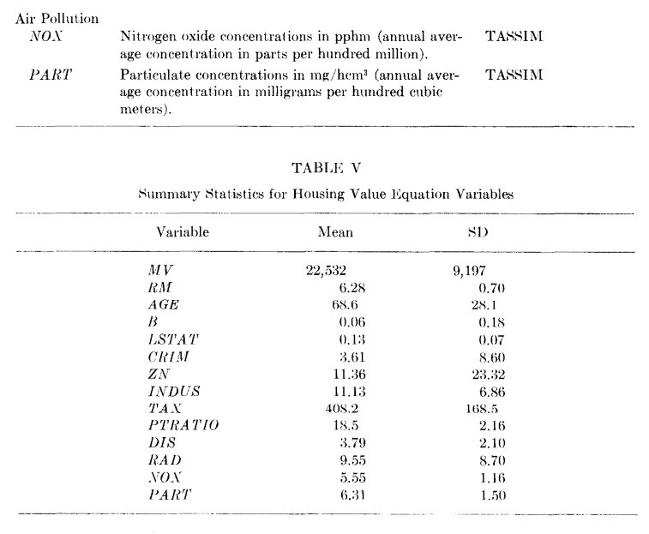
Dataset

