Slide 1
NAM Rates
June 2020
HERrising

Slide 2
User Journey
User(Actor) | Actions(Jobs) | Story Ending
Task Creator | Build Profile Create Task Find Contributor Contact Contributor | Task Delegated
Contributor | Build Profile Browse Tasks Apply Task | Informal skills used to earn money

Slide 3
Pain and Gain map
Pains | Action | Gains
Trouble delegating house hold task | Create Task | Task delegated
Need to buy anything urgently | Search contributors(home-based seller) | View available sellers and buy immediately
Home-maker wants to utilize here informal skills to earn money | Browse and apply task | Informal skill used to earn money
College girl wants to earn some extra quick money | Browse and apply for micro tasks | Quick money earned by completing micro tasks

Slide 4
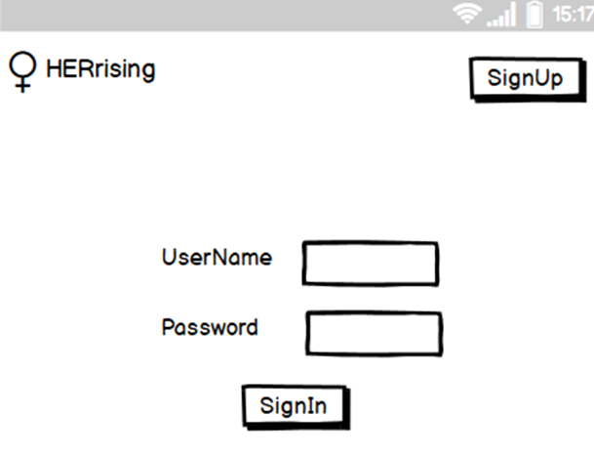
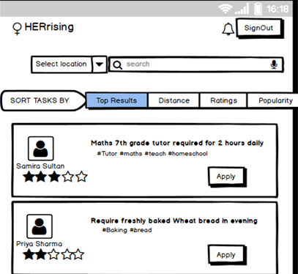
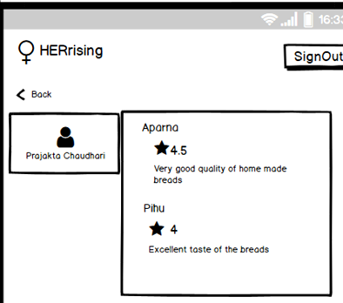
Story board- Search and Apply Task
User logs in with credentials
User is defaulted Tasks page
Click on name to view profile of contributor
Notification sent
to task creator
to accept/reject
contributor

Slide 5
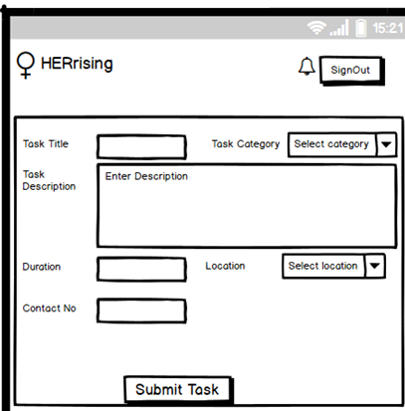
Story board – Create Task
User creates Task
Portal validates, creates task, sends back recommended contributors for the task
Task creator can
click on recommended
contributor and contact
him through portal
A notification sent to
contributor to accept/reject task
Portal internally validates the
content and sends
recommended contributor
list for the specified task

Slide 6
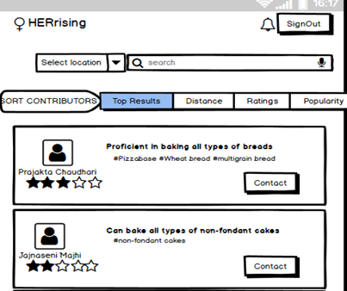
Story board – Search and contact contributors
Notification sent
to contributor
to accept/reject
task
User can search contributors by selecting category from auto select search block or side bar menu
User can search contributors locally, or by his popularity

Slide 7
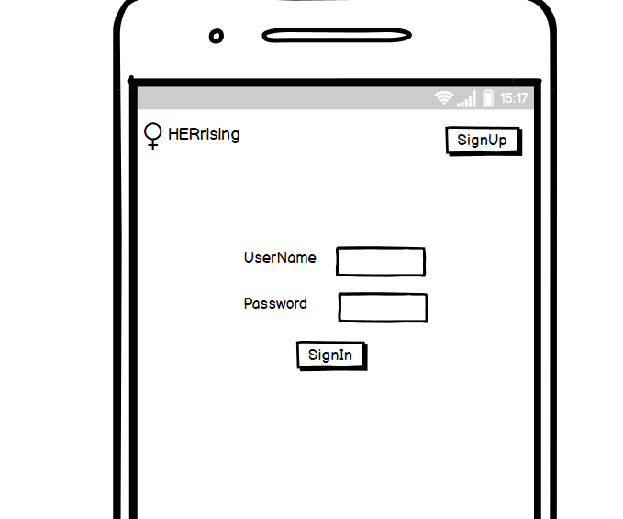
Login Page

Slide 8
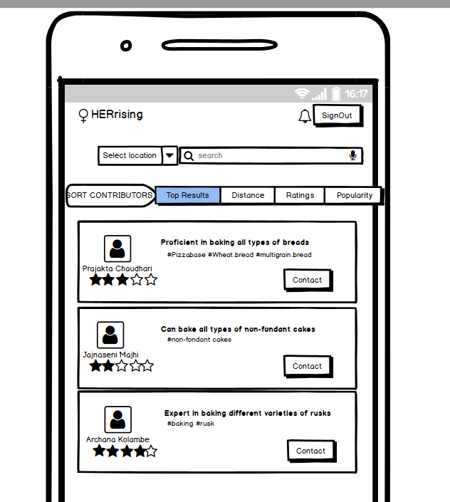
Search Contributor

Slide 9
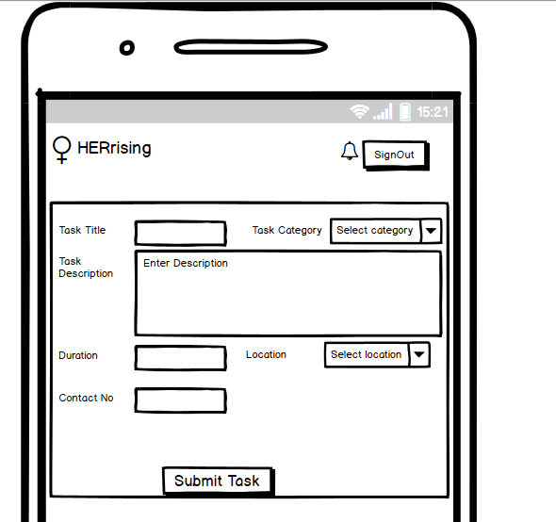
Create Task

Slide 10
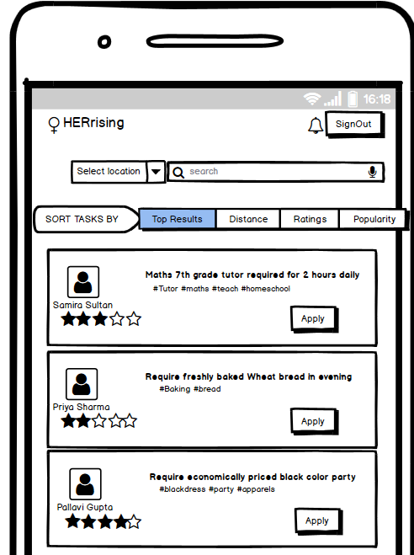
Browse Task

Slide 11
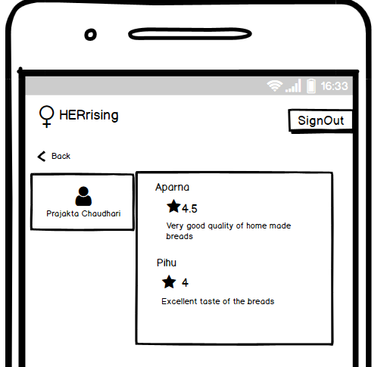
Profile

