Slide 1
PIP_generator
Rev 0 02.26.18 Preliminary. BL
Rev 1 02.26.18 Added photos bl
Rev - 03.06.18 Release BL
Rev A 03.13.18 Removed auto preview BL

Slide 2
Installation
Download “build” folder from Z:\FTP\RNDFtp\EQD\FA Procedure\PIP_Generator onto your desktop

Slide 3
Procedure generation
Navigate to “*\Desktop\build\exe.win-amd64-3.6” folder that was downloaded
Double click the “PIP_GEN_id-0” application
Drag the edited x.xml file into the generator window and verify that this window is active
Press Enter and an Excel document will generate in desktop folder “build\exe.win-amd64-3.6”
Double click on the “Parts – Consoles.xlsx” file to preview a “TrackVia” style procedure
Copy Excel document and completed x.xml to RNDftp in the “Procedure” folder
NOTE:
Create shortcut if you choose
Generator will create one PIP called “Parts – Consoles.xlsx” at a time
“ConsoleProcedures.xlsx” database will be updatable
If the PIP fails to generate, contact Icon QC with details

Slide 4
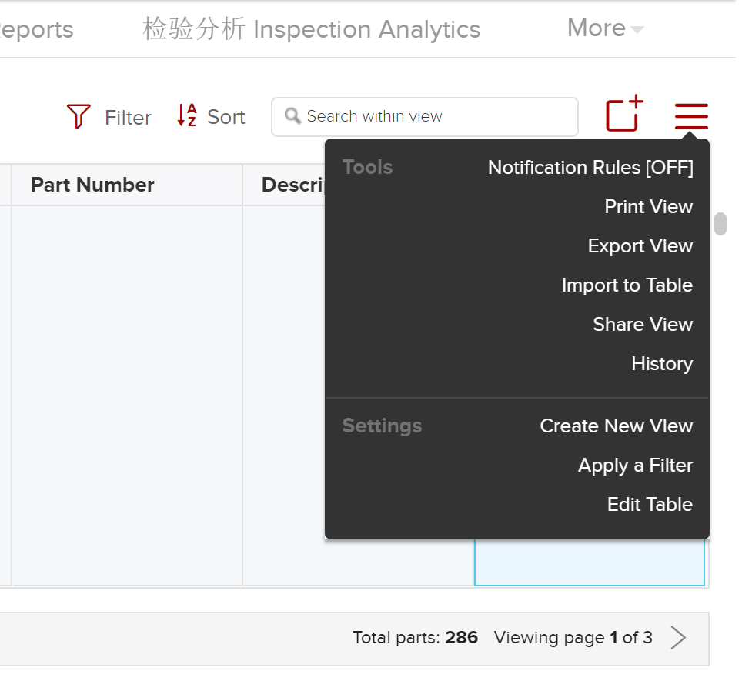
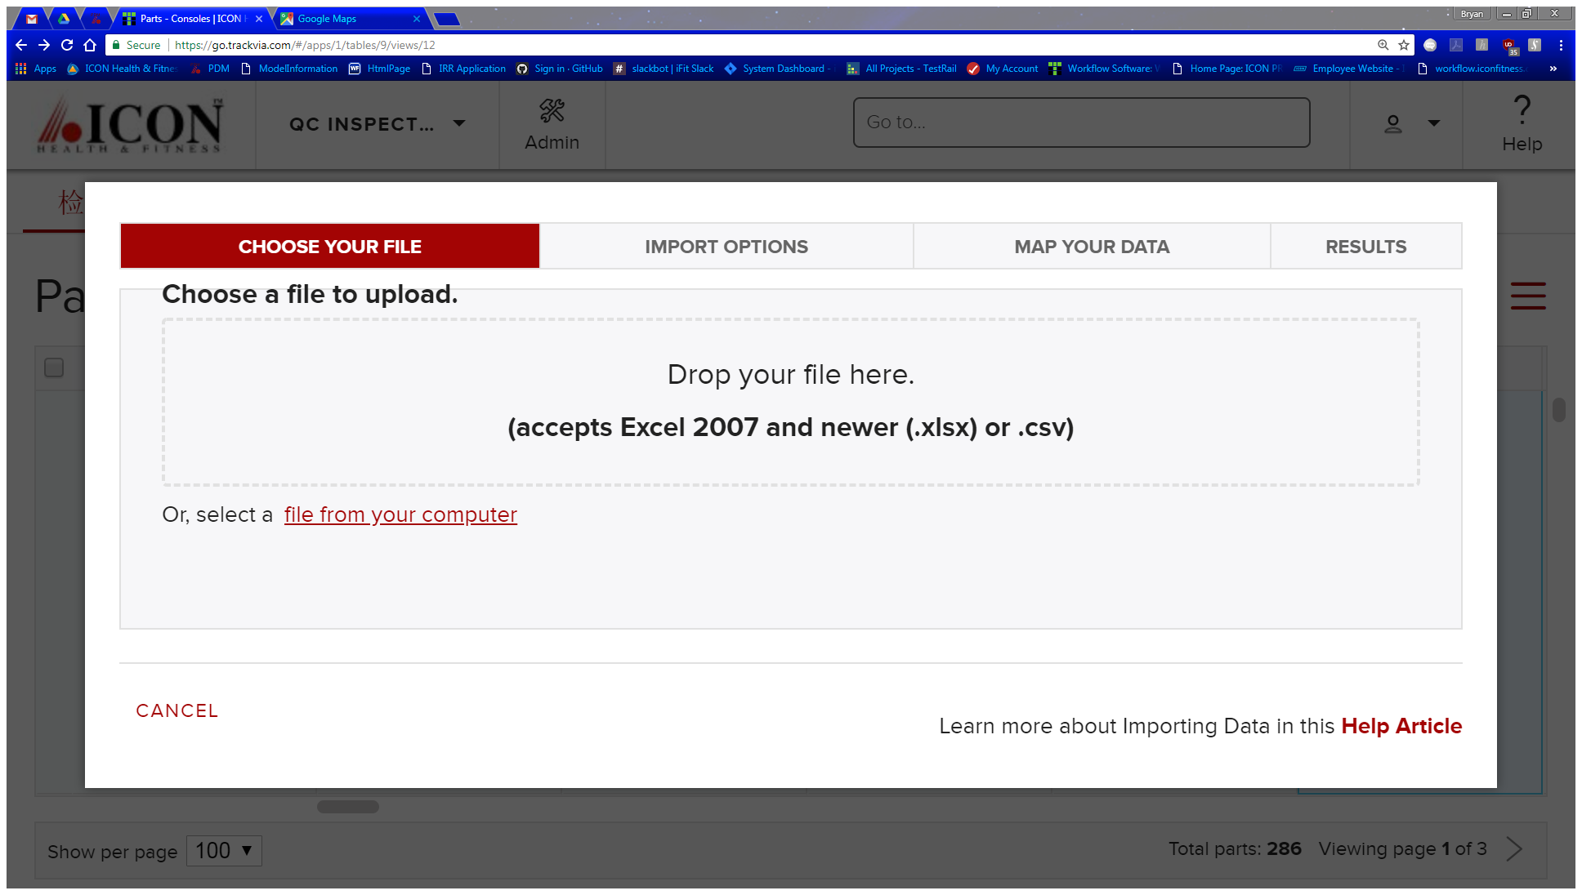
TrackVia Upload
Login to TrackVia and click “Admin” icon
Select Parts-Consoles from the Tables dropdown
Select Import to Table from the Menu dropdown
Drag “Parts – Consoles.xlsx” file into the drop window on

Slide 5
TrackVia Upload continued
Click NEXT>>
Check “Link imported rows to [Part Types] Link to Parts – Consoles” option
In “Link to Parts-Consoles” column, select “[Part Types][Link to Parts-Consoles]Part Type” from the drop down
Click NEXT>>
Click FINISH

Slide 6
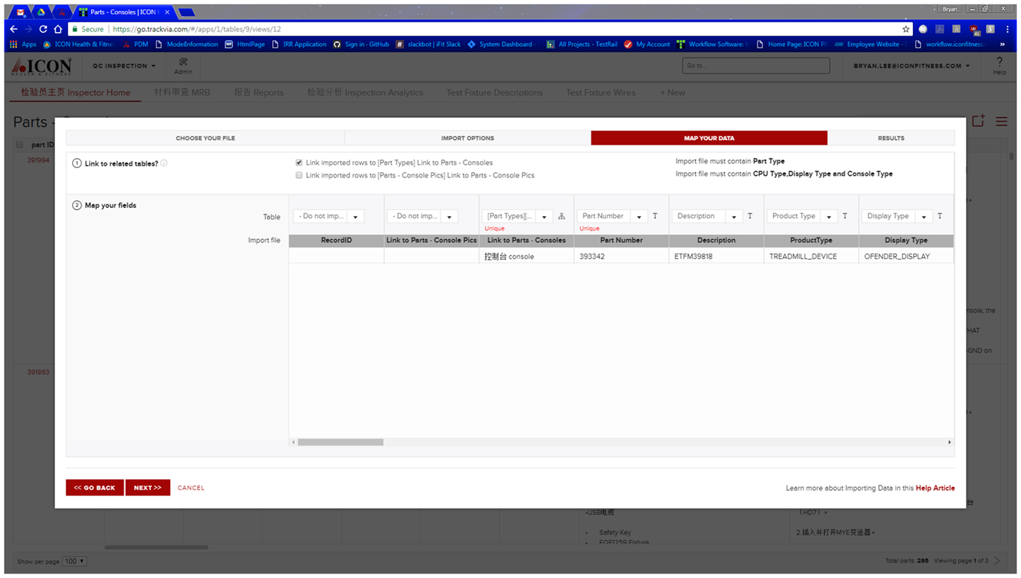

Slide 7
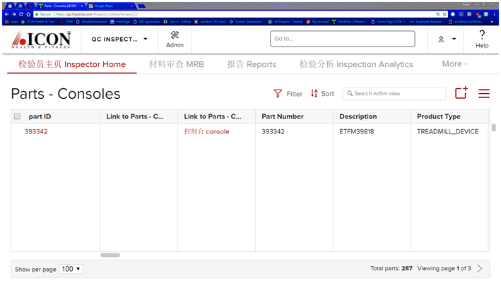
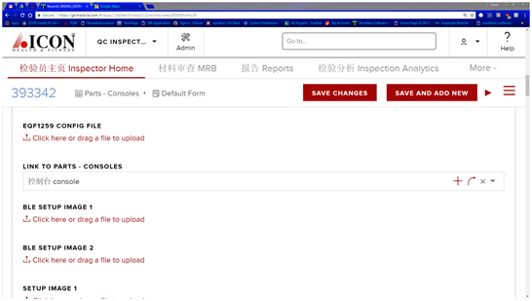
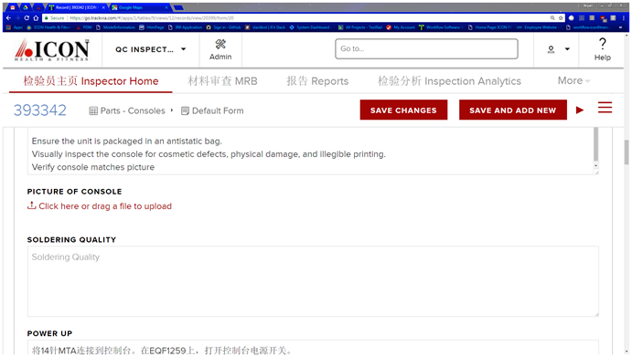
Upload x.xml and console photo
Click part ID/#
Drag x.xml file to “EQF1259 CONFIG FILE”
Drag x.jpg file to “PICTURE OF CONSOLE”

Slide 8
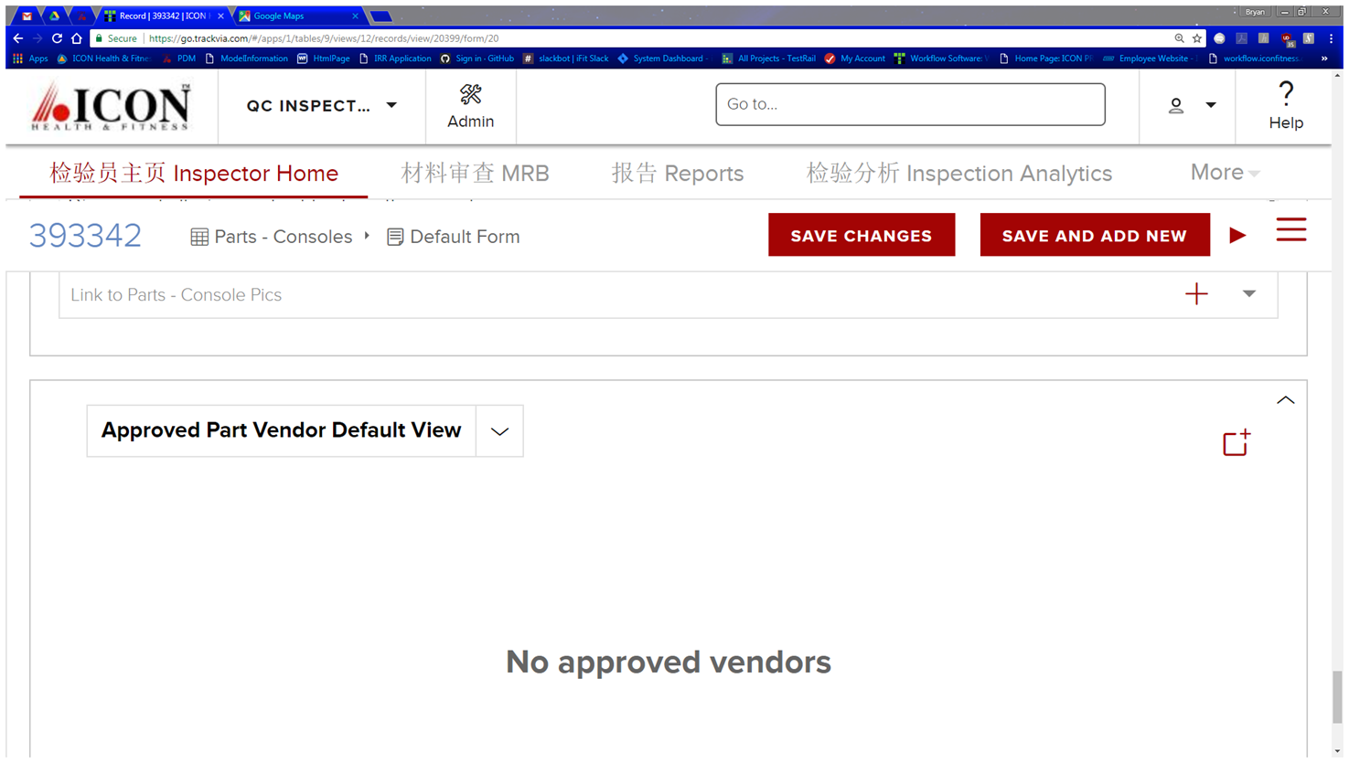
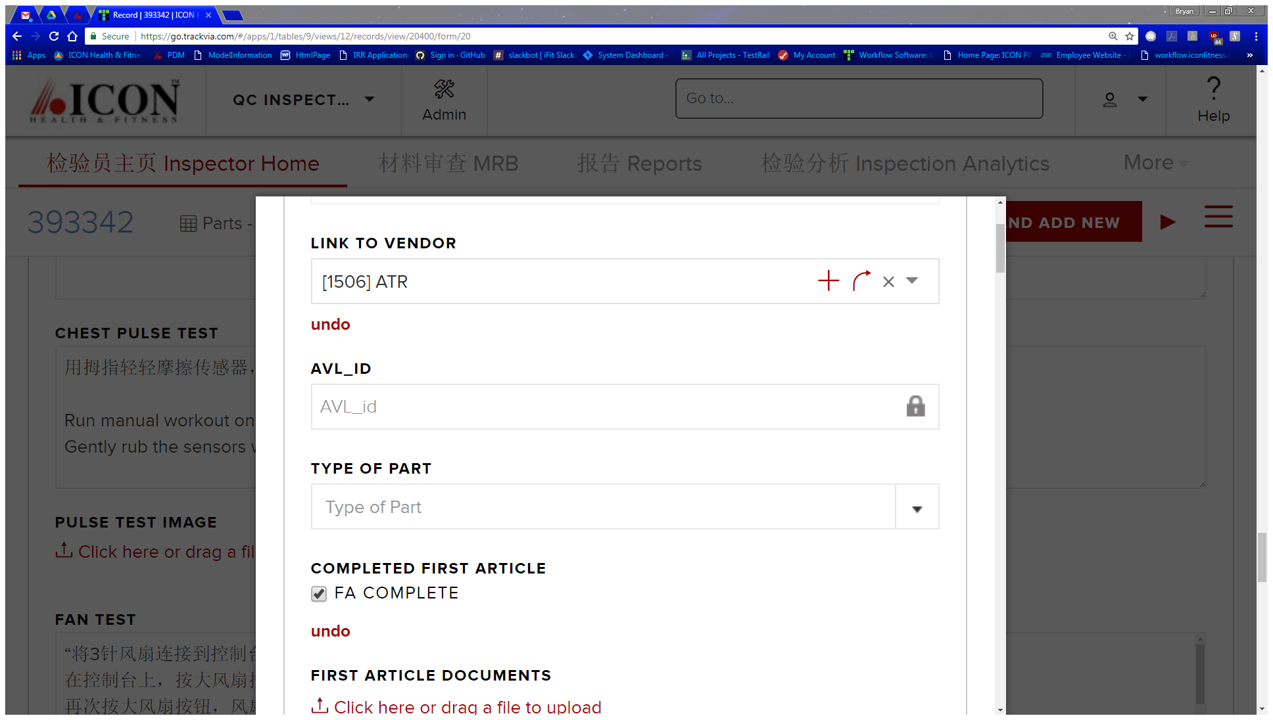
Approve vendor
At the bottom select the add icon at the right
Add LINK TO VENDOR via dropdown list
Check FA Complete
At the bottom click SAVE AND ADD NEW

Slide 9
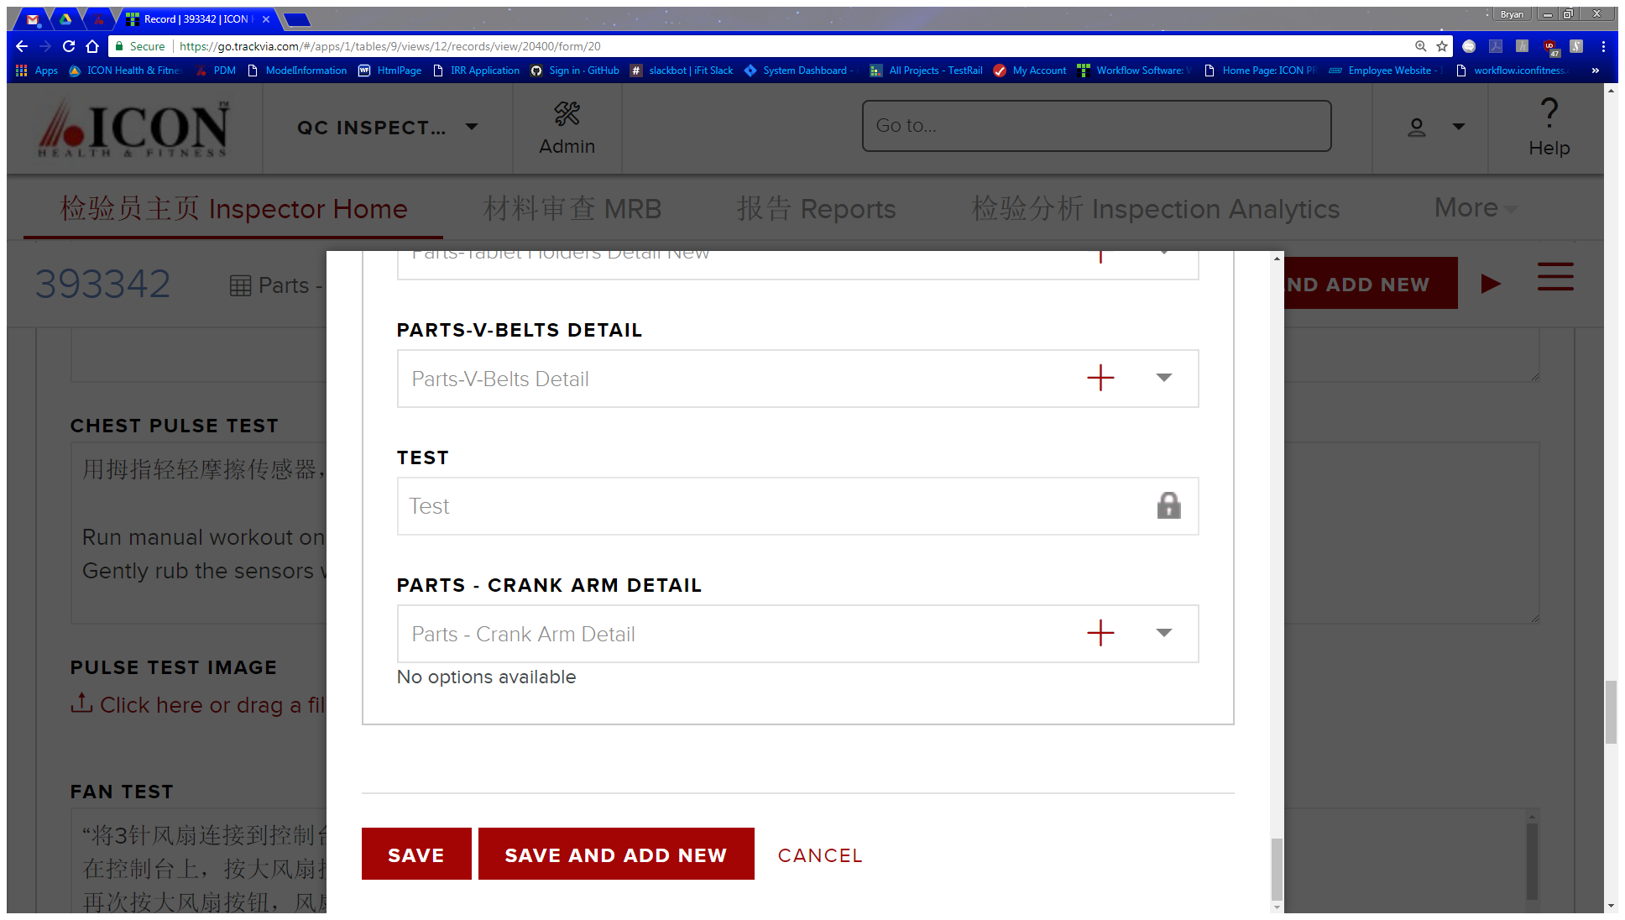
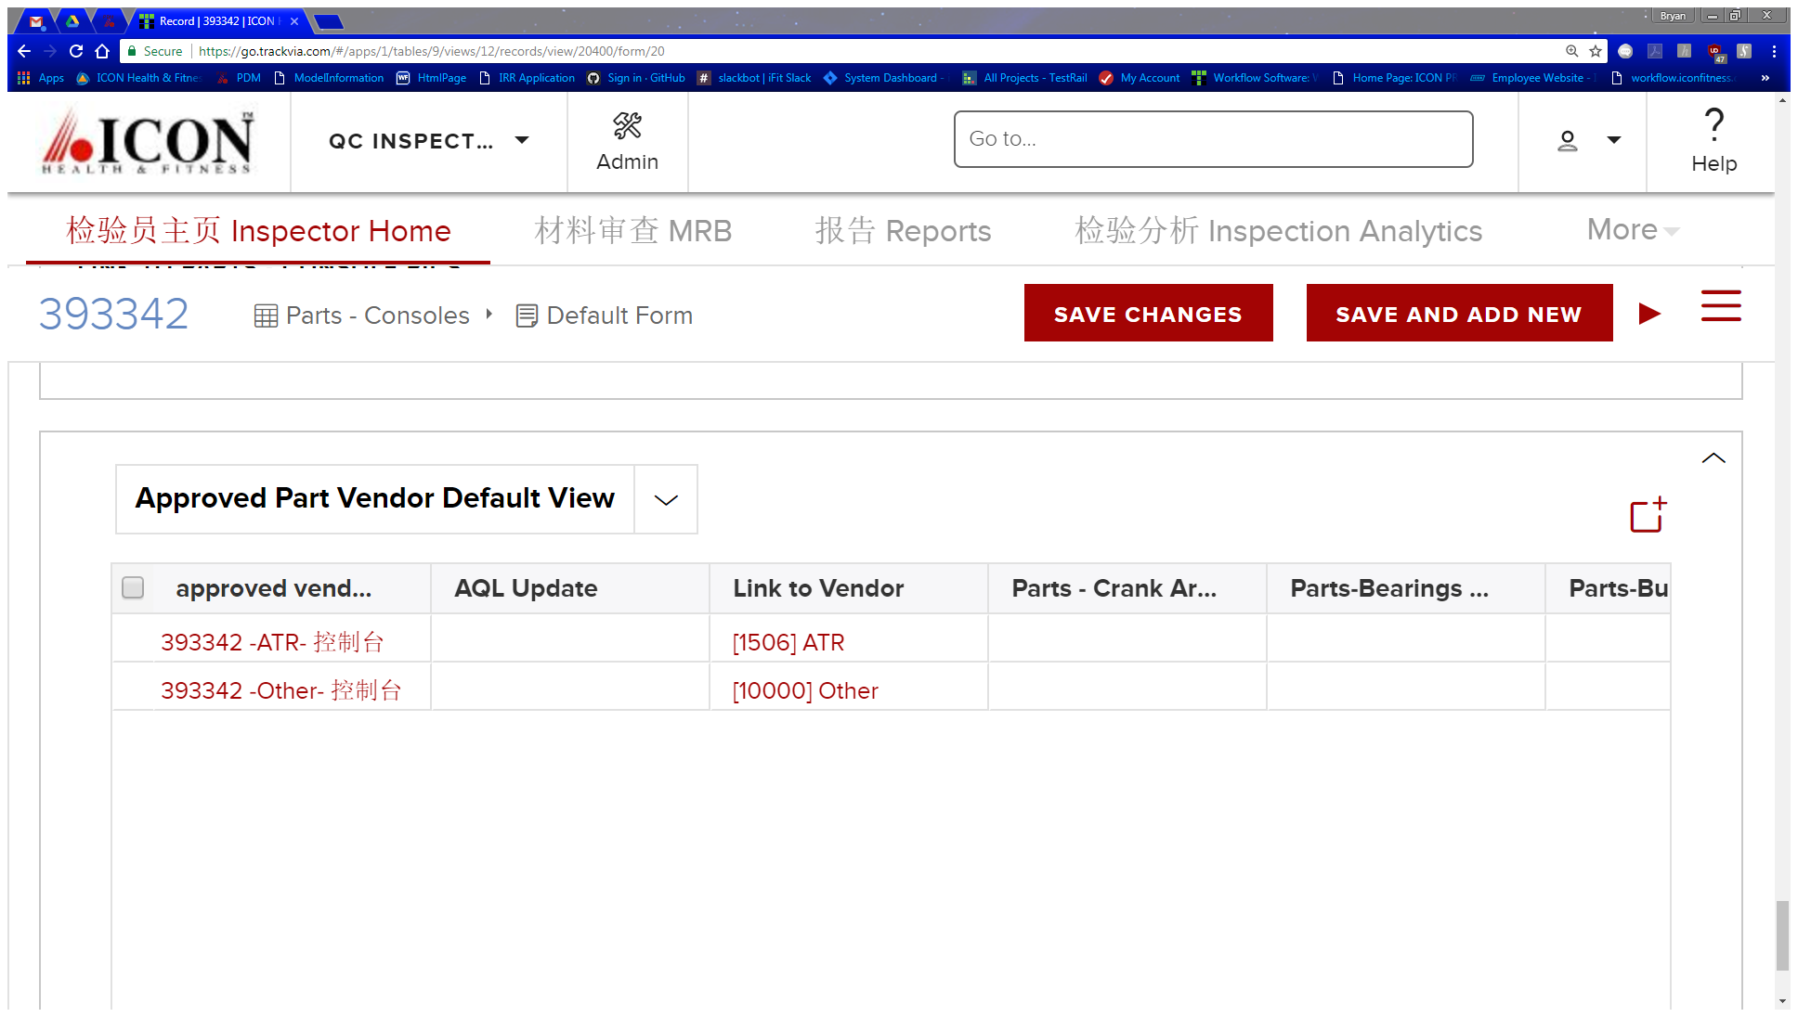
APPROVE VENDOR CONT.
Add “Other” as second vendor as per previous steps
Click SAVE
At the top of screen click SAVE CHANGES

