Slide 1
Character-Level Bangla Text-to-IPA Transcription Using Transformer Architecture with Sequence Alignment
Team
Presented By
phoneme
Jakir Hasan
Shrestha Datta
Ameya Debnath

Slide 2
Introduction
Dataset Analysis
Outline
Methodology
Result
Future Scope

Slide 3

Introduction
Bangla text-to-ipa transcription is the process of converting Bangle text into International Phonetic Alphabet (IPA) notation.
Transformer architecture has gained huge popularity for solving different NLP tasks including machine translation.
In our work, we have trained transformer model with sequence alignment for Bangla text-to-ipa transcription in character-level.

Slide 4
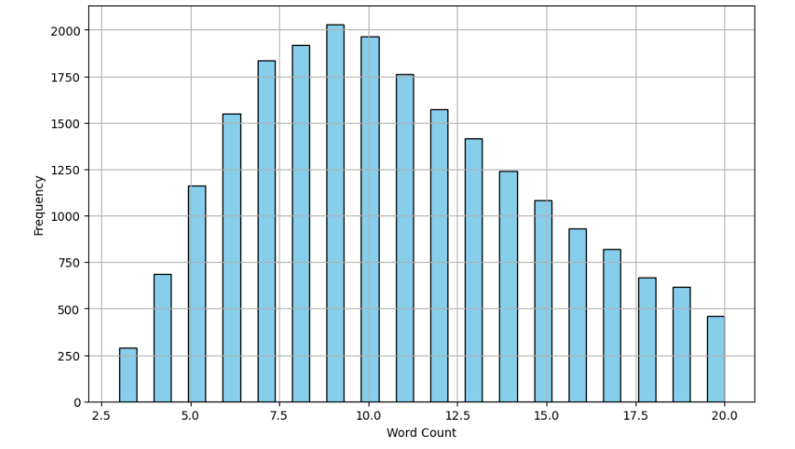
Dataset Analysis
Text column of firstly provided training dataset contains foreign characters along with Bengali characters but these foreign characters are ignored in IPA transcription.
Except 7 sentences all of the the sentences of text column and IPA column have equal number of words in the training dataset.
Test dataset contains Bengali numerals but training dataset doesn’t contain any Bengali numeral.
In the training dataset, the maximum length of a word in the text column is 31, and in the ipa column, it is 34. The maximum length of a word in the text column of the test dataset is 36

Slide 5

Methodology
Direct Mapping
Transformer Model
Foreign Characters Elimination
Sequence Alignment
Number Handling

Slide 6
Direct Mapping
In the training set almost all the Bengali text and its corresponding IPA has equal number of words.
IPA representation of Bengali words remain same in different (or all?) sentences.
Create a dictionary where key is every distinct Bengali word and value is its IPA representation.
এরপরও তারা বকেয়া পরিশোধ করেনি।
eɾpɔɾo t̪ɐɾɐ bɔkeʲɐ poɾɪʃod̪ʱ kɔɾenɪ।

Slide 7
Transformer Model
Represent word and IPA pairs as sentences consisting of individual characters without changing relative order of characters.
বাড়ি, bɐɽi
'ব া ড় ি ' 'b ɐ ɽ i'
Perform machine translation in character-level using a lightweight transformer model having single encoder and decoder layer.
Vocabulary is adapted from training set and its size is 125.
The model is trained for 50 epochs with a learning rate of 0.001 and batch size of 64 with mini-batch approach

Slide 8
Foreign Characters Elimination
In the IPA transcription of Bengali text foreign characters are eliminated.
A vocabulary of all Bengali characters, punctuations and symbols is created with consideration of some irregularities.
Characters which are not present in this Bengali vocabulary list are eliminated in the IPA transcription.
FAO-এর
-eɾ

Slide 9
Sequence Alignment
Generates tokens by splitting words with positional and category informations.
IPA representation is generated by the model for only the tokens of category Bengali (BN) and token list is updated with that value and other tokens remain same.
Finally token list is merged for generating the transcription of the initial word.

Slide 10
Sequence Alignment (Cont.)
Can handle word with bigger length which potentially cause incorrect prediction in character-level translation and efficiently handle the characters which are not seen in the training set.
Finally token list is merged for generating the transcription of the initial word.
Word: ‘(কৃষিবিদ্যা/প্রাণিবিদ্যা/উদ্ভিদবিদ্যা)।’
Token List: [‘(‘, ‘কৃষিবিদ্যা’, ‘/’, ‘প্রাণিবিদ্যা’, ‘/’, ‘উদ্ভিদবিদ্যা’, ‘)।’]
Category : [‘EXT’, ‘BN’, ‘EXT’, ‘BN’, ‘EXT’, ‘BN’, ‘EXT’]
Updated token list: [‘(‘, ‘kɾiʃibid̪d̪ɐ’, ‘/’, ‘pɾɐnibid̪d̪ɐ’, ‘/’, ‘ud̪bʱid̪bid̪d̪ɐ’, ‘)।’]
IPA: ‘(kɾiʃibid̪d̪ɐ/pɾɐnibid̪d̪ɐ’/ud̪bʱid̪bid̪d̪ɐ)।’

Slide 11
Number Handling
Using previously mentioned sequence alignment approach we generated tokens representing Bengali numbers.
Bengali numbers are then converted into word representation and IPA representation is generated.
But, in this approach word error rate increases significantly, so we ultimately replaces Bengali digits with empty strings.

Slide 12
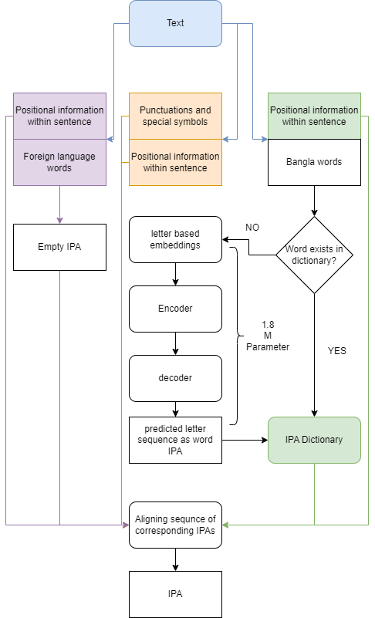
System Architecture

Slide 13
Results
Approach | Word Error Rate (%)
Direct mapping | 20.48
Punctuations and English letters handling | 11.41
Bengali numerals handling | 13.43
All foreign symbols handling | 10.58

Slide 14
Future Scope
Investigating correct word representation of Bengali numerals on different contexts as alternative representations commonly used.
Preparing annotated dataset of Bengali single and double digit numbers as they are the basis of forming bigger numbers.
To preserve contextual informations training another model in sentence level in case a sentence have Bengali numerals.

Slide 15
THANK YOU!

