Slide 1
CNN-Based Image Analysis for Malaria Diagnosis
1
Authors: Zhaohui Liang, Andrew Powell, Ilker Ersoy, Mahdieh Poostchi, Kamolrat Silamut, Kannappan Palaniappan, Peng Guo, Md Amir Hossain, Antani Sameer, Richard James Maude, Jimmy Xiangji Huang, Stefan Jaeger, George Thoma.
Presented by
Jakir Hasan
Golam Mostafa Naeem
BSc. Computer Science & Engineering
Shahjalal University of Science & Technology

Slide 2
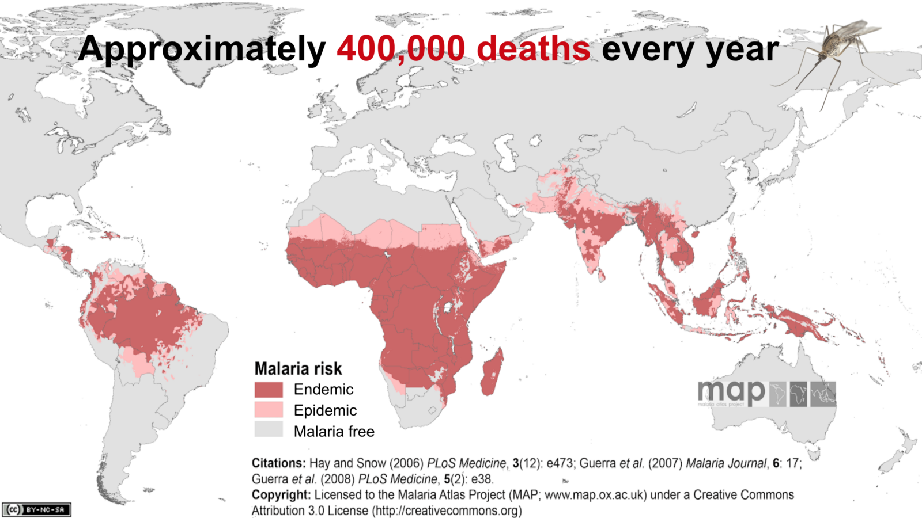
What is Malaria?
2
Malaria is a life-threatening disease caused by parasites that are transmitted to people through the bites of infected female Anopheles mosquitoes.

Slide 3
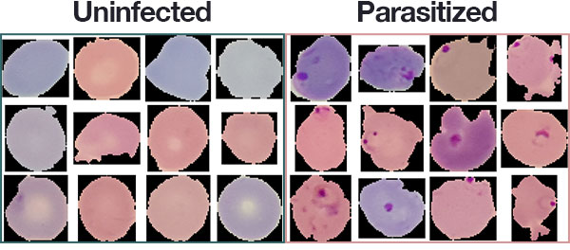
Current Diagnostic Methods
Malaria pathogens infiltrate the human erythrocytes and can be detected by examining parasite-infected red blood cells.

Slide 4
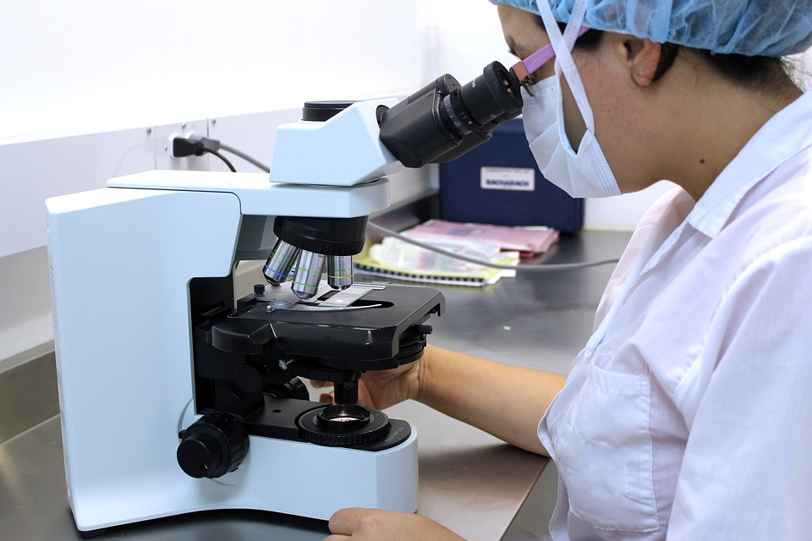
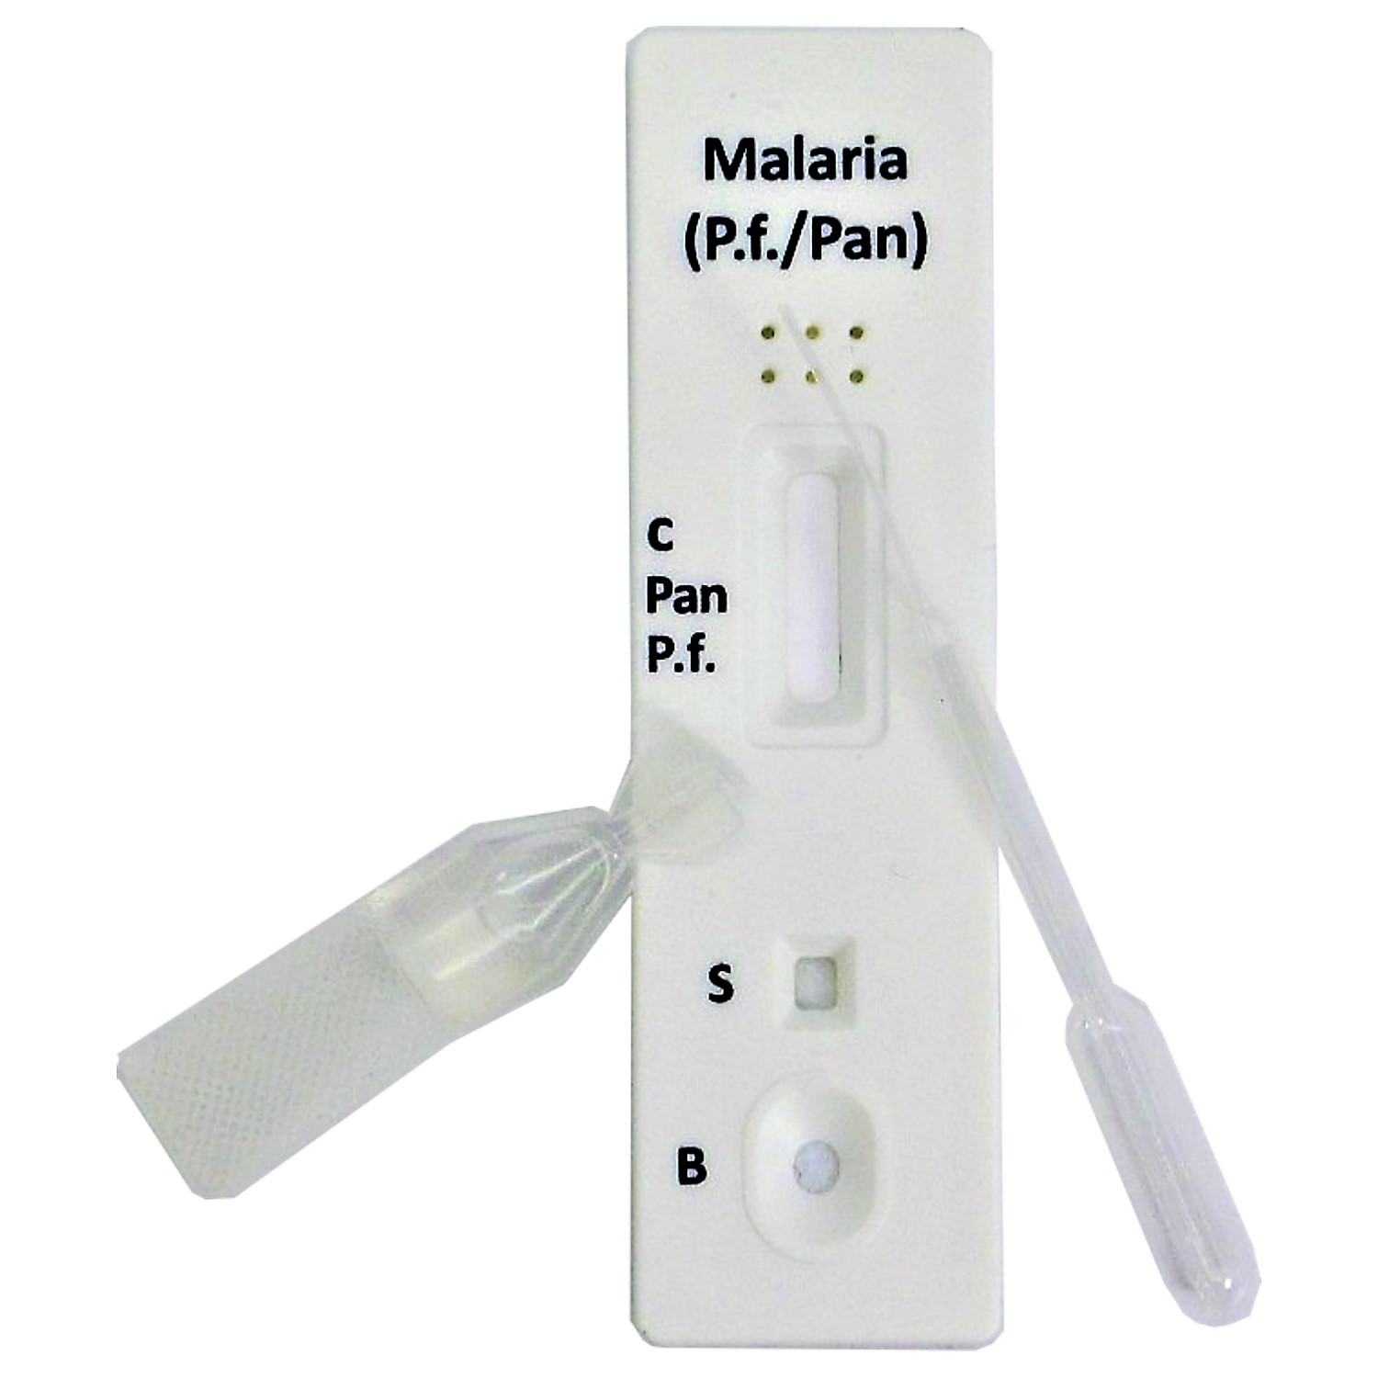
Current Diagnostic Methods (contd.)
4
Microscopy
Inefficient and dependent on the expertise of microscopist
Rapid Diagnostic Test(RDT)
Expensive
Provide less information than microscopy

Slide 5
Problem Context
5
How can we reduce the wait time and improve the sensitivity and specificity of the malaria diagnostic process?
Automatic image recognition based on Machine Learning!
This study proposes a new and robust machine learning model based on a convolutional neural network (CNN) to automatically classify single cells in thin blood smears on standard microscope slides as either infected or uninfected.

Slide 6
Related Work
6
Automatic Malaria Blood Smear Classification.
Automatic image recognition technologies based on machine learning and big data have been applied to both thick and thin malaria blood smears for microscopic diagnosis since 2005.
Convolutional Neural Network(CNN) Application.
A convolutional neural network (CNN) is a specific deep learning architecture suitable for image recognition, CNN classifier has performed exceptionally well under limited computational resources giving an accuracy of 95%.

Slide 7
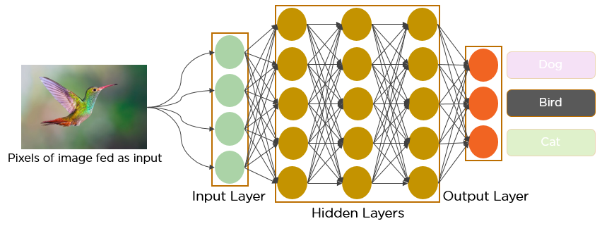
Configuration of a Convolutional Neural Network
Deep Learning applies a multi-layer network to map the input space by transforming it at the hidden nodes.

Slide 8
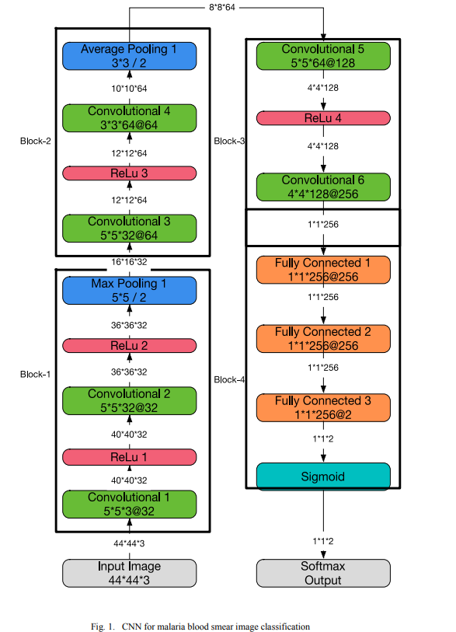
Configuration of a Convolutional Neural Network
Learning of a CNN model consists of feed-forward and back-propagation computation.
17-layer CNN model is applied for malaria blood smear classification.

Slide 9
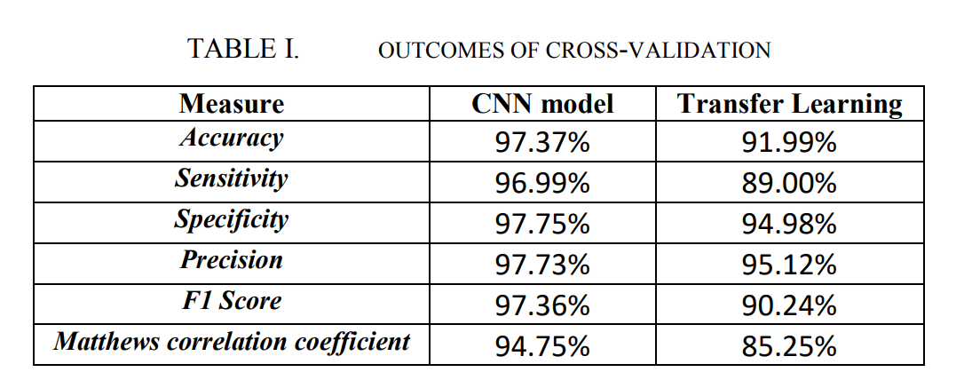
Model Evaluation
The dataset contains 27578 erythrocyte images.
The infected and uninfected image ratio is 1:1
Ten-fold cross-validation is applied to the whole dataset.
To train and evaluate the CNN model 90% of images are used for training and 10% for testing
The average classification accuracy of the model is 97.37%

Slide 10
Conclusions and Discussions
The significance of the study of this paper is to propose a new and robust machine learning model based on a convolutional neural network (CNN) to automatically classify single cells in thin blood smears on standard microscope slides as either infected or uninfected.
Compared to Transfer Learning model, the CNN model shows much better classification performance after training with more than 27,000 images and it is scalable.

Slide 11
THANK YOU
11

