Slide 1

2023 LOAN DISBURSEMENT AND SETTLEMENT

Slide 2
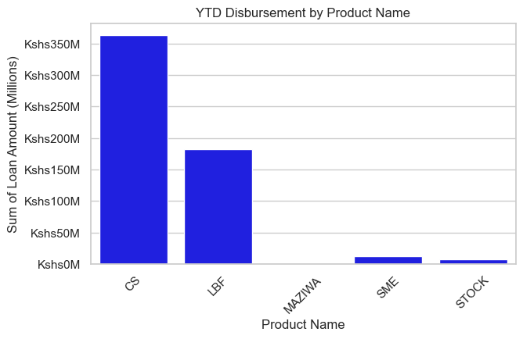
2023 YTD Loan Disbursement per Product
In 2023 the 5 products performed differently in terms of value of loan disbursed, CS closed the year at 364M,LBF 182M,SME 12M, Stock 8M and finally Maziwa at 0.3M.
From the below graphical representation,a lot of effort needs to be invested in Maziwa,SME and stock if they are o improve their numbers in 2024.

Slide 3
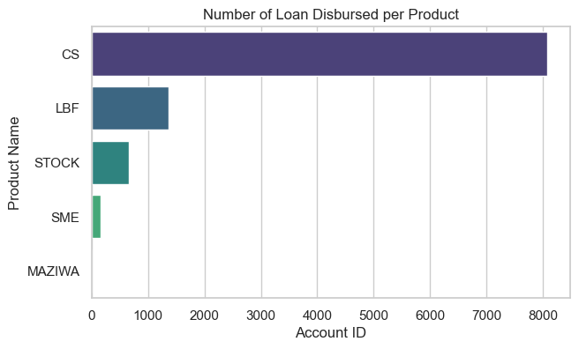
2023 YTD Number of Loans Disbursed per Product
Looking at total number of loans disbursded in 2023,CS product registered the higest count,8.1K, LBF had 1.4K accounts disbursed,Stock 667 while SME and Maziwa had 165 and 10 accounts disbursed respectively.

Slide 4
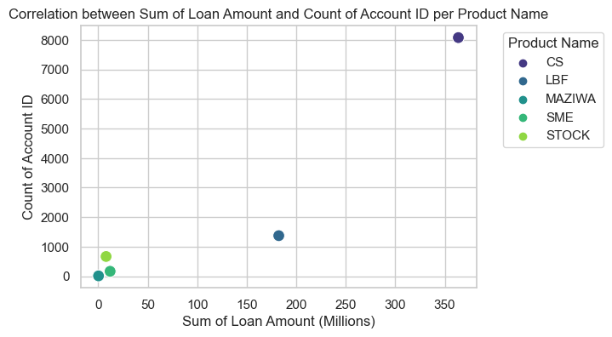
2023 Value of Loans Disbursed vs Count
The graphical representation below shows existence of a postive correlation between number of loans dibursed and value . As the number of accounts disbursed increases, the total sum of loans disbursed also increases.

Slide 5
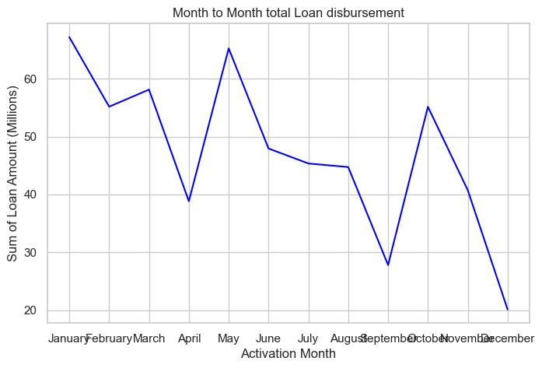
2023 Month to month sum of loan amount dsbursed trend
High demand for money in January, driven by back-to-school and new high school intake, resulted in the largest volume of loan disbursals. However, subsequent fluctuations were observed due to changes in consumer behavior influenced by new taxation, reducing disposable income and eligibility for loans.

Slide 6
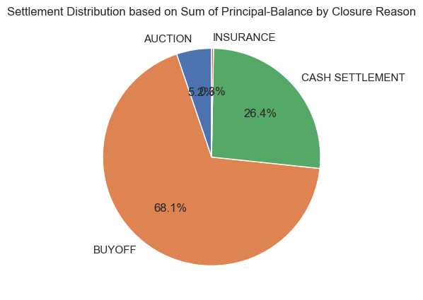
Loan settlement Distribution Based on Closure/settlement Reason
Of the total value of settled loans, 68% involved buyoffs by other institutions, 26% comprised cash settlements from clients, 5% occurred through auctions, and 1% was facilitated through insurance.

Slide 7
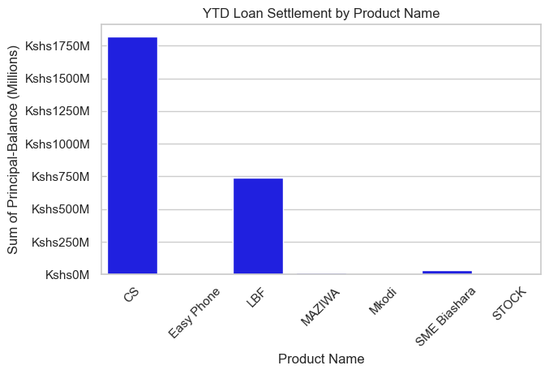
2023 Loan settlement per product
As a business, we had a bad year across all the products as far as loan settlement is concerned with the exception the SME products (SME biashara,Mkodi,Maziwa and Stock).
CS and LBF registered the highest settlement in history .Annual settlement to disbursement ratio for the 2 products was greater than 100% looking at annual settlement vs annual disbursement for the year ending 2023

Slide 8
Policy Recommenation
Loan Disbursement
Urgent need for diversification inorder to remain competative in the continuosly changing market.Consider carrying out a market research to identify what other items can we offer when demand for money decreases.
Market visibility: Opening of more branches in strategic location in order to boost our visibility and coverage thus we will be able to tap the untapped markets
Growth of sales force: With the proposed opening of new branches, it is also essential to grow our sales team through recruitment and make their remunaration package more attractive as compared to our competitors’.
Loan Settlement
Review of our our loan settlement process: The loan settlement process needs to be reviewed and proper measures put in place to curb any misconduct that may be triggering the huge settlement.
Grow new business book: Grow new business book by targeting newly employed staff and business owners thus growing our book.
Introduction of a lucrative portfolio growth incentive: This will motivate the sales team interms of client base growth and retention thus boosting the overall book growth

Slide 9

THE END

