Slide 1

Metrolinx REAM Analyst Case Study
Portfolio Performance Analysis & Strategic Recommendations
Xiao(Jake) Ma • April 2025

Slide 2
✅ Objective
Looked at property performance using occupancy, financials, satisfaction, and ops data
Flagged underperformers based on benchmarks and internal results
Suggested what to do: acquire, hold, renovate, or sell
Showed how I approached each question — with methods and visuals
Metrolinx REAM – April 2025

Slide 3
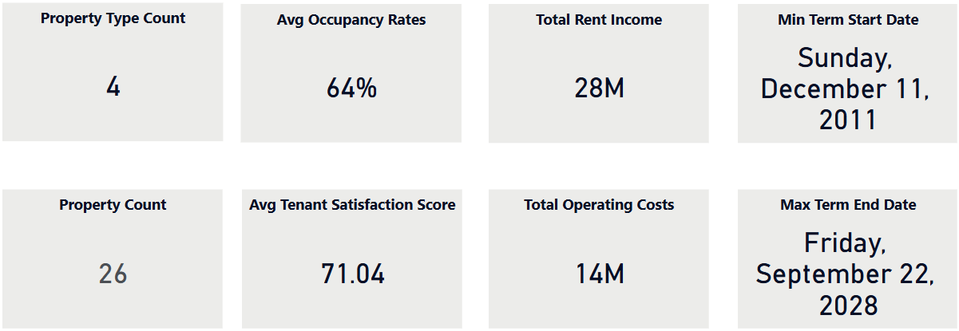
📊 Data Preparation & Summary
Data preparation included:
Verified dataset contains 26 unique properties across 4 types
Standardized date formats and numerical fields
No missing or duplicate values found
Created new fields: ROI, Net Income, Years Since Renovation
Performed integrity checks across satisfaction, occupancy, and financials
Metrolinx REAM – April 2025

Slide 4
1. Underperforming Properties (Occupancy)
Created a calculated column in Power BI for Occupancy Rate = Occupied Area / Total Area
Set industry benchmark thresholds by property type: Office: 85%, Residential & Retail: 90%, Industrial: 95%
Defined underperforming as properties below 70% of their industry benchmark, to highlight only the most critical gaps
Identified properties falling below their benchmark using filter
Added benchmark lines to the visual for quick comparison
Metrolinx REAM – April 2025

Slide 5
📚 Reference
Colliers Toronto Office Report (Q4 2024)
Marcus & Millichap Retail Report (2025)
Colliers National Snapshot Report(Q4 2024)
City of Toronto Rental Housing Plan
Metrolinx REAM – April 2025

Slide 6
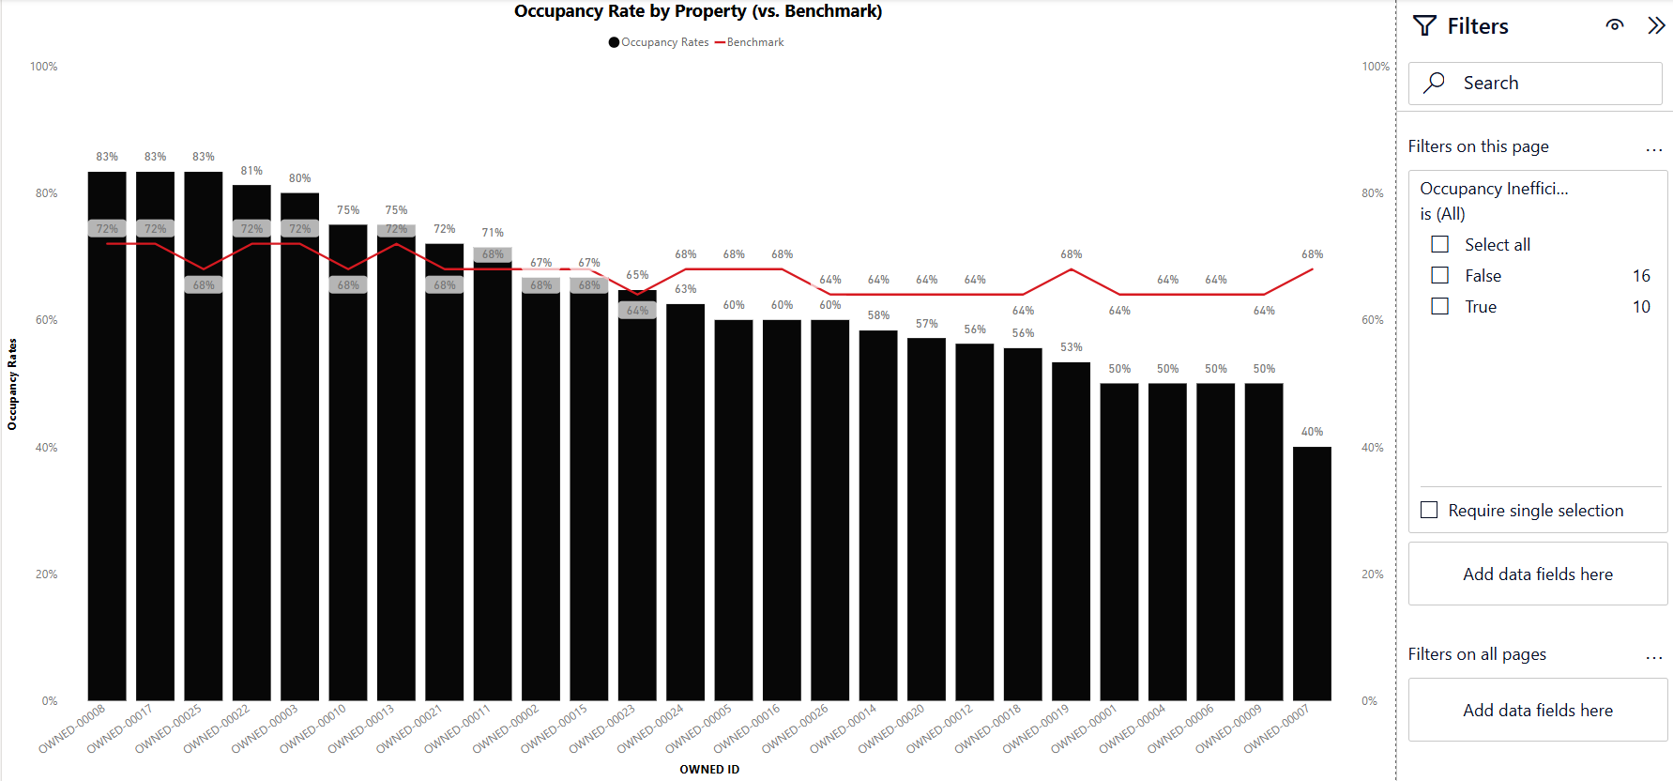
Occupancy Rate by Property vs. Internal Benchmark
Metrolinx REAM – April 2025

Slide 7
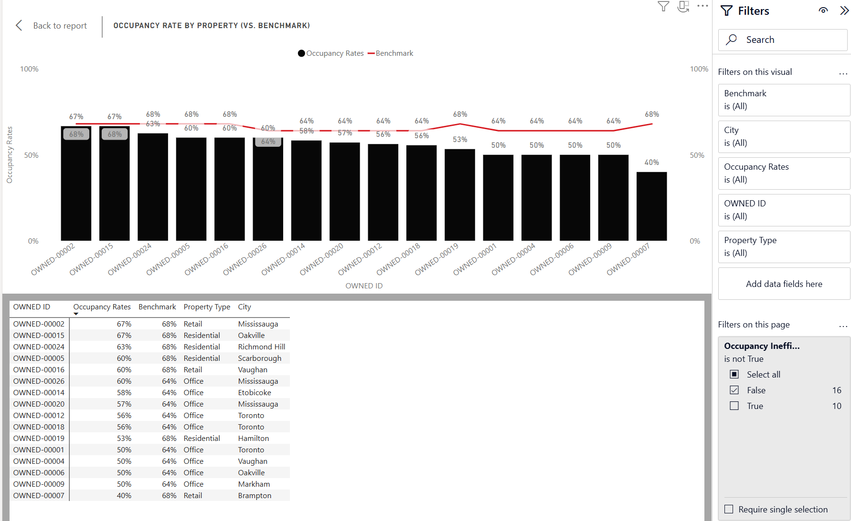
Underperforming Properties
Metrolinx REAM – April 2025

Slide 8
2 & 3. What’s Driving Low Occupancy?
Used a scatter plot to map occupancy rates against tenant satisfaction, with bubble size based on property age
Created a bar chart showing average occupancy by satisfaction groups
Added a grouped bar chart to compare occupancy by years since renovation
Built a matrix to show occupancy rates across satisfaction levels by property type
Metrolinx REAM – April 2025

Slide 9
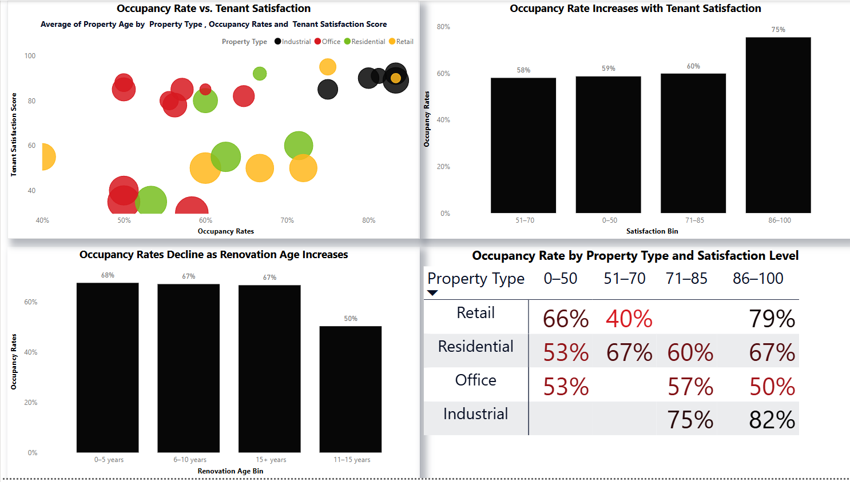
📉 Low Occupancy Drivers: Satisfaction & Renovation Age
Tenant satisfaction scores (especially below 70) are associated with significantly lower occupancy rates
Older renovations (11–15 years) correspond with the lowest average occupancy (~50%)
Property types like Retail and Residential are more sensitive to satisfaction drops — as shown in the matrix
Metrolinx REAM – April 2025

Slide 10
📌 Recommendation
Focus on improving satisfaction and updating older properties, particularly in Retail and Residential sectors. These properties show the strongest link between tenant experience and occupancy performance
📈 Tenant Satisfaction Drives Occupancy.
Metrolinx REAM – April 2025

Slide 11
4. Operating Costs vs. Rent
Calculated Operating Cost Ratio = Operating Costs / Rent Income
Applied benchmark thresholds by property type:
Office: 55%
Retail: 30%
Residential: 45%
Industrial: 25%
Created a bar + line chart to highlight properties above their target cost ratios
Flagged those assets as “Cost Inefficient” using DAX
📚 Reference:
BullpenRE:operating expense ratio in real estate
Metrolinx REAM – April 2025

Slide 12
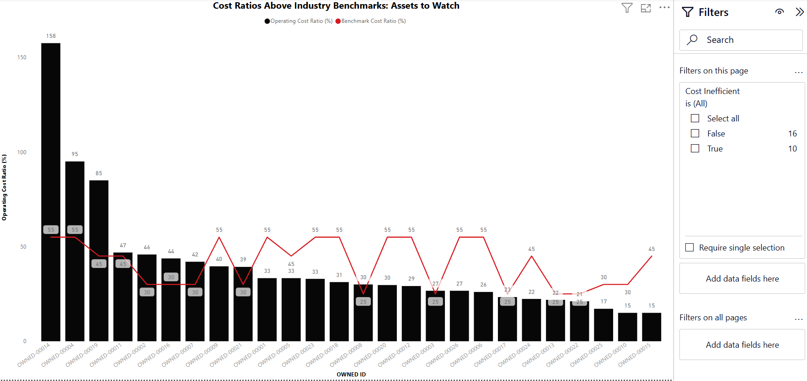
Operating Cost Ratios by Property vs. Industry Benchmarks
Metrolinx REAM – April 2025

Slide 13
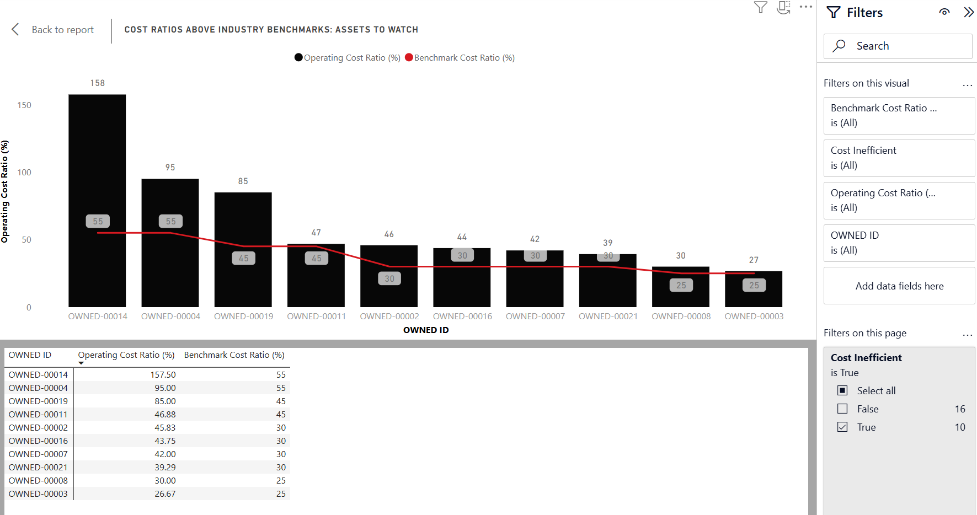
📊 What the Visual Shows
10 properties are operating above their benchmark thresholds - meaning costs are higher than income. These assets stand out as financially inefficient, regardless of occupancy
Metrolinx REAM – April 2025

Slide 14
5. Highest ROI Properties
Calculated Return on Investment (ROI) using: ROI = Net Income / Capital Expenditures
Created a scatter plot to explore the relationship between tenant satisfaction and ROI
Compared additional drivers (CapEx, occupancy, satisfaction) across property types using stacked visuals
Linked findings back to Q2/Q3 to show how operational drivers (satisfaction, age, occupancy) ultimately influence ROI
Metrolinx REAM – April 2025

Slide 15
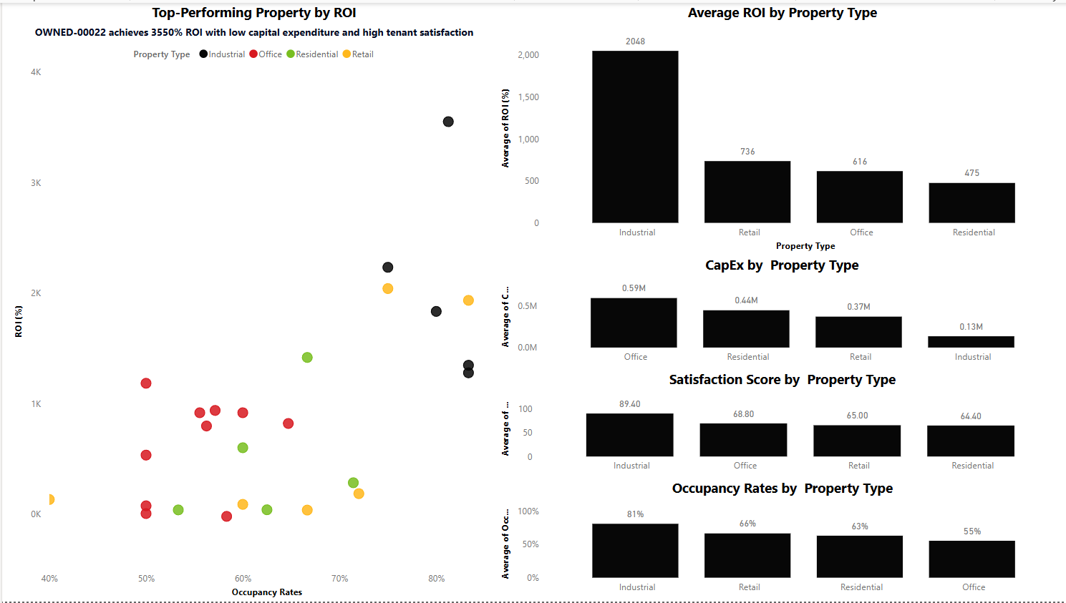
Return on Investment (ROI) Performance and Key Drivers I
Metrolinx REAM – April 2025

Slide 16
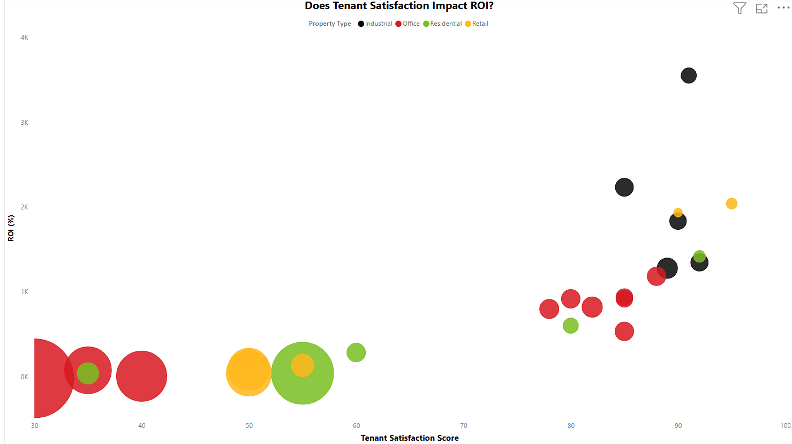
Return on Investment (ROI) Performance and Key Drivers II
Metrolinx REAM – April 2025

Slide 17
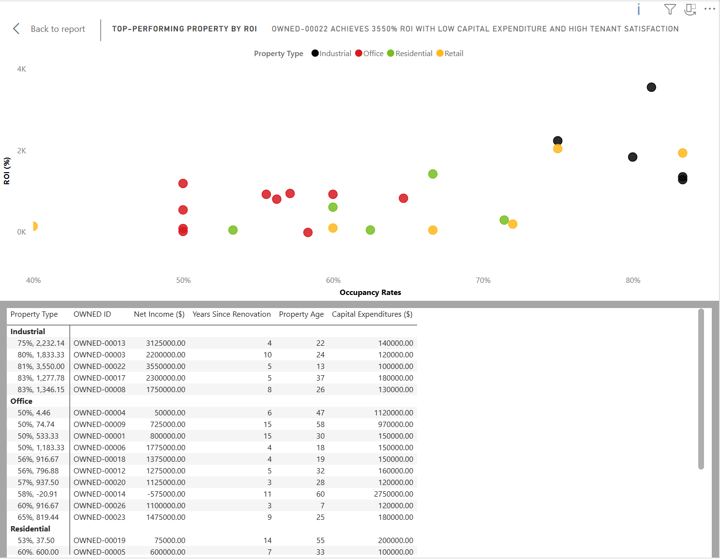
📊 What the Visuals Show
OWNED-00022 (Industrial) is the top performer with 3550% ROI, Driven by low capital expenditure and high tenant satisfaction
Industrial properties overall have the highest average ROI (~2048%)
Office and Residential properties show lower ROI averages, despite higher property count
Metrolinx REAM – April 2025

Slide 18
🧠 Drivers of ROI Differences
ROI is positively influenced by:
Lower capital expenditures
Higher tenant satisfaction
Occupancy rates >70%
Property type matters: Industrial outperforms due to cost efficiency and stable tenants
Metrolinx REAM – April 2025

Slide 19
6. Optimizing Strategy
Created a summary matrix comparing:
Average ROI
Average Capital Expenditure (CapEx)
Average Tenant Satisfaction
Added a recommendation logic using DAX based on thresholds:
[ROI] > 1000 AND [Satisfaction] > 80 AND [CapEx] < 300000, "✅ Acquire More",
[ROI] > 800 OR [Satisfaction] > 85, "🟡 Monitor for Opportunity",
[ROI] < 500 AND [CapEx] > 400000 AND [Satisfaction] < 70, "❌ Consider Selling",
"⚪ Hold / Monitor"
Metrolinx REAM – April 2025

Slide 20
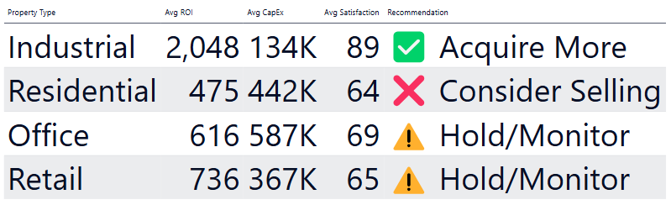
Property Type Recommendation Matrix
Metrolinx REAM – April 2025

Slide 21
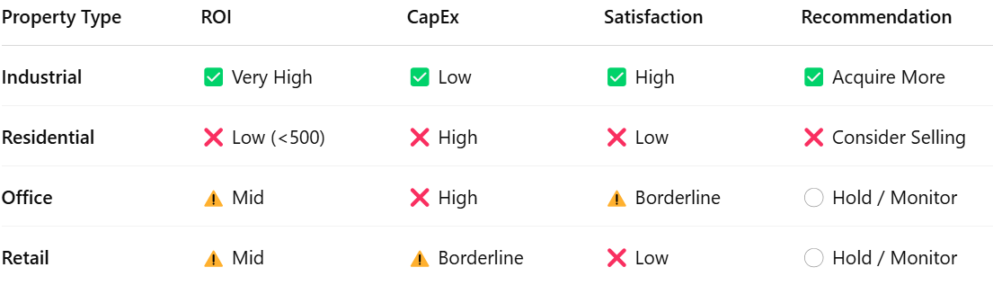
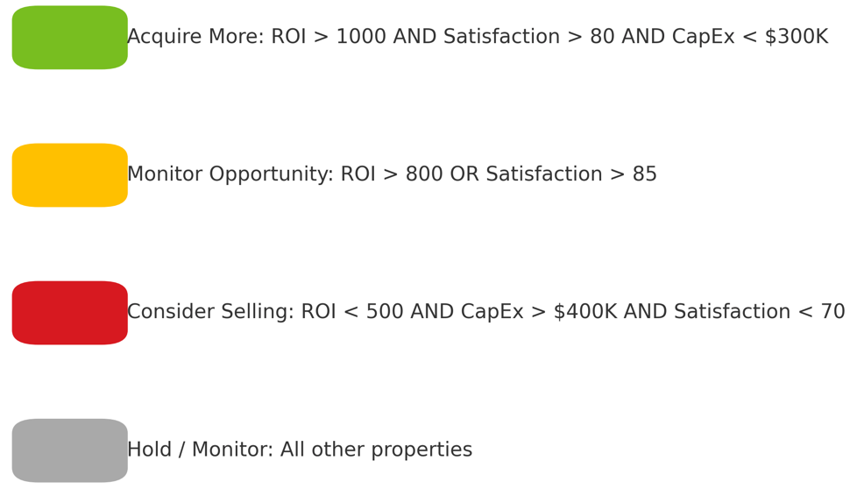
6. Optimizing Strategy
Metrolinx REAM – April 2025

Slide 22
✅ Final Recommendations I
✅ Industrial – Acquire More
Consistently delivers very high ROI (2048%), with low capital expenditure ($134K) and excellent tenant satisfaction (89).
This category is performing on all fronts — it's cost-efficient, profitable, and well-received by tenants.
Recommend expanding holdings or prioritizing similar industrial investments.
❌ Residential – Consider Selling
Has low ROI (475%), high CapEx ($442K), and poor tenant satisfaction (64).
This asset type is underperforming across all key indicators, suggesting misalignment with portfolio goals.
Explore divestment or redevelopment options to reduce sunk cost and reallocate capital.
Metrolinx REAM – April 2025

Slide 23
✅ Final Recommendations II
⚪ Office – Hold / Monitor
Moderate ROI (616%), but very high CapEx ($587K) and only borderline satisfaction (69).
Performance is mixed; the ROI is not bad, but costs are high, and tenant sentiment is uncertain.
Monitor for shifts in market or operational performance. Consider future renovation or optimization.
⚪ Retail – Hold / Monitor
ROI is better than residential (736%), CapEx is moderate ($367K), but satisfaction remains low (65).
Could be improved with better tenant experience or smarter investment — but not a strong case to expand or divest yet.
Maintain holdings but assess tenant needs or modernization potential.
Metrolinx REAM – April 2025

Slide 24
❓ What I would do next
Validate ROI and satisfaction trends over time to catch volatility
Explore specific high-ROI and low-satisfaction assets for hidden risk
Interview tenants in low-performing properties to confirm survey data
Layer in market rent benchmarks for deeper pricing insight
Build dashboard for ongoing asset health monitoring
Metrolinx REAM – April 2025

