Slide 1




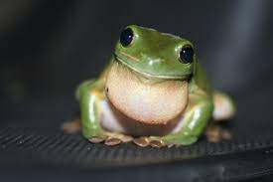


Back End Database Connection
QA/QC
Query, Analyze, and Develop Manuscript with Quarto Document
Author 1
Reproducible results in Happy Healthy Frogs
Push
Pull
Seamless Collaboration
Author 2
Push
Pull
Publish the entire Reproducible Repository

