Slide 1
Data Management Agenda
Topic: Connecting and Interacting with the RIBBiTR data base
DBeaver
Rstudio
RIBBiTR Web App!
Meeting Time and Future Topics

Slide 2
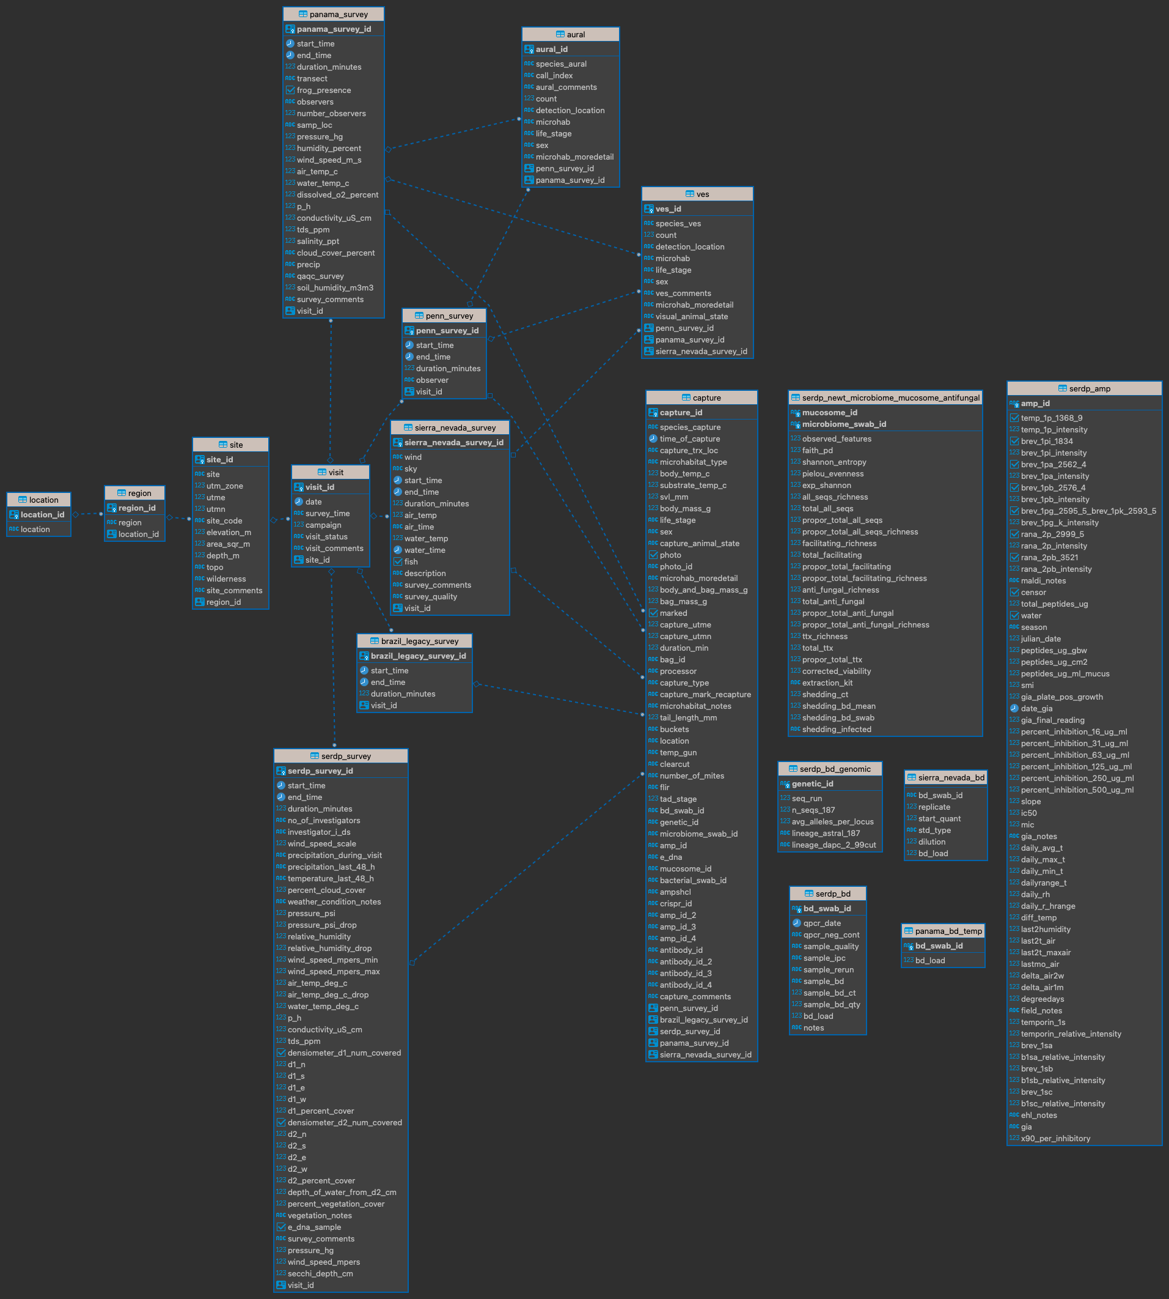
Old ‘survey_data’ Schema

Slide 3
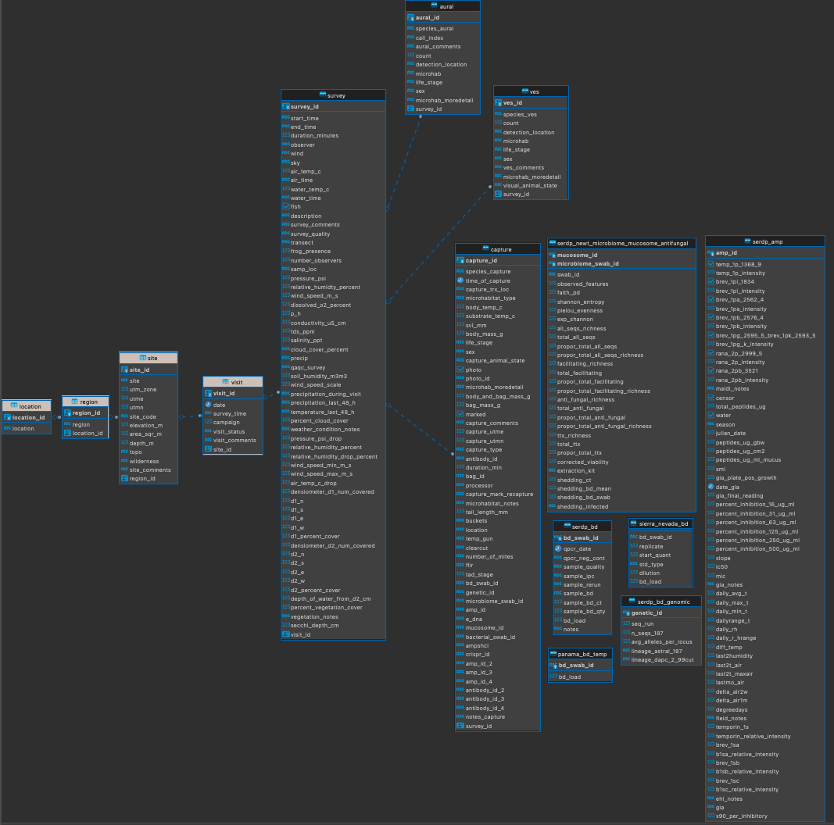
New ‘survey_data’ Schema

