Slide 1
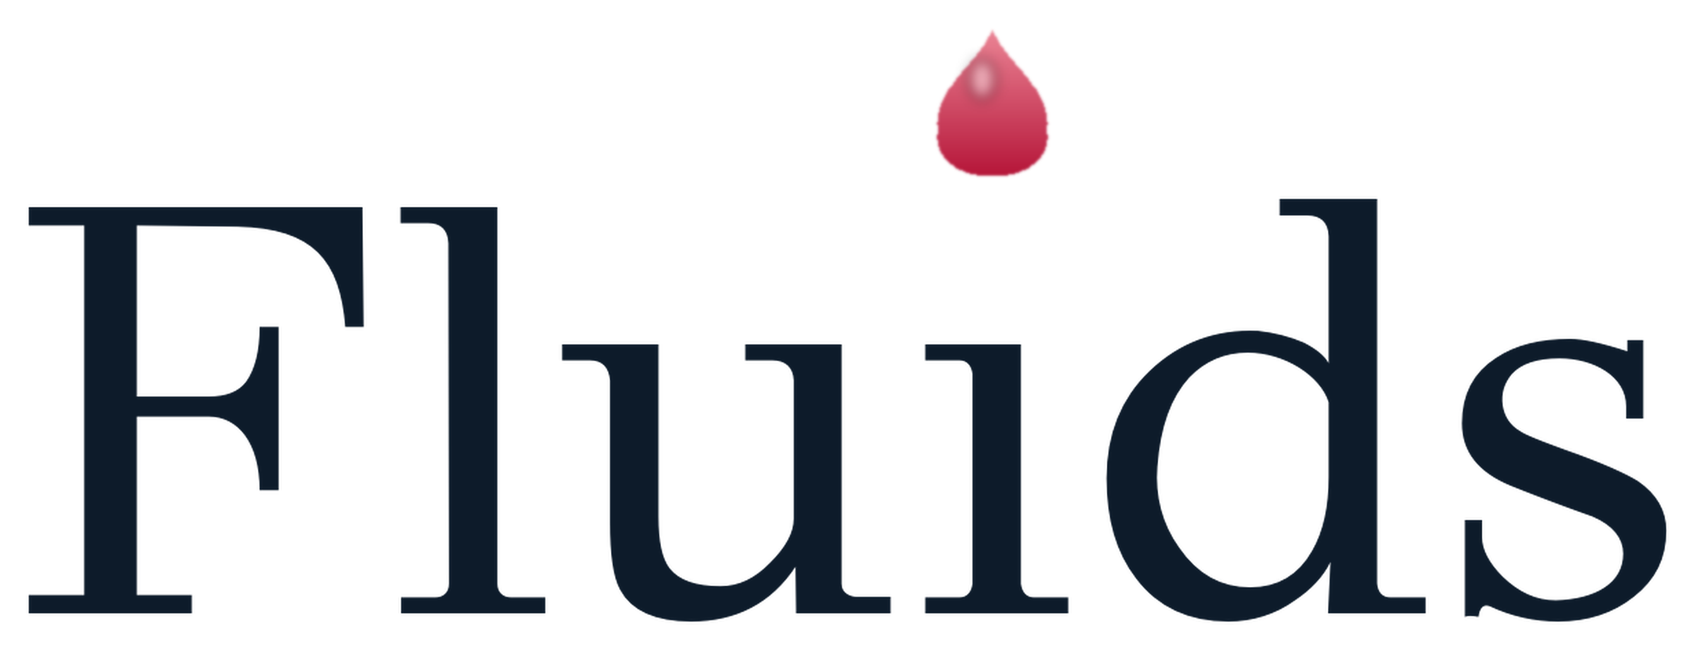
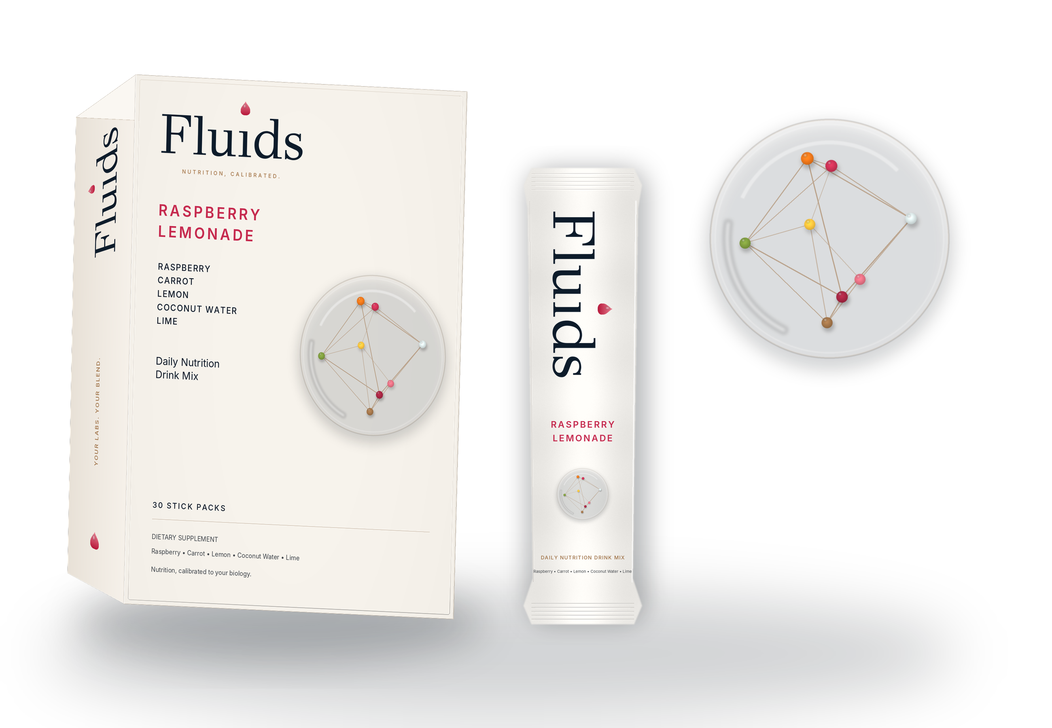
PRE-SEED INVESTOR OVERVIEW
The product family hiding inside bloodwork.
Fluids ran our model across NHANES to turn routine labs into nutrient vectors, standard function blends, and personalized daily drink mixes.
NHANES-informed whole-food drink mix
Standard menu. Custom upgrade.
01
Notes:
Opening thesis: Fluids is not guessing at wellness SKUs; the model discovers the product family from bloodwork.
[Sources]
- Internal NHANES product run, July 2026
- Internal population pitch insights, July 2026

Slide 2

PROBLEM
Health data has outpaced nutrition.
Current consumer journey
1
Bloodwork
↓
high signal
2
Report
Consumers can measure more than ever. But after a blood test, the daily action is still generic: supplement shelves, broad advice, and products that do not reflect the person in front of them.
↓
low actionability
3
Supplements
↓
generic choice
4
Behavior
low adherence
The gap is turning health signal into a product someone can understand, drink, and repeat.
02
Notes:
Keep the problem simple: bloodwork has become available, but product behavior has not caught up.
[Sources]
- Internal Fluids product narrative.

Slide 3
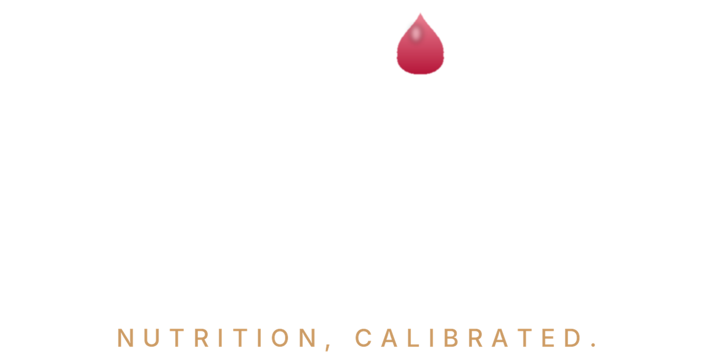
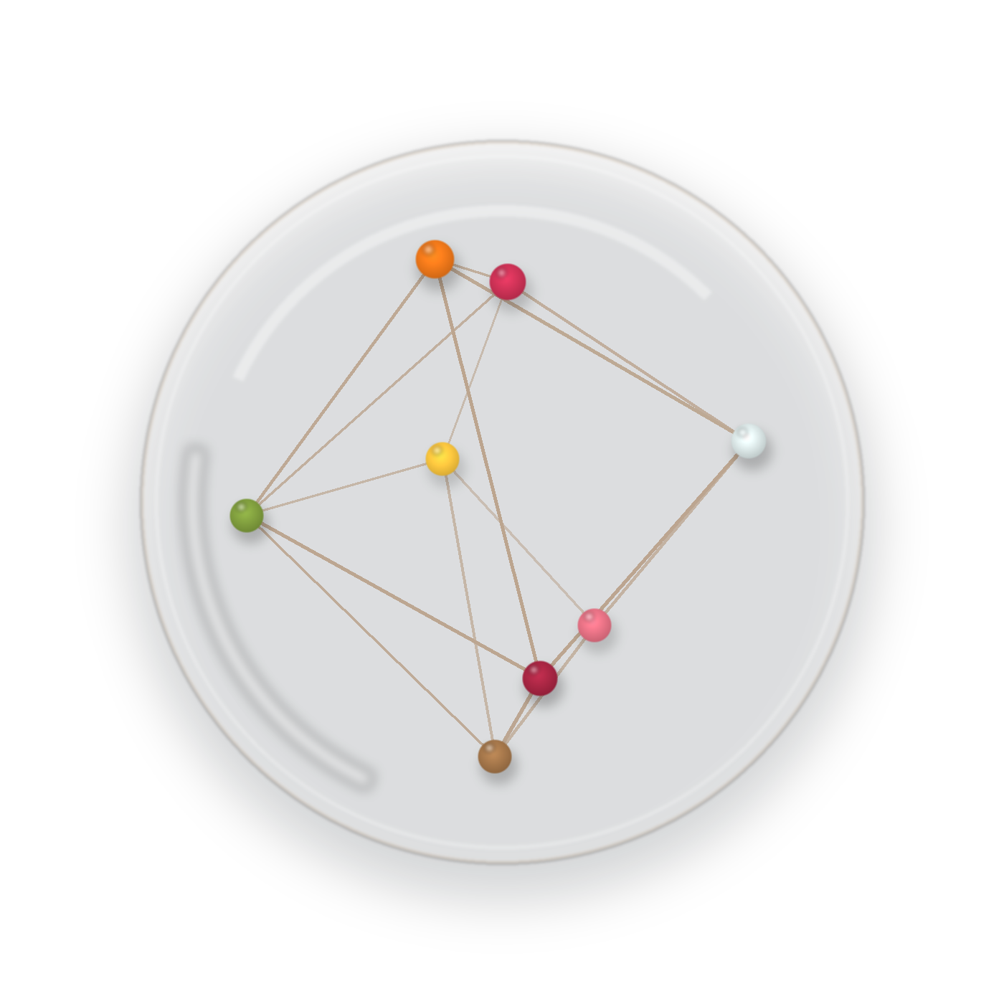
CORE INSIGHT
The nutrient vector is the interface.
A blood test should not map straight to a pill shelf. It should map to a nutrient direction, then to a product-realistic formula that can be made and used daily.
The model translates messy biomarker inputs into a formulation target that a consumer can actually act on.
Biomarkers -> nutrient vector -> standard or custom blend
03
Notes:
This slide defines the core abstraction: labs do not equal a SKU; labs produce a vector.
[Sources]
- Internal product decision layer, July 2026

Slide 4
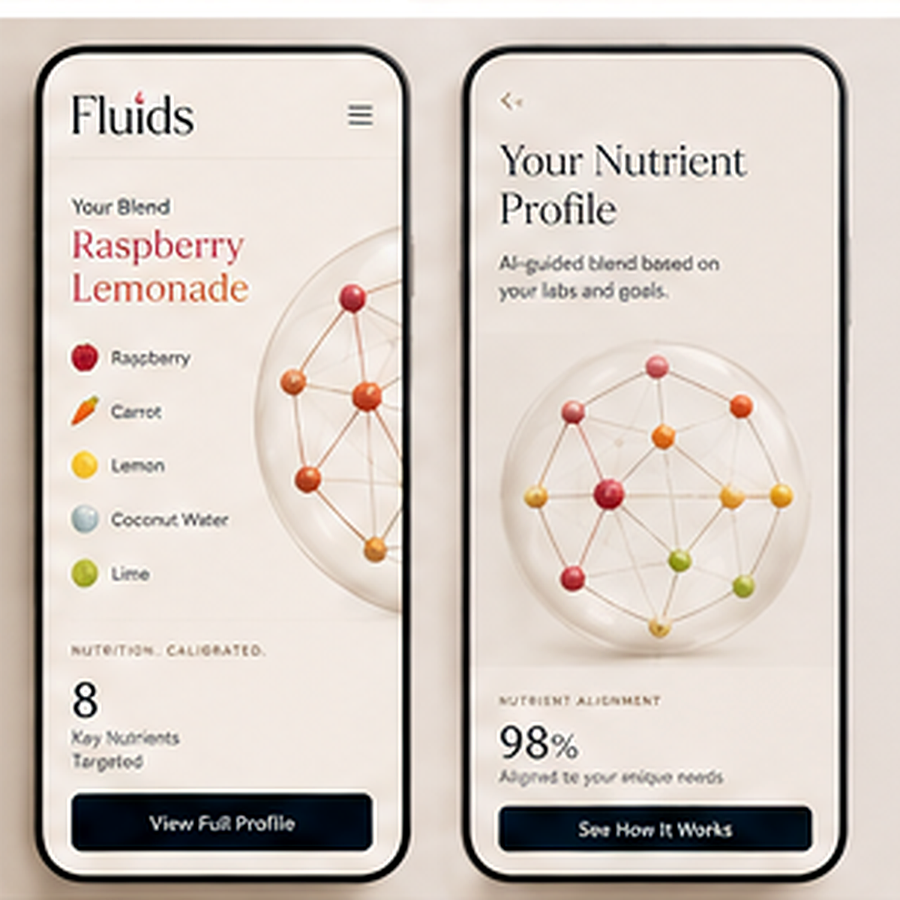
PRODUCT
Menu first. Custom with labs.
Fluids starts with an eight-blend function menu, then uses bloodwork to generate a personalized blend when someone wants the full custom experience.
01
Measure
02
Match
03
Drink
04
Learn
Standard function menu or lab PDF
Our model finds a nutrient direction
Daily powder blend
Retest improves the next recommendation
04
Notes:
Position the homepage menu and lab upload as the same product system, not separate products.
[Sources]
- App backend/UI: /Users/jake.pittman/Desktop/Nutrition Science - FLUIDS/nhanes_engine/local_app.py

Slide 5
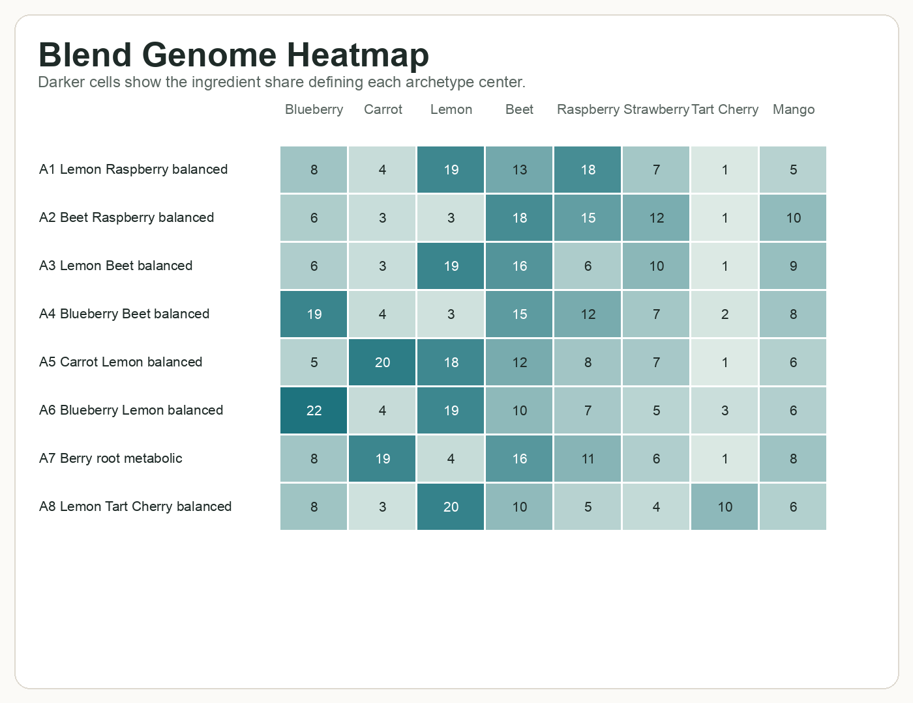
ENGINE
We tested the engine as a real product system.
The first product is a drink mix. The bigger asset is the loop from labs to formula vectors.
Population proof
Makeable formulas
Our model
One product system
16,936 NHANES participants ran through the same product path.
Every blend stays inside real fruit, vegetable, mineral, and juice powder rails.
The model ranks nutrient directions and chooses the best blend path.
The standard menu and custom blends now use the same formula logic.
05
Notes:
This is the credibility slide: the model was tested as an app workflow, not just a notebook.
[Sources]
- Internal NHANES product run, July 2026
- Internal population pitch insights, July 2026
- Blend genome visual from internal population pitch insights

Slide 6
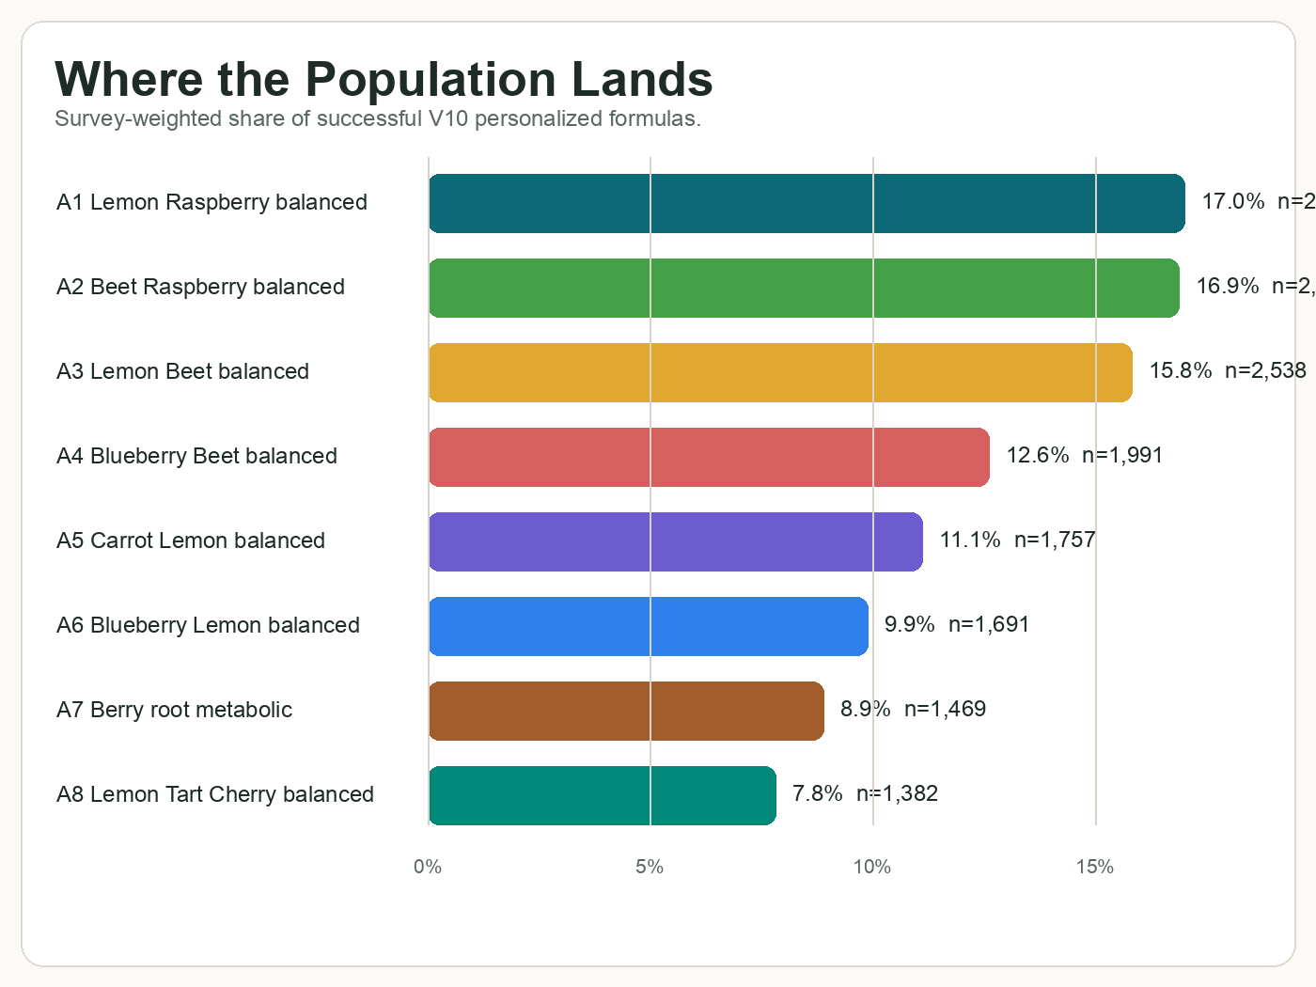
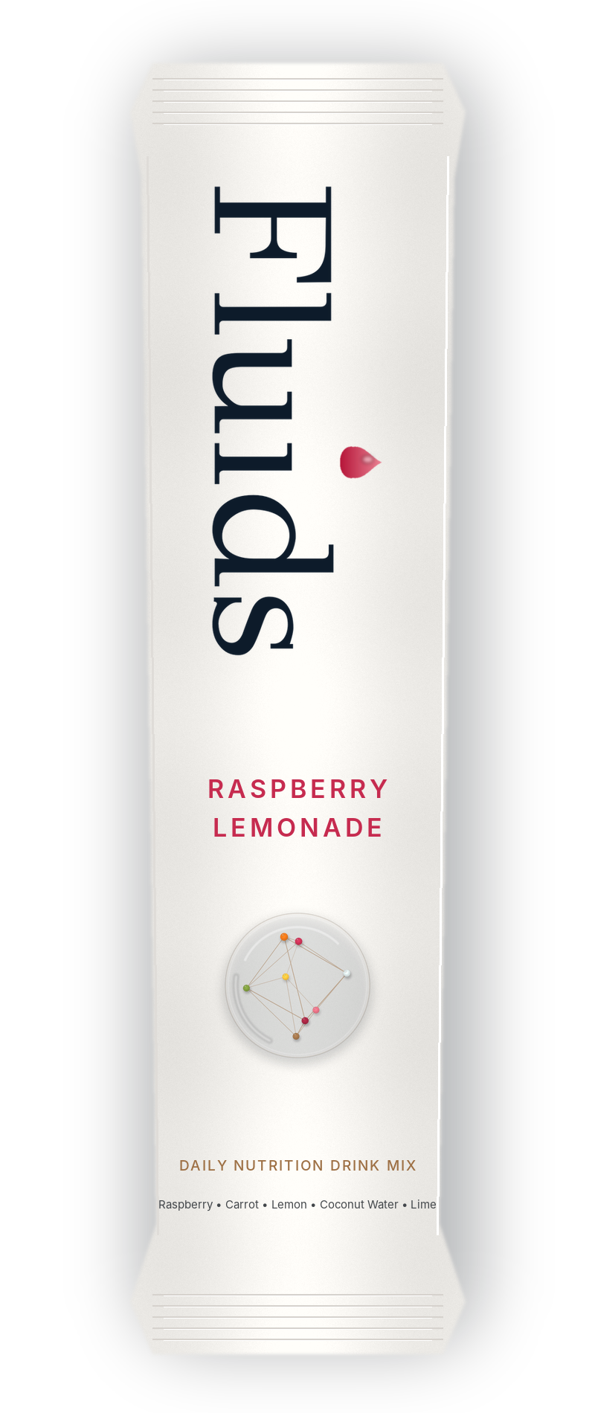
NHANES PROOF
The model discovered recurring product families.
Running the app across NHANES produced 16,406 successful personalized formulas that clustered into stable standard function lanes.
16,406
8 stable product families
First five cover 73.4%
8-blend fit 92.3%
successful custom formulas
Internal model output; recommendations are modeled nutrition directions, not clinical efficacy claims.
06
Notes:
This is the NHANES proof slide. Say product families, function lanes, and modeled recommendation.
[Sources]
- Internal archetype summary, July 2026
- Population bar visual from internal population pitch insights

Slide 7
WHY NOW
Consumers want science-backed wellness they can actually use.
At-home labs, wearables, longevity culture, and supplement fatigue are converging around one expectation: personalized recommendations should become simple daily routines.
$6.8T
82%
60.2%
global wellness economy in 2024; forecast near $9.8T by 2029
of U.S. consumers consider wellness a top or important priority
of U.S. adults used a dietary supplement in the past 30 days
Sources: Global Wellness Institute 2025; McKinsey Future of Wellness 2024; CDC/NCHS Data Brief 561, May 2026.
07
Notes:
Market timing slide retained from the investor deck with source links verified July 27, 2026.
[Sources]
- Global Wellness Institute 2025 monitor: https://globalwellnessinstitute.org/industry-research/2025-global-wellness-economy-monitor/
- McKinsey Future of Wellness 2024: https://www.mckinsey.com/industries/consumer-packaged-goods/our-insights/the-trends-defining-the-1-point-8-trillion-dollar-global-wellness-market-in-2024
- CDC/NCHS Data Brief 561, May 2026: https://www.cdc.gov/nchs/products/databriefs/db561.htm

Slide 8
BUSINESS MODEL
A standard menu with custom-blend upside.
Why the menu matters
Standards make the product easy to buy
Standard function blends create a clear entry shelf. Lab uploads create the premium personalized product and the data loop that compounds.
Custom gives the premium reason to upload labs
Population families become repeatable SKUs
Entry product
Standard box
Eight function blends make the menu easy to understand
Formula intelligence supports margin and retention
Premium upgrade
Custom blend
Upload labs, generate vector, personalize formula
Partner channel
Lower CAC
Labs, clinicians, coaches, wellness platforms
Scale path
60%+ GM target
Shared ingredient rails improve COGS as standards and custom scale together
Pricing and gross-margin targets are planning assumptions for investor discussion.
08
Notes:
Business model point: standards reduce customer confusion; custom preserves personalization and premium price.
[Sources]
- Internal product decision layer, July 2026
- Internal standard-blend architecture comparison, July 2026

Slide 9
MOAT
The moat is the formulation graph.
Measured-response loop
Every customer cycle can sharpen the next recommendation and the next standard blend.
01
NHANES + bloodwork
Population and individual signal
↓
The advantage is the graph from biomarker pattern to nutrient vector, formula family, adherence, retest, and measured response.
02
Nutrient vector
Our model's direction
↓
03
Blend family
Standard or custom formula
↓
04
Adherence
Real-world use
↓
Population map thesis
05
Retest response
Measured outcome
NHANES proves the map has structure before Fluids has proprietary response data.
09
Notes:
The moat is not only uploaded labs. It is the data structure around formulation decisions and response.
[Sources]
- Internal NHANES product run, July 2026
- Internal archetype summary, July 2026

Slide 10
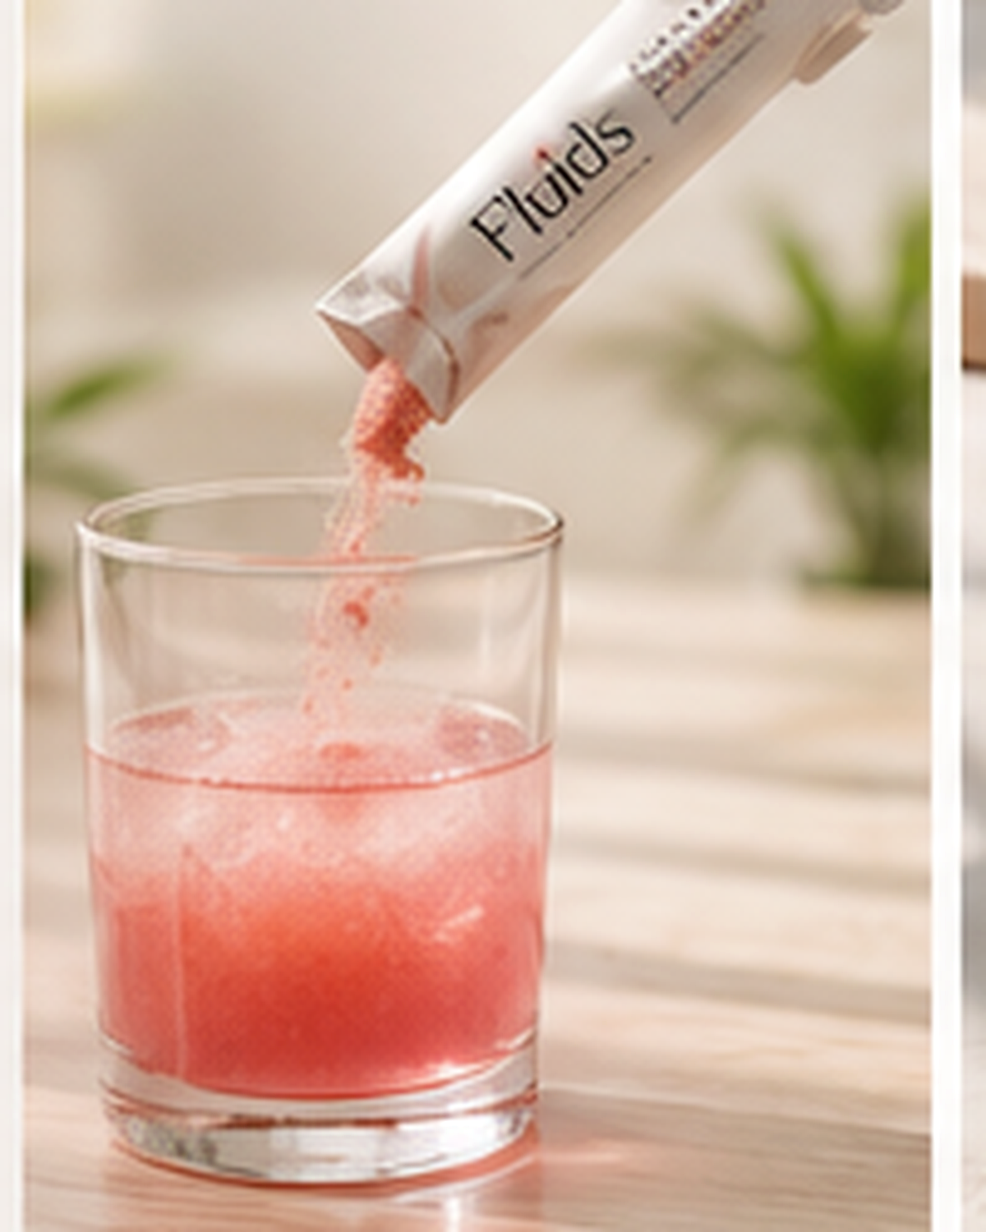
GO-TO-MARKET
Start where the signal already exists.
Fluids enters through people and partners already using biomarkers, while the standard menu makes the product simple to explain.
01
Founder-led cohort
Early believers pick a function blend or upload labs, drink daily, retest, and give feedback.
02
Biomarker partners
Labs, clinicians, coaches, and wellness platforms become lower-CAC distribution paths.
03
Replenishment
30-day boxes become repeat orders, standard-function cohorts, and personalized formulas.
10
Notes:
GTM point: the app now has both an easy homepage menu and a personalized demo moment.
[Sources]
- Internal Fluids GTM planning.

Slide 11
PILOT
The pilot answers adoption, reorder, and signal.
Will people use it?
Will they buy again?
Is there a measurable signal?
Taste score, daily adherence, ease of routine
Standard reorder, custom upgrade, subscription interest
Modeled direction, safety review, and biomarker movement after use
1
2
3
4
Baseline
Daily use
Retest
Learn
blood panel + survey
60-90 days
same biomarkers
response + reorder
Study cohort planning case: 25-50 participants, standard-function entry, custom upgrade, adherence and retest tracking.
11
Notes:
Pilot language stays careful: modeled direction and measured signal, not treatment claims.
[Sources]
- Internal Fluids pilot planning.

Slide 12
RAISE
$500K gets Fluids to a seed-ready proof point.
Use of funds
$150K
Standard blends, packaging + initial inventory
The round funds the standard-function launch, custom-blend app, measured pilot, partner channel, and operating system needed to turn formulation into a platform.
$125K
Biomarker pilot + analysis
$125K
Team, operations + custom app polish
$100K
Regulatory, QA, partner launch + buffer
12-month milestones
Eight-blend menu | custom blend demo | 25-50 person pilot | 1-2 platform partners | early reorder signal
12
Notes:
Use of funds remains directional and investor-discussion level.
[Sources]
- Internal Fluids operating plan.

Slide 13
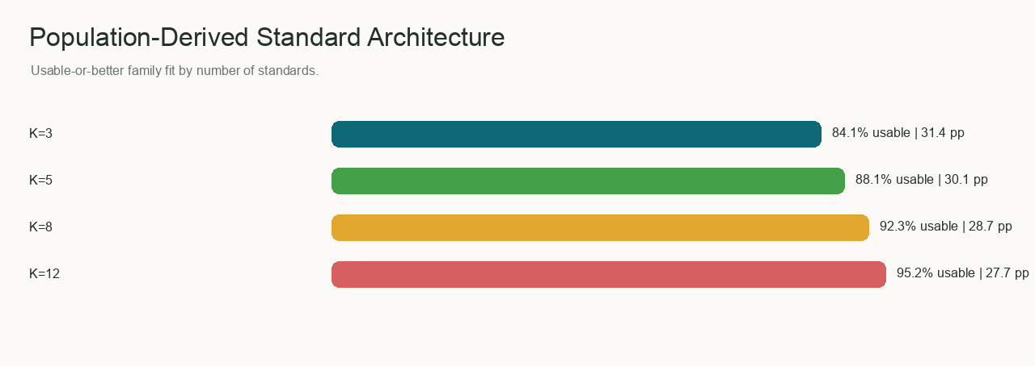
LONG-TERM VISION
The model discovers the product families.
NHANES gave Fluids population-scale labs. Our model turned those labs into personalized formulas. The formulas showed us the standard functions, custom lanes, and operating forecasts.
1
Population map
2
Standard functions
3
Custom blends
4
Response graph
Main sources: internal NHANES product run, population pitch insights, GWI 2025, McKinsey Future of Wellness 2024, CDC/NCHS Data Brief 561.
13
Notes:
Close with the strongest claim: Fluids does not guess its product families; the model discovers them.
[Sources]
- Internal NHANES product run, July 2026
- Internal population pitch insights, July 2026
- Internal standard-blend architecture comparison, July 2026
- Global Wellness Institute: https://globalwellnessinstitute.org/industry-research/2025-global-wellness-economy-monitor/
- McKinsey: https://www.mckinsey.com/industries/consumer-packaged-goods/our-insights/the-trends-defining-the-1-point-8-trillion-dollar-global-wellness-market-in-2024
- CDC/NCHS: https://www.cdc.gov/nchs/products/databriefs/db561.htm

