Slide 1



DATA 422 Group Project
Fuel Prices by Car Type
The A+ Team:
Jacob Reid Mr. T
Rick (Mengyao Liu) John "Hannibal" Smith
Katie (Jinghang Liu) Amy Amanda "Triple A" Allen

Slide 2
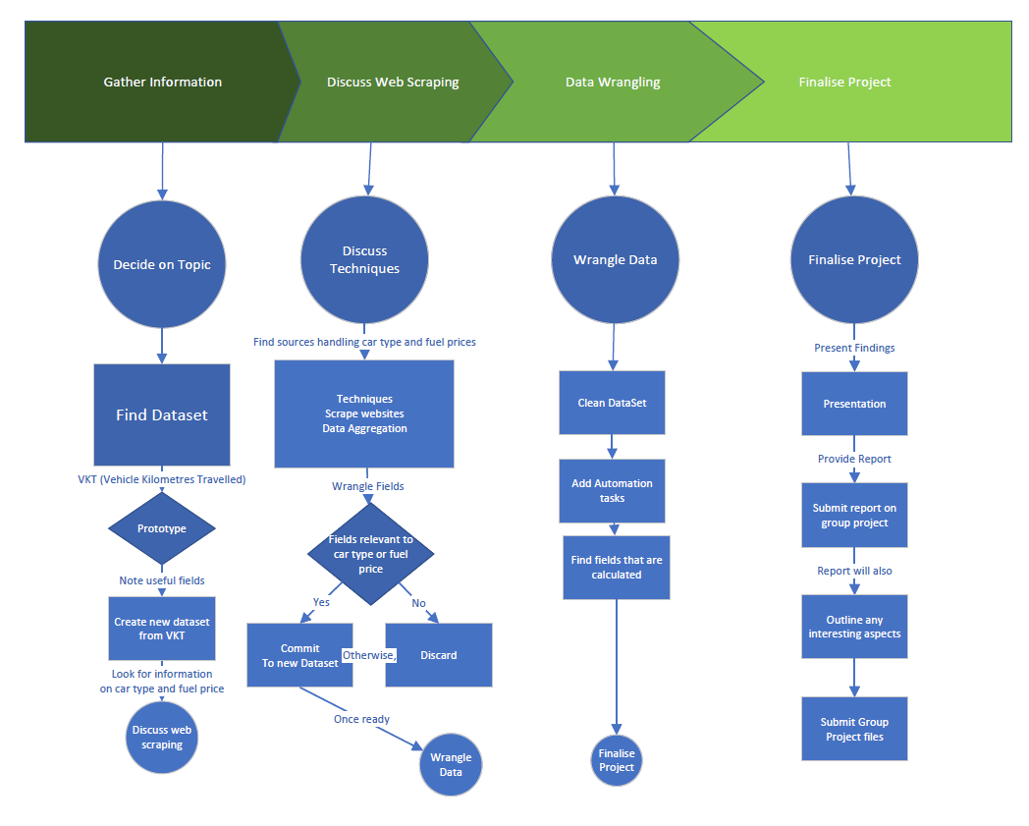
Introduction
Customer
The customer wanted to modernize the Vehicle Kilometers Travelled Dataset to find out the cost of running a fleet of 10 cars over a year.
。
Type
They wanted each fleet to be the same make and model and wanted light vehicles only
DATA
We identified three datasets that would work but they are from different sites.

Slide 3
Project Management and Data Sources
Vehicle Kilometres Travelled from government
“https://www.stuff.co.nz/motoring/132420696/how-much-fuel-and-money-could-you-save-by-buying-a-new-car”
Csv file from website (https://figure.nz/chart/lSYJzICrinllOY7p)
Project Management
Trello
VKT
Code Repository
Github
Car
Types
Main Project File
Onedrive
Weekly
Fuel Prices

Slide 4
Topic
Hint from VKT(vehicle Type) CAS too clean
Looking for
information
on Car Type and
Fuel Prices
Note
Useful
fields
Create new dataset
from VKT
VKT, CAS
Prototype
Find Dataset
Decide on Topic
We covered Type of datasets to use
Protoyping to assess usability
Will we obtain the dataset

Slide 5
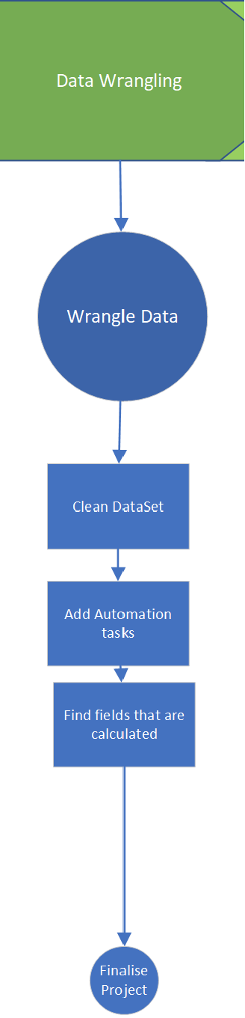
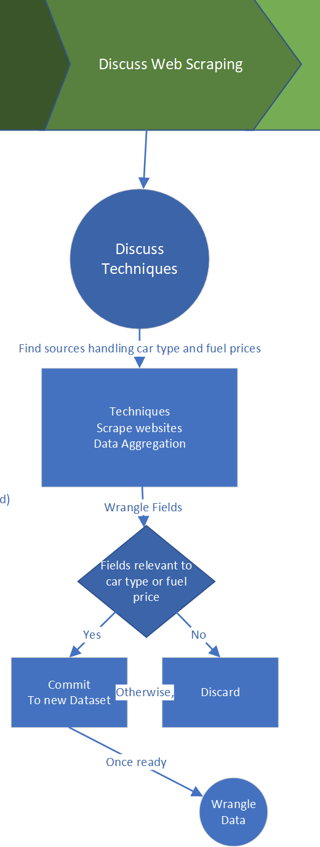

Data Wrangling
Techniques
Data Preparation
Visualize missing data
Clean the datasets

Slide 6
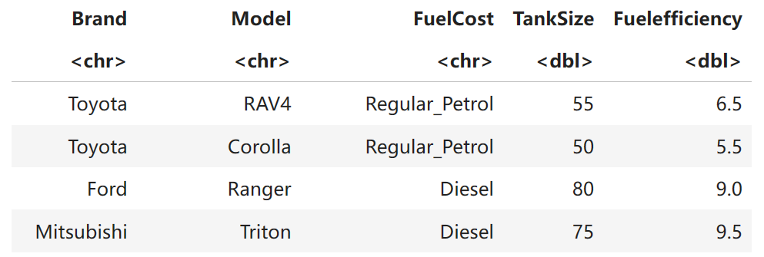
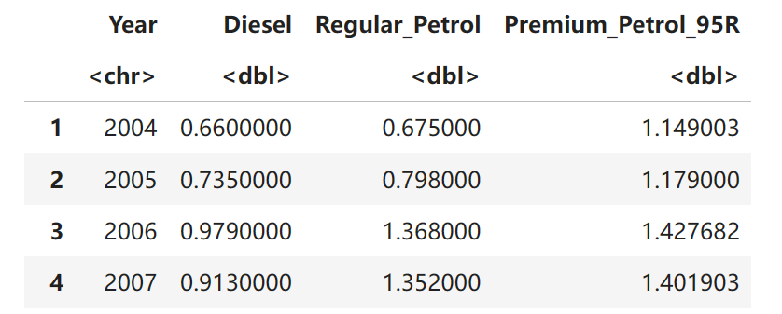
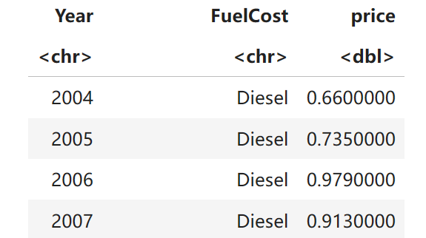
Data Wrangling
Data Model
Create new dataframes
Link new dataframes
Car_Type
Model
Brand
FuelCost*
TankSize …
Left Join (Multiple)
Fuel_price
Year
FuelCost*
Price
Wide to Long

Slide 7
Data Wrangling
Calculations
Mutate new columns
Rename columns
 | Fuel efficiency | Range | KM_10vehicles_26refuels | FuelCosts_10vehicles | kmperdollar
… | 9 | 857.5661984 | 222967.2116 | 13728 | 16.24178406
… | 9.5 | 798.6558504 | 207650.5211 | 12870 | 16.13446162
… | 7.5 | 1024.885236 | 266470.1614 | 13728 | 19.41070523
… | 7.5 | 1093.097373 | 284205.3171 | 13041.6 | 21.79221239
Average of fuel efficiency
Average of Fuel efficiency (Car Type)
AVG of Distribution from Distance one car can move with full Tank Size
Assume 26 refuels per year
Total
Cost
Distance per dollar

Slide 8
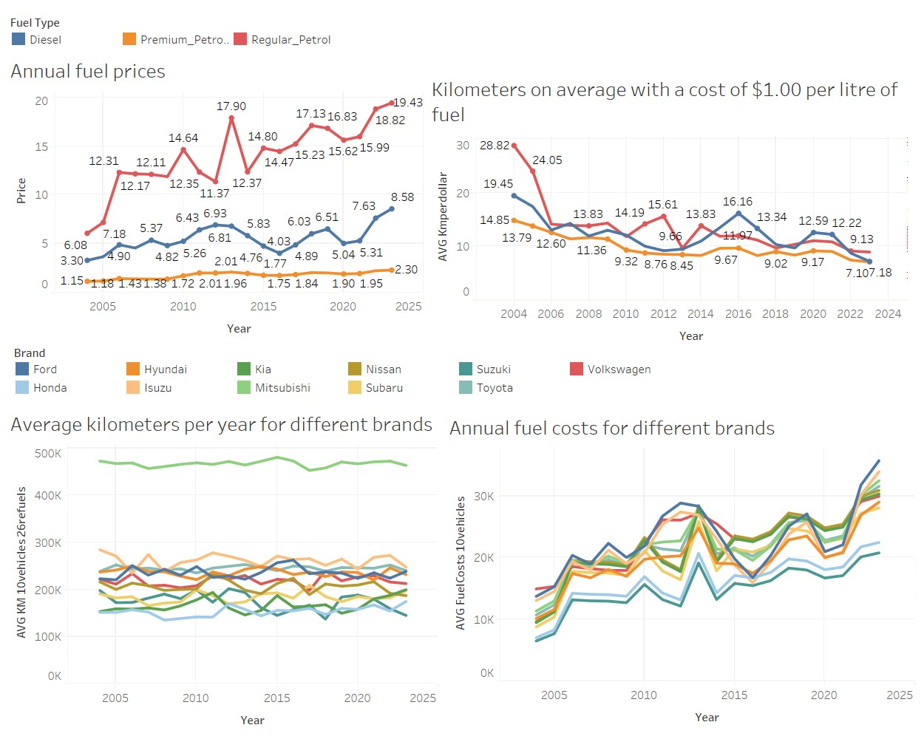
Result and insights

Slide 9
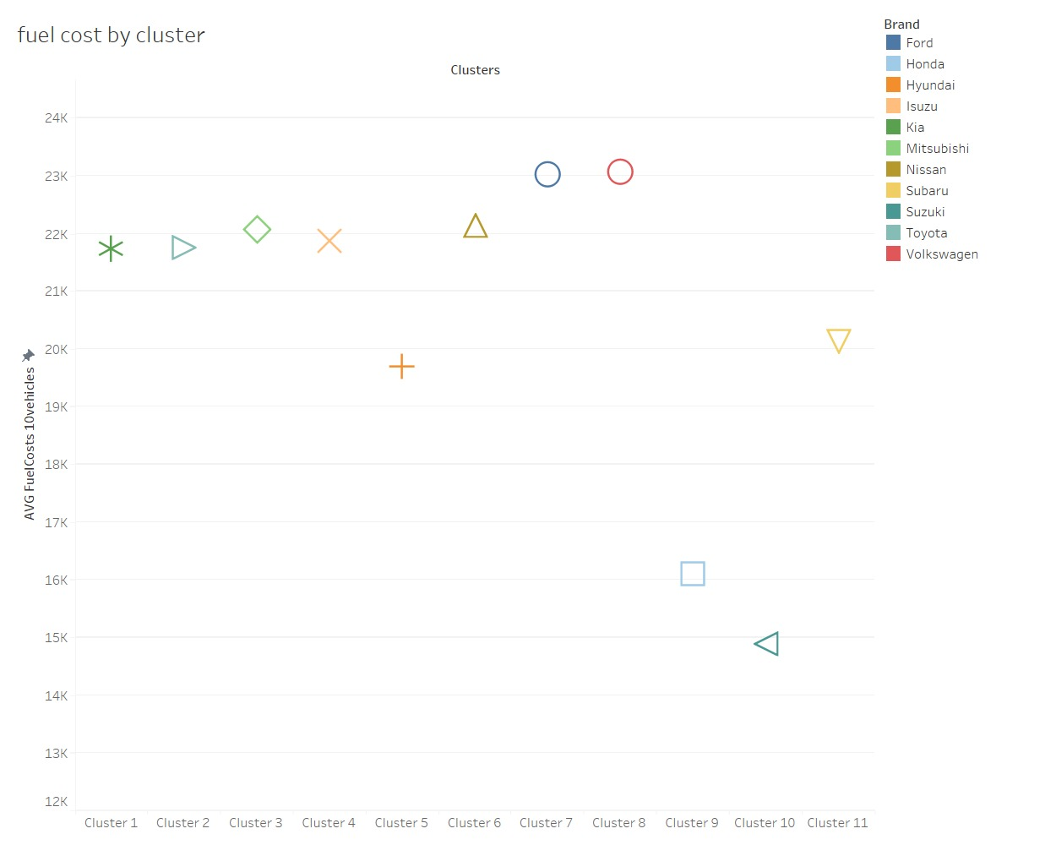
Result and insights

Slide 10
Summary
Finalize the Project
Issues Encountered
Resolve minor issues
Datasets can be blocked from scraping or behind paywalls
Complete documentation
Wrangling Techniques
Sanitized data looks clean but it is mostly useless
Combined with Statistics
Results and Insights

Slide 11
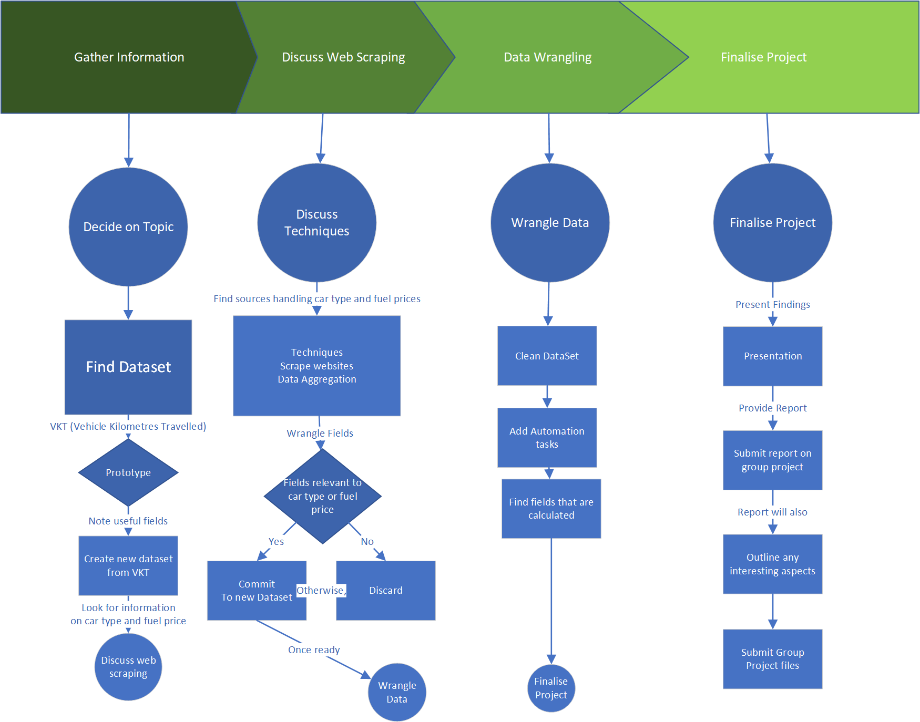
Q&A

Slide 12
DATA 422 Group Project
Thanks for Listening
The A+ Team:
Jacob Reid Mr. T
Rick (Mengyao Liu) John "Hannibal" Smith
Katie (Jinghang Liu) Amy Amanda "Triple A" Allen
Questions?

