Slide 1
Open note ware
By : Imraan Manzoor
Jatin P M
K N Bhargav

Slide 2
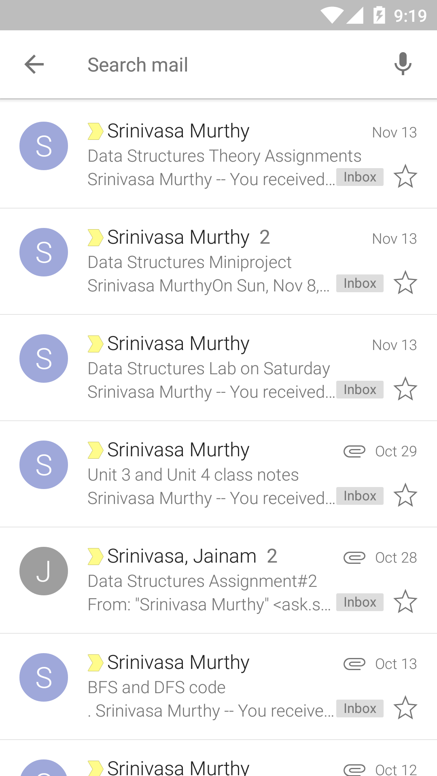
Observe this image

Slide 3
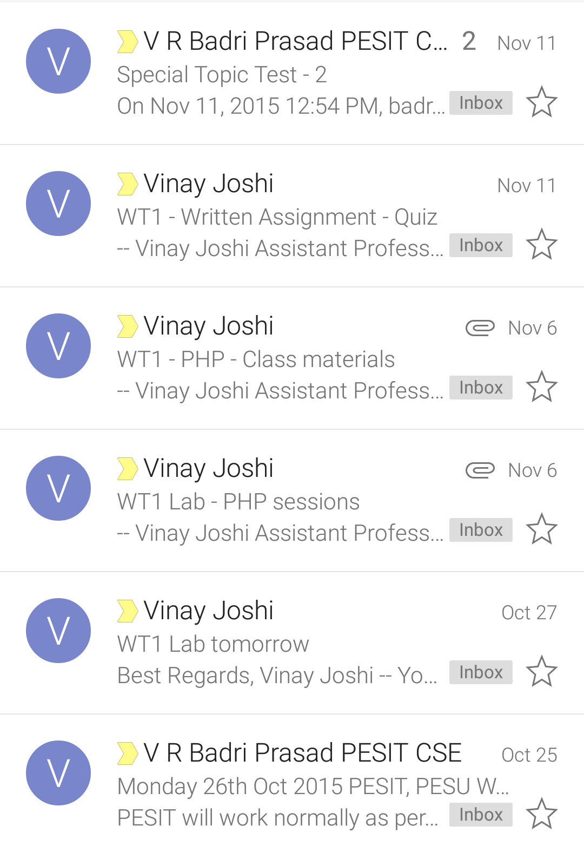
And this one

Slide 4
The previous two slides show the email inbox of any student in this university. Each faculty member knows the pain of creating new course materials for every batch that they encounter and sending each student these materials through the email groups on time.
In this archaic process, there exists the initialisation period of creating the email groups, then making sure that each student of the class is in the group that is just created, and then making sure that the student, who presumably has got the course material from the faculty member, does send this material to other students on time.

Slide 5
The Solution
We students think that this process consists of too many people with too many responsibilities, which can be avoided by making use of a proper course management system.
We propose OpenNoteWare, a website where the users (typically faculty members and students of the college) can sign up to the website, add courses to it, and upload the course materials for a particular course as and when they need.
These course materials, once uploaded, can be downloaded by the students through the website.
The website obviates the need to undergo the laborious processes discussed in the previous slide and provides each student an easy access to the course materials for any course.

Slide 6
Technologies used…
Our website mainly makes use of PHP Sessions and MySQL and the ability of PHP to make queries to databases created in MySQL.
The Website is written in HTML and the styling is added using CSS
There are three main tables in our database :
Course : The table which consists of all the courses
Branch : The table which consists of all the branches of the college
Admin : The table which consists of all the usernames and passwords (encrypted) that are signed up to our website
We also make use of PHP’s ability to encrypt data using BlowFish cipher to encrypt the passwords of admins before they are stored in the database.

Slide 7
Future scope of the website
Further features can be added to the website (for example, upload the calendar of events for a particular course and creating a chat forum where the faculty and students can have discussions about the course) and make the website sufficient for any course that the college makes available for the students. Given enough time, the website can be improved in such a way that it is good enough to the extent that no student or faculty member would have to depend on emails being sent on time to gain information about a particular course. Everything will be available on OpenNoteWare!

Slide 8
The end

