Slide 1


Cover page
Locator-O-Pets
Help is on the way!
Have you lost your Pet?
Ave you seen a frighten and lost Pet

Slide 2



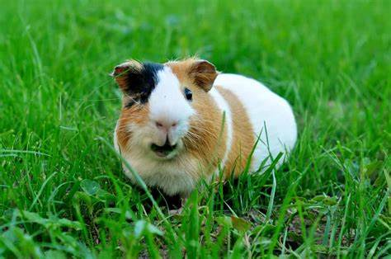
Agenda
About Locate-O-Pet
Register and Log in
Report Lost Pet
Seeing a Lost Pet

Slide 3

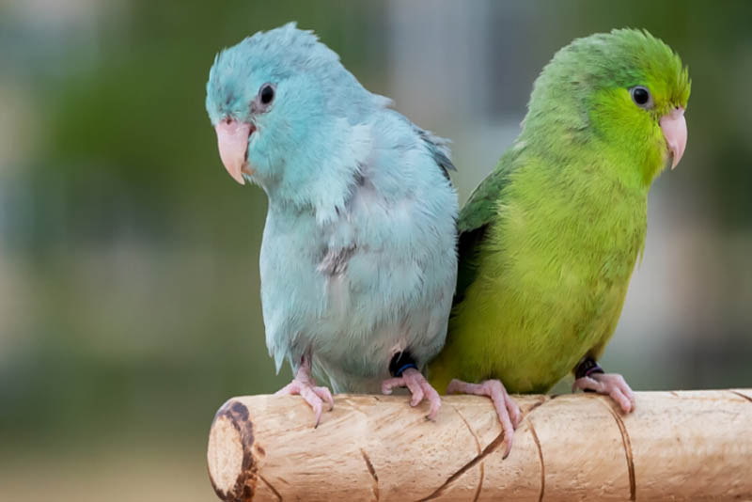

About Locate-O-Pet
Locate-O-Pet is a customized community page that will allow pet owners who have lost their pet, using the power of social media. People would be able to search for lost pets in their neighborhood. It is a not-profitable page that will focus on serving the community.

Slide 4
Technology Used
Server
Client-side
Server core was developed using Express.js
Apollo with GraphQL to retrieve data.
Node.js cross-platform, JavaScript runtime environment.
MongoDB – with mongoose -a straight-forward, schema-based solution to model your application data.
Apollo client - a management library for JavaScript to manage both local and remote data with GraphQL.
Cloudinary – a cloud-based media management platform.
GraphQL
React – one page web application.

