Slide 1

PUMPKIN SEED FRAMEWORK
UAT GSIP
12.8.2021
Jake A O'Connor

Slide 2

What is it?

Slide 3
Turn-Based Game Framework
Cross-Platform
Genre-Agnostic
Highly Modular

Slide 4

What is the need?

Slide 5
Few Cross-Platform
Nothing Genre-Agnostic

Slide 6
Construction

Slide 7
.NET Core
Multi-Threaded
Software Patterns

Slide 8
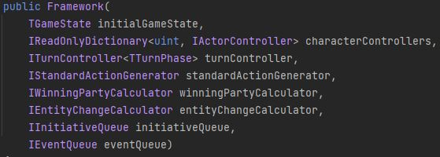
Modular Construction

Slide 9

Basic Building Blocks

Slide 10
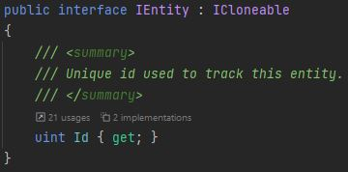
Entities

Slide 11
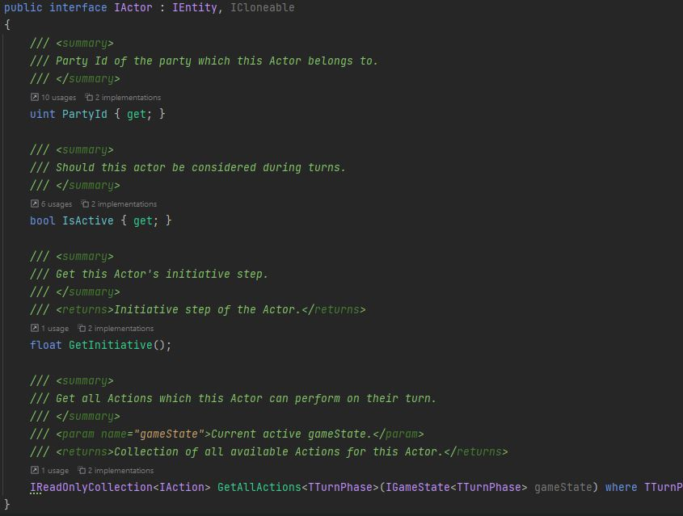
Actors

Slide 12
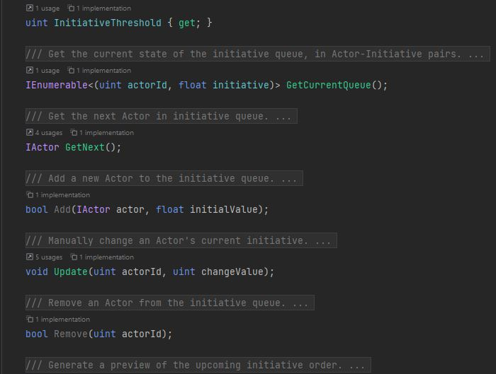
Initiative

Slide 13

Example Uses

Slide 14
Checkers
Entities
Pieces
Actors
Players

Slide 15
JRPG
Entities
Items
Equipment
Actors
Players
Monsters/Enemies
Status Effects

Slide 16
Pumpkin Seed Framework

