Slide 1
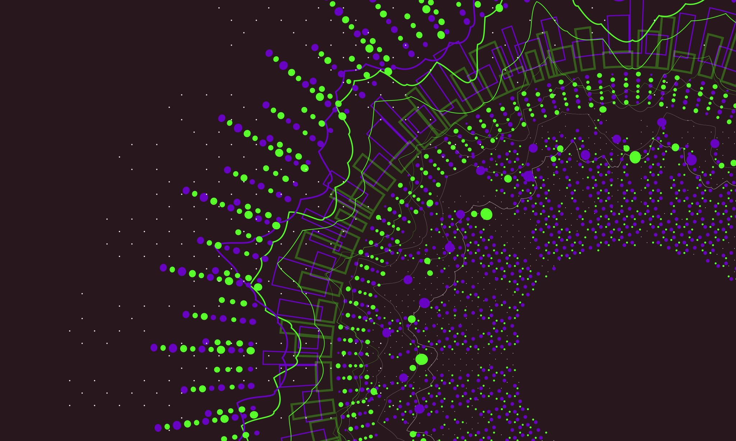
NLP Chunking for Game Rules Parsing
MS548 NLP Teach-back
Jake O'Connor

Slide 2
What is Chunking
Extracting meaning from patterns in natural language.
Heavily relies on POS tagging.
Patterns depend on language and context.
Chunks can range from general or specific (chunking-up or -down).
Often visualized as trees.

Slide 3
What are Game Rules
Natural language describing game logic.
Written by non-engineers using human-readable text.
Specific words and phrases have functional meanings.

Slide 4
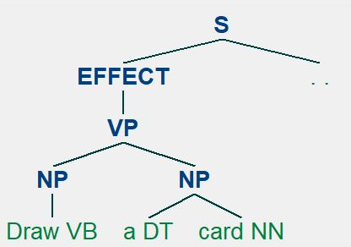
"Draw a card."
Very simple example.
Single effect, with no cost or additional parts.

Slide 5
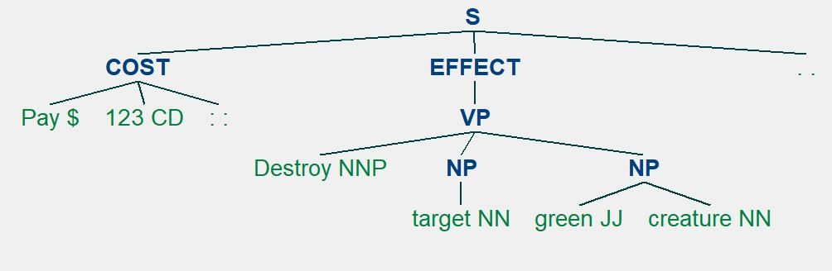
"Pay 123: Destroy target green creature."
Intermediate example.
Includes both a cost and effect group, including noun qualifiers.

Slide 6
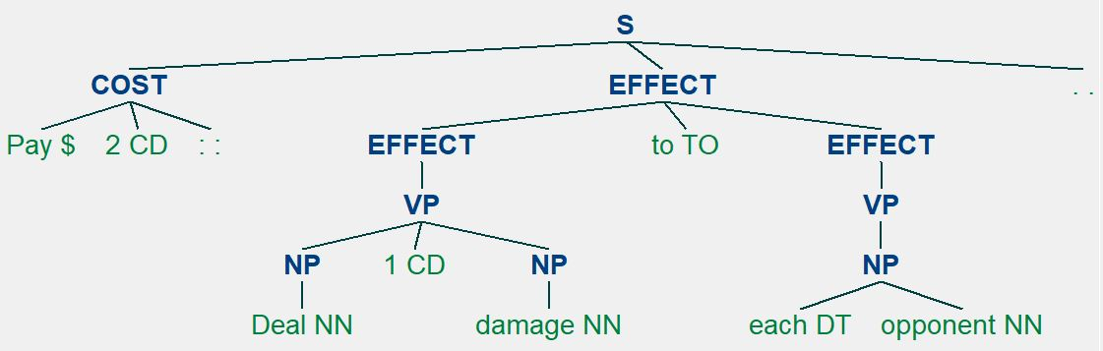
"Pay 2: Deal 1 damage to each opponent."
Advanced example.
Cost phrase, as well as a complex Effect phrase with numbers, determiners, and an action target.

Slide 7
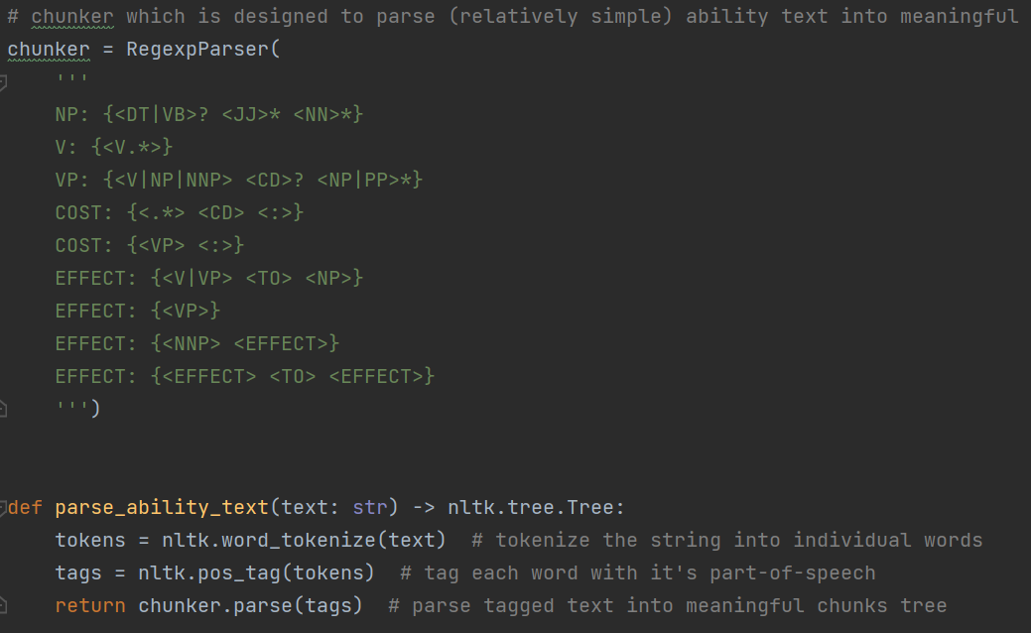
How does any of this work?
Tokenize the phrase into words.
Tag each word with its part-of-speech.
Default NLTK tagger used here, real code would need a better POS tagger.
Parse the tag collection using the Regex parser.
Cost defined as verb pairs or numerals followed by a colon.
Effect defined as verb pairs, noun pairs, and/or groups of effects.

Slide 8
But why would this ever be useful?
Hard-coding logic is expensive, bad, and fragile.
As new chunk-patterns emerge, they can be codified into game logic.
Allows non-engineers to create, iterate, and expand upon game rules without engineer support (to an extent).
Allows smaller teams to support larger projects.

