Slide 1
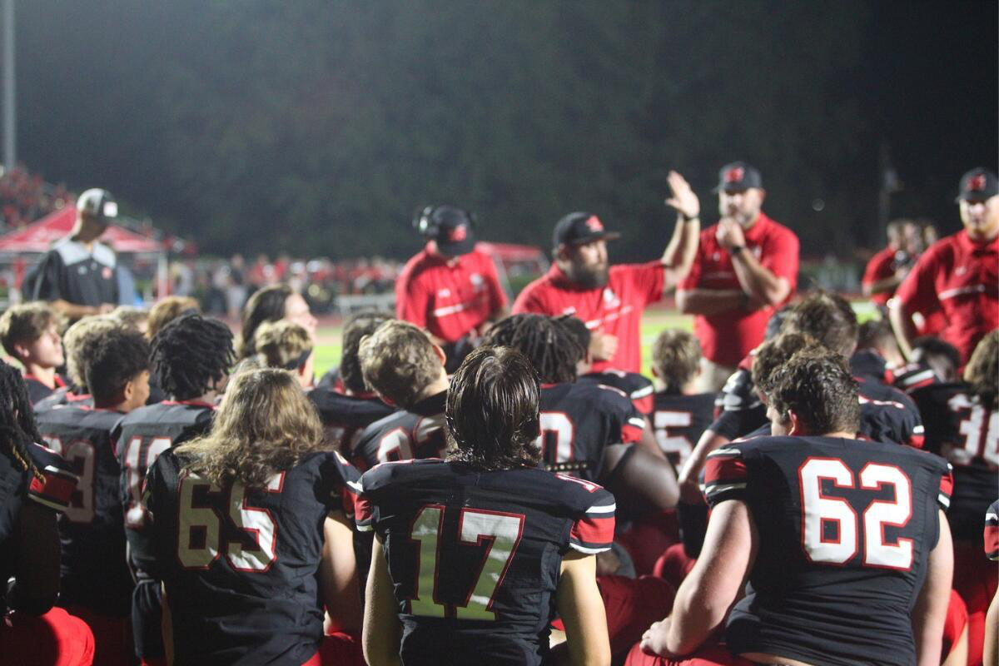

Winder-Barrow High School Preliminary Analysis

Slide 2
 | Plays | Average Yards Gained | First Downs Gained | TDs Scored | Explosive Plays | Negative Plays
Pass | 271 | 7.66 | 75.00 | 19.00 | 64.00 | 40.00
Run | 362 | 4.92 | 91.00 | 22.00 | 36.00 | 57.00
 | Plays | Average Yards Allowed | First Downs Allowed | TDs Allowed | Explosive Plays Allowed | Negative Plays Created
Pass | 200 | 7.41 | 49.00 | 14.00 | 31.00 | 15.00
Run | 293 | 4.71 | 57.00 | 18.00 | 26.00 | 40.00

Slide 4
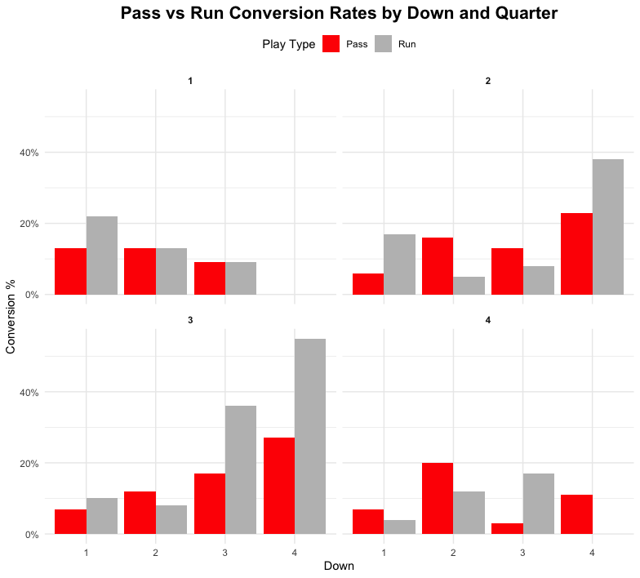
Offense is is more efficient running on 4th down in the 2nd Qtr.
Offense is is more efficient running on 4th down in the 3rd Qtr.
Offense didn’t get a 4th down conversion in the 4th Qtr.
Could depend on point differential

Slide 6
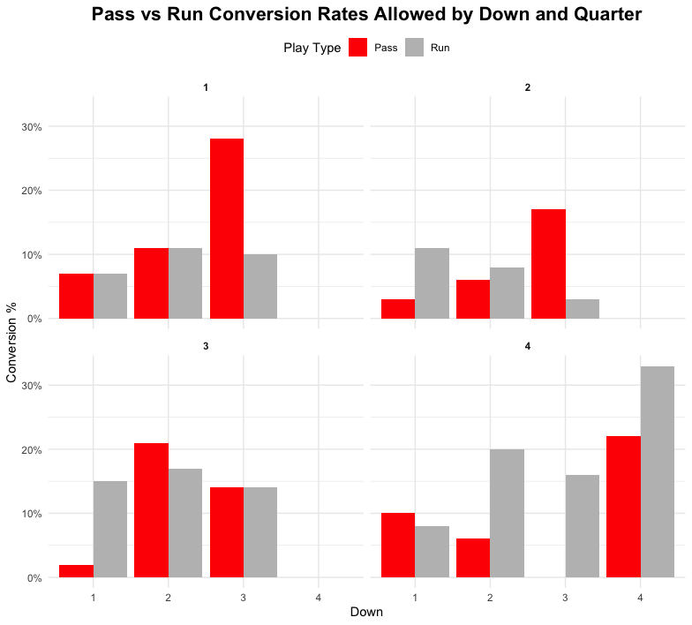
Defense plays its best by far in the 2nd Qtr. Allowing no more that 20% of any conversion
Defense is bad at stopping the run on 4th down in the 4th Qtr.
But they only allow around 30% of attempts to convert

Slide 13
Offense
Passing game is at it’s best in the 1st Qtr.
Running game is at it’s best in the 4th Qtr.

Slide 14
Defense
Pass defense plays best on 4th down.
Defense plays its worst run defense in the 3rd Qtr.
Defense gives up the most run yardage in the 4th Qtr.

