Slide 1
Fall 2026 Intro to Cognition and Perception Slides
All adapted from slides created by Dr. Sahil Luthra

Slide 2
How to Study the Mind Recap
08/26/26

Slide 3
How does a cognitive scientist study the mind?
Traditionally, cognitive science focuses on the computational and algorithmic levels of analysis.
Computational (Representations)
Algorithmic (Processes)
The mind creates abstract representations and
transforms representations through mental processes
that are instantiated in the brain
Implementational
(Brain)
(Marr, 1982)
If cognitive science focuses primarily on the more abstract levels of analysis, direct observation is very difficult – if not impossible!
Notes:
A quick recap on the three levels of analysis as well as our working definition of the mind
This definition does cause some trouble for us, however: computational and algorithmic processes are abstract by nature, so they cannot be directly observed.

Slide 4
If the mind can’t be directly observed,
how do we study it?
Mental processes must be inferred from observable phenomena
(behavior, brain responses, etc.)
Notes:
Our discussion about the Donders study started from this core question: If the mind can’t be directly observed, then how do we study it?
The solution is that mental processes must be inferred from observable phenomena. Because we can’t touch or directly manipulate cognition, we study the things that arise as a result cognition.

Slide 5
Consider a very straightforward experiment
If we’re testing the effect of ramp characteristics on the time it takes for the marbles to reach the ground, we have directly observable phenomena.
… But the world is not always so forgiving!
Notes:
This is a nice example because we have things we can directly observe and/or manipulate.
It also allows us to make inferences about phenomena we can’t directly observe such as forces like friction, drag, and gravity.

Slide 6
Mental processes must be inferred from observable phenomena
(behavior, brain responses, etc.)
In other words, we study the things that arise as a result of the mind.
The same way gravity might not be directly observable, we can study its effects.

Slide 7
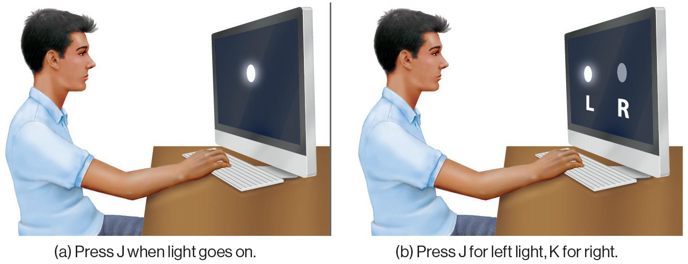
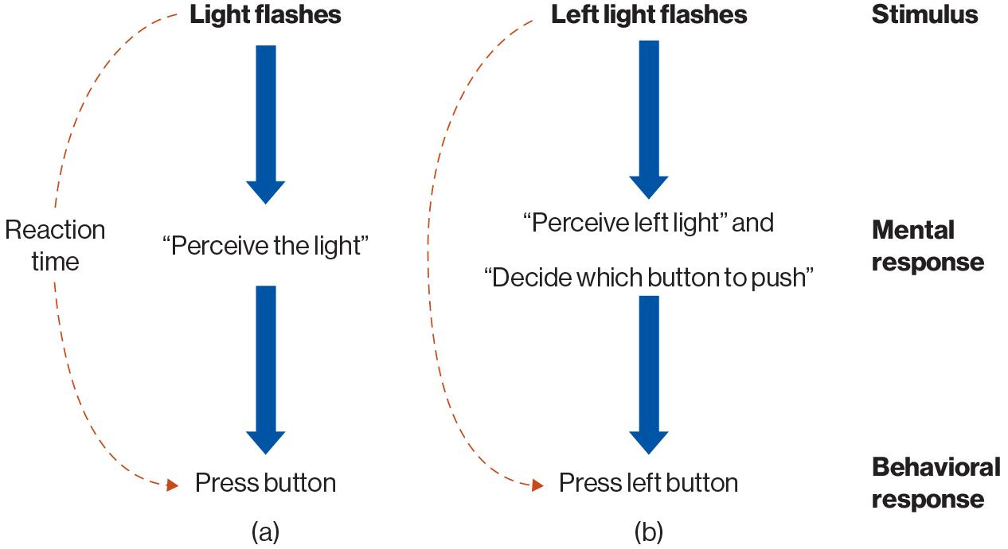
Clever experiments can isolate mental processes of interest
If there’s a 100 ms difference between the choice condition and non-choice condition, we can infer that making a choice takes roughly 100 ms
But we never “see” that decision happen; we only see the effect it has on timing!
Donders (1868)
~200 ms
~300 ms
Notes:
Franciscus Donders
Suppose I want to study decision making
How long does it take to make a decision about a stimulus?

Slide 8
Perception Recap
9/2/2026

Slide 9
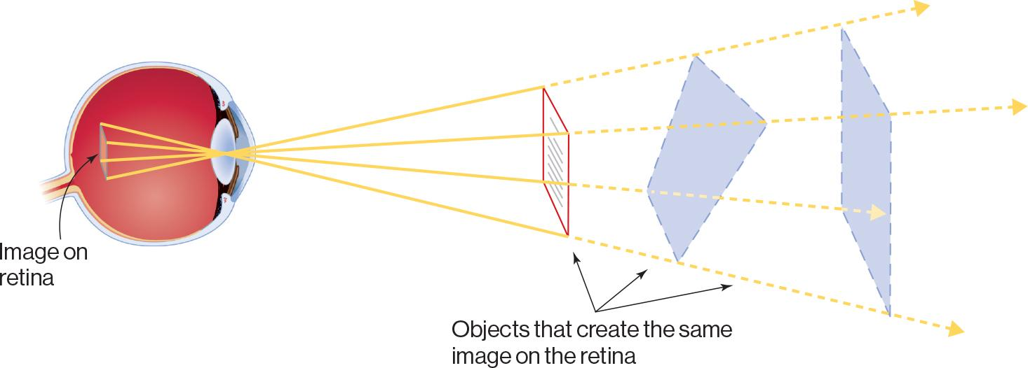
Perception is ambiguous
Inverse projection problem: Multiple 3D objects can give rise to same 2D image on retina
Notes:
When you look at something with your eyes, the visual information you’re seeing is simply a 2-d projection from a distant object

Slide 10
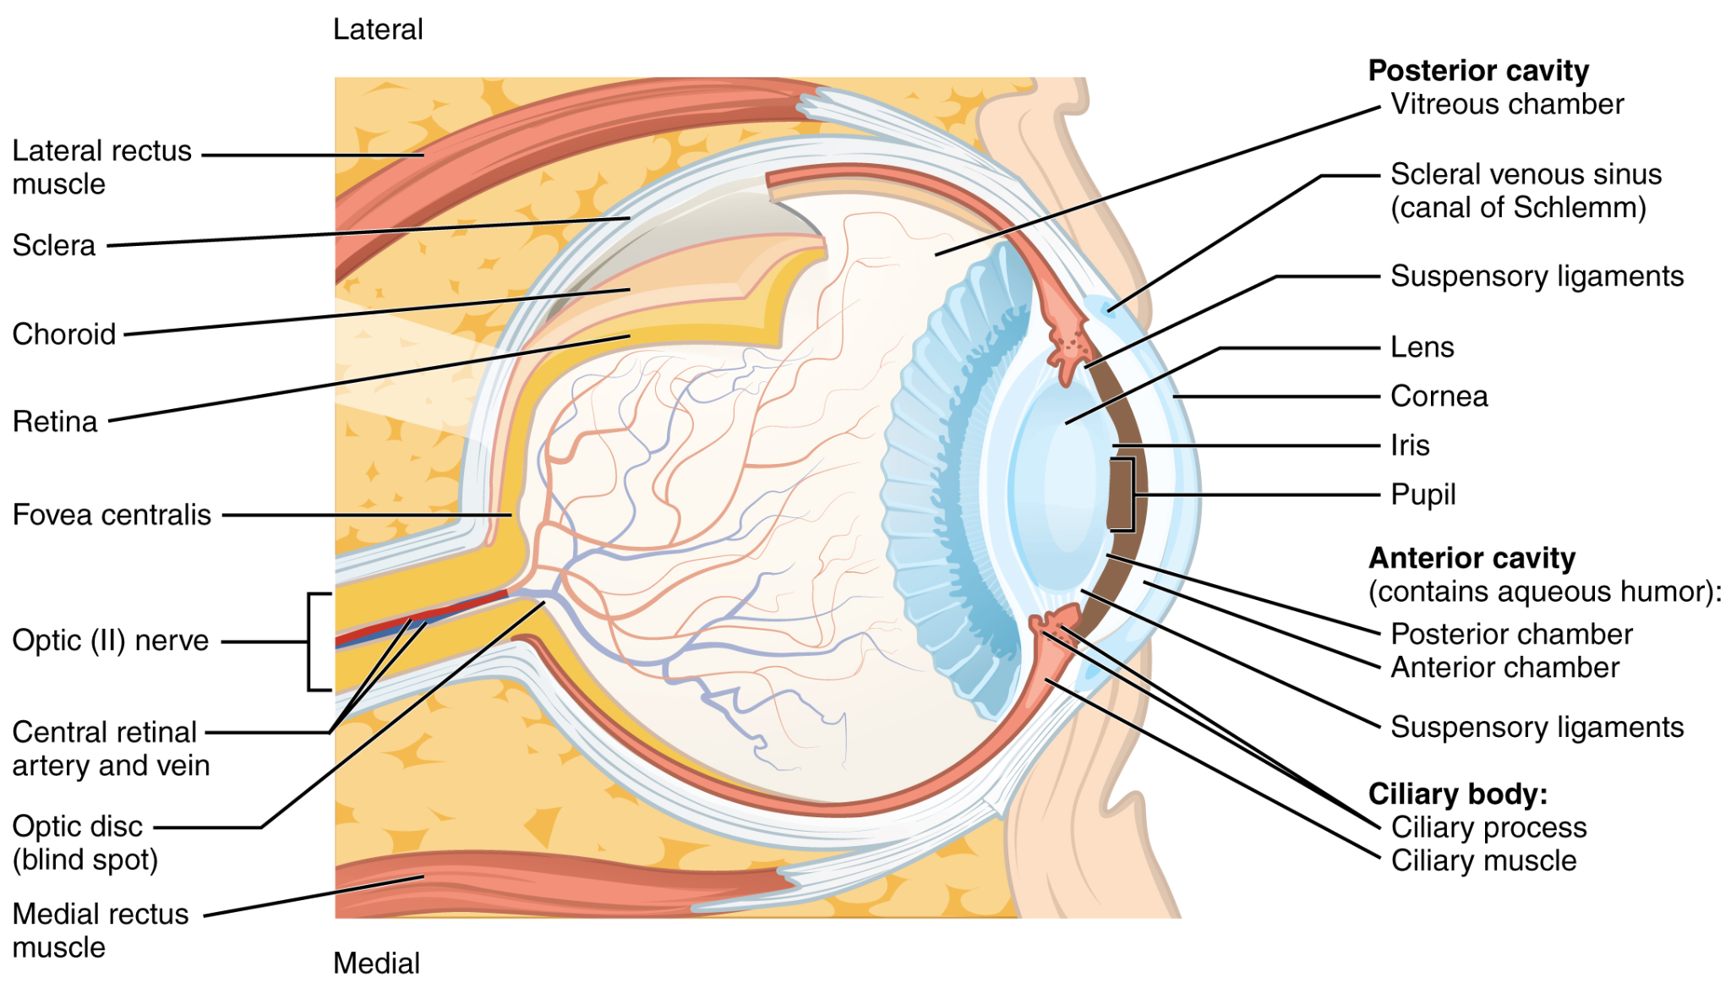

Slide 11
The eyeball doesn’t automatically “know” what it’s looking at.
From its perspective, light is exciting cells on the retina, which means it could be multiple things.

Slide 12
A non-visual example
How to recognize speech.
How to wreck a nice beach.
Inverse projection problem (rephrased): Multiple phrases can give rise to the same acoustic signals in the ear.

Slide 13
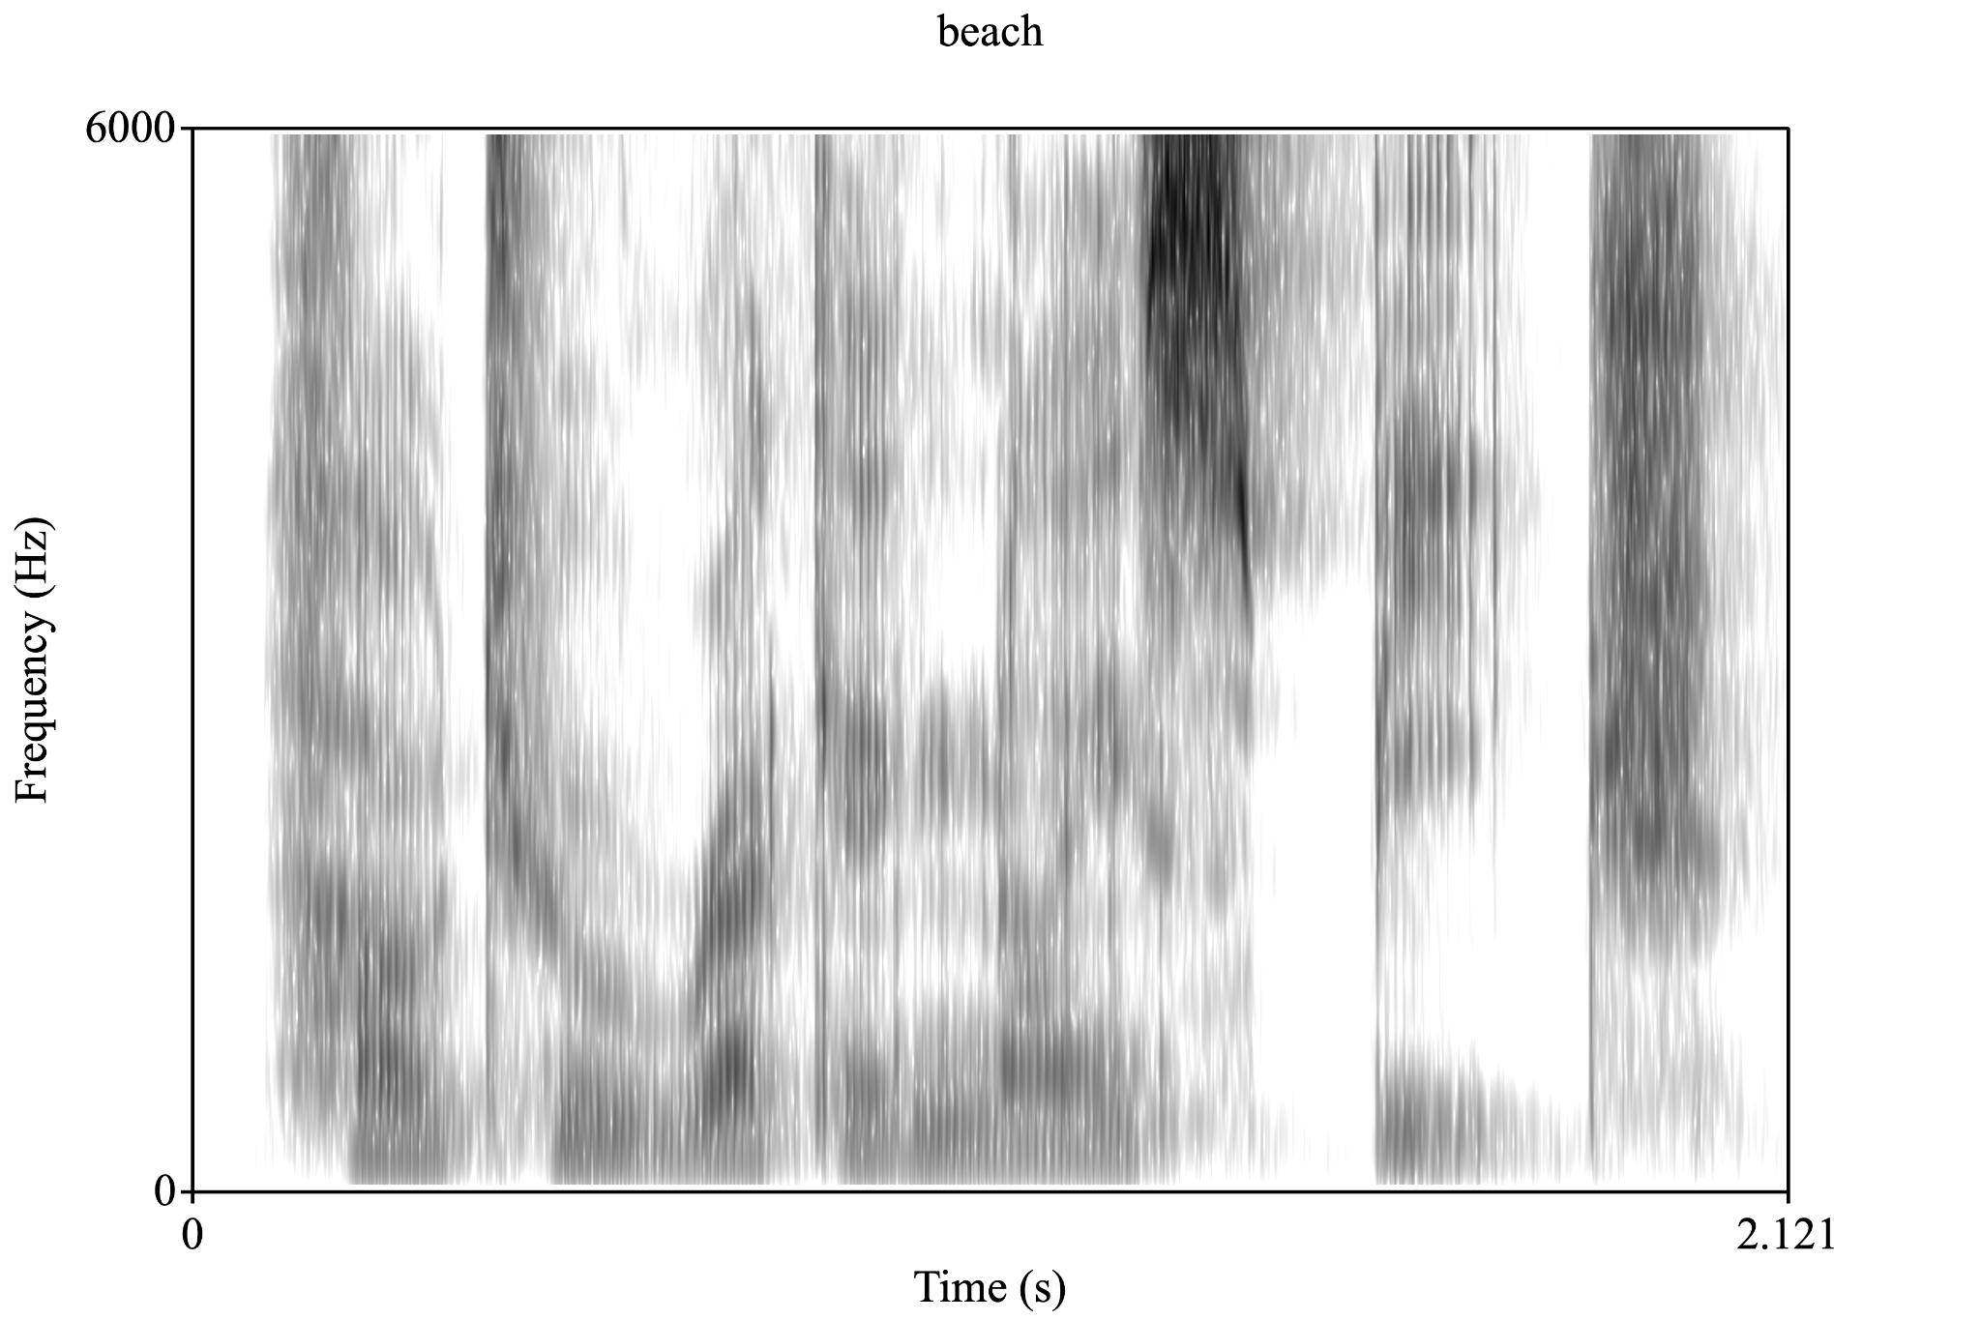
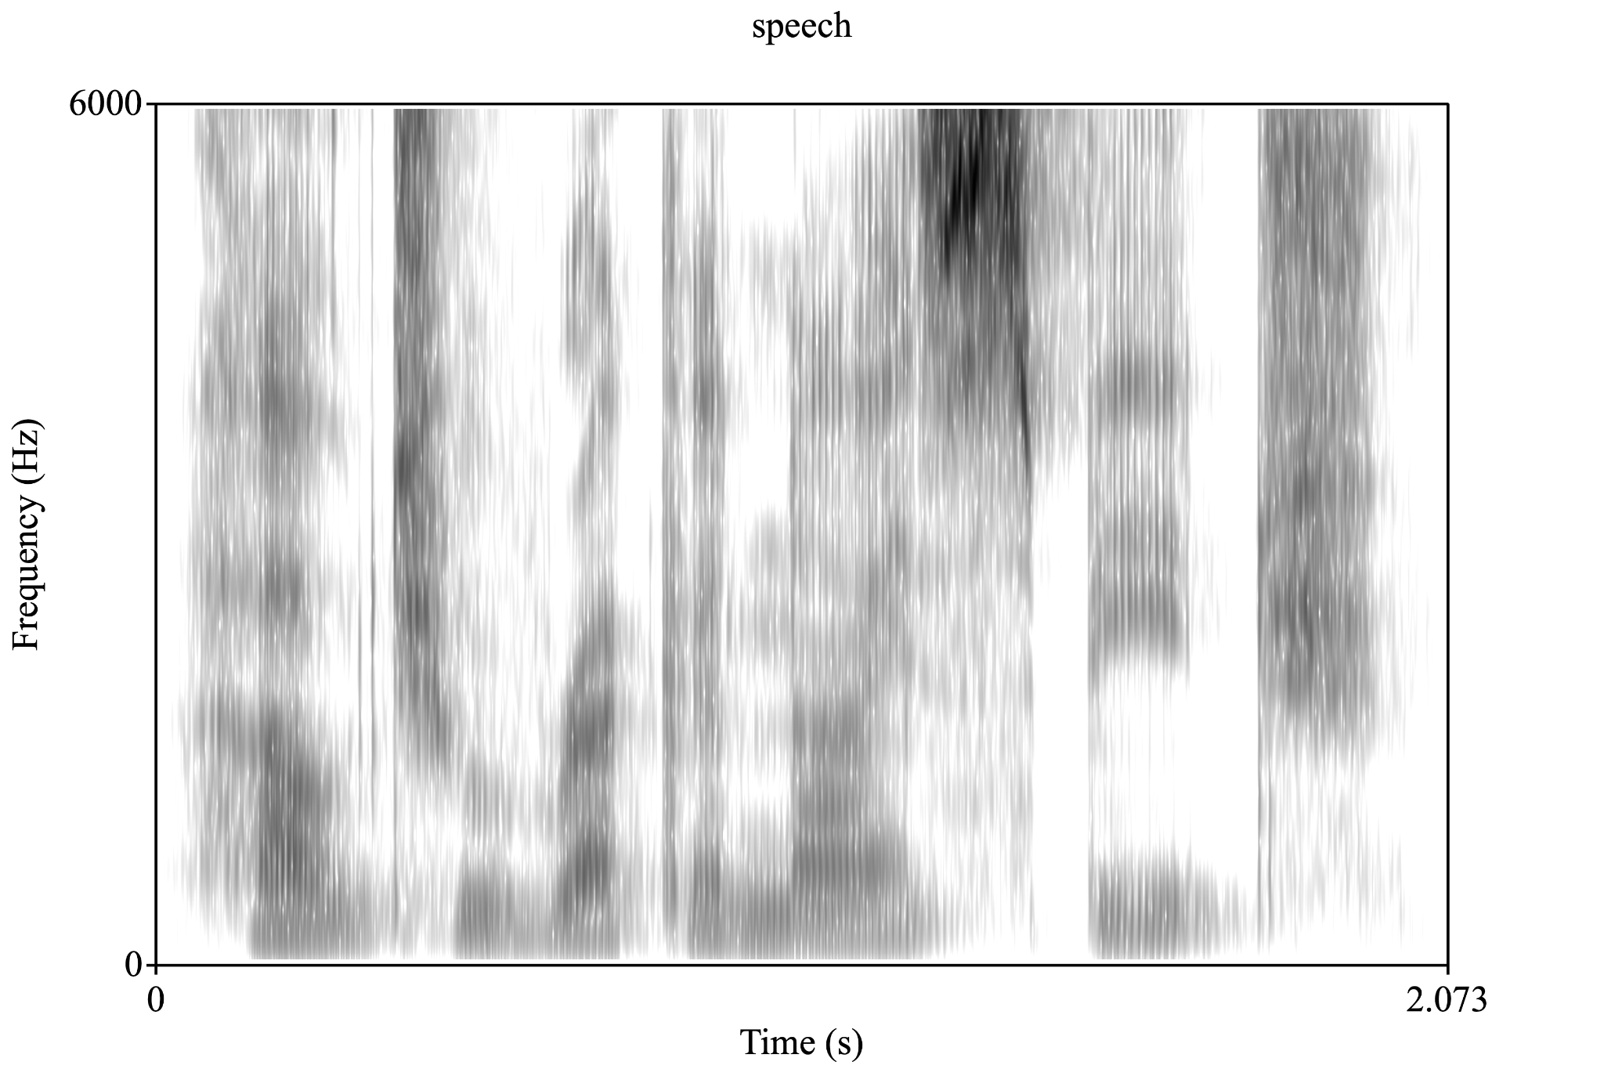
A non-visual example (this time with a visual)
Notes:
Copy and paste these annotations in real-time to further illustrate the point!!

Slide 14
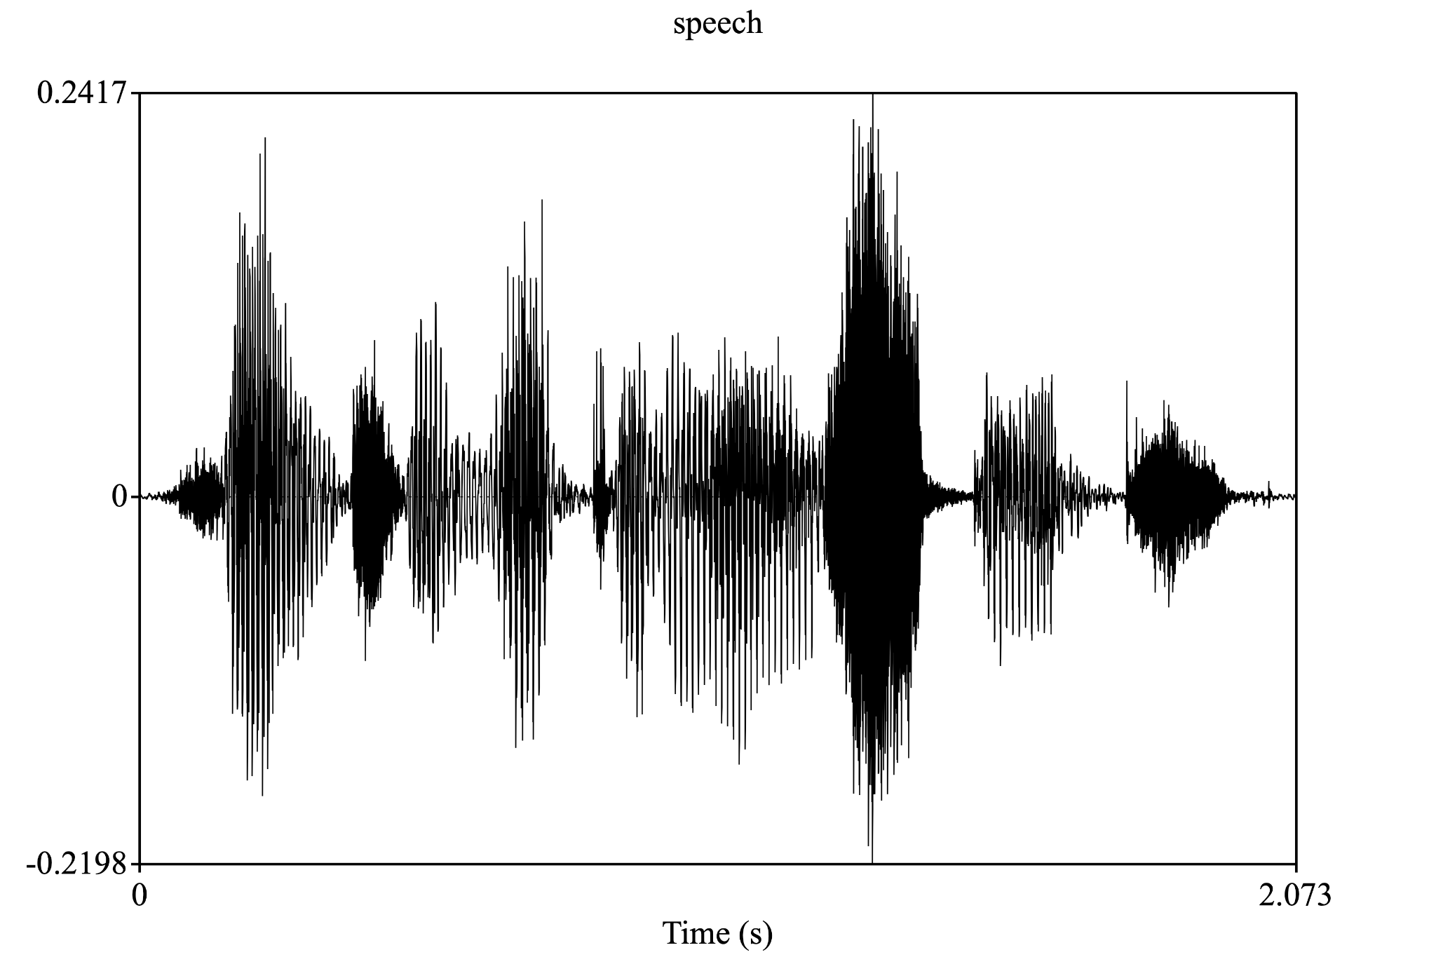
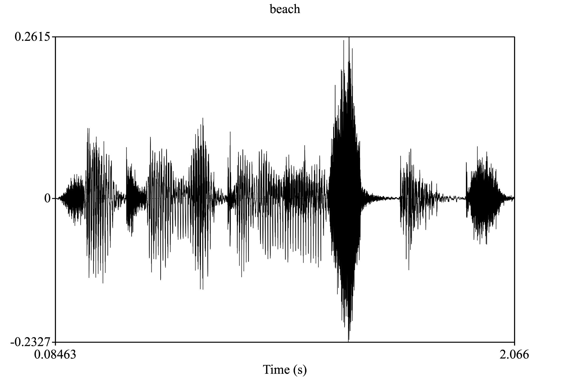
A non-visual example (this time with a visual)

Slide 15
A non-visual example (this time with a visual)

Slide 16
A non-visual example (this time with a visual)

Slide 17
How do we solve this problem?
We construct perception out of the context surrounding it using things like our previous knowledge and experience!
I can teach you I can teach you
🗣️ 🗣️
Speech pathologist Troublemaker

Slide 18
One more example
An interesting genre of video I’ve been getting on instagram

Slide 19
Exam 1 Review

Slide 20
Ch.1 How to Study the Mind
Ch.5 Object Recognition
Ch.2 Cognitive Neuroscience
Ch.6 Visual Imagery
Ch.4 Perception
Ch.7 Concepts & Categories

Slide 21
How to study the mind
Marr’s Levels of Analysis
  Computational
    What is the goal of the system?
  Algorithmic
    How does it do that/what are the rules that govern it?
  Implementational
    How is that physically instantiated in the brain?
Schools of thought
  Analytic introspection
    One can understand the mind via self-reflection.
  Behaviorism
    Mental processes are unobservable; behavior is absolute.
    Stimuli produce responses
  Cognitive revolution
    Some behaviors are not driven by stimuli alone (rats have a mental map of a maze they use to navigate)
Additional note: the general question of “how do we approach studying/understanding the mind?” informs almost everything about what scientists do – hypotheses, the methods, what we conclude from results, etc. are all informed by or arise from this core question!

Slide 22
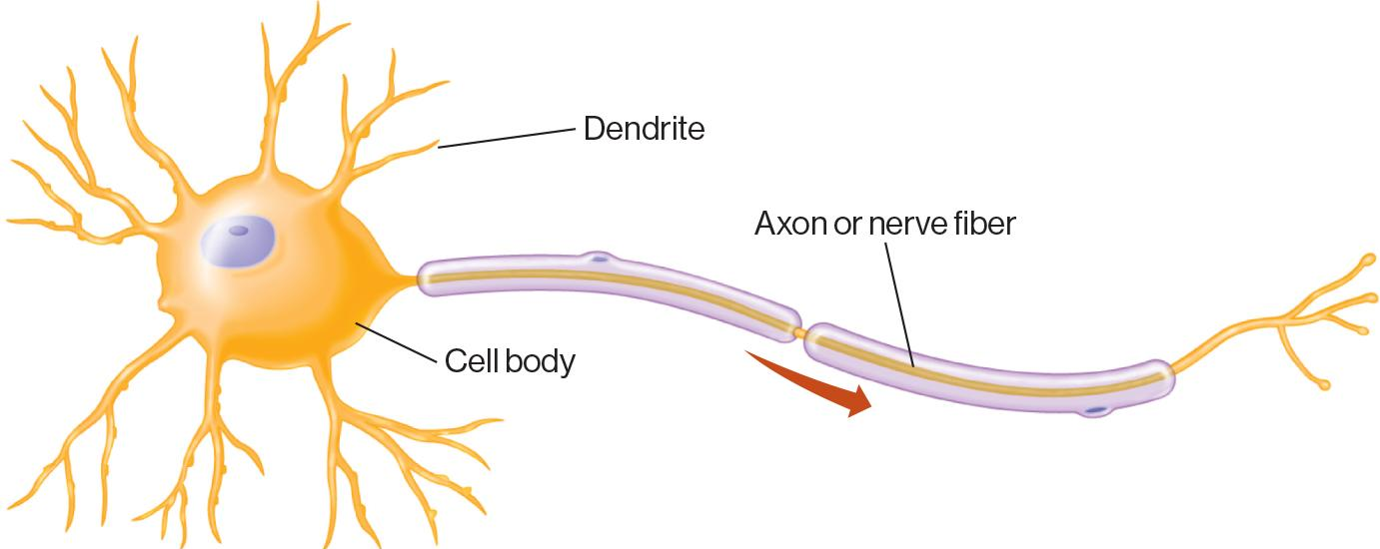
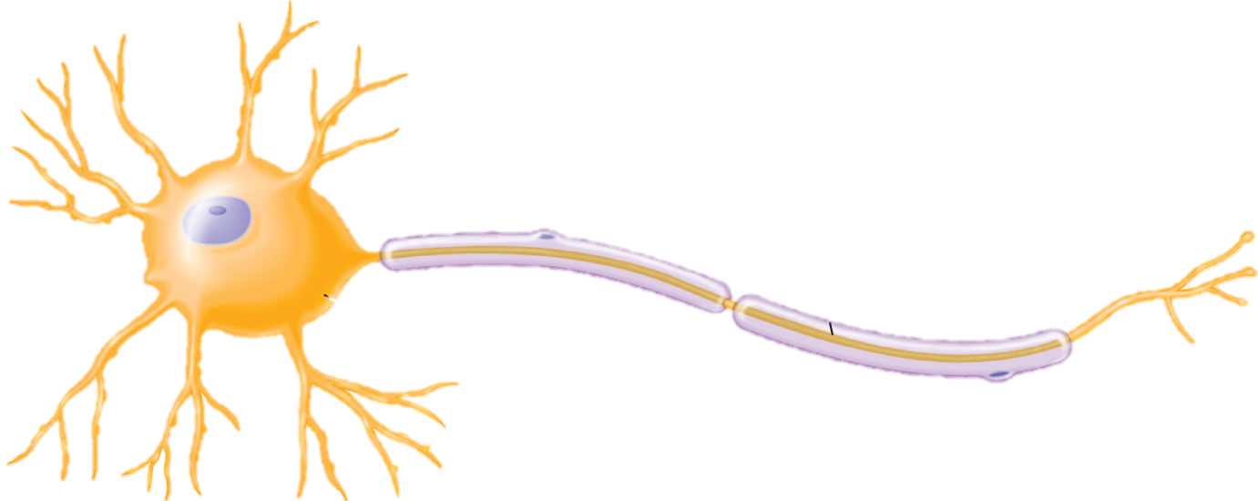
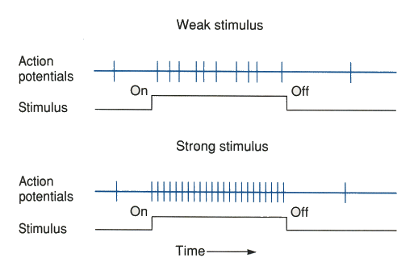
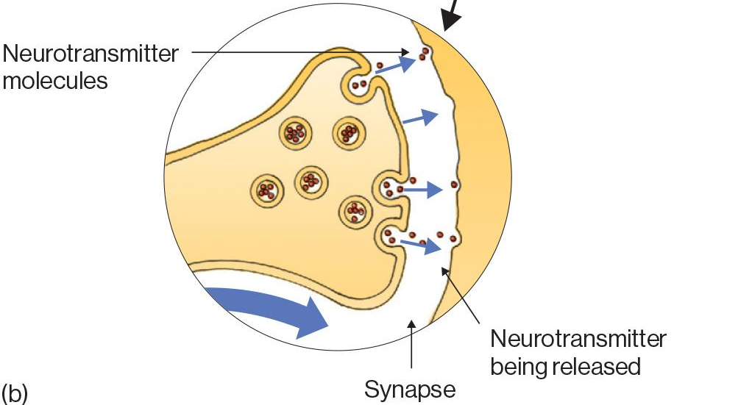
Cognitive Neuroscience
Action potentials as a measure of how excited a neuron is
‹#›
Brain regions communicate through mix of electrical and chemical signaling via neurons

Slide 23
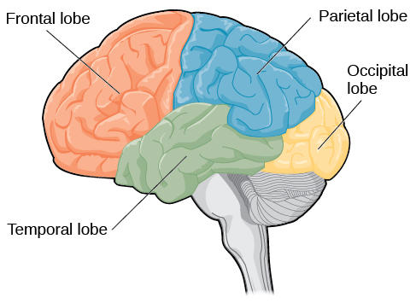
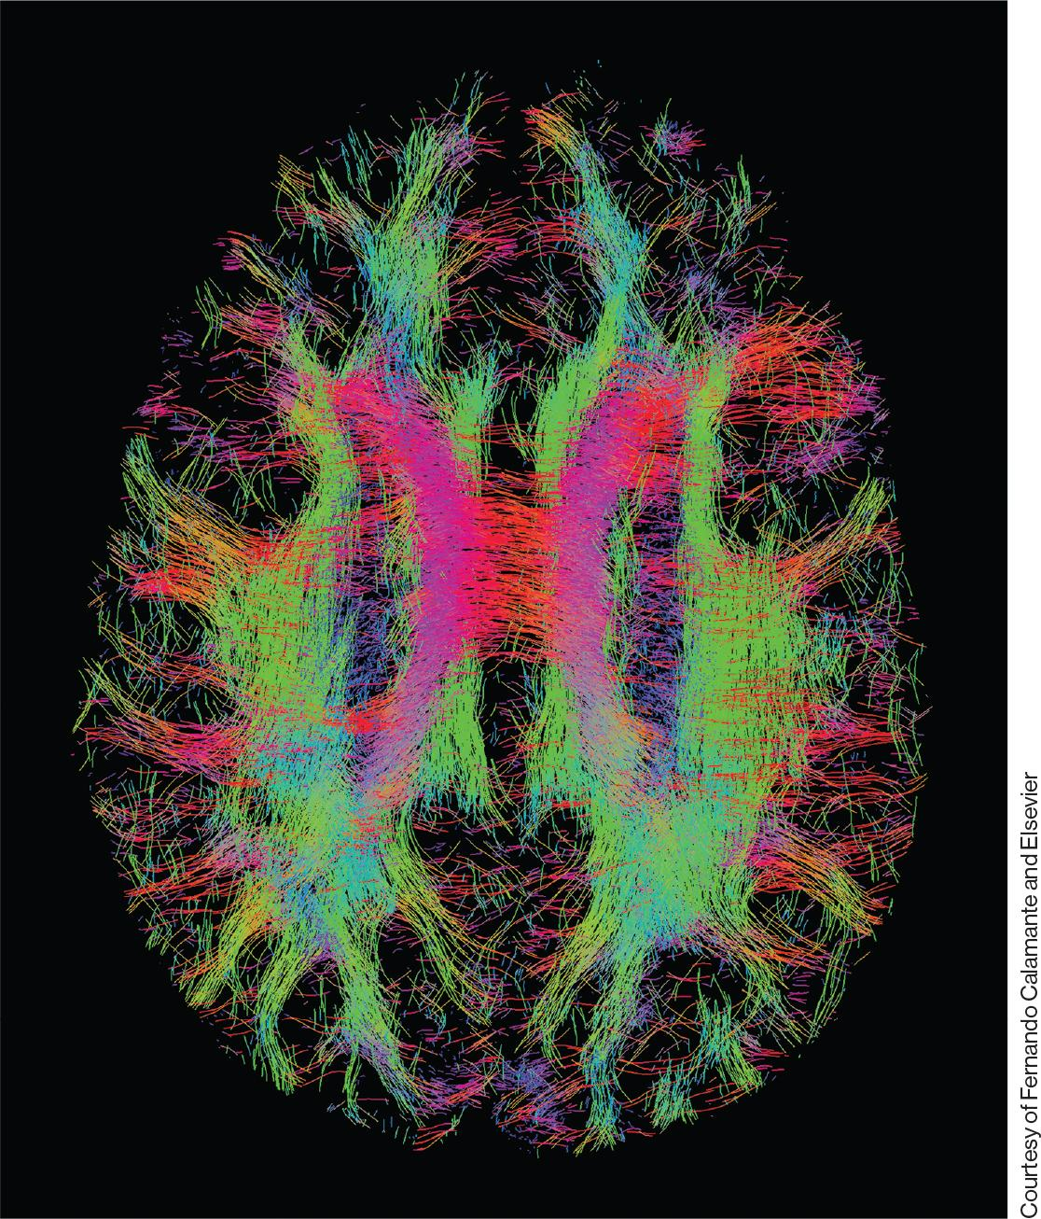
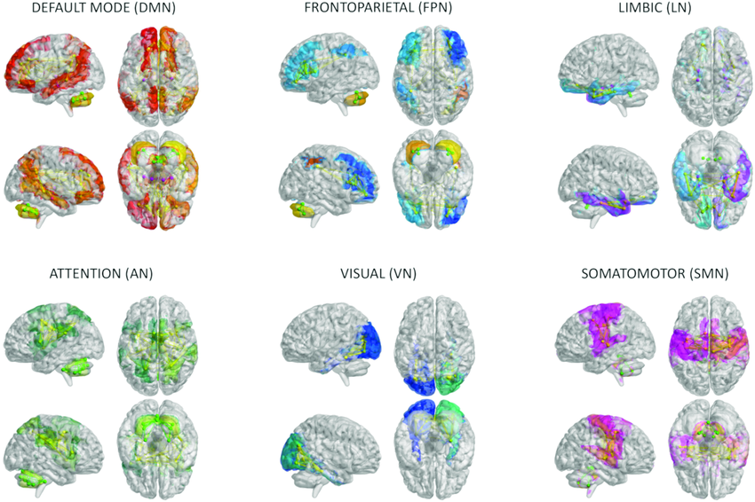
Cognitive Neuroscience
Different brain areas support different functions
Different brain networks support different functions
Monteverdi et al., 2023

Slide 24
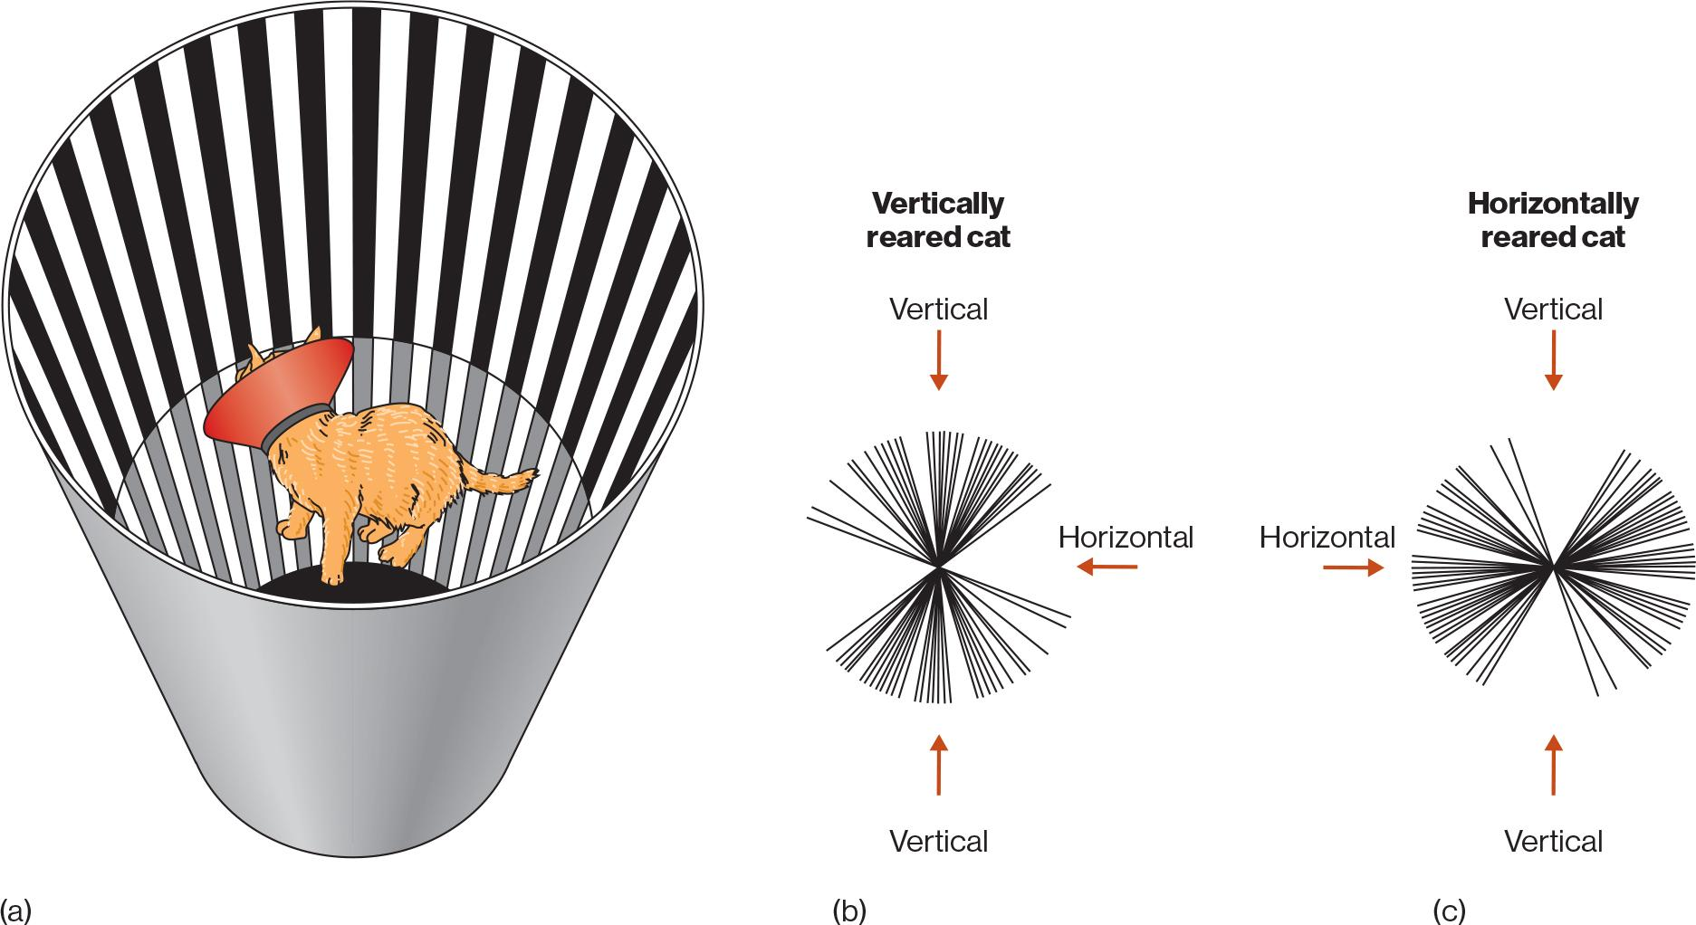
Cognitive Neuroscience
Cats brought up in vertical line environments showed more activity in the visual cortex to vertical lines
Different brain areas support different functions
These patterns of activity are also shaped by experience
(Blakemore & Cooper, 1970)

Slide 25
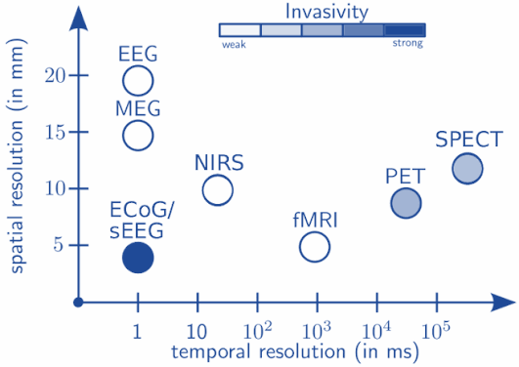
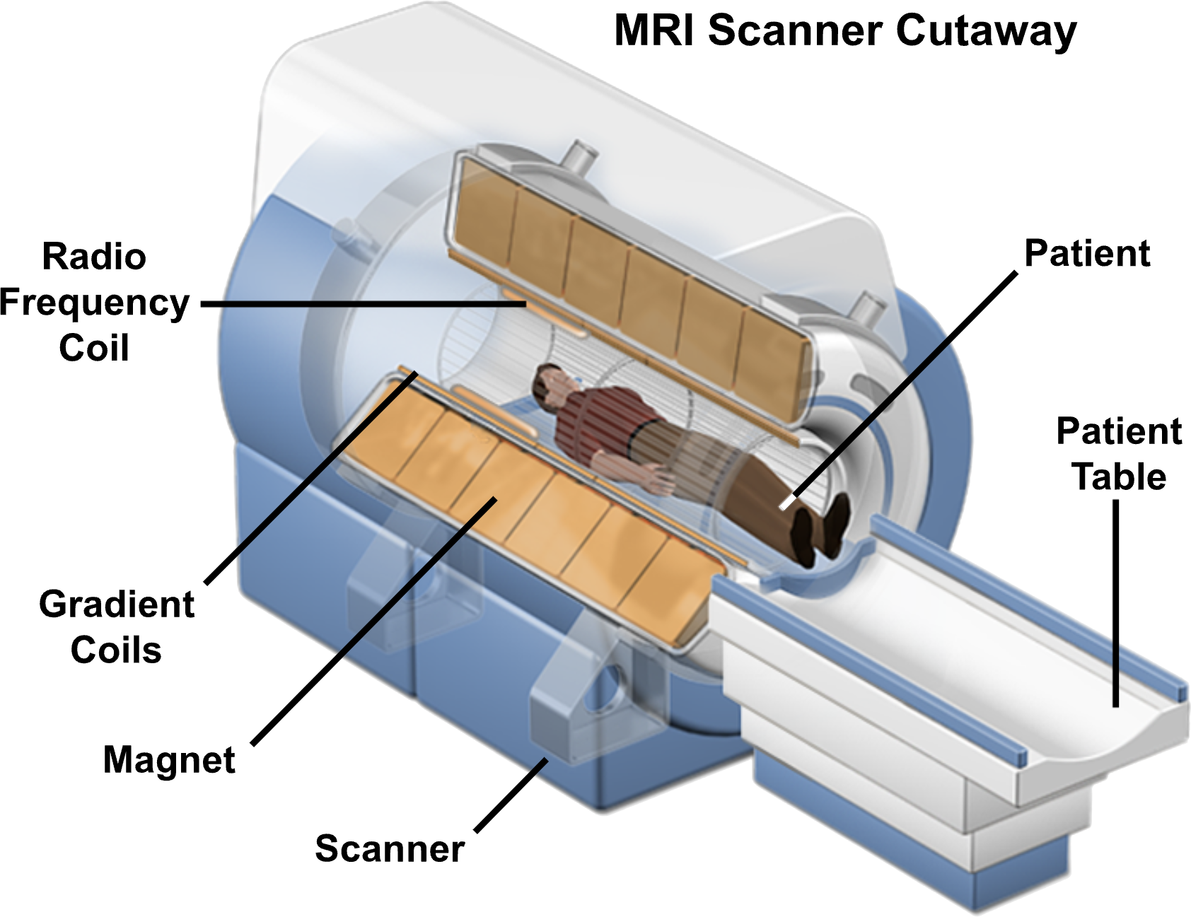
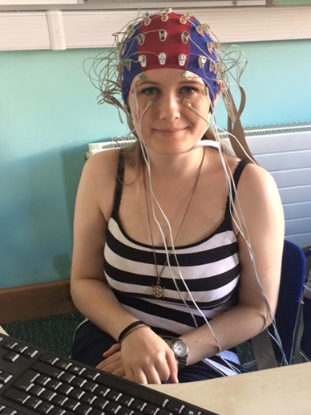
Neuroimaging Techniques
fMRI uses magnets to detect the presence of oxygenated and non-oxygenated blood in the brain
Different methods have different benefits & drawbacks; fMRI is high-resolution, but it takes longer than EEG
EEG places electrodes on the scalp to measure electrical activity in the brain

Slide 26
Perception
Perceptual ambiguity and the Inverse Projection Problem
Perception – Conscious experience resulting from sensation (information received by sensory organs)
Perception is ambiguous!
1966: MIT researchers tried to solve computer vision in a summer and they still haven’t
Why is it taking so long? It turns out perception is very complex!

Slide 27

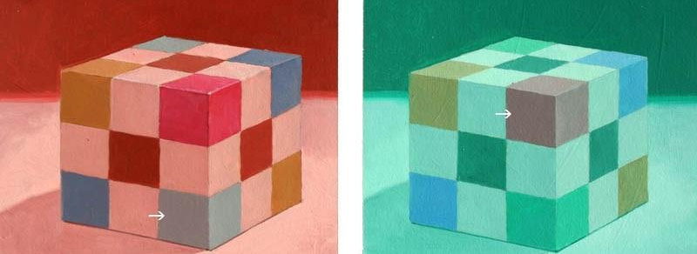

Perception
Viewpoint and color constancy: even though each of these images “look” different, they have to be recognized by the system as being the same despite their context
Apparent motion
Apparent motion: Individual images in sequence can give rise to the appearance of motion

Slide 28
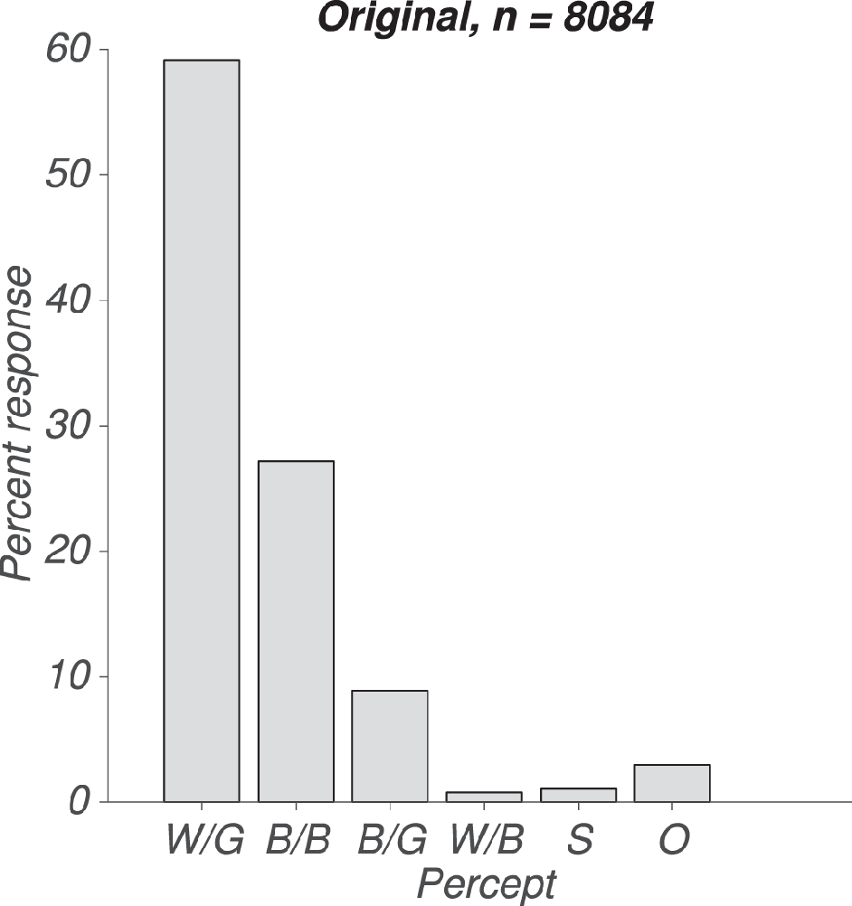
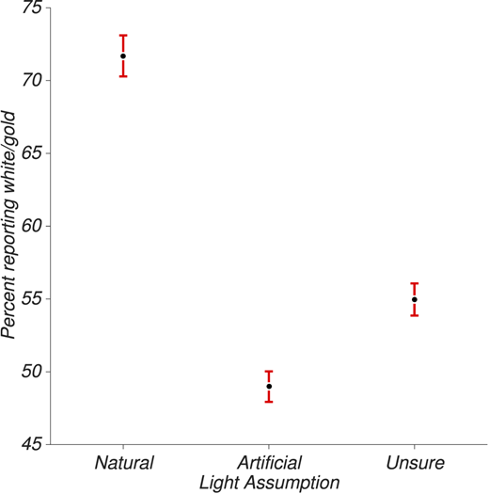
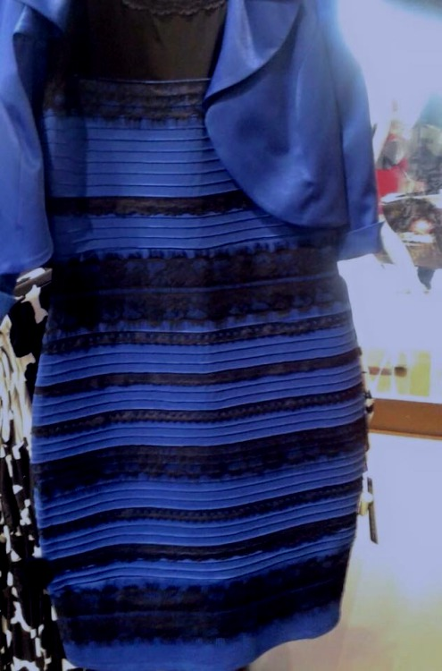
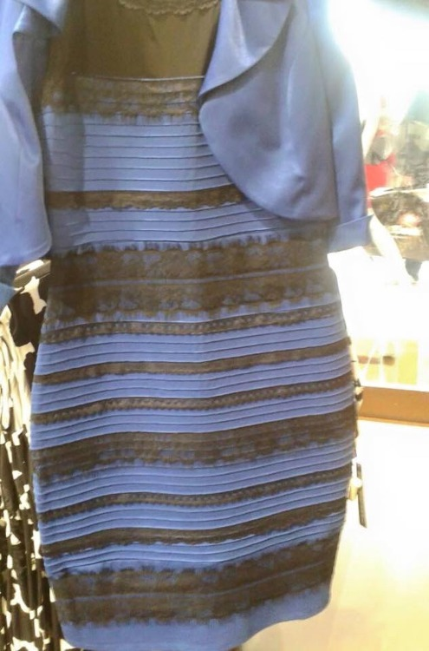
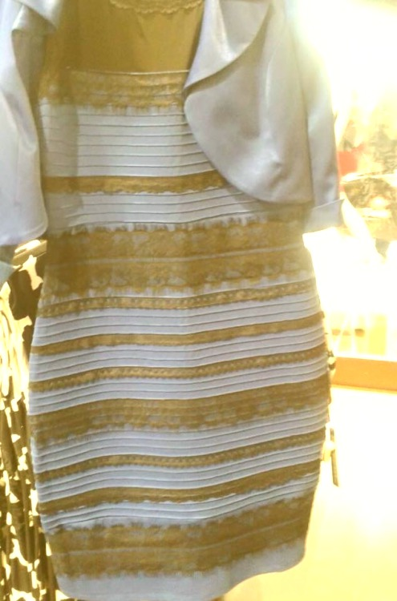
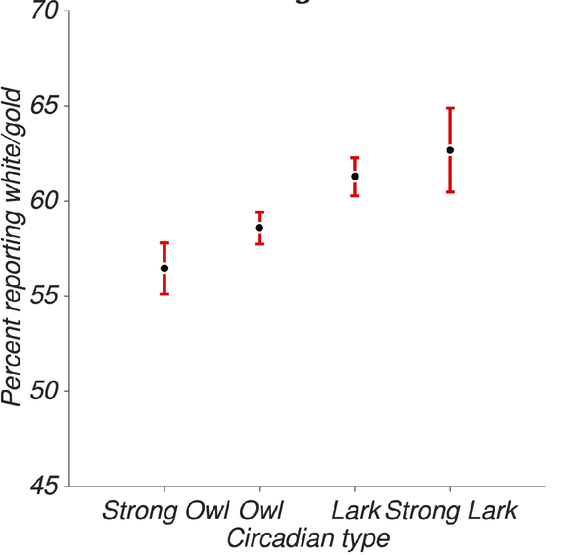
Perception
Perception is shaped by experience
Wallisch (2017)
‹#›

Slide 29
Perception
Perception is constructive and stochastic
Perception is constructed in the mind, with some percepts more likely than others
Multiple percepts can arise from input, with perception varying from moment to moment
Knowledge and experience are important determinants for perception and allow us to achieve perceptual constancy

Slide 30
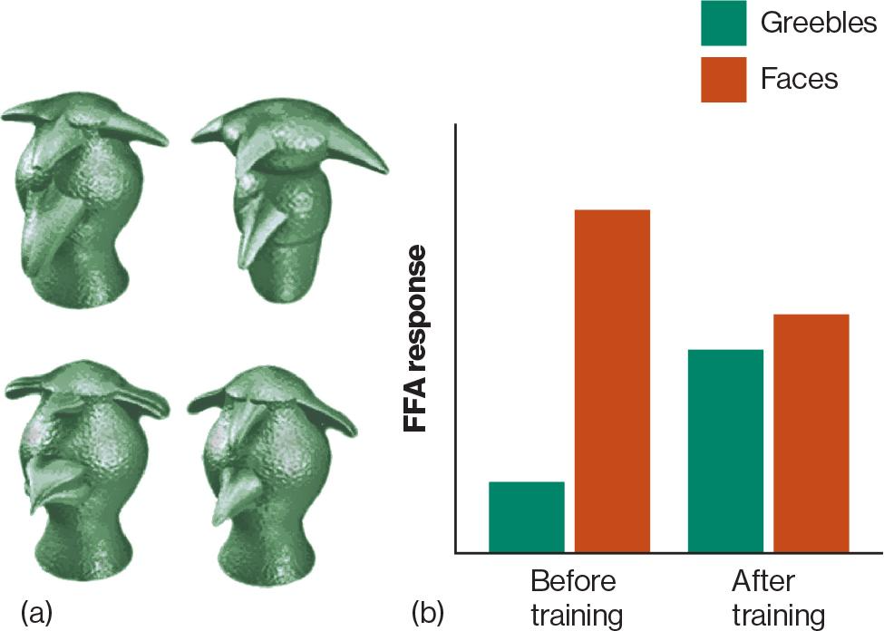
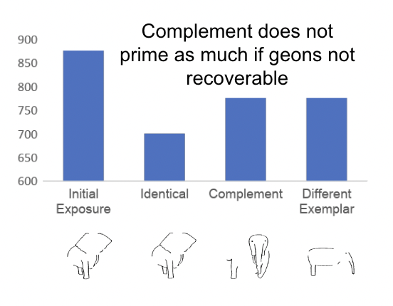
Object Recognition
Components – objects are made of geons, and we recognize these basic components
The FFA is recruited more when viewing faces than other objects
BUT it is also recruited when we accumulate expertise with something
If an image is altered such that its complement (inverse) has unrecognizable geons, priming is not as strong
Expertise increases holistic object recognition

Slide 31
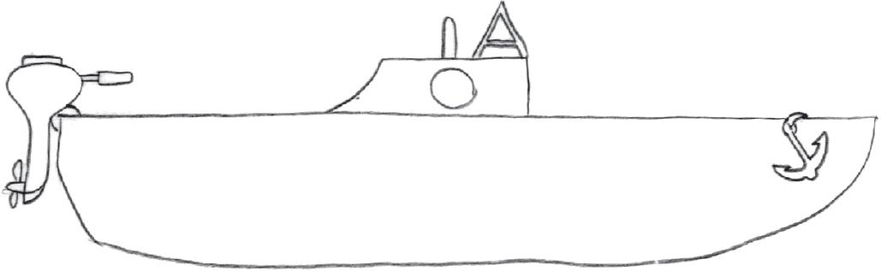
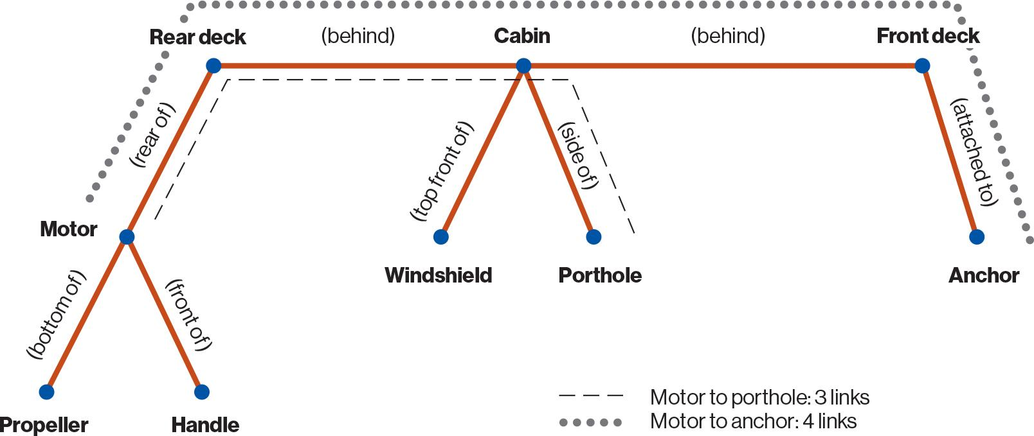
Visual Imagery
Imagery: Creating a perceptual experience in the absence of physical stimuli
Individual Differences: Individuals differ to which degree they rely on visual imagery to think
Some even have aphantasia, which is the absence of visual imagery and they:
May have impairments in visual working memory, but may use verbal working memory to compensate
But they still have thought!
Does thought rely on visual or abstract (propositional) representations?
Mental scanning experiment
Focus on anchor in mind’s eye; does boat also have a motor?
Responses times vary based on distance from starting point, consistent with spatial imagery
But also consistent with propositional representation
(Pylyshyn, 1973)
Kosslyn (1973)
Kosslyn et al. (1995)
‹#›

Slide 32
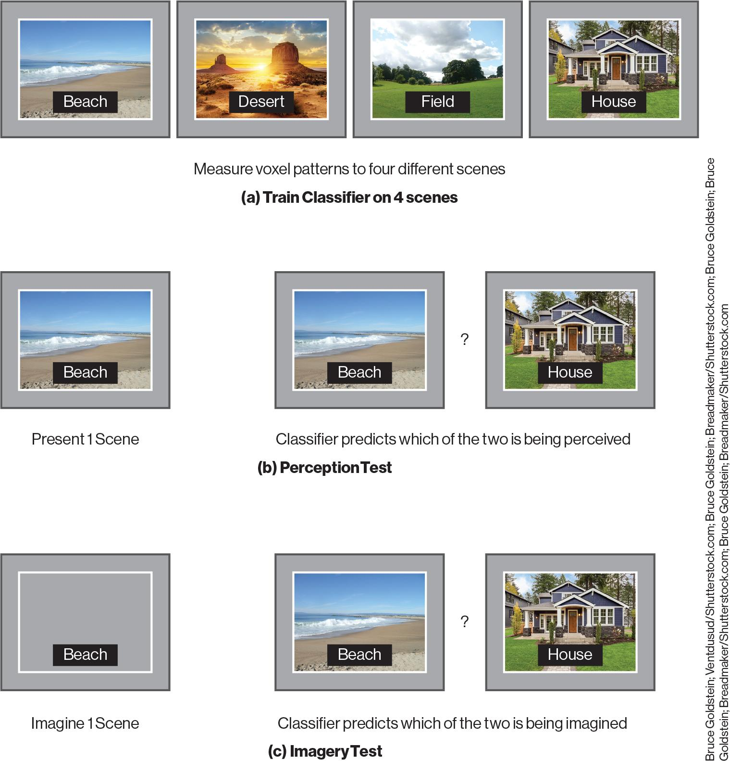
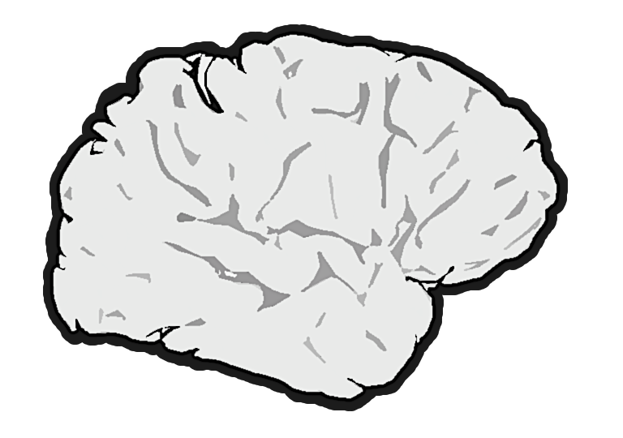
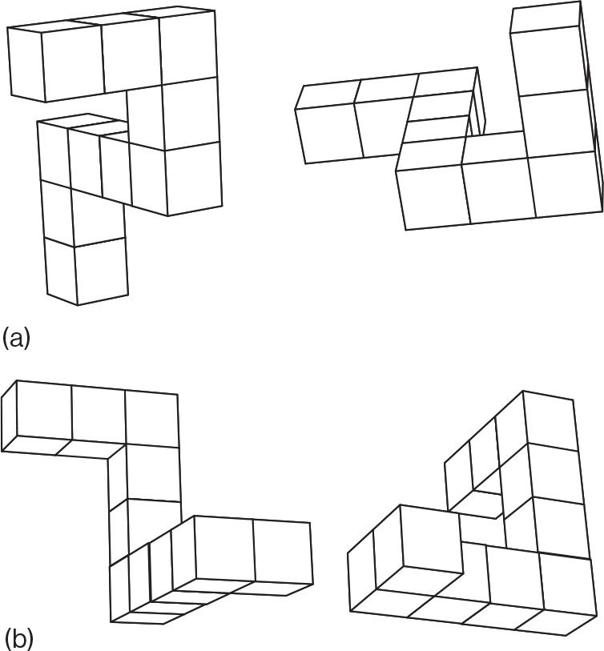
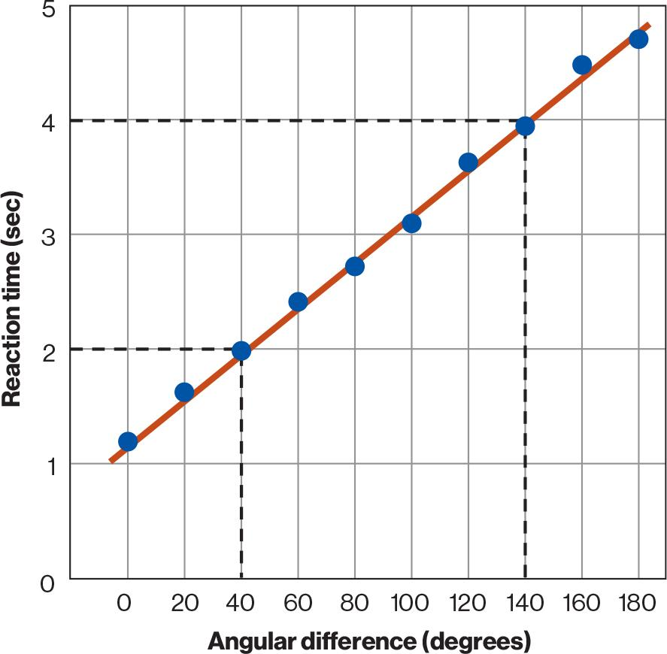

Visual Imagery
Brain imaging studies support a
common mechanism for perception and imagery
Mental chronometry studies support a link between perception and imagery
Multi-voxel pattern analysis: What is the pattern of activity across different voxels (3D pixels) in the brain?
How long does it take to perform a mental task?
63% accuracy
Similar patterns of activation for perceived and imagined inputs
Johnson and Johnson (2004)
55% accuracy
But there are also important differences between imagery and perception!
The method of loci: using imagery to aid in memory (remembering a deck of cards)
Perception is automatic, imagery is effortful
Can switch between percepts in perception but difficult in imagery
Shepard & Metzler (1971)

Slide 33
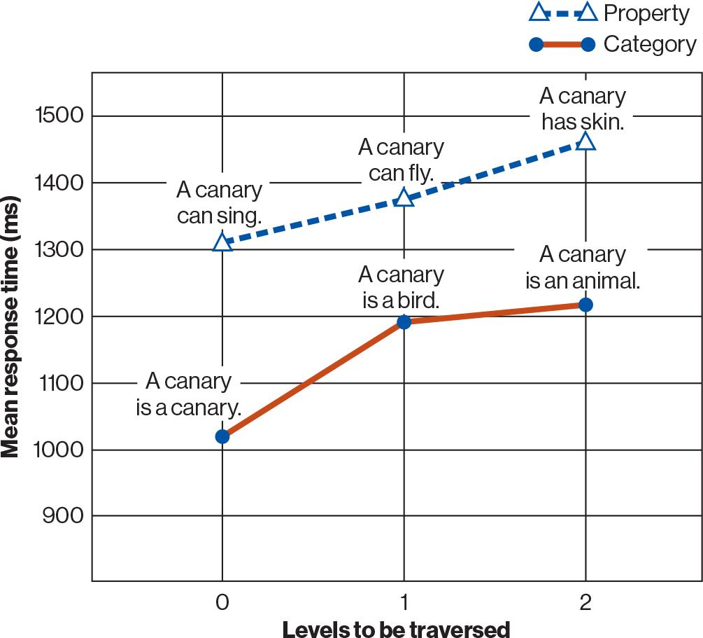
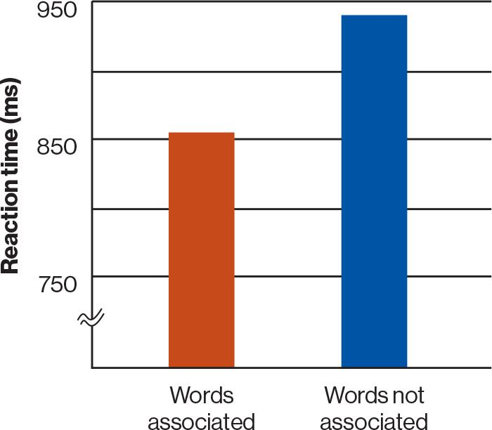
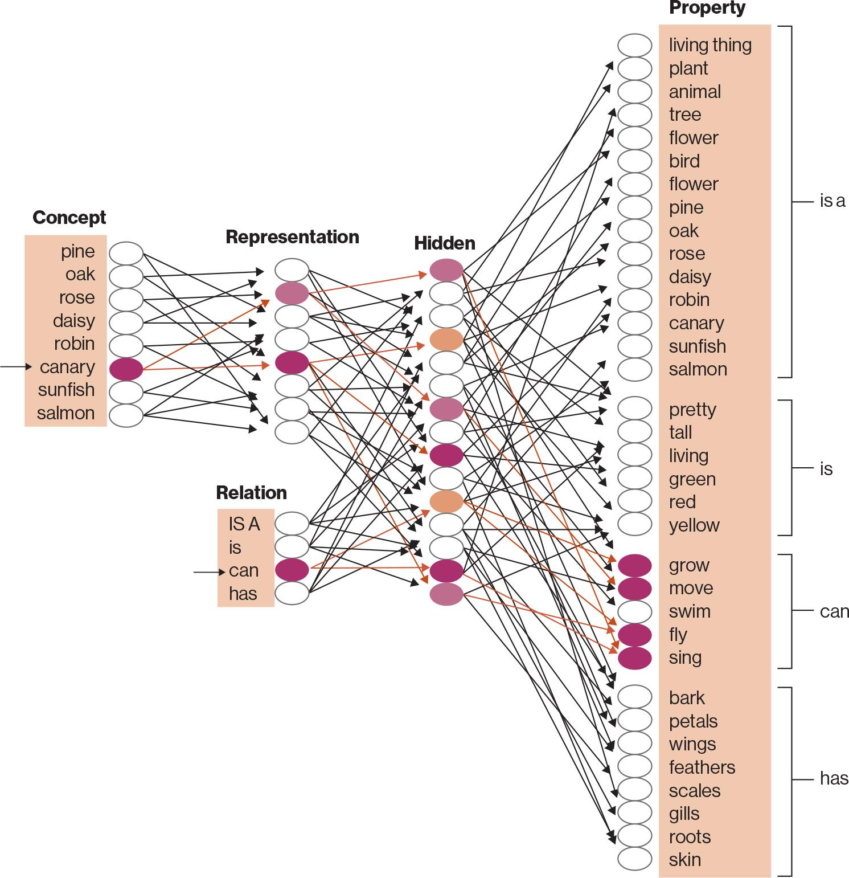
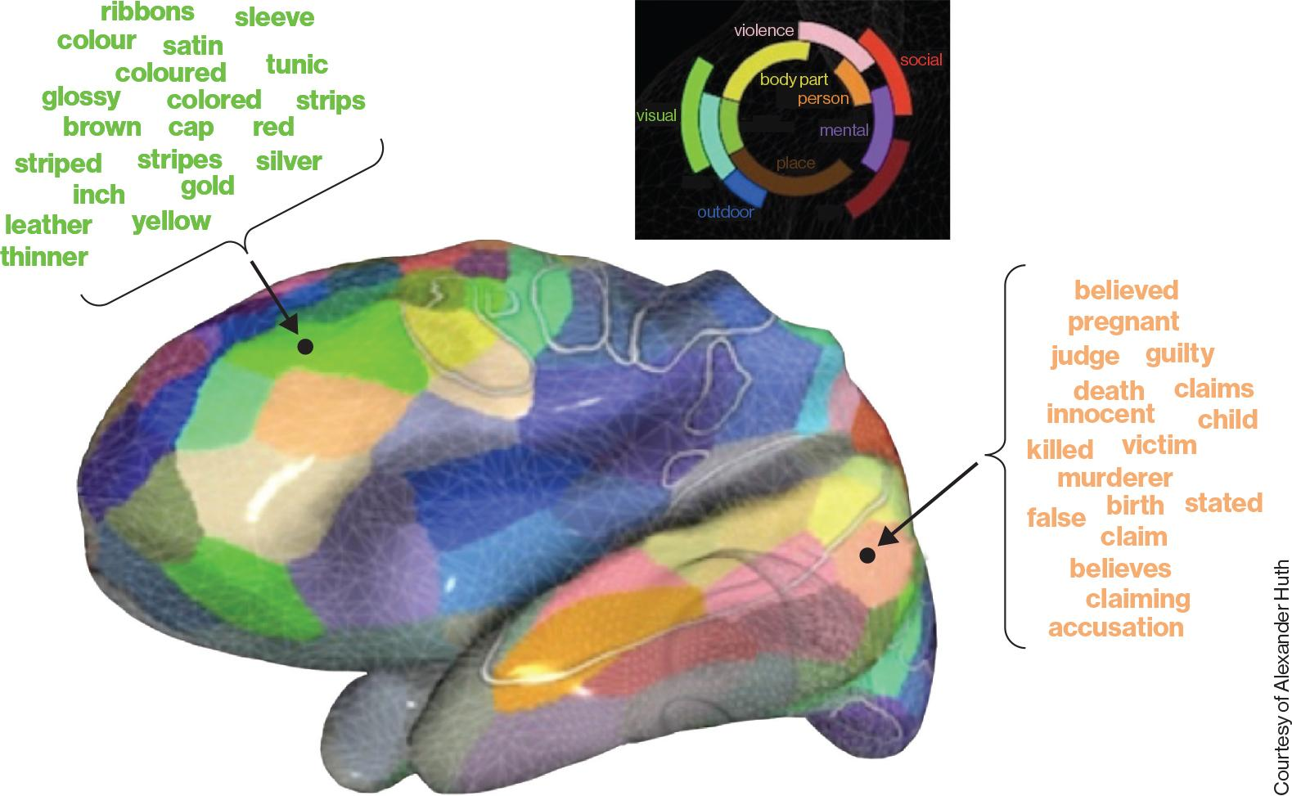
Concepts and categories
Hierarchical semantic models capture much of behavior, especially taxonomic relations
  But not all relations (e.g., thematic) or behavior (e.g., typicality) effects
Connectionist models offer an alternative model of semantic organization
  Suggest that representations are distributed across features
Animal
Animal
Bird
Bird
Canary
Robin
Canary
Ostrich
Robin
Ostrich
‹#›
Neural data also support distributed representations of concepts

Slide 34
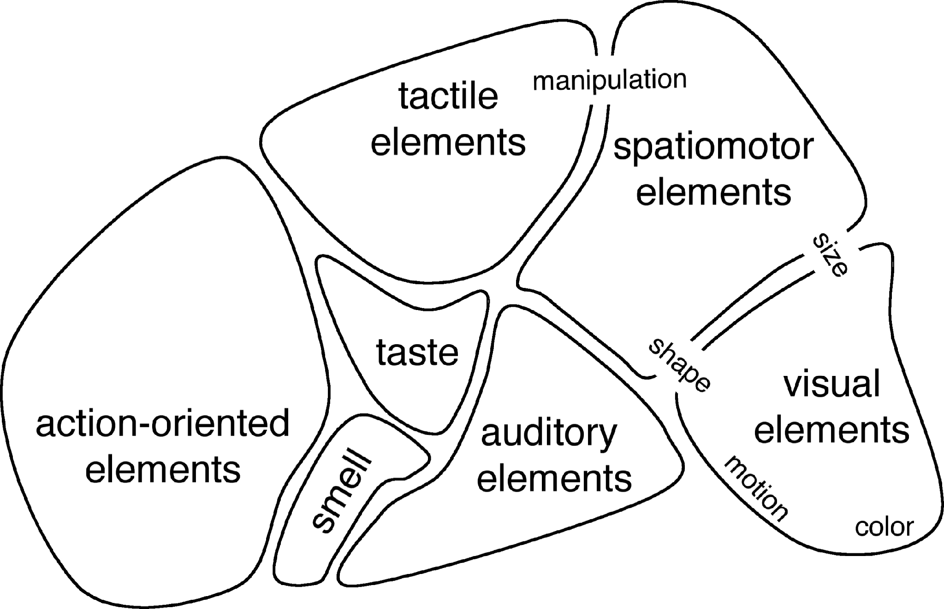

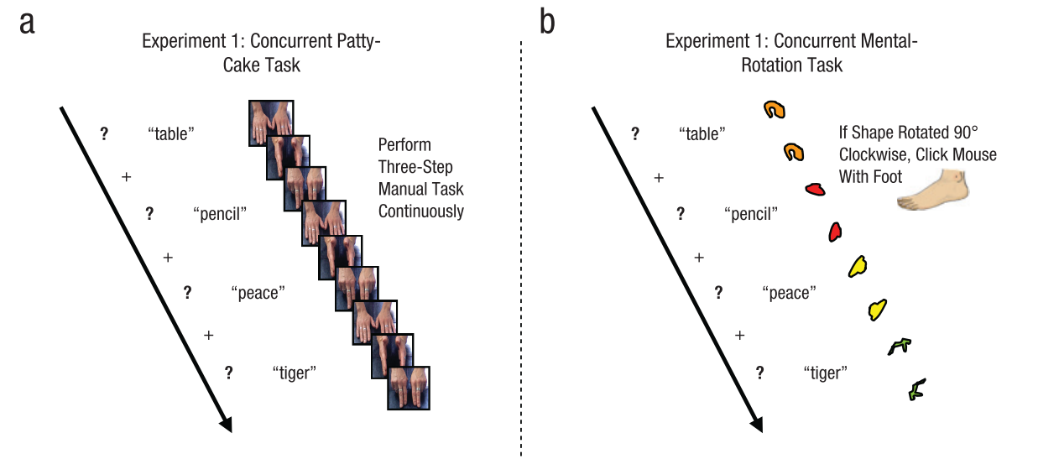
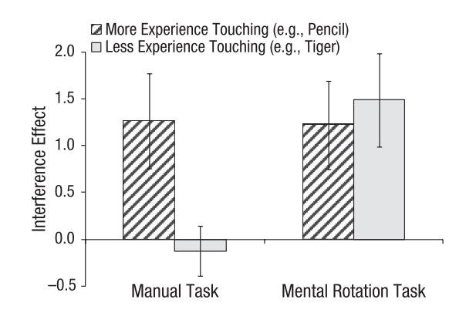
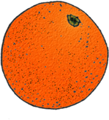
Concepts and categories
Embodied (sensorimotor-based) cognition
An embodied approach to semantic knowledge
Logic: If manual experience is integral to accessing meaning, semantic processing should be harder when hands engaged in incompatible action
Interference Effect:
Error Rate_{(Concurrent Task)} – Error Rate_{(No concurrent task)}
Yee et al. (2013)
An embodied approach to cognition:
  Sensorimotor experience is critical to concept representation
  Amodal hub is especially important for abstract concepts
Is sensorimotor recruitment integral to meaning or incidental?
It is striking that brain regions associated with meaning of an object are also recruited when interacting with that object

Slide 35
Neuropsychological effects on attention
10/5/26

Slide 36
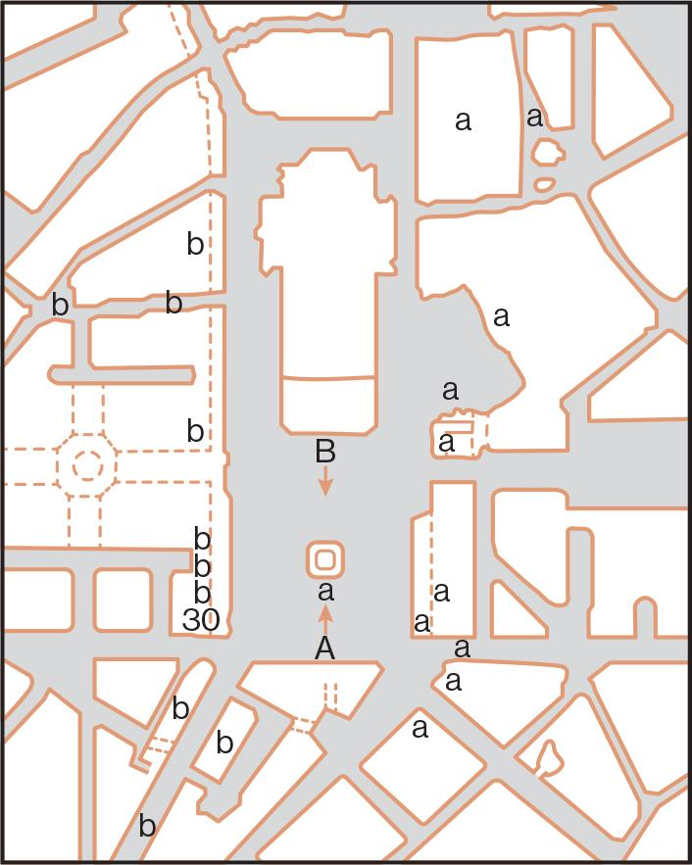
Hemispatial / Unilateral neglect:
Inability to attend to half of visual field, often due to damage in parietal lobe
Most often left visual field, following right hemisphere damage
May be seen both in perception and in imagery
Case study: Patient ignored left half of visual field, even in imagery
(Bisiach & Luzzatti, 1978)

Slide 37
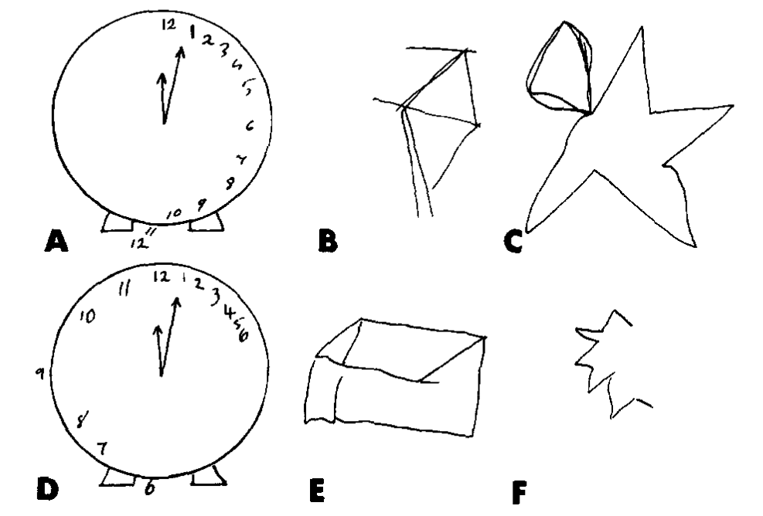
Hemispatial / Unilateral neglect:
Ignoring half of the visual field might lead individuals with neglect to:
Only put makeup on half of their face
Only eat half a plate of food
Only draw half a clock (or half of anything, really)
Bump into things on the neglected side
(Ogden, 1985)
It is worth noting that this is not a lack of vision in one half of the visual field, but a deficit in attention to it. One notable study (Berti & Rizzolatti, 1992) suggests that patients are able process visual stimuli in the affected field.
Notes:
Can visual processing be carried out without visual awareness of the presented objects? In the present study we addressed this problem in patients with severe unilateral neglect. The patients were required to respond as fast as possible to target stimuli (pictures of animals and fruits) presented to the normal field by pressing one of the two keys according to the category of the targets. We then studied the influence of priming stimuli, again pictures of animals or fruits, presented to the neglected field on the responses to targets. By combining different pairs of primes and targets, three different experimental conditions were obtained. In the first condition, "Highly congruent," the target and prime stimuli belonged to the same category and were physically identical; in the second condition, "Congruent," the stimuli represented two elements of the same category but were physically dissimilar; in the third condition, "Noncongruent," the stimuli represented one exemplar from each of the two categories of stimuli. The results showed that the responses were facilitated not only in the Highly congruent condition, but also in the Congruent one. This finding suggests that patients with neglect are able to process stimuli presented to the neglected field to a categorical level of representation even when they deny the stimulus presence in the affected field. The implications of this finding for psychological and physiological theory of neglect and visual cognition are discussed.

Slide 38
Takeaway
There are neuropsychological effects on attention, meaning that certain types of damage to the brain can fundamentally alter how one attends objects in the visual field.
  Often due to damage in the parietal lobe specifically.
This affects both perception and imagery, as well as other aspects such as spatial awareness.
Effects are often contralateral, meaning that damage to the right side causes impairments to the left visual field.

