Slide 1

Experiment Plan: Gamified Sightseeing in Asakusa
Checkpoints, points design, participant instructions, schedule and budget
HyoSeok (Jake) Choi
15 October 2026 · Draft for discussion

Slide 2
Table of contents
1
Experiment at a glance
2
Checkpoint list (16 spots)
3
Spot details
4
Points and stamp rally
5
Participant instructions
6
Schedule
7
Participants
8
Budget
9
Items to confirm

Slide 3
Experiment at a glance
2
groups
With vs without gamification
16
checkpoints
3 popular, 13 less popular
40
participants
20 per group, plus 4 in a pilot
2.5 h
free walk
Alone, on foot, within 1.5 km
Research question
Do gamification features in a tourism app (Suisui Tabi) lead visitors from crowded famous spots to less popular spots nearby?
Design
Control: app map with all 16 checkpoints and spot information
Gamification: the same map, plus points, photo missions, a stamp rally, ranking and medals
Same for both: area, spots, days, time limit, payment; no extra reward for less popular spots
Measured: GPS tracks (visits, time in the crowded core) and separate pre / post questionnaires

Slide 4
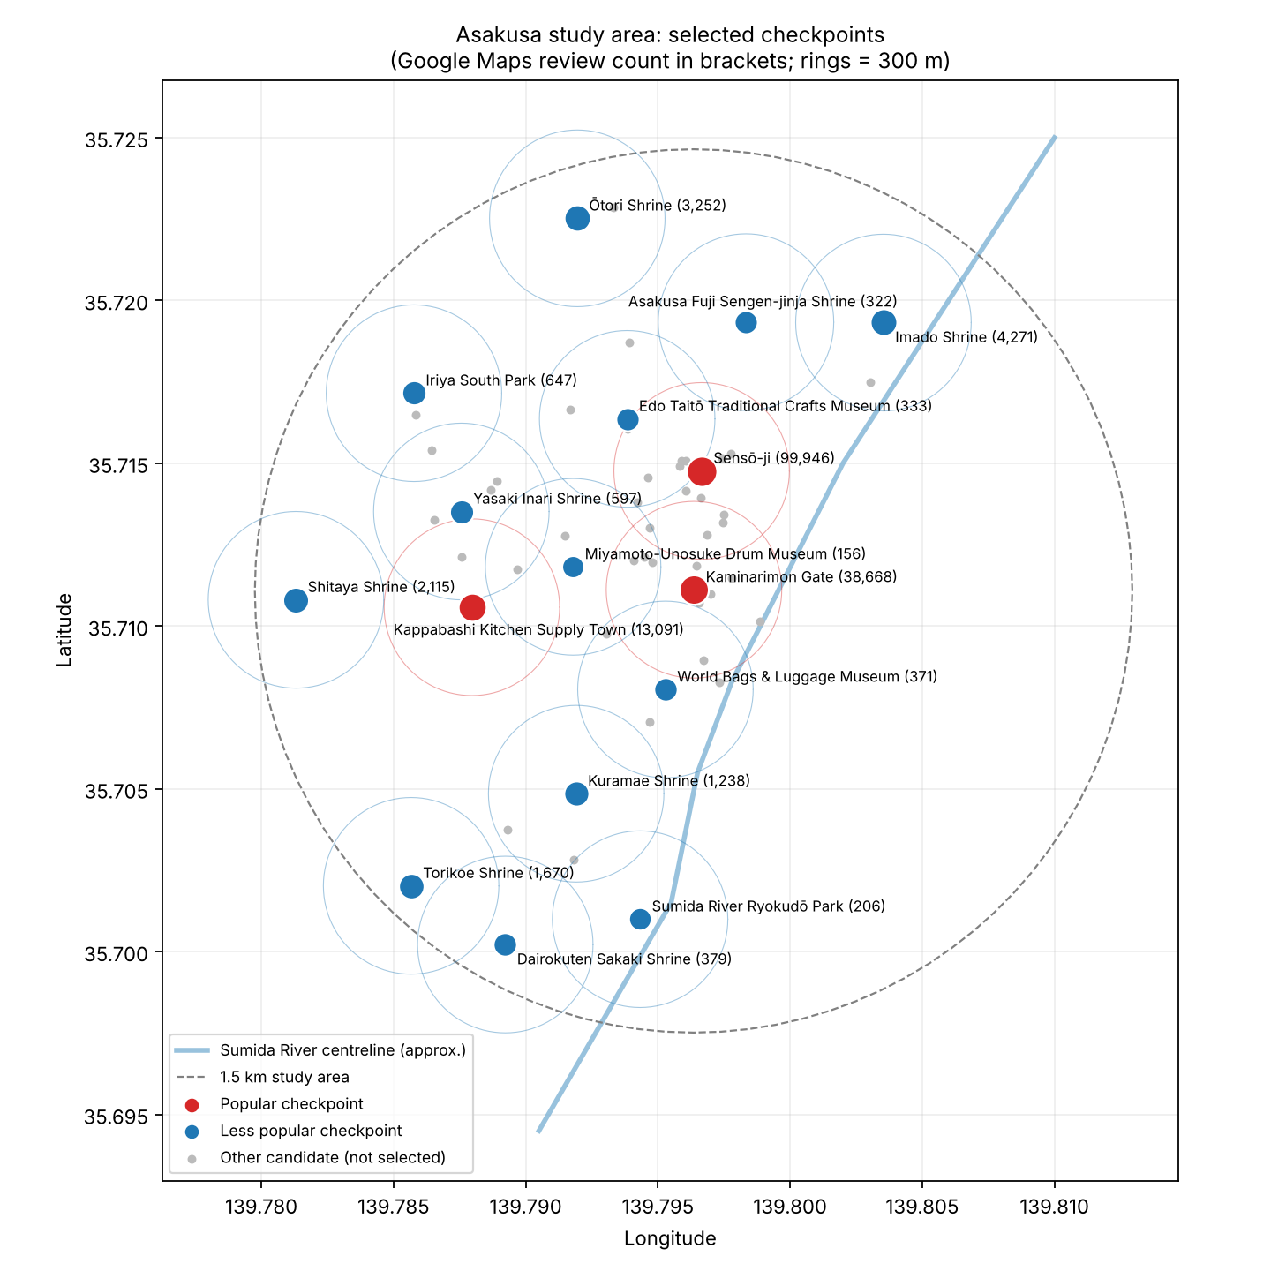
Checkpoint map
Study area
1.5 km around Kaminarimon, west bank of the Sumida River
Start and finish
Asakusa Culture Tourist Information Center (opposite Kaminarimon) or a rented room nearby
Selection rules
Popularity from Google Maps review counts (Jenks natural breaks)
All checkpoints at least 300 m apart
Less popular spots 300–1,500 m from a popular spot
Red = popular, blue = less popular

Slide 5
Checkpoint list (1–8 of 16)
# | Spot | Japanese | Type | Popularity | Reviews | Rating | From start
1 | Sensō-ji | 浅草寺 | Temple | Popular | 99,946 | 4.6 | 451 m
2 | Kaminarimon | 雷門 | Landmark | Popular | 38,668 | 4.5 | 48 m
3 | Kappabashi | かっぱ橋道具街 | Shopping street | Popular | 13,091 | 4.3 | 775 m
4 | Imado Shrine | 今戸神社 | Shrine | Less pop. (medium) | 4,271 | 4.2 | 1,146 m
5 | Ōtori Shrine | 鷲神社 | Shrine | Less pop. (medium) | 3,252 | 4.3 | 1,378 m
6 | Shitaya Shrine | 下谷神社 | Shrine | Less pop. (medium) | 2,115 | 4.2 | 1,376 m
7 | Torikoe Shrine | 鳥越神社 | Shrine | Less pop. (medium) | 1,670 | 4.2 | 1,378 m
8 | Kuramae Shrine | 蔵前神社 | Shrine | Less pop. (medium) | 1,238 | 4.3 | 775 m
Orange = popular. Reviews and ratings: Google Maps, 13 Oct 2026. "From start" = straight-line distance from the Asakusa Culture Tourist Information Center.

Slide 6
Checkpoint list (9–16 of 16)
# | Spot | Japanese | Type | Popularity | Reviews | Rating | From start
9 | Iriya South Park | 入谷南公園 | Park | Less pop. (medium) | 647 | 3.9 | 1,208 m
10 | Yasaki Inari Shrine | 矢先稲荷神社 | Shrine | Less pop. (medium) | 597 | 4.2 | 869 m
11 | Dairokuten Sakaki Shrine | 第六天榊神社 | Shrine | Less pop. (low) | 379 | 3.9 | 1,341 m
12 | World Bags & Luggage Museum | 世界のカバン博物館 | Museum | Less pop. (low) | 371 | 4.3 | 317 m
13 | Edo Taitō Crafts Museum | 江戸たいとう伝統工芸館 | Museum | Less pop. (low) | 333 | 4.0 | 675 m
14 | Asakusa Fuji Sengen Shrine | 浅草富士浅間神社 | Shrine | Less pop. (low) | 322 | 4.0 | 972 m
15 | Sumida River Ryokudō Park | 隅田川沿いの緑道公園 | Park | Less pop. (low) | 206 | 4.2 | 1,098 m
16 | Drum Museum (Taiko-kan) | 太鼓館 | Museum | Less pop. (low) | 156 | 4.3 | 447 m
Orange = popular. Reviews and ratings: Google Maps, 13 Oct 2026. "From start" = straight-line distance from the Asakusa Culture Tourist Information Center.

Slide 7
Spot details (1–4)
1. Sensō-ji 浅草寺
Popular · Temple · 99,946 reviews (4.6) · 451 m from start
Tokyo's oldest temple (founded 628): main hall, five-storey pagoda, Hōzōmon gate.
Entry: Free. Grounds open all day; main hall about 6:00–17:00.
Location: 35.71477, 139.79666
2. Kaminarimon 雷門
Popular · Landmark · 38,668 reviews (4.5) · 48 m from start
The "Thunder Gate" with its giant red lantern; entrance to Sensō-ji and Nakamise street.
Entry: Free. Open all day.
Location: 35.71112, 139.79637
3. Kappabashi かっぱ橋道具街
Popular · Shopping street · 13,091 reviews (4.3) · 775 m from start
About 800 m of shops selling kitchenware, knives and plastic food samples.
Entry: Free to walk. Many shops close on Sundays and holidays.
Location: 35.71058, 139.78796
4. Imado Shrine 今戸神社
Less popular (medium) · Shrine · 4,271 reviews (4.2) · 1,146 m from start
Said to be a birthplace of the maneki-neko (beckoning cat); known for matchmaking.
Entry: Free. Grounds open; office hours limited.
Location: 35.71932, 139.80353
Descriptions, fees and hours are from general knowledge; confirm on official sites before the experiment.

Slide 8
Spot details (5–8)
5. Ōtori Shrine 鷲神社
Less popular (medium) · Shrine · 3,252 reviews (4.3) · 1,378 m from start
Famous for the Tori-no-ichi fair in November, with decorated kumade rakes.
Entry: Free. Very crowded on fair days in November.
Location: 35.72252, 139.79195
6. Shitaya Shrine 下谷神社
Less popular (medium) · Shrine · 2,115 reviews (4.2) · 1,376 m from start
One of the oldest shrines in Taitō City; site of Edo's first yose (rakugo hall).
Entry: Free. Grounds open.
Location: 35.71081, 139.78131
7. Torikoe Shrine 鳥越神社
Less popular (medium) · Shrine · 1,670 reviews (4.2) · 1,378 m from start
Old local shrine known for its heavy mikoshi festival in June.
Entry: Free. Grounds open.
Location: 35.70202, 139.78567
8. Kuramae Shrine 蔵前神社
Less popular (medium) · Shrine · 1,238 reviews (4.3) · 775 m from start
Hachiman shrine where kanjin sumo tournaments were held in the Edo period.
Entry: Free. Grounds open.
Location: 35.70485, 139.79191
Descriptions, fees and hours are from general knowledge; confirm on official sites before the experiment.

Slide 9
Spot details (9–12)
9. Iriya South Park 入谷南公園
Less popular (medium) · Park · 647 reviews (3.9) · 1,208 m from start
Neighbourhood park in Iriya, between Kappabashi and Ueno.
Entry: Free. Open all day.
Location: 35.71715, 139.78577
10. Yasaki Inari Shrine 矢先稲荷神社
Less popular (medium) · Shrine · 597 reviews (4.2) · 869 m from start
Inari shrine on Kappabashi with a ceiling of paintings on the history of mounted archery.
Entry: Free. Grounds open.
Location: 35.71352, 139.78757
11. Dairokuten Sakaki Shrine 第六天榊神社
Less popular (low) · Shrine · 379 reviews (3.9) · 1,341 m from start
Old shrine in the Kuramae / Yanagibashi area.
Entry: Free. Grounds open.
Location: 35.70022, 139.78923
12. World Bags & Luggage Museum 世界のカバン博物館
Less popular (low) · Museum · 371 reviews (4.3) · 317 m from start
Museum of bags and luggage from around the world, run by a luggage maker.
Entry: Free. Check opening days and hours.
Location: 35.70805, 139.79529
Descriptions, fees and hours are from general knowledge; confirm on official sites before the experiment.

Slide 10
Spot details (13–16)
13. Edo Taitō Crafts Museum 江戸たいとう伝統工芸館
Less popular (low) · Museum · 333 reviews (4.0) · 675 m from start
Exhibits of traditional crafts made in Taitō City, with craft demonstrations.
Entry: Free. Check opening days and hours.
Location: 35.71636, 139.79384
14. Asakusa Fuji Sengen Shrine 浅草富士浅間神社
Less popular (low) · Shrine · 322 reviews (4.0) · 972 m from start
Small shrine of Mt Fuji worship; hosts a plant fair (ueki-ichi) in early summer.
Entry: Free. Grounds open.
Location: 35.71933, 139.79833
15. Sumida River Ryokudō Park 隅田川沿いの緑道公園
Less popular (low) · Park · 206 reviews (4.2) · 1,098 m from start
Riverside green walkway along the Sumida River near Kuramae.
Entry: Free. Open all day.
Location: 35.70100, 139.79433
16. Drum Museum (Taiko-kan) 太鼓館
Less popular (low) · Museum · 156 reviews (4.3) · 447 m from start
Hands-on museum of drums from around the world, above a drum maker's shop.
Entry: Paid (about ¥500; confirm). Check opening days.
Location: 35.71182, 139.79179
Descriptions, fees and hours are from general knowledge; confirm on official sites before the experiment.

Slide 11
Points design (gamification group only)
Action | Points | Where | Notes
Check-in at a checkpoint | 10 | All 16 checkpoints | Within 200 m; once per spot (app default)
Photo mission | 20 | All 16 checkpoints | Photo of a set feature, e.g. the gate or main hall
Stamp | 1 stamp | All 16 checkpoints | Given with each check-in; fills the rally card
Stamp rally bonus | 30–150 | Rally goals | See next slide
App sign-up bonus | 100 | Registration | Existing app feature; same for everyone
Every checkpoint is worth the same.
Popular and less popular spots give identical points, so the test is of gamification itself, not of an extra incentive.
Maximum per spot: 30 points (check-in 10 + photo 20). Maximum overall: 480 + 330 rally bonus + 100 sign-up = 910.
Points do not change the payment. Participants are told this clearly.

Slide 12
Stamp rally and rewards
4 stamps
+30
bonus points
8 stamps
+60
bonus points
12 stamps
+90
bonus points
16 stamps
+150
bonus points
Asakusa Master badge
Rewards are in-app only
Bonus points, medals (Star at 500 points) and a completion badge
No money, gifts or prizes for points, stamps or ranking
Medal levels already exist in the app: Star 500, Professional 1,000
Why no material prize
A prize would be a monetary incentive; the study tests gamification alone
The control group cannot earn it, so groups would differ in more than gamification
If a prize is wanted, give the same small gift to every participant in both groups

Slide 13
Participant procedure (both groups)
1
Reception
Consent form, participant ID
2
Pre-questionnaire
10 min, paper or online
3
Briefing
10 min, groups briefed separately
4
Free walk
2.5 h, alone, on foot
5
Return
Back by the set time
6
Post-questionnaire
10 min, then payment
Rules for everyone
Walk alone and on foot. No trains, taxis, buses or bikes.
Keep the app running with location set to "Always". A mobile battery is provided.
Go anywhere you like, eat and shop as normal; stay inside the area shown on the map.
Return by the set time even if you have not finished.
Do not discuss the app with other participants until the study ends.
Payment is the same for everyone and does not depend on what you do in the app.

Slide 14
Instructions: control group (no gamification)
What staff read to participants
"Today you will sightsee freely in Asakusa for 2.5 hours using this app. We are testing a sightseeing app."
The map shows 16 places with information about each one. Visit any of them, or none; it is up to you.
You can also go to places that are not on the map, as long as you stay inside the area.
Keep the app open or running in the background so it can record your route.
Walk alone and on foot. Please be back here by [16:00].
If you have a problem, call [staff phone number].

Slide 15
Instructions: gamification group
What staff read to participants
"Today you will sightsee freely in Asakusa for 2.5 hours using this app. We are testing a sightseeing app."
The map shows 16 places with information about each one. Visit any of them, or none; it is up to you.
When you are near a place, press "Check in" to earn 10 points and a stamp. Each place also has a photo mission worth 20 points.
Collect stamps for bonus points: 4, 8, 12 and all 16 stamps. Check your points, medals and ranking in the app.
Points are just for fun: they do not change your payment.
Keep the app running, walk alone and on foot, and be back here by [16:00]. Problems: call [staff phone number].

Slide 16
Schedule on an experiment day (example)
Time | Activity | Who
12:30 | Staff set up; charge batteries; check the app server | Staff
12:45 | Reception: consent form, participant ID, group assignment | All
13:00 | Pre-questionnaire (10 min) | All
13:10 | Briefing in two separate spots, one per group; app check | Each group
13:30 | Start walking, one person every 1–2 minutes | All
16:00 | Return deadline; check app data uploaded | All
16:05 | Post-questionnaire (10 min); payment | All
16:30 | End; ask participants not to share details | All
Per session
10 participants: 5 control, 5 gamification
2 staff: one briefs each group
Why Saturday afternoons
Crowding at Sensō-ji is clearest
Many Kappabashi shops close on Sundays
Back before dark (sunset about 16:30 in December)

Slide 17
Overall schedule (proposal)
Oct 19 – Nov 6
Approval and setup
Professor approval; ethics application; request app changes; register 16 spots, missions and rally
Nov 9 – Nov 27
Preparation
Recruit participants; build pre / post questionnaires (Japanese and English); buy batteries and gift cards
Sat Nov 28
Pilot
4 people run the full procedure; check GPS logs and timing
Sat Dec 5, Dec 12
Sessions 1–2
10 people each. Avoid Dec 17–19 (Hagoita-ichi at Sensō-ji) and the year end
Sat Jan 16, Jan 23
Sessions 3–4
10 people each. Jan 30 kept as a rain date
Feb
Analysis
GPS visit counts, time in the core, questionnaires; write up

Slide 18
Participants
40 main study
20 per group; 4 sessions of 10
+4 pilot
Not included in the analysis
~50% international
For the Japanese / foreign comparison
Who
Aged 18 or over; Japanese and international students
Own a smartphone that can install the app (iOS or Android)
Able to walk for 2.5 hours
Prior visits to Asakusa are recorded, not excluded
Recruitment
University mailing lists, posters, international student office
Recruit 44–48 so dropouts still leave 20 per group
Group assignment
Random, separately for Japanese and international participants
Friends who sign up together go into the same group
Each session has 5 people in each group
Sample size
20 per group detects a large effect (d ≈ 0.9) at α = 0.05, power = 0.80
Results are presented as exploratory

Slide 19
Budget estimate
Item | Unit (¥) | Qty | Total (¥) | Notes
Participation fee (¥3,000 gift card) | 3,000 | 44 | 132,000 | Main 40 + pilot 4
Transport allowance (up to ¥1,000) | 1,000 | 44 | 44,000 | Round trip to Asakusa
Meeting room rental | 6,000 | 5 | 30,000 | Pilot + 4 sessions; about 4 h each
Mobile batteries | 2,500 | 6 | 15,000 | Lent during the walk
Drinks | 200 | 44 | 8,800 | At return
Printing | 5,000 | 1 | 5,000 | Consent forms, maps, instructions
Insurance | 10,000 | 1 | 10,000 | If the university requires it; confirm
Google Maps Places API | 0 | 1 | 0 | Within the free monthly allowance
Contingency (10%) |  |  | 24,000 | Extra participants, rain date
Total |  |  | 268,800
Lower option: ¥2,000 fee and no transport allowance, about ¥170,000. Kawanaka et al. (2020) paid ¥5,000 for a 4.5-hour session including transport and lunch.

Slide 20
Items to confirm
Questions for you
1. Is the budget acceptable, and which budget code pays for it?
2. Gift cards or cash, and what receipts does the university need?
3. Does this study need ethics review? How long does it take?
4. Are December and January sessions acceptable for my deadline?
5. Keep the 16 spots, or swap some shrines for variety?
Depends on Le Laboratory
Control-group version of the app (no points, missions, ranking or medals)
16 checkpoints, photo missions and the stamp rally on the server
Ranking limited to participants of the same session
Participant ID at registration
Raw GPS log export for analysis

