Slide 1

Spot Selection for a Gamified Tourism Experiment in Asakusa
Progress report: study area, checkpoints and open decisions
HyoSeok (Jake) Choi
13 October 2026
Notes:
Progress report on choosing the study area and the experiment checkpoints, and the decisions still open.

Slide 2
Table of contents
1
Background and research goal
2
Study area: why Asakusa
3
Spot selection method
4
Selected checkpoints
5
Open decisions on the spot list
6
Experiment design
7
Hypotheses and measures
8
Surveys and app changes
9
Next steps and questions

Slide 3
Background and research goal
What this study adds
Research question
Can gamification features in a tourism app lead visitors from crowded famous spots to less popular spots nearby?
 | Kawanaka et al. (2020) | This study
Framing | Collecting tourism data | Reducing overtourism
Control group | None | Yes: with vs without gamification
Participants | 33 students, mostly Japanese | Japanese and foreign tourists
Comparison | User motivation type | Nationality and region
Area | Kyoto (Higashiyama) | Tokyo (Asakusa)
Reference study
Kawanaka et al. (2020), Smart Cities 3, 736-757
Kyoto, 33 students, 3 reward schemes
Higher points at lesser-known spots changed routes and stay time
Check-in missions lowered sightseeing enjoyment
Notes:
The closest prior work is Kawanaka et al. 2020. Our study differs mainly in framing, a control group, and a mixed Japanese and foreign sample.

Slide 4
Study area: why Asakusa
01
02
03
04
Clear overtourism hotspot
Sensō-ji has about 100,000 Google reviews, the most in the area by far.
Japanese and foreign visitors
Needed for the nationality comparison in this study.
Alternatives nearby
Shrines, parks, museums and shopping streets 0.5–1.5 km from the core.
Walkable
Everything fits in a 1.5 km radius, about a 20-minute walk from Kaminarimon.
Study area boundary
Circle of 1.5 km radius centred on Kaminarimon Gate
West bank of the Sumida River only, so Tokyo Skytree does not act as a second hub
Less popular spots must be 300 m to 1.5 km from a popular spot: close enough to substitute, far enough to be a separate place

Slide 5
Spot selection method
Step 1
520
places
Google Maps scrape within 1.5 km of Kaminarimon (13 Oct 2026)
Step 2
56
candidates
Public, non-commercial, west of the river, 50+ reviews
Step 3
3
classes
Jenks natural breaks on log review count
Step 4
16
checkpoints
All at least 300 m apart (app check-in radius)
Why review counts?
Reproducible and widely used as a proxy for visitor volume. Kawanaka et al. (2020) used a similar measure (web search hits).
Jenks breaks set the popular / less popular cut at a natural gap in the data, not an arbitrary percentile.

Slide 6
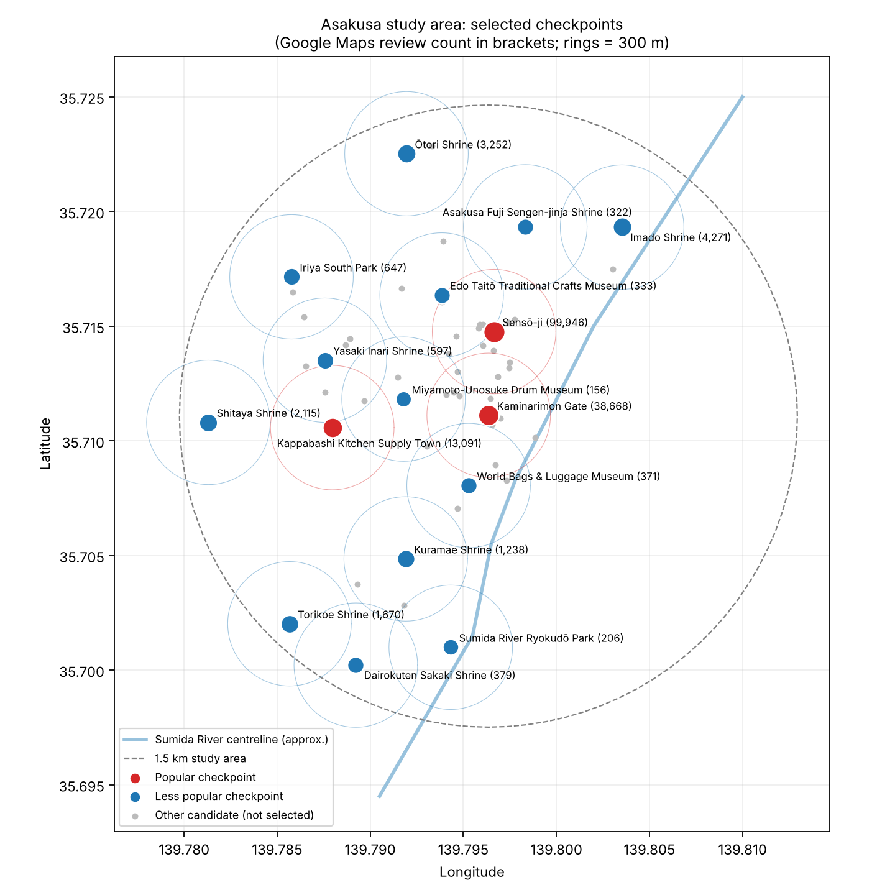
Result: 16 checkpoints
High (popular) ≥ 13,091 reviews
Sensō-ji, Kaminarimon, Kappabashi
Medium 597 – 13,090 reviews
7 checkpoints, mostly shrines
Low < 597 reviews
6 checkpoints: museums, parks, shrines
Nakamise is merged into the Kaminarimon checkpoint (85 m apart).
Minimum distance between any two checkpoints: 310 m.
Distances are straight-line, not walking routes.

Slide 7
Selected checkpoints
# | Spot | Type | Reviews | Dist. (m)
1 | Sensō-ji | Temple | 99,946 | –
2 | Kaminarimon Gate | Landmark | 38,668 | –
3 | Kappabashi Kitchen Town | Shopping street | 13,091 | –
4 | Imado | Shrine | 4,271 | 801
5 | Ōtori | Shrine | 3,252 | 962
6 | Shitaya | Shrine | 2,115 | 601
7 | Torikoe | Shrine | 1,670 | 974
8 | Kuramae | Shrine | 1,238 | 730
# | Spot | Type | Reviews | Dist. (m)
9 | Iriya South Park | Park | 647 | 757
10 | Yasaki Inari | Shrine | 597 | 329
11 | Dairokuten Sakaki | Shrine | 379 | 1,158
12 | World Bags & Luggage Museum | Museum | 371 | 354
13 | Edo Taitō Crafts Museum | Museum | 333 | 310
14 | Asakusa Fuji Sengen | Shrine | 322 | 530
15 | Sumida River Ryokudō Park | Park | 206 | 1,140
16 | Miyamoto-Unosuke Drum Museum | Museum | 156 | 372
Orange = popular checkpoint. Dist. = straight-line distance to the nearest popular checkpoint. "Shrine" dropped from names to save space; reviews = Google Maps review count on 13 Oct 2026.

Slide 8
Open decisions on the spot list
1. Spot variety
9 of 13 less popular spots are shrines.
Recommendation: Swap Yasaki Inari → Kappabashi Hondōri, and Kuramae Shrine → Seika Park (7 of 13).
2. Shōden or Imado Shrine
Only 209 m apart, so one must go.
Recommendation: Keep Imado (4,271 vs 2,495 reviews), following the stated rule.
3. Radius: 1.5 or 1.2 km
1.2 km removes 4 outer shrines, ~21 min walk each way.
Recommendation: 1.2 km for 2–3 h sessions; 1.5 km for 4 h or more.
4. River boundary
The river line was traced by hand.
Recommendation: Check addresses of 3 spots near the river (should say 台東区).

Slide 9
Experiment design: with vs without gamification
Group | What participants see in the app
Without gamification (control) | Map with all 16 checkpoints and spot information
With gamification | The same map, plus points, missions, a stamp rally, ranking and medals
26 per group
Large effect (d = 0.8)
64 per group
Medium effect (d = 0.5)
Only gamification differs
Equal rewards at every checkpoint: no extra points for less popular spots
Stamp rally of all 16 checkpoints: 13 of 16 stamps are at less popular spots
Same fee for everyone: no bonus by ranking
Same measurement: automatic GPS check-in in both groups
Random assignment within Japanese and foreign participants
11 per group
Kawanaka et al. (2020), for comparison
α = 0.05, power = 0.80; to be confirmed with G*Power.

Slide 10
Hypotheses and measures
# | The gamification group… | Measure (app logs) | Test
H1 | visits more less popular checkpoints | Distinct less popular checkpoints visited | Mann–Whitney U
H2 | has a larger share of visits at less popular checkpoints | Less popular visits ÷ all checkpoint visits | Mann–Whitney U
H3 | travels farther from the crowded core | Max distance from Kaminarimon; time > 300 m from popular spots | Mann–Whitney U
H4 | shows an effect that differs by origin | H1 measure by group × Japanese / foreign | Poisson / neg. binomial regression
H5 | is no less satisfied with the trip | Post-survey satisfaction | Mann–Whitney U
Why H1 and H2 together: gamification may raise visits everywhere. H1 alone could rise with no shift away from popular spots; H2 shows whether the balance actually moves.

Slide 11
Surveys and app changes
Pre-survey (in the app)
Add country of residence and nationality
Replace "visits to Yamanashi" with visits to Asakusa / Tokyo
Add a motivation question (sightseeing, game or reward)
Post-survey (to build)
Sightseeing vs mission priority (comparable with Kawanaka et al.)
Satisfaction, discovery of new places, perceived crowding
Intention to revisit, free comment
App changes (from the code review)
Control-group switch: a flag exists but is unused; hide points, missions, ranking and medals
Stamp rally and missions at all 16 checkpoints; equal points everywhere (current 10 per check-in is fine)
Popular / less popular tag on each spot, to count visits by type
Add the 16 checkpoints to the server database
Tokyo survey text in place of Yamanashi

Slide 12
Next steps and questions
Next steps
Finalise the spot list (decisions 1–4)
Count pedestrians at each checkpoint on one weekend to confirm crowding
Agree app changes with Le Laboratory
Build the post-survey and update the pre-survey
Timing
Weekend afternoons; all groups on the same days
Avoid Sanja Matsuri (May), Sumida fireworks (July), Tori-no-ichi (Nov), New Year
Plan a rain date
Questions for you
1. Is 1.2 km or 1.5 km more suitable for our session length?
2. What sample size can we realistically recruit (26 or 64 per group)?
3. When should the experiment run?
4. Is excluding commercial spots the right rule, or should a few free-entry shops be allowed?

