Slide 1

ETL Project
Carlie Azar Andrea Pappa, Jake Gieser, Dave Moorman

Slide 2




Project Proposal
Group: Carlie Azar, Dave Moorman, Jake Geiser, Andrea Pappa
The team extracted three csv files from Kaggle examining an expanse of cities around the world, their cost of living, and quality of life.
Using ETL methodology, we investigated municipalities where the population exceeds 500,000.
After extracting data from the csv files, we will reconstruct the data and reload them into a relational database.

Slide 3
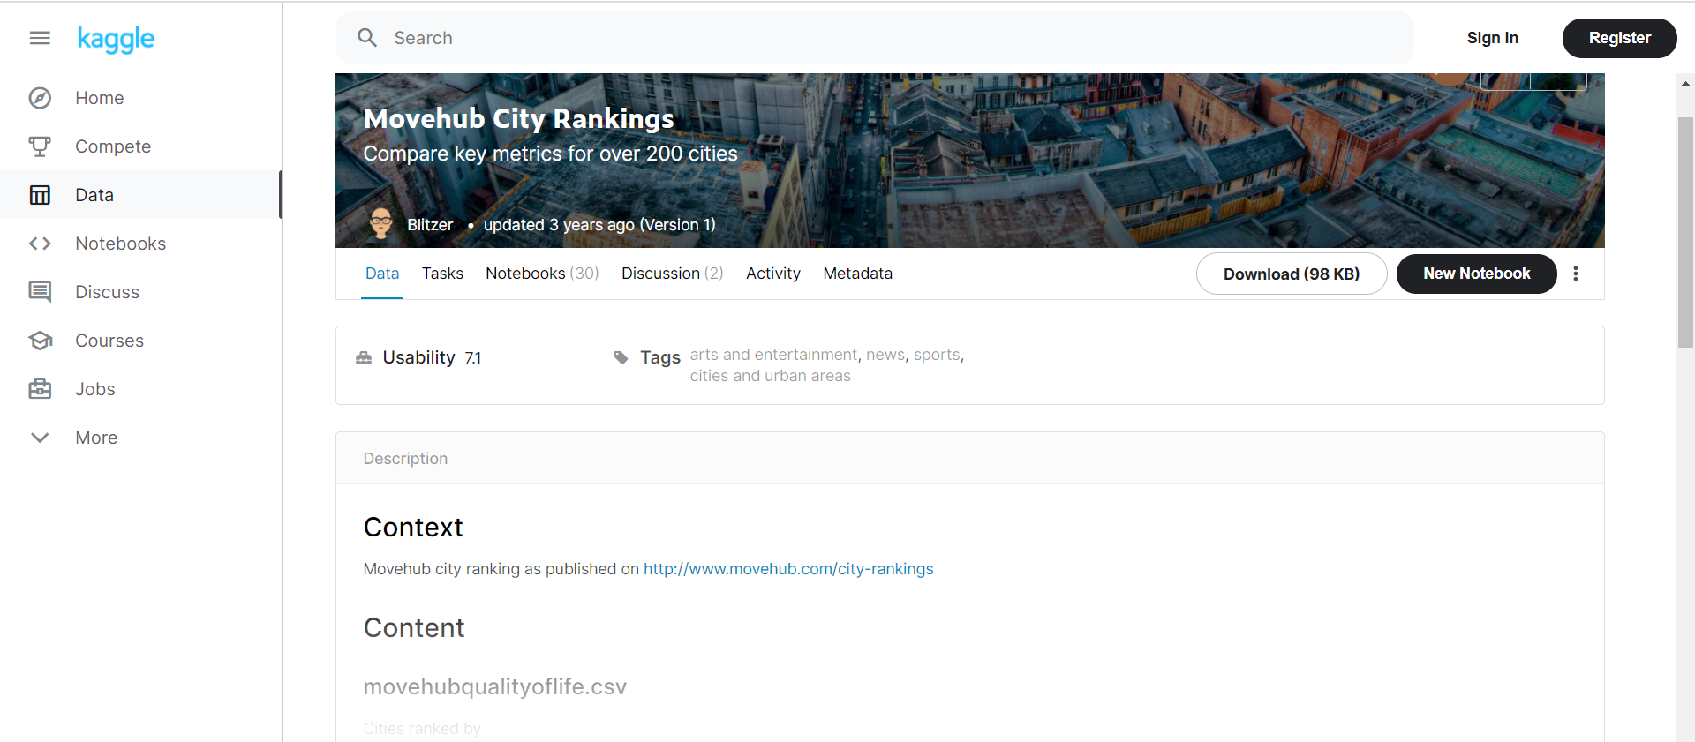
Extract
Extracted three CSV files from Kaggle
List of cities around the world
Cost of living
Quality of life
Extracted world population csv file
Sources:
https://www.kaggle.com/blitzr/movehub-city-rankings?select=cities.csv
https://www.kaggle.com/blitzr/movehub-city-rankings?select=movehubcostofliving.csv
https://www.kaggle.com/blitzr/movehub-city-rankings?select=movehubqualityoflife.csv
https://worldpopulationreview.com/world-cities

Slide 4
Transform
MERGED CITY LOCATION WITH QUALITY OF LIFE AND COST OF LIVING DATA
Extracted the csv files containing city location, quality of life ratings and cost of living averages in GBP.
Created a new dataframe by joining the datasets of location and cost of living by the “city” variable
Created another dataframe joining the city location and the quality of life csv files
Cleaned, re-named and sorted the columns. Set index to city.
Merged the cost of living and quality of life dataframes per city.
WORLD POPULATION MERGED WITH QUALITY OF LIFE AND COST OF LIVING DATA
File (csv) pulled from world population review and merged with the quality of life, the cost of living and the cities dataset.
Datasets pulled from Kaggle were cleaned by dropping any city with an unknown country
The population CSV was converted into a pandas dataframe, where the columns were renamed and the population rank was dropped.
Moved the “country” variable to the front of the table beside the “city” column.

Slide 5
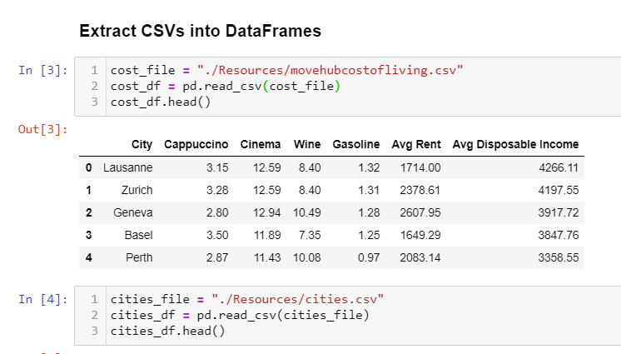
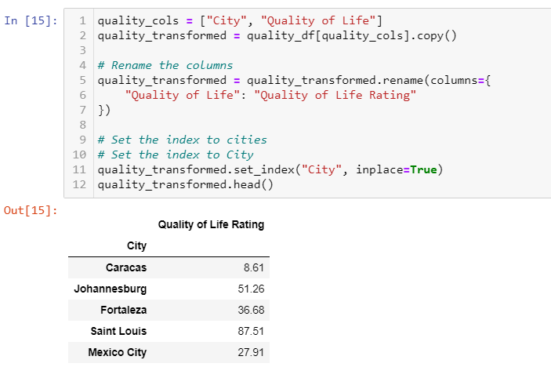
Transform
Imported csv files from Kaggle into Pandas
Transformed data into data frames
Set the index to the City
Searched for Duplicates - found none
Searched for “N/A” - found none
Re-named Columns

Slide 6
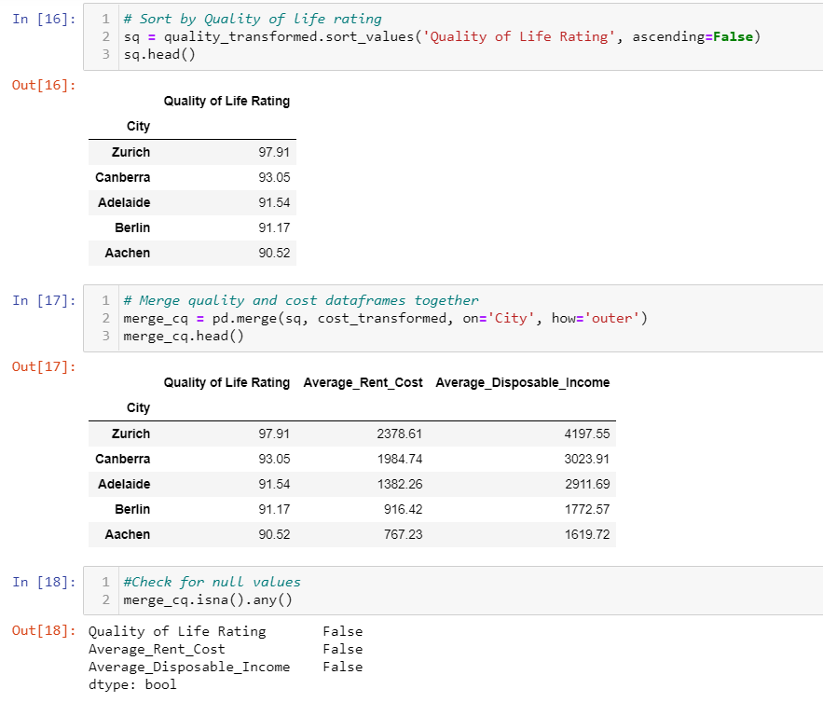
Transform
Merged the cost of living and quality of life data frames

Slide 7
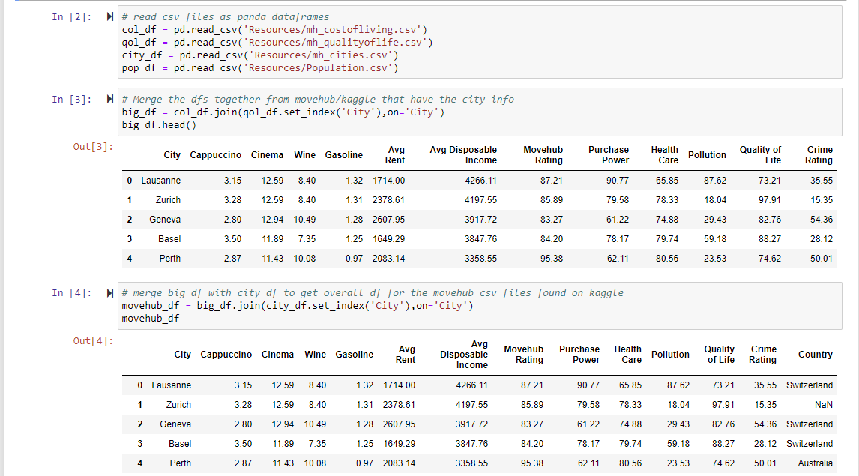
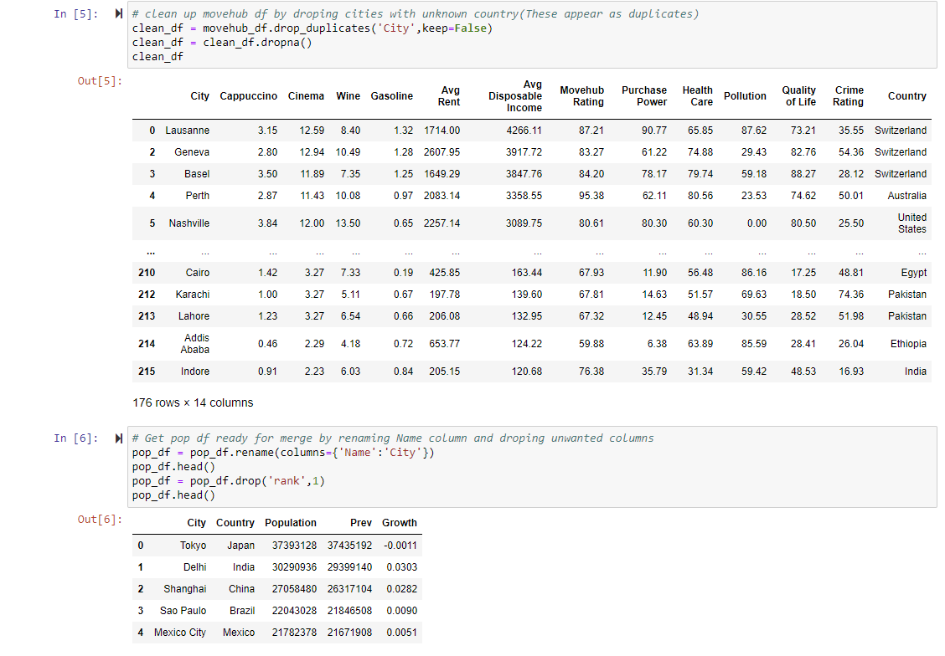
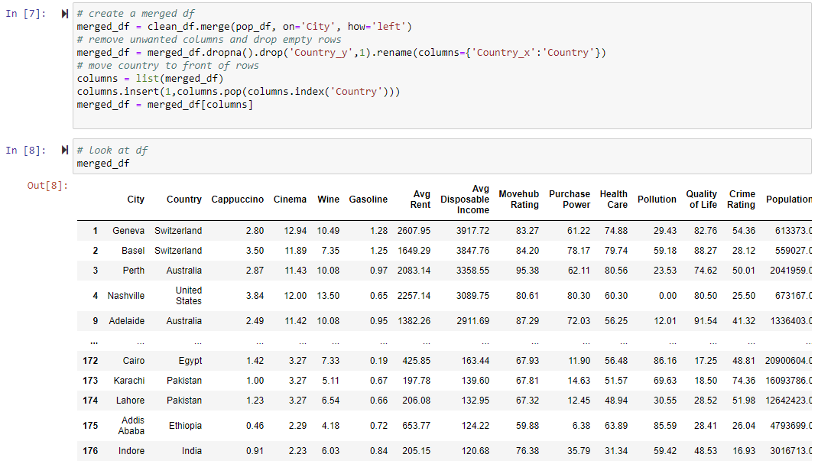
Transform
1
Merged csv files from Kaggle
Cleaned rows with empty values
Then, used the merged Kaggle file with the world population review csv file
2
3
4

Slide 8
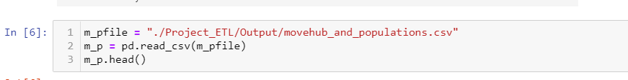
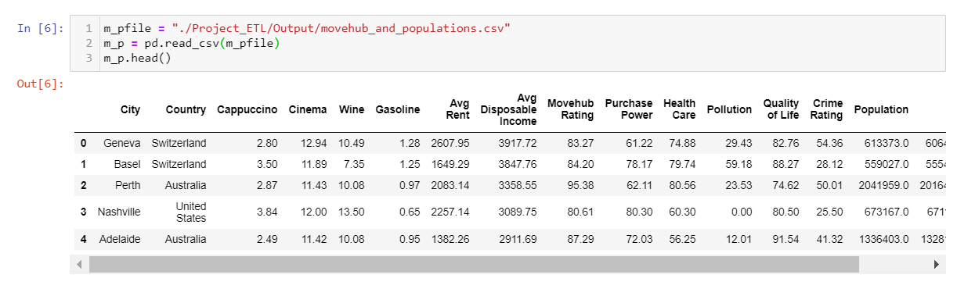
LOAD
Create database in PostgreSQL (ETL_db)
Created table for each file
QOL
COL
merged_cq
m_p
Loaded tables into database
Confirmed data had been added

Slide 9
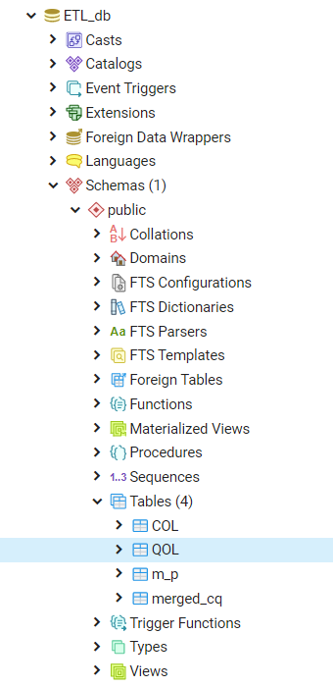
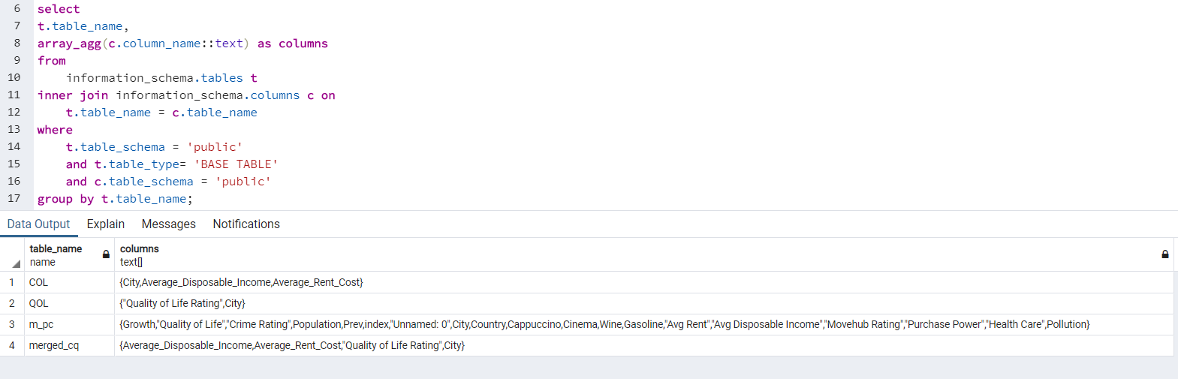
LOAD
Confirmed data had been added

Slide 10
Questions into the data
Is there a relationship between average rent cost and average disposable income across cities around the globe?
Do people pay higher rent in order to live in cities with higher quality of life rankings?
If they do, is it because they have higher averages in disposable income?
Or, because the average disposable income is higher and is used on things like cappuccinos and wine?

Slide 11
Why this data
Provided an opportunity to compare cost of living and quality of life across various cities around the world
All cities in the database are large (> 500,000)
May be of interest for people looking to retire

