Slide 1
Group Presentation
By Michael Smyth, Ciarán De Pree,
Robert Barriscale and Jake Horner

Slide 2
MCTV Limited
MCTV Limited is an electronics company at retail level situated in Limerick.
We are four representatives of the co.owners of the company, working as heads of our section:
Sales and Marketing – Michael
Social Media - Robert
Accounting – Jake
IT - Ciarán

Slide 3
Who did what?
Access Database – Collaborative
Gantt Chart – Robert
UML Chart – Robert & Ciarán
Word Press - Ciarán
Presentation – Collaborative
Trello – Michael
Github – Jake

Slide 4
Database Overview
Our Access Database was split into four sections: Queries, Reports, Forms and Tables.
The former three have been created using the data and layout found in the tables.
The forms were laid out to make filling in information easy and accessible.
Queries were selected to resemble realistically common searches by users.

Slide 5
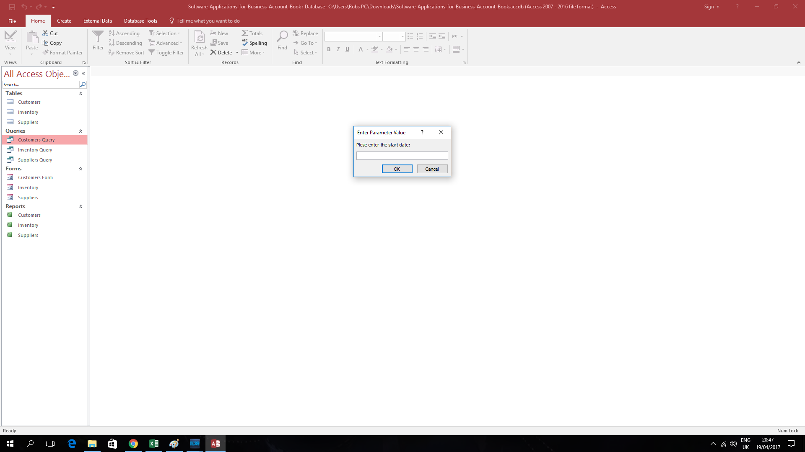

Slide 6
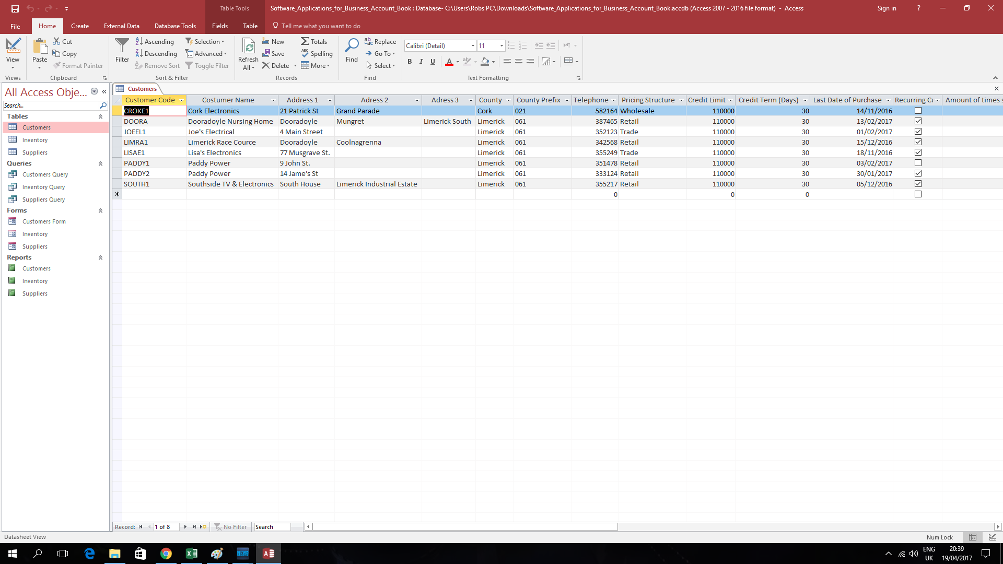

Slide 7
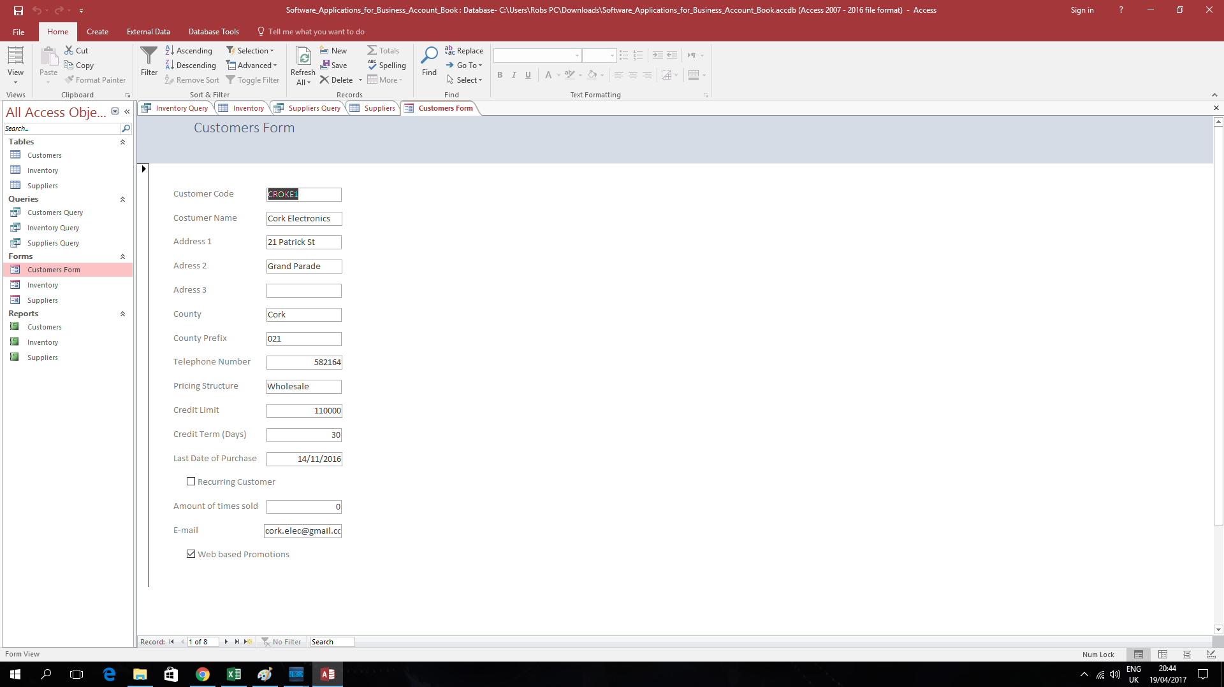

Slide 8
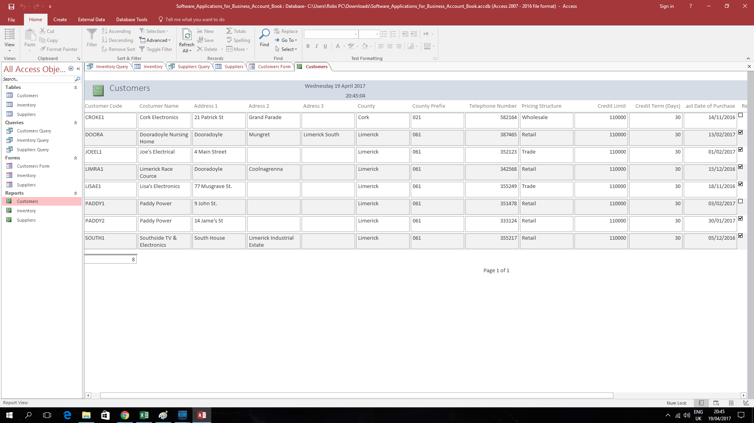

Slide 9
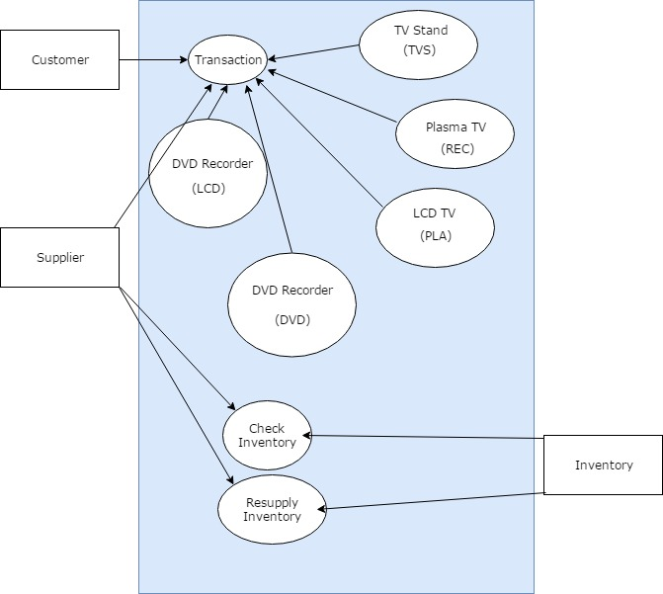
UML Chart
The UML Chart is a visual representation of the accounts of the company. This shows how the service the company offer works. The diagram shows the customer, supplier and the inventory as they relate to each other within the company infrastructure.

Slide 10
Microsoft Dynamics
This program is integrated into the same software that allowed us as a group to edit the presentation we are showing you now.
It is a Customer Relations Management system that allows various users in a company to enter and keep track of accounts, clients and vendors using a cloud-based system.
This system is excellent for inter-company tracking of what groups and clients have made transactions quickly and efficiently, with the added benefit of using the well established microsoft package.

Slide 11
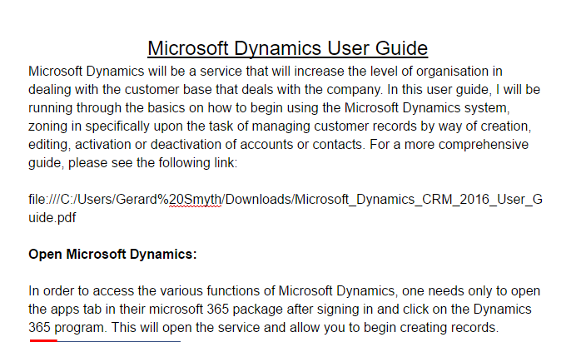
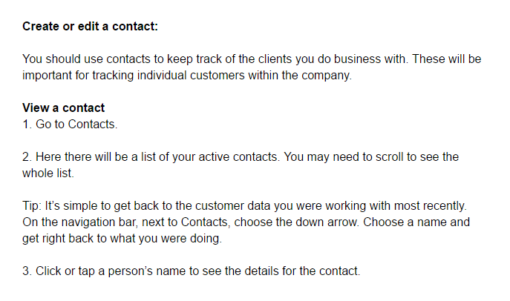
Screenshots of Dynamics

Slide 12


Sage 50.
Sage is an accounting application that tracks cash flow, creates simple invoicing, Controls stock and inventory, Manages VAT, and manages payroll and payments.
This is very easy to use and accessible software, that you can import your Microsoft Excel file into for easy transition.
Sage also has Microsoft Office 365 integration making it simple to manage your business on the go on multiple devices.

Slide 13
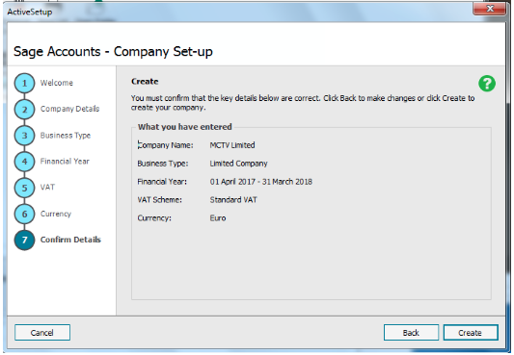
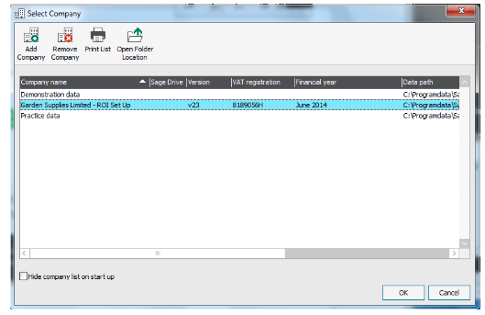
Sage 50 - Screenshots

Slide 14
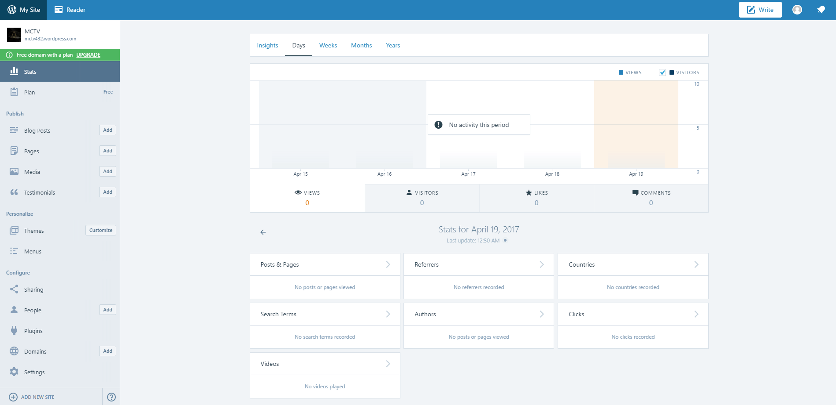
WordPress.
WordPress is the software that is used to build websites, I chose to use this to build our company website. I believe that this is the best and easiest way for MCTV to have and manage a website because of how easy WordPress is to use and manage.

Slide 15
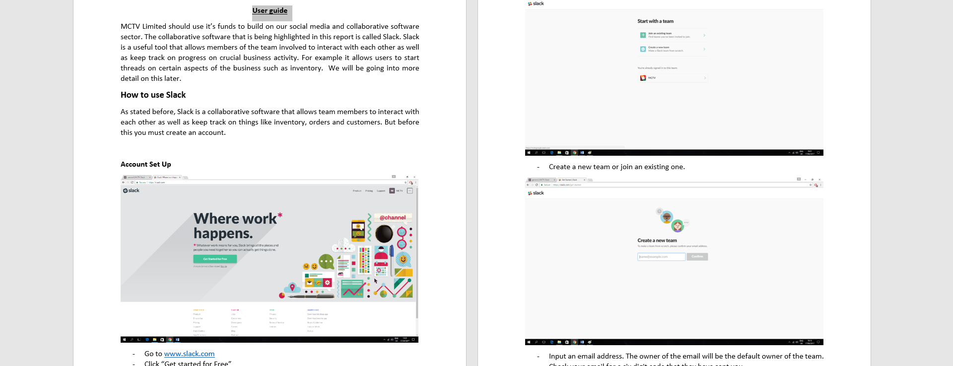
Slack
Social Media & Collaborative Software

Slide 16
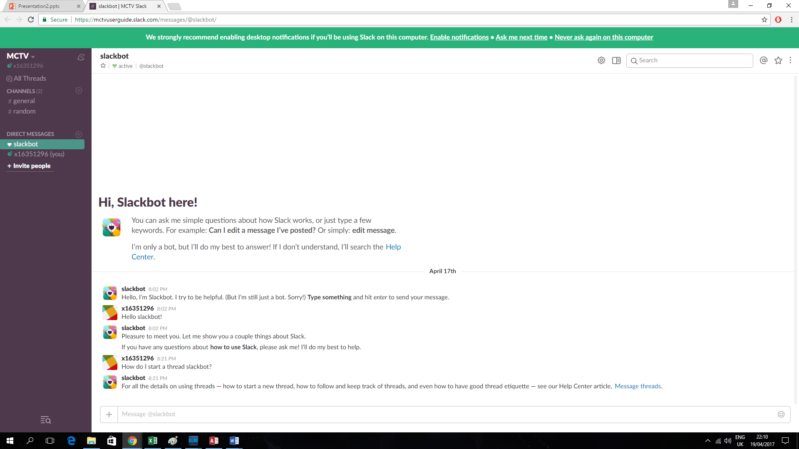
Slack
Slack is a collaborative software that offers a platform for employees to communicate with each other using chat rooms and boards to discuss either work related matters or to simply talk to each other.
To use Slack, you click on one of the chatrooms to post a comment or image or start a topic on something. Team members can reply to whatever is posted in these chatrooms, starting threads. You can view all the threads you are a part of using the "All Threads" board on the panel on the left side of the user interface.

Slide 17
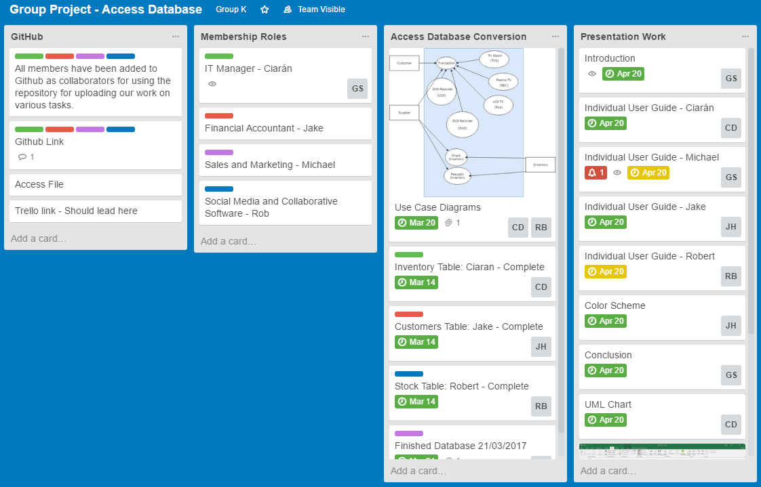
Trello
Using Trello, the group was able to keep track of our progress on various parts of the project.
Every person was given tasks to complete by a certain date. This information was then pushed on into the Gantt chart.

Slide 18
Gantt Chart
Here we detailed the workflow of the group over the course of the joint work needed to be done.
Each person worked simultaneously on various aspects of the workload so as that each part of the project were finished at roughly the same time.
A portion of time during interim between group projects was filled up by work on individual projects.

Slide 19
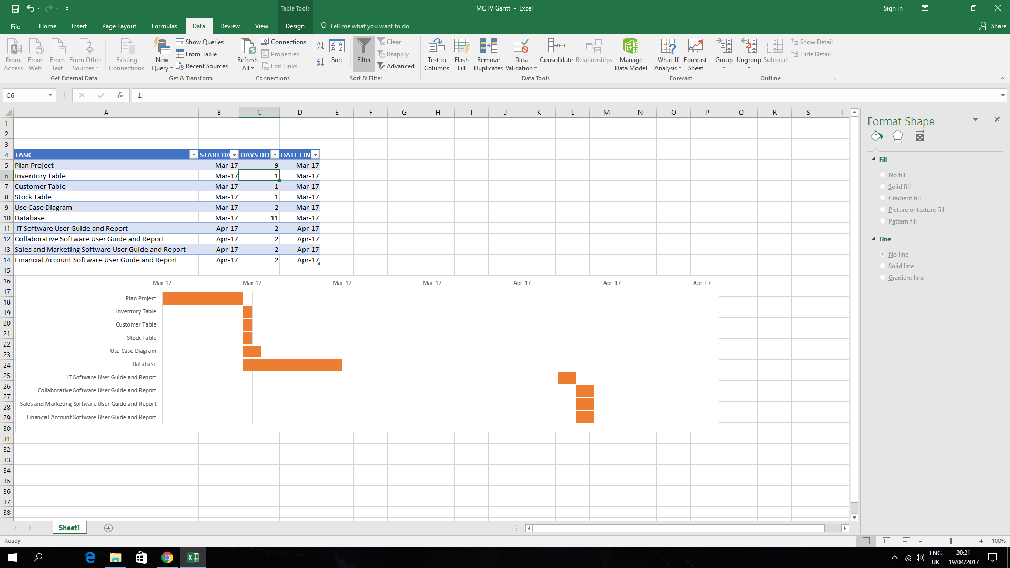

Slide 20
Design and Aesthetics
The color scheme we chose for the company was red and chrome with a light grey background.
We chose two duller colors so the information wouldn’t be clouded, and a red to liven up the color scheme.
These colors look professional, easy on the eye, and consumer friendly.

Slide 21
Conclusion: Future Developments
In the future, we hope to bring different elements of the company together to more seamlessly. Using the quickly improving state of social media, we hope to improve communication between members of staff along with the staff and customers or wholesalers.
Furthermore with the advances in cloud computing we hope to extend our company to additional outlets that share their information across the internet.

Slide 22
THE END.
Thank you for listening!

